Slide 1
B39HF High Frequency Circuits
Lecture 1 Introduction
Yongqiang Hei
yqhei@mail.xidian.edu.cn

Slide 2
Outline and Review
Development of Electromagnetics
Dimensions, Units, and Notation
The Nature of Electromagnetism
Traveling Waves
The Electromagnetic Spectrum
Review of Complex Numbers
Review of Phasors

Slide 3
Outline and Review
Development of Electromagnetics
Dimensions, Units, and Notation
The Nature of Electromagnetism
Traveling Waves
The Electromagnetic Spectrum
Review of Complex Numbers
Review of Phasors

Slide 4
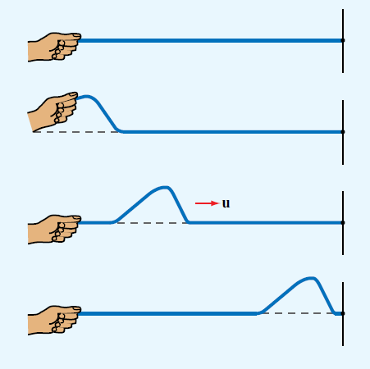
Traveling Waves
A one-dimensional wave traveling on a string

Slide 5
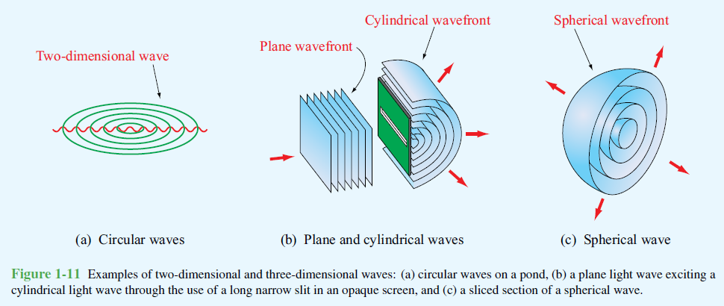
Traveling Waves
• Two-dimensional wave: propagates out across a surface, like the ripples on a pond , and its disturbance can be described by two space variables.
• Three-dimensional wave: propagates through a volume and its disturbance may be a function of all three space variables. may take on many different shapes; include plane waves, cylindrical waves, and spherical waves.

Slide 6
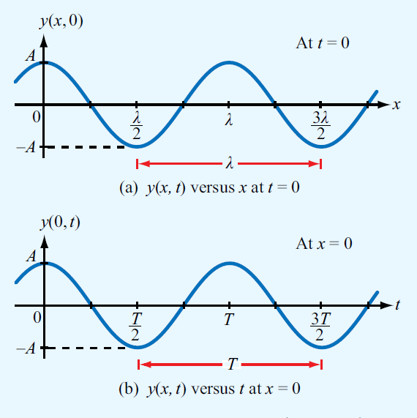
Traveling Waves

Slide 7
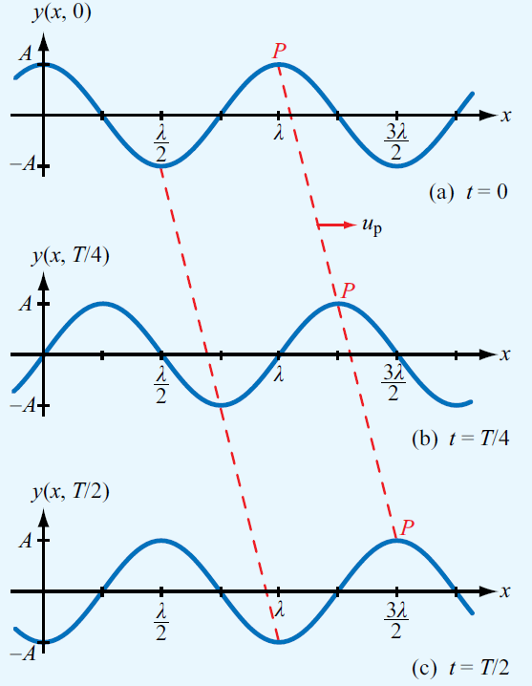
Traveling Waves

Slide 8
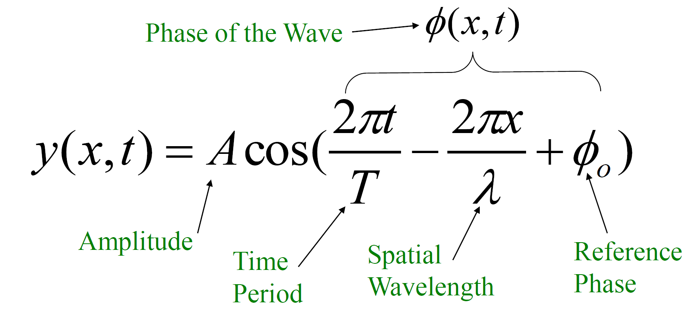
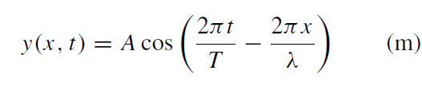
Traveling Waves
Sinusoidal Waves in a Lossless Medium
Let us first analyze the simple case when φ₀ = 0:

Slide 9





Traveling Waves
At the peaks of the wave pattern, the phase φ(x, t) is equal to zero or multiples of 2π radians. Thus,
Had we chosen any other fixed height of the wave, say y₀,
and monitored its movement as a function of t and x, this again would have been equivalent to setting the phase φ(x, t) constant such that
which gives the phase velocity up as

Slide 10
Traveling Waves
Phase Velocity
λ
u_{p} =
T
A traveling wave is characterized by a spatial wavelength λ, a time period T and a phase velocity u_{p}=λ/T.

Slide 11
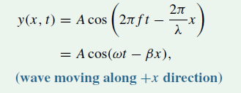






Traveling Waves
phase velocity
The phase velocity, also called the propagation velocity, is the velocity of the wave pattern as
it moves across the water surface.
with

Slide 12
Traveling Waves
Direction of Travel
Determined by inspection of both t and x terms in phase of the wave
If one sign is positive and the other negative, then the wave is traveling in the positive x-direction
If both signs are positive or both are negative, then the wave is
traveling in the negative x-direction

Slide 13
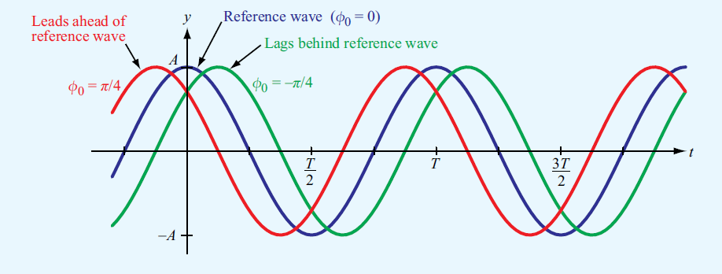
Traveling Waves
The constant reference φ₀ has no influence on either velocity or the direction of wave propagation

Slide 14
Traveling Waves
Sinusoidal Wave in a Lossless Medium
Alternate Form
y(x,t) = Acos(ωt − βx +φ_{o} )
Angular Velocity
Phase Constant or Wavenumber

Slide 15
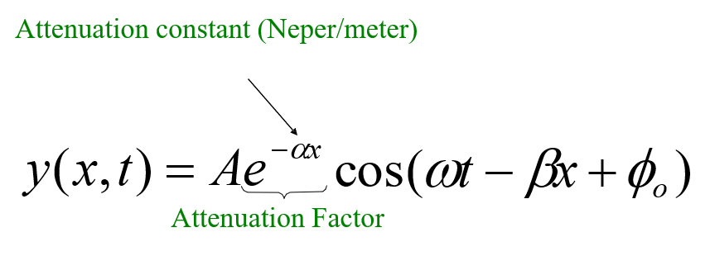
Traveling Waves
Sinusoidal Waves in a Lossy Medium
If a wave is traveling in the x direction in a lossy medium, its amplitude decreases as e^{−αx}. This factor is called the
attenuation factor, and α is called the attenuation constant of the medium and its unit is neper per meter (Np/m).

Slide 16
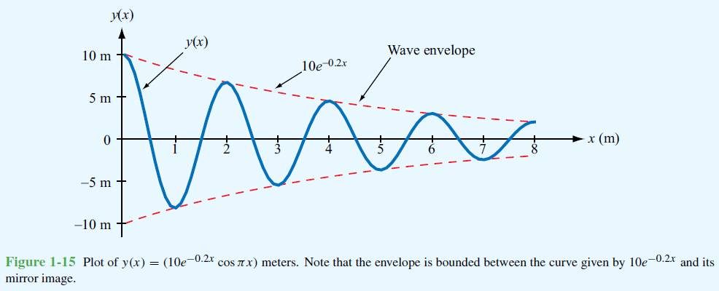
Traveling Waves
Sinusoidal Waves in a Lossy Medium

Slide 17
Traveling Waves
Example
The electric field of a traveling electromagnetic wave is given by
E(z, t) = 10 cos(π × 10⁷t + πz/15 + π/6) (V/m).
Determine
the direction of wave propagation
(b) The wave frequency f
(c) its wavelength λ
(d) its phase velocity u_{p}.
Answer: (a)−z direction, (b) f = 5 MHz, (c) λ = 30 m,
(d) u_{p} = 1.5 × 10⁸ m/s.

Slide 18
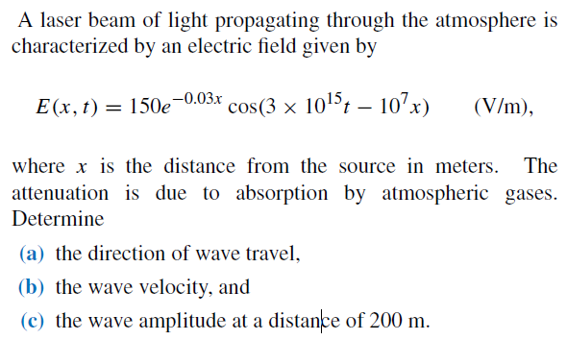
Traveling Waves
Sinusoidal Waves in a Lossy Medium
Example

Slide 19
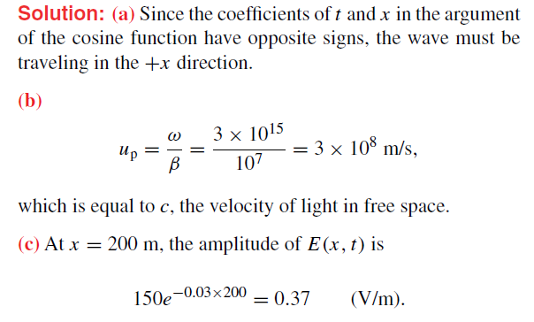
Traveling Waves
Sinusoidal Waves in a Lossy Medium

Slide 20
Outline and Review
Development of Electromagnetics
Dimensions, Units, and Notation
The Nature of Electromagnetism
Traveling Waves
The Electromagnetic Spectrum
Review of Complex Numbers
Review of Phasors

Slide 21
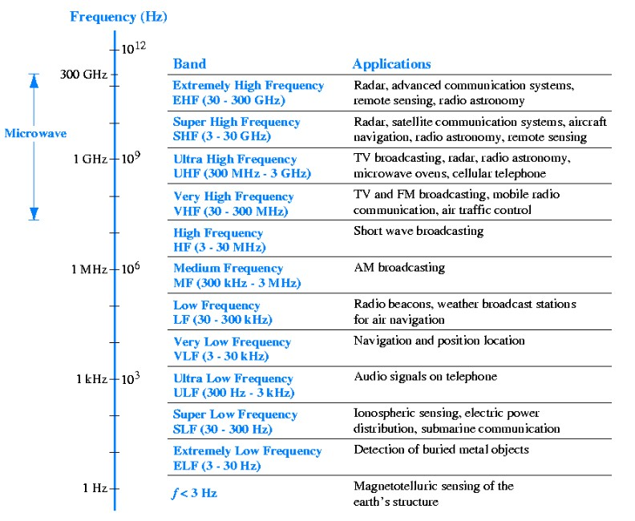
The Electromagnetic Spectrum

Slide 22
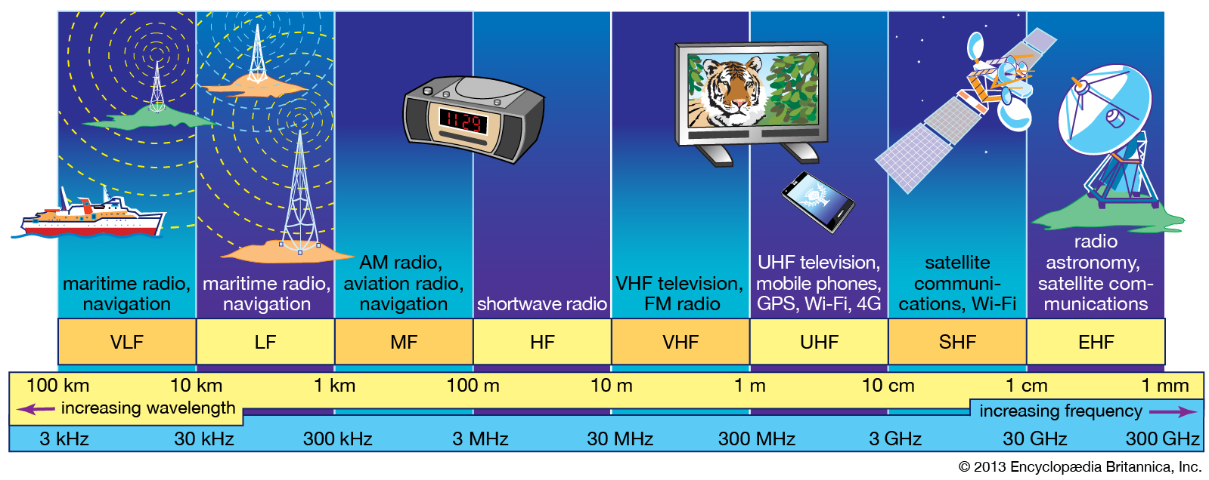
The Electromagnetic Spectrum

Slide 23
Outline and Review
Development of Electromagnetics
Dimensions, Units, and Notation
The Nature of Electromagnetism
Traveling Waves
The Electromagnetic Spectrum
Review of Complex Numbers
Review of Phasors

Slide 24

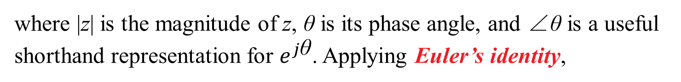
Review of Complex Numbers
Any complex number z can be expressed in rectangular form as
where x and y are the real (Re) and imaginary (Im) parts of z, respectively, and j=$\sqrt{−1}$. That is,
Alternatively, z may be cast in polar form as
where |z| is the magnitude of z, θ is its phase angle, and ∠θ is a useful shorthand representation for $e^{j\text{θ}}$. Applying Euler’s identity,

Slide 25
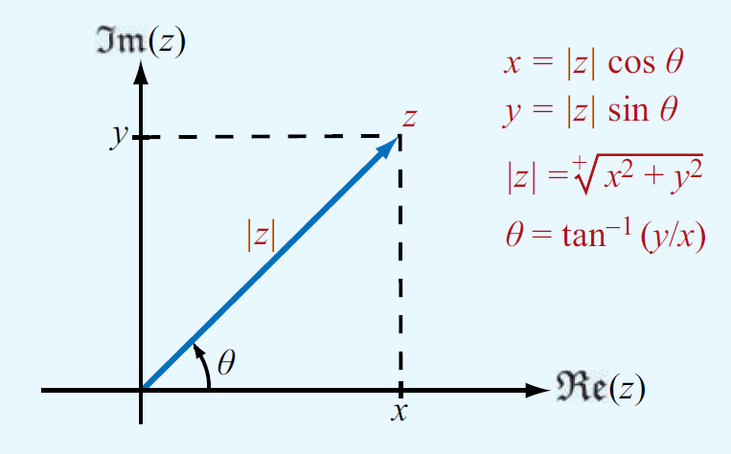
Review of Complex Numbers
The magnitude |z| is equal to the positive square root of the product of z and its complex conjugate:
The complex conjugate of z, denoted with a star superscript (or asterisk), is obtained by replacing j (wherever it appears) with −j , so that

Slide 26
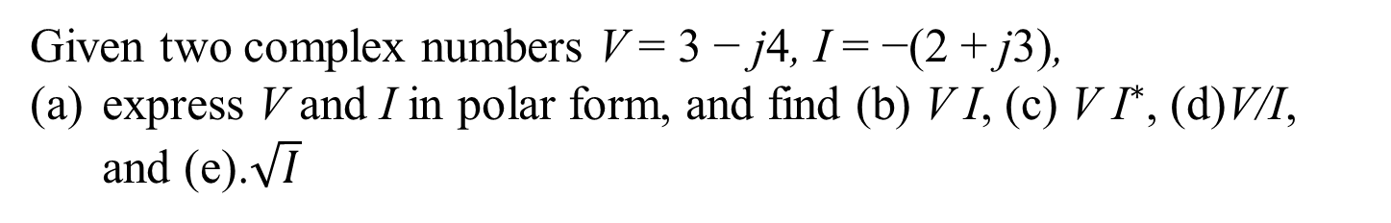
Review of Complex Numbers
Example
Given two complex numbers V = 3 − j4, I = −(2 + j3),
express V and I in polar form, and find (b) V I, (c) ${\text{V} \text{I}}^{∗}$, (d)V/I, and (e).$\sqrt{I}$

Slide 27
Review of Complex Numbers
Solution
(a)
Since I = (−2 − j3) is in the third quadrant in the complex plane
(b)
(c)
(d)
(e)

Slide 28
Outline and Review
Development of Electromagnetics
Dimensions, Units, and Notation
The Nature of Electromagnetism
Traveling Waves
The Electromagnetic Spectrum
Review of Complex Numbers
Review of Phasors

Slide 29
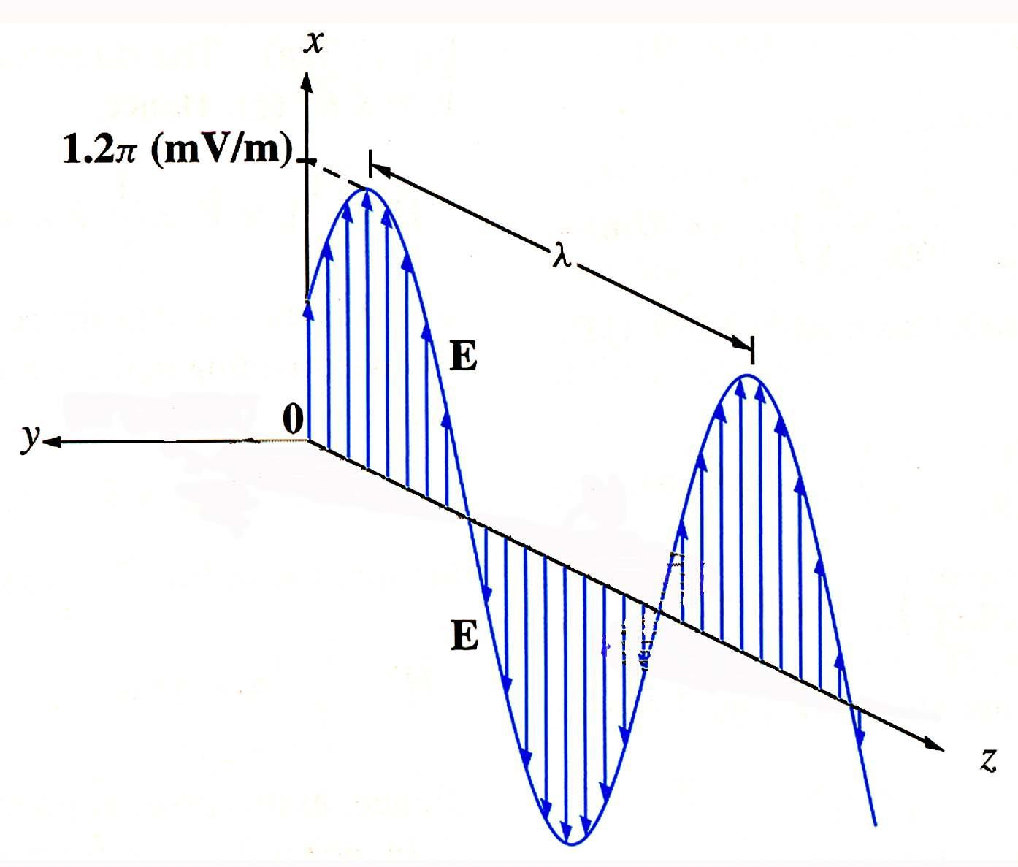
Traveling Wave for Electric Field or Voltages

Slide 30
Traveling Wave for Electric Field or Voltages
~
E(x, y, z;t) = Re[E
jωt
(x, y, z)e ]
Instantaneous
Vector Phasor

Slide 31
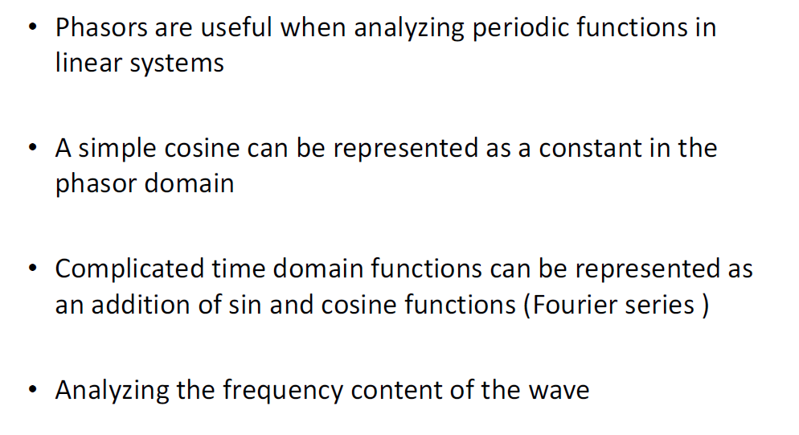

Phasors

Slide 32
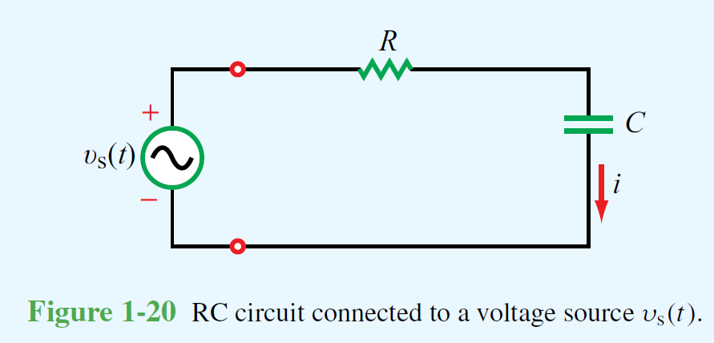
Review of Phasors
The simple RC circuit shown in Fig. 1-20 contains a sinusoidally time-varying voltage source given by
Application of Kirchhoff’s voltage law gives the following loop equation:
Our objective is to obtain an expression for the current i(t).
We can do this by solving equation in the time domain, which is somewhat cumbersome because the forcing function v_{s}(t) is a sinusoid.

Slide 33
Review of Phasors
Solution
Step 1: Adopt a cosine reference
Step 2: Express time-dependent variables as phasors

Slide 34
Review of Phasors
Solution
Step 3: Recast the differential / integral equation in phasor form
Step 4: Solve the phasor-domain equation
(phasor domain).

Slide 35
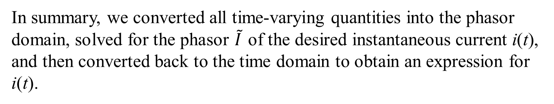
Review of Phasors
Solution
Step 5: Find the instantaneous value
In summary, we converted all time-varying quantities into the phasor domain, solved for the phasor $\tilde{I}$ of the desired instantaneous current i(t), and then converted back to the time domain to obtain an expression for i(t).

Slide 36
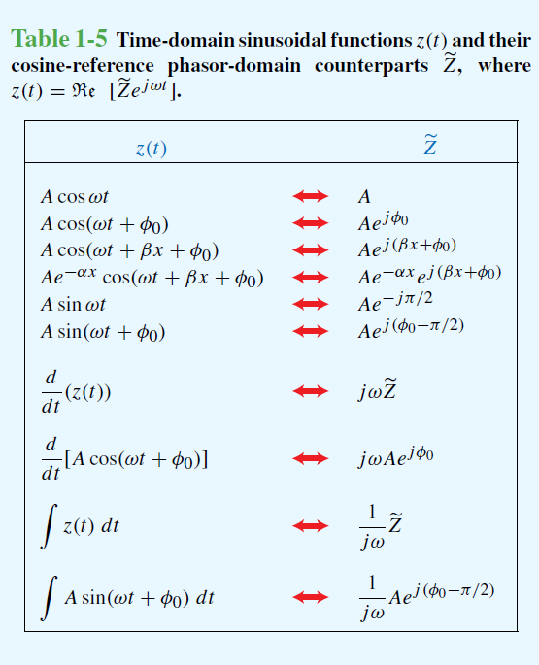
Review of Phasors

Slide 37
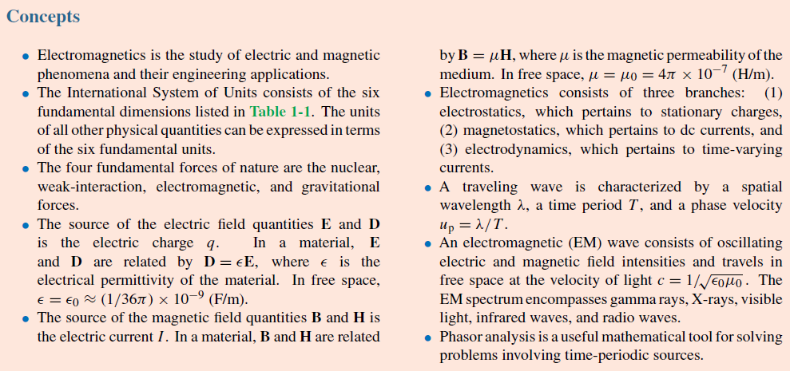
Summary

