Slide 1
Fourier Analysis and Sampling

Slide 2
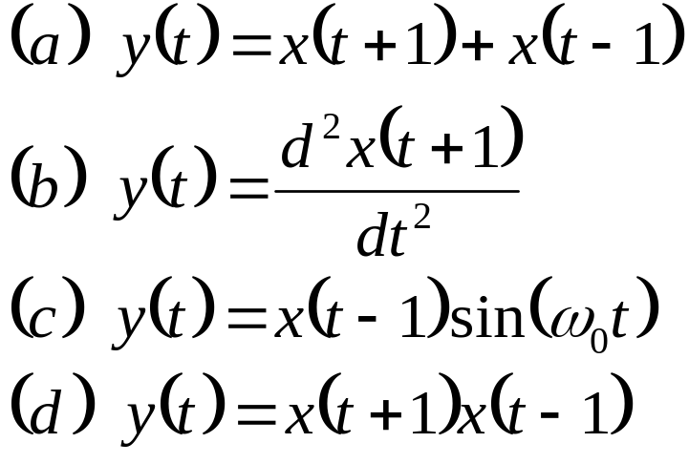
Problem F1.
Let x(t) be a signal with Nyquist rate ω₀. In other words, X(ω₀), the Fourier transform of x(t), vanishes when |ω|> ω₀ / 2. Determine the Nyquist rates for the following signals:

Slide 3
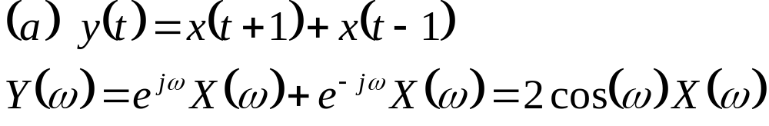
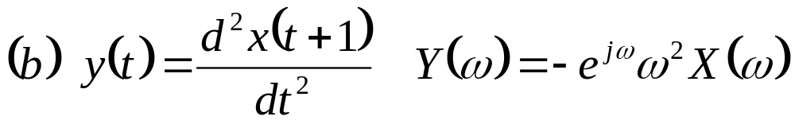
Problem F1ab brief solutions
Let x(t) be a signal with Nyquist rate ω₀. That is, X(ω₀), the Fourier transform of x(t), vanishes when |ω|> ω₀ / 2. Determine the Nyquist rates for the following signals:
the same Nyquist rate
the same Nyquist rate

Slide 4
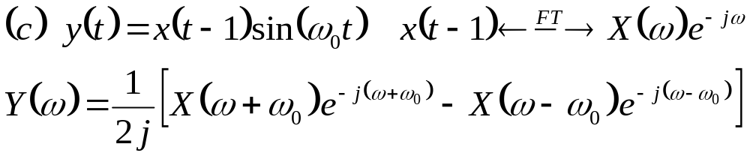

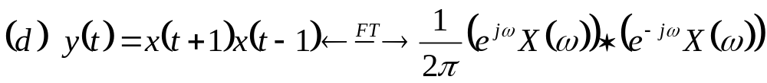

Problem F1cd brief solutions
Let x(t) be a signal with Nyquist rate ω₀. That is, X(ω₀), the Fourier transform of x(t), vanishes when |ω|> ω₀ / 2. Determine the Nyquist rates for the following signals:
Y(ω) vanishes when |ω|> ω₀ + ω₀ / 2. The Nyquist rate is
Y(ω) vanishes when |ω|> ω₀. The Nyquist rate is

Slide 5
Two-sided (bilateral) Laplace transform

Slide 6
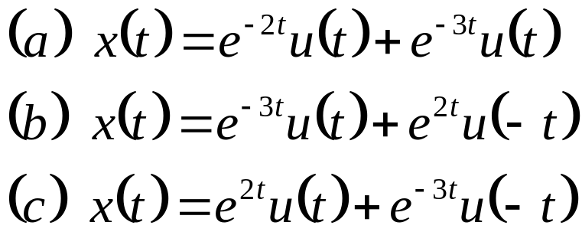
Problem L1.
Find the Laplace transform X(s) are and sketch the pole-zero diagram with the ROC for the following signals x(t):

Slide 7

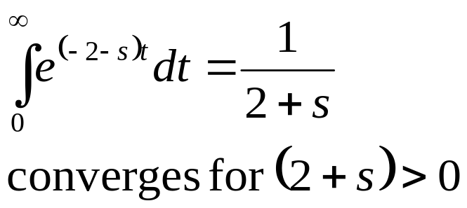
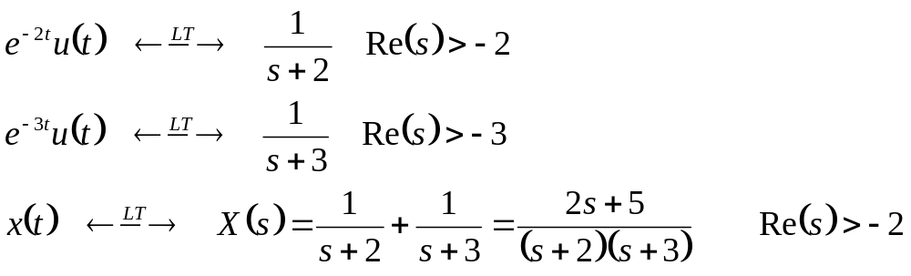





Problem L1a brief solution
Find the Laplace transform X(s) are and sketch the pole-zero diagram with the ROC for the following signals x(t):

Slide 8

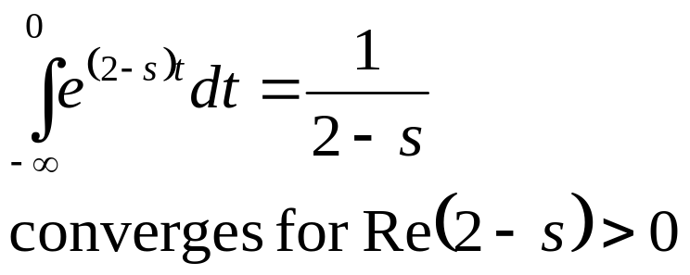
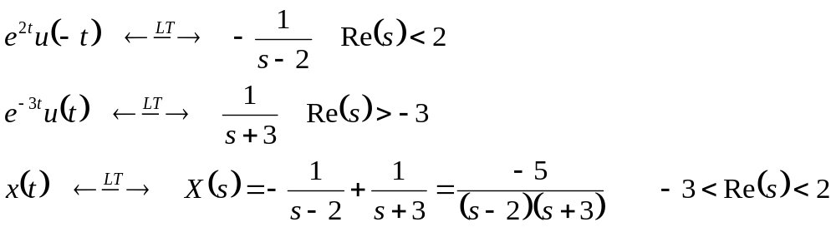

Problem L1b brief solution
Find the Laplace transform X(s) are and sketch the pole-zero diagram with the ROC for the following signals x(t):

Slide 9

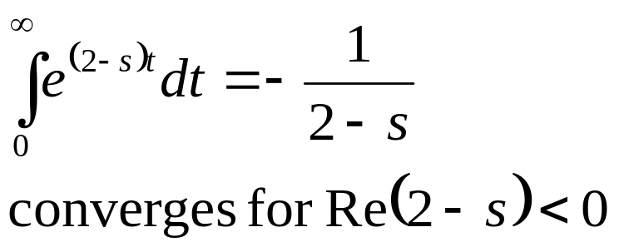
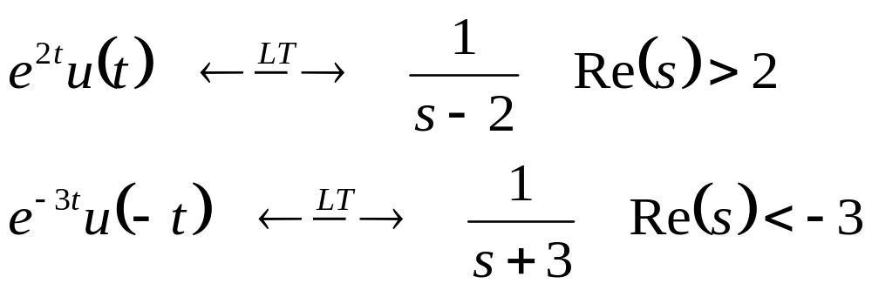
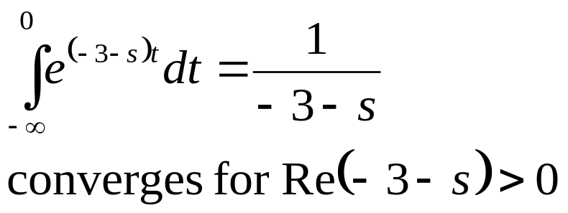
Problem L1c brief solution
Find the Laplace transform X(s) are and sketch the pole-zero diagram with the ROC for the following signals x(t):
The ROCs do not overlap and, therefore, there is no common ROC. Thus x(t) has no Laplace transform

Slide 10
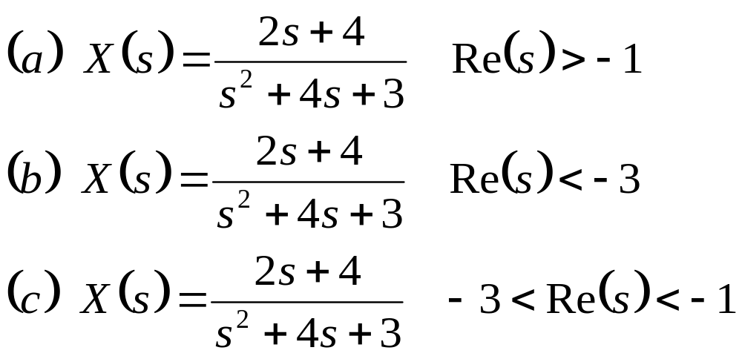
Problem L2.
Find the inverse Laplace transform of the following X(s)

Slide 11
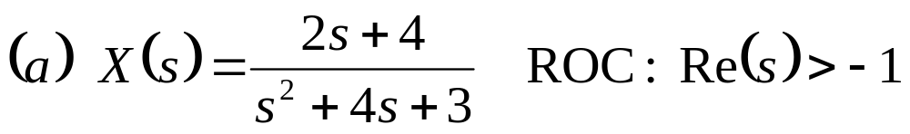
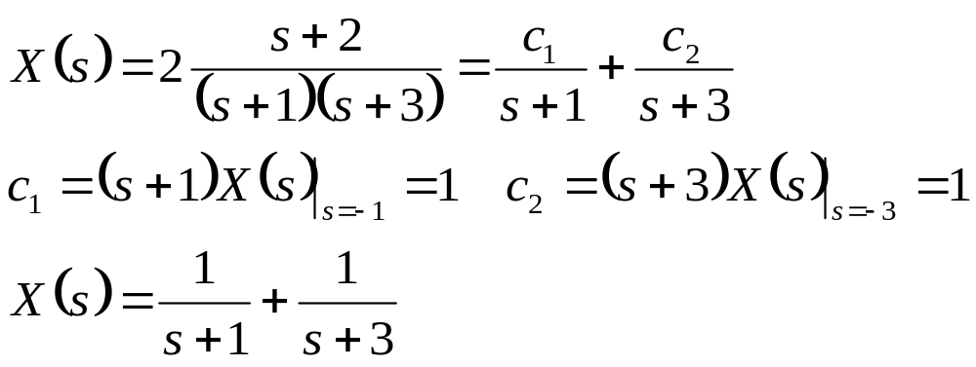
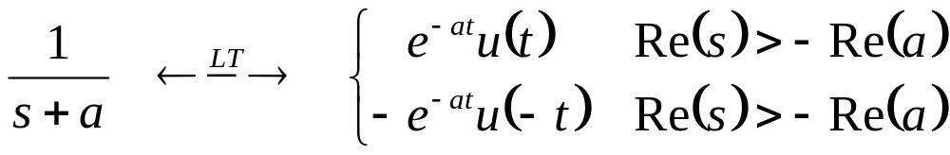
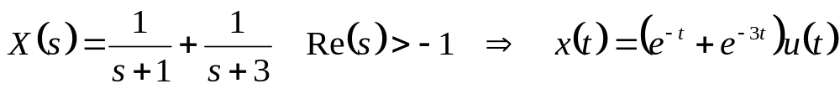
Problem L2a brief solution
Find the inverse Laplace transform of the following X(s)

Slide 12
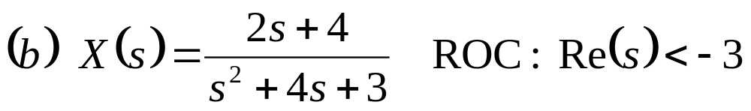
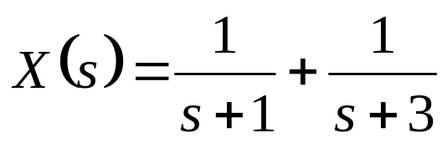
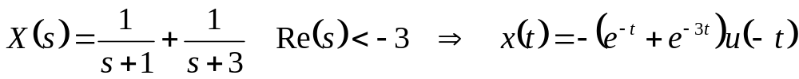
Problem L2b brief solution
Find the inverse Laplace transform of the following X(s)

Slide 13
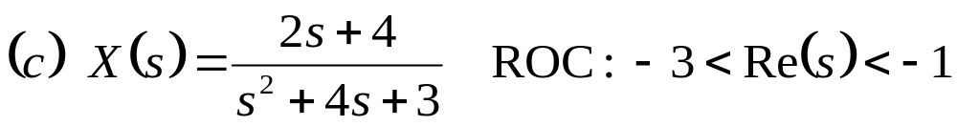
Problem L2c brief solution
Find the inverse Laplace transform of the following X(s)

Slide 14
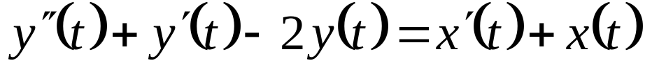
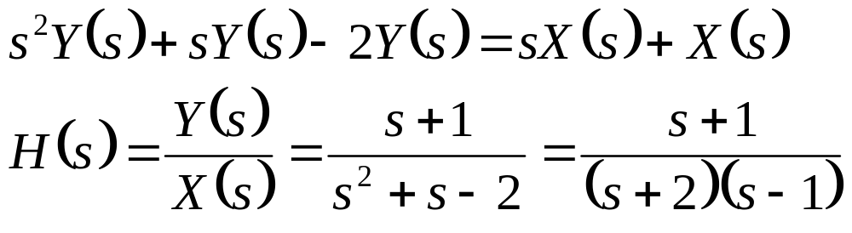
Problem L3a brief solution
In a continuous-time LTI system the input x(t) and output y(t) are related by
Find the system function H(s).
Determine the impulse response h(t) for each of the following three cases: (i) the system is casual, (ii) the system is stable, (iii) the system is neither casual nor stable.
We have

Slide 15
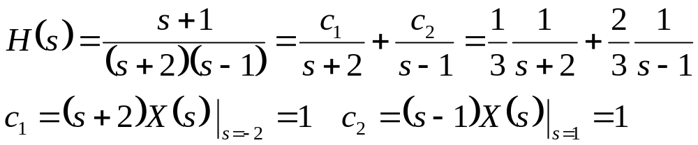

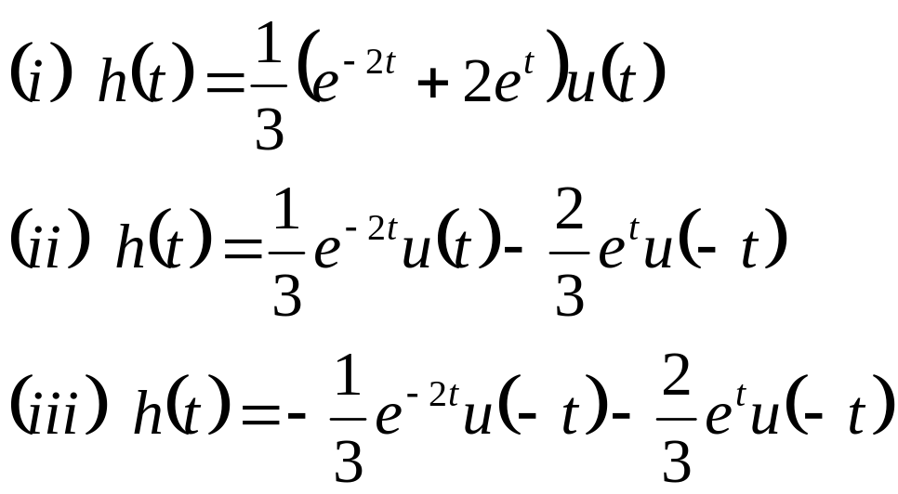


Problem L3b brief solution
In a continuous-time LTI system the input x(t) and output y(t) are related by
(b) Determine the impulse response h(t) when (i) the system is casual, (ii) stable, (iii) neither casual nor stable.
(iii) neither casual nor stable
(ii) stable
(i) casual

