Slide 1
Project 3 Discussion
Multi-Process and Multi-Threaded Web Servers

Slide 2
Setup
Use the same virtual machine as in Project 2
Login as root
If you want a new copy, grab the appropriate software and disk image from the assignment page

Slide 3
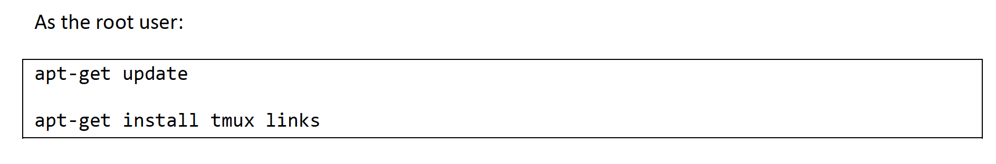
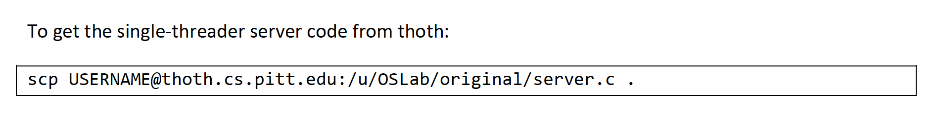
Setup

Slide 4
Now, let’s try to send requests to the single-threaded server (server.c)

Slide 5
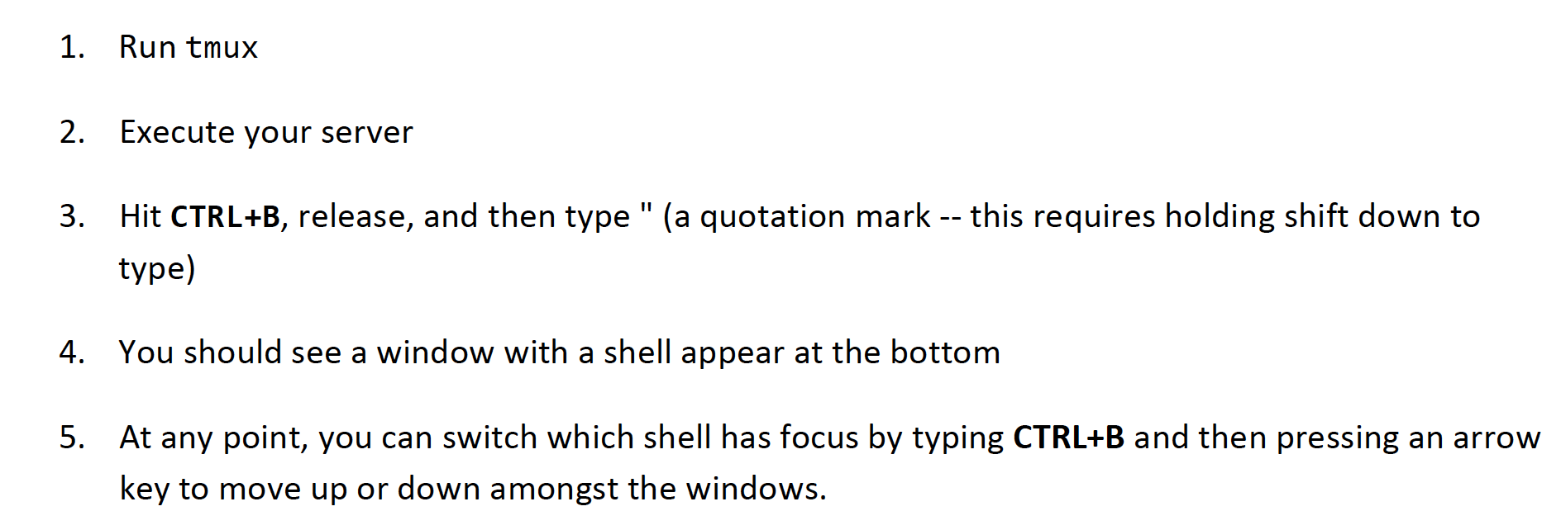
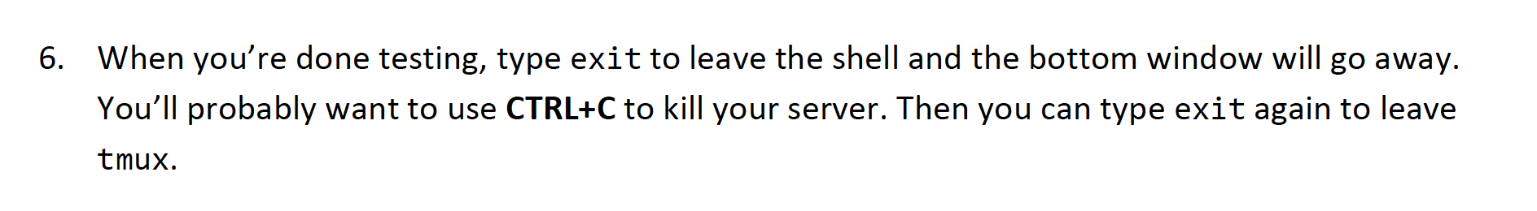
Before that, do this
Just type tmux on the command line and press ENTER

Slide 6

terminal 1
terminal 2

Slide 7
Running server and client
Run the server on one terminal
Run the client(s) on the other terminal

Slide 8
DEMO

Slide 9
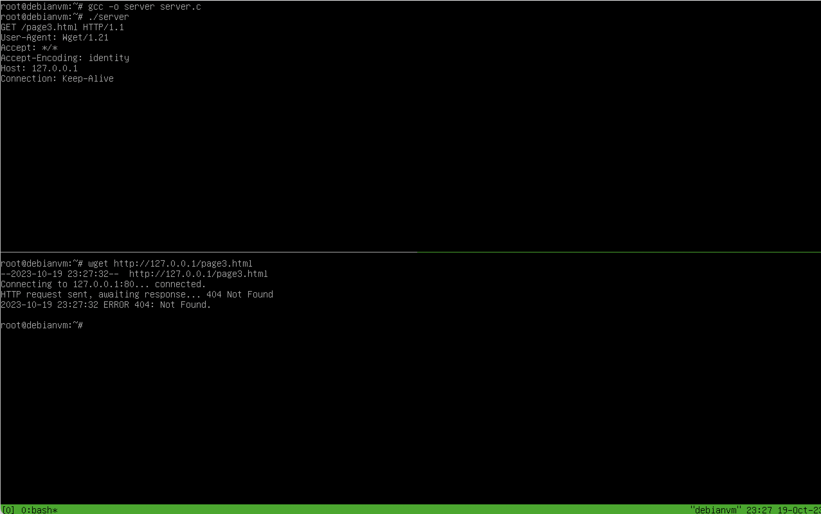
Server runs on this terminal.
Server could not find the requested file, page3.html
Client runs on this terminal.
Client requested for page3.html
Server returned status 404(file not found).

Slide 10
What do you need to do?
Write code for a multi-process version of the server in the file server_proc.c
Write code for a multi-threaded version of the server in the file server_thread.c
Write a 1-2 page paper
Answer this question
Which implementation of the server is faster?
Describe your experimental design, your results, and your conclusions in a 1-2 page paper.

Slide 11
Multi-process version of the server

Slide 12
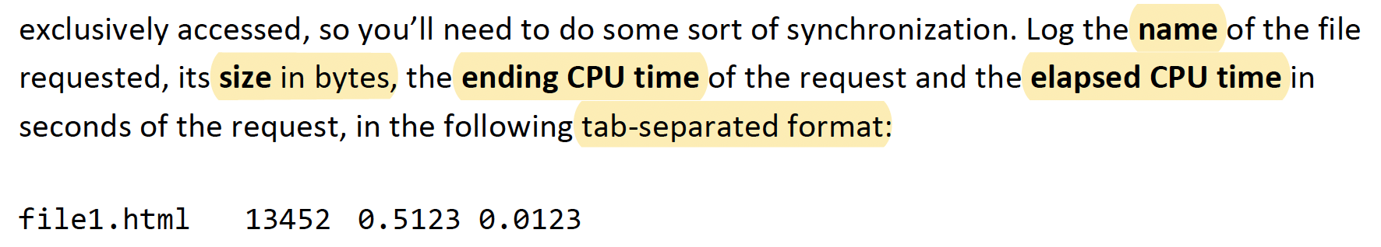
server_proc.c
Use fork() to create a worker process
Worker Process
Handles sending the requested file over the network connection
When done sending the file, it should log the request for that particular webpage by appending it to a file named stats_proc.txt
Access to stats_proc.txt needs to be synchronized
Use sem_wait() and sem_post() from <semaphore.h>

Slide 13
server_proc.c
If you need shared space to hold something between processes, use mmap() with the MAP_SHARED and MAP_ANONYMOUS flags.
When you create a child process, you’ll have two copies of the socket file descriptor and two of the connection file descriptors. The parent only needs one of those and the child only needs one. Make sure to close() the other.

Slide 14
Using fork() to create a child process
DEMO

Slide 15
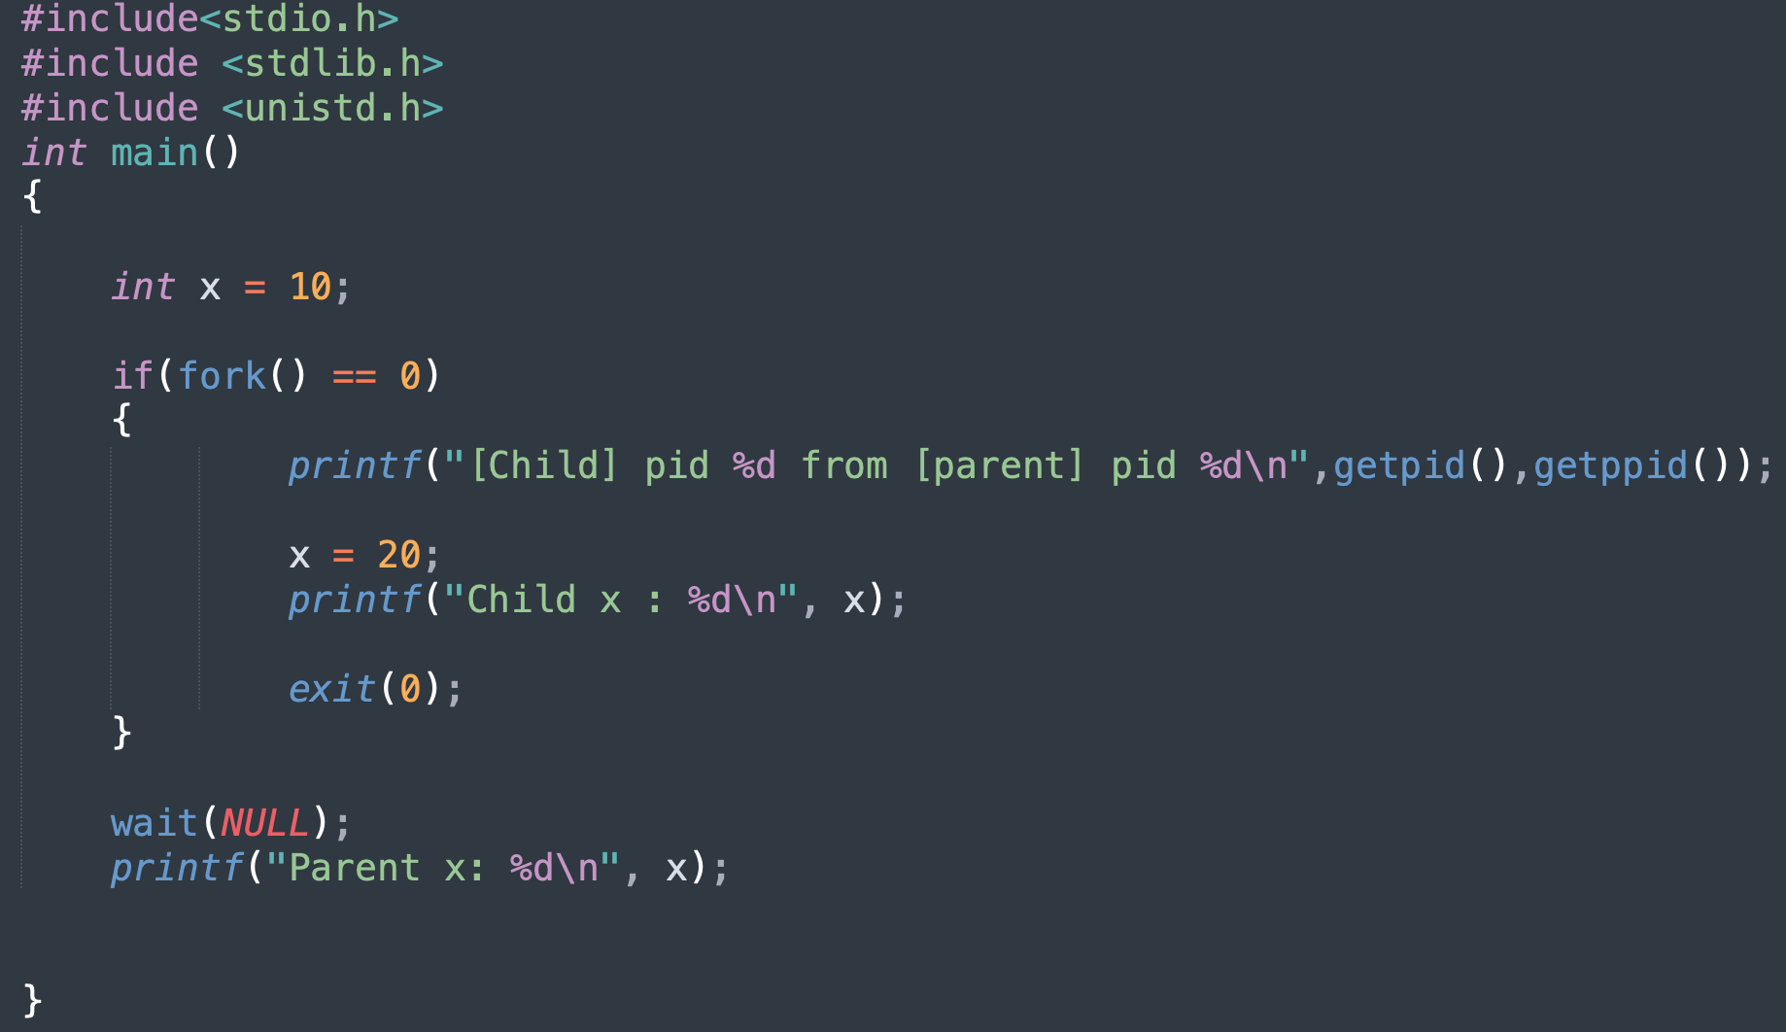
Using fork() to create a child process

Slide 16
Multi-threaded version of the server

Slide 17
server_thread.c
Use pthread_create() to create a worker thread
Worker Thread
Handles sending the requested file over the network connection
When done sending the file, it should log the request for that particular webpage by appending it to a file named stats_thread.txt
Access to stats_thread.txt needs to be synchronized
Use pthread_mutex_lock() and pthread_mutex_unlock() from <pthread.h>

Slide 18
server_thread.c
Sharing between threads is just allocating things in the heap or globals.
Compile your server_thread.c file with the –pthread flag
DEMO

Slide 19
CLIENT

Slide 20
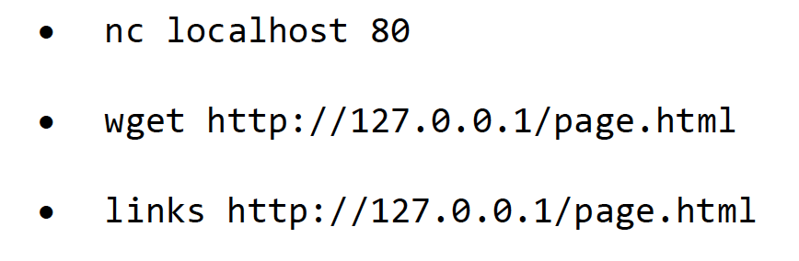
Test from the client side

Slide 21
Client
You can run multiple programs from the client side to send requests to the server in parallel
To run two programs simultaneously on the command line, put an & between them
Here, a program can be wget or curl or any program that can download from a web server. Or you can even write you own test program as HTTP is not a complicated protocol.

