Slide 1
CS 1550
Project 5 – Virtual Memory Simulator

Slide 2
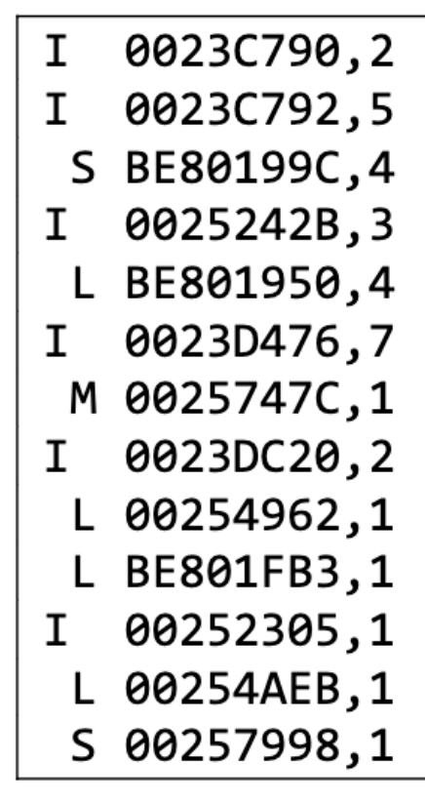
Trace File
I – Instruction fetch from RAM
L – Load data
S – Store data
M – 1st Load then Store

Slide 3
Example – Assumptions
Number of frames = 3
Page Size = 4 KB
Address = 32 bits
Number of entries in Root of the page table = 256 = 2^8
IMPORTANT!!
These are my assumptions for the examples in these slides. For your implementation, please follow the specifications given in the project description

Slide 4
Example – Address Breakdown
32-bit Address = 00101010 101010101 010101010 010101010
8 bits
Index to Root Page Table
This is because root has 256 = 2^8 entries
12 bits
Index to leaf page table
So, each leaf page table has 2^11 entries.
12 bits
Byte Offset
This is because Page Size = 4 KB = 2 ^ 12 Bytes

Slide 5
For this assumption, Consider the following example
Trace File
Root Page Table
I 0000abcd, 1
M 00001234, 1
S 00002345, 1
I 0000abcd, 1
L 00003456, 1
NULL
NULL
… … …
NULL
256 entries
Physical Memory
3 frames

Slide 6
For this assumption, Consider the following example
Root PT index = 00
Leaf PT Index = 000
Trace File
Root Page Table
I 00000bcd, 1
M 00001234, 1
S 00002345, 1
I 00000bcd, 1
L 00003456, 1
NULL
NULL
… … …
NULL
256 entries
Physical Memory
3 frames

Slide 7
For this assumption, Consider the following example
Root PT index = 00
Index in Leaf PT = 000
Leaf PT 0
Trace File
V | D | R
 |  | … … …
 |  | .
Root PT
I 00000bcd, 1
M 00001234, 1
S 00002345, 1
I 00000bcd, 1
L 00003456, 1
000
00
.
NULL
… … …
NULL
2^12 entries
Physical Memory
PAGE FAULT!!
What will be the initial values of valid, dirty and reference bits in Leaf PT 0??

Slide 8
For this assumption, Consider the following example
Root PT index = 00
Index in Leaf PT = 000
Leaf PT 0
Trace File
V | D | R
1 | 0 | 1
 |  | … … …
 |  | .
Root PT
I 00000bcd, 1
M 00001234, 1
S 00002345, 1
I 00000bcd, 1
L 00003456, 1
000
00
.
NULL
… … …
NULL
Physical Memory
00000

Slide 9
For this assumption, Consider the following example
Root PT index = 00
Index in Leaf PT = 001
Leaf PT 0
Trace File
V | D | R
1 | 0 | 1
 |  | … … …
 |  | .
Root PT
I 00000bcd, 1
M 00001234, 1
S 00002345, 1
I 00000bcd, 1
L 00003456, 1
00
.
NULL
… … …
NULL
001
Physical Memory
00000
PAGE FAULT!!

Slide 10
For this assumption, Consider the following example
Root PT index = 00
Index in Leaf PT = 001
Leaf PT 0
Trace File
V | D | R
1 | 0 | 1
1 | 0 | 1
 |  | … … …
 |  | .
Root PT
I 00000bcd, 1
M 00001234, 1
S 00002345, 1
I 00000bcd, 1
L 00003456, 1
00
.
NULL
… … …
NULL
001
Physical Memory
00000
M = 1st Load
PAGE FAULT!!

Slide 11
For this assumption, Consider the following example
Root PT index = 00
Index in Leaf PT = 001
Leaf PT 0
Trace File
V | D | R
1 | 0 | 1
1 | 0 | 1
 |  | … … …
 |  | .
Root PT
I 00000bcd, 1
M 00001234, 1
S 00002345, 1
I 00000bcd, 1
L 00003456, 1
00
.
NULL
… … …
NULL
001
Physical Memory
00000
00001
M = 1st Load
PAGE FAULT!!

Slide 12
For this assumption, Consider the following example
Root PT index = 00
Index in Leaf PT = 001
Leaf PT 0
Trace File
V | D | R
1 | 0 | 1
1 | 1 | 1
 |  | … … …
 |  | .
Root PT
I 00000bcd, 1
M 00001234, 1
S 00002345, 1
I 00000bcd, 1
L 00003456, 1
00
.
NULL
… … …
NULL
001
Dirty Bit Set
because it is a store
Physical Memory
00000
00001
M = Then Store
PAGE HIT!!

Slide 13
That’s how you will modify the page table and the physical memory

Slide 14
Page Replacement Algorithms

Slide 15
Example – Assumptions
Number of physical frames = 3
Page Size = 4 KB
Address = 32 bits
Number of entries in Root of the page table = 256 = 2^8
IMPORTANT!!
These are my assumptions for the examples in these slides. For your implementation, please follow the specifications given in the project description

Slide 16
Project - Virtual Memory Simulator
Number of physical frames = 3
Page Size = 4 KB = 2^12 B
Address = 32 bits
Number of entries in Root of the page table = 256 = 2^8
Physical Memory
S | 3856bbe0 | 0
L | 190afc20 | 0
L | 15216f00 | 0
L | 190a7c20 | 0
L | 190a7c28 | 0
L | 190a7c28 | 0
L | 190aff38 | 0

Slide 17
Shift Operations
Left shift (x << n)
Fill with 0s on right
Right shift (x >> n)
Logical shift
Unsigned values
Fill with 0s on left
Arithmetic shift
Signed values
Replicate most significant bit on left
Notes:
x | 0010 | 0010
x<<3 | 0001 | 0000
x>>2 | 0000 | 1000
x>>2 | 0000 | 1000
logical:
arithmetic:
x | 1010 | 0010
x<<3 | 0001 | 0000
x>>2 | 0010 | 1000
x>>2 | 1110 | 1000
logical:
arithmetic:
Shifts by n<0 or n≥w (w is bit width of x) are undefined
C: behavior of >> is determined by compiler
In gcc / Clang, depends on data type of x (signed/unsigned)
Java: logical shift is >>> and arithmetic shift is >>
7

Slide 18
LRU
Assume 12KB physical memory, each page is 4KB, so there're 3 page frames
Assume Least Recently Used(LRU)
Physical Memory
Least Recently Used
L | 190a7c20 | 0
S | 3856bbe0 | 0
L | 190afc20 | 0
L | 15216f00 | 0
L | 190a7c20 | 0
L | 190a7c28 | 0
L | 190a7c28 | 0
L | 190aff38 | 0
0
1
2
Most Recently Used

Slide 19
LRU
Assume 12KB physical memory, each page is 4KB, so there're 3 page frames
Assume Least Recently Used(LRU)
Least Recently Used
L | 190a7c20 | 0
S | 3856bbe0 | 0
L | 190afc20 | 0
L | 15216f00 | 0
L | 190a7c20 | 0
L | 190a7c28 | 0
L | 190a7c28 | 0
L | 190aff38 | 0
0
1
2
Most Recently Used

Slide 20
LRU
Assume 12KB physical memory, each page is 4KB, so there're 3 page frames
Pagefault since it is not in the physical memory
Assume Least Recently Used(LRU)
Least Recently Used
L | 190a7c20 | 0
S | 3856bbe0 | 0
L | 190afc20 | 0
L | 15216f00 | 0
L | 190a7c20 | 0
L | 190a7c28 | 0
L | 190a7c28 | 0
L | 190aff38 | 0
0
1
2
Most Recently Used

Slide 21
LRU
Assume 12KB physical memory, each page is 4KB, so there're 3 page frames
Pagefault since it is not in the physical memory
Assume Least Recently Used(LRU)
Least Recently used
L | 190a7c20 | 0
S | 3856bbe0 | 0
L | 190afc20 | 0
L | 15216f00 | 0
L | 190a7c20 | 0
L | 190a7c28 | 0
L | 190a7c28 | 0
L | 190aff38 | 0
0 | 190a7
1
2
Most Recently Used

Slide 22
LRU
Assume 12KB physical memory, each page is 4KB, so there're 3 page frames
Assume Least Recently Used(LRU)
Least Recently used
L | 190a7c20 | 0
S | 3856bbe0 | 0
L | 190afc20 | 0
L | 15216f00 | 0
L | 190a7c20 | 0
L | 190a7c28 | 0
L | 190a7c28 | 0
L | 190aff38 | 0
0 | 190a7
1
2
Most Recently Used

Slide 23
LRU
Assume 12KB physical memory, each page is 4KB, so there're 3 page frames
Pagefault since it is not in the physical memory
Assume Least Recently Used(LRU)
Least Recently used
L | 190a7c20 | 0
S | 3856bbe0 | 0
L | 190afc20 | 0
L | 15216f00 | 0
L | 190a7c20 | 0
L | 190a7c28 | 0
L | 190a7c28 | 0
L | 190aff38 | 0
0 | 190a7
1
2
Most Recently Used

Slide 24
LRU
Assume 12KB physical memory, each page is 4KB, so there're 3 page frames
Pagefault since it is not in the page table
Assume Least Recently Used(LRU)
Least Recently used
L | 190a7c20 | 0
S | 3856bbe0 | 0
L | 190afc20 | 0
L | 15216f00 | 0
L | 190a7c20 | 0
L | 190a7c28 | 0
L | 190a7c28 | 0
L | 190aff38 | 0
0 | 190a7
1 | 3856b
2
Most Recently Used

Slide 25
LRU
Assume 12KB physical memory, each page is 4KB, so there're 3 page frames
Assume Least Recently Used(LRU)
Least Recently used
L | 190a7c20 | 0
S | 3856bbe0 | 0
L | 190afc20 | 0
L | 15216f00 | 0
L | 190a7c20 | 0
L | 190a7c28 | 0
L | 190a7c28 | 0
L | 190aff38 | 0
0 | 190a7
1 | 3856b
2
Most Recently Used

Slide 26
LRU
Assume 12KB physical memory, each page is 4KB, so there're 3 page frames
Pagefault since it is not in the physical memory
Assume Least Recently Used(LRU)
Least Recently used
l | 190a7c20 | 0
s | 3856bbe0 | 0
l | 190afc20 | 0
l | 15216f00 | 0
l | 190a7c20 | 0
l | 190a7c28 | 0
l | 190a7c28 | 0
l | 190aff38 | 0
0 | 190a7
1 | 3856b
2 | 190af
Most Recently Used
l = load
s = store

Slide 27
Assume 12KB physical memory, each page is 4KB, so there're 3 page frames
Pagefault again
Assume Least Recently Used(LRU)
Least Recently used
We need to evict | l | 190a7c20 | 0
someone!! | s | 3856bbe0 | 0
 | l | 190afc20 | 0
 | l | 15216f00 | 0
 | l | 190a7c20 | 0
 | l | 190a7c28 | 0
 | l | 190a7c28 | 0
 | l | 190aff38 | 0
0 | 190a7
1 | 3856b
2 | 190af
Most Recently Used

Slide 28
LRU
Assume 12KB physical memory, each page is 4KB, so there're 3 page frames
Pagefault again
Assume Least Recently Used(LRU)
Least Recently used
We need to evict | l | 190a7c20 | 0
someone!! | s | 3856bbe0 | 0
 | l | 190afc20 | 0
 | l | 15216f00 | 0
 | l | 190a7c20 | 0
 | l | 190a7c28 | 0
 | l | 190a7c28 | 0
 | l | 190aff38 | 0
0 | 190a7
1 | 3856b
2 | 190af
Most Recently Used

Slide 29
LRU
Assume 12KB physical memory, each page is 4KB, so there're 3 page frames
Pagefault again
Assume Least Recently Used(LRU)
Least Recently used
We need to evict | l | 190a7c20 | 0
someone!! | s | 3856bbe0 | 0
 | l | 190afc20 | 0
Evict the LRU page | l | 15216f00 | 0
 | l | 190a7c20 | 0
 | l | 190a7c28 | 0
 | l | 190a7c28 | 0
 | l | 190aff38 | 0
0
190a7
1
3856b
2
190af
Most Recently Used

Slide 30
LRU
Assume 12KB physical memory, each page is 4KB, so there're 3 page frames
Pagefault again
Assume Least Recently Used(LRU)
Least Recently used
We need to evict | l | 190a7c20 | 0
someone!! | s | 3856bbe0 | 0
 | l | 190afc20 | 0
 | l | 15216f00 | 0
 | l | 190a7c20 | 0
 | l | 190a7c28 | 0
 | l | 190a7c28 | 0
 | l | 190aff38 | 0
0 | 3856b
1 | 190af
2 | 15216
Most Recently Used
What type of data structure can you use for your physical memory?

Slide 31
LRU
Assume 12KB physical memory, each page is 4KB, so there're 3 page frames
Least Recently used
l | 190a7c20 | 0
s | 3856bbe0 | 0
l | 190afc20 | 0
l | 15216f00 | 0
0 | 190af
1 | 15216
2 | 190a7
l 190a7c20 0
l 190a7c28 0
l 190a7c28 0
l 190aff38 0
Assume we skip to page 190af
Most Recently Used

Slide 32
LRU
Assume 12KB physical memory, each page is 4KB, so there're 3 page frames
Least Recently used
l | 190a7c20 | 0
s | 3856bbe0 | 0
0 | 15216
1 | 190af
2 | 190a7
Page hit! However, we need to | l | 190afc20 | 0
change its position since it was | l | 15216f00 | 0
most recently used | l | 190a7c20 | 0
 | l | 190a7c28 | 0
 | l | 190a7c28 | 0
 | l | 190aff38 | 0
Most Recently Used

Slide 33
LRU
Assume 12KB physical memory, each page is 4KB, so there're 3 page frames
Least Recently used
l | 190a7c20 | 0
s | 3856bbe0 | 0
0 | 15216
1 | 190a7
2 | 190af
Page hit! However, we need to | l | 190afc20 | 0
change its position since it was | l | 15216f00 | 0
most recently used | l | 190a7c20 | 0
 | l | 190a7c28 | 0
 | l | 190a7c28 | 0
 | l | 190aff38 | 0
Most Recently Used

Slide 34
Dirty Bit
Dirty bit
Stores will set the target’s dirty bit, while Loads won’t change the dirty bit.
Upon eviction, dirty bit decides whether writing page to disk is necessary.
Set dirty bit for a store
If we evict 3856b whose dirty bit is set, we need to write (save) the updated page data to disk.
If we evict 190a7 whose dirty bit is not set, there’s no need to write disk because no data changes.
l | 190a7c20 | 0
s | 3856bbe0 | 0
l | 190afc20 | 0
l | 15216f00 | 0
l | 190a7c20 | 0
l | 190a7c28 | 0
l | 190a7c28 | 0
l | 190aff38 | 0
0 | 190a7 | 0
1 | 3856b | 1
2

Slide 35
OPT
Assume 12KB physical memory, each page is 4KB, so there're 3 page frames
Assume OPT
To find the optimal victim, you’ll need to know all future memory accesses
L | 190a7c20 | 0
S | 3856bbe0 | 0
L | 190afc20 | 0
L | 15216f00 | 0
L | 190a7c20 | 0
L | 190a7c28 | 0
L | 190a7c28 | 0
L | 190aff38 | 0
0
1
2

Slide 36
OPT
Assume 12KB physical memory, each page is 4KB, so there're 3 page frames
Pagefault again
Assume OPT
We need to evict someone!!
l 190a7c20 0
s 3856bbe0 0
l 190afc20 0
l 15216f00 0
l 190a7c20 0
l 190a7c28 0
l 190a7c28 0
l 190aff38 0
0 | 190a7
1 | 3856b
2 | 190af

Slide 37
OPT
Assume 12KB physical memory, each page is 4KB, so there're 3 page frames
Pagefault again
Assume OPT
We need to evict someone!!
l 190a7c20 0
s 3856bbe0 0
l 190afc20 0
l 15216f00 0
l 190a7c20 0
l 190a7c28 0
l 190a7c28 0
l 190aff38 0
0 | 190a7
1 | 3856b
2 | 190af
Page 190a7 will be used later!

Slide 38
OPT
Assume 12KB physical memory, each page is 4KB, so there're 3 page frames
Pagefault again
Assume OPT
We need to evict someone!!
l 190a7c20 0
s 3856bbe0 0
l 190afc20 0
l 15216f00 0
l 190a7c20 0
l 190a7c28 0
l 190a7c28 0
l 190aff38 0
0 | 190a7
1 | 3856b
2 | 190af
Page 3856b is no longer needed in the future.
Evict it.

Slide 39
OPT
Assume 12KB physical memory, each page is 4KB, so there're 3 page frames
Pagefault again
Assume OPT
l | 190a7c20 | 0
s | 3856bbe0 | 0
l | 190afc20 | 0
l | 15216f00 | 0
l | 190a7c20 | 0
l | 190a7c28 | 0
l | 190a7c28 | 0
l | 190aff38 | 0
0 | 190a7
1 | 3856b
2 | 190af
What if there is a tie: multiple pages no longer needed in the future?
--Break the tie by evicting any arbitrary of those pages

Slide 40
OPT
Implementing OPT in a naïve fashion will lead to unacceptable performance caused by searching across trace
It should not take more than 5 minutes to run your program

Slide 41
OPT
Implementing OPT in a naïve fashion will lead to unacceptable performance caused by searching across trace
It should not take more than 5 minutes to run your program
How to be more eﬃcient on searching
E.g., use Hash table with Page Number as Key. If you’re using C, here’s one example of hash based on the Horner’s method¹
int hash(char *v, int M)
{
int h, a = 117;
for (h = 0; *v != '\0'; v++) h = (a*h + *v) % M;
return h;
}
[1] Horner’s method: https://www.cs.iupui.edu/~cs240/summer10/slides/t99Hashing.pdf

Slide 42
OPT
Hash Example
1) l | 190a7c20 | 0
2) s | 3856bbe0 | 0
3) l | 190afc20 | 0
4) l | 15216f00 | 0
5) l | 190a7c20 | 0
6) l | 190a7c28 | 0
7) l | 190a7c28 | 0
8) l | 190aff38 | 0
190a7
3856b
190af
15216
1
5
6
7
2
3
8
4

Slide 43

OPT
190a7
3856b
190af
15216
1
5
6
7
2
3
8
4
l 190a7c20 0
s 3856bbe0 0
l 190afc20 0
l 15216f00 0
l 190a7c20 0
l 190a7c28 0
l 190a7c28 0
l 190aff38 0
0 | 190a7
1
2

Slide 44

OPT
190a7
3856b
190af
15216
1
5
6
7
2
3
8
4
l 190a7c20 0
s 3856bbe0 0
l 190afc20 0
l 15216f00 0
l 190a7c20 0
l 190a7c28 0
l 190a7c28 0
l 190aff38 0
0 | 190a7
1 | 3856b
2

Slide 45


OPT
190a7
3856b
190af
15216
1
5
6
7
2
3
8
4
l 190a7c20 0
s 3856bbe0 0
l 190afc20 0
l 15216f00 0
l 190a7c20 0
l 190a7c28 0
l 190a7c28 0
l 190aff38 0
0 | 190a7
1 | 190af
2 | 15216

Slide 46
OPT
190a7
3856b
190af
15216
1
5
6
7
2
3
8
4
l 190a7c20 0
s 3856bbe0 0
l 190afc20 0
l 15216f00 0
l 190a7c20 0
l 190a7c28 0
l 190a7c28 0
l 190aff38 0
0 | 190a7
1 | 190af
2 | 15216

Slide 47
Virtual Memory Simulator
No need to use qemu
You will write the simulator from scratch with Java, C/C++, Java, or Python
Read from memory traces text files
Statistics: count the number of events (pagefaults, page evictions etc.)

Slide 48
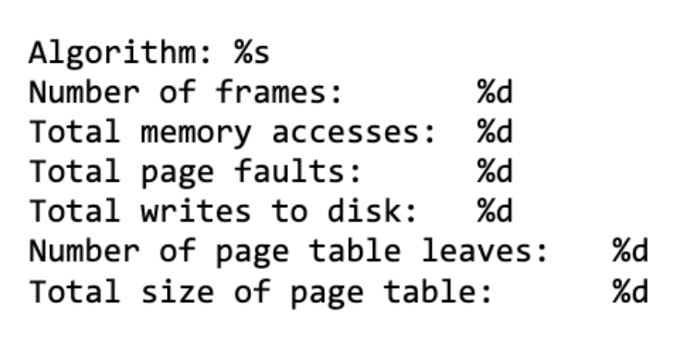
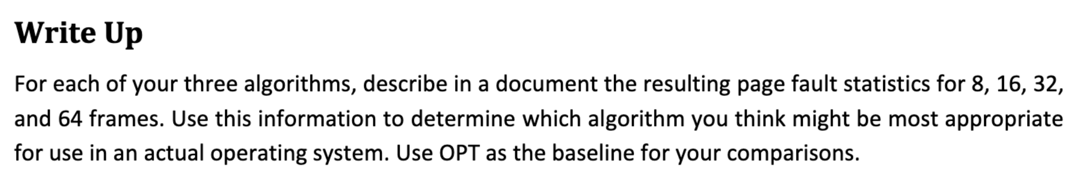
Statistics

