Slide 1
K Maps, Lab 9

Slide 2

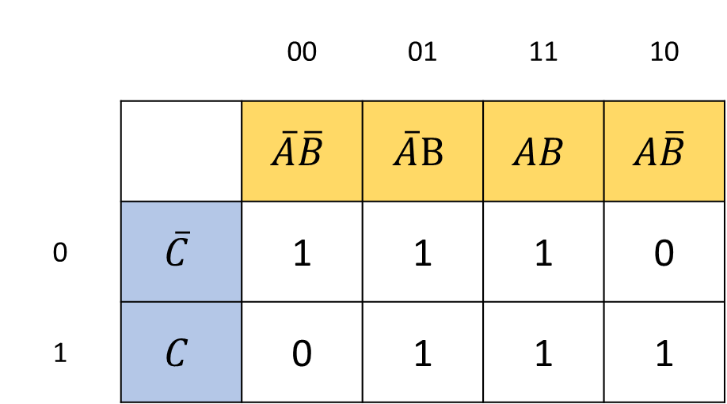
From Truth Table To K Map
K Map
 |  | 00 | 01 | 11 | 10
 |  | $$\overline{A}\overline{B}$$ | $$\overline{A}B$$ | $$AB$$ | $$A\overline{B}$$
0 | $$\overline{C}$$ | 1 | 1 | 1 | 0
1 | $$C$$ | 0 | 1 | 1 | 1
A | B | C | Y
0 | 0 | 0 | 1
0 | 0 | 1 | 0
0 | 1 | 0 | 1
0 | 1 | 1 | 1
1 | 0 | 0 | 0
1 | 0 | 1 | 1
1 | 1 | 0 | 1
1 | 1 | 1 | 1
Truth Table
$$\overline{A}\overline{C}+B+AC$$

Slide 3



Minimize the Boolean Expression Using K Map
$$\overline{A}B+B\overline{C}+BC+A\overline{B}\overline{C}$$
 |  | 00 | 01 | 11 | 10
 |  | $$\overline{A}\overline{B}$$ | $$\overline{A}B$$ | $$AB$$ | $$A\overline{B}$$
0 | $$\overline{C}$$ | 0 | 1 | 1 | 1
1 | $$C$$ | 0 | 1 | 1 | 0
$$B+A\overline{C}$$

Slide 4
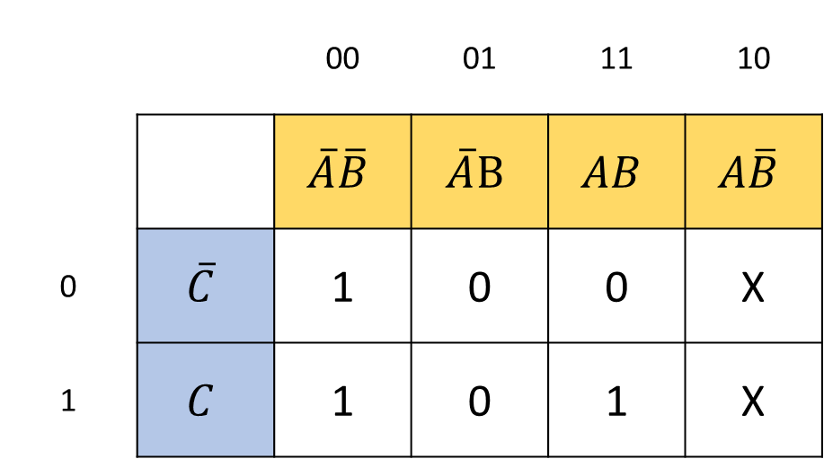

Write the equivalent Minimized BE
 |  | 00 | 01 | 11 | 10
 |  | $$\overline{A}\overline{B}$$ | $$\overline{A}B$$ | $$AB$$ | $$A\overline{B}$$
0 | $$\overline{C}$$ | 1 | 0 | 0 | X
1 | $$C$$ | 1 | 0 | 1 | X
Boolean Expression:
$$AC+\overline{B}$$

Slide 5

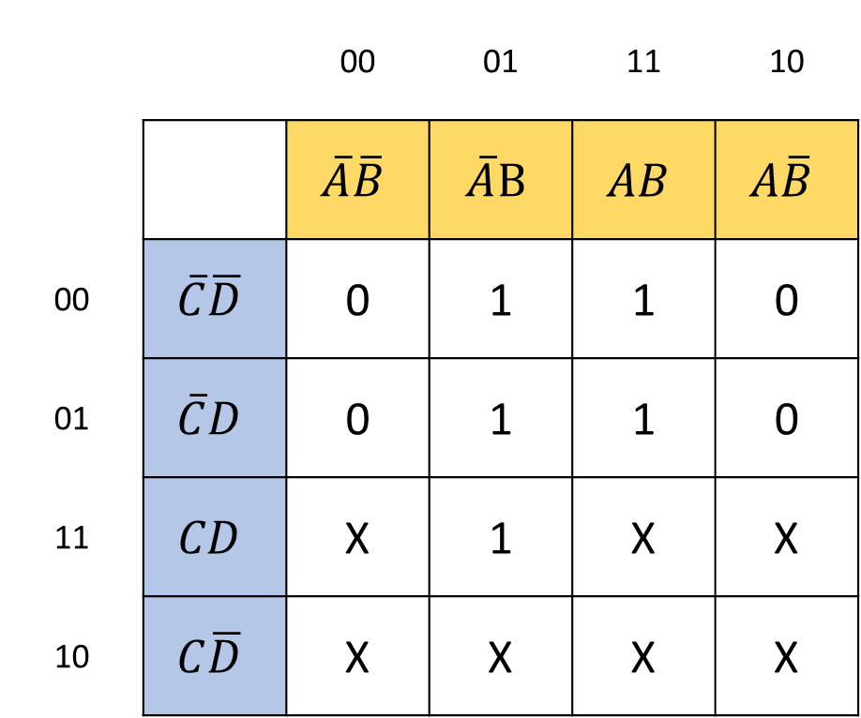
Write the equivalent Minimized BE
 |  | 00 | 01 | 11 | 10
 |  | $$\overline{A}\overline{B}$$ | $$\overline{A}B$$ | $$AB$$ | $$A\overline{B}$$
00 | $$\overline{C}\overline{D}$$ | 0 | 1 | 1 | 0
01 | $$\overline{C}D$$ | 0 | 1 | 1 | 0
11 | $$CD$$ | X | 1 | X | X
10 | $$C\overline{D}$$ | X | X | X | X
Boolean Expression:
$$B+C$$

Slide 6


Write the equivalent Minimized BE
 |  | 00 | 01 | 11 | 10
 |  | $$\overline{A}\overline{B}$$ | $$\overline{A}B$$ | $$AB$$ | $$A\overline{B}$$
00 | $$\overline{C}\overline{D}$$ | 1 | 0 | 0 | 1
01 | $$\overline{C}D$$ | 0 | 1 | 1 | 0
11 | $$CD$$ | 0 | X | X | 0
10 | $$C\overline{D}$$ | X | 0 | 0 | X
Boolean Expression:
$$BD+\overline{B}\overline{D}$$

Slide 7


Write the equivalent Minimized BE
 |  | 00 | 01 | 11 | 10
 |  | $$\overline{A}\overline{B}$$ | $$\overline{A}B$$ | $$AB$$ | $$A\overline{B}$$
00 | $$\overline{C}\overline{D}$$ | X | 0 | 0 | X
01 | $$\overline{C}D$$ | 0 | 1 | 0 | 0
11 | $$CD$$ | 0 | X | 1 | 0
10 | $$C\overline{D}$$ | X | 0 | 0 | 1
Boolean Expression:
$$\overline{A}BD+BCD+\overline{B}\overline{D}$$

