Slide 1
Floating Point, Lab 7

Slide 2

Exercise
Number ${122.75}_{10}$
Convert to:
Binary
Normalized Decimal Scientific Notation
Normalized Binary Scientific Notation

Slide 3
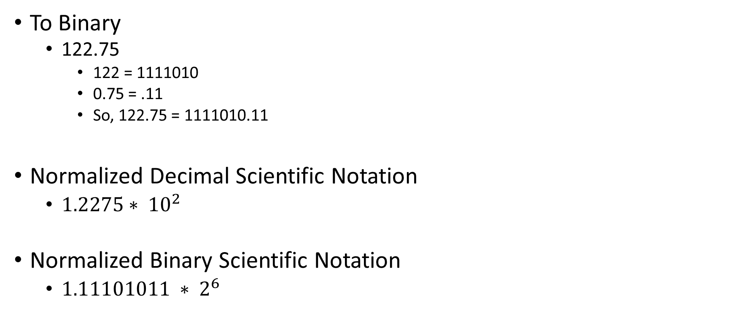
Exercise
To Binary
122.75
122 = 1111010
0.75 = .11
So, 122.75 = 1111010.11
Normalized Decimal Scientific Notation
$1.2275∗ {10}^{2}$
Normalized Binary Scientific Notation
$1.11101011 ∗ 2^{6}$

Slide 4

Now, Convert to IEEE 754 format
$$1.11101011 ∗ 2^{6}$$
Fraction
$11101011$
Biased Exponent
exp + 127 = 127 + 6 = 133 = 10000101
Significand
$1.11101011$
Sign:
0

Slide 5
Convert to IEEE 754

Slide 6
Convert to IEEE 754
0 | 1 | 0 | 0 | 0 | 0 | 1 | 0 | 1 | 1 | 1 | 1 | 0 | 1 | 0 | 1 | 1 | 0 | 0 | 0 | 0 | 0 | 0 | 0 | 0 | 0 | 0 | 0 | 0 | 0 | 0 | 0

Slide 7
Convert from IEEE 754 to decimal
1 | 1 | 0 | 0 | 0 | 0 | 1 | 1 | 1 | 0 | 0 | 1 | 1 | 1 | 0 | 1 | 1 | 1 | 0 | 0 | 0 | 0 | 0 | 0 | 0 | 0 | 0 | 0 | 0 | 0 | 0 | 0
Sign
1
Exponent
10000111 -127 = 135-127 = 8
Fraction
001110111

Slide 8
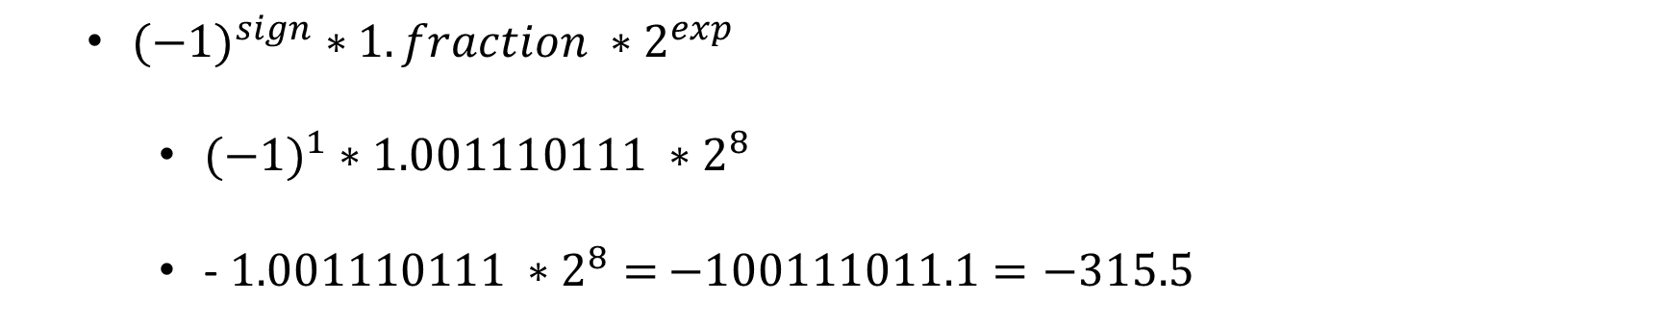
Convert from IEEE 754 to decimal
1 | 1 | 0 | 0 | 0 | 0 | 1 | 1 | 1 | 0 | 0 | 1 | 1 | 1 | 0 | 1 | 1 | 1 | 0 | 0 | 0 | 0 | 0 | 0 | 0 | 0 | 0 | 0 | 0 | 0 | 0 | 0
${(−1)}^{sign} ∗1.fraction ∗2^{exp}$
${(−1)}^{1} ∗1.001110111 ∗2^{8}$
- $1.001110111 ∗2^{8}=$ $−100111011.1=−315.5$

