Slide 1
Lab 1

Slide 2
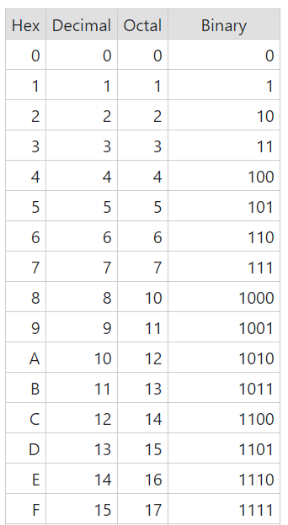

Slide 3
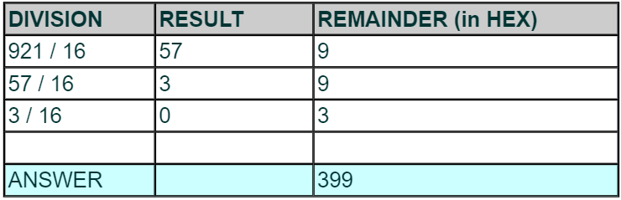
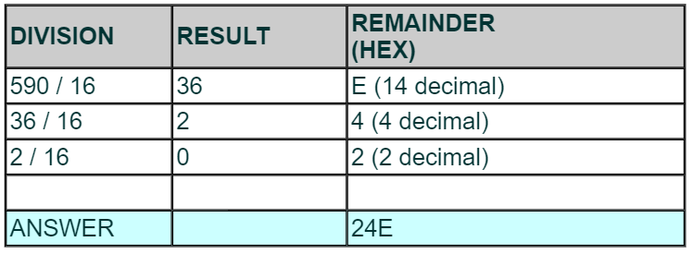
Decimal to Hexadecimal

Slide 4
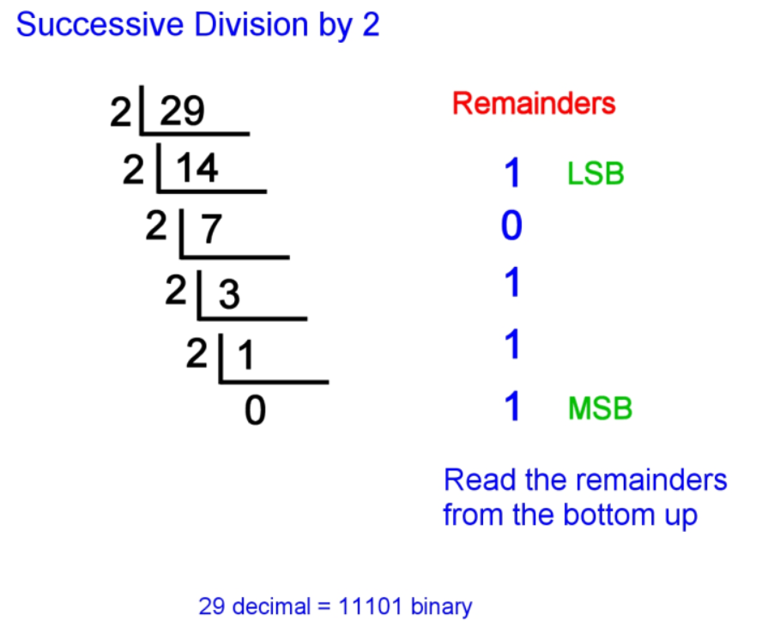
Decimal to Binary

Slide 5
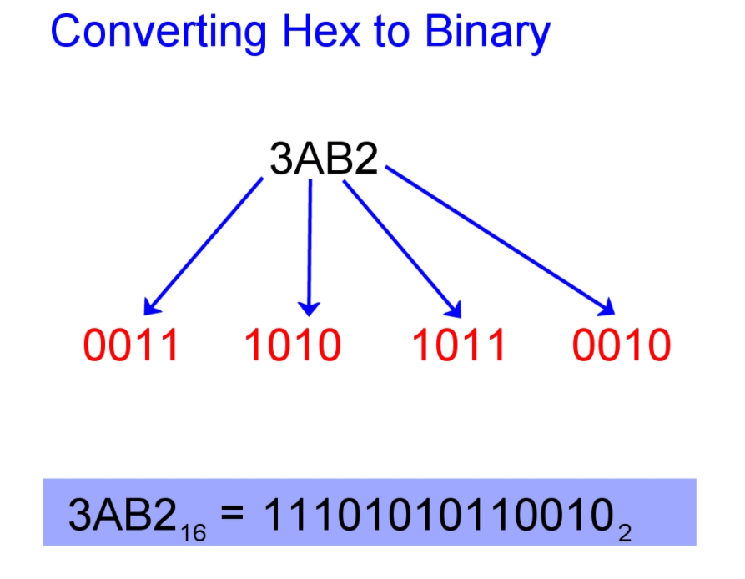
Hexadecimal to Binary

Slide 6
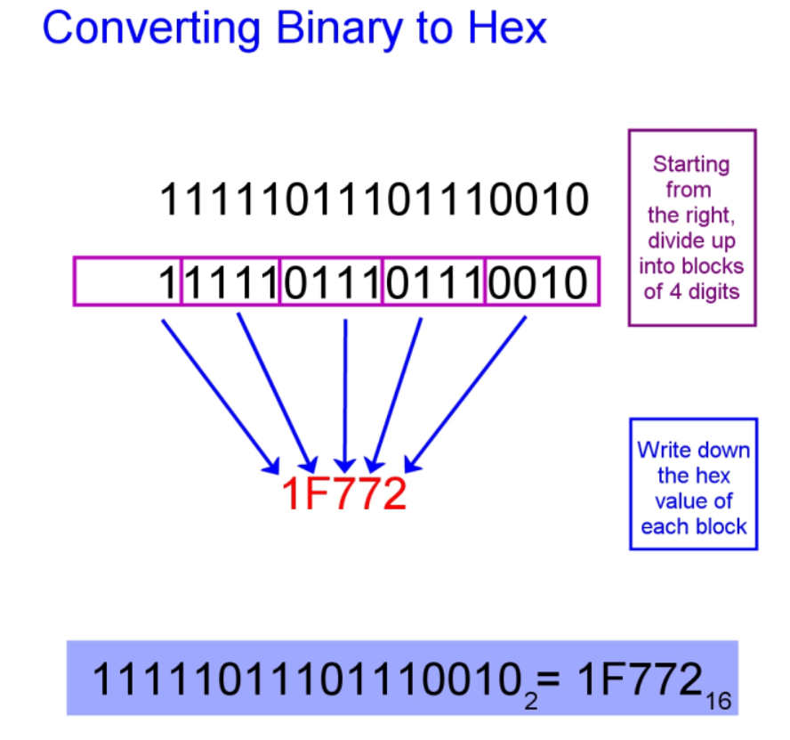
Binary to Hexadecimal

Slide 7
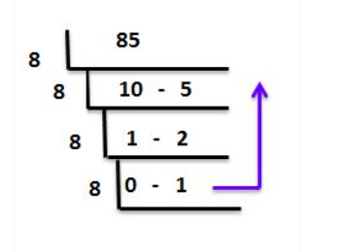

Decimal to Octal
$${85}_{10}={125}_{8}$$

Slide 8
Exercise
Convert the following from hexadecimal to octal:
0x1AF6C -> ________ in octal

Slide 9
Exercise
Convert the following from hexadecimal to octal:
0x1AF6C -> 110444 in decimal -> 327554 in octal

Slide 10
Signed Conversions
For the binary sequence 10010101, what are following in decimal?
Unsigned
Signed magnitude
1’s complement
2’s complement

Slide 11
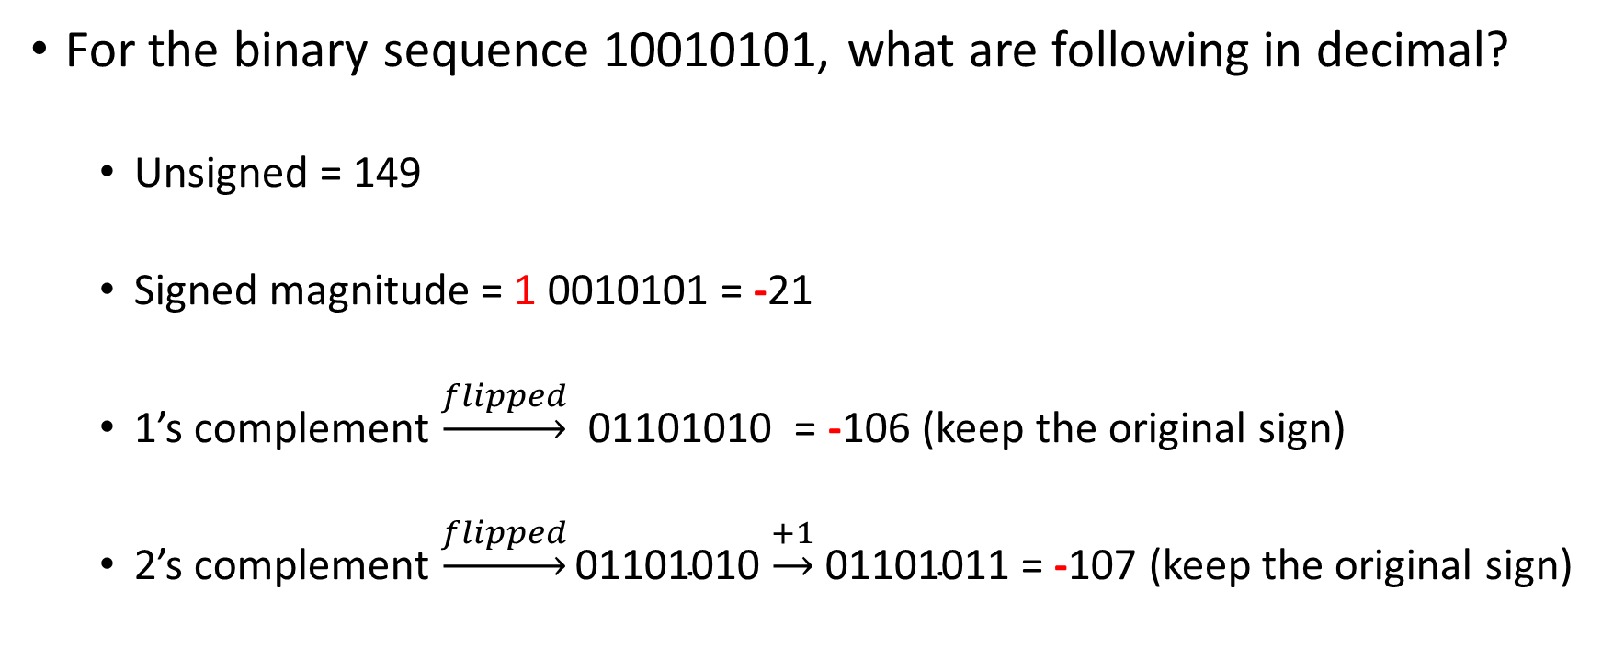
Signed Conversions
For the binary sequence 10010101, what are following in decimal?
Unsigned = 149
Signed magnitude = 1 0010101 = -21
1’s complement $\underset{→}{flipped}$ 01101010 = -106 (keep the original sign)
2’s complement $\underset{→}{flipped}\text{01101010}$ $\underset{→}{+1}$ $\text{0110101}\text{1}$ = -107 (keep the original sign)

Slide 12
QUIZ
Solve the Numbers Quiz in Gradescope.

Slide 13
MIPS and MARS

