Slide 1
Logic Gates, Lab 8

Slide 2





Boolean Expression from Truth Table
A | B | C | Output
0 | 0 | 0 | 0
0 | 0 | 1 | 0
0 | 1 | 0 | 0
0 | 1 | 1 | 1
1 | 0 | 0 | 0
1 | 0 | 1 | 1
1 | 1 | 0 | 1
1 | 1 | 1 | 1
$$\overline{A}BC=1$$
$$A\overline{B}C=1$$
$\overline{A}BC$ + $A\overline{B}C$ + $AB\overline{C}$ + $ABC$
$$AB\overline{C}=1$$
$$ABC=1$$

Slide 3
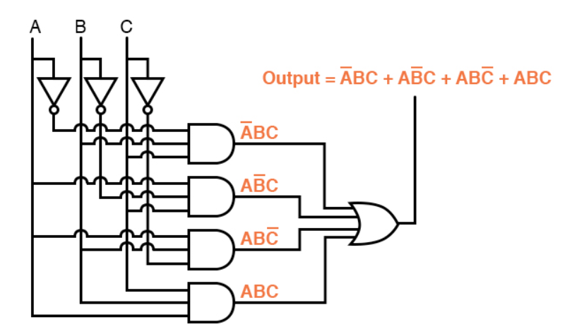
Logic Gate Circuit based on the Boolean Expression

Slide 4
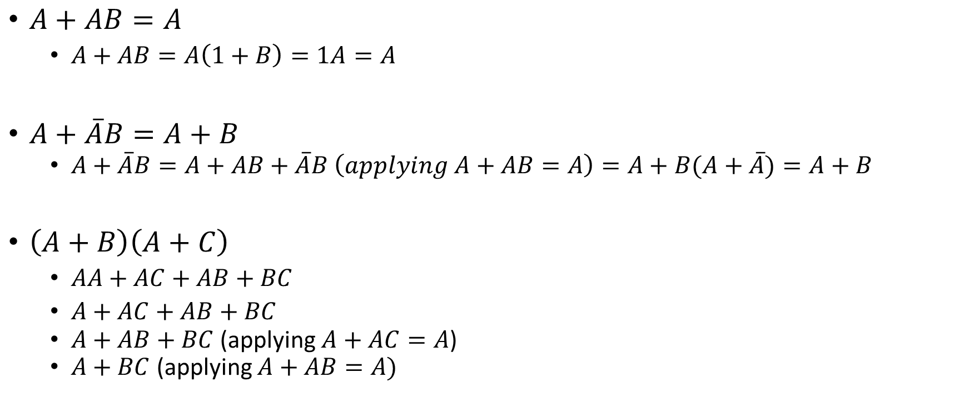
Simplifying Boolean Expression
$A+AB=A$
$A+AB=A\left(1+B\right)=1A=A$
$A+\overline{A}B=A+B$
$A+\overline{A}B=A+AB+\overline{A}B \left(applying A+AB=A\right)=A+B(A+$ $\overline{A})=A+B$
$\left(A+B\right)\left(A+C\right)$
$AA+AC+AB+BC$
$A+AC+AB+BC$
$A+AB+BC$ (applying $A+AC=A$)
$A+BC$(applying $A+AB=A)$

Slide 5
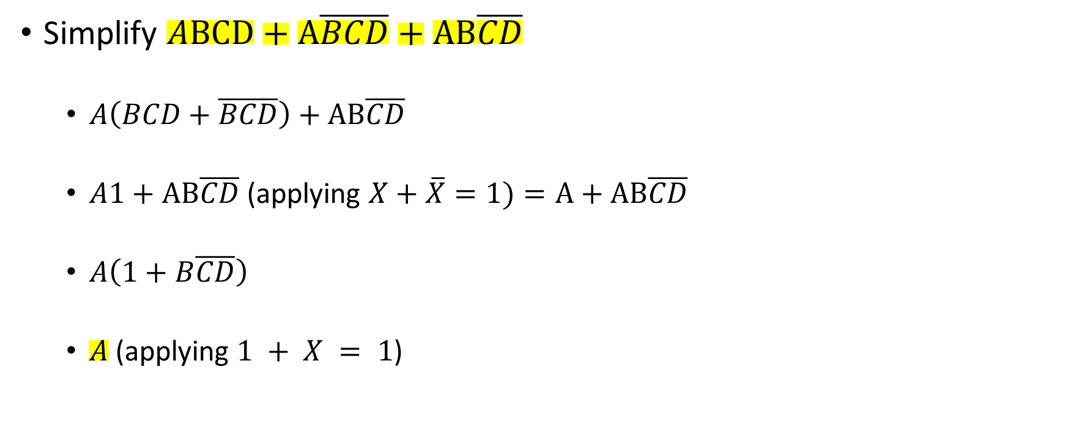
Example
Simplify $ABCD+A\overline{BCD}+AB\overline{CD}$
$A\left(BCD+\overline{BCD}\right)+AB\overline{CD}$
$A1+$ $AB\overline{CD}$ (applying $X+\overline{X}=1)=A+AB\overline{CD}$
$A\left(1+B\overline{CD}\right)$
$A$ (applying $1 + X = 1$)

Slide 6

Lab 8
Demo of drawing circuit for the expression $\left(A+\overline{B}\right)\left(A+B\right)$
Discussion of Part A, B, C

