Slide 1
Functions

Slide 2
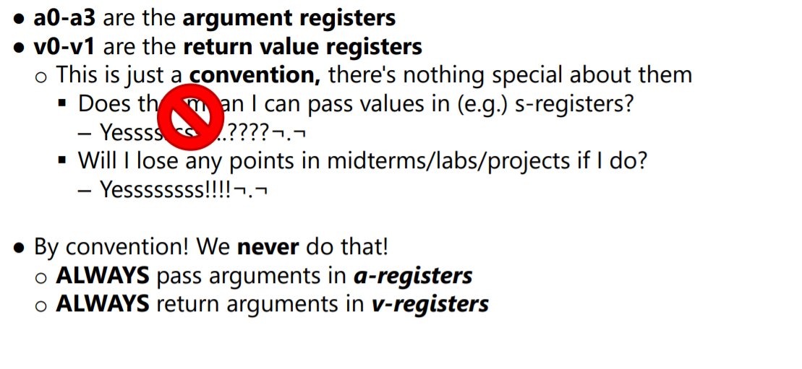
Convention 1
Put the arguments in a registers before calling another function using jal.
Make sure to load the return value in v0 to another register before you use v0 to make a syscall.

Slide 3
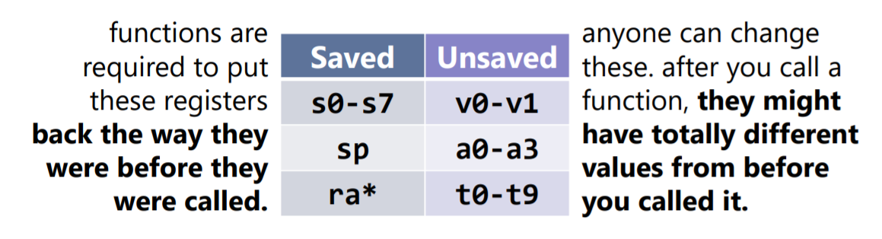
Convention 2

Slide 4
Exercise 1
Code:
func1: push ra
li s0, 10
li s1, 20
jal add
pop ra
add: add a0, s0, s1
jr ra
Do the functions follow all the conventions?

Slide 5
Exercise 2
Code:
func1: push ra
li a0, 10
li a1, 20
jal add
pop ra
add: push s0
add s0, a0, a1
move v0, s0
pop s0
jr ra
Do the functions follow all the conventions?

Slide 6
Exercise 3
main: li a0, 1
jal func2
..
li v0, 10 #exit code
syscall
func2: push s0
push ra
add s0, a0, 2
move a0, s0
jal func3
pop ra
pop s0
jr ra
func3: move v0, a0
jr ra
What conventions are broken?
Will this function execute correctly?

Slide 7
Exercise 4
main: li a0, 1
li a1, 2
jal func1
add s0, v0, s0
jal func2
sub s1, v1, s1
li v0, 10
syscall
func1: move v0, a0
move s0, v0
jr ra
func2: move v1, a1
move s1, v1
jr ra
What is the final value of s0 and s1?
s0 = 2, s1 = 0
What conventions are broken?

Slide 8
Exercise 5
8 Bytes
12 Bytes
16 Bytes
4 Bytes
How big is the activation frame of function add?
add:
push ra
push s0
push s1
push s2
# Code Omitted
pop s2
pop s1
pop s0
pop ra

Slide 9
Tower of Hanoi
There are three towers
N round disks, with decreasing sizes, placed on the first tower
You need to move all of the disks from the first tower to the last tower
Larger disks can not be placed on top of smaller disks
The third tower can be used to temporarily hold disks

Slide 10
Tower of Hanoi

Slide 11
What you need to do ?
Print the correct sequence using recursion
Example sequence
Moving disk 1 from src to aux
Moving disk 2 from src to dest
...
...
...

