Slide 1
Conditionals, Loops

Slide 2
Agenda
Conditionals and Loops Examples
Lab 4 Overview
Project 1 overview

Slide 3
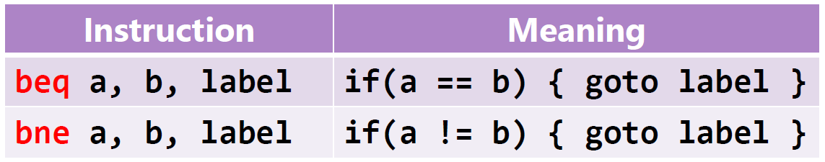
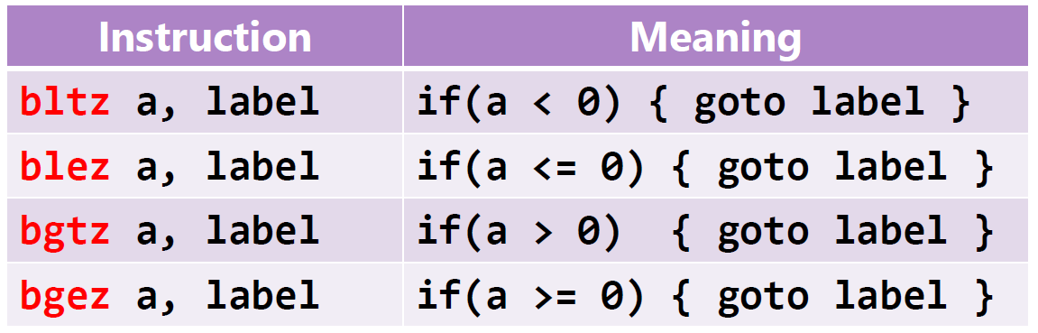

Slide 4
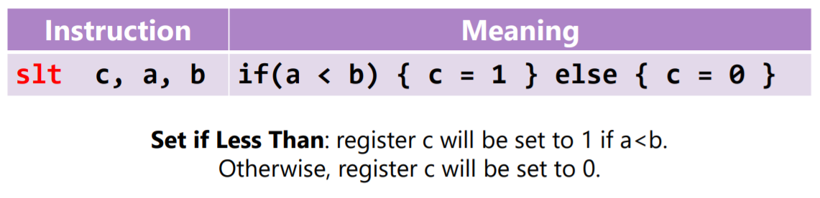
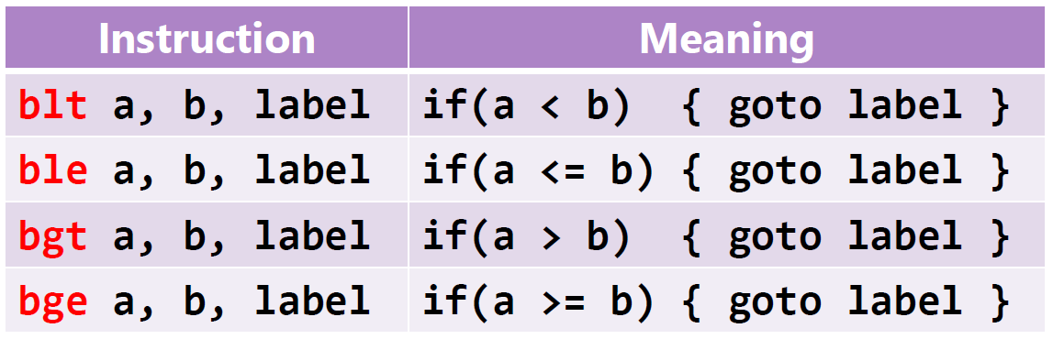

Slide 5
Exercise – Convert from C to MIPS
MIPS Code
if (i == j)
{
i++;
}
else
{
j--;
}
j += i;
s1 | i
s2 | j
bne s1, s2, ELSE
addi s1, s1, 1 # i++
j NEXT # jump over else
ELSE: addi s2, s2, -1 # else j--
NEXT: add s2, s2, s1 # j += i

Slide 6
Exercise 2
Pseudo Code
if(i < j)
{ i++;}
if(i > 100)
{ i --; }
else
{ i ++;}
i+=j;
s1 | i
s2 | j
if i >= j goto condition2
i ++
condition2: if i <= 100 goto Else
i - -
jump to NEXT
Else: i ++
NEXT: i + = j

Slide 7
Exercise 2
MIPS Code
Pseudo Code
ble s1, s2,cond2
addi s1, s1, 1 # i++
cond2: ble i, 100, Else
addi s1, s1, -1 # i--
j Next
Else: addi s1, s1, 1 # i++
Next: add s1, s2, s1
if i >= j goto condition2
i ++
condition2: if i <= 100 goto Else
i - -
jump to NEXT
Else: i ++
NEXT: i + = j

Slide 8
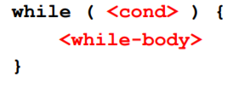
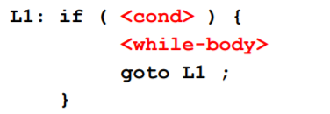
Loops - While

Slide 9
Example
Pseudo Code 1
L1: if (i < j)
{
k ++
i = i *2
goto L1
}
while (i < j)
{
k++;
i = i * 2;
}

Slide 10
Example
Pseudo Code 1
Pseudo Code 2
L1: if (i < j)
{
k ++
i = i *2
goto L1
}
L1: if (i >= j) goto OutsideLoop
k ++
i = i *2
Jump to L1
OutsideLoop

Slide 11
Example
Pseudo Code 2
MIPS
L1: if (i >= j) goto OutsideLoop
k ++
i = i *2
Jump to L1
OutsideLoop
L1: bge i, j, OutsideLoop
addi s3, s3, 1
add s1, s1, s1
j L1
OutsideLoop:

Slide 12
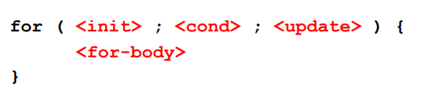
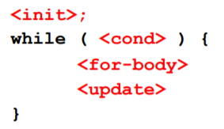
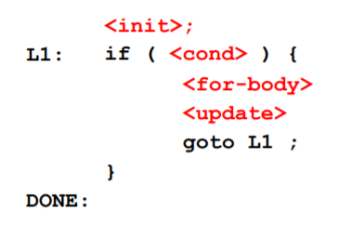
Loops - For

Slide 13
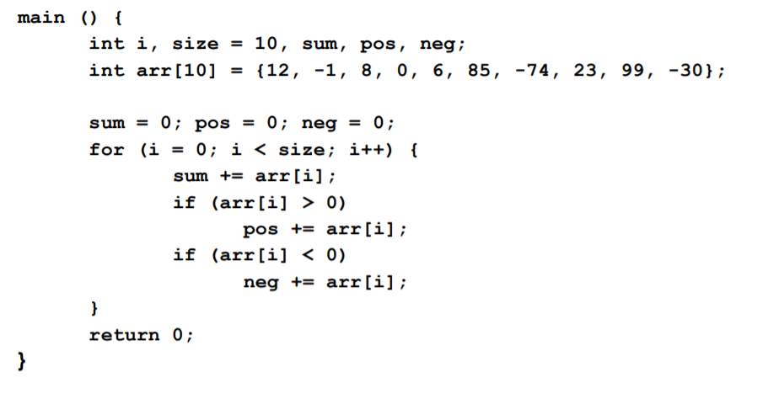
Example

Slide 14
Example
.data
size .word 10
arr .word 12, -1, 8, 0, 6, 85, -74, 23, 99, -30
.text
.globl main
main:
#1. Load each of the variables to a register and initialize them
la s0, size # initialize registers
lw s1, 0(s0) # $s1 = size
ori s2, zero, 0 # $s2 = sum
ori s3, zero, 0 # $s3 = pos
ori s4, zero, 0 # $s4 = neg
# <init>
ori s5, zero, 0 # $s5 = i
la s6, arr # $s6 = &arr

Slide 15
Example
# if (<cond>)
L1: bge s5, s1, DONE
# <for-body>
lw s7, 0(s6) # $s7 = arr[i]
addu s2, s2, s7 # sum += arr[i]
blez s7, NEG # if ! (arr[i] > 0)
addu s3, s3, s7 # pos += arr[i];
j UPDATE # goto UPDATE
NEG: bgez $s7, UPDATE # if ! (arr[i] < 0)
addu $s4, $s4, $s7 # neg += arr[i];
UPDATE: # <update>
addi $s5, $s5, 1 # i++
addi $s6, $s6, 4 # move array pointer
j L1 # goto L1
DONE:

Slide 16
MIPS to C
MIPS Code
Pseudo Code
ble s1, s2,cond2
addi s1, s1, 1 # i++
cond2: ble s1, 100, Else
addi s1, s1, -1 # i--
j Next
Else: addi s1, s1, 1 # i++
Next: add s1, s2, s1
if s1 <= s2 goto cond2
s1 = s1 + 1
cond2: if s1 <= 100 goto Else
s1 = s1 - 1
jump Next
Else
s1 = s1 + 1
Next
s1 = s1 + s2

Slide 17
MIPS to C
Pseudo Code
C Code
if s1 <= s2 goto cond2
s1 = s1 + 1
cond2: if s1 <= 100 goto Else
s1 = s1 - 1
jump Next
Else
s1 = s1 + 1
Next
s1 = s1 + s2
if(s1 > s2)
{
s1++;
}
if(s1 > 100)
{
s1--;
}
else{
s1++;
}
s1 = s1 + s2;

Slide 18
MIPS to C
C Code
C Code
if(i > j)
{
i++;
}
if(i > 100)
{
i --;
}
else{
i++;
}
i+=j;
if(s1 > s2)
{
s1++;
}
if(s1 > 100)
{
s1--;
}
else{
s1++;
}
s1 = s1 + s2;

