Slide 1
Bitwise Operations, Bit Fields

Slide 2
Bitwise Operations

Slide 3
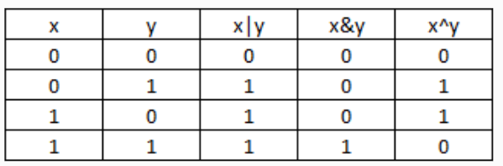
Bitwise Operators
AND (&) outputs 1 only when both input bits are 1
OR (|) outputs 1 when either input bit is 1
XOR(^) outputs 1 when either input is exclusively 1(i.e., when two input bits are different)
NOT(~) inverts 0 to 1 and 1 to 0

Slide 4
Exercise 2
x & 0
x|0
x^0
x&1
x|1
x^1

Slide 5
Exercise 2
x & 0 | 0
x|0 | x
x^0 | x
x&1 | x
x|1 | 1
x^1 | ~x
x ^ 1
x = 0: 0 ^ 1 = 1 = ~x
x = 1: 1 ^ 1 = 0 = ~x

Slide 6
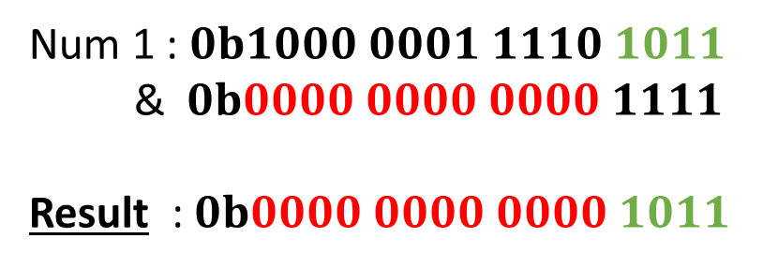
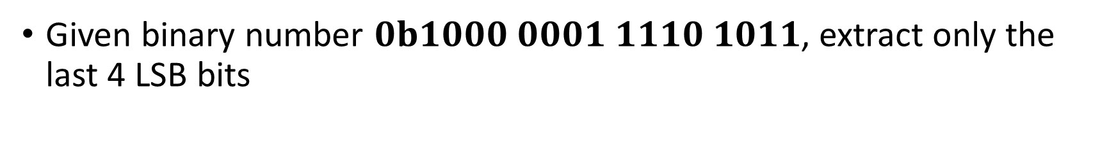
Masking to extract Bits
Given binary number $0b1000 0001 1110 1011$, extract only the last 4 LSB bits
Num 1 : $0b1000 0001 1110 1011$
& $0b0000 0000 0000 1111$
Result : $0b0000 0000 0000 1011$
Bit 1 | Bit 2 | Bitwise AND
1 | Y | Y
0 | Y | 0

Slide 7
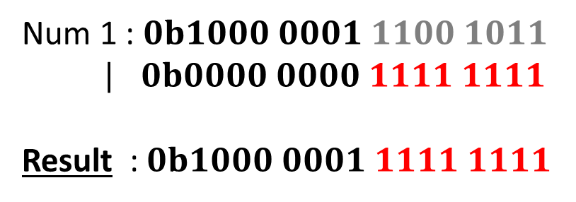
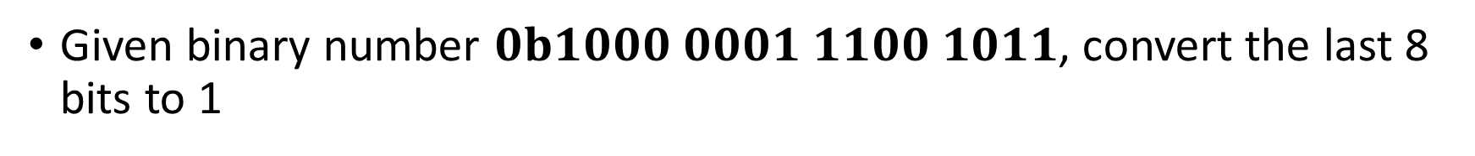
Masking Bits to 1
Given binary number $0b1000 0001 1100 1011$, convert the last 8 bits to 1
Num 1 : $0b1000 0001 1100 1011$
| $0b0000 0000 1111 1111$
Result : $0b1000 0001 1111 1111$
Bit 1 | Bit 2 | Bitwise OR
1 | Y | 1
0 | Y | Y

Slide 8

Exercise
What is x << n equivalent to?
$x^{n}$
$2^{nx}$
$n^{x}$
$x.2^{n}$

Slide 9
Exercise
Assume x is a 32-bit number. How do you get the 19th bit from LSB?
(x >> 18) & 0x1
19th bit
19th bit
0x1
19th bit
x = 01010…0…0001>>18 = 0000….01010…0 & (0000…0001) = 0000…00000
LSB
LSB
LSB

Slide 10
Exercise
Convert from 0011 0101 1001 0001 -> 0000 0000 0000 1011
Assume x = 0011 0101 1001 0001
Step 1: x << 4
x = 0101 1001 0001 0000
Step 2: x >> 11
x = 0000 0000 0000 1011

Slide 11
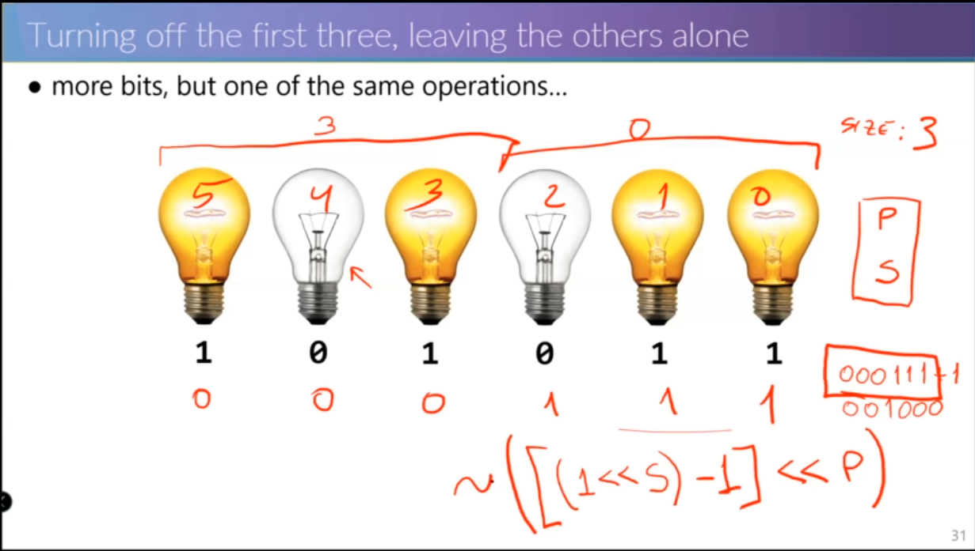

Slide 12
Exercise
Convert from 0101 1010 1010 -> 0101 0000 1010
Concept 1: 0 & 1 = 0
Concept 2: 111 + 1 = 1000 or we can say 1000 – 1 = 111
Step 1: Get the number 1111 0000 1111
(1<<4) - 1 = 10000 – 1 = 1111
1111 << 4 = 1111 0000 = 0000 1111 0000
~(0000 1111 0000) = 1111 0000 1111
Step 2: 0101 1010 1010 & 1111 0000 1111 = 0101 0000 1010

Slide 13
Bit Fields

Slide 14
Z
31 30 | 29 16 | 15 8 | 7 0
a | b | c | d
What is the position of the following fields?
a
30
b
16
c
8
d
0

Slide 15
Z
31 30 | 29 16 | 15 8 | 7 0
a | b | c | d
What is the mask of the following fields?
a
0x03
b
0x3FFF
c
0xFF
d
0xFF

Slide 16
Z
31 30 | 29 16 | 15 8 | 7 0
a | b | c | d
Write the formula to obtain the value of Z in terms of a, b, c and d. (using bitwise operation(s)).
Z = (a<<30) | (b<<16) | (c<<8) | d

Slide 17
Z
31 30 | 29 16 | 15 8 | 7 0
a | b | c | d
Write the formula to obtain the value of the following fields in terms of Z (using bitwise operation(s)).
a
a = (Z>>30) & 0x03
b
b = (Z>>16) & 0x3FFF
c
c = (Z >> 8) & 0xFF
d
d = Z & 0xFF

