Slide 1
Lab 2

Slide 2
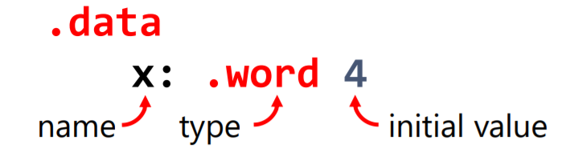
MIPS Variables
Type of variable:
word (4 Bytes)
half (2 Bytes)
byte (1 Byte)

Slide 3
Load and Store Instructions
Load : Memory -> Register
Store: Register -> Memory

Slide 4
Load
lw
copy word (4 bytes) at source memory address to destination register
lw can be replaced with lb or lh depending on the type of variable that is being loaded
lb or lbu if variable is of type byte (1 Byte)
lh or lhu if variable is of type half (or half word = 2 Bytes)
a: .word 0
lw t0, a

Slide 5
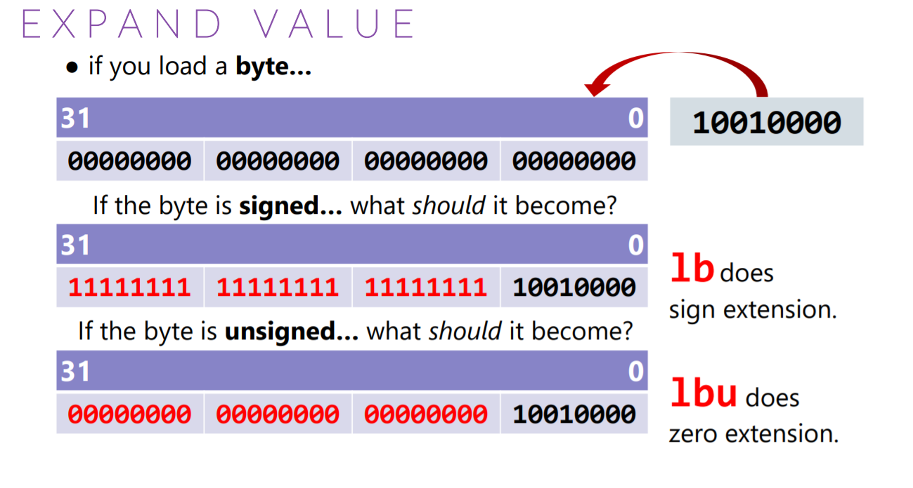

Slide 6
Load address
la t0, var1
Copy memory address of var1 (a variable defined in the program) into register t0
Indirect Addressing
lw t2, (t0)
load word at memory address contained in t0 into t2
sw t2, (t0)
store word in register t2 into memory at address contained in t0

Slide 7
Exercise
If memory address of variable x is 0x10010001,
la t0, x
lw t1, 16(t0)
lw t1, -12(t0)
t1 stores the value at which memory address?

Slide 8
Load Immediate
li register_destination, value
Loads immediate value in destination register

Slide 9
Store Instructions

Slide 10
Lab Overview

