Slide 1
Assembly Lab, Part 2

Slide 2
RECAP
Stacks and Return Addresses

Slide 3
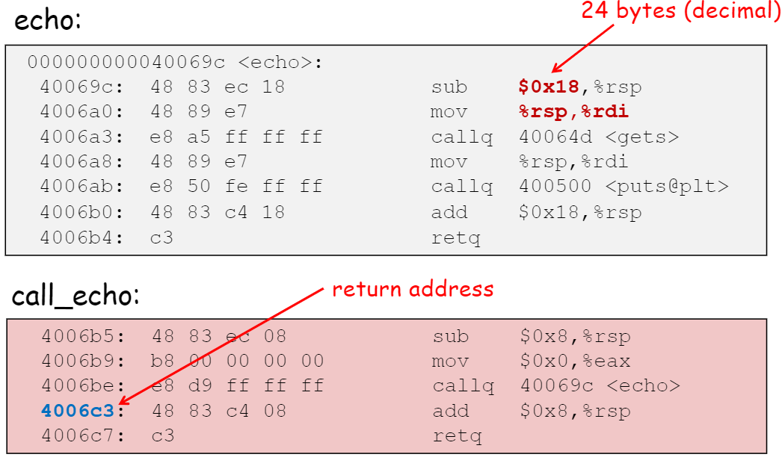
After echo() finishes execution, the return address 4006c3 is popped from the stack
call to function echo() pushes the return address 4006c3 to the stack

Slide 4
Functions and Memory Stack
Some data
int add(int x, int y)
{ return x+y;
}
int double_sum(int x, int y){ return 2*add(x,y);
}
int main() {
int b = double_sum(10, 20); return 0;
}
b
Main
rsp

Slide 5
Functions and Memory Stack
Some data
int add(int x, int y)
{ return x+y;
}
int double_sum(int x, int y){ return 2*add(x,y);
}
int main() {
int b = double_sum(10, 20); return 0;
}
b
main
return address in main
x
double_sum
y
rsp

Slide 6
Functions and Memory Stack
Some data
int add(int x, int y)
{ return x+y;
}
int double_sum(int x, int y){ return 2*add(x,y);
}
int main() {
int b = double_sum(10, 20); return 0;
}
b
main
return address in main
x
double_sum
y
return address in double_sum
x
add
y
rsp

Slide 7
Functions and Memory Stack
Some data
int add(int x, int y)
{ return x+y;
}
int double_sum(int x, int y){
return 2*add(x,y);
}
int main() {
int b = double_sum(10, 20); return 0;
}
b
main
return address in main
x
double_sum
y
rsp

Slide 8
Functions and Memory Stack
Some data
int add(int x, int y)
{ return x+y;
}
int double_sum(int x, int y){
return 2*add(x,y);
}
int main() {
int b = double_sum(10, 20); return 0;
}
b
main
rsp

Slide 9
Functions and Memory Stack
Some data
rsp
int add(int x, int y)
{ return x+y;
}
int double_sum(int x, int y){
return 2*add(x,y);
}
int main() {
int b = double_sum(10, 20); return 0;
}

Slide 10
Buffer Overflow

Slide 11
Problem with gets(buf)
int getBuffer()
{
char buf[SIZE];
int x = 16;
gets(buf);
}
Gets(buf) reads in user input till there is ‘\n’ or EOF
No constraint on the size of input
Gets() returns the input to the given address even if size is longer than allocated space of memory

Slide 12
Problem with Gets(buf)
char buf[5]
int x
 |  |  |  |  |  | 00 | 00 | AB | CD
int getBuffer()
{
char buf[SIZE];
int x = 43981;
gets(buf);
}
char buf[5]
int x
Input = “CAT”
 | ‘C’ | ‘A’ | ‘T’ | ‘\0’ | ‘\0’ | 00 | 00 | AB | CD
char buf[5]
int x
Input = ‘PANTHER’
 | ‘P’ | ‘A’ | ‘N’ | ‘T’ | ‘H’ | ‘E’ | ‘R’ | ‘\0’ | CD
What if it overwrites the return address?

Slide 13
Stack
Higher Memory Address
Stack Frame of Caller()
Return Address
Padding Data Stored in Stack
Unused Space
HEAP
void Caller(){
…
Callee();
…
}
void Callee(){
…
local variables
}
8 Bytes
Stack Frame of Callee()
What data?
Lower Memory Address

Slide 14
Attack 1
Change the value of a constant integer variable in the stack by overflowing the buffer

Slide 15
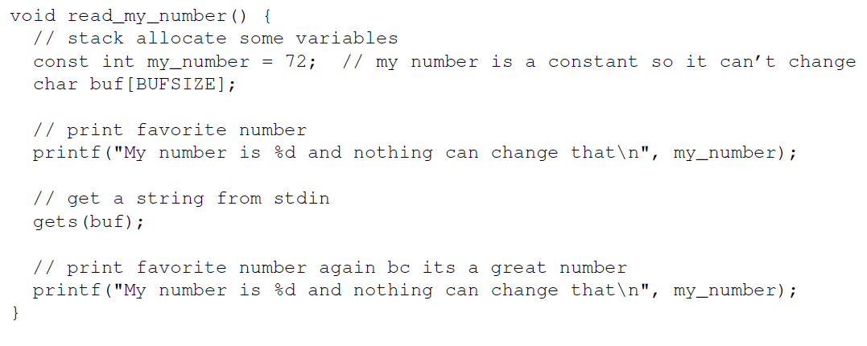
User Input
USER INPUT:
exploit1.txt

Slide 16
How to prepare exploit1.txt?
1. Overflow buf

Slide 17
How to prepare exploit1.txt?
2. Overwrite my_number

Slide 18
Stack Content
my_number
What is the total size??
buf
Let’s check the x86 code!!

Slide 19
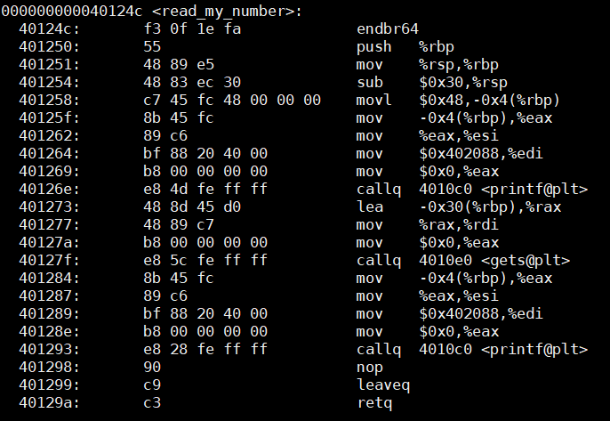
Code
Space allocated in the stack = 0x30 Bytes
Where is the my_number??
at address %rbp - 4

Slide 20
Stack Content
some data
%rbp, %rsp

Slide 21
Stack Content
sub 0x30, %rsp
some data
%rbp
48 Bytes
%rsp

Slide 22
Stack Content
sub 0x30, %rsp
movl $0x48,-0x4(%rbp)
some data
%rbp
my_number
4 Bytes
buf
44 Bytes
%rsp

Slide 23
How to prepare exploit string?
Task 1:
Overflow buf
How many bytes of data?
Can you use any character?
Task 2:
Change value of my_num to 449 or 0x01C1

Slide 24
Little Endian
Write the exploit string for the number 0xABCD10EF
Tip: LSB goes to the lowest address
Exploit string: EF 10 CD AB
Demo

Slide 25
Attack 2
main (caller)
Overflow the buffer to overwrite the return address
return address
my_number
buf
read_my_number (callee)

Slide 26
Important Points
What do we overwrite the return address with??
Address of function hack()
How to get this??
How big should our exploit string be?
Is it 48 + 8 Bytes??
You need to find out using gdb.
Use x /10gx $rsp inside gdb to look at the contents of the stack

Slide 27
Attack 3

Slide 28
Code Injection
Replace the return address with address of buf
Insert assembly code in the buf
ret = starting address of buf
my_number
Fill up this entire space using your exploit code
buf
Assembly Code

Slide 29
1. Address of buf
How to get the address of buf?
Approach 1:
What is the value of %rbp?
How many bytes was allocated in the stack?

Slide 30
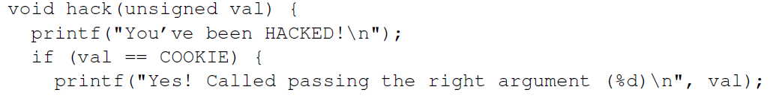
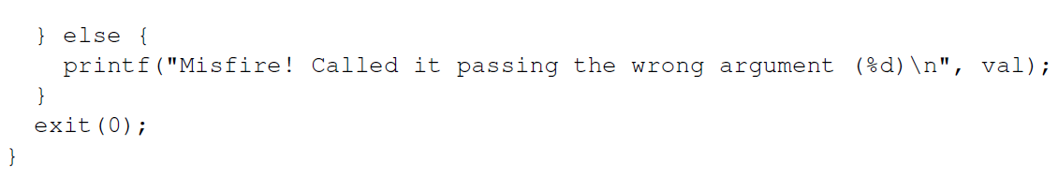
Function hack()

Slide 31
2. Insert Assembly Code
What should your assembly code do?
Call hack() by passing the argument COOKIE
What is COOKIE?
Read the x86 code of hack – Demo
How to write the assembly for calling hack??
DO NOT use call or jmp instruction
Instead use ret

Slide 32
2. Insert Assembly Code
What should your assembly code do?
Push the return address of hack to the stack
Put the value COOKIE in the correct register
Remember which registers are used for passing arguments??
Finally, return to the address of hack

Slide 33
3. Converting from x86 to machine code
You cannot insert x86 code directly to the stack
Convert it to machine code
Demo

