Slide 1
Malloc, Structs, Queue Lab

Slide 2
void Pointer
“A pointer that has no associated data type with it.”
Can point to the address of a variable of any data type and can be type-casted to the any type

Slide 3
Example
int main()
{
int a = 10;
char b = 'A';
void *p = &a;
p = &b;
return 0;
}
This is allowed. Code will compile and run successfully!

Slide 4
Exercise 1 – What is the output?
int main()
{
int a = 10;
char b = 'A';
void *p = &a;
p = &b;
printf(“Address : %p\n", p);
return 0;
}
Address of variable b
//Address : 0x56F..….

Slide 5
Exercise 2 – What is the output?
int main()
{
int a = 10;
char b = 'A';
void *p = &a;
p = &b;
printf(“Value : %c\n", *p);
return 0;
}
//Compilation error

Slide 6
Exercise 2 - Solution
Typecast the void pointer to the type of pointer whose value you are trying to print.
int main()
{
int a = 10;
char b = 'A';
void *p = &a;
p = &b;
printf(“Value : %c\n", *(char*)p); //Value : A
return 0;
}

Slide 7
Why do we need malloc()?
To be able to allocate space in runtime (or dynamically).
Example: You do NOT know the size of an array and require user input to determine it.
This means size of the array is determined at run time
Space has to be allocated in run time (or dynamically!)
Time to use malloc()

Slide 8
malloc(size in Bytes)
Why is the return type of malloc() void*??
int* p = (int*) malloc (n * sizeof(int));
Size in bytes of n integers
Stores either:
1) Address of the 1st byte of the allocated space in memory, or
2) NULL, if the allocation fails.
Return type of malloc() is void* , so we need to typecast it to the correct type (int* in this case)

Slide 9
Revisiting Strings
Dynamically allocate space for a string containing ‘n’ characters
Initialize the string to “CS449”
Modify the string to “CS44_”
char *p = (char*) malloc (sizeof(char) * (n + 1));
strcpy(p, “CS449”);
p[4] = ‘_’;

Slide 10
Why did we use strcpy() to initialize?
char *p = (char*) malloc (sizeof(char) * (n + 1));
p = “CS449”;
p[4] = ‘_’;
printf(“%s”, p);
Undefined behavior. Will result in segmentation fault most likely.
Use strcpy() to INITIALIZE a dynamically allocated string

Slide 11
Some Important Points
malloc() does NOT initialize the dynamically allocated space.
calloc() initializes the allocated memory space to 0.
Make sure to do conditional check on whether malloc returned NULL
After you have finished using the dynamically allocated space using malloc, make sure that you free the space.

Slide 12
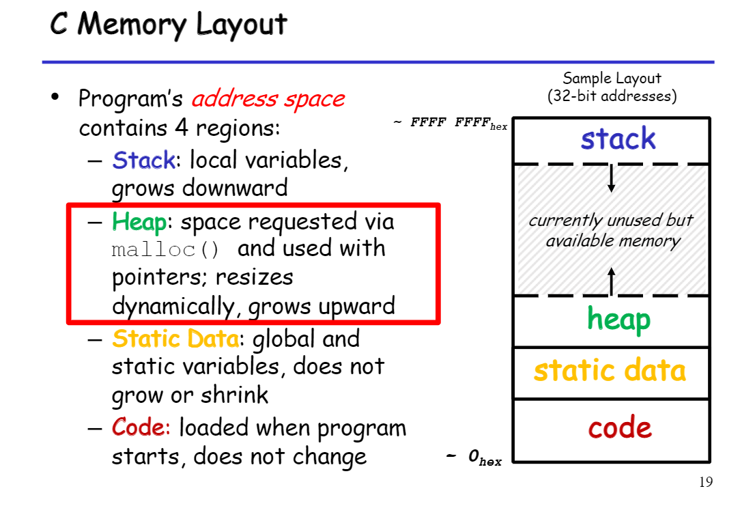

Slide 13
Why do we need to free the allocated memory?
0xFF…
int *p = malloc(…)
..
..
//work with the allocated space
..
int *q = malloc(…)
0x00…

Slide 14
Why do we need to free the allocated memory?
0xFF…
int *p = malloc(…)
..
//work with the allocated space
..
0x00…

Slide 15
Why do we need to free the allocated memory?
0xFF…
int *p = malloc(…)
..
//work with the allocated space
..
free(p);
0x00…

Slide 16
Why do we need to free the allocated memory?
0xFF…
int *p = malloc(…)
..
//work with the allocated space
..
free(p);
Unallocated
0x00…

Slide 17
Why do we need to free the allocated memory?
0xFF…
int *p = malloc(…)
..
//work with the allocated space
..
free(p);
int *q = malloc(…)
ALLOCATED
Unallocated
0x00…

Slide 18
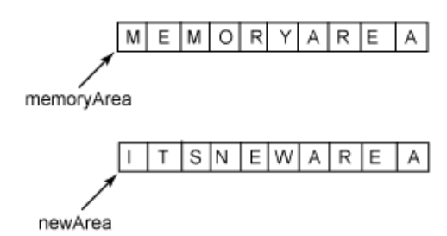

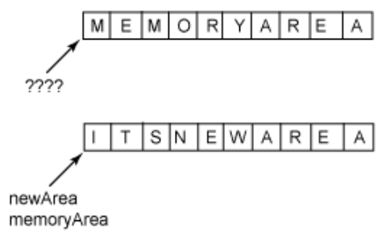

Correct Utilization of free()
Call free with the pointer that points to the starting address of the allocated space. Otherwise, there will likely be memory leak.

Slide 19
struct
User defined data type
Can hold several data items of different types
C is not object oriented like Java but structs can be utilized the same way you can use java classes
C struct vs JAVA class
C struct can hold only data items
Java class can hold both data items and functions

Slide 20
C struct and Java class
C
Java
struct MyJavaClass {
int x;
};
int MyJavaClass_getX(struct MyJavaClass* this)
{
return this->x;
}
void MyJavaClass_setX(struct MyJavaClass* this, int value)
{
this->x = value;
}
public class MyJavaClass
{
private int x;
public int getX() {
return x;
}
public int setX(int value){
x = value;
}
}

Slide 21
Example
Use struct to create the profile of two students in Pitt
The attributes of a student are:
First name
Last Name
Peoplesoft #
typedef struct Student
{
char * first_name;
char * last_name;
int Peoplesoft;
}Student;
Design the struct

Slide 22
Initialize the credentials of the 1st student
int main()
{
Student *s1 = (Student*)malloc (sizeof(Student));
s1->first_name = (char*)malloc(25 * sizeof(char));
strcpy(s1->first_name, “Harry”);
s1->last_name = (char*)malloc(25 * sizeof(char));
strcpy(s1->first_name, “Potter”);
s1->Peoplesoft = 123456;
}

Slide 23
Initialize the credentials of the 2nd student
int main()
{
…
…
Student *s2 = (Student*)malloc (sizeof(Student));
s2->first_name = (char*)malloc(25 * sizeof(char));
strcpy(s2->first_name, “Hermione”);
s2->last_name = (char*)malloc(25 * sizeof(char));
strcpy(s2->first_name, “Granger”);
s1->Peoplesoft = 654321;
}

Slide 24
Free all the allocated space
int main()
{
…
…
free(s1->first_name);
free(s1->last_name);
free(s2->first_name);
free(s2->last_name);
free(s1);
free(s2);
}

Slide 25
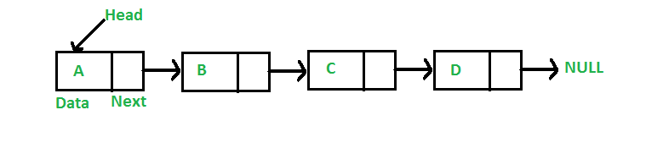
Linked List
Node
// A linked list node
struct Node
{
int data;
struct Node *next;
};
Data
Pointer to next available node

Slide 26
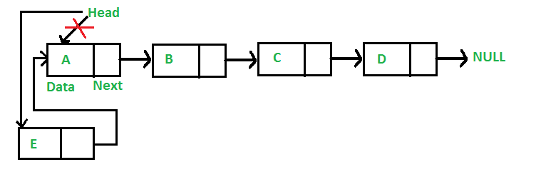
Insertion – At the front

Slide 27
Insertion – At the front
Check the top answer(answer with most votes) in this link to see why head is passed as a double pointer:
Link
void insert_front(struct Node** head, int new_data) {
/* 1. allocate node */
struct Node* new_node = (struct Node*) malloc(sizeof(struct Node));
/* 2. put in the data */
new_node->data = new_data;
/* 3. Make next of new node as head */
new_node->next = (*head);
/* 4. move the head to point to the new node */
(*head) = new_node;
}

Slide 28
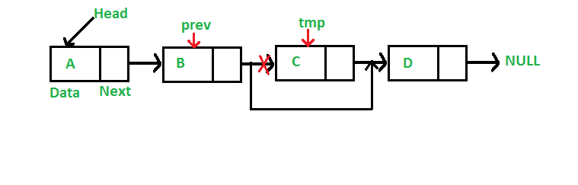
Deleting a node
Given a ‘key’, delete the first occurrence of this key in linked list.
To delete a node from linked list, we need to do following steps.
1) Find previous node of the node to be deleted.
2) Change the next of previous node.
3) Free memory for the node to be deleted.

Slide 29
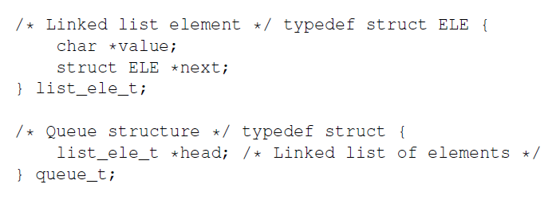
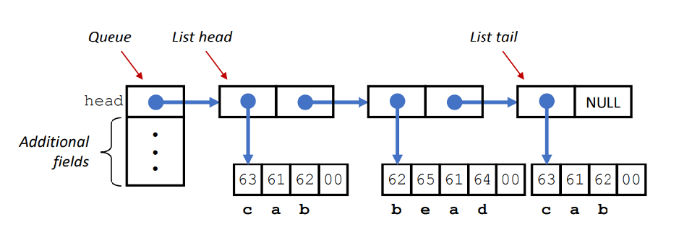
Queue Lab

Slide 30
Queue Lab
queue_t * q
list_ele_t * l1
list_ele_t * l2
list_ele_t * l3

Slide 31
queue_t * q
list_ele_t * l1
list_ele_t * l2
list_ele_t * l3
value
value
value
Head
next
next
next
NULL

Slide 32
Now, do the linked list implementations

