Slide 1
Pointers

Slide 2
Office Hours
Thursday 1 to 3 pm
Friday 1 to 3 pm

Slide 3
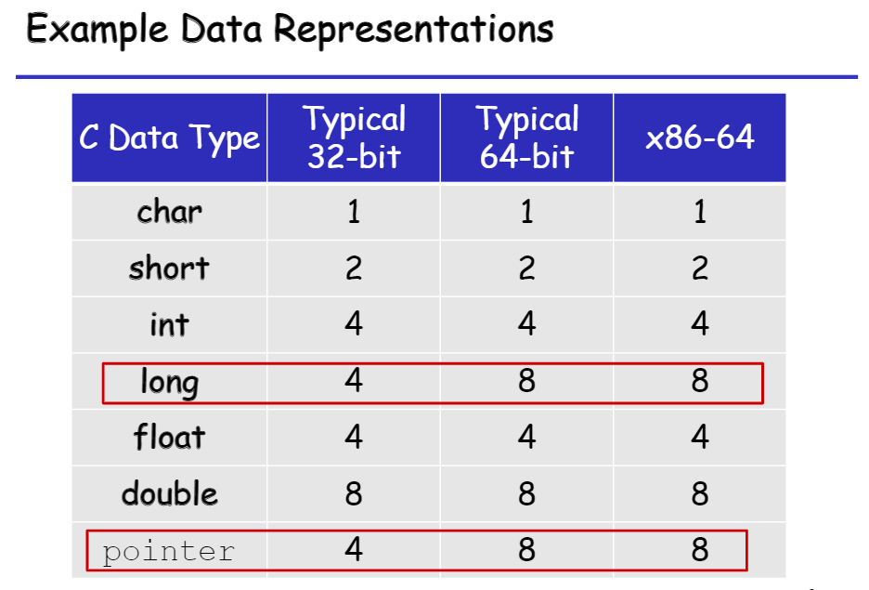

Slide 4
How a C variable is stored in memory
int main()
{
int a = 9;
char c = ‘z’;
}
…
01111010
…
00000000
00000000
00000000
00001001
210
1 byte
209
208
207
c
ASCII value of ‘z’
203
202
a
201
200
Usually, addresses are represented as Hex values. For simplicity, I denote addresses as decimals

Slide 5
A pointer to variable ‘a’
…
Address of variable a, i.e., 200
…
00000000
00000000
00000000
00001001
264
263
int main()
{
int a = 9;
int *p = &a;
printf(“&a = %d\n”, &a);
printf(“p = %d\n”, p);
printf(“*p = %d\n”, *p);
}
…
p
259
258
257
203
202
a
201
200

Slide 6
A pointer to variable ‘a’
Binary Equivalent of address of a, i.e., 200
int main()
{
int a = 9;
int *p = &a;
printf(“&a = %d\n”, &a); //&a = 200
printf(“p = %d\n”, p); //p = 200
printf(“*p = %d\n”, *p); //*p = 9
}
…
00000000
….
00000000
11001000
…
00000000
00000000
00000000
00001001
264
…
p
258
257
203
202
a
201
200

Slide 7
A pointer to variable ‘a’
int main()
{
int a = 9;
int *p = &a;
printf(“&a = %d\n”, &a); //&a = 200
printf(“p = %d\n”, p); //p = 200
printf(“*p = %d\n”, *p); //*p = 9
*p = 16;
printf(“a = %d\n”, a);
}
…
p = 200
…
a = ?
269
265
257
212
208
204
200

Slide 8
A pointer to variable ‘a’
int main()
{
int a = 9;
int *p = &a;
printf(“&a = %d\n”, &a); //&a = 200
printf(“p = %d\n”, p); //p = 200
printf(“*p = %d\n”, *p); //*p = 9
*p = 16;
printf(“a = %d\n”, a); //a = 16
}
…
p = 200
…
a = 16
269
265
257
212
208
204
200

Slide 9
A pointer to variable ‘a’
int main()
{
int a = 9;
int *p = &a;
int b = 25;
printf(“&a = %d\n”, &a); //&a = 200
printf(“p = %d\n”, p); //p = 200
printf(“*p = %d\n”, *p); //*p = 9
*p = 16;
printf(“a = %d\n”, a); //a = 16
*p = b;
printf(“p = %d\n”, p);
printf(“a = %d\n”, a);
}
…
p = 200
…
b = 25
a = 16
273
269
265
257
212
208
204
200

Slide 10
A pointer to variable ‘a’
int main()
{
int a = 9;
int *p = &a;
int b = 25;
printf(“&a = %d\n”, &a); //&a = 200
printf(“p = %d\n”, p); //p = 200
printf(“*p = %d\n”, *p); //*p = 9
*p = 16;
printf(“a = %d\n”, a); //a = 16
*p = b;
printf(“p = %d\n”, p); //p = 200
printf(“a = %d\n”, a); //a = 25
}
…
p = 200
…
b = 25
a = 25
273
269
265
257
257
257
212
212
212
208
208
208
204
204
204
200
200
200

Slide 11
Pointer Arithmetic
int main()
{
int a = 9;
int *p = &a;
int b = 25;
int c = 35;
p = p + 2;
printf(“p = %d\n”, p);
printf(“*p = %d\n”, *p);
printf(“b = %d\n”, b);
}
…
p = ??
…
c = 35
b = 25
a = 9
273
269
265
257
257
257
212
212
212
208
208
208
204
204
204
200
200
200

Slide 12
Pointer Arithmetic
int main()
{
int a = 9;
int *p = &a;
int b = 25;
int c = 35;
p = p + 2; //p = p + 2*(sizeof(int))
printf(“p = %d\n”, p); //p = 208
printf(“*p = %d\n”, *p); //*p = 25
printf(“b = %d\n”, b); //b = 25
}
…
p = 208
…
c = 35
b = 25
a = 9
273
269
265
257
257
257
212
212
212
208
208
208
204
204
204
200
200
200

Slide 13
Pointer Arithmetic
int main()
{
int a = 9;
int *p = &a;
int b = 25;
int c = 35;
p = p + 2; //p = p + 2*(sizeof(int))
printf(“p = %d\n”, p); //p = 208
printf(“*p = %d\n”, *p); //*p = 25
printf(“b = %d\n”, b); //b = 25
p = p + 1; //p = p + 1* (sizeof(int))
printf(“p = %d\n”, p); //p = 212
printf(“*p = %d\n”, *p); //*p = 35
}
…
p = 212
…
c = 35
b = 25
a = 9
273
269
265
257
257
257
212
212
212
208
208
208
204
204
204
200
200
200

Slide 14
Give output of the following:
int main()
{
int a = 2049;
int *p = &a;
printf(“Address = %d, Value = %d\n”, p, *p);
printf(“Address = %d, Value = %d\n”, p+1, *(p+1));
char *p0;
p0 = (char*)p;
printf(“Address = %d, Value = %d\n”, p0, *p0);
printf(“Address = %d, Value = %d\n”, p0+1, *(p0+1));
}
…
200
200
…
00000000
00000000
00001000
00000001
277
269
p0
265
257
p
203
202
a
201
200

Slide 15
Give output of the following:
int main()
{
int a = 2049;
int *p = &a;
printf(“Address = %d, Value = %d\n”, p, *p);
//Address = 200, Value = 2049
printf(“Address = %d, Value = %d\n”, p+1, *(p+1));
//Address = 204, Value = -867181191
char *p0;
p0 = (char*)p;
printf(“Address = %d, Value = %d\n”, p0, *p0);
//Address = 200, Value = 1
printf(“Address = %d, Value = %d\n”, p0+1, *(p0+1));
//Address = 201, Value = 8
}
…
200
200
…
00000000
00000000
00001000
00000001
277
269
p0
265
257
p
203
202
a
201
200

Slide 16
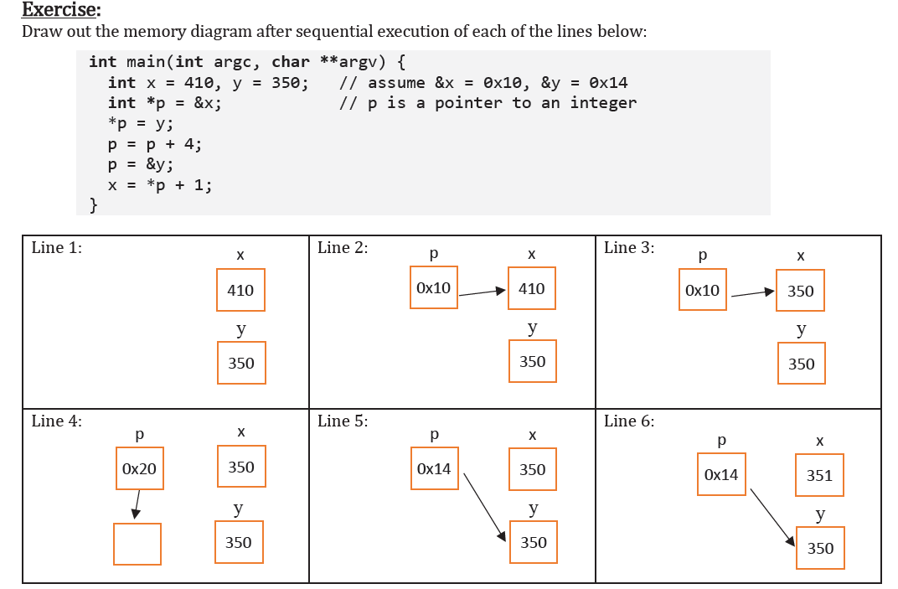

Slide 17
Pointer to pointer to pointer
int main()
{
int a = 16;
int *p = &a;
int **q = &p;
int ***r = &q;
}
…
q = ?
p = ?
…
r = ?
a = 16
277
269
265
257
216
208
204
200

Slide 18
Pointer to pointer to pointer
int main()
{
int a = 16;
int *p = &a;
int **q = &p;
int ***r = &q;
}
…
q = 257
p = 200
…
r = 269
a = 16
277
269
265
257
216
208
204
200

Slide 19
Pointer to pointer to pointer
int main()
{
int a = 16;
int *p = &a;
int **q = &p;
int ***r = &q;
printf(“%d\n”, *p);
printf(“%d\n”, *q);
printf(“%d\n”, *r);
printf(“%d\n”, **q);
printf(“%d\n”, ***r);
}
…
q = 257
p = 200
…
r = 269
a = 16
277
269
265
257
216
208
204
200

Slide 20
Pointer to pointer to pointer
int main()
{
int a = 16;
int *p = &a;
int **q = &p;
int ***r = &q;
printf(“%d\n”, *p); //16
printf(“%d\n”, *q); //200
printf(“%d\n”, *r); //257
printf(“%d\n”, **q); //16
printf(“%d\n”, ***r); //16
}
…
q = 257
p = 200
…
r = 269
a = 16
277
269
265
257
216
208
204
200

Slide 21
Pointer to pointer to pointer
int main()
{
int a = 16;
int *p = &a;
int **q = &p;
int ***r = &q;
printf(“%d\n”, *p); //16
printf(“%d\n”, *q); //200
printf(“%d\n”, *r); //257
printf(“%d\n”, **q); //16
printf(“%d\n”, ***r); //16
***r = 25;
printf(“%d\n”, a); //25
}
…
q = 257
p = 200
…
r = 269
a = 25
277
269
265
257
216
208
204
200

Slide 22
Exercise
Give output of the following code snippet
int main()
{
int a = 10;
int *p = &a;
int **q = &p;
printf("value of q: %d, value of q+1: %d\n", q, q+1);
//Value of q: 2000, q+1: 2008
}
Assume that the address of variable p is 2000.

Slide 23
Call by value
void increment(int a)
{
printf(“Address of a = %d”, &a);
a = a + 1;
printf(“a = %d\n”, a);
}
int main()
{
int a = 10;
increment(a);
printf(“a = %d\n”, a);
printf(“Address of a = %d”, &a);
}

Slide 24
Call by value
void increment(int a)
{
printf(“Address of a = %d”, &a);
//“Address of a = 234000
a = a + 1;
printf(“a = %d\n”, a); //a = 11
}
int main()
{
int a = 10;
increment(a);
printf(“Address of a = %d”, &a);
//“Address of a = 222000
printf(“a = %d\n”, a); //a = 10
}
NO CHANGE IN value of a

Slide 25
Pointers as function arguments – Call by Reference
void increment(int *p)
{
*p = (*p) + 1;
}
int main()
{
int a = 10;
increment(&a);
printf(“a = %d\n”, a); //a = 11
}
CHANGE IN value of a

Slide 26
Pointers and Arrays
int a[] = {2, 4, 6, 8};
int *p = a; //Equivalent to *p = &a[0]
printf(“%d , %d”, (p+1), *(p+1)); //204, 4
printf(“%d , %d”, (a+1), *(a+1)); //204, 4
printf(“%d , %d”, &a[1], a[1]); //204, 4
…
p = 200
…
8
6
4
2
273
269
261
257
212
a[3]
208
a[2]
204
a[1]
200
a[0]

Slide 27
Pointers and Arrays
int a[] = {2, 4, 6, 8};
int *p = a; //Equivalent to int *p = &a[0]
printf(“%d , %d”, (p+1), *(p+1)); //204, 4
printf(“%d , %d”, (a+1), *(a+1)); //204, 4
p = p + 2
printf(“%d , %d”, p, *p);
a = a + 2;
…
p = 208
…
8
6
4
2
269
265
261
257
212
a[3]
208
a[2]
204
a[1]
200
a[0]

Slide 28
Pointers and Arrays
int a[] = {2, 4, 6, 8};
int *p = a; //Equivalent to *p = &a[0]
printf(“%d , %d”, (p+1), *(p+1)); //204, 4
printf(“%d , %d”, (a+1), *(a+1)); //204, 4
p = p + 2
printf(“%d , %d”, p, *p); //208, 6
a = a + 2; //INVALID. a always points to the base address
…
p = 208
…
8
6
4
2
269
265
261
257
212
a[3]
208
a[2]
204
a[1]
200
a[0]

Slide 29
Character arrays and strings
#include <stdio.h>
#include <string.h>
int main()
{
char c[] = “Mary”;
char d[3] = “Tea”;
char e[6] = “Chair”;
printf(“Size in bytes: %d\n”, sizeOf(c));
int len = strlen(c);
printf(“Length of string: %d\n”, len);
}

Slide 30
Character arrays and strings
#include <stdio.h>
#include <string.h>
int main()
{
char c[] = “Mary”; //Equivalent to char c[] = {‘M’, ‘a’, ‘r’, ‘y’, ‘\0’}
char d[3] = “Tea”; //Invalid because it cannot accommodate ‘\0’
char e[6] = “Chair”; //Equivalent to char e[6] = {‘C’, ‘h’, ‘a’, ‘i’, ‘r’,‘\0’}
printf(“Size in bytes: %d\n”, sizeOf(c));
//Size in bytes: 5
int len = strlen(c);
printf(“Length of string: %d\n”, len);
//Length of string: 4
}

Slide 31
Character arrays as pointers
char c1[10] = “Hello”;
char *c2 = c1;
printf(“%c, %c”, c2[1], *(c2 + 1)); //e, e
*(c2) = z;
printf(“%s”, c1); //zello
c1 = c2; //Invalid because c1 points to base address of the array c1[]
c2 ++; //Valid. Now c2 points to the address of the second character
printf(“%c”, *c2); //e

Slide 32
Arrays as function arguments
void sum(int A[])
{
int i, sum = 0;
printf("Size of A: %d, Size of A[0]: %d \n", sizeof(A), sizeof(A[0]));
}
int main()
{
int A[] = {1, 2, 3, 4, 5};
sum(A);
printf("Size of A: %d, Size of A[0]:%d \n", sizeof(A), sizeof(A[0]));
return 0;
}

Slide 33
Arrays as function arguments
⬅ same as void sum(int *A)
void sum(int A[])
{
int i, sum = 0;
printf("Size of A: %d, Size of A[0]: %d \n", sizeof(A), sizeof(A[0]));
//Size of A: 8, Size of A[0]: 4
}
int main()
{
int A[] = {1, 2, 3, 4, 5};
sum(A);
printf("Size of A: %d, Size of A[0]:%d \n", sizeof(A), sizeof(A[0]));
//Size of A: 20, Size of A[0]: 4
return 0;
}
Base address of array A

Slide 34
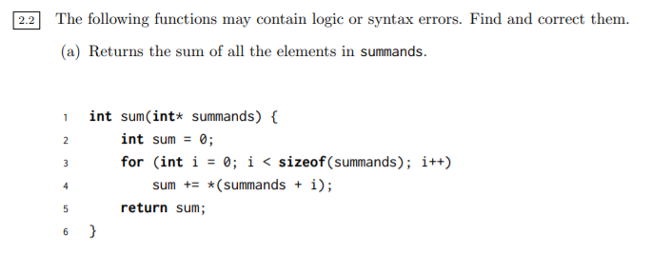

Slide 35
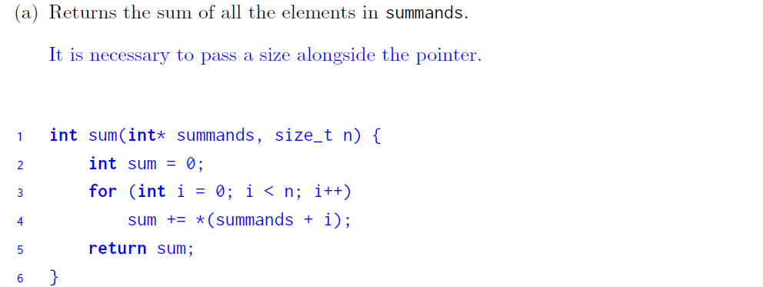

Slide 36
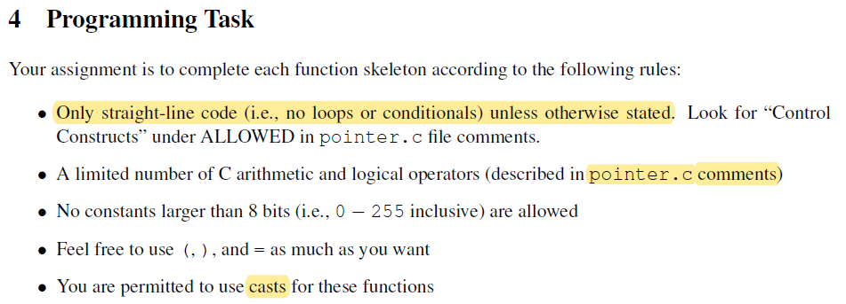
Lab 2

Slide 37
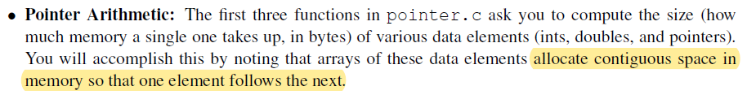
Problem 1

Slide 38
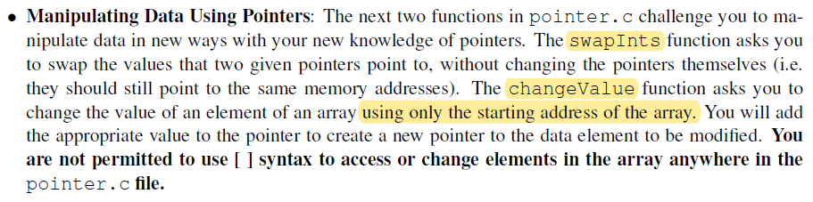
Problem 2

Slide 39
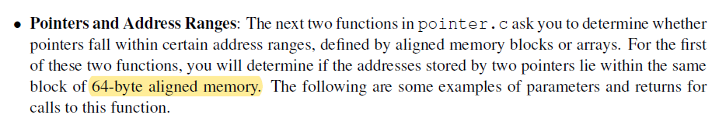
Problem 3

Slide 40
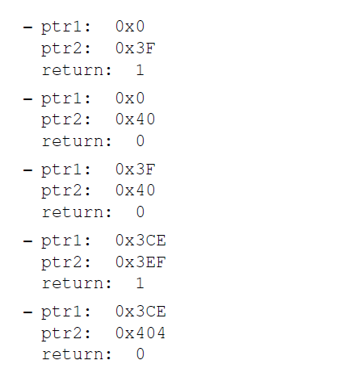
Problem 3

Slide 41
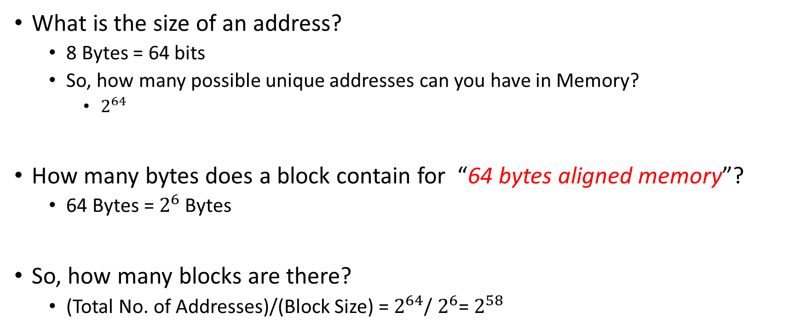
withinSameBlock() Hints
What is the size of an address?
8 Bytes = 64 bits
So, how many possible unique addresses can you have in Memory?
$2^{64}$
How many bytes does a block contain for “64 bytes aligned memory”?
64 Bytes = $2^{6}$ Bytes
So, how many blocks are there?
(Total No. of Addresses)/(Block Size) = $2^{64}$/ $2^{6}$= $2^{58}$

Slide 42

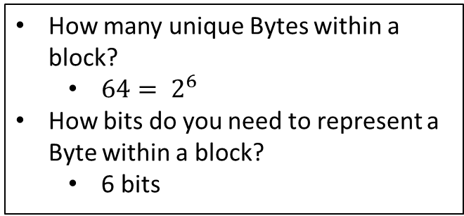
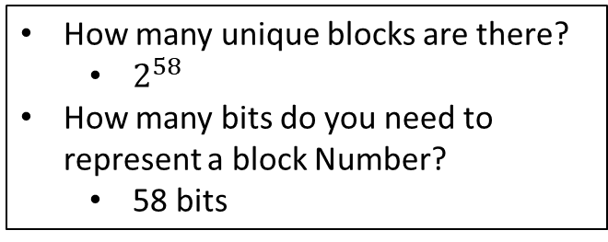

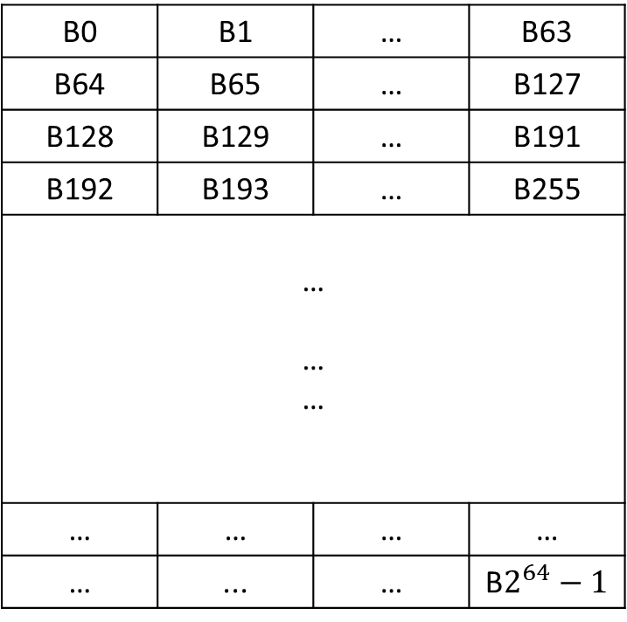
Blocks
Memory
How many unique blocks are there?
$2^{58}$
How many bits do you need to represent a block Number?
58 bits
Block 0
B0 | B1 | … | B63
B64 | B65 | … | B127
B128 | B129 | … | B191
B192 | B193 | … | B255
… … …
… | … | … | …
… | ... | … | B$2^{64}−1$
Block 1
Block 2
Block 3
Bytes in a Block
How many unique Bytes within a block?
$64= 2^{6}$
How bits do you need to represent a Byte within a block?
6 bits
Block $2^{58}−2$
Block $2^{58}−1$
64 - bit address
Block Number | Byte offset
58 bits
6 bits

Slide 43
withinSameBlock() Hints
64 - bit address
Block Number | Byte offset
58 bits
6 bits
So, you do not need to worry about the least significant 6 bits
If two addresses are in the same block, then their block numbers will be same!!
How do you figure if the block numbers are the same?

Slide 44
withinArray
Size is the number of ints contained in the array
Can assume size != 0
Pointing anywhere in the array is fair game, ptr does not have to point to the beginning of an element.
Hint
Use the size to calculate the range of address within which the ptr should lie

Slide 45
stringLength
Return the length of a string, given a pointer to its beginning
Can use loops
When do you stop the loop?
Null terminator character does not count as part of the string length

Slide 46
Little Endian and Big Endian Data Storage
Big-endian: is an order in which the "big end" (most significant value in the sequence) is stored first (at the lowest storage address).
Little-endian is an order in which the "little end" (least significant value in the sequence) is stored first (at the lowest storage address).
Example: For Hex Number 0x4F52
Big Endian: if 4F is stored at storage address 1000, 52 will be at address 1001)
Little Endian: it would be stored as 524F (52 at address 1000, 4F at 1001)

Slide 47
endianExperiment
Consider this example from Slide 14
int *func()
{
int a = 2049;
int *p = &a;
char *p0;
p0 = (char*)p;
printf(“Address = %d, Value = %d\n”, p0, *p0);
printf(“Address = %d, Value = %d\n”, p0+1, *(p0+1));
return p;
}
…
200
200
…
00000000
00000000
00001000
00000001
277
269
p0
265
257
p
203
202
a
201
200

Slide 48
Add 1 to each of the bytes of the value of a
int *func()
{
int a = 2049;
int *p = &a;
char *p0;
p0 = (char*)p;
*p0 = (*p0) + 1;
return p;
}
…
200
200
…
00000000
00000000
00001000
00000010
277
269
p0
265
257
p
203
202
a
201
200

Slide 49
Add 1 to each of the bytes of the value of a
int *func()
{
int a = 2049;
int *p = &a;
char *p0;
p0 = (char*)p;
(*p0)++;
p0++;
(*p0)++;
return p;
}
…
201
200
…
00000000
00000000
00001001
00000010
277
269
p0
265
257
p
203
202
a
201
200

Slide 50
Add 1 to each of the bytes of the value of a
int *func()
{
int a = 2049;
int *p = &a;
char *p0;
p0 = (char*)p;
(*p0)++;
p0++;
(*p0)++;
p0++;
(*p0)++;
return p;
}
…
202
200
…
00000000
00000001
00001001
00000010
277
269
p0
265
257
p
203
202
a
201
200

Slide 51
Add 1 to each of the bytes of the value of a
int *func()
{
int a = 2049;
int *p = &a;
char *p0;
p0 = (char*)p;
(*p0)++;
p0++;
(*p0)++;
p0++;
(*p0)++;
p0++;
(*p0)++;
return p;
}
…
203
200
…
00000001
00000001
00001001
00000010
277
269
p0
265
257
p
203
202
a
201
200

Slide 52
stringSpan Hints
Returns the length of the initial portion of str1 which consists only of characters that are part of str2.
stringSpan("abcdefgh", "abXXcdeZZh"); // returns 5
Uninterrupted spans from the beginning of string 1
stringSpan (“123456”, “156”);
Returns 1 (Because the span has to be uninterrupted)
stringSpan(“aaaab”, “a”);
What should it return ?
4

Slide 53
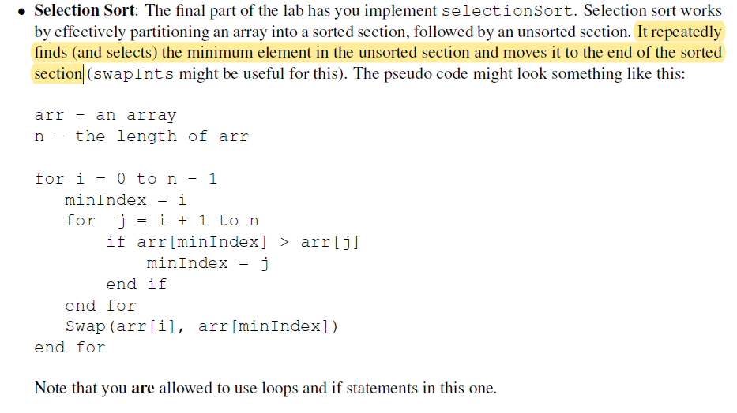
Lab 2 Problem 5

Slide 54
References
https://www.youtube.com/playlist?list=PL2_aWCzGMAwLZp6LMUKI3cc7pgGsasm2_

