Slide 1
Data Representation

Slide 2
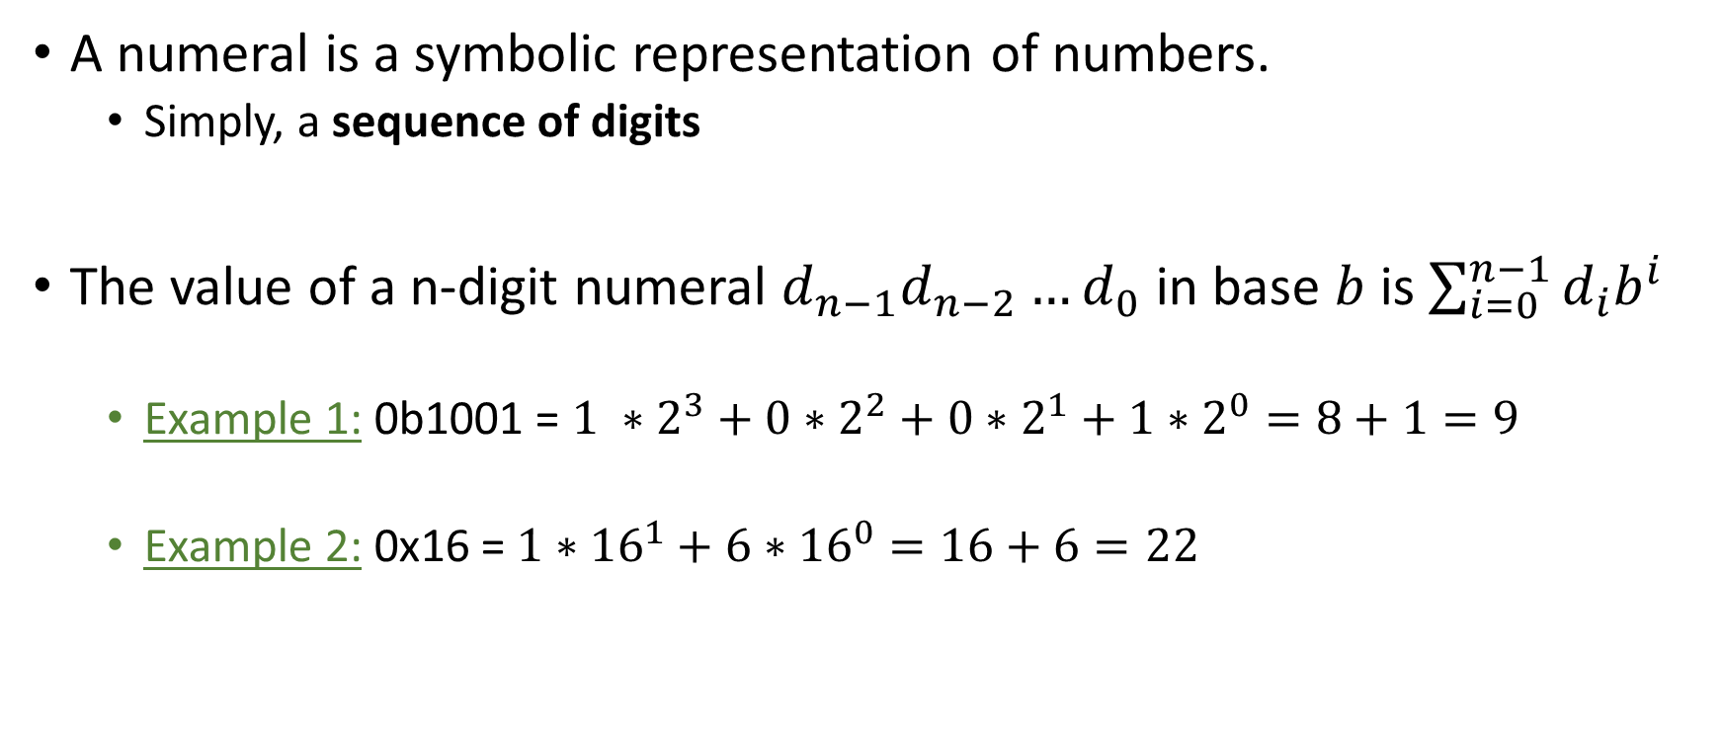
Numerals
A numeral is a symbolic representation of numbers.
Simply, a sequence of digits
The value of a n-digit numeral $d_{n−1}d_{n−2}…d_{0}$ in base $b$ is $\sum_{i=0}^{n−1}{d_{i}b^{i}}$
Example 1: 0b1001 = $1 ∗2^{3}+0∗2^{2}+0∗2^{1}+1∗2^{0}=8+1=9$
Example 2: 0x16 = $1∗{16}^{1}+6∗{16}^{0}=16+6=22$

Slide 3
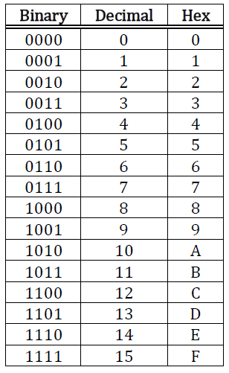

Slide 4
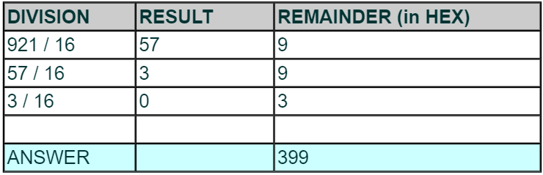
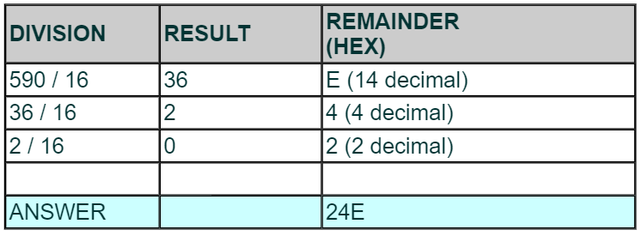
Decimal to Hexadecimal

Slide 5
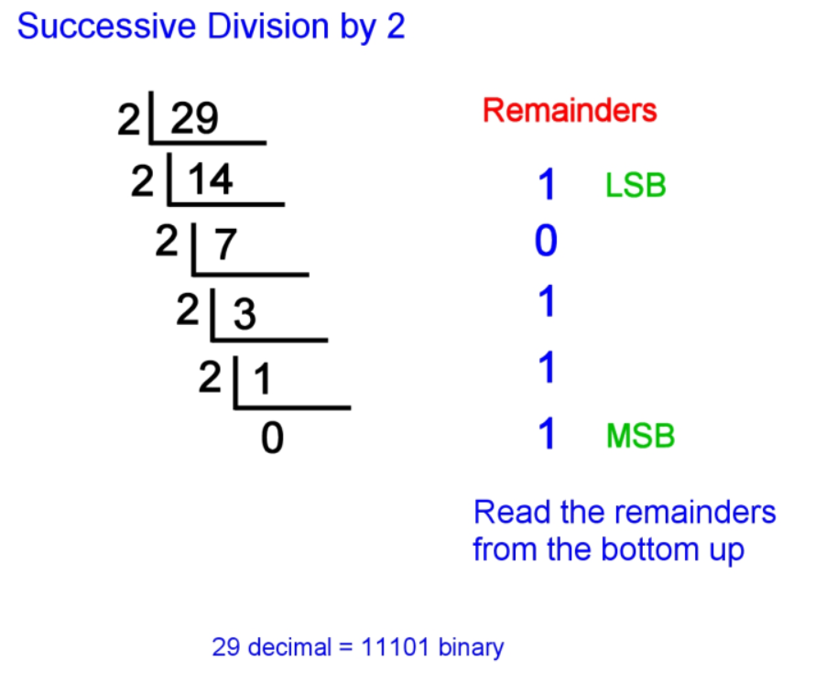
Decimal to Binary

Slide 6
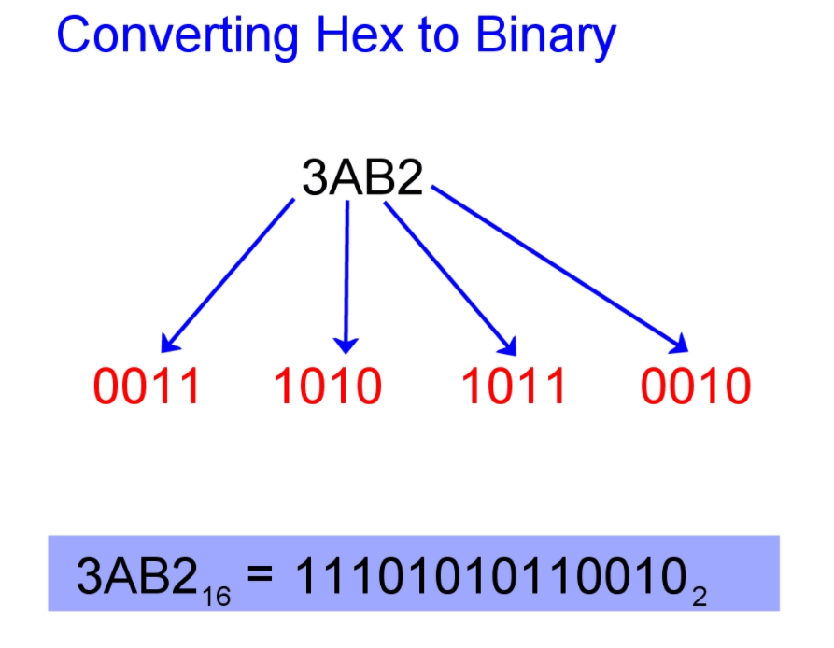
Hexadecimal to Binary

Slide 7
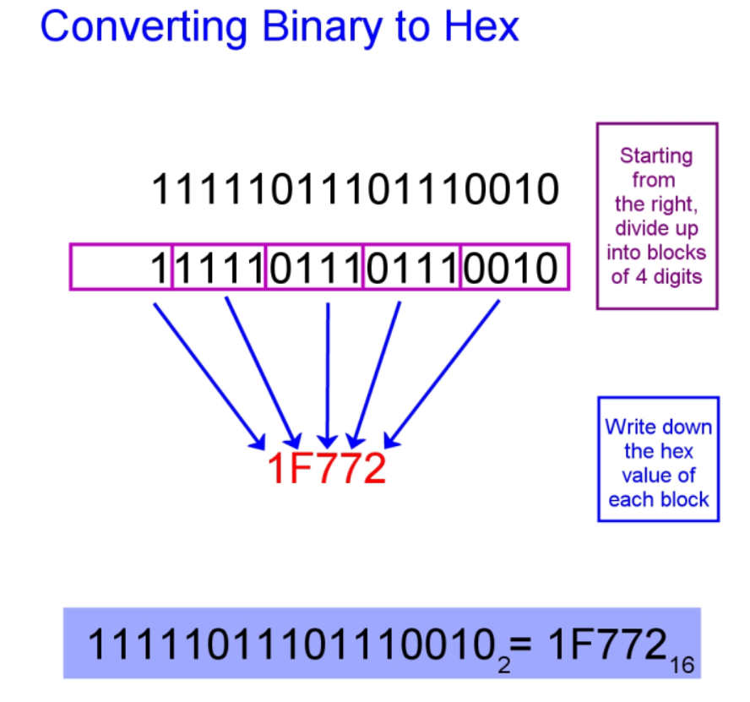
Binary to Hexadecimal

Slide 8
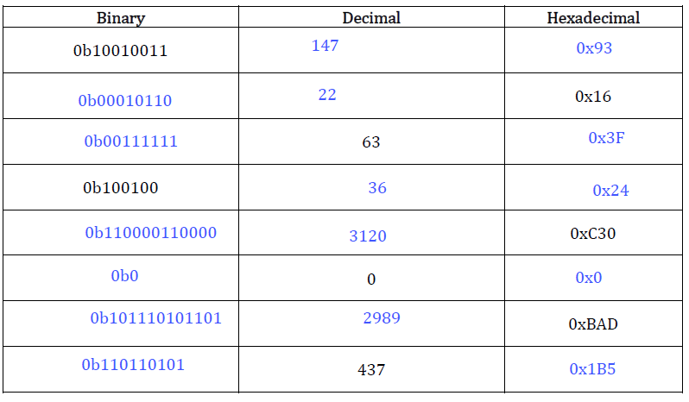
Exercise 1

Slide 9
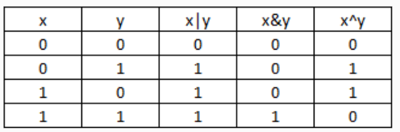
C Bitwise Operators
AND (&) outputs 1 only when both input bits are 1
OR (|) outputs 1 when either input bit is 1
XOR(^) outputs 1 when either input is exclusively 1(i.e., when two input bits are different)
NOT(~) inverts 0 to 1 and 1 to 0

Slide 10
NOT (~) vs Negation(!)
Bitwise NOT (~) takes each bit in a number and inverts it
~(0b001010) = 0b110101
Logical Negation(!) operator reverses the meaning of its operand
!0 = 1
!(non-zero)= 0

Slide 11
Exercise 2
x & 0
x|0
x^0
x&1
x|1
x^1

Slide 12
Exercise 2
x & 0 | 0
x|0 | x
x^0 | x
x&1 | x
x|1 | 1
x^1 | ~x
x ^ 1
x = 0: 0 ^ 1 = 1 = ~x
x = 1: 1 ^ 1 = 0 = ~x

Slide 13
Bit Masking
‘Using a mask, multiple bits can be set either on, off or inverted from on to off (or vice versa) in a single bitwise operation.’

Slide 14
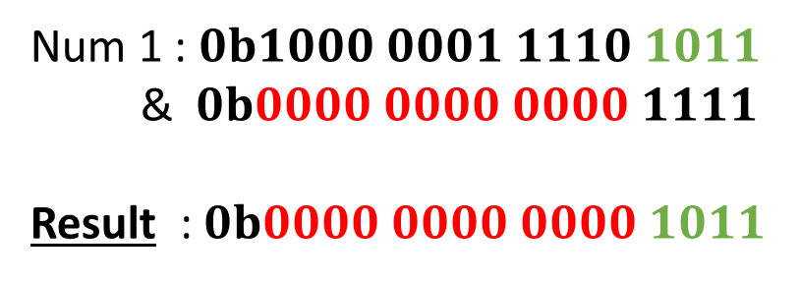
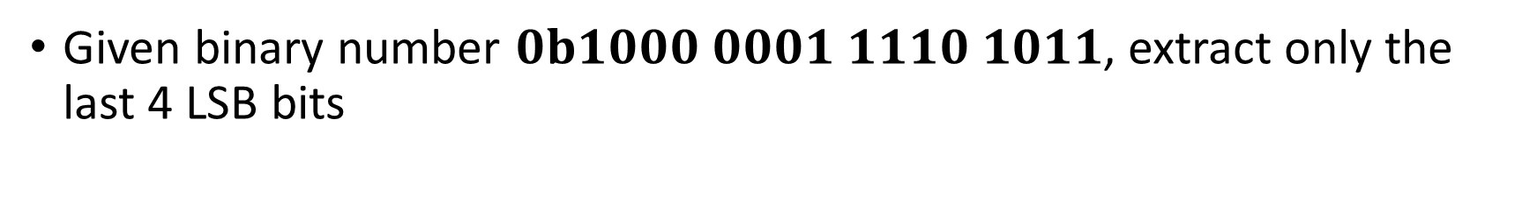
Masking to extract Bits
Given binary number $0b1000 0001 1110 1011$, extract only the last 4 LSB bits
Num 1 : $0b1000 0001 1110 1011$
& $0b0000 0000 0000 1111$
Result : $0b0000 0000 0000 1011$
Bit 1 | Bit 2 | Bitwise AND
1 | Y | Y
0 | Y | 0

Slide 15
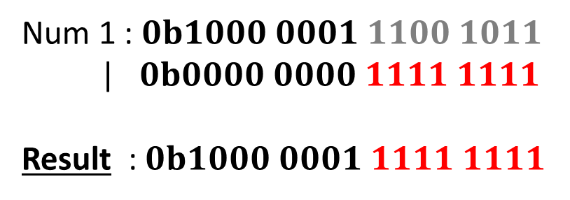
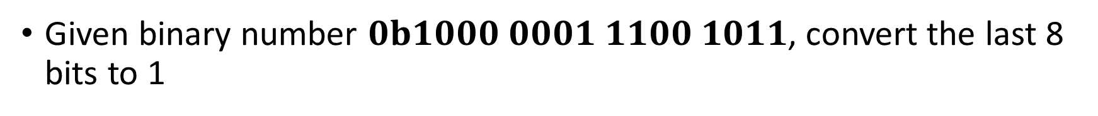
Masking Bits to 1
Given binary number $0b1000 0001 1100 1011$, convert the last 8 bits to 1
Num 1 : $0b1000 0001 1100 1011$
| $0b0000 0000 1111 1111$
Result : $0b1000 0001 1111 1111$
Bit 1 | Bit 2 | Bitwise OR
1 | Y | 1
0 | Y | Y

Slide 16
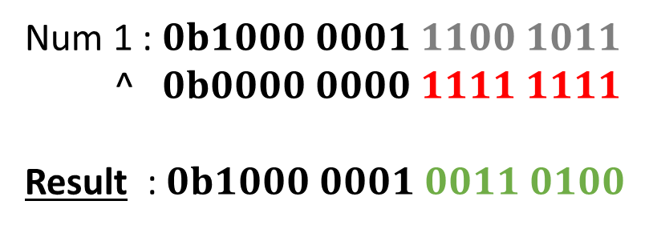

Masking to toggle Bits
Given binary number $0b1000 0001 1110 1011$, invert/toggle the last 8 bits
Num 1 : $0b1000 0001 1100 1011$
^ $0b0000 0000 1111 1111$
Result : $0b1000 0001 0011 0100$
Bit 1 | Bit 2 | Bitwise XOR
1 | X | ~X

Slide 17
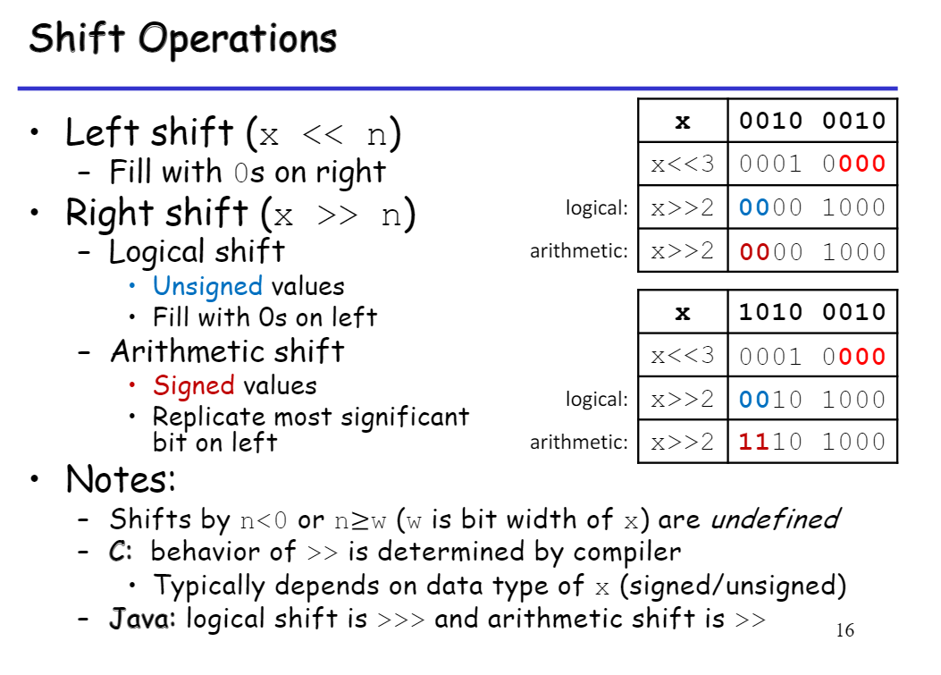

Slide 18

Exercise
What is x << n equivalent to?
$x^{n}$
$2^{nx}$
$n^{x}$
$x.2^{n}$

Slide 19
Exercise
Convert from 0011 0101 1001 0001 -> 0000 0000 0000 1011
Assume x = 0011 0101 1001 0001
Step 1: x << 4
x = 0101 1001 0001 0000
Step 2: x >> 11
x = 0000 0000 0000 1011

Slide 20
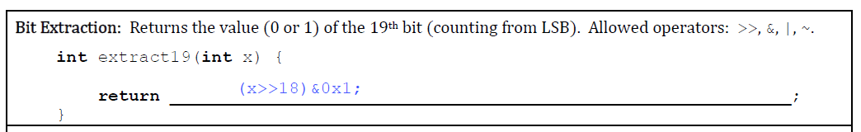
Exercise
Extraction of bits usually needs application of masking
Requires extracting just the 19th bit while masking (blocking) the other bits

Slide 21
Exercise
Extraction of bits usually needs application of masking
Requires extracting just the 19th bit while masking (blocking) the other bits
19th bit
19th bit
0x1
19th bit
x = 01010…0…0001>>18 = 0000….01010…0 & (0000…0001) = 0000…00000
LSB
LSB
LSB

Slide 22
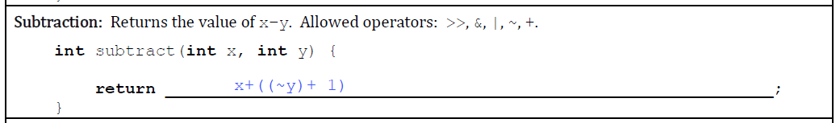
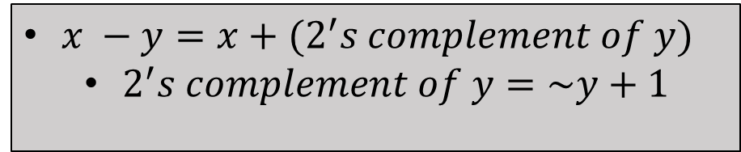
Exercise
$x −y=x+(2^{′}s complement of y)$
$2^{′}s complement of y=\sim y+1$

Slide 23
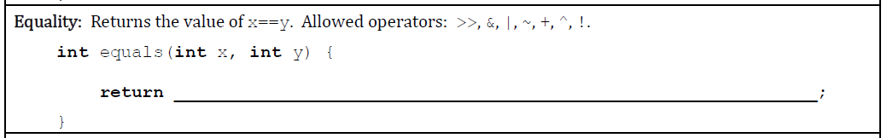
Exercise
Use the property x ^ x = 0
Check for equality usually means you need to use bitwise XOR operator

Slide 24
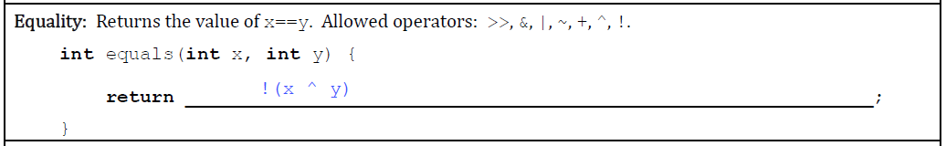
Exercise

Slide 25
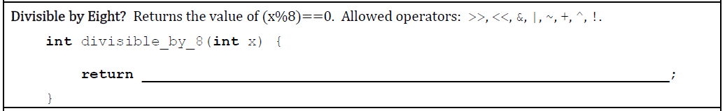
Exercise
Check if the last 3 digits of the binary equivalent of x are 0
8 = 0b1000, 16 = 0b10000, 24 = 0b11000, …

Slide 26
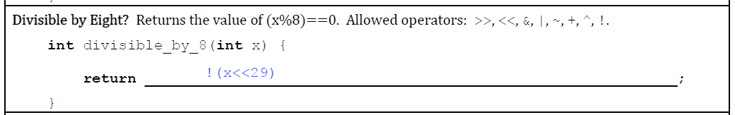
Exercise
0011…001000 <<29 = 0000000…000
LSB
MSB

Slide 27
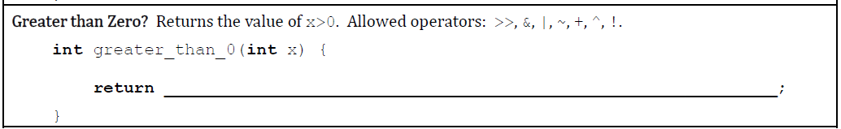
Exercise
Requirements
Required to check the value of sign bit of the integer x (Most Significant bit (leftmost bit))
If sign bit is 1, the number is negative and we return false
Also, required to check if the number is zero. If the number is zero, then we return false

Slide 28
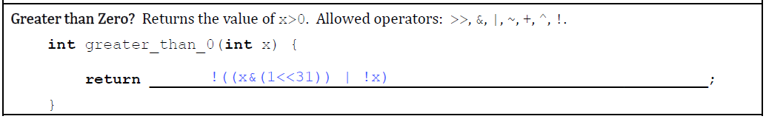
Exercise
x &(1 << 31) checks if the number is negative
1<<31 is a number with all 0s except the MSB being 1
So, x &(1 << 31) masks x with 1<<31 to extract the value of x’s MSB (sign bit)
!x is to check if x is 0
x>0 if it is not negative and not zero

Slide 29
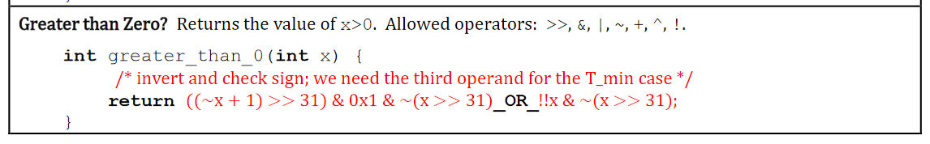
Exercise

Slide 30
Take care of operator precedences
Take care of operator precedence
In c&a>>b, a>>b operation takes place first, followed by the operation using &
c&a>>b is equivalent to c&(a>>b)
Using parenthesis to separate individual operations is a safe practice.
Find the full operator precedence list of C here.

Slide 31
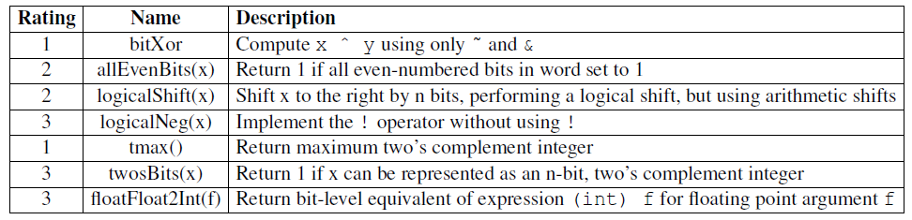
Data Lab Puzzles

Slide 32
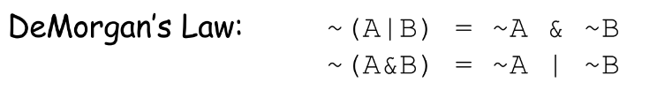
Puzzle bitXOR
Example: Puzzle bitAND
Compute x & y using only ~ and |
x & y
= ~(~(x & y))
=~(~x | ~y)
= ~(~x) & ~(~y)
= x & y

Slide 33
Puzzles
logicalNeg(x)
!x will return 1 only if x == 0
How to determine if x == 0?
logicalShift(x)
Recall what arithmetic right shift does for signed integers
How to take care of the extended sign bits?
If x = 1101
For arithmetic right shift, x>>2 = 11 1101
For logical right shift, x>>2 = 00 1101
How to ensure this?

Slide 34
allEvenBits(x)
Return 1 if all even-numbered bits in word set to 1
allEvenBits(0x55555555) = 1
0x5555 5555 = 0x0101 0101 … 0101
What is allEvenBits(0xFFFFFFFF)?
Rough idea: x & (0x0101 0101 … 0101) = 0x0101 0101 … 0101
But this solution will NOT be accepted!
Try to find a way to check if the even bits are all 1 without making use of such big constant
Keep in mind the limit of the number of operators that can be used.

Slide 35
Puzzle tmax()
What is the Maximum value of unsigned int?
0xFFFFFFFF
How can you get this number?
Not allowed to use big constants
What is the Maximum value of 2’s complement integer?
Maximum value of signed int?
How to get this with the help of bit manipulation discussed previously?

Slide 36
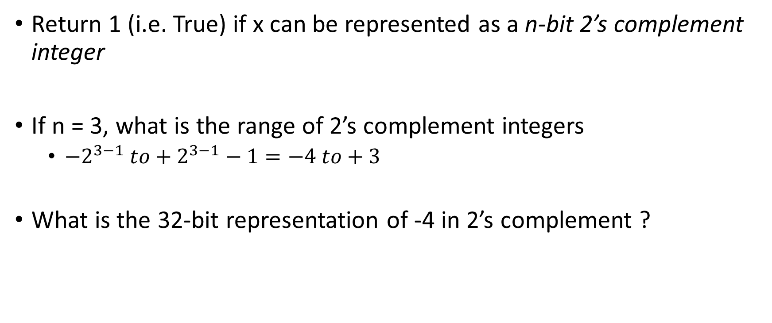
Puzzle twosBits(x, n)
Return 1 (i.e. True) if x can be represented as a n-bit 2’s complement integer
If n = 3, what is the range of 2’s complement integers
$−2^{3−1} to+2^{3−1}−1=−4 to+3$
What is the 32-bit representation of -4 in 2’s complement ?

Slide 37
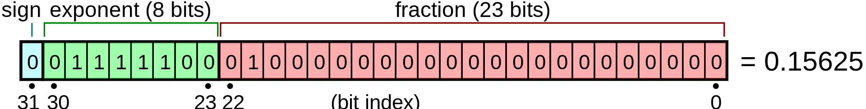
Single Precision Floating Point Numbers
Representation of decimal numbers as a IEEE 754 single-precision floating point value
Resources:
Decimal to IEEE 754 Floating point representation
https://www.youtube.com/watch?v=8afbTaA-gOQ
IEEE 754 Floating Point Representation to its Decimal Equivalent
https://www.youtube.com/watch?v=LXF-wcoeT0o

Slide 38
Puzzle floatFloat2Int(f)
Argument is passed as unsigned int, but it is to be interpreted as the bit-level representation of a single-precision floating point value.
Hints
Extract the components of a float ( sign, exponent, etc)
Check if the input is valid (i.e. within range)
Check if the exponent is valid
For instance, it should not make the corresponding integer overflow.
Follow the procedure for converting from IEEE 754 Floating Point Representation to its Decimal Equivalent

Slide 39
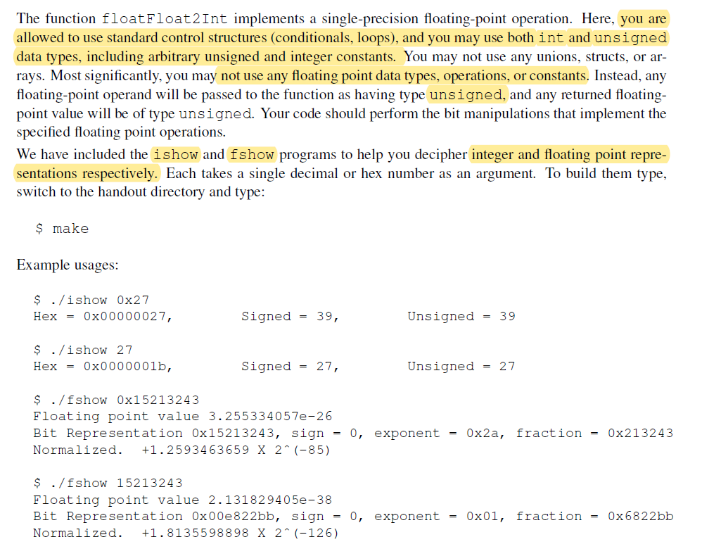

Slide 40
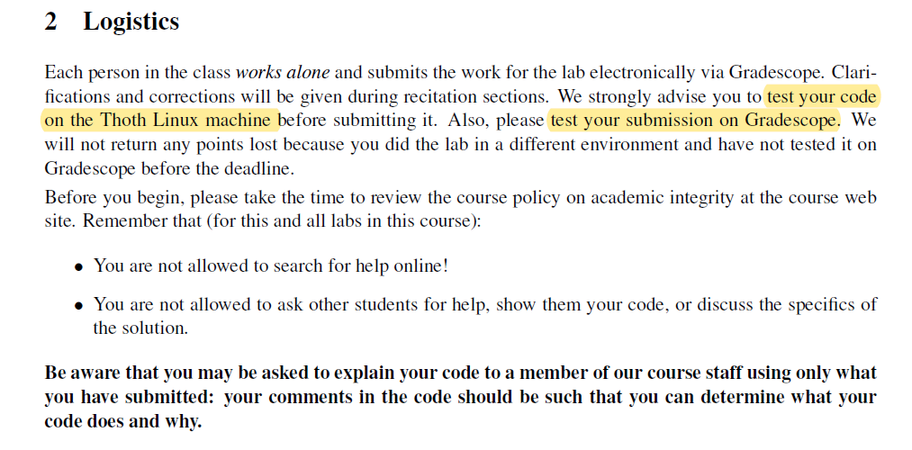
Lab 1 - Logistics

Slide 41
DON’Ts for Integer based puzzles (in bits.c)
You are expressly forbidden to:
You are expressly forbidden to:
Use any control constructs such as if, do, while, for, switch, etc.
Define or use any macros.
Define any additional functions in this file.
Call any functions.
Use any other operations, such as &&, ||, -, or ?:
Use any form of casting.
Use any data type other than int. This implies that you cannot use arrays, structs, or unions.

Slide 42
Evaluation and Submission

Slide 43
Thank you!

