Slide 1
Malloc Lab - Part 2, Processes

Slide 2
OMET Survey
Please take some time to complete the OMET survey.

Slide 3
Malloc Lab (Part 2)

Slide 4
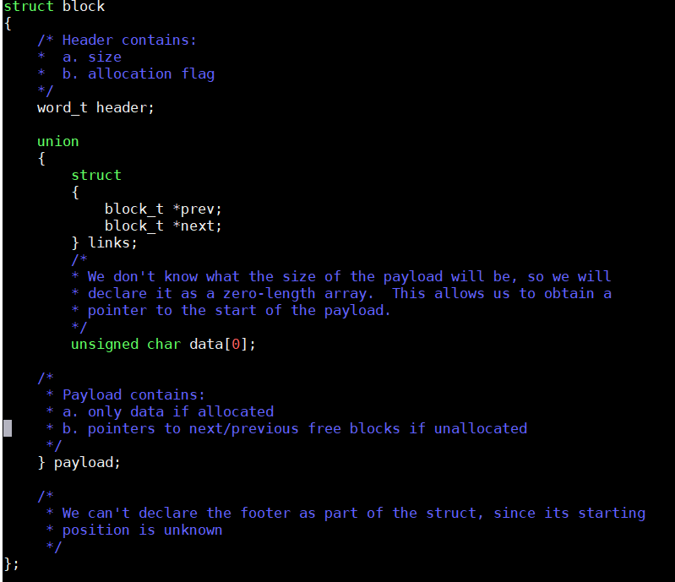

Slide 5
struct block
If NOT allocated
n
n +8
n+16
header | prev | next
If allocated
n
n +8
n+16
header | data | data
You DO NOT need to put any data in the allocated space
You just need to know the STARTING ADDRESS OF data (which is the address of header + size of a word)
Utilize the prev and next pointer when using explicit list traversal

Slide 6
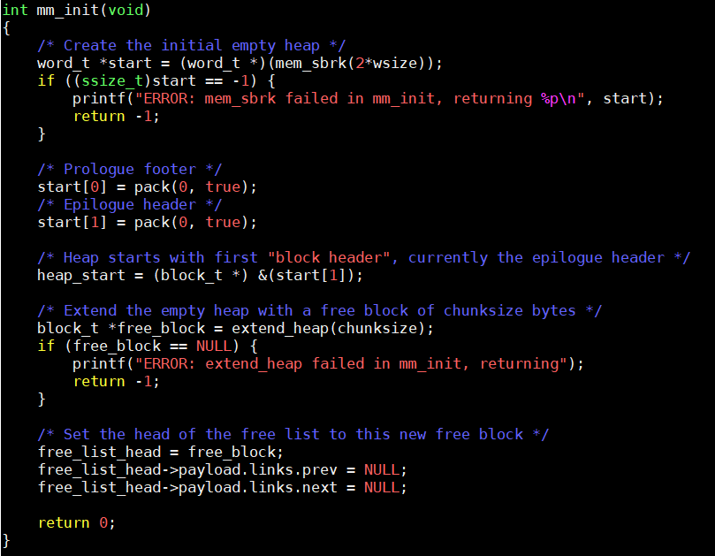
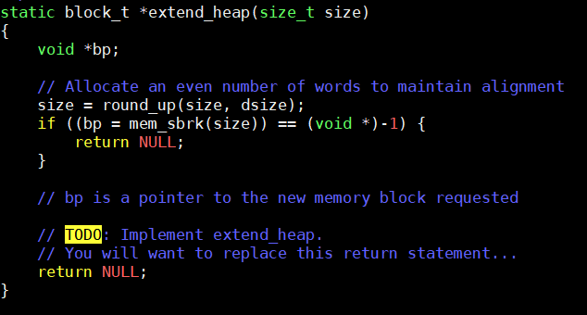
Let’s See Some Code

Slide 7
Example: extend_heap by 64 Bytes
Prologue
Epilogue
0|1 | 0|1
void *p = mem_sbrk(64)
p
Prologue
Epilogue
0|1 | 0|1
64 Bytes
p
Prologue
Epilogue
0|1 | 0|1
64 Bytes
(block_t*)p
Prologue
Epilogue
0|1 | 64|0 |  | 64|0 | 0|1
Block 1 (64 Bytes)

Slide 8

Let’s See Some Code

Slide 9
Visualizing the Heap
free_list_head
8 Bytes
0|1 | 64|0 | prev = NULL | next = NULL |  | 64|0 | 0|1
Block 1 (64 Bytes)
FREE LIST
NULL
Block 1
NULL
free_list_head

Slide 10
Allocating in the Heap
free_list_head
0|1 | Block 1 | 0|1
64 Bytes
malloc (16)
32 Bytes
32 Bytes
0|1 | Block 1 | Block 2 | 0|1
free_list_head
Step 1: Remove Block 1 from Free List
Step 2: Add Block 2 to Free List
FREE LIST
NULL
Block 2
NULL
free_list_head

Slide 11
Free List
The Free List is conceptually a doubly Linked List.
A node (essentially a free block) in the Free list
Has pointer (prev) pointing to the previous free block
Has pointer (next) pointing to the next free block

Slide 12
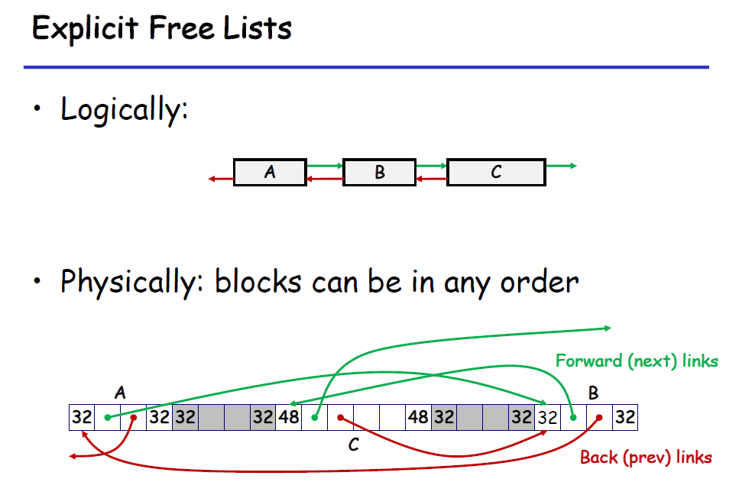

Slide 13
Updating Free List During Allocation

Slide 14
Consider this Scenario
32 Bytes
96 Bytes
64 Bytes
0/1 | B1 | B2 | B3 | B4 | B5 | B6 | B7 | 0/1
FREE LIST
B2
B6
B4
NULL
NULL
free_list_head

Slide 15
CASE 1 (with Splitting)

Slide 16
Which free block will you allocate in??
Will depend on the Allocation Policy. Let’s assume Worst Fit for this example
malloc(32)
32 Bytes
96 Bytes
64 Bytes
0|1 | B1 | B2 | B3 | B4 | B5 | B6 | B7 | 0|1
FREE LIST
B2
B6
B4
NULL
NULL
free_list_head

Slide 17
malloc(32)
Splitting!!
32 Bytes
48 Bytes
48 Bytes
64 Bytes
0|1 | B1 | B2 | B3 | B4.1 | B4.2 | B5 | B6 | B7 | 0|1
FREE LIST
Step 1: Remove Block 4 from FREE LIST
B2
B6
B4
NULL
NULL
free_list_head

Slide 18
malloc(32)
Splitting!!
32 Bytes
48 Bytes
48 Bytes
64 Bytes
0|1 | B1 | B2 | B3 | B4.1 | B4.2 | B5 | B6 | B7 | 0|1
FREE LIST
Step 2: Insert Block 4.2 to the beginning of the FREE LIST (LIFO)
B4.2
B2
B6
NULL
NULL
free_list_head

Slide 19
CASE 2 (without Splitting)

Slide 20
Which free block will you allocate in??
Will depend on the Allocation Policy. Let’s assume First Fit for this example
malloc(80)
32 Bytes
96 Bytes
64 Bytes
0|1 | B1 | B2 | B3 | B4 | B5 | B6 | B7 | 0|1
FREE LIST
B2
B6
B4
NULL
NULL
free_list_head

Slide 21
malloc(80)
32 Bytes
96 Bytes
64 Bytes
80 Bytes
0|1 | B1 | B2 | B3 | B4 | B5 | B6 | B7 | 0|1
Remove Block 4 from FREE LIST
FREE LIST
B2
B6
NULL
NULL
free_list_head

Slide 22
mm_malloc (size_t size)
Found a free Block that fits?
find_fit
Implicit/Explicit List Traversal
NO
Extend Heap
Yes
Split?
Return Pointer to Payload of the allocated Block
NO
Yes
Update Free List

Slide 23
Updating Free List During De-Allocation

Slide 24

Freeing A Block (Case 1)
Free Block 4
32 Bytes
96 Bytes
64 Bytes
80 Bytes
0|1 | B1 | B2 | B3 | B4 | B5 | B6 | B7 | 0|1
FREE LIST
B2
B6
NULL
NULL
free_list_head

Slide 25
Freeing A Block (Case 1)
Free Block 4
32 Bytes
96 Bytes
64 Bytes
80 Bytes
0|1 | B1 | B2 | B3 | B4 | B5 | B6 | B7 | 0|1
Where do you put Block 4 in the Free List?
LIFO
FIFO
Address Ordered Policy

Slide 26
Freeing A Block (Case 1)
Free Block 4
32 Bytes
96 Bytes
64 Bytes
80 Bytes
0|1 | B1 | B2 | B3 | B4 | B5 | B6 | B7 | 0|1
Insert Block 4 to the Free List
FREE LIST
B4
B2
B6
NULL
NULL
free_list_head

Slide 27

Freeing A Block (Case 2)
Free Block 4
32 Bytes
96 Bytes
64 Bytes
80 Bytes
0|1 | B1 | B2 | B3 | B4 | B5 | B6 | B7 | 0|1
Step 1: Remove Block 5 from the Free List
FREE LIST
B2
B5
B7
NULL
NULL
free_list_head

Slide 28
Freeing A Block (Case 2)
Free Block 4
32 Bytes
160 Bytes
80 Bytes
0|1 | B1 | B2 | B3 | B4_5 | B6 | B7 | 0|1
Step 2: Insert Block 4_5 from the Free List
FREE LIST
B4_5
B2
B7
NULL
NULL
free_list_head

Slide 29

Freeing A Block (Case 3)
Free Block 4
32 Bytes
64 Bytes
96 Bytes
80 Bytes
0|1 | B1 | B2 | B3 | B4 | B5 | B6 | B7 | 0|1
Step 1: Remove Block 3 from the Free List
FREE LIST
B1
B3
B7
NULL
NULL
free_list_head

Slide 30
Freeing A Block (Case 3)
Free Block 4
32 Bytes
160 Bytes
80 Bytes
0|1 | B1 | B2 | B3_4 | B5 | B6 | B7 | 0|1
Step 2: Insert Block 3_4 to the Free List
FREE LIST
B3_4
B1
B7
NULL
NULL
free_list_head

Slide 31

Freeing A Block (Case 4)
Free Block 4
32 Bytes
64 Bytes
96 Bytes
64 Bytes
80 Bytes
0|1 | B1 | B2 | B3 | B4 | B5 | B6 | B7 | 0|1
Step 1: Remove Block 3 and Block 5 from the Free List
FREE LIST
B1
B3
B5
B7
NULL
NULL
free_list_head

Slide 32
Freeing A Block (Case 4)
Free Block 4
32 Bytes
224 Bytes
80 Bytes
0/1 | B1 | B2 | B3_4_5 | B6 | B7 | 0/1
Step 2: Insert Block 3_4_5 to the Free List
FREE LIST
B3_4_5
B1
B7
NULL
NULL
HEAD

Slide 33
mm_free(void *p)
Coalesce
Update Free List
Yes
NO

Slide 34
insert_block(block_t *free_block)
Insert a Free Block to the Free List using LIFO
Cases
What if the free list is empty?
What if the free list is Not empty?
Any other cases?

Slide 35
remove_block(block_t *free_block)
Cases
What if the Free list is empty?
Will you ever need to check this case in this function, ideally?
What if the block to be removed is the head?
What if the block to be removed is Not the head?
What if it’s in the middle and what if it’s in the end of the free list?
Any other cases?

Slide 36
On Improving the Performance of Your Code
Explicit Free List Implementation
Modifying the Find_Fit algorithm
Traverse only the Free Blocks
Find a hybrid of the different Find fit algorithms, if needed.
Turn OFF (or comment out) all calls to examine_heap() and/or check_heap()

Slide 37
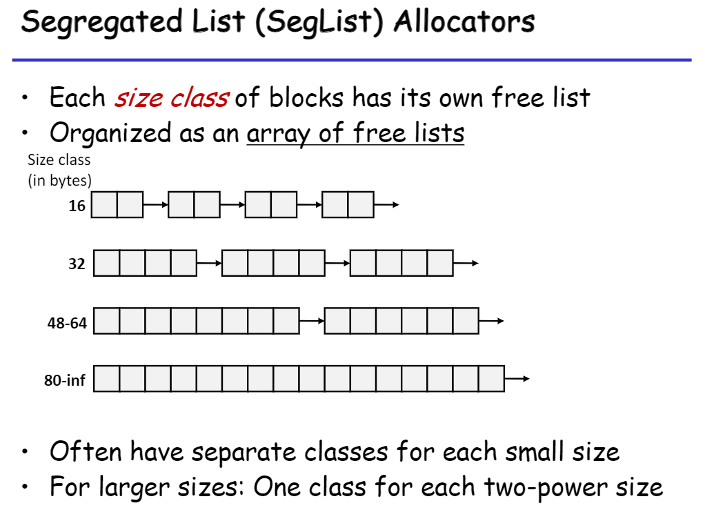
On Improving the Performance of Your Code

Slide 38
Processes

Slide 39
fork()
Creates a new process by duplicating the calling process.
Return value
On success, the PID of the child process is returned in the parent, and 0 is returned in the child.
On failure, -1 is returned in the parent, no child process is created

Slide 40
Example 1
int main()
{
fork();
printf("Hello world!\n");
exit(0);
}
Hello World!
printf
exit
Hello World!
main
fork
printf
exit

Slide 41
Example 1
int main()
{
fork();
printf("Hello world!\n");
exit(0);
}
Output
Hello world!
Hello world!

Slide 42
Example 2
Hello
printf
exit
int main()
{
fork();
fork();
printf(“Hello\n");
exit(0);
}
Hello
fork
printf
exit
Hello
printf
exit
Hello
main
fork
fork
printf
exit

Slide 43
Example 2
int main()
{
fork();
fork();
printf(“Hello\n");
exit(0);
}
Output
Hello
Hello
Hello
Hello

Slide 44
wait()
A call to wait() blocks the calling process until one of its child processes exits
Return value:
On success, returns the process ID of the terminated child
On error, -1 is returned.

Slide 45
Exercise
int main(){
if (fork() == 0)
printf(“a”);
else{
printf(“b”);
wait(NULL);
}
printf(“c”);
exit(0);
}
Can the following sequences be printed?
acbc
abcc
bacc
bcac
cbca

Slide 46
Exercise
int main(){
if (fork() == 0)
printf(“a”);
else{
printf(“b”);
wait(NULL);
}
printf(“c”);
exit(0);
}
a
c
exit
printf
printf
b
c
main
fork
printf
wait
printf
exit

Slide 47
Exercise
int main(){
if (fork() == 0)
printf(“a”);
else{
printf(“b”);
wait(NULL);
}
printf(“c”);
exit(0);
}
Can the following sequences be printed?
acbc - Yes
abcc - Yes
bacc - Yes
bcac - No
cbca - No

Slide 48
Resource on wait
A simple example of when wait() is needed
https://www.youtube.com/watch?v=tcYo6hipaSA

Slide 49
exec()
The exec() family of functions replaces the current process image with a new process image.
The initial argument for these functions is the pathname of a file which is to be executed.

Slide 50
Example
ex1.c
int main(int argc, char *argv[])
{
printf(“PID of ex1.c = %d\n”, getpid());
char *args = {“hello”, NULL};
execv(“./ex2”, args);
printf(“Next line of ex1.c”);
return 0;
}
ex2.c
int main(int argc, char *argv[])
{
printf(“Inside ex2.c\n”);
printf(“PID of ex2.c: %d\n”, getpid());
return 0;
}

Slide 51
Example
Compilation
thoth$ gcc -o ex1 ex1.c
thoth$ gcc -o ex2 ex2.c
thoth$ ./ex1
Output
PID of ex1.c = 5551
Inside ex2.c
PID of ex2.c: 5551

