Slide 1
Hello Lab

Slide 2
Thoth Machine
What is it?
Linux machine in the CS department of Pitt
Hosted at thoth.cs.pitt.edu
Will be used by you to compile and run your programming labs
Why?
Needed softwares, packages etc. are already installed in this machine

Slide 3
1st thing to do: INCREASE your UNIX quota
To ensure you have sufficient space to run the assignments/projects of this class
Steps:
Login to https://accounts.pitt.edu/
Click “EMAIL & MESSAGING” menu
Click “UNIX QUOTA”
Click “Increase Quota”

Slide 4
Accessing Thoth
Windows
Use Putty
Source: https://www.chiark.greenend.org.uk/~sgtatham/putty/latest.html
Use Powershell/Bash
Command Line
Mac OS/Linux
Open the terminal
Type ssh pittusername@thoth.cs.pitt.edu
Enter yes if prompted to accept the new ssh key
Enter Pitt password (note: terminal will not show anything you type)

Slide 5
What next??
You’d probably want to
Create a new folder
Delete an existing folder
Run a C program
Transfer files from your laptop to the thoth machine, etc., etc.
How?
By running Bash commands

Slide 6
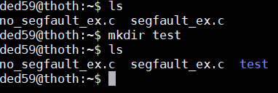
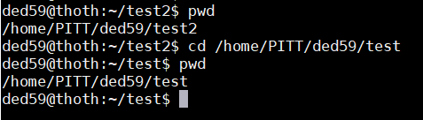
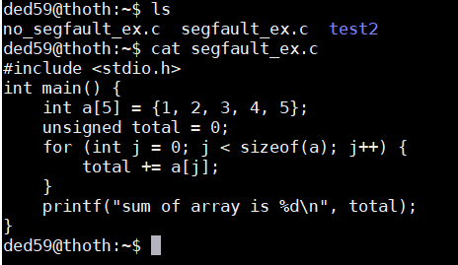
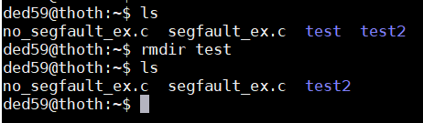
Common Bash Commands
Make Directory : mkdir directory_name
Change Directory : cd directory_name
Show file content: cat filename
Delete Directory : rmdir directory_name

Slide 7
More Bash Commands
Some resources you can refer to:
https://www.educative.io/blog/bash-shell-command-cheat-sheet
https://hackernoon.com/top-10-bash-file-system-commands-you-cant-live-without-4cd937bd7df1

Slide 8
Transferring files to and from thoth
Download and install a user-friendly file transferring software
Windows
WinSCP
https://winscp.net/eng/download.php
Mac OS/Linux
FileZilla
https://filezilla-project.org/download.php?show_all=1

Slide 9
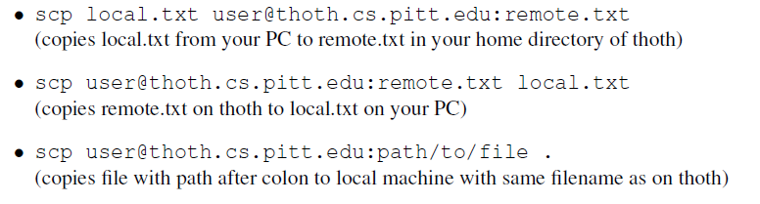
Transferring files to and from thoth
Command line

Slide 10
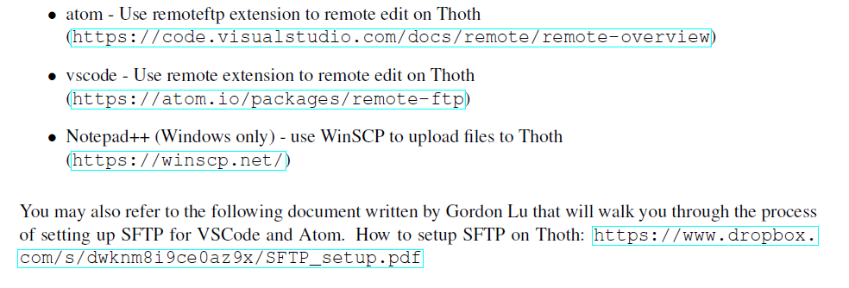
Where to write your C code? Text Editors
Text Editors in your local machine
Text Editors built in Thoth
nano – super basic
emacs - full featured
vim – full-featured, modal
Tutorial -https://www.openvim.com/

Slide 11
Sample C Program
stdio.h file contains functions such as scanf() and printf() to take input and display
output respectively
#include <stdio.h>
int main (int argc, char* argv[]){
// Declare a variable
int x;
// Assign a variable
x = 2;
// Print a string and a variable
printf("Hello world! x is currently %d \n", x);
return 0;
}
Placeholders:
%d: signed int
%u: unsigned int
%f: float
%s: string
%p: pointer
%x: hexadecimal
Preprocessor command that tells the compiler to include the contents of stdio.h

Slide 12
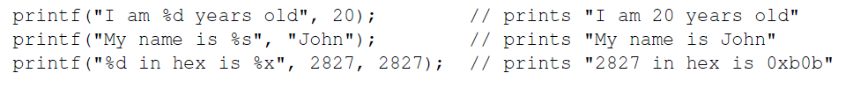
printf()
printf() is a library function to send formatted output to the screen
printf() without stdio.h will give compilation error

Slide 13
Compiling and Running a C Program
hello.c
C file
$ gcc hello.c
Executable file
Compiler
a.out
Runs the C program
$ ./a.out

Slide 14

Compiling and Running a C Program
-g : turns on debugging symbols
-W: Sets warnings
-Wall: Enable all warnings
-std: Sets the version of C to be used
-std=c99: Sets the version of C to be c99
-o: sets the name of the resulting executable

Slide 15
Debugging Tools - GDB
Used to sift through the assembly code of compiled programs in later labs
Used to locate bugs in your code

Slide 16
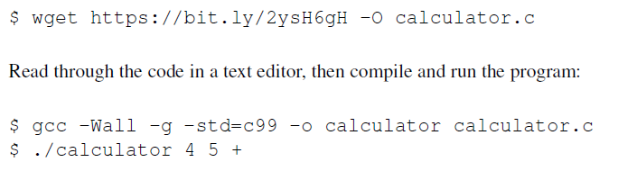
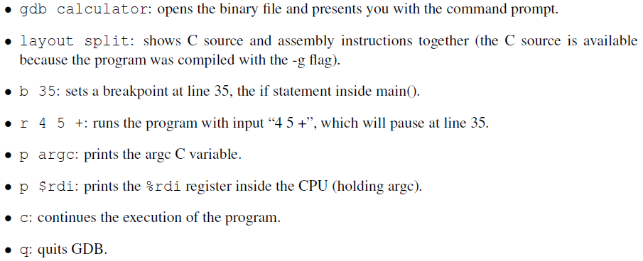
Debugging Tools - GDB
Download, compile and run calculator.c
Use these commands to use gdb for debugging

Slide 17
Debugging Tools - Valgrind
Helps catch memory bugs
Emulates CPU and tracks memory access

Slide 18


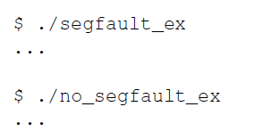
Valgrind Example
Download
Compile
Run

Slide 19
Segmentation fault
Running segfault_ex results in a segmentation fault.
Occurs when a program crashes from trying to access memory that is not available to it
The file segfault_ex.c is very small so you should be able to open the file and understand what is causing the segfaults.
But what to do when the file is too large?
Use Valgrind
Outputs where the illegal access occurred
gdb can also be helpful sometimes (more on this later)

Slide 20
Valgrind Example
Run:
$valgrind ./segfault_ex
Should cause Valgrind to output where the illegal access occurred
$valgrind ./no_segfault_ex
Valgrind seems to not be able to tell you exactly where the problem is occurring
Use the message provided by Valgrind to determine the issue

Slide 21
Lab Quiz: C Warm Up
Download lab0.c
$ wget https://bit.ly/35LYokU -O lab0.c
Navigate to directory where lab0.c resides
Compile
$ clang -g -Wall -std=c99 -o lab0 lab0.c
Run
$ ./lab0 <number ranging from 1 to 5>
Eg: $./lab0 1
Go to Gradescope and complete the quiz
Open lab0.c in a text editor and go through the comments and code and make any required changes in it
Recompile lab0.c after you make any change in it.

Slide 22
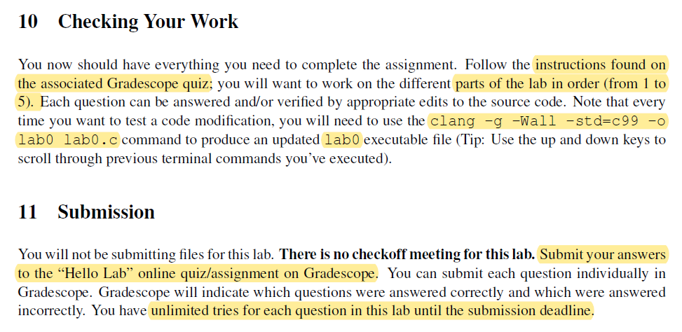
Lab Quiz: C Warm Up

