Slide 1
Cache Mapping, Cache Lab

Slide 2
Fully Associative Mapping
A Main Memory Block can be mapped to any Cache line.
Advantage
Better Cache Hit Rate
Disadvantages
Slow because the valid bit and tag of every cache line has to be compared.
Expensive due to the high cost of associative-comparison hardware.

Slide 3
Fully Associative Mapping
Cache
Block 0
B0 | B1 | B2 | B3
B4 | B5 | B6 | B7
B8 | B9 | B10 | B11
B12 | B13 | B14 | B15
… … …
B56 | B57 | B58 | B59
B60 | B61 | B62 | B63
Tag 0
Block 0/1/2/…/15
Block 0/1/2/…/15
Block 0/1/2/…/15
Block 0/1/2/…/15
Block 1
Line 0
Block 2
Tag 1
Block 3
Line 1
Tag 2
Line2
Main Memory
Tag 3
Line 3
Tag i
Block 14
6-bit address
Block 15
b5 | b4 | b3 | b2 | b1 | b0
b5 | b4 | b3 | b2 | b1 | b0
Block Number
Block Offset

Slide 4
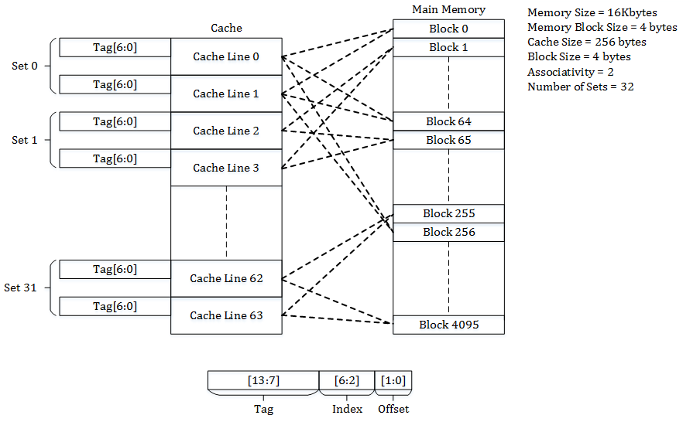
Set Associative Mapping
Cache lines grouped into sets
A main memory block is mapped to a set
Associative Mapping within a set
Tradeoff between Direct Mapping and Fully Associative Mapping
Disadvantages
Can still suffer from conflict miss.

Slide 5
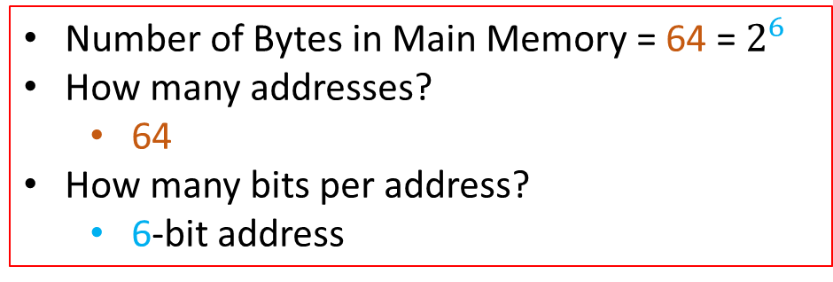
Set Associative Mapping
Block 0
B0 | B1 | B2 | B3
B4 | B5 | B6 | B7
B8 | B9 | B10 | B11
B12 | B13 | B14 | B15
… … …
B56 | B57 | B58 | B59
B60 | B61 | B62 | B63
Block 1
Block 2
Cache
Block 3
Line 0
Set 0
Block 0/2/4/6/8/10/12/14
Main Memory
Line 1
Line 2
Set 1
Block 1/3/5/7/9/11/13/15
Line 3
Block 14
A MM Block is Direct Mapped to a Set
Set Number/Index = K mod s
K = Block Number
s = Number of Sets
Block 15
Number of Bytes in Main Memory = 64 = $2^{6}$
How many addresses?
64
How many bits per address?
6-bit address

Slide 6
Set Associative Mapping
Block 0
B0 | B1 | B2 | B3
B4 | B5 | B6 | B7
B8 | B9 | B10 | B11
B12 | B13 | B14 | B15
… … …
B56 | B57 | B58 | B59
B60 | B61 | B62 | B63
Block 1
Block 2
Cache
Block 3
Line 0
Set 0
Block 0/2/4/6/8/10/12/14
Main Memory
Line 1
Line 2
Set 1
Block 1/3/5/7/9/11/13/15
Line 3
Block 14
Block 15
How many bits for Set Index?
1
How many bits for Tag?
3
Number of Bytes in Main Memory = 64 = $2^{6}$
How many addresses?
64
How many bits per address?
6-bit address

Slide 7
Set Associative Mapping
Block 0
B0 | B1 | B2 | B3
B4 | B5 | B6 | B7
B8 | B9 | B10 | B11
B12 | B13 | B14 | B15
… … …
B56 | B57 | B58 | B59
B60 | B61 | B62 | B63
Block 1
Cache
Block 2
Line 0
Block 3
Set 0
Line 1
Line 2
Main Memory
Set 1
Line 3
Tag
Block 14
Set Index
Block 15
6-bit address
b5 | b4 | b3 | b2 | b1 | b0
Main Memory Block Number
Block Offset

Slide 8
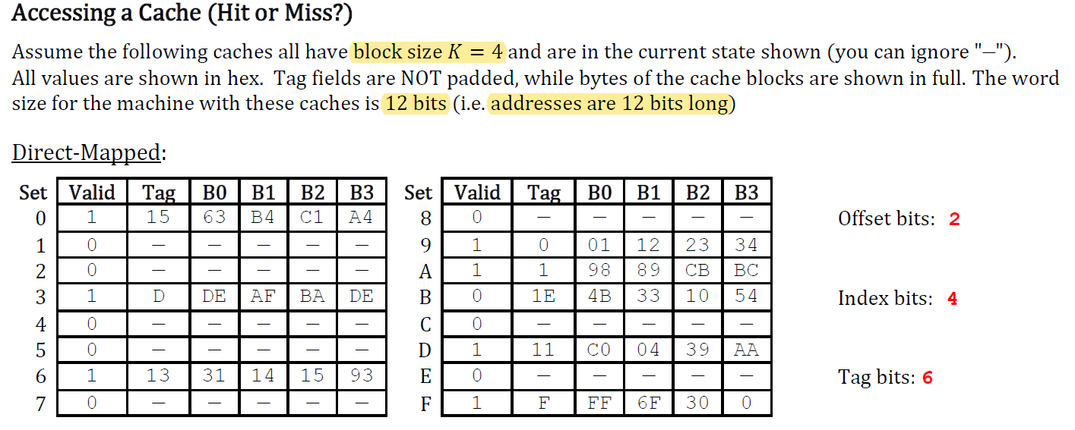
Cache Tutorial

Slide 9
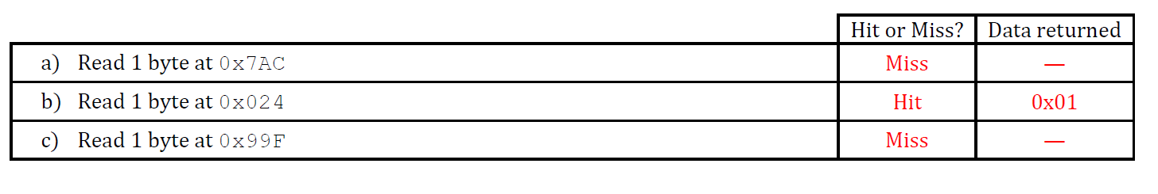
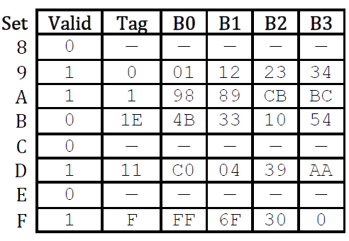
Cache Tutorial
Address: 011110101100
Block Offset : 0
Set/Line Index = 11 = 0xB
Tag = 30 = 0x1E

Slide 10
Cache Tutorial
Address: 000000100100
Block Offset : 0
Set/Line Index = 0x9
Tag: 0x0

Slide 11
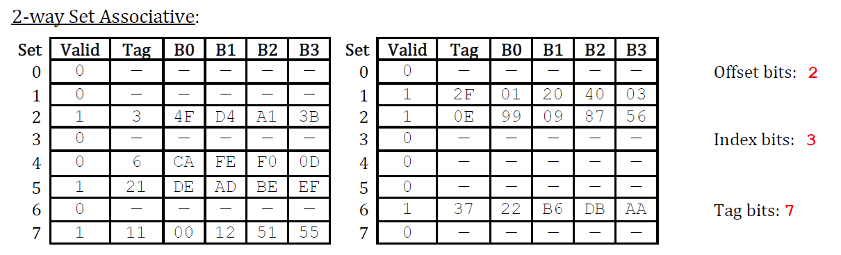
Cache Tutorial

Slide 12
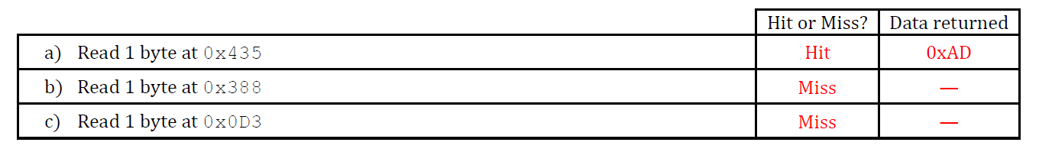
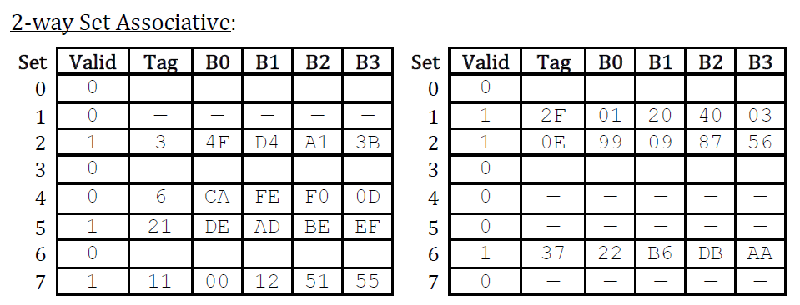
Cache Tutorial
Address: 010000110101
Block Offset = 1
Set Index = 5 = 0x5
Tag = 0x21

Slide 13
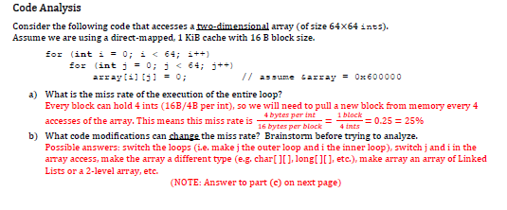
Cache Tutorial

Slide 14
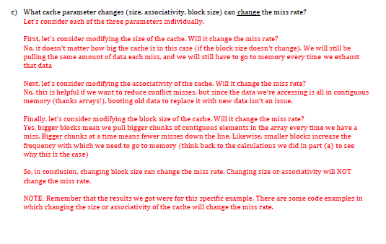
Cache Tutorial

Slide 15
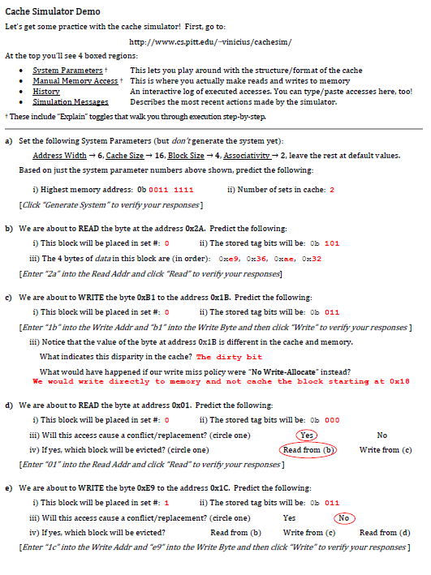
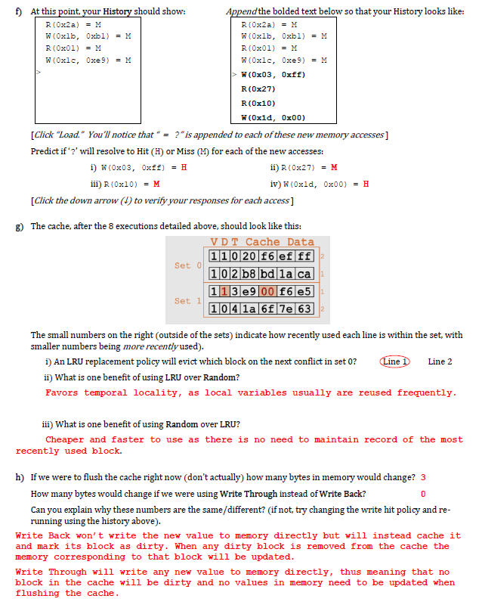

Slide 16
Cache Lab

Slide 17
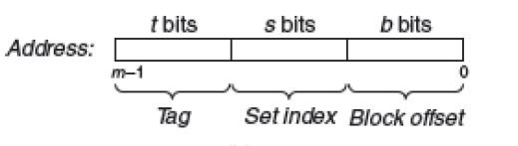
Cache Lab
A cache simulator is NOT a cache!
Main Memory contents are NOT stored
Block offsets are NOT used – don’t worry about the b bits in your address.
Simply count hits, misses, and evictions

Slide 18
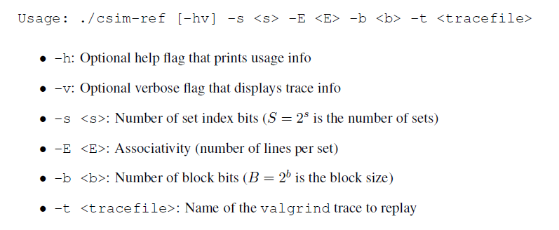
Step 1: Understanding the Command Line Arguments

Slide 19
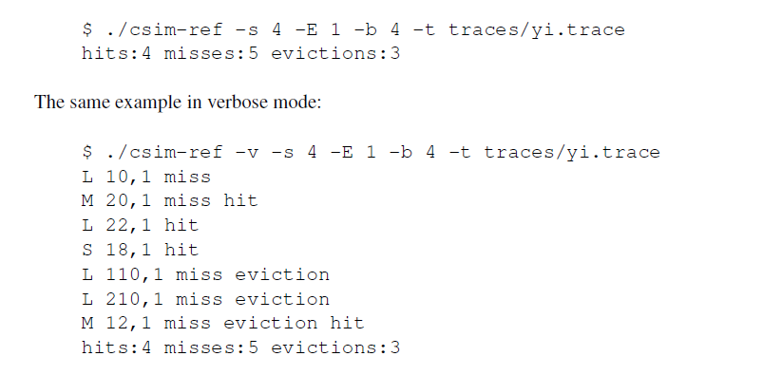
Step 1: Understanding the Command Line Arguments
Cross-check your results with the results obtained by the reference simulator csim-ref

Slide 20
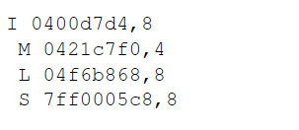
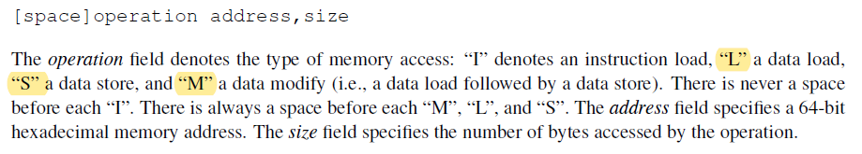
Step 2 : Understanding the Trace files

Slide 21
Step 2 : Understanding the Trace files
Instruction loads (I) are ignored, since we are interested in evaluating data cache performance.
Each load/store means 1 memory access.
Can cause at most one cache miss.
Data modify (M) is treated as a load followed by a store to the same address. 2 Memory Accesses.
Hence, an M operation can result in two cache hits, or a miss and a hit plus a possible eviction.
Assume that memory accesses are aligned properly, such that a single memory access never crosses block boundaries. By making this assumption, you can ignore the request sizes in the valgrind traces.

Slide 22
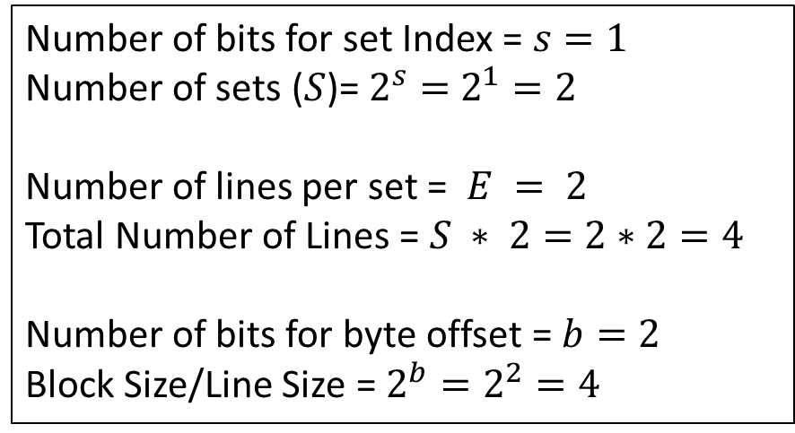
Example
Command Line Argument
$./csim –s 1 –E 2 –b 2 –t traces/tr1.trace
Cache
Valid
Bit
Number of bits for set Index = $s=1$
Number of sets ($S$)= $2^{s}=$ $2^{1}=2$
Number of lines per set = $E = 2$
Total Number of Lines = $S ∗ 2=2∗2=4$
Number of bits for byte offset = $b=2$
Block Size/Line Size = $2^{b}=2^{2}=4$
Line 0
Line 1
Line 2
Line 3
0
0
0
0
Set 0
Set 1

Slide 23
Example
Command Line Argument
$./csim –s 1 –E 2 –b 2 –t traces/tr1.trace
Cache
Valid
Bit
tr1.trace
I 10, 1
L 20, 1
M 25, 1
S 35, 1
L 50, 1
Line 0
Line 1
Line 2
Line 3
0
0
0
0
Set 0
Set 1
Ignore I operations

Slide 24
Example
Cache MISS!
Command Line Argument
$./csim –s 1 –E 2 –b 2 –t traces/tr1.trace
Cache
Valid
Bit
tr1.trace
I 10, 1
L 20, 1
M 25, 1
S 35, 1
L 50, 1
Line 0
Line 1
Line 2
Line 3
0
0
0
0
Set 0
Set 1
64-bit Address = 20 = 000000…00000010100
Tag
Set Index
Byte Offset

Slide 25
Example
Update the Cache
Command Line Argument
$./csim –s 1 –E 2 –b 2 –t traces/tr1.trace
Cache
Valid
Bit
Tag
tr1.trace
Line 0
Line 1
Line 2
Line 3
0
0
1
0
0
0
0..0010
0
Set 0
I 10, 1
L 20, 1
M 25, 1
S 35, 1
L 50, 1
Set 1
64-bit Address = 20 = 000000…00000010100
Tag
Set Index
Byte Offset

Slide 26
Example
Operation M means 2 memory accesses
1st access: Cache MISS!
Command Line Argument
$./csim –s 1 –E 2 –b 2 –t traces/tr1.trace
Cache
Valid
Bit
Tag
tr1.trace
Line 0
Line 1
Line 2
Line 3
0
0
1
0
0
0
0..0010
0
Set 0
I 10, 1
L 20, 1
M 25, 1
S 35, 1
L 50, 1
Set 1
64-bit Address = 25 = 000000…00000011001
Tag
Set Index
Byte Offset

Slide 27
Example
Operation M means 2 memory accesses
1st access: Cache MISS!
Update the Cache
2nd access: Cache HIT!
Command Line Argument
$./csim –s 1 –E 2 –b 2 –t traces/tr1.trace
Cache
Valid
Bit
Tag
tr1.trace
Line 0
Line 1
Line 2
Line 3
1
0
1
0
0..0011
0
0..0010
0
Set 0
I 10, 1
L 20, 1
M 25, 1
S 35, 1
L 50, 1
Set 1
64-bit Address = 25 = 000000…00000011001
Tag
Set Index
Byte Offset

Slide 28
Example
Cache MISS!
Command Line Argument
$./csim –s 1 –E 2 –b 2 –t traces/tr1.trace
Cache
Valid
Bit
Tag
tr1.trace
Line 0
Line 1
Line 2
Line 3
1
0
1
0
0..0011
0
0..0010
0
Set 0
I 10, 1
L 20, 1
M 25, 1
S 35, 1
L 50, 1
Set 1
64-bit Address = 35 = 000000…00000100011
Tag
Set Index
Byte Offset

Slide 29
Example
Update the cache
Command Line Argument
$./csim –s 1 –E 2 –b 2 –t traces/tr1.trace
Cache
Valid
Bit
Tag
tr1.trace
Line 0
Line 1
Line 2
Line 3
1
1
1
0
0..0011
0..0100
0..0010
0
I 10, 1
L 20, 1
M 25, 1
S 35, 1
L 50, 1
Set 0
Set 1
64-bit Address = 35 = 000000…00000100011
Tag
Set Index
Byte Offset

Slide 30
Example
Cache MISS!
Which cache line to be replaced/evicted??
Command Line Argument
$./csim –s 1 –E 2 –b 2 –t traces/tr1.trace
Cache
Valid
Bit
?
Tag
tr1.trace
Line 0
Line 1
Line 2
Line 3
1
1
1
0
0..0011
0..0100
0..0010
0
Set 0
I 10, 1
L 20, 1
M 25, 1
S 35, 1
L 50, 1
?
Set 1
64-bit Address = 50 = 000000…00000110010
Tag
Set Index
Byte Offset

Slide 31
Least Recently Used (LRU) Eviction
Cache
Line 0
Set 0
Line 1
Line 2
Tag Requests
0, 4, 1, 4, 2, 4, 3, 4, 2
Global Counter = 0

Slide 32
Least Recently Used (LRU) Eviction
Cache
Line 0
0 [Counter = 1]
Set 0
Line 1
Line 2
Tag Requests
0, 4, 1, 4, 2, 4, 3, 4, 2
Global Counter = 1

Slide 33
Least Recently Used (LRU) Eviction
Cache
Line 0
0 [Counter = 1]
4 [Counter = 2]
Set 0
Line 1
Line 2
Tag Requests
0, 4, 1, 4, 2, 4, 3, 4, 2
Global Counter = 2

Slide 34
Least Recently Used (LRU) Eviction
Cache
Line 0
0 [Counter = 1]
4 [Counter = 2]
1 [Counter = 3]
Set 0
Line 1
Line 2
Tag Requests
0, 4, 1, 4, 2, 4, 3, 4, 2
Global Counter = 3

Slide 35
Least Recently Used (LRU) Eviction
Cache
Line 0
0 [Counter = 1]
4 [Counter = 4]
1 [Counter = 3]
Set 0
Line 1
Line 2
Tag Requests
0, 4, 1, 4, 2, 4, 3, 4, 2
Global Counter = 4

Slide 36
Least Recently Used (LRU) Eviction
Cache
Line 0
2 [Counter = 5]
4 [Counter = 4]
1 [Counter = 3]
Set 0
Line 1
Line 2
Tag Requests
0, 4, 1, 4, 2, 4, 3, 4, 2
Global Counter = 5

Slide 37
Least Recently Used (LRU) Eviction
Cache
Line 0
2 [Counter = 5]
4 [Counter = 6]
1 [Counter = 3]
Set 0
Line 1
Line 2
Tag Requests
0, 4, 1, 4, 2, 4, 3, 4, 2
Global Counter = 6

Slide 38
Least Recently Used (LRU) Eviction
Cache
Line 0
2 [Counter = 5]
4 [Counter = 6]
3 [Counter = 7]
Set 0
Line 1
Line 2
Tag Requests
0, 4, 1, 4, 2, 4, 3, 4, 2
Global Counter = 7

Slide 39
Least Recently Used (LRU) Eviction
Cache
Line 0
2 [Counter = 5]
4 [Counter = 8]
3 [Counter = 7]
Set 0
Line 1
Line 2
Tag Requests
0, 4, 1, 4, 2, 4, 3, 4, 2
Global Counter = 8

Slide 40
Least Recently Used (LRU) Eviction
Cache
Line 0
2 [Counter = 9]
4 [Counter = 8]
3 [Counter = 7]
Set 0
Line 1
Line 2
Tag Requests
0, 4, 1, 4, 2, 4, 3, 4, 2
Global Counter = 9

Slide 41
Least Recently Used (LRU) Eviction
Cache
Line 0
2 [Counter = 9]
4 [Counter = 8]
0 [Counter = 10]
Set 0
Line 1
Line 2
Tag Requests
0, 4, 1, 4, 2, 4, 3, 4, 2, 0
Global Counter = 10

Slide 42
Step 3: Build Your Cache
Design your cache
Define your own data structures
Types: cache, cache line, cache set
You can use a counter to implement LRU replacement policy

Slide 43
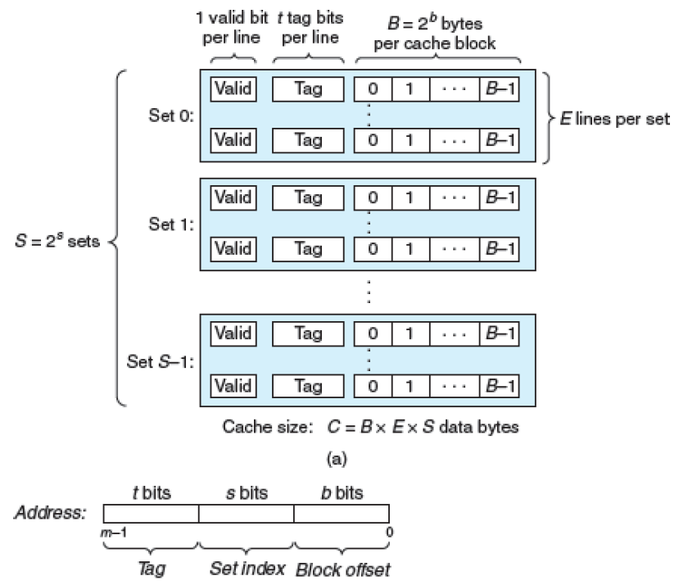
Step 3: Build Your Cache
How big is your Cache?
Depends on user inputs of s, E and b.
So, use malloc() for allocating space for
Each of the sets
Lines per set
Initialize valid bit, tag and LRU counter
Deallocate (with free) the cache data structures of each set and line.

Slide 44
LINE 0 (Tag, Valid Bit, Counter)
SET 0
…
LINE E-1 (Tag, Valid Bit, Counter)
LINE 0 (Tag, Valid Bit, Counter)
SET 2
…
LINE E-1 (Tag, Valid Bit, Counter)
CACHE
…
…
…
LINE 0 (Tag, Valid Bit, Counter)
…
SET S - 1
LINE E-1 (Tag, Valid Bit, Counter)

Slide 45
Example of a 2D array of integers
//ALLOCATE
int** matrix = malloc(10 * sizeof(int*));
for (int i=0; i<10; ++i)
{
matrix[i] = malloc(10 * sizeof(int));
}
//DEALLOCATE
for (int i=0; i<10; ++i)
{
free(matrix[i]);
}
free(matrix);

Slide 46
Step 4: Parsing
Use getopt to parse command-line arguments.
Open/close file trace_fn for reading (using fopen/fclose)
Read lines (using fgets, fscanf, or getline) from the file handle (may name `trace_fp` variable)
Use sscanf to parse fields within a string
Skip lines not starting with ` S`, ` L` or ` M`
Parse the memory address (unsigned long, in hex) and len (unsigned int, in decimal) from each input line
Most of Parsing has already been done for you. Check the code and comments in csim.c.

Slide 47
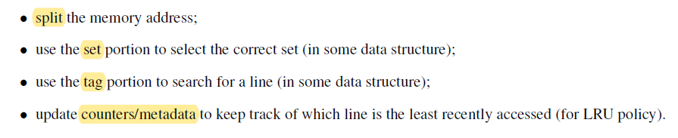
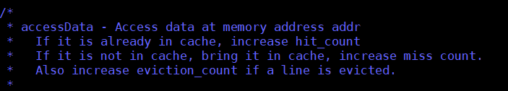
Step 5: Access Data

Slide 48
References
https://www.youtube.com/watch?v=3eriC-pIQKg
https://www.youtube.com/watch?v=mCF5XNn_xfA
https://www.youtube.com/watch?v=j5PUJllPPVE
https://en.wikipedia.org/wiki/Cache_placement_policies
https://www.cs.cmu.edu/afs/cs/academic/class/15213-s15/www/recitations/recitation-7.pdf
Locality
http://www.mathcs.emory.edu/~cheung/Courses/355/Syllabus/9-virtual-mem/LRU-replace.html

