Slide 1
Malloc Lab, Part 1

Slide 2
OMET Survey
Please take some time to complete the OMET survey of my recitations.

Slide 3
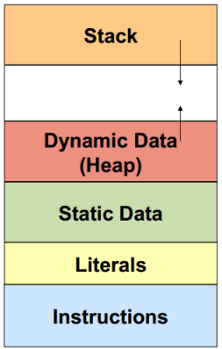
Heap

Slide 4
Heap
HEAP
B0 | B1 | B2 | B3 | B4 | B5 | B6 | B7
8 Bytes
A sequence of Bytes!

Slide 5
Increasing the heap size
HEAP
B0 | B1 | B2 | B3 | B4 | B5 | B6 | B7
Increase the Heap by 8 Bytes
8 Bytes
void *p = mem_sbrk(8)
p
HEAP
B0 | B1 | B2 | B3 | B4 | B5 | B6 | B7 | B8 | B9 | B10 | B11 | B12 | B13 | B14 | B15
Heap Size = 16 Bytes

Slide 6
mem_sbrk() (part of “memlib.c”)
void *mem_sbrk(int incr)
{
char *old_brk = mem_brk;
if ( (incr < 0) || ((mem_brk + incr) > mem_max_addr)) {
errno = ENOMEM;
fprintf(stderr, "ERROR: mem_sbrk failed. Ran out of memory...\n");
return (void *)-1;
}
mem_brk += incr;
return (void *)old_brk;
}

Slide 7
Visualizing the Heap
1 Word = 8 Bytes
End of Heap
Start of Heap
1 Word
10 Words = 80 Bytes
Prologue
1 Word
Epilogue
1 Word
8 Words = 64 Bytes
1 Word
Prologue
Epilogue
BLOCK 1 = 64 Bytes

Slide 8
Let’s Allocate (malloc()) some space from Heap
Prologue
Epilogue
HEAP
BLOCK 1
int *p = (int*) malloc (12);
Is Block 1 free ??
Can allocate there only if it is FREE
Or is there some data in there already??
How Will I know??!

Slide 9
Header and Footer
Prologue
Epilogue
HEADER
HEAP
FOOTER
 | 64 B, False |  | 64 B, False
1 Word
1 Word
1 Word
1 Word
BLOCK 1
Now I know that Block 1 is free because:
I can check the header and/or footer to check the allocation status.
BLOCK 1:
Size: 64 Bytes
Allocation Status: False

Slide 10
Header and Footer
Prologue
Epilogue
HEADER
HEAP
FOOTER
0|1 | 64|0 |  | 64|0 | 0|1
1 Word
1 Word
1 Word
1 Word
BLOCK 1
Now I know that Block 1 is free because:
I can check the header and/or footer to check the allocation status.
BLOCK 1:
Size: 64 Bytes
Allocation Status: False

Slide 11
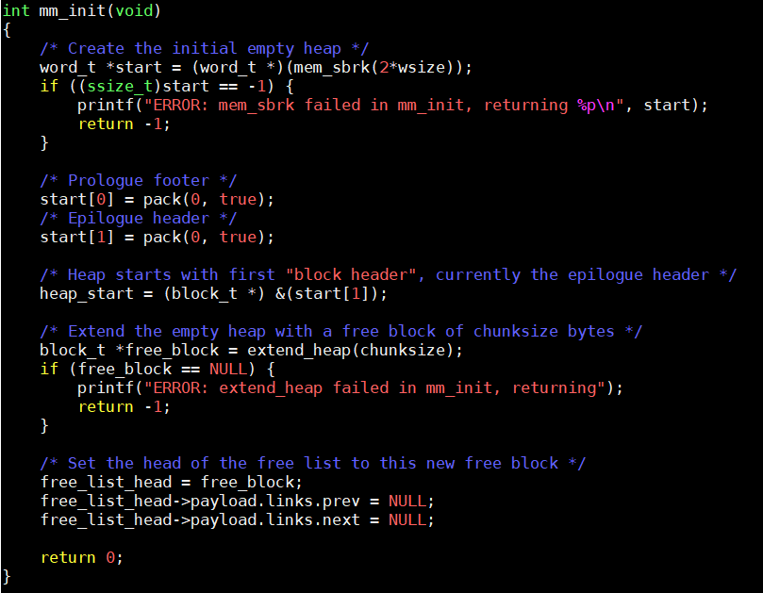
Let’s See Some Code

Slide 12
1 word = 8 Bytes
Representing the Heap as a sequence of Bytes
Prologue
Epilogue
start[0]
start[1]
Representing the Heap as a sequence of Words
Prologue
Epilogue
0|1 | 0|1
start[0]
start[1]

Slide 13
Let’s See Some Code

Slide 14
Representing the Heap as a sequence of Bytes
heap_start
Prologue
Epilogue
start[0]
start[1]
1 Word = 8 Bytes
heap_start
Representing the Heap as a sequence of Words
Prologue
Epilogue
0|1 | 0|1
start[0]
start[1]

Slide 15
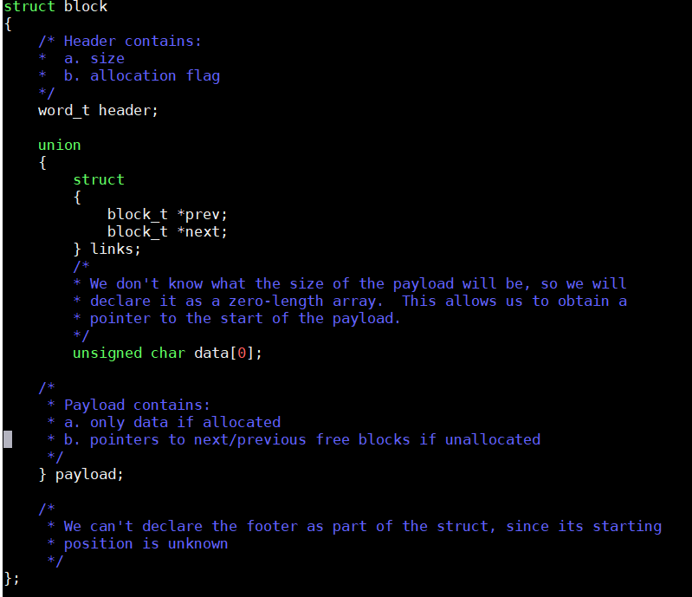

Slide 16
Union
Union allocates one common storage space for all its members
union student {
int a;
int b;
struct s{
int x;
int y;
}struct_var;
};
int main(){
union student st;
printf("Size of Union:%ld", sizeof(st)); //8
printf("\nAddress of a:%p",&st.a );//0x04
printf("\nAddress of b:%p",&st.b );//0x04
printf("\nAddress of x:%p",&st.struct_var.x);//0x04
printf("\nAddress of x:%p",&st.struct_var.y);//0x08
return 0;
}

Slide 17
struct block
If NOT allocated
n
n +8
n+16
header | prev | next
If allocated
n
n +8
n+16
header | data | data
You DO NOT need to put any data in the allocated space
You just need to know the STARTING ADDRESS OF data (which is the address of header + size of a word)
Utilize the prev and next pointer when using explicit list traversal

Slide 18
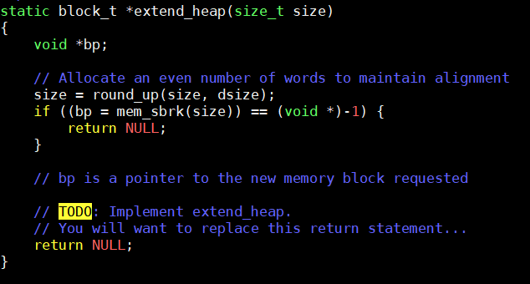
Let’s See Some Code

Slide 19
Example: extend_heap by 64 Bytes
Prologue
Epilogue
0|1 | 0|1
void *p = mem_sbrk(64)
p
Prologue
Epilogue
0|1 | 0|1
64 Bytes
p
Prologue
Epilogue
0|1 | 0|1
64 Bytes
(block_t*) p
Prologue
Epilogue
0|1 | 64|0 |  | 64|0 | 0|1
Block 1 (64 Bytes)

Slide 20
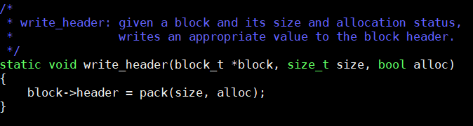
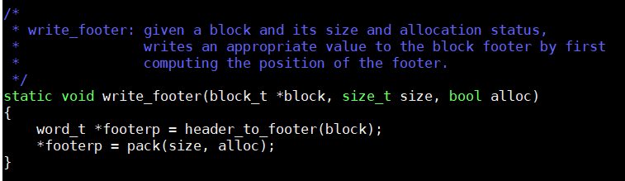
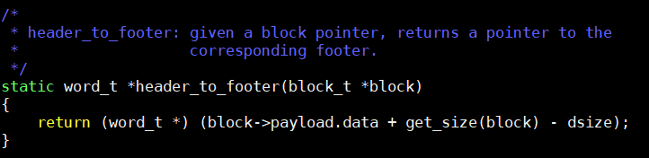
Writing header and footer of a Block
(block_t* block)
Prologue
Epilogue
0|1 | 64|0 |  | 64|0 | 0|1
Block 1 (64 Bytes)

Slide 21
Allocation (mm_malloc())

Slide 22
HEAP
0|1 | 64|0 |  | 64|0 | 0|1
BLOCK 1
char *q = (char*) malloc (12);
What will be the size of the payload?
16 Bytes
What will be the size of the new block?
Size of Payload + Size of Header + Size of Footer = 32 Bytes
So, what is the minimum Block Size?
32 Bytes
BLOCK
H | Payload | F
16 Byte aligned
16 Byte aligned

Slide 23
HEAP
0|1 | 64|0 |  | 64|0 | 0|1
BLOCK 1
char *q = (char*) malloc (12);
q
0|1 | 32|1 |  | 32|1 | 32|0 |  | 32|0 | 0|1
BLOCK 1
BLOCK 2
How much space did we waste in Block 1?
32 Bytes - 12 Bytes = 20 Bytes
This is called Internal Fragmentation

Slide 24
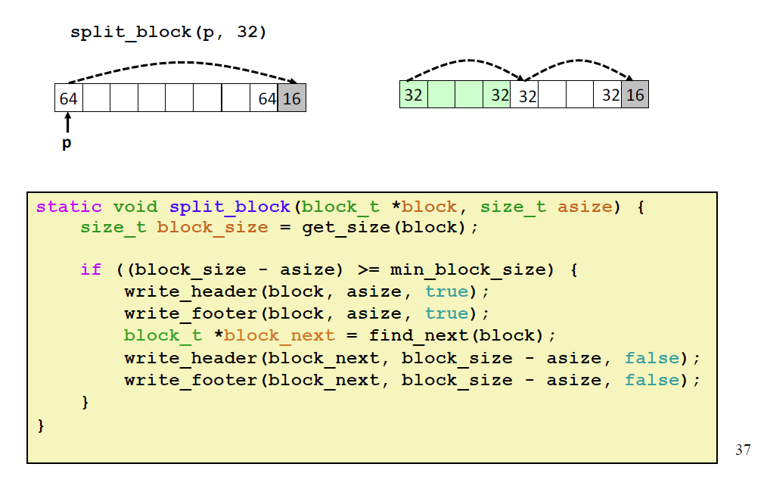
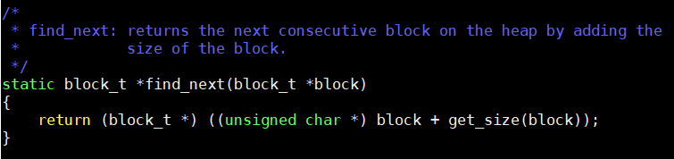
Splitting A Free Block to Two Blocks

Slide 25
Should I split Here?
HEAP
0|1 | 64|0 |  | 64|0 | 0|1
BLOCK 1
char *q = (char*) malloc (20);
What will be the size of the payload?
32 Bytes
What will be the size of the new block?
48 Bytes
What is the remaining space?
16 Bytes
Is the remaining space enough for a block?
NO. Minimum Block Size is 32 B

Slide 26
Should I split Here? No
q
HEAP
0|1 | 64|1 |  | 64|1 | 0|1
BLOCK 1
char *q = (char*) malloc (20);
What will be the size of the payload?
32 Bytes
What will be the size of the new block?
48 Bytes
What is the remaining space?
16 Bytes
Is the remaining space enough for a block?
NO. Minimum Block Size is 32 B

Slide 27
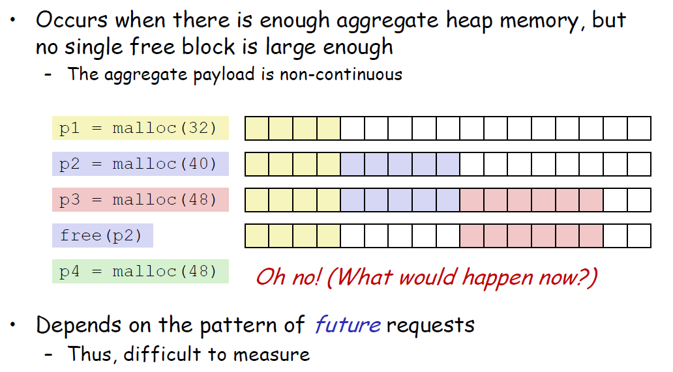
External Fragmentation

Slide 28
Consider this scenario
 | A | B | C | D | E | F
0|1 | 32 B | 64 B | 32 B | 96 B | 32 B | 128 B | 0|1
malloc (16)
Block Size = 32 Bytes
Need to allocate 32 Bytes in a FREE block

Slide 29
How do I find the Blocks which are Free?
Implict List
Traverse all block and check if it is free
Explicit List
Traverse only the FREE blocks

Slide 30

Implicit List
heap_start
 | A | B | C | D | E | F
0|1 | 32 B | 64 B | 32 B | 96 B | 32 B | 128 B | 0|1

Slide 31
Which Free Block To allocate in?
malloc (16)
Block Size = 32 Bytes
First Fit
 | A | B | C | D | E | F
0|1 | 32 B | 64 B | 32 B | 96 B | 32 B | 128 B | 0|1
 | A | B | C | D | E | F
0|1 | 32 B | 32 B | 32 B | 32 B | 96 B | 32 B | 128 B | 0|1

Slide 32
Which Free Block To allocate in?
malloc (16)
Block Size = 32 Bytes
Pointer to where previous search finished
Next Fit
 | A | B | C | D | E | F
0|1 | 32 B | 64 B | 32 B | 96 B | 32 B | 128 B | 0|1
 | A | B | C | D | E | F
0|1 | 32 B | 64 B | 32 B | 32 B | 64 B | 32 B | 128 B | 0|1

Slide 33
Which Free Block To allocate in?
malloc (16)
Block Size = 32 Bytes
Best Fit
 | A | B | C | D | E | F
0|1 | 32 B | 64 B | 32 B | 96 B | 32 B | 128 B | 0|1
 | A | B | C | D | E | F
0|1 | 32 B | 32 B | 32 B | 32 B | 96 B | 32 B | 128 B | 0|1

Slide 34
Which Free Block to allocate in?
malloc (16)
Block Size = 32 Bytes
Worst Fit
 | A | B | C | D | E | F
0|1 | 32 B | 64 B | 32 B | 96 B | 32 B | 128 B | 0|1
 | A | B | C | D | E | F
0|1 | 32 B | 64 B | 32 B | 96 B | 32 B | 32 B | 96 B | 0|1

Slide 35
mm_malloc (size_t size)
Found a free Block that fits?
find_fit
Implicit/Explicit List Traversal
NO
Extend Heap
Yes
Split?
Return Pointer to Payload of the allocated Block
NO
Yes
Update Free List
(needed when you do Explicit List implementation)

Slide 36
De-Allocation (mm_free())

Slide 37
q
0|1 | 32|1 |  | 32|1 | 32|0 |  | 32|0 | 0|1
BLOCK 1
BLOCK 2
free(q);
0|1 | 32|0 |  | 32|0 | 32|0 |  | 32|0 | 0|1
BLOCK 1
BLOCK 2
0|1 | 64|0 |  | 64|0 | 0|1
BLOCK 1

Slide 38
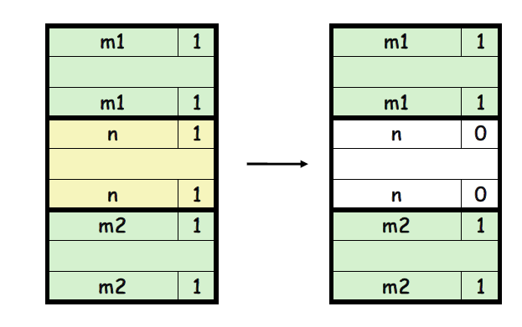
Coalescing

Slide 39
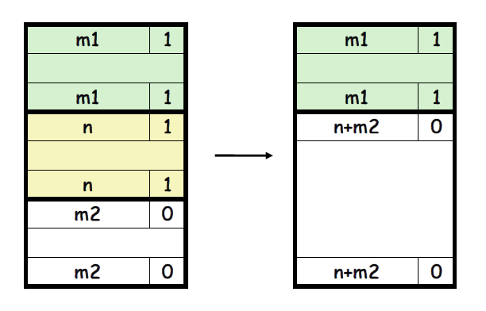
Coalescing

Slide 40
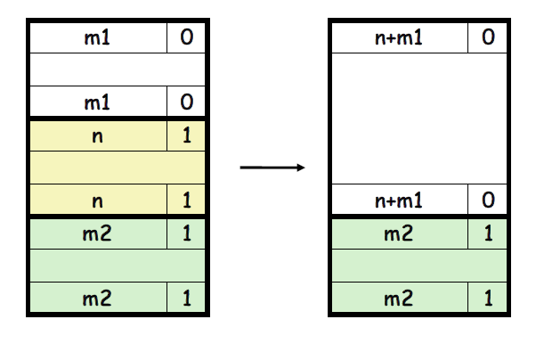
Coalescing

Slide 41
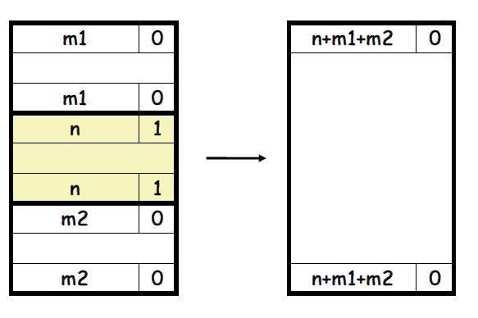
Coalescing

Slide 42
Where else do you need to Coalesce?
IMPORTANT REMINDER
No Two Adjacent Blocks should be free.
If adjacent blocks are free, coalesce them

Slide 43
mm_free(void *p)
Coalesce
Update Free List
(needed when you do Explicit List implementation)
Yes
NO

Slide 44
Debugging

Slide 45
examine_heap()
Already implemented
Prints content of the heap

Slide 46
check_heap()
Partially Implemented
Left for you to implement as per need
Optional. But Highly Recommended
Write the check_heap() as you go, do not write it at the end.
Consider using a macro to turn the calls to check_heap() and/or examine_heap() on or off
Can make use of a built-in macro called __LINE__ that gets replaced with the current line number in the source file
You can use this with your check_heap() to indicate where the check_heap() call failed or gave an error.

Slide 47
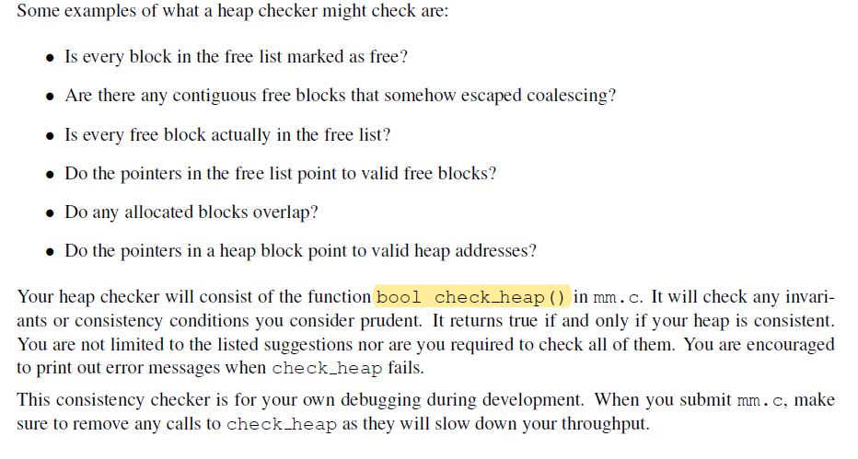
Some ideas of check_heap()

Slide 48
More Ideas for check_heap()
Block level:
Header and footer match.
Payload area is aligned.
List level:
Next/prev pointers in consecutive free blocks are consistent.
Free list contains no allocated blocks.
All free blocks are in the free list.
No contiguous free blocks in memory (unless you defer coalescing).
There are no cycles in the list (unless you use circular lists).
Segregated list contains only blocks that belong to the size class
Heap level:
Prologue/Epilogue blocks are at the boundaries and have special size/alloc fields.
All blocks stay in between the heap boundaries.
And your own invariants (e.g. address order)

Slide 49
How to use a macro to turn on/off check_heap??
Turning it ON
#define check_heap_actual() check_heap();
//#define check_heap_actual();
..
..
mm_free()
{ ..
..
check_heap_actual();
}

Slide 50
How to use a macro to turn on/off check_heap??
Turning it OFF
//#define check_heap_actual() check_heap();
#define check_heap_actual();
..
..
mm_free()
{ ..
..
check_heap_actual();
}

Slide 51
Important Points
Make sure to turn OFF calls to check_heap() and examine_heap() before your final submission and when you are testing the performance of your code
Otherwise, the performance of your code will decrease because of the time taken to execute these functions.
Turn ON calls to check_heap() and examine_heap() ONLY when you are debugging your code.

