Slide 1
Cache Exercises, Virtual Memory

Slide 2
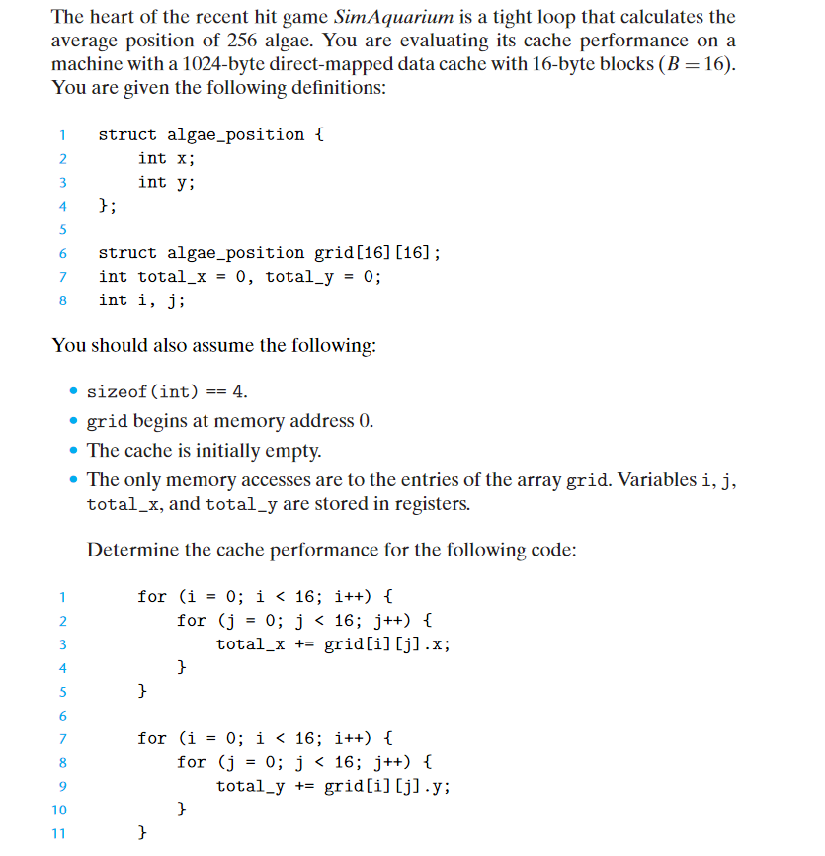
Exercise 1
What is the total number of reads?
What is the total number of reads that miss in the cache?
What is the miss rate?
Will increasing the Cache size improve the performance?
Will increasing the Block size improve performance?

Slide 3
Visualize the Cache and Main Memory
Main Memory
Sequence of accesses
//1st nested for loop sequence
grid[0][0] -> miss
grid[0][1] -> hit
…
grid[8][0] -> miss
grid[8][1] -> hit
…
grid[15][14] -> miss
grid[15][15] -> hit
//2nd nested for loop sequence
grid[0][0] -> miss
grid[0][1] -> hit
…
grid[15][0] -> miss
grid[15][1] -> hit
Cache
0
1
2
…
64
…
127
grid[0][0] | grid[0][1]
grid[0][2] | grid[0][3]
grid[0][4] | grid[0][5]
… …
grid[8][0] | grid[8][1]
…
grid[15][14] | grid[15][15]
… …
16 B
0
1
2
..
..
..
63
… … … … …
Block 63, 127
16 B
Block 0, 64
Block 1, 65
Block 2, 66
50% MISS RATE

Slide 4
If we double the cache
Sequence of accesses
//1st nested for sequence
grid[0][0] -> miss
grid[0][1] -> hit
…
grid[8][0] -> miss
grid[8][1] -> hit
…
grid[15][14] -> miss
grid[15][15] -> hit
//2nd nested for sequence
grid[0][0] -> hit
grid[0][1] -> hit
…
grid[8][0] -> hit
grid[8][1] -> hit
…
grid[15][0] -> hit
grid[15][1] -> hit
Cache
0
1
2
..
..
..
..
127
… … … … …
Block 0
16 B
Block 1
Block 2
25% MISS RATE
Block 127

Slide 5
What is the total number of reads?
512
What is the total number of reads that miss in the cache?
256
What is the miss rate?
50%
Will doubling the Cache size improve the performance?
Yes
What will the number of misses in this case?
128 misses for the first nested for loop sequence. 0 misses for the next nested for loop sequence.
Will increasing the Block size improve performance?
Yes

Slide 6
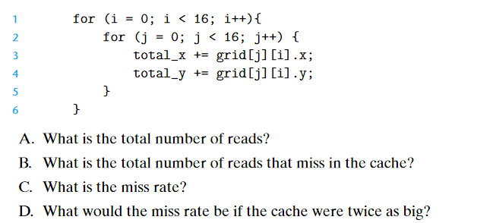
Exercise 2

Slide 7
Visualize the Cache and Main Memory
Main Memory
Cache
Sequence of accesses
grid[0][0] -> miss
grid[0][0] -> hit
grid[1][0] -> miss
grid[1][0] -> hit
…
grid[8][0] -> miss
grid[8][0] -> hit
…
grid[15][0] -> miss
grid[15][0] -> hit
grid[0][1] -> miss
grid[0][1] -> hit
…
grid[15][1] ->miss
grid[15][1] -> hit
…
… … … … …
Block 63, 127
0
1
2
…
64
…
127
grid[0][0] | grid[0][1]
grid[0][2] | grid[0][3]
grid[0][4] | grid[0][5]
… …
grid[8][0] | grid[8][1]
…
grid[15][14] | grid[15][15]
… …
16 B
0
1
2
..
..
..
63
Block 0, 64
16 B
Block 1, 65
Block 2, 66

Slide 8
If we double the cache
Sequence of accesses
grid[0][0] -> miss
grid[0][0] -> hit
grid[1][0] -> miss
grid[1][0] -> hit
…
grid[8][0] -> miss
grid[8][0] -> hit
…
grid[15][0] -> miss
grid[15][0] -> hit
grid[0][1] -> hit
grid[0][1] -> hit
…
grid[15][1] -> hit
grid[15][1] -> hit
grid [0][2] -> miss
grid [0][2] -> hit
…
grid[0][3] -> hit
grid[0][3] -> hit
…
Cache
0
1
2
..
..
..
..
127
… … … … …
Block 0
16 B
Block 1
Block 2
Block 127
25% MISS RATE

Slide 9
Exercise 2 - Answers
512
256
50%
25%

Slide 10
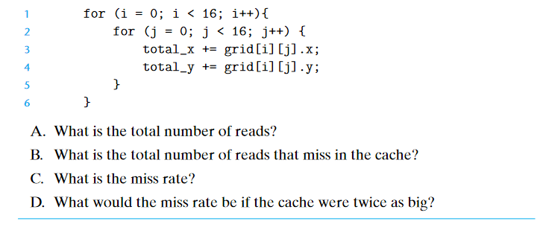
Exercise 3 – Try to solve it
Sequence of accesses
grid[0][0]
grid[0][0]
grid[0][1]
grid[0][1]
…
grid[15][14]
grid[15][14]
grid[15][15]
grid[15][15]

Slide 11
Exercise 3 – Answers
512
128
25%
No change

Slide 12
Virtual Memory

Slide 13
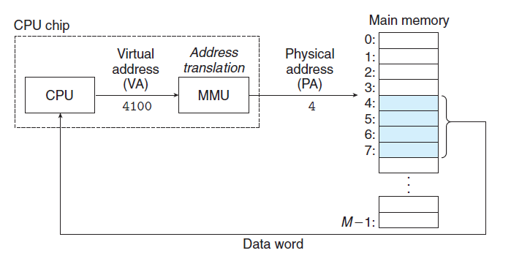

Slide 14
Consider a Scenario
Main Memory
Size of Main Memory = 64 Bytes
Frame Size = 4 Bytes
Number of Frames = 64/4 = 16
Process
Size of Process = 16 Bytes
Page Size = 4 Bytes
Number of Pages = 16/4 = 4

Slide 15
Paging
How does the MMU get the Physical address of B14 in Main Memory?!!
Main Memory
Frame 0
B0 | B1 | B2 | B3
B4 | B5 | B6 | B7
B8 | B9 | B10 | B11
B12 | B13 | B14 | B15
B16 | B17 | B18 | B19
B20 | B21 | B22 | B23
… … …
B56 | B57 | B58 | B59
B60 | B61 | B62 | B63
Process P1
Frame 1
B0 | B1 | B2 | B3
B4 | B5 | B6 | B7
B8 | B9 | B10 | B11
B12 | B13 | B14 | B15
Frame 2
Page 0
Frame 3
Process P1
Page 1
Frame 4
Frame 5
Page 2
Page 3
CPU
VA of B6
= 0110
MMU
PA of B14
Frame 14
Frame 15

Slide 16
Process P1
Main Memory
B0 | B1 | B2 | B3
B4 | B5 | B6 | B7
B8 | B9 | B10 | B11
B12 | B13 | B14 | B15
CPU
Page 0
Frame 0
B0 | B1 | B2 | B3
B4 | B5 | B6 | B7
B8 | B9 | B10 | B11
B12 | B13 | B14 | B15
B16 | B17 | B18 | B19
B20 | B21 | B22 | B23
… … …
B56 | B57 | B58 | B59
B60 | B61 | B62 | B63
VA of B6
= 0110
Frame 1
Page 1
Frame 2
Page 2
Frame 3
Process P1
Frame 4
Page 3
MMU
Frame 5
Page Table of Process P1
Frame 2
Frame 3
Frame 4
Frame 5
Page 0
Page 1
PA of B14
= 001110
Frame 14
Page 2
Frame 15
Page 3
How many bits is the Physical Address?

Slide 17
Related Links
You can refer to the following links to know more about virtual memory, how frames are allocated to processes and about the page replacement policies.
Allocation of frames in Operating Systems
Page Replacement Algorithms in Operating Systems
Virtual Memory

Slide 18
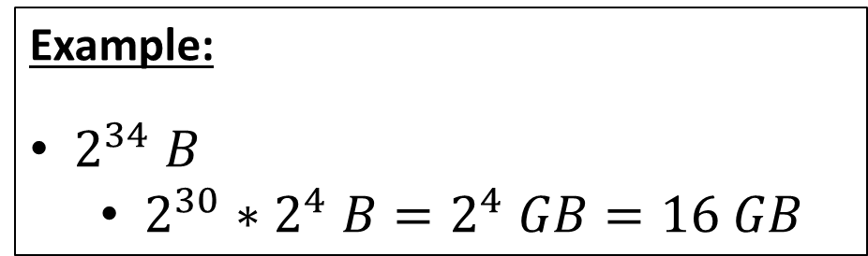
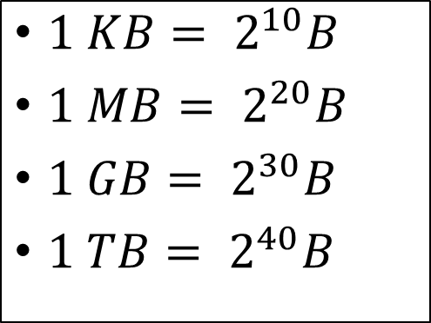
Some Important Byte Conversions
$1 KB= 2^{10}B$
$1 MB= 2^{20}B$
$1 GB= 2^{30}B$
$1 TB= 2^{40}B$
Example:
$2^{34} B$
$2^{30}∗2^{4} B=2^{4} GB=16 GB$

Slide 19
Exercise
Physical Address Space (PAS)
Size of Main Memory
Virtual Address Space (VAS)
Size of the process
PAS = 128 KB
VAS = 128 KB
How many bits for PA?
17
How many bits for VA?
17

Slide 20
Exercise
Physical Address Space (PAS)
Size of Main Memory
Virtual Address Space (VAS)
Size of the process
PAS = 128 KB
VAS = 128 KB
Page Size = 4 KB
How many bits for the page offset?
12 bits

Slide 21
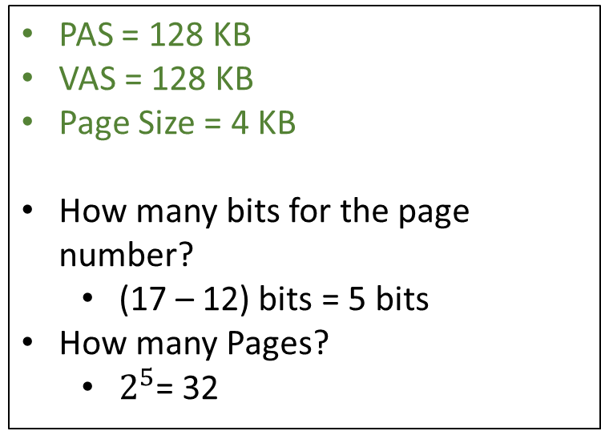
Exercise
Physical Address Space (PAS)
Size of Main Memory
Virtual Address Space (VAS)
Size of the process
PAS = 128 KB
VAS = 128 KB
Page Size = 4 KB
How many bits for the page number?
(17 – 12) bits = 5 bits
How many Pages?
$2^{5}$= 32

Slide 22

Exercise
Physical Address Space (PAS)
Size of Main Memory
Virtual Address Space (VAS)
Size of the process
PAS = 128 KB
VAS = 128 KB
Page Size = 4 KB
How many bits for the Frame number?
(17 – 12) bits = 5 bits
How many Frames?
$2^{5}$= 32

Slide 23
Exercise
Physical Address Space (PAS)
Size of Main Memory
Virtual Address Space (VAS)
Size of the process
PAS = 128 KB
VAS = 128 KB
Page Size = 4 KB
How many bits for a Page Table Entry (PTE)?
5 bits
*For this example, we assume that a page table entry contains only the bits to represent the Frame Number.

Slide 24
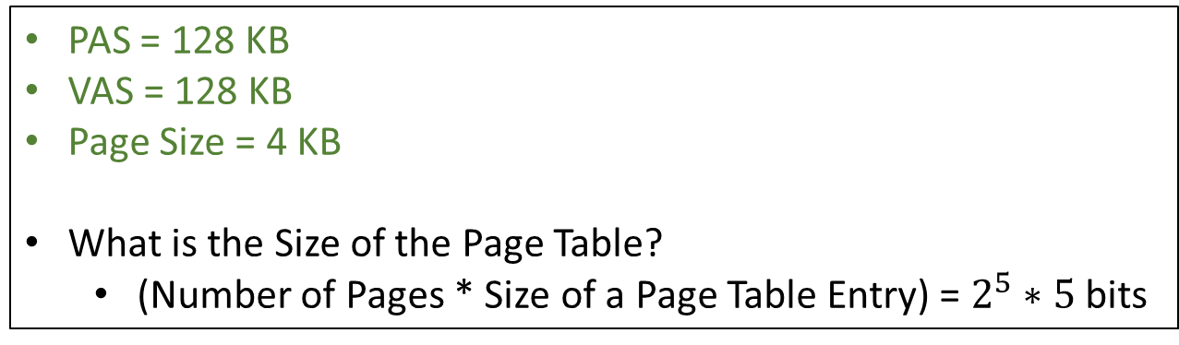
Exercise
Physical Address Space (PAS)
Size of Main Memory
Virtual Address Space (VAS)
Size of the process
PAS = 128 KB
VAS = 128 KB
Page Size = 4 KB
What is the Size of the Page Table?
(Number of Pages * Size of a Page Table Entry) = $2^{5}∗5$ bits
*For this example, we assume that a page table entry contains only the bits to represent the Frame Number.

Slide 25
Exercise 2
$For this example, we assume that a page table entry contains only the bits to represent the Frame Number.
VAS | PAS | VA | PA | Page Size | Page Offset | # of Virtual Pages | # of Physical Pages(or frames) | PTE$ | Size of Page Table
1 MB |  |  |  |  | 10 |  | 256

Slide 26
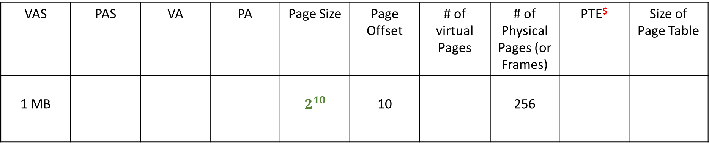
Exercise 2
$For this example, we assume that a page table entry contains only the bits to represent the Frame Number.
VAS | PAS | VA | PA | Page Size | Page Offset | # of virtual Pages | # of Physical Pages (or Frames) | PTE$ | Size of Page Table
1 MB |  |  |  | $$2^{10}$$ | 10 |  | 256

Slide 27
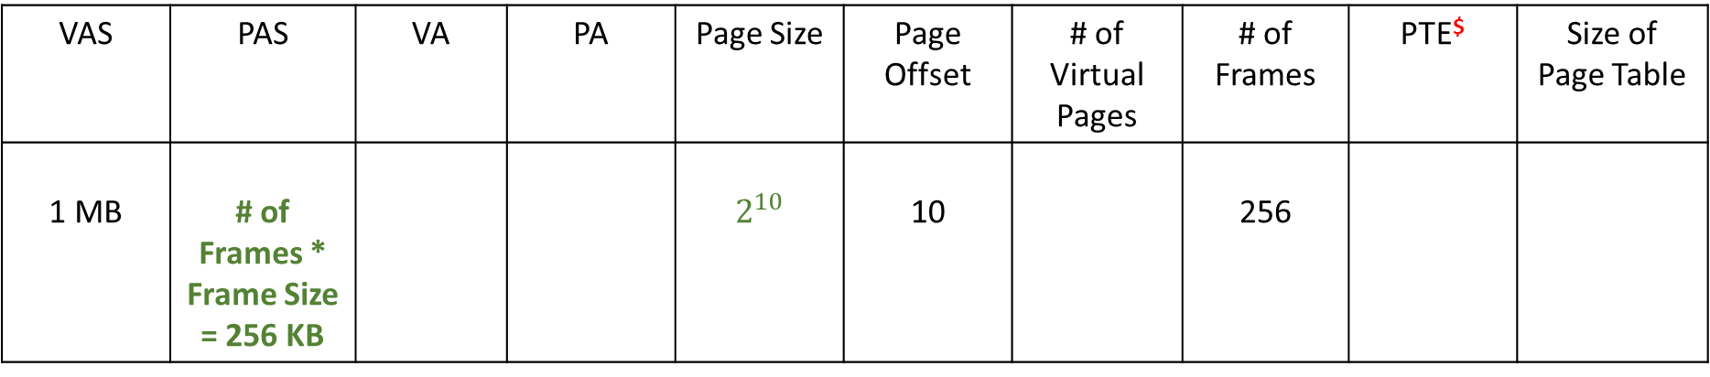
Exercise 2
$For this example, we assume that a page table entry contains only the bits to represent the Frame Number.
VAS | PAS | VA | PA | Page Size | Page Offset | # of Virtual Pages | # of Frames | PTE$ | Size of Page Table
1 MB | # of Frames * Frame Size = 256 KB |  |  | $$2^{10}$$ | 10 |  | 256

Slide 28
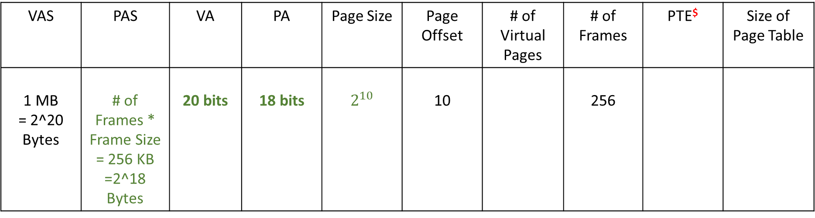
Exercise 2
$For this example, we assume that a page table entry contains only the bits to represent the Frame Number.
VAS | PAS | VA | PA | Page Size | Page Offset | # of Virtual Pages | # of Frames | PTE$ | Size of Page Table
1 MB = 2^20 Bytes | # of Frames * Frame Size = 256 KB =2^18 Bytes | 20 bits | 18 bits | $$2^{10}$$ | 10 |  | 256

Slide 29
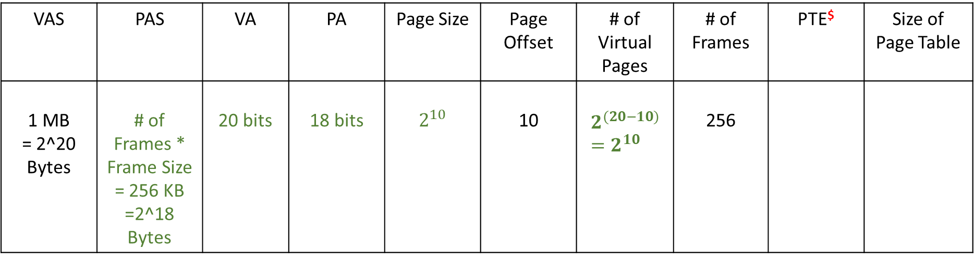
Exercise 2
$For this example, we assume that a page table entry contains only the bits to represent the Frame Number.
VAS | PAS | VA | PA | Page Size | Page Offset | # of Virtual Pages | # of Frames | PTE$ | Size of Page Table
1 MB = 2^20 Bytes | # of Frames * Frame Size = 256 KB =2^18 Bytes | 20 bits | 18 bits | $$2^{10}$$ | 10 | $$2^{(20−10)}=2^{10}$$ | 256

Slide 30
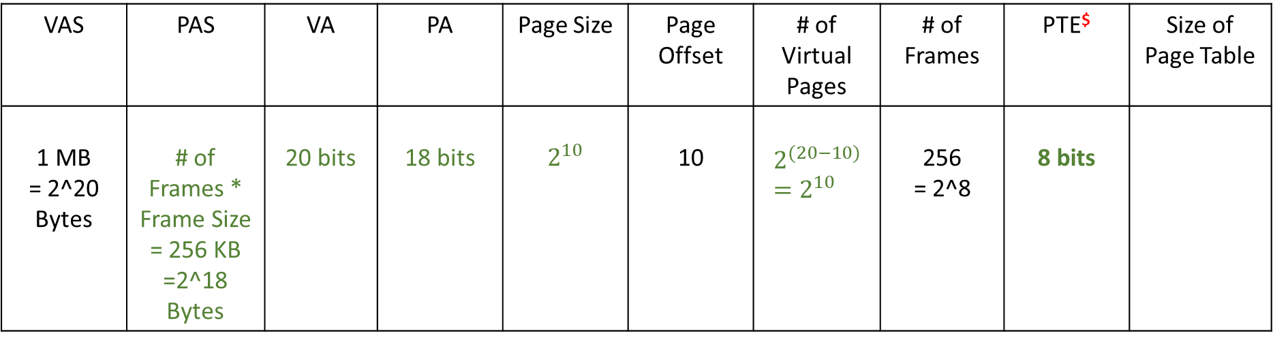
Exercise 2
$For this example, we assume that a page table entry contains only the bits to represent the Frame Number.
VAS | PAS | VA | PA | Page Size | Page Offset | # of Virtual Pages | # of Frames | PTE$ | Size of Page Table
1 MB = 2^20 Bytes | # of Frames * Frame Size = 256 KB =2^18 Bytes | 20 bits | 18 bits | $$2^{10}$$ | 10 | $$2^{(20−10)}=2^{10}$$ | 256 = 2^8 | 8 bits

Slide 31
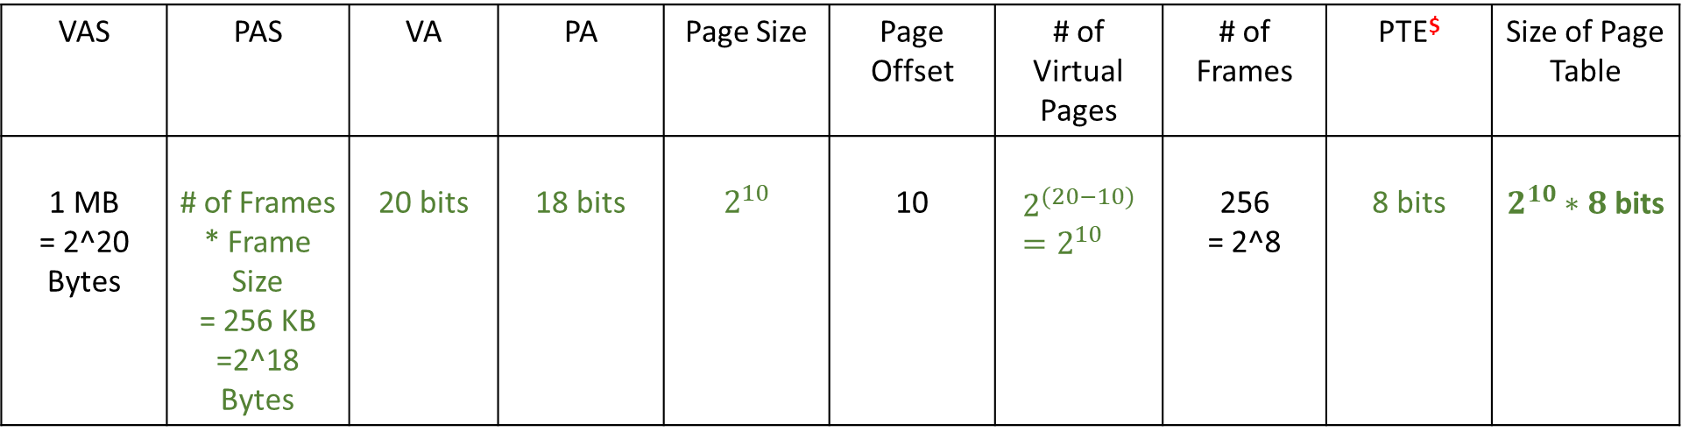
Exercise 2
$For this example, we assume that a page table entry contains only the bits to represent the Frame Number.
VAS | PAS | VA | PA | Page Size | Page Offset | # of Virtual Pages | # of Frames | PTE$ | Size of Page Table
1 MB = 2^20 Bytes | # of Frames * Frame Size = 256 KB =2^18 Bytes | 20 bits | 18 bits | $$2^{10}$$ | 10 | $$2^{(20−10)}=2^{10}$$ | 256 = 2^8 | 8 bits | $2^{10}∗8$ bits

Slide 32
TLB

Slide 33
Virtual Address
Main Memory/Cache
VPN | PO
Page Table
VPN 1
PTE
PTE
PTE
.. ..
MMU
VPN
VPN 2
PPN
VPN 3
…
…
Physical Address
PPN | PO

Slide 34
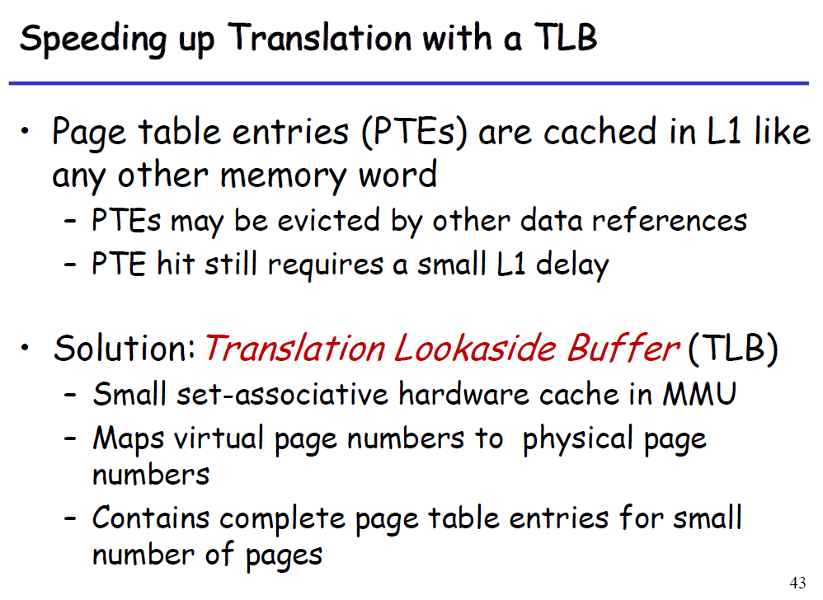

Slide 35
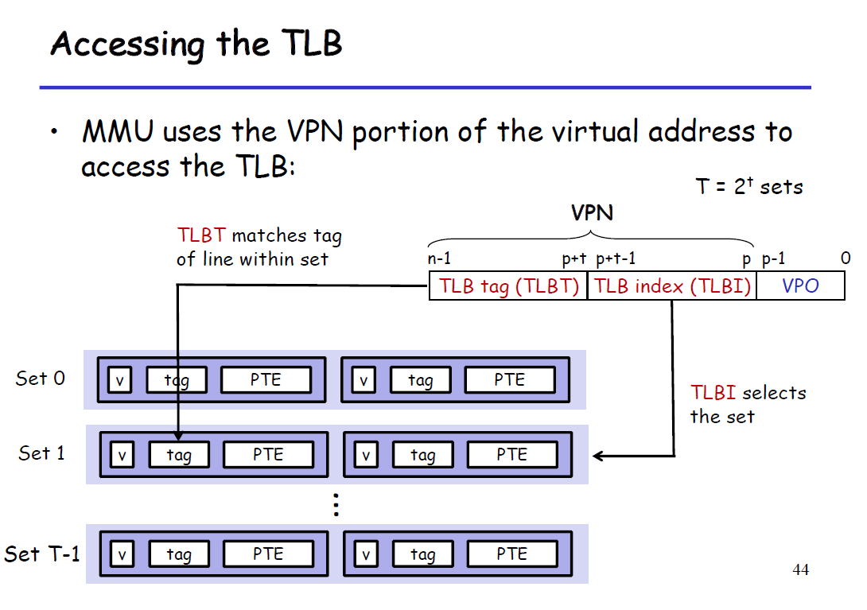

Slide 36
VPN
TLB Tag | TLB Index | PO
2-way set associative TLB
Virtual Address
Valid Bit
TLB HIT!!
Tag
0
1
2
3
…
…
…
PTE
PTE
PTE
PTE
…
TLB Index, Tag
Set 0
MMU
PPN
Set 1
Physical Address
PPN | PO

Slide 37
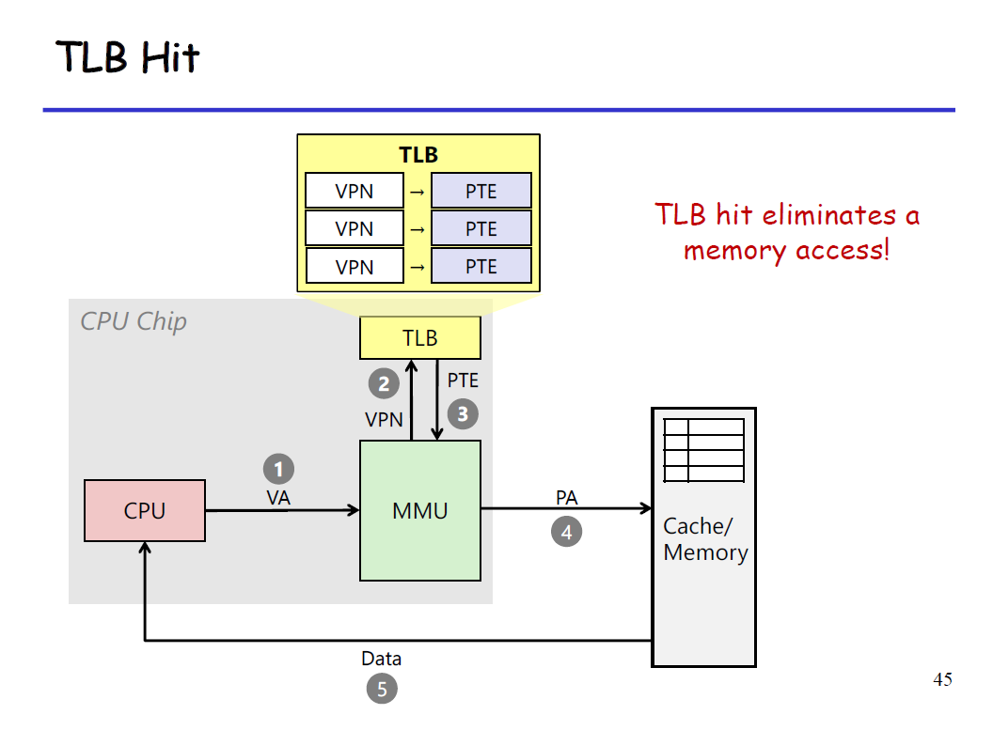

Slide 38
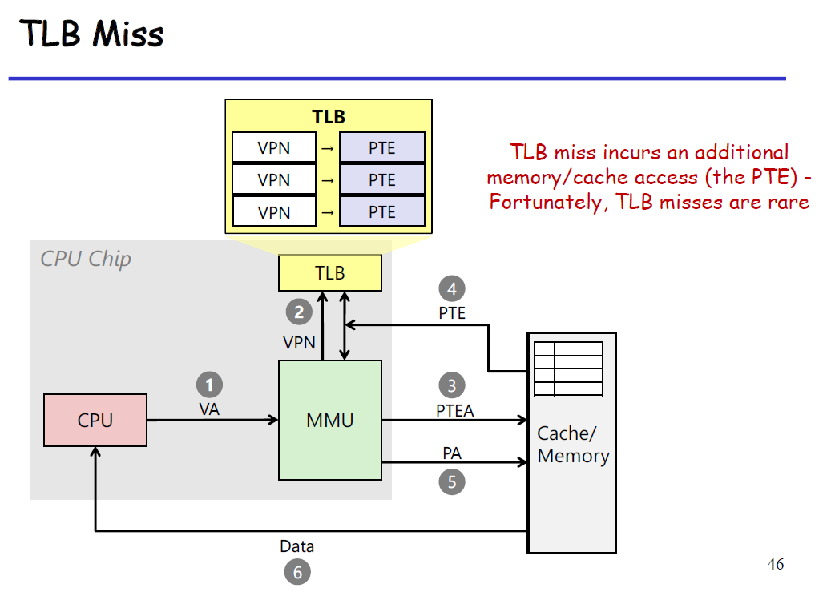

Slide 39
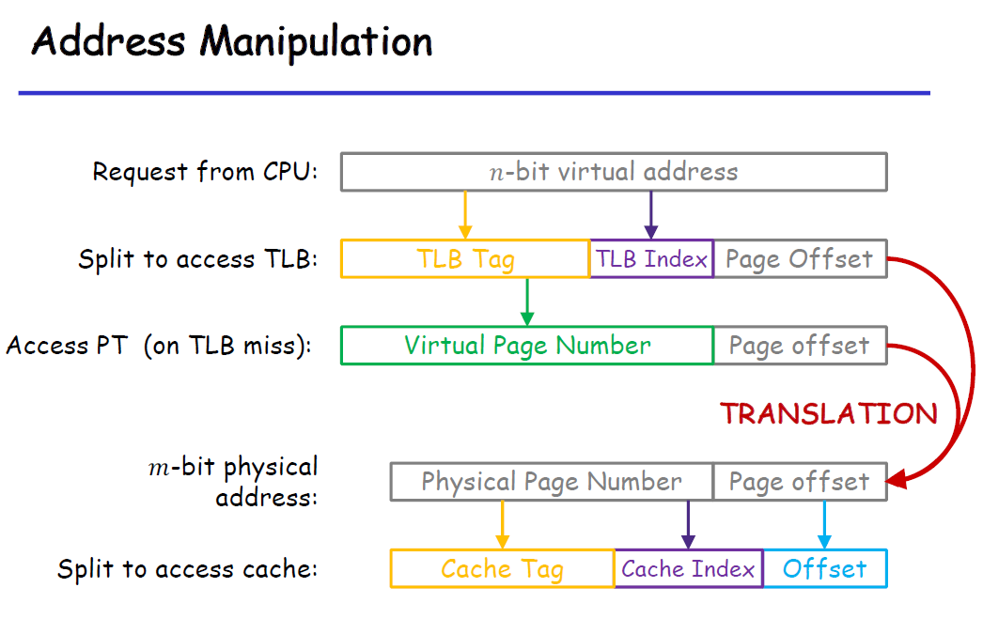

Slide 40
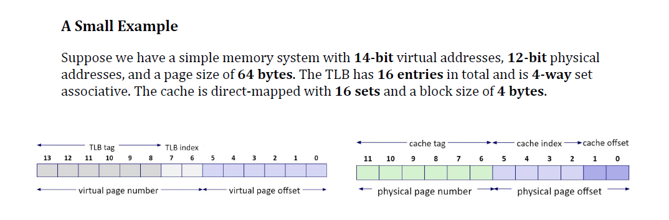
Cache Tutorial

Slide 41
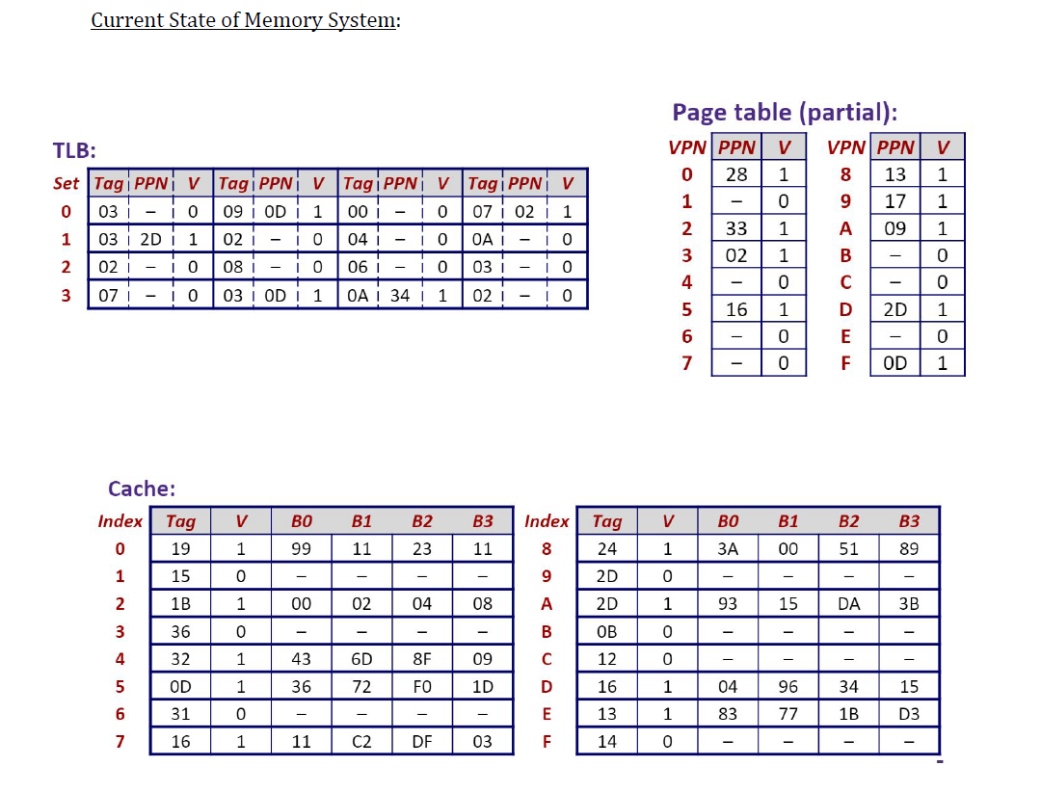

Slide 42
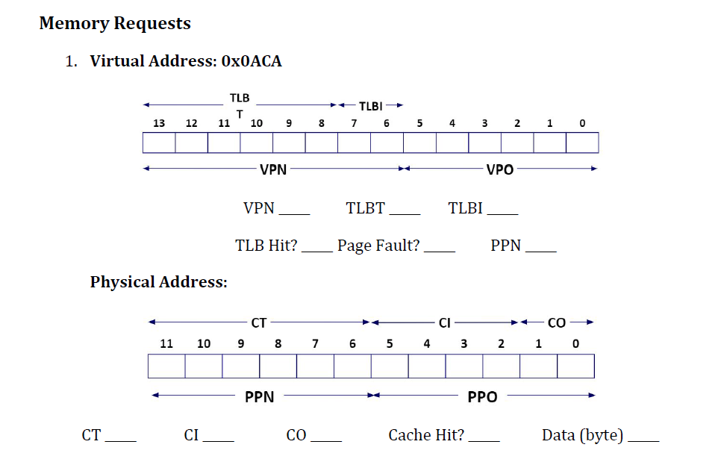

Slide 43
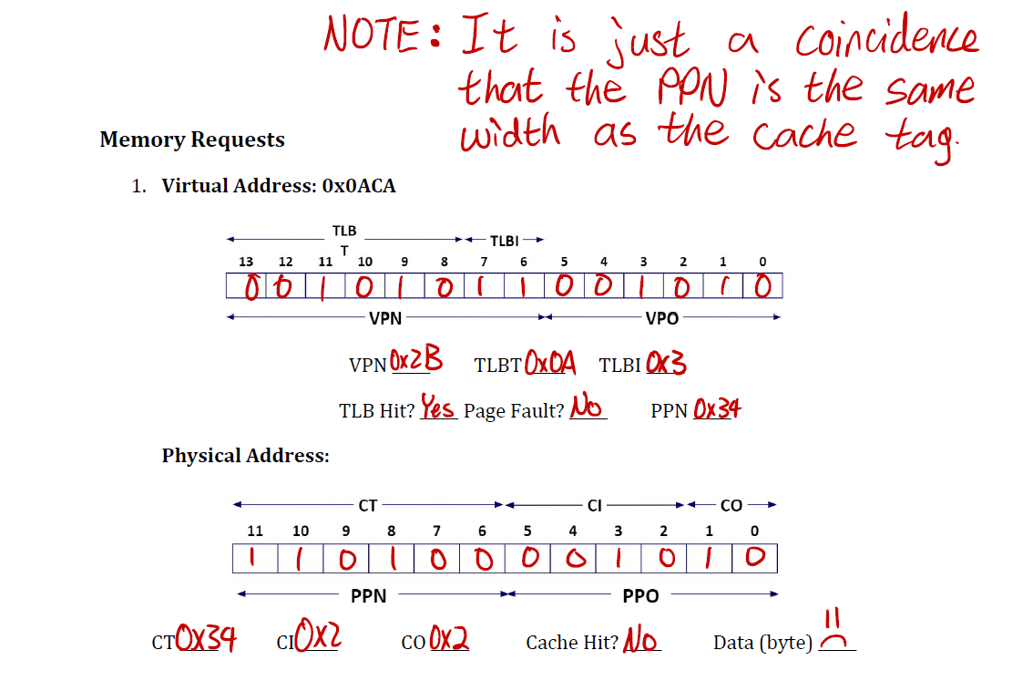

Slide 44
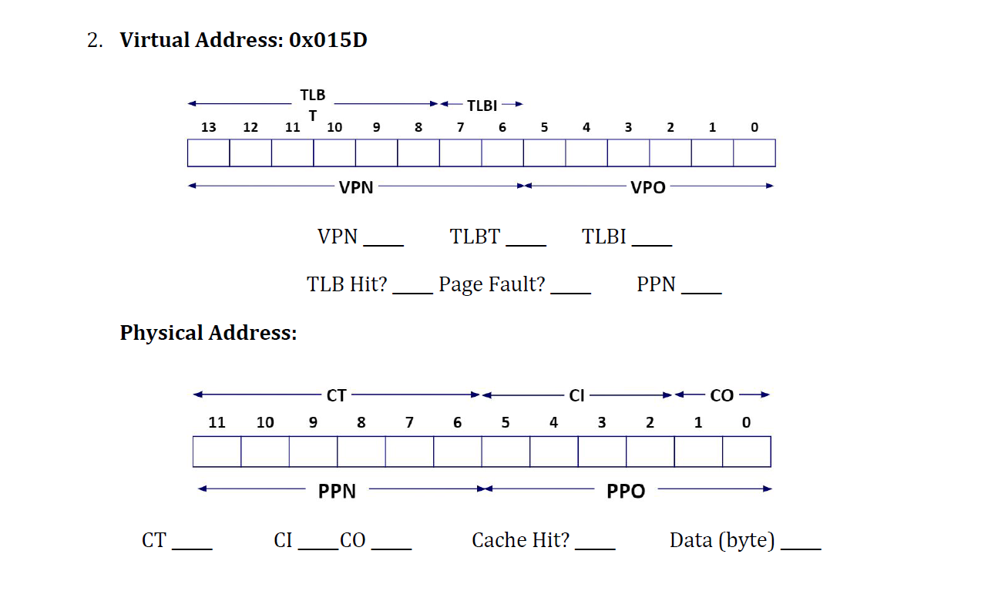

Slide 45
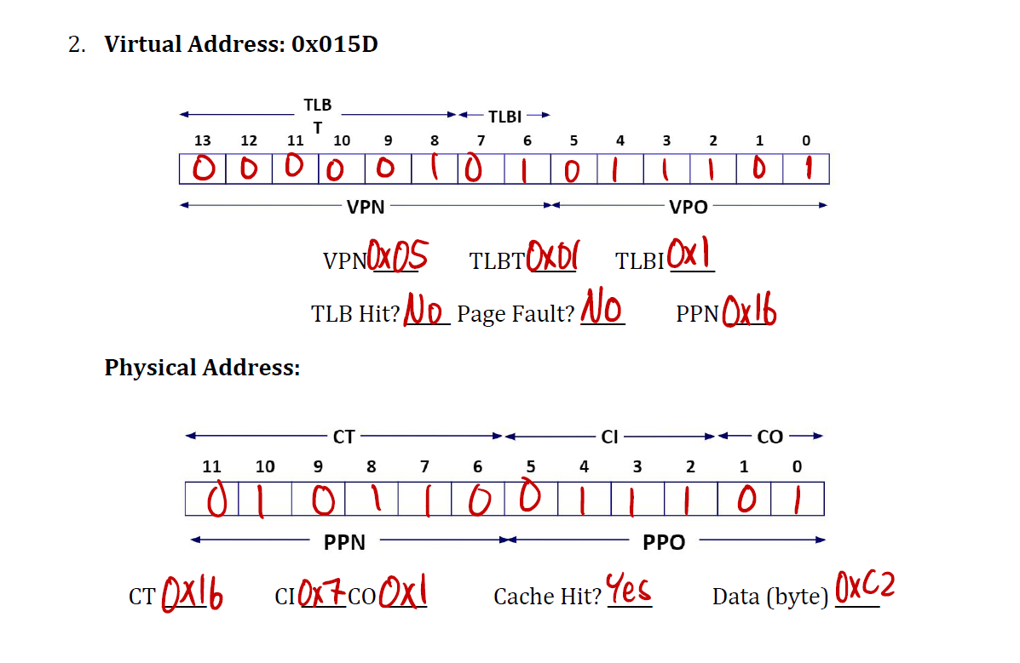

Slide 46
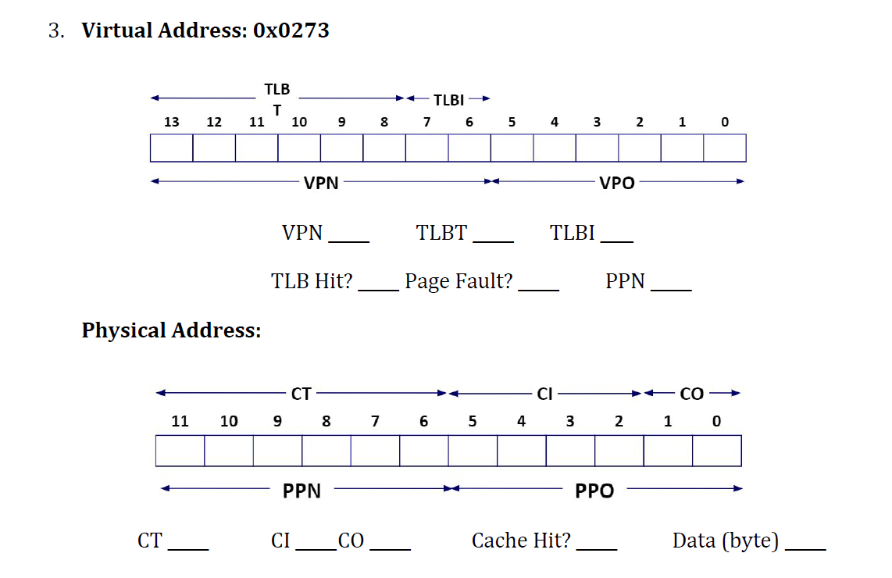

Slide 47
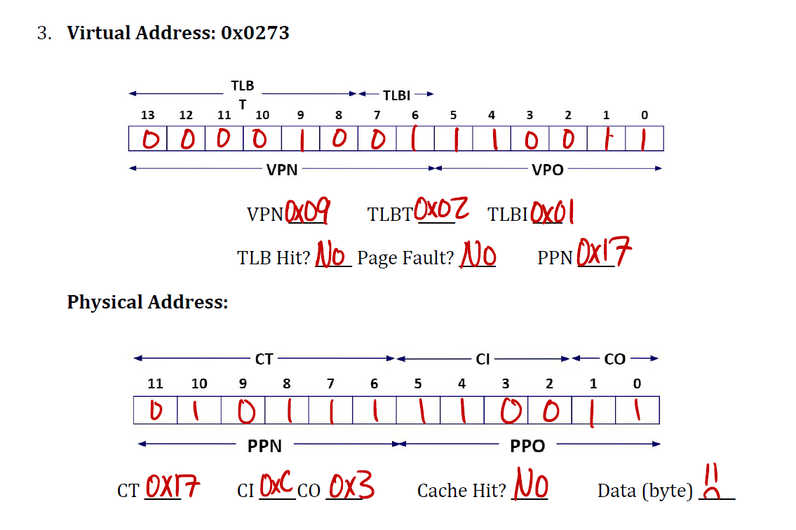

Slide 48
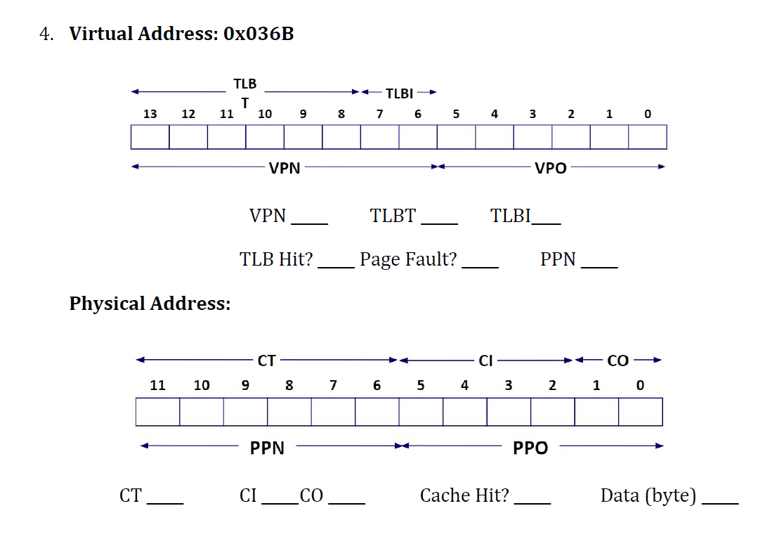

Slide 49
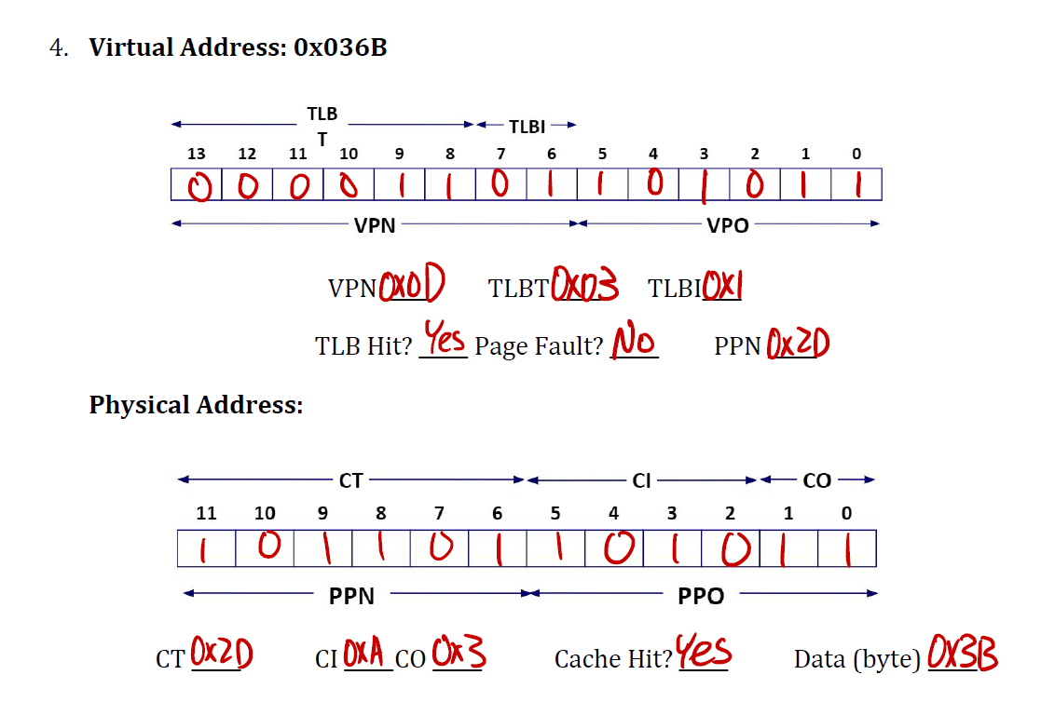

Slide 50
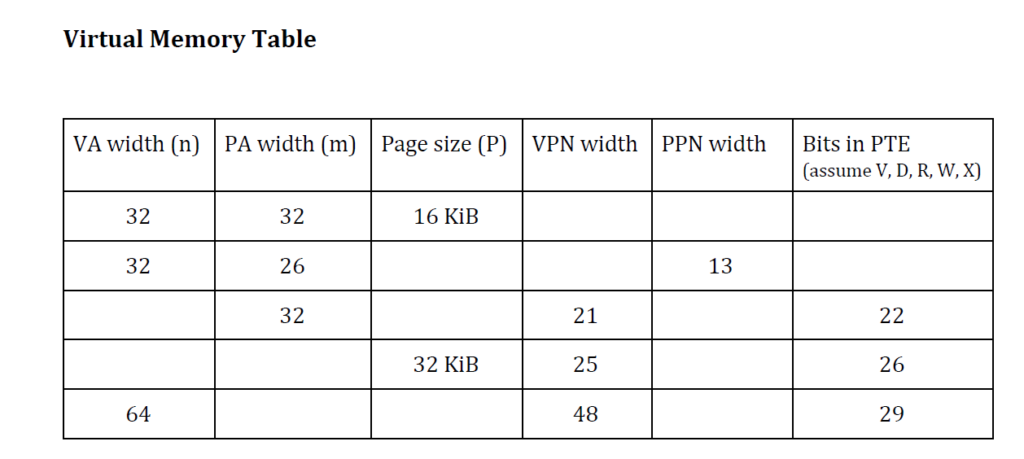

Slide 51
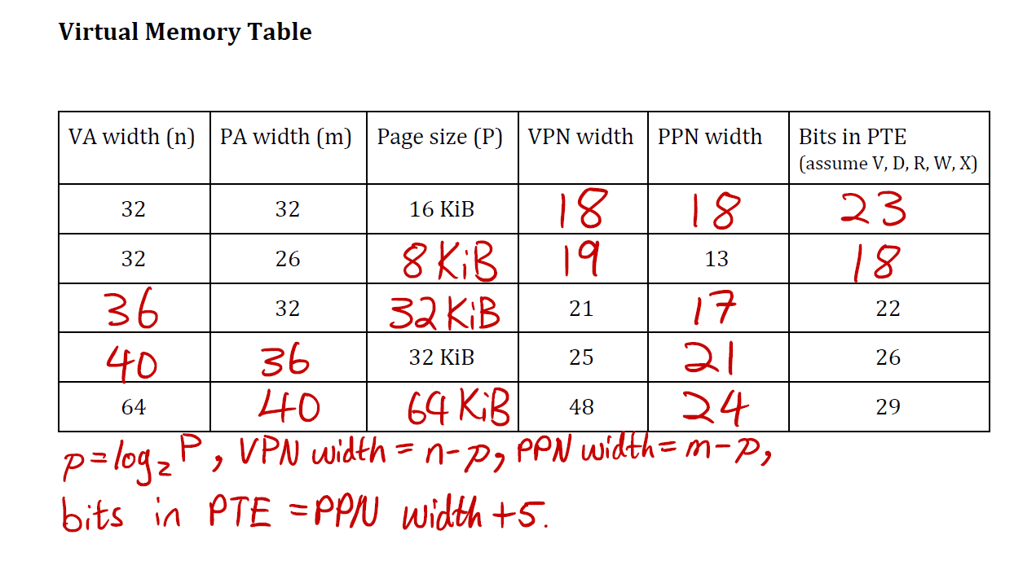

Slide 52
References
https://www.youtube.com/watch?v=2i2N_Qo_FyM&list=PLEbnTDJUr_If_BnzJkkN_J0Tl3iXTL8vq
https://www.geeksforgeeks.org/multilevel-paging-in-operating-system/
https://ravindrababuravula.com/index.php

