Slide 1
More x86-64, Assembly Lab

Slide 2
Condition Codes
cmpq op2, op1 # computes result = op1 - op2, discards result, sets condition codes
testq op2, op1 # computes result = op1 & op2, discards result, sets condition codes
Condition Codes - ZF (zero flag), SF (sign flag), OF (overflow flag, signed), and CF (carry flag, unsigned)

Slide 3
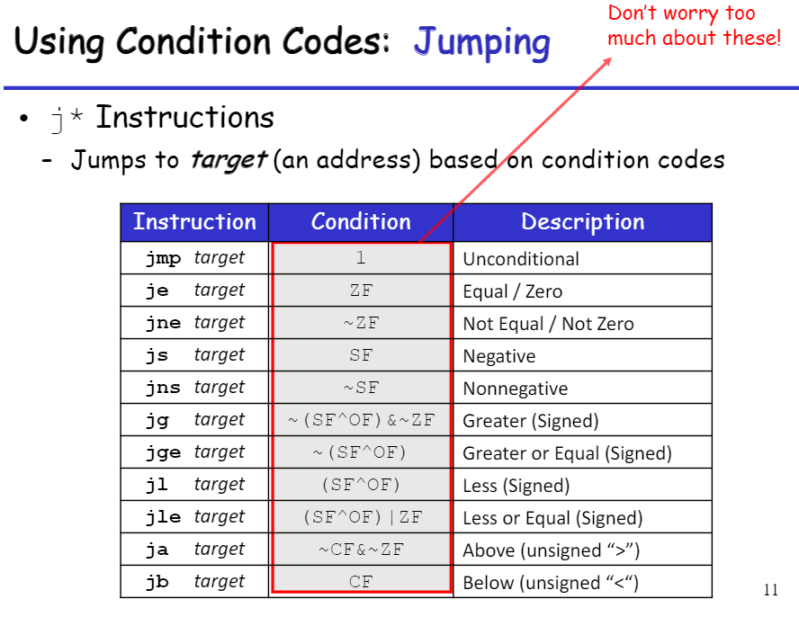

Slide 4
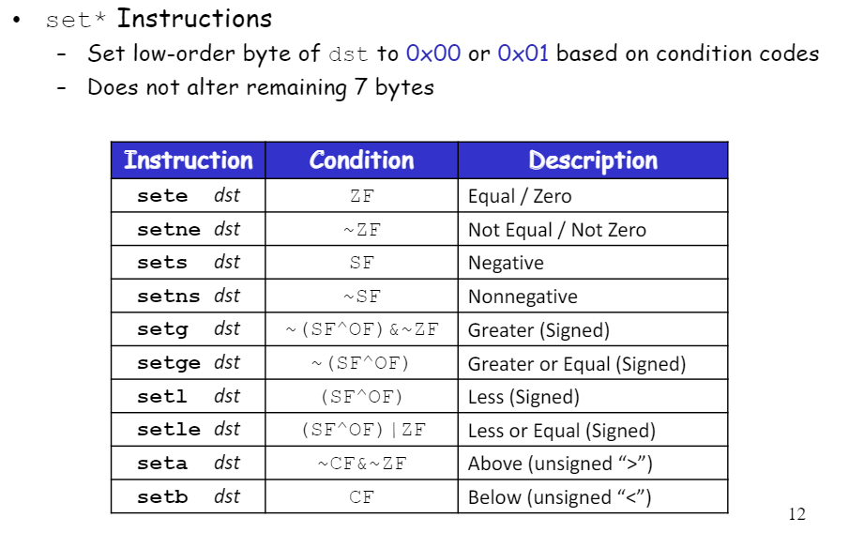

Slide 5
Exercise 1
int compound(int x, int y)
{
______________
return 1;
else
return 2;
}
compound:
cmpl $-48, %edi
jl .L3 movl $1, %eax
ret
.L3:
movl $2, %eax
ret

Slide 6
Exercise 1
int compound(int x, int y)
{
if(x > -49)
return 1;
else
return 2;
}
compound:
cmpl $-48, %edi
jl .L3 movl $1, %eax
ret
.L3:
movl $2, %eax
ret

Slide 7
Exercise 2
…
…
movl $0xABCD, %eax
movl $0x1BCD, %edi
cmpl %edi, %eax
setg %al
…
…
What is the final value of %al?
0000 0001
What is the final value of %eax?
0xAB01

Slide 8
Exercise 3
compound:
cmpl %esi, %edi
jle .L2
cmpl $5, %esi
jle .L3
addl $3, %edi
.L2:
leal (%rdi,%rsi), %eax
ret
.L3:
cmpl %esi, 4(%rdx)
je .L4
addl %edi, %esi
jmp .L2
.L4:
addl $5, %esi
jmp .L2
int compound(int x, int y, int *z) {
if(_____){
if (_____){
x = _____;
}
else if(_____){
y = _____;
}
else{
y = _____;
}
}
return x + y;
}

Slide 9
Exercise 3
compound:
cmpl %esi, %edi
jle .L2
cmpl $5, %esi
jle .L3
addl $3, %edi
.L2:
leal (%rdi,%rsi), %eax
ret
.L3:
cmpl %esi, 4(%rdx)
je .L4
addl %edi, %esi
jmp .L2
.L4:
addl $5, %esi
jmp .L2
int compound(int x, int y, int *z) {
if(x > y){
if (y > 5){
x = x + 3;
}
else if(y != *(z+1)){
y = y + x;
}
else{
y = y + 5;
}
}
return x + y;
}

Slide 10
Push and Pop to Memory stack
pushq %rbp
…
…
%rsp
0x0..108
Some value

Slide 11
Push and Pop to Memory stack
0xFFF…
pushq %rbp
…
…
pop %rbp
0x0..108
Some value
%rsp
0x0..100
rbp

Slide 12
Push and Pop to Memory stack
pushq %rbp
…
…
pop %rbp
%rsp
0x0..108
Some value

Slide 13
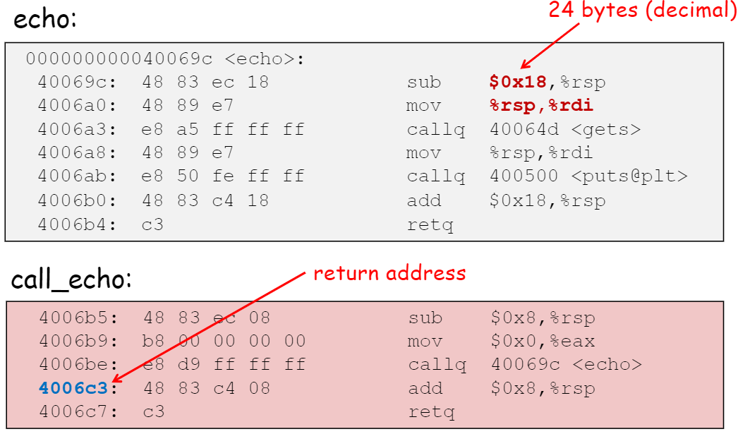
After echo() finishes execution, the return address 4006c3 is popped from the stack
call to function echo() pushes the return address 4006c3 to the stack

Slide 14
Functions and Memory Stack
Some data
int add(int x, int y)
{ return x+y;
}
int double_sum(int x, int y){ return 2*add(x,y);
}
int main() {
int b = double_sum(10, 20); return 0;
}
b
Main
rsp

Slide 15
Functions and Memory Stack
Some data
int add(int x, int y)
{ return x+y;
}
int double_sum(int x, int y){ return 2*add(x,y);
}
int main() {
int b = double_sum(10, 20); return 0;
}
b
main
return address in main
x
double_sum
y
rsp

Slide 16
Functions and Memory Stack
Some data
int add(int x, int y)
{ return x+y;
}
int double_sum(int x, int y){ return 2*add(x,y);
}
int main() {
int b = double_sum(10, 20); return 0;
}
b
main
return address in main
x
double_sum
y
return address in double_sum
x
add
y
rsp

Slide 17
Functions and Memory Stack
Some data
int add(int x, int y)
{ return x+y;
}
int double_sum(int x, int y){
return 2*add(x,y);
}
int main() {
int b = double_sum(10, 20); return 0;
}
b
main
return address in main
x
double_sum
y
rsp

Slide 18
Functions and Memory Stack
Some data
int add(int x, int y)
{ return x+y;
}
int double_sum(int x, int y){
return 2*add(x,y);
}
int main() {
int b = double_sum(10, 20); return 0;
}
b
main
rsp

Slide 19
Functions and Memory Stack
Some data
rsp
int add(int x, int y)
{ return x+y;
}
int double_sum(int x, int y){
return 2*add(x,y);
}
int main() {
int b = double_sum(10, 20); return 0;
}

Slide 20
Reverse Engineering a x86 code to C code - I
.LFBO
pushq %rbp
movq %rsp,%rbp
movl %edi,-4(%rbp)
movl %esi,-8(%rbp)
movl -4(%rbp),%eax
cmpl -8(%rbp),%eax
jg .L2
movl -8(%rbp),%eax
jmp .L3
.L2:
movl -4(%rbp),%eax
.L3:
popq %rbp
ret
int LFBO (int edi, int esi)
{
rbp = rsp
[rbp - 4] = edi
[rbp - 8] = esi
eax = [rbp - 4]
if (eax > [rbp - 8]) goto L2
eax = [rbp - 8]
goto L3
L2:
eax = [rbp - 4]
L3:
return eax
}
Step 1

Slide 21
Reverse Engineering a x86 code to C code - I
int LFBO (int edi, int esi)
{
rbp = rsp
[rbp - 4] = edi
[rbp - 8] = esi
eax = [rbp - 4]
if (eax > [rbp - 8]) goto L2
eax = [rbp - 8]
goto L3
L2:
eax = [rbp - 4]
L3:
return eax
}
int LFBO (int edi, int esi)
{
int eax;
eax = edi;
if (eax > esi) goto L2;
eax = esi;
goto L3;
L2:
eax = edi;
L3:
return eax;
}
Step 2

Slide 22
Reverse Engineering a x86 code to C code - I
int LFBO (int edi, int esi)
{
int eax;
eax = edi;
if (eax > esi) goto L2;
eax = esi;
goto L3;
L2:
eax = edi;
L3:
return eax;
}
int LFBO (int edi, int esi)
{
if (edi <= esi) {
return esi;
}
else {
return edi;
}
}
Step 3

Slide 23
Reverse Engineering a x86 code to C code - I
int LFBO (int edi, int esi)
{
if (edi <= esi) {
return esi;
}
else {
return edi;
}
}
int LFBO (int x, int y)
{
if (x <= y) {
return y;
}
else {
return x;
}
}
Step 4
int LFBO (int x, int y)
{
return (x > y) ? x : y;
}
Step 5

Slide 24
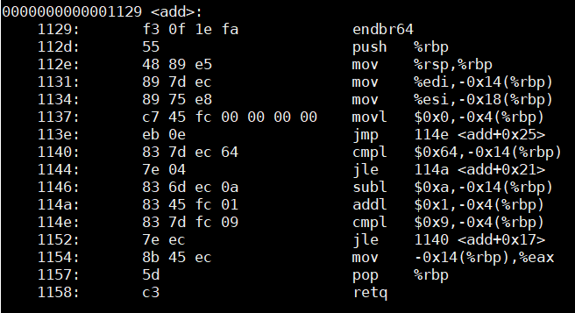
Pseudocode 1
Reverse Engineer the following x86-64 code to C code
add (int edi, int esi)
{ rbp = rsp
[rbp-0x14]= edi
[rbp-0x18]= esi
[rbp -0x4] = 0
goto L1
L3:if [rbp-0x14]<=$0x64
goto L2
[rbp-0x14]-= 0xa
L2:[rbp -0x4] +=1
L1:if [rbp -0x4] <=0x9
goto L3
eax = [rbp-0x14]
}

Slide 25
Pseudocode 1
Pseudocode 2
add (int edi, int esi)
{ rbp = rsp
[rbp-0x14]= edi
[rbp-0x18]= esi
[rbp -0x4] = 0
goto L1
L3: if [rbp-0x14]<=$0x64
goto L2
[rbp-0x14]-= 0xa
L2: [rbp -0x4] +=1
L1: if [rbp -0x4] <=0x9
goto L3
eax = [rbp-0x14]
}
add(int edi, int esi)
{
int i = 0
while i <= 0x9
{
if edi > 0x64
edi -= 0xa
i ++
}
return edi
}

Slide 26
Pseudocode 2
C code
add(int edi, int esi)
{
i = 0
while i <= 0x9{
if edi > 0x64
edi -= 0xa
i ++
}
return edi
}
add (int x, int y)
{
i = 0;
while (i <= 9){
if (x > 100)
x -= 10;
i ++;
}
return x;
}

Slide 27
Assembly Lab
Refer to the Panopto video

