Slide 1
x86-64

Slide 2
Agenda
x86-64
Concepts
Exercises
Demo

Slide 3
Example of Memory Stack and Heap
Stack_Heap_Link

Slide 4
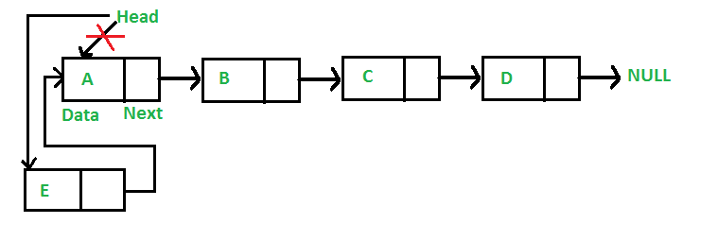
Insertion – At the front
Check the top answer(answer with most votes) in this LINK to see why head is passed as a double pointer.
void insert_front(struct Node** head, int new_data) {
/* 1. allocate node */
struct Node* new_node = (struct Node*) malloc(sizeof(struct Node));
/* 2. put in the data */
new_node->data = new_data;
/* 3. Make next of new node as head */
new_node->next = (*head);
/* 4. move the head to point to the new node */
(*head) = new_node;
}

Slide 5
Registers
A register is a location within the processor that is able to store data
Names, not addresses
Much faster than DRAM
Can hold any value: addresses, values from operations, characters etc.
Usually, register
%rip stores the address of the next instruction
%rsp is used as a stack pointer
%rax holds the return value from a function
A register in x86-64 is 64 bits wide
‘The lower 32-, 16- and 8-bit portions are selectable by a pseudo-register name’.

Slide 6
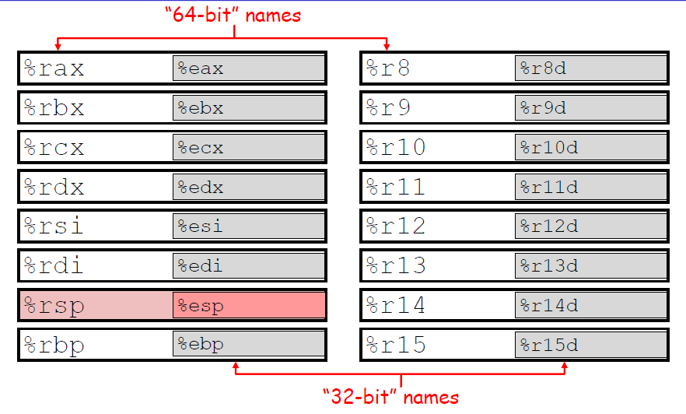

Slide 7
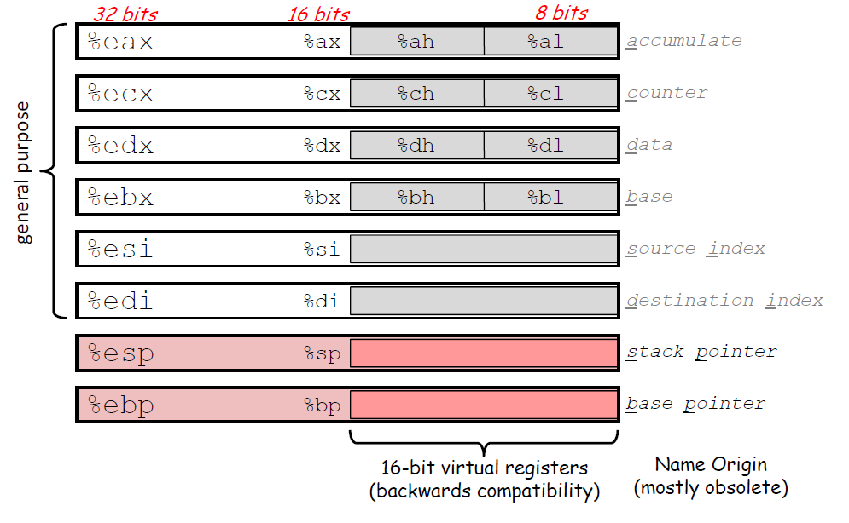

Slide 8
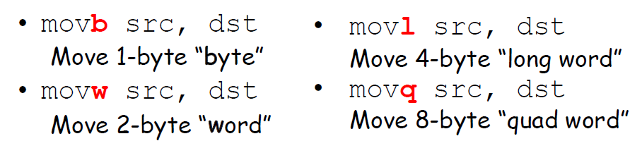
mov
movq src, dst # general form of instruction dst = src
movl $0, %eax # %eax = 0
movq %rax, $100 #Invalid!! destination cannot be an immediate value
movsbl %al, %edx # copy 1-byte %al, sign-extend into 4-byte %edx
movzbl %al, %edx # copy 1-byte %al, zero-extend into 4-byte %edx

Slide 9
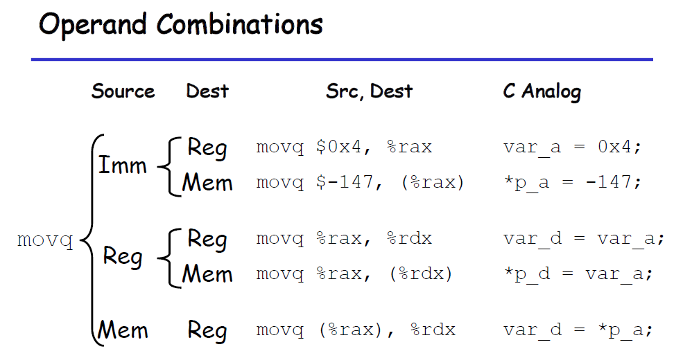

Slide 10
Addressing Modes
‘An addressing mode is an expression that calculates an address in memory to be read/written to.’
General expression
D (Rb, Ri, S) = Mem[Reg[Rb]+Reg[Ri]*S+D]

Slide 11
Addressing Modes - Example
movq %rdi, 0x568892 # direct (address is constant value)
movq %rdi, (%rax) # indirect (address is in register %rax)
mov (%rsi), %rdi #%rdi = Mem[%rsi]
movq %rdi,-24(%rbp) # indirect with displacement (address = %rbp -24)
movq %rsi, 8(%rsp, %rdi, 4)
# indirect with displacement and scaled-index (address = 8 + %rsp + %rdi*4)
movq %rsi, 0x4(%rax, %rcx) #Mem[0x4 + %rax +%rcx*1] = %rsi
movq %rsi, 0x8(, %rdx, 4) #Mem(0x8 + %rdx*4) = %rsi

Slide 12
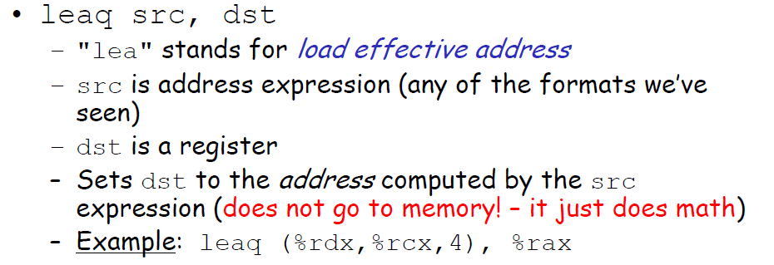
lea

Slide 13
lea
lea or Load effective address
Does not dereference the source address, it simply calculates its location.
leaq 0x20(%rsp), %rdi # %rdi = %rsp + 0x20 (no dereference!)
leaq (%rdi,%rdx,1), %rax # %rax = %rdi + %rdx * 1

Slide 14
Exercise 1
int compound(int y)
{
int *t3 = &y;
*t3 = *t3 + *t3;
return *t3;
}
compound:
_________________
ret

Slide 15
Exercise 1
int compound(int y)
{
int *t3 = &y;
*t3 = *t3 + *t3;
return *t3;
}
compound:
leal (%rdi,%rdi), %eax
ret

Slide 16
Exercise 2
int compound(int x, int y)
{
int a[2] = {x, y};
int z = a[0];
int y1 = z + a[1];
int *y2 = &y1;
return *y2;
}
compound:
_________________
ret

Slide 17
Exercise 2
int compound(int x, int y)
{
int a[2] = {x, y};
int z = a[0];
int y1 = z + a[1];
int *y2 = &y1;
return *y2;
}
compound:
leal (%rdi,%rsi), %eax
ret

Slide 18
Example
long compound(long *xp, long *yp, long *zp) {
long t0 = *xp;
long t1 = *yp;
long t10 = *zp;
long t15 = 15;
long t2 = t0 + t1 + t10 - t15;
long t3 = t2 + t2;
return t2;
}
compound:
movq (%rsi), %rax
addq (%rdi), %rax
addq (%rdx), %rax
subq $15, %rax
ret

Slide 19
Exercise 3
int pointer1(int *x)
{
return *(x+1);
}
pointer1(int*):
____________________
ret
int* pointer2(int **x)
{
return *(x+1);
}
pointer2(int*):
____________________
ret

Slide 20
Exercise 3
int pointer1(int *x)
{
return *(x+1);
}
pointer1(int*):
movl 4(%rdi), %eax
ret
int* pointer2(int **x)
{
return *(x+1);
}
pointer2(int*):
movq 8(%rdi), %rax
ret

Slide 21
What is the C equivalent?
Intermediate Pseudo Code 1
x86-64 code
arith(int x, int y, int z)
{
ecx = edi
ecx = ecx * esi
edi = edi * edx
esi = esi * edx
eax = edi + ecx
eax = eax + esi
return eax
}
arith(int, int, int):
movl %edi, %ecx
imull %esi, %ecx
imull %edx, %edi
imull %edx, %esi
leal (%rcx,%rdi), %eax
addl %esi, %eax
ret

Slide 22
What is the C equivalent?
Intermediate Pseudo Code 1
Intermediate Pseudo Code 2
arith(int x, int y, int z)
{
ecx = edi
ecx = ecx * esi
edi = edi * edx
esi = esi * edx
eax = edi + ecx
eax = eax + esi
return eax
}
arith(int x, int y, int z)
{
ecx = x
ecx = x * y
edi = x * z
esi = y * z
eax = x * z + x * y
eax = eax + y * z
return eax
}
arith(int x, int y, int z)
{
ecx = edi
ecx = ecx * esi
edi = edi * edx
esi = esi * edx
eax = edi + ecx
eax = eax + esi
return eax
}

Slide 23
What is the C equivalent?
Intermediate Pseudo Code 2
arith(int x, int y, int z)
{
ecx = x
ecx = x * y
edi = x * z
esi = y * z
eax = x * z + x * y
eax = eax + y * z
return eax
}
C code
int arith (int x, int y, int z)
{
return x*y + x*z + y*z;
}

Slide 24
Example
Intermediate Pseudocode
x86-64 code
test(int *x, int *y, int **z)
{
eax = *(y+1)
eax = *(x+1) + *(y+1)
rdx = *(z-1)
eax = *(x+1) + *(y+1) + **(z-1)
return eax
}
test(int*, int*, int**): movl 4(%rsi), %eax
addl 4(%rdi), %eax
movq -8(%rdx), %rdx
addl (%rdx), %eax
ret

Slide 25
Example
C code
Intermediate Pseudocode
int test (int *x, int *y, int**z)
{
return *(x+1)+*(y+1)+**(z-1);
}
test(int *x, int *y, int **z)
{
eax = *(y+1)
eax = *(x+1) + *(y+1)
rdx = *(z-1)
eax = *(x+1) + *(y+1) + **(z-1)
return eax
}

Slide 26
Exercise 4
long type_cast(char a, int b, long c)
{
____________;
}
type_cast(char, int, long):
movsbl %dil, %edi
addl %edi, %esi
movslq %esi, %rsi
leaq (%rsi,%rdx), %rax
ret

Slide 27
Exercise 4
long type_cast(char a, int b, long c)
{
return a+b+c;
}
type_cast(char, int, long):
movsbl %dil, %edi
addl %edi, %esi
movslq %esi, %rsi
leaq (%rsi,%rdx), %rax
ret

Slide 28
Exercise 4.1
long type_cast(unsigned char a, int b, long c)
{
return a+b+c;
}
type_cast(unsigned char, int, long):
movzbl %dil, %edi
addl %edi, %esi
movslq %esi, %rsi
leaq (%rsi,%rdx), %rax
ret

Slide 29
Demo
Demo of using gdb and objdump
Refer to the video in Panopto.

