Slide 1
Cache Memory

Slide 2
From what we know until now
I Store data
I Process data
Main Memory
CPU
Registers
Access (read/write) data
SLOW!!
Low Bus bandwidth

Slide 3
Solution – Cache Memory
I Store data
Main Memory (DRAM)
I Store data too
I Process data
CACHE (SRAM)
CPU
Registers
+ FASTER!!
+ Closer to Processor
– More Expensive
– Smaller Capacity
BOTH SRAM and DRAM are VOLATILE memory, i.e., they require power to maintain stored information
– SLOWER
– Far from Processor
+ Cheaper
+ Larger Capacity

Slide 4
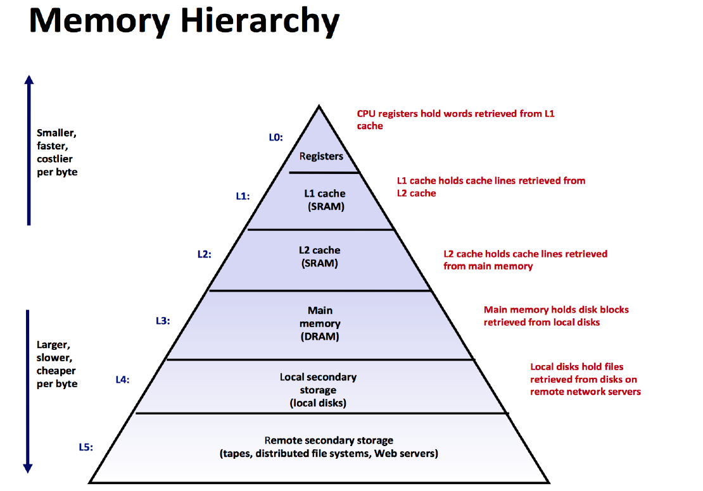

Slide 5
Looking Inside Cache and Main Memory
Main Memory
0
1
2
3
4
5
6
7
Cache
0
1
2
3
BLOCK
LINE
A collection of Cache Lines is called a Cache SET.

Slide 6
Looking Inside Cache and Main Memory
Main Memory
0
1
2
3
4
5
6
7
B0 | B1 | B2 | B3
B4 | B5 | B6 | B7
B8 | B9 | B10 | B11
B12 | B13 | B14 | B15
B16 | B17 | B18 | B19
B20 | B21 | B22 | B23
B24 | B25 | B26 | B27
B28 | B29 | B30 | B31
Cache
0
1
2
3
BLOCK
LINE
LINE SIZE = BLOCK SIZE

Slide 7
Accessing Data
Read Byte B2
CPU
Main Memory
0
1
2
3
4
5
6
7
B0 | B1 | B2 | B3
B4 | B5 | B6 | B7
B8 | B9 | B10 | B11
B12 | B13 | B14 | B15
B16 | B17 | B18 | B19
B20 | B21 | B22 | B23
B24 | B25 | B26 | B27
B28 | B29 | B30 | B31
Cache
0
1
2
3
Step 1: Search in CACHE
IF B2 exists in Cache
HIT
IF B2 NOT found in Cache
MISS
Proceed to Step 2

Slide 8

Accessing Data
Read Byte B2
CPU
Step 2: Access Byte B2 from Main Memory
Main Memory
0
1
2
3
4
5
6
7
B0 | B1 | B2 | B3
B4 | B5 | B6 | B7
B8 | B9 | B10 | B11
B12 | B13 | B14 | B15
B16 | B17 | B18 | B19
B20 | B21 | B22 | B23
B24 | B25 | B26 | B27
B28 | B29 | B30 | B31
Cache
0
1
2
3
Step 1: Search in CACHE
Step 3: Copy the entire Block 0 to the Cache
IF B2 exists in Cache
HIT
IF B2 NOT found in Cache
MISS
Proceed to Step 2

Slide 9
Two Important Questions
Why did I copy the entire Block 0 to the cache?
In which Cache Line will I place Block 0?

Slide 10
Two Important Questions
Why did I copy the entire Block 0 to the cache?
In which Cache Line will I place Block 0?

Slide 11


Locality
“Tendency of a processor to access the same set of memory locations repetitively over a short period of time.”
Spatial
If a Byte is accessed now then the Byte next to it is likely be accessed next
The number of Bytes in a block affects spatial locality
Temporal
If a Byte is referenced now then the same Byte is likely be referenced again in the future

Slide 12
Two Important Questions
Why did I copy the entire Block 0 to the cache?
In which Cache Line will I place Block 0?

Slide 13
Mapping
‘In which line of the cache is one block of the main memory mapped to?’
Main Memory
0
1
2
3
4
5
6
7
B0 | B1 | B2 | B3
B4 | B5 | B6 | B7
B8 | B9 | B10 | B11
B12 | B13 | B14 | B15
B16 | B17 | B18 | B19
B20 | B21 | B22 | B23
B24 | B25 | B26 | B27
B28 | B29 | B30 | B31
Cache
0
1
2
3
?

Slide 14
Types of Mapping
Direct Mapping
Fully Associative Mapping
Set Associative

Slide 15
Consider a Scenario
Main Memory
Block 0
B0 | B1 | B2 | B3
B4 | B5 | B6 | B7
B8 | B9 | B10 | B11
B12 | B13 | B14 | B15
… … …
B56 | B57 | B58 | B59
B60 | B61 | B62 | B63
BYTE addressable
Address associated with each Byte
Main Memory
Total number of Bytes = 64
Divided into Blocks
Block Size = 4 Bytes
How many blocks?
64/4 = 16 Blocks
Block 1
Block 2
Block 3
Block 14
Block 15

Slide 16
Consider a Scenario
Cache
Byte addressable
Address associated with each Byte
Cache
Total number of Bytes = 16
Divided into Sets
1 Set = 1 Line
Line Size = 4 Bytes
How many Lines?
16/4 = 4 Lines
Line 0
Line 1
Line2
Line 3

Slide 17
Block 0
B0 | B1 | B2 | B3
B4 | B5 | B6 | B7
B8 | B9 | B10 | B11
B12 | B13 | B14 | B15
… … …
B56 | B57 | B58 | B59
B60 | B61 | B62 | B63
Block 1
Cache
Block 2
Block 3
Line 0
Main Memory
Line 1
Line 2
Line 3
Block 14
Block 15
Byte Addressable = Each Byte in Main Memory is identified by an address

Slide 18
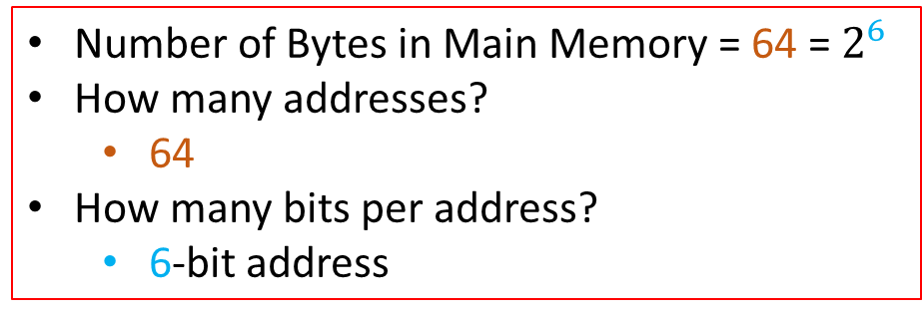
Cache
Block 0
B0 | B1 | B2 | B3
B4 | B5 | B6 | B7
B8 | B9 | B10 | B11
B12 | B13 | B14 | B15
… … …
B56 | B57 | B58 | B59
B60 | B61 | B62 | B63
Block 1
Line 0
Block 2
Line 1
Block 3
Line 2
Main Memory
Line 3
Number of Bytes in Main Memory = 64 = $2^{6}$
How many addresses?
64
How many bits per address?
6-bit address
Block 14
Block 15

Slide 19
Block 0
B0 | B1 | B2 | B3
B4 | B5 | B6 | B7
B8 | B9 | B10 | B11
B12 | B13 | B14 | B15
… … …
B56 | B57 | B58 | B59
B60 | B61 | B62 | B63
Block 1
Block 2
Block 3
Cache
Main Memory
Line 0
Line 1
Line 2
Block 14
Block 15
Line 3
Access Byte B5 in Main Memory
Byte Address = 000101
Block Number
Block Offset

Slide 20
Direct Mapping

Slide 21
Direct Mapping
1 Set = 1 Line, so Line Number and Set Number are the same
Block 0
B0 | B1 | B2 | B3
B4 | B5 | B6 | B7
B8 | B9 | B10 | B11
B12 | B13 | B14 | B15
… … …
B56 | B57 | B58 | B59
B60 | B61 | B62 | B63
Cache
Block 1
Block 2
Line 0
Block 3
Line 1
Main Memory
Line 2
Line 3
Mapped in Round Robin manner
Line Number/Index = K mod n
K = Block Number
n = Number of lines
Block 14
Block 15

Slide 22
Direct Mapping
1 Set = 1 Line , so Line Number and Set Number are the same
Block 0
B0 | B1 | B2 | B3
B4 | B5 | B6 | B7
B8 | B9 | B10 | B11
B12 | B13 | B14 | B15
… … …
B56 | B57 | B58 | B59
B60 | B61 | B62 | B63
Cache
Block 1
Block 0/4/8/12
Block 1/5/9/13
Block 2/6/10/14
Block 3/7/11/15
Block 2
Line 0
Block 3
Line 1
Main Memory
Line 2
Line 3
Mapped in Round Robin manner
Line Number/Index = K mod n
K = Block Number
n = Number of lines
Block 14
Block 15

Slide 23
Direct Mapping – Many to One Mapping
Main Memory Blocks
0
1
2
3
4
5
6
7
8
9
10
11
12
13
14
15
Cache Lines
0
1
2
3

Slide 24
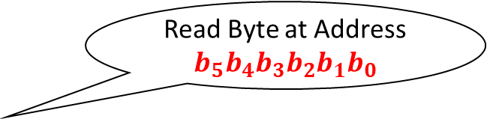
Direct Mapping
Read Byte at Address $b_{5}b_{4}b_{3}b_{2}b_{1}b_{0}$
CPU
Step 1: Search in Cache
If MISS, go to Step 2
Cache
Line 0
Block 0/4/8/12
Block 1/5/9/13
Block 2/6/10/14
Block 3/7/11/15
Byte address
Line 1
b5 | b4 | b3 | b2 | b1 | b0
Line 2
Tag
Set/Line Number
Block Offset
Line 3

Slide 25
Direct Mapping
Read Byte at Address $b_{5}b_{4}b_{3}b_{2}b_{1}b_{0}$
CPU
Step 2: Access From Main Memory
Block 0
B0 | B1 | B2 | B3
B4 | B5 | B6 | B7
B8 | B9 | B10 | B11
B12 | B13 | B14 | B15
… … …
B56 | B57 | B58 | B59
B60 | B61 | B62 | B63
Block 1
Block 2
Block 3
Byte address
b5 | b4 | b3 | b2 | b1 | b0
Main Memory
Block Number
Block Offset
Block 14
Block 15

Slide 26
Direct Mapping
Suppose Line 0 of the cache has Tag ’00’
What are the addresses of the Bytes present in line 0 of the cache?
Cache
0 | 0 | b3 | b2 | b1 | b0
Line 0
Tag = 00
Line 1
Tag
Line Number
Block Offset
Line 2
Line 3

Slide 27
Direct Mapping
Suppose Line 0 of the cache has Tag ’00’
What are the addresses of the Bytes present in line 0 of the cache?
Cache
0 | 0 | 0 | 0 | b1 | b0
Line 0
Tag = 00
Line 1
Tag
Line Number
Block Offset
Line 2
Line 3

Slide 28
Direct Mapping
Suppose Line 0 of the cache has Tag ’00’
What are the addresses of the Bytes present in line 0 of the cache?
Cache
0 | 0 | 0 | 0 | b1 | b0
Line 0
Tag = 00
Tag
Line Number
00
01
10
11
Line 1
Line 2
Line 3

Slide 29
Direct Mapping
Block 0
B0 | B1 | B2 | B3
B4 | B5 | B6 | B7
B8 | B9 | B10 | B11
B12 | B13 | B14 | B15
… … …
B56 | B57 | B58 | B59
B60 | B61 | B62 | B63
Block 1
Block 2
Block 3
Suppose Line 0 of the cache has Tag ’00’
What are the addresses of the Bytes present in line 0 of the cache?
Main Memory
Cache
Tag 00
B0, B1, B2, B3
Cache Line Number
Line 0
Block 14
Tag
Line 1
Block 15
Line 2
0 | 0 | 0 | 0 | b1 | b0
Line 3
Main Memory Block Number
00
01
10
11

Slide 30

Sequence of Actions
Read Byte at Address $100101$
CPU
Byte Address
1 | 0 | 0 | 1 | 0 | 1
Cache
Valid
Bit
Tag
Line Number
Block Offset
Line 0
Tag = 01
Tag = 11
Tag = 10
1
1
0
1
Step 1: Go to Line Number 01
Step 2: Check Valid Bit. If Valid Bit = 0, then it’s a MISS. If Valid Bit = 1, go to Step 3
Step 3: If Tag matches, then it’s HIT, or else MISS
Line 1
Line 2
Line 3

Slide 31
Sequence of Actions
Byte Address
1 | 0 | 0 | 1 | 0 | 1
Cache
Valid
Bit
Tag
Line Number
Block Offset
Line 0
Tag = 01
Tag = 11
Tag = 10
1
1
0
1
Line 1
Line 2
This is a MISS!!
Line 3

Slide 32
Sequence of Actions
Byte Address
1 | 0 | 0 | 1 | 0 | 1
Cache
Valid
Bit
Tag
Line Number
Block Offset
Line 0
Tag = 01
Tag = 10
Tag = 10
1
1
0
1
Line 1
Line 2
This is a HIT!!
Line 3

Slide 33
Disadvantages of Direct Mapping
Cache
5
Sequence of Block Numbers requested by CPU
Line 0
5, 4, 8 , 12, 9, 13
Line 1
Line 2
Line 3

Slide 34
Disadvantages of Direct Mapping
Cache
4
5
Sequence of Block Numbers requested by CPU
Line 0
5, 4, 8 , 12, 9, 13
Line 1
Line 2
Line 3

Slide 35
Disadvantages of Direct Mapping
Cache
4 8
5
Sequence of Block Numbers requested by CPU
Line 0
5, 4, 8 , 12, 9, 13
Line 1
Line 2
Line 3
This results in Conflict MISS!!
Waste of Space!!

Slide 36
Disadvantages of Direct Mapping
Cache
4 8 12
5
Sequence of Block Numbers requested by CPU
Line 0
5, 4, 8 , 12, 9, 13
Line 1
Line 2
Line 3
This results in Conflict MISS!!
Waste of Space!!

Slide 37
Disadvantages of Direct Mapping
Cache
4 8 12
5 9
Sequence of Block Numbers requested by CPU
Line 0
5, 4, 8 , 12, 9, 13
Line 1
Line 2
Line 3
This results in Conflict MISS!!
Waste of Space!!

Slide 38
Disadvantages of Direct Mapping
Cache
4 8 12
5 9 13
Sequence of Block Numbers requested by CPU
Line 0
5, 4, 8 , 12, 9, 13
Line 1
Line 2
Line 3
This results in Conflict MISS!!
Waste of Space!!

Slide 39
Solutions
Fully Associative Mapping
A Main Memory Block can be mapped to any Cache line.
Advantages: Better Cache Hit Rate
Disadvantages
Slow because the valid bit and tag of every cache line has to be compared.
Expensive due to the high cost of associative-comparison hardware.

Slide 40
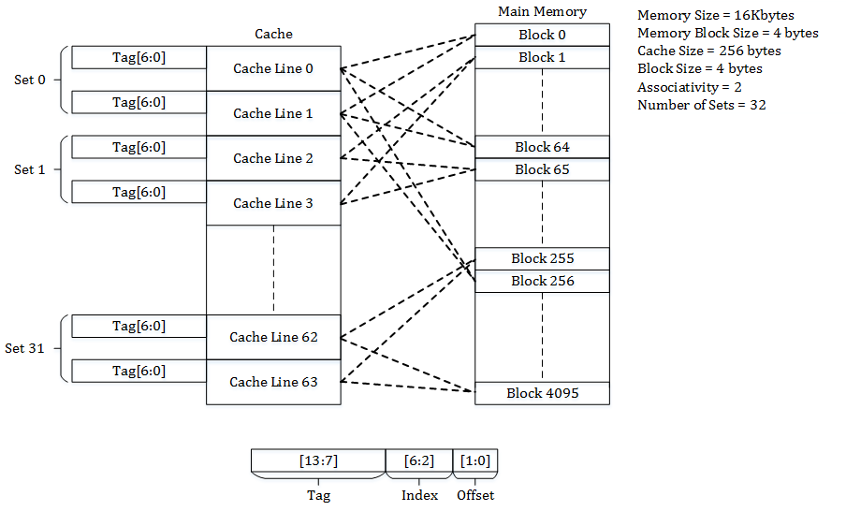
Solutions
Set Associative Mapping
Cache lines grouped into sets
A main memory block is mapped to a set
Associative Mapping within a set
Tradeoff between Direct Mapping and Fully Associative Mapping
Disadvantages
Can still suffer from conflict miss.
More details in next recitation

Slide 41
References
https://www.youtube.com/watch?v=VePK5TNgQU8
https://www.youtube.com/watch?v=N_OJn7jdKCc
https://en.wikipedia.org/wiki/Cache_placement_policies
Locality

