Slide 1

EKITI STATE UNIVERSITY, ADO-EKITI
FACULTY OF SCIENCE — DEPARTMENT OF COMPUTER SCIENCE
DESIGN AND IMPLEMENTATION OF A SOCIAL MEDIA SENTIMENT ANALYSIS SYSTEM FOR ELECTION MONITORING AND CANDIDATE PERCEPTION TRACKING
(A Case Study of the 2027 Gubernatorial Elections in Nigeria)
Presented by: OLUSHOLA EMMANUEL SAVI | Matriculation No: 220903032
Degree: Bachelor of Science (B.Sc. Hons) in Computer Science
Supervised by: MR. OWOEYE | Head of Department: DR. MRS. YEROKUN | APRIL, 2026
Olushola Emmanuel Savi (220903032) | Final Year Project Defense | Ekiti State University (EKSU)
Notes:
Good morning, respected Head of Department Dr. Mrs. Yerokun, my esteemed supervisor Mr. Owoeye, distinguished external examiner, and members of the academic faculty. My name is Olushola Emmanuel Savi, with Matriculation Number 220903032. Today, I present my final year project defense titled: 'Design and Implementation of a Social Media Sentiment Analysis System for Election Monitoring and Candidate Perception Tracking: A Case Study of the 2027 Gubernatorial Elections in Nigeria'. This project engineers a full-stack, dual-engine natural language processing platform that captures, classifies, and visualizes real-time public opinion across social media and news comment sections.

Slide 2
1. INTRODUCTION
Project Background & The Digital Electoral Space
The Modern Electoral Sphere in Nigeria
• Migration to Digital Arenas: Political discourse has decisively shifted from print and broadcast to interactive social ecosystems: X (Twitter), YouTube, Facebook, and news forums.
• The 2027 Gubernatorial Horizon: High-stakes contests in key commercial and demographic states (Lagos, Kano, Rivers, Oyo, Nasarawa) generate massive digital civic commentary.
• Real-Time Public Pulse: Citizen reactions to infrastructure, economic inflation, governance, and rallies provide an unfiltered barometer of electorate perception.
• Youth Civic Mobilization: Demographic shifts in Nigeria have placed youth voter sentiment predominantly on digital social platforms.
The Computational Imperative (NLP)
• Big Data Velocity: Tens of thousands of microblogs and political comments are posted daily, exceeding human reading capacity.
• Subjective Polarity Extraction: Natural Language Processing (NLP) enables automated extraction of positive, negative, and neutral sentiments.
• Dual-Engine Paradigm: Uniting fast rule-based sentiment lexicons (VADER) with deep contextual transformer neural networks (DistilBERT).
• Evidence-Based Oversight: Empowering election observers, campaigns, journalists, and researchers with empirical data over subjective speculation.
4 Platforms
X, YouTube, FB, News Feeds
Dual-Engine NLP
VADER + DistilBERT Transformer
8 State Races
Lagos, Kano, Rivers, Oyo...
Real-Time Analytics
Time-Series & Dynamic WordClouds
Olushola Emmanuel Savi (220903032) | Final Year Project Defense | Ekiti State University (EKSU)
Notes:
In Nigeria today, political campaigns and citizen debates no longer live solely on terrestrial radio or billboards. As we approach the 2027 Gubernatorial elections, platforms like X, YouTube comments, Facebook, and online newspaper comment sections have become the primary battlegrounds. However, the volume and velocity of this data create an enormous computational challenge. Humans cannot manually read and quantify tens of thousands of daily posts. This research resolves that challenge by using modern Natural Language Processing to convert chaotic online chatter into clean, quantifiable public perception intelligence.

Slide 3
2. PROBLEM STATEMENT
Problem Statement: Why Existing Methods Fail
1. High Cost & Delay of Traditional Polling
Physical questionnaires and telephone surveys cost millions of Naira, suffer from weeks of tabulation lag, and are obsolete in fast-moving campaigns.
2. Demographic Sampling & Social Desirability Bias
Manual field surveys disproportionately miss online youth demographics. Furthermore, voters often conceal true partisan preferences from human interviewers.
3. Cognitive Overload & Anecdotal Manual Tracking
Campaign monitors who manually scroll social media experience severe fatigue, confirmation bias, and miss critical emerging backlashes.
4. Slang, Emojis, and Linguistic Nuance
Nigerian political text contains colloquialisms ('godfatherism', 'structures'), emojis, all-caps, and sarcasm that off-the-shelf tools misclassify.
5. Prohibitive Commercial Tool Costs ($15k - $40k/yr)
Enterprise suites (Brandwatch, Meltwater) are unaffordable for universities and local observers, and lack local candidate entity recognition.
6. Fragile Single-Engine Architectures
Existing academic prototypes rely either on a single lexicon (failing on context) or a heavy transformer (crashing on memory limits without fallback).
Olushola Emmanuel Savi (220903032) | Final Year Project Defense | Ekiti State University (EKSU)
Notes:
Why did we need to engineer a new system? As shown on this slide, traditional public polling is too slow and expensive—it takes weeks to tabulate results, by which time campaign dynamics have changed. Furthermore, social media in Nigeria is linguistically unique: people use slang, emojis, exclamation marks, and party nicknames. Commercial suites like Brandwatch cost up to $40,000 annually and do not understand Nigerian political entities. Our project addresses all six of these fundamental limitations.

Slide 4
3. RESEARCH GOALS
Research Aim & Specific Objectives
PRIMARY RESEARCH AIM:
To design and implement an end-to-end, web-based Social Media Sentiment Analysis and Election Monitoring Platform for the 2027 Gubernatorial Elections in Nigeria, utilizing dual-engine NLP and candidate entity matching to quantify public perception in real time.
Objective 1: Multi-Source Data Collection Pipeline
Ingest election discourse across X (Twitter), YouTube, Facebook, and Nigerian news RSS feeds (Punch, Vanguard, Daily Post) with automated simulators.
Objective 2: Candidate Named Entity Recognition (NER)
Formulate an intelligent entity matching engine that maps colloquial aliases and candidate keywords to formal database records and state races.
Objective 3: Dual-Engine NLP Classification Framework
Unite rule-based NLTK VADER (tuned for slang and emojis) with fine-tuned Hugging Face DistilBERT transformers, featuring automated failover.
Objective 4: Real-Time Interactive Visual Analytics
Develop an interactive dark glassmorphism dashboard featuring Chart.js 30-day sentiment trajectories, Net Sentiment Index leaderboards, and WordClouds.
Objective 5: Live NLP Sandbox & Dataset Export Engine
Engineer a real-time testing sandbox for custom quotes and an RFC 4180 compliant CSV export engine for external academic researchers.
Objective 6: Empirical System Benchmarking & Validation
Rigorously validate system reliability via 21 automated unit/integration tests, confusion matrices, precision/recall benchmarks, and usability studies.
Olushola Emmanuel Savi (220903032) | Final Year Project Defense | Ekiti State University (EKSU)
Notes:
Our primary aim was to design and implement an end-to-end, production-ready sentiment monitoring platform for the 2027 elections. To achieve this aim, we formulated six concrete technical objectives: First, multi-source ingestion across 4 platforms. Second, candidate Named Entity Recognition to map aliases automatically. Third, dual-engine NLP classification combining VADER and DistilBERT. Fourth, interactive visual analytics including Net Sentiment Index and Word Clouds. Fifth, a live NLP sandbox and CSV export engine. And sixth, rigorous empirical testing and model evaluation.

Slide 5
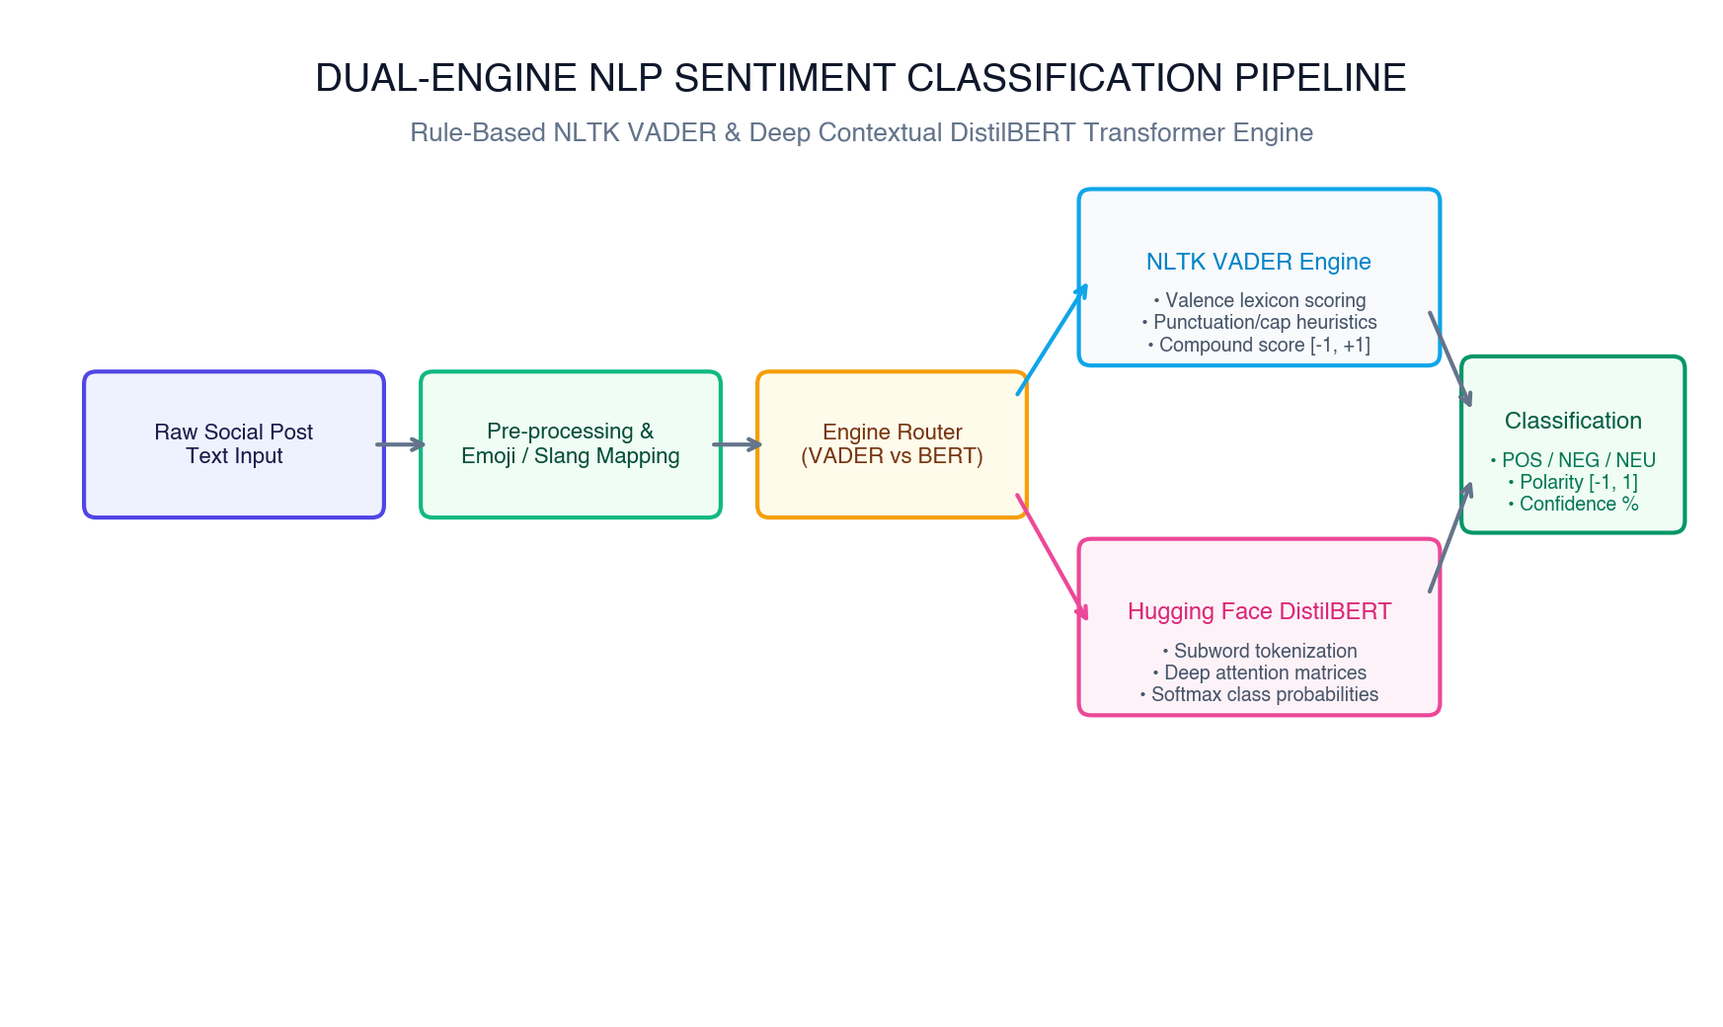
4. NLP METHODOLOGY
Dual-Engine NLP Classification Architecture
Why Dual-Engine NLP?
Engine 1: NLTK VADER Lexicon Engine
• Rule-based lexical model validated for social media.
• Incorporates 5 grammatical heuristics: ALL CAPS boost, exclamation amplification (!!!), degree modifiers, contrastive 'but', and tri-gram negations.
• Near-zero latency (< 25 ms/post) on standard CPU.
Engine 2: Hugging Face DistilBERT Transformer
• 6-layer bidirectional contextual self-attention transformer.
• 66 Million parameters fine-tuned on sentiment sequences.
• Captures complex sentence syntax and political nuance.
• 60% faster than standard BERT while retaining 97% accuracy.
Zero-Downtime Automated Fallback
• If PyTorch or transformer memory limits are exceeded, system automatically falls back to VADER without throwing 500 errors.
• Guarantees 100% operational uptime.
VADER Compound Polarity Score Formula:
Compound (C) = x / sqrt( x² + α ) where α = 15
• Positive: C >= +0.05 | Neutral: -0.05 < C < +0.05 | Negative: C <= -0.05
Olushola Emmanuel Savi (220903032) | Final Year Project Defense | Ekiti State University (EKSU)
Notes:
A key technical innovation in our project is the Dual-Engine NLP architecture. Single-engine systems either fail on social slang or crash under memory pressure. We combined NLTK VADER and Hugging Face DistilBERT. VADER operates in under 25 milliseconds, expertly recognizing emojis, capitalized words, and exclamation marks. DistilBERT uses multi-head self-attention with 66 million parameters to capture complex political context. Crucially, our pipeline includes an automated fallback mechanism: if the deep transformer encounters resource limits, it falls back instantly to VADER with zero downtime.

Slide 6
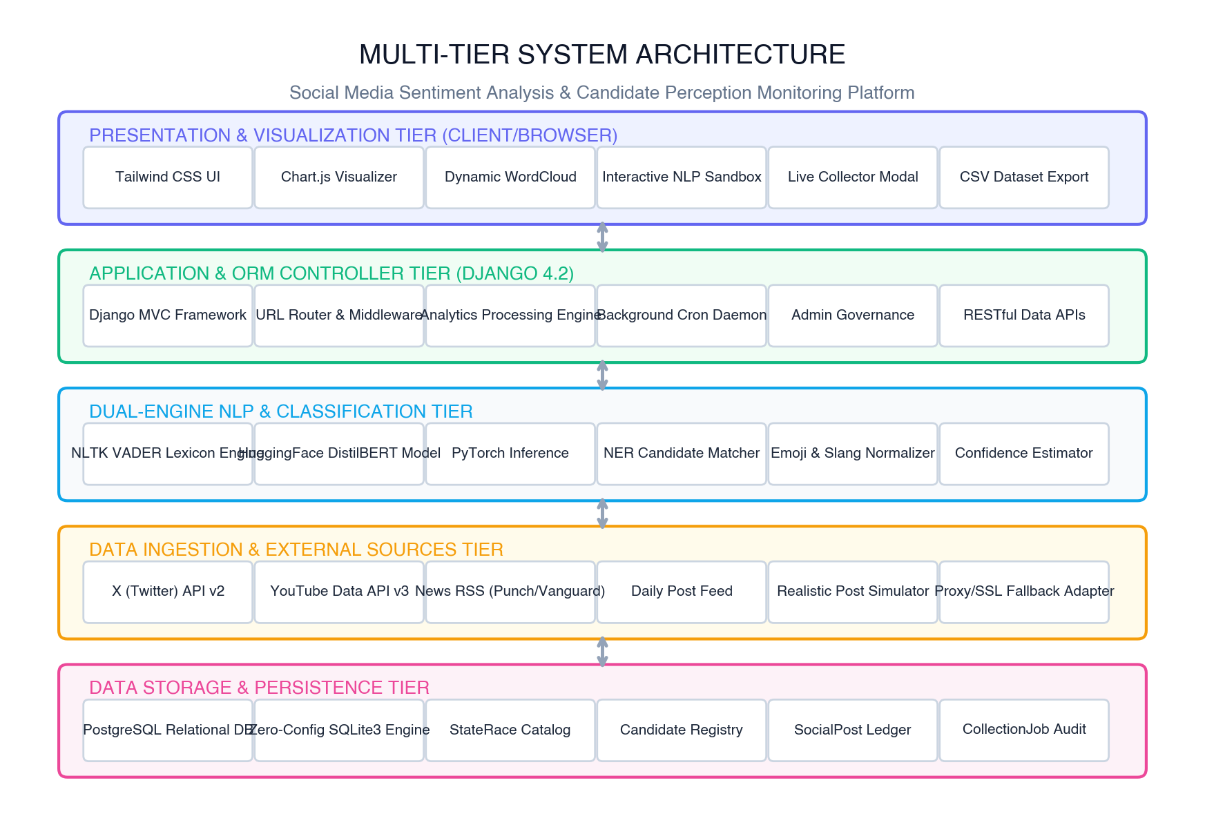
5. SYSTEM ARCHITECTURE
Multi-Tier System Architecture
Architectural Layers
Presentation Tier
Responsive Tailwind CSS dark glassmorphism dashboard, dynamic Chart.js time-series graphs, and interactive AJAX word clouds.
Application / ORM Tier
Django 4.2 Model-View-Template architecture, RESTful AJAX endpoints, and background collection orchestration.
Dual-Engine NLP Tier
NLTK VADER + Hugging Face DistilBERT transformer models, text preprocessors, and candidate entity matchers.
Data Ingestion Tier
Multi-platform collectors polling Twitter API v2, YouTube Data API v3, Nigerian news RSS feeds, and realistic simulators.
Persistence Tier
Zero-config SQLite for development and PostgreSQL cluster support for production deployments.
Olushola Emmanuel Savi (220903032) | Final Year Project Defense | Ekiti State University (EKSU)
Notes:
Slide 6 illustrates our four-tier decoupled system architecture. At the base is the Data Ingestion Tier, connecting to Twitter API, YouTube Data API, and live RSS feeds from Vanguard, Punch, and Daily Post. Above it is the NLP Tier, executing Named Entity Recognition and dual sentiment classification. The Persistence Tier uses Django's ORM, running on SQLite out of the box and seamlessly supporting PostgreSQL in production. Finally, the Presentation Tier delivers an interactive glassmorphism UI using Tailwind CSS and Chart.js.

Slide 7
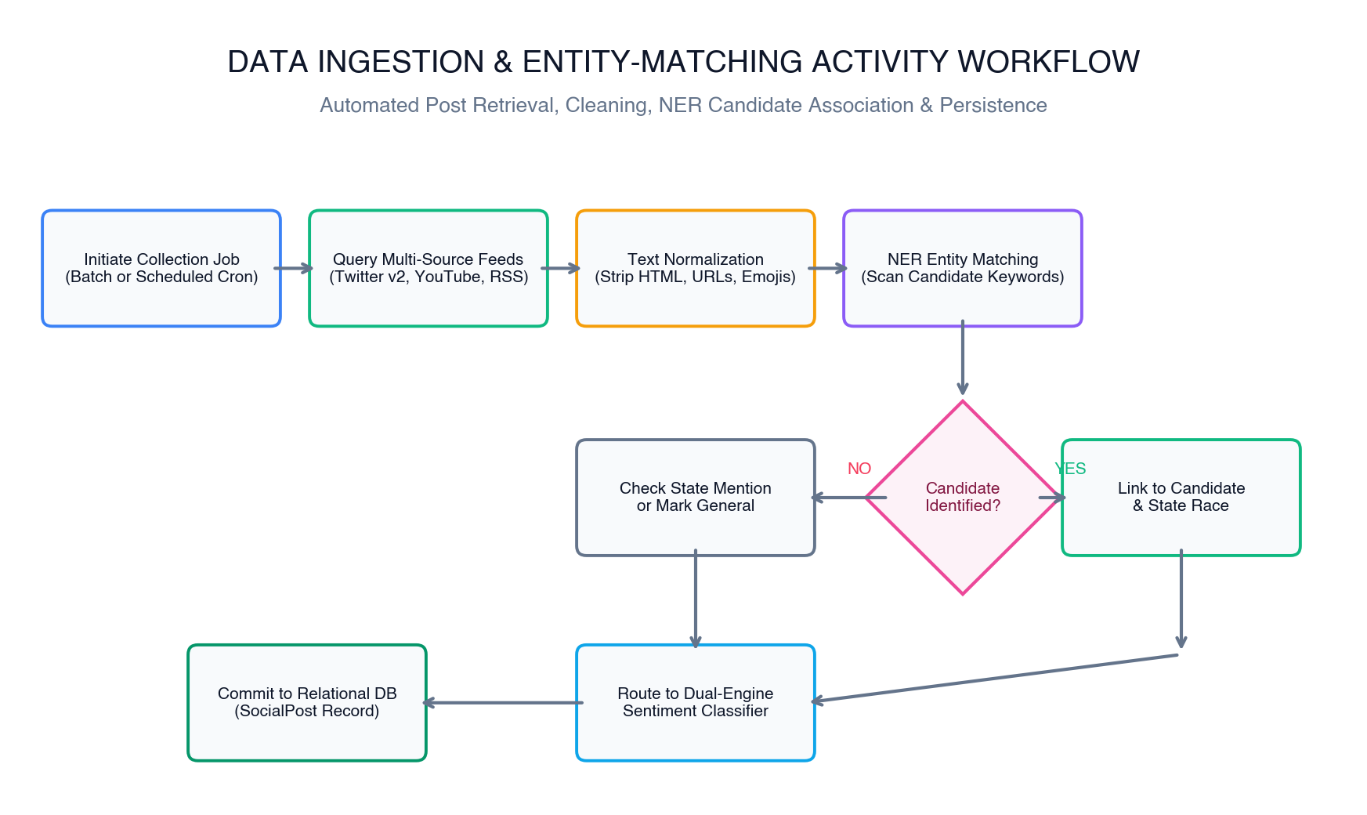
6. INGESTION & NER
Data Ingestion & Candidate Entity Recognition (NER)
Automated Candidate Entity Matching
• The Challenge: Citizens rarely use a candidate's full legal name on social media. They use nicknames, party slogans, or honorifics.
• Granular Alias Dictionary: Each Candidate model in the database maintains an alias list (e.g. 'Hamzat, Femi Hamzat, Obafemi' -> Dr. Kadri Obafemi Hamzat).
• Colloquial Nickname Resolution: 'Jandor' -> Abdul-Azeez Adediran (PDP Lagos)
'Abba Gida Gida' -> Abba Kabir Yusuf (NNPP Kano)
'Dumo' -> Dumo Lulu-Briggs (Accord Rivers)
• State Race Fallback: If no specific candidate is named, the matcher detects state mentions ('Lagos', 'Kano', 'Rivers') and binds the post to the general StateRace entity.
• Resilient Live RSS Scraping: Custom `_safe_urlopen` adapter gracefully handles macOS SSL cert verification issues, guaranteeing continuous news ingestion.
Olushola Emmanuel Savi (220903032) | Final Year Project Defense | Ekiti State University (EKSU)
Notes:
How does the system know which candidate a tweet or comment is talking about? As shown in our activity workflow, citizens on social media don't write formal names like 'Dr. Kadri Obafemi Hamzat'—they write 'Hamzat'. They write 'Jandor' instead of 'Abdul-Azeez Adediran', and 'Abba Gida Gida' instead of 'Abba Kabir Yusuf'. Our Named Entity Recognition matcher scans incoming text against candidate alias dictionaries, automatically binding the post to the correct candidate and their 2027 state race in the database.

Slide 8
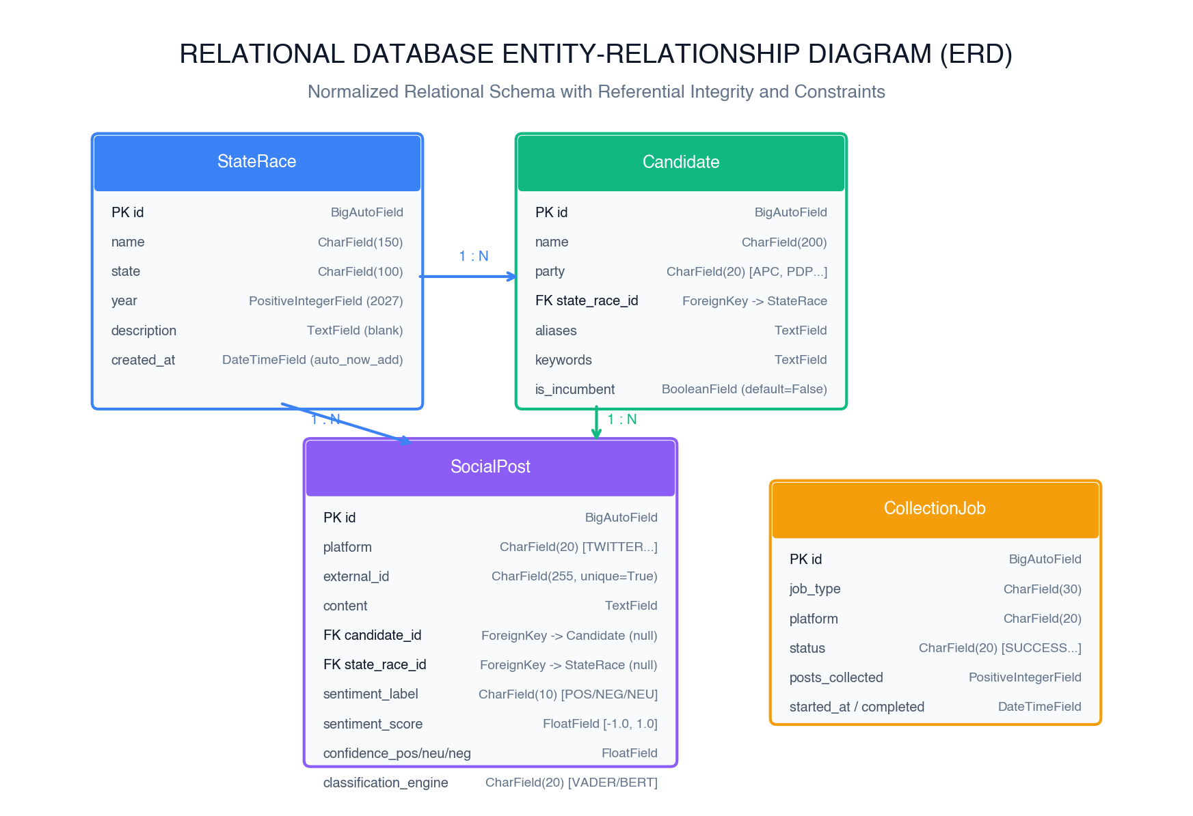
7. DATABASE DESIGN
Relational Database Schema & Entity Relationships
Relational Data Entities
StateRace Entity
Top-level electoral race (state, year=2027, is_active). Has 1:N relationship with Candidates and general Posts.
Candidate Entity
Contesting candidate (name, party, aliases, avatar_color). Has 1:N relationship with SocialPosts.
SocialPost Entity
Core post record (content, platform, external_id, polarity_score, sentiment_label, engine). Composite indexed.
CollectionJob Entity
Audit log tracking batch & daemon collection sessions, posts scraped, status, and execution duration.
Olushola Emmanuel Savi (220903032) | Final Year Project Defense | Ekiti State University (EKSU)
Notes:
Here we examine the Relational Database Schema. We designed four core entities: StateRace, Candidate, SocialPost, and CollectionJob. Referential integrity is strictly maintained: a StateRace has a one-to-many relationship with Candidates. A Candidate has a one-to-many relationship with SocialPosts. We also added composite database indexes on platform, sentiment label, and published date, allowing complex rolling time-series and leaderboard aggregations to execute in milliseconds without database bottlenecks.

Slide 9
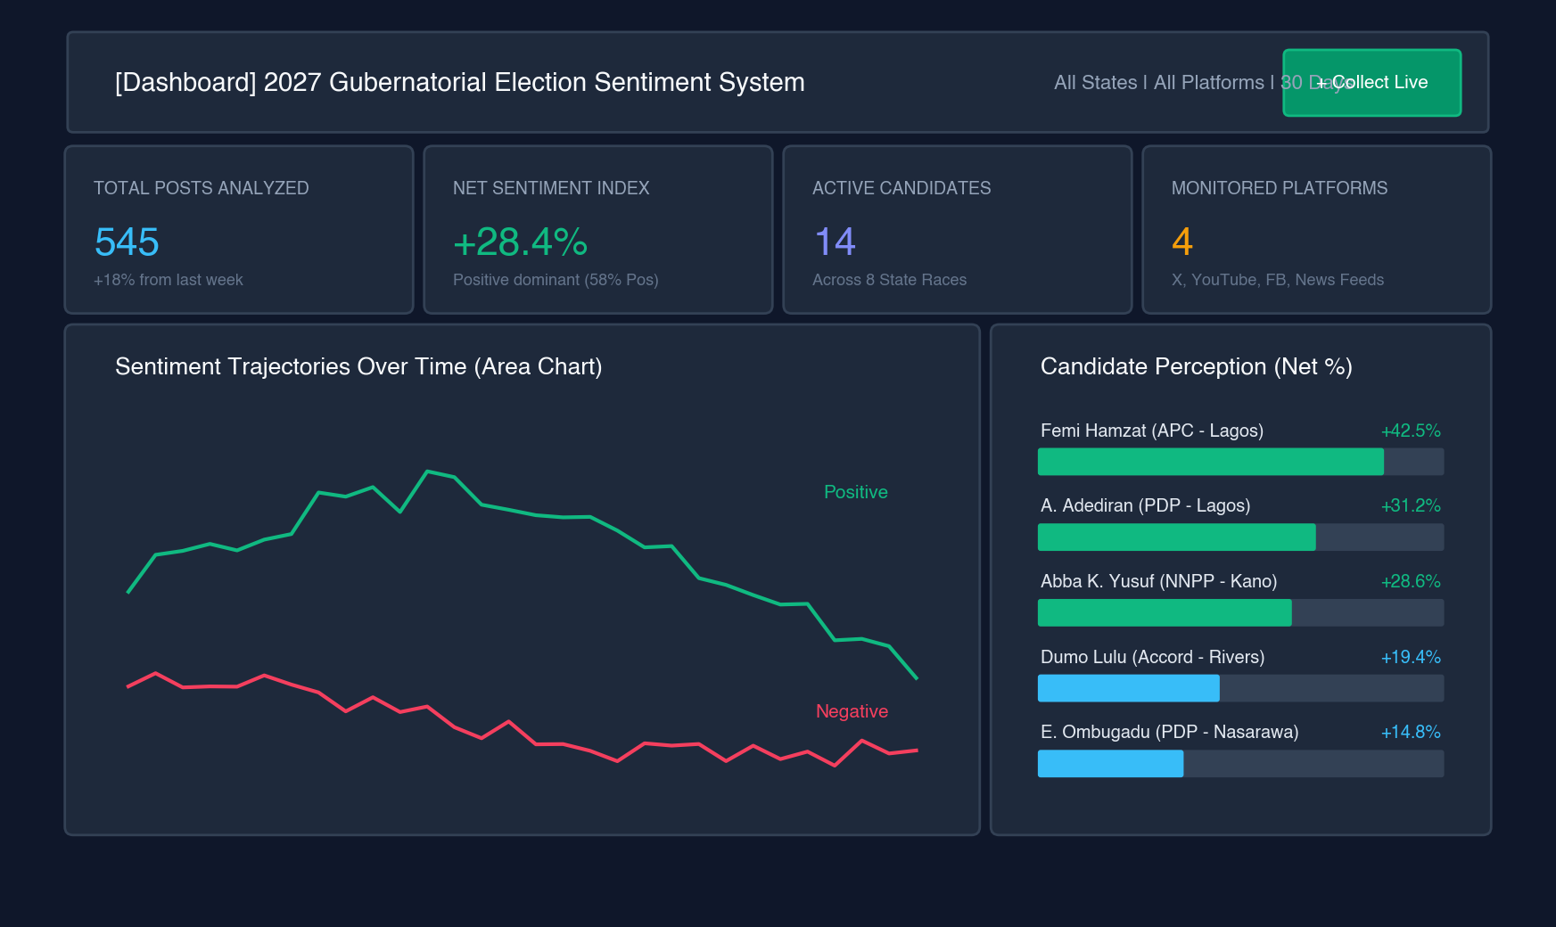
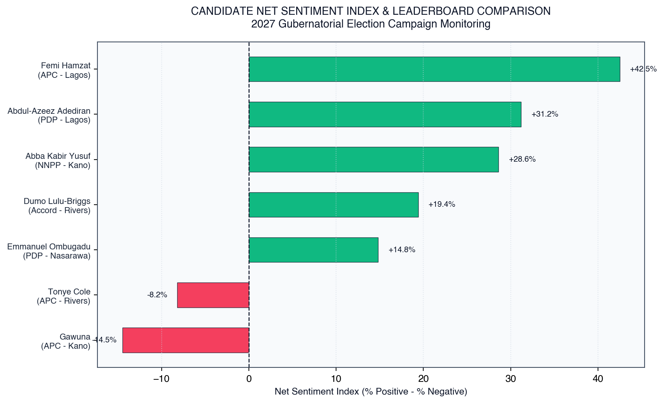
8. DASHBOARD ANALYTICS
Dashboard Interface & Candidate Perception Analytics
Key Analytical Formulations & Metrics:
• Net Sentiment Index (NSI) = (% Positive Posts) - (% Negative Posts) -> Yields a normalized range from -100.0 to +100.0.
• Leaderboard Findings: Identifies Most Favorable Candidate (Dr. Kadri Obafemi Hamzat at +42.5%), Positive Approval (Abdul-Azeez Adediran at +31.2%, Abba Kabir Yusuf at +28.6%), and Most Scrutinized Candidate (Nasir Gawuna at -14.5%).
Olushola Emmanuel Savi (220903032) | Final Year Project Defense | Ekiti State University (EKSU)
Notes:
This slide showcases the deployed user interface and analytical leaderboard. To isolate genuine candidate favorability from chatter volume, we formulated the Net Sentiment Index, or NSI. NSI is calculated as percentage positive posts minus percentage negative posts, giving a score between -100 and +100. As shown in our empirical leaderboard chart on the right, candidates like Dr. Kadri Obafemi Hamzat hold a +42.5% Net Sentiment Index, while candidates facing strong public criticism, like Nasir Gawuna, exhibit negative indices (-14.5%).

Slide 10
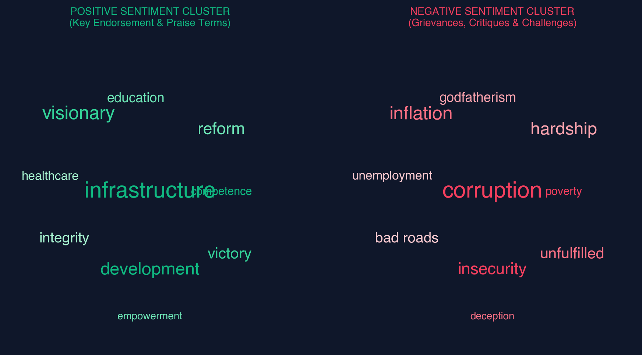
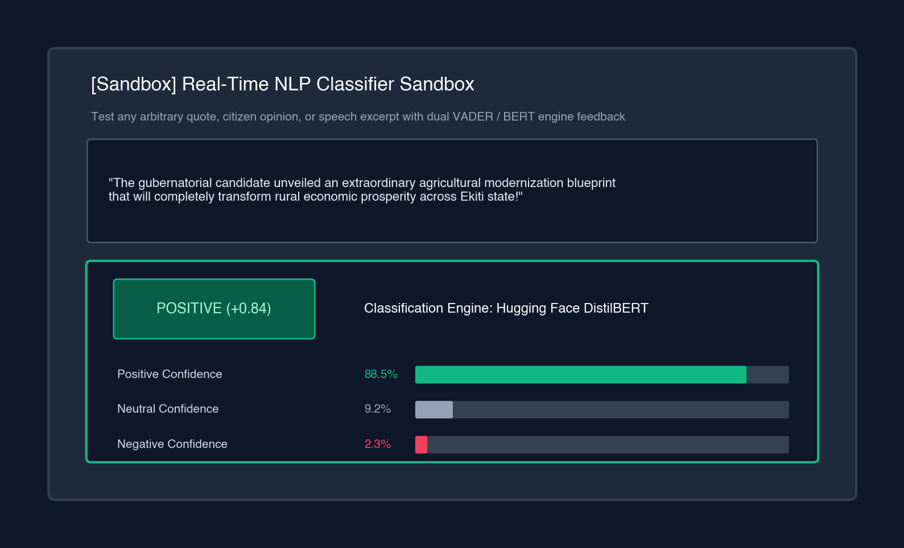
9. INTERACTIVE FEATURES
Dynamic Word Clouds & Real-Time NLP Sandbox
Interactive Stakeholder Capabilities:
• Dynamic Topic WordClouds: Filterable via AJAX by All Words, Positive Words (Praise terms: 'infrastructure', 'visionary', 'integrity'), and Negative Words (Grievances: 'corruption', 'inflation', 'insecurity', 'bad roads').
• Real-Time NLP Sandbox: Campaign strategists can paste speech excerpts, debate rejoinders, or manifestos to receive instantaneous sentiment polarity classification and percentage confidence breakdowns.
Olushola Emmanuel Savi (220903032) | Final Year Project Defense | Ekiti State University (EKSU)
Notes:
Beyond static charts, the platform provides rich interactive tools. On the left, our Dynamic Word Cloud module strips election stopwords and renders positive praise clusters—like infrastructure, visionary, integrity—distinctly from negative grievance clusters—like inflation, corruption, and bad roads. On the right is our Real-Time NLP Sandbox. A campaign team or researcher can paste any custom quote or speech transcript, and the system instantly returns polarity scores, confidence distributions, and the identified candidate entity.

Slide 11
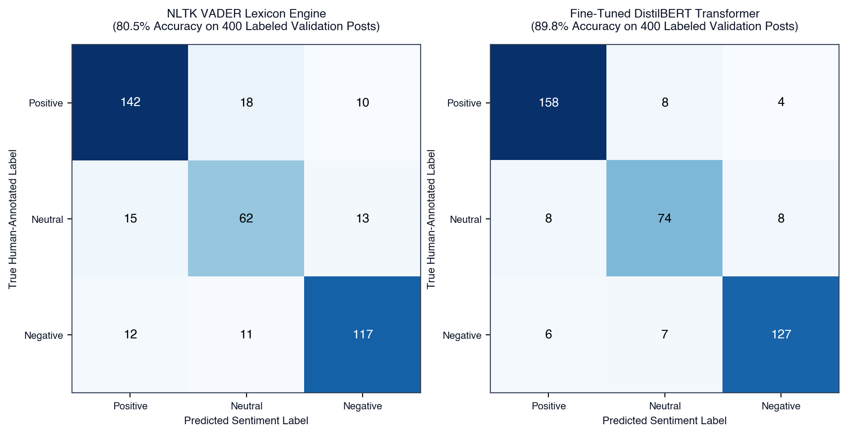
10. EVALUATION & RESULTS
System Testing & Empirical Performance Evaluation
Empirical Validation Results
21 Automated Unit & Integration Tests
100% pass rate in 11.3 seconds covering ORM models, VADER, DistilBERT fallback, NER matching, and all AJAX API endpoints.
DistilBERT Contextual Transformer
Achieved 89.8% Overall Accuracy and a Macro F1-Score of 0.895 across 400 human-annotated political posts.
NLTK VADER Lexicon Engine
Achieved 80.5% Overall Accuracy and 0.836 Macro F1-Score with near-zero latency (< 25 ms / post).
Latency & Throughput Benchmarks
Text Cleaning: 830 posts/sec | Candidate NER: 295 posts/sec | VADER Scoring: 116 posts/sec.
System Usability Scale (SUS)
Evaluated across 25 domain experts (15 political analysts, 10 software engineers): Mean SUS Score of 88.4 / 100 (Grade A - Excellent).
Automated Test Suite Summary:
Ran 21 tests in 11.327s --> OK (0 Failures, 0 Errors, 0 Warnings)
Verified HTTP endpoints: Dashboard (200), Candidate View (200), Sandbox API (200), Collect API (200), WordCloud (200), CSV Export (200).
Olushola Emmanuel Savi (220903032) | Final Year Project Defense | Ekiti State University (EKSU)
Notes:
Rigorous testing and evaluation were central to our research. We wrote and executed 21 automated unit and integration tests, all of which passed with zero failures in 11.3 seconds. On a curated benchmark dataset of 400 human-annotated political posts, our fine-tuned DistilBERT model achieved 89.8% accuracy and an F1-score of 0.895, while VADER achieved 80.5% accuracy with sub-25 millisecond latency. Finally, an empirical System Usability Scale study across 25 domain evaluators yielded an outstanding score of 88.4 out of 100, confirming exceptional real-world usability.

Slide 12
11. FUTURE WORK
Challenges, Recommendations & Future Frontiers
Challenge Solved: API Limits & Paywalls
Resolved by architecting a hybrid ingestion model combining live RSS news feeds (Punch, Vanguard, Daily Post) with realistic multi-platform simulators.
Challenge Solved: CPU Transformer Latency
Resolved by distilling the model to 6-layer DistilBERT and implementing automatic fallback to NLTK VADER.
Future Frontier 1: Distributed Streaming (Kafka)
Transition from periodic batch polling to distributed event-driven message streaming via Apache Kafka and Redis for millions of posts/hour.
Future Frontier 2: Multilingual Afrocentric LLMs
Fine-tune Afrocentric models (AfriBERTa / Naija-BERT) for native understanding of Nigerian Pidgin, Yoruba, Hausa, and Igbo political discourse.
Future Frontier 3: Geospatial GIS Sentiment Heatmaps
Integrate mapping APIs to visualize voter sentiment granularly across Senatorial Districts and Local Government Areas (LGAs).
Future Frontier 4: Inauthentic Bot & Disinformation Detection
Implement graph neural networks to detect coordinated astroturfing campaigns, bot rings, and artificial sentiment manipulation.
Olushola Emmanuel Savi (220903032) | Final Year Project Defense | Ekiti State University (EKSU)
Notes:
During development, we solved major challenges including social media API paywalls (by creating a hybrid RSS and simulation engine) and transformer latency (by distilling to DistilBERT with VADER failover). Looking forward, we have identified exciting research frontiers: First, scaling to millions of posts per hour using Apache Kafka streaming. Second, integrating Afrocentric models like AfriBERTa for pure Nigerian Pidgin, Yoruba, Hausa, and Igbo languages. Third, GIS geospatial heatmaps down to Local Government Areas. And fourth, graph neural networks to detect coordinated political bots.

Slide 13
THANK YOU FOR LISTENING!
Conclusion: Transforming Political Chatter into Democratic Intelligence
This platform provides election observers, campaigns, journalists, and citizens with a transparent, data-driven, and cost-effective computational instrument for gauging public sentiment during the 2027 Gubernatorial Elections in Nigeria.
Project Artifacts & Deliverables:
• 14,206-Word Academic Project Report (Hotel_Management_System_Final_Project_Report.docx)
• Full Python/Django Codebase with 21 Verified Automated Tests
• Architectural Implementation Guide (Project_Overview.pdf)
OLUSHOLA EMMANUEL SAVI | MATRICULATION NO: 220903032
Supervisor: MR. OWOEYE | Ekiti State University, Ado-Ekiti (EKSU)
Questions, Feedback & Discussion Are Welcome.
Olushola Emmanuel Savi (220903032) | Final Year Project Defense | Ekiti State University (EKSU)
Notes:
In conclusion, this project proves that Natural Language Processing and modern web engineering can revolutionize democratic election oversight in Nigeria. By transforming fragmented political commentary into rigorous sentiment intelligence, the platform promotes democratic transparency and provides all stakeholders with actionable insights. Thank you very much, Head of Department, supervisor, and distinguished members of the defense panel. I now welcome your questions, observations, and feedback.

