Slide 1
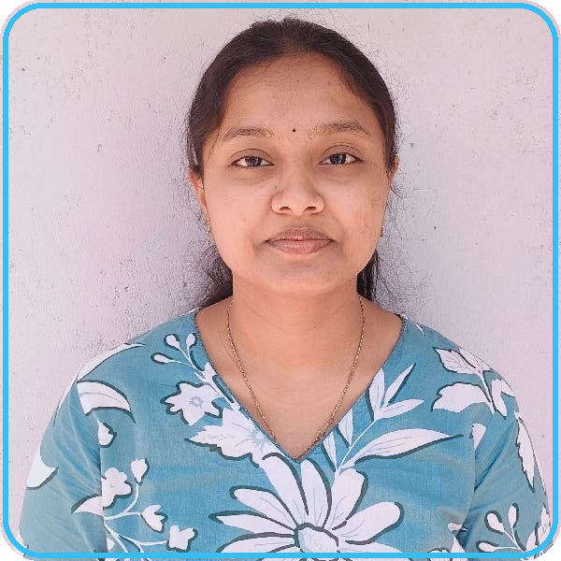
Dedeepya Majety
Azure Data Engineer & Lakehouse Specialist | Azure Data Engineer (Staff)
EY Global Delivery Services | AI and DATA (D&A) / Metadata Management Practice | Req ID: 4477576256
• Associate - Data Engineer @ Cognizant: 3.9 YOE delivering enterprise cloud lakehouse solutions.
• Databricks Certified Associate: Hands-on PySpark, Delta Lake, Unity Catalog, and Medallion architecture.
• Microsoft Certified PL-300: Power BI data modeling, DAX optimization, and Direct Lake integration.
• Immediate Availability: Serving official notice period at Cognizant; available to join within 30 days.
🟢 AVAILABLE IN 30 DAYS
+91-6281869953 | majetydedeepya0@gmail.com | linkedin.com/in/dedeepya-majety | dedeepya-majety-portfolio.vercel.app

Slide 2
My Technical Strategy for EY Global Delivery Services: 3 Core Pillars
High-throughput data engineering, cost efficiency, and automated governance
01
Lakehouse Modernization
02
Performance & Scale
03
Governance & Trust
• Legacy Cutover: Migrate batch ETL to Azure Databricks Delta Lake and PySpark.
• Auto Loader Streaming: Continuous file ingestion with RocksDB state tracking.
• Zero-Loss Validation: 100% row-count and checksum parity across cutovers.
• Measurable ROI: 40% pipeline runtime cut and ~30% compute savings.
• Skew Elimination: Salt hotspot keys and broadcast dimension joins (<10MB).
• Engine Tuning: Leverage Adaptive Query Execution (AQE) for dynamic shuffle.
• Compaction: Automated OPTIMIZE and Z-ORDER on high-cardinality keys.
• Orchestration: Modular Python Airflow DAGs with 99.8% SLA adherence.
• Unity Catalog: 3-level namespace (catalog.schema.table) with RBAC policies.
• Data Security: Dynamic column masking and row-level filtering for PII.
• Master Data: Informatica MDM match-merge rule tuning for golden records.
• Executive BI: Optimized Power BI DAX models and Direct Lake connectivity.
Dedeepya Majety | Azure Data Engineer | EY Global Delivery Services | Req 4477576256 | Available in 30 Days
2 / 8

Slide 3
Production Medallion Lakehouse Architecture Flow
Visual multi-hop data refinement blueprint: Raw Ingestion ➔ Silver Curated ➔ Gold Analytics
SOURCE INGESTION
BRONZE TIER
SILVER TIER
GOLD TIER
Enterprise Sources
Raw Ingestion
Conformed & Clean
Business Marts
• On-Premises ERP: Informatica & Oracle DB feeds.
• File Drops: CSV, JSON, XML in ADLS Gen2.
• REST APIs: External business telemetry streams.
• Auto Loader: cloudFiles streaming with RocksDB.
• Schema Drift: _rescued_data column defense.
• Delta Append: Immutable raw audit retention.
• Data Quality: Deduplication & schema contracts.
• ACID MERGE: SCD Type 1 & Type 2 tracking.
• Unity Catalog: Table & column RBAC security.
• Star Schema: Curated Fact & Dimension tables.
• Compaction: OPTIMIZE & Z-ORDER on join keys.
• Serving: Power BI & Databricks Serverless.
Dedeepya Majety | Azure Data Engineer | EY Global Delivery Services | Req 4477576256 | Available in 30 Days
3 / 8

Slide 4
Enterprise Value Delivery Scorecard & Production ROI
Verified quantitative performance improvements and infrastructure optimization across 3.9 YOE
40% FASTER
~30% SAVED
99.8% UPTIME
~15% CLEANUP
Pipeline Runtime Reduction
Cloud Compute Savings
Production SLA Reliability
Duplicate Record Elimination
Slashed daily batch execution window from 5 hours to under 3 hours via Azure Databricks.
Cluster rightsizing, auto-termination policies, and spot instance allocation cut cloud bills.
Engineered modular Python Airflow DAGs with exponential retries and automated alerts.
Tuned Informatica MDM match-merge logic, establishing unified golden customer records.
BEFORE VS AFTER VALUE REALIZATION BENCHMARK
Daily Pipeline Execution Window:
Legacy Informatica: 5.0 Hours
▼ 44% RUNTIME CUT
Databricks: 2.8 Hours
Cloud Compute Infrastructure Spend:
Unoptimized Baseline Spend (100%)
▼ 30% COST SAVINGS
Rightsized & Spot Compute (70%)
Dedeepya Majety | Azure Data Engineer | EY Global Delivery Services | Req 4477576256 | Available in 30 Days
4 / 8

Slide 5
PySpark Performance Tuning & Troubleshooting Matrix
Solving distributed data skew, memory bottlenecks, and executor failures at the root
DATA SKEW & 200TH TASK STALL
SHUFFLE OVERHEAD & NETWORK IO
Partition Skew Diagnosis & Salting
Broadcast Hash Join Optimization
• Symptom: 199 tasks finish in 10s; 200th task spills to disk for 35 mins.
• Engineered Fix: Key Salting via concat(key, floor(rand() * 10)) to disperse hotspot keys uniformly across executors.
• Verified Impact: 100% uniform executor utilization and elimination of straggler tasks.
• Symptom: Costly SortMergeJoin triggering multi-GB shuffle across network.
• Engineered Fix: Force broadcast(dim_df) for lookup and dimension tables under 10MB.
• Verified Impact: Zero network shuffle stage, cutting join execution latency by up to 70%.
CONTAINER CRASH & 137 OOM
QUERY PLANNING DRAG
Executor Memory & OOM Shielding
Small File Compaction & Z-ORDER
• Symptom: Driver crashes or ExecutorLostFailure with exit code 137.
• Engineered Fix: Ban collect() on large datasets, tune spark.memory.fraction, and persist with MEMORY_AND_DISK_SER.
• Verified Impact: Rock-solid pipeline execution with zero container evictions.
• Symptom: Streaming sink generates 10,000+ tiny sub-MB files, stalling query scans.
• Engineered Fix: Enable autoCompact and optimizeWrite; schedule scheduled OPTIMIZE table ZORDER BY (high_cardinality_keys).
• Verified Impact: Sub-second analytical queries via file-skipping metadata.
Dedeepya Majety | Azure Data Engineer | EY Global Delivery Services | Req 4477576256 | Available in 30 Days
5 / 8

Slide 6
Enterprise Governance & Master Data Architecture
Dual-engine architecture for centralized access control, lineage, and golden record survivorship
Databricks Unity Catalog Governance
Informatica Master Data Management (MDM)
• 3-Level Namespace: Hierarchical governance across catalog.schema.table.
• Fine-Grained RBAC: Role-based access permissions tailored for data consumers.
• Dynamic Column Masking: Automated redaction of sensitive customer PII.
• Row-Level Filtering: Context-aware data filtering based on business domain.
• Automated Lineage: End-to-end provenance tracking from ingestion to Power BI.
• Compliance Auditing: Immutable query audit logs for regulatory readiness.
• Deterministic Matching: Exact matching rules across enterprise primary keys.
• Probabilistic Matching: Fuzzy string match rules for customer names and addresses.
• Trust Decay Scoring: Configured confidence curves prioritizing verified CRM data.
• Survivorship Logic: Automated field-level survivorship creating single golden records.
• Entity Deduplication: Eliminated ~15% duplicate entities across master tables.
• DataOps Integration: Airflow validation gates verifying data parity before publish.
Dedeepya Majety | Azure Data Engineer | EY Global Delivery Services | Req 4477576256 | Available in 30 Days
6 / 8

Slide 7
My Operating Principles: Velocity & High-Agency Ownership
Core professional execution standards defining day-to-day engineering delivery
01
Mathematical Parity Before Cutover
02
Proactive Schema Drift Defense
Never migrate an ETL pipeline based on spot checks. Enforce automated row-count reconciliation, primary key uniqueness tests, and column checksums to guarantee zero data loss.
Source schemas change without warning. Build resilient pipelines with Databricks Auto Loader _rescued_data to ensure streaming jobs never halt unexpectedly while capturing unmapped attributes.
03
Root-Cause Spark Performance Tuning
04
Full-Lifecycle High-Agency Ownership
Never mask an algorithmic bottleneck by doubling cluster size. Inspect Spark UI DAG execution stages, diagnose partition skew, and apply salting or broadcasting to fix latency permanently.
Take active ownership from raw source drops to executive Power BI scorecards. Author clear runbooks, establish CI/CD quality gates, and communicate transparently across cross-functional teams.
Dedeepya Majety | Azure Data Engineer | EY Global Delivery Services | Req 4477576256 | Available in 30 Days
7 / 8

Slide 8
30-60-90 Day Value Realization Roadmap for EY Global Delivery Services
Phased delivery plan ensuring immediate day-1 contribution and long-term technical value
PHASE 1: DAYS 1 TO 30
PHASE 2: DAYS 31 TO 60
PHASE 3: DAYS 61 TO 90
Immersion & Baseline Stability
Lakehouse Modernization & Tuning
Governance & Enterprise Scale
• Pipeline Audit: Review existing Airflow DAGs, ADLS storage, and Spark logs.
• Bottleneck Identification: Map compute cost hotspots, query bottlenecks, and skew.
• Incident Ownership: Take ownership of ETL batch runs and SLA alert triage.
• Day-1 Quick Win: Deliver priority pipeline bug fixes with 100% test coverage.
• Delta Migration: Modernize priority batch workflows to Databricks Auto Loader.
• PySpark Tuning: Implement salting, broadcast joins, and partition pruning.
• Compaction Routine: Schedule automated OPTIMIZE, Z-ORDER, and VACUUM jobs.
• Data Quality Gates: Establish automated reconciliation asserts in CI/CD.
• Unity Catalog Scale: Expand 3-level namespace RBAC and dynamic column masking.
• Curated Data Marts: Design optimized star-schema tables for high-concurrency BI.
• BI Acceleration: Partner with analysts to tune Direct Lake and DAX measures.
• Engineering Velocity: Author comprehensive runbooks and mentor junior engineers.
Dedeepya Majety | Azure Data Engineer | EY Global Delivery Services | Req 4477576256 | Available in 30 Days
8 / 8

