Slide 1

Shri Vishnu Engineering College For Women (AUTONOMOUS)
Department of Computer Science
Title : Chronic Kidney Disease Prediction
Project Guide :
Mr.K.Bhadrachalam (M.Tech(Ph.D.))
Project Members :
K.L.N.Pravallika(17B01A0567)
M.Dedeepya (17B01A0585)
D.Srilakshmi (17B01A0591)
N.S.L.Meghana (17B01A05A4)
01 July 2021

Slide 2
Contents
Introduction
Domain Knowledge
Existing system
Proposed System
Requirements
Analysis
System Design
Implementation
Testing

Slide 3
Introduction
Chronic Kidney Disease is a type of kidney disease due to which kidney functionality decreased over a period of months or years.
Currently, there are many people in the world suffering from chronic kidney diseases worldwide. Due to the several risk factors like food, environment and living standards many people get diseases suddenly.
Diagnosing of chronic kidney diseases is generally invasive, costly, time-consuming and often risky.
Therefore, the early detection of the disease remains important

Slide 4
Domain Knowledge
Artificial intelligence and machine learning are the part of computer science that are correlated with each other. These two technologies are the most trending technologies which are used for creating intelligent systems.
Artificial intelligence is a technology using which we can create intelligent systems that can simulate human intelligence.
Machine learning is a subfield of artificial intelligence, which enables machines to learn from past data or experiences without being explicitly programmed.
Machine learning enables a computer system to make predictions.
Machine learning is being used in various places such as for online recommender system, for Google search algorithms, Email spam filter, etc.
It can be divided into three types:

Slide 5
Supervised Learning: Supervised learning is when the model is getting trained on a labeled dataset. Labeled dataset is one which have both input and output parameters.
Unsupervised learning: There are no labels or correct outputs. The task is to discover the structure of the data
Reinforcement learning: Commonly used in situations where an AI agent like a self-driving car must operate in an environment and where feedback about good or bad choices is available with some delay.

Slide 6
Existing System
The existing system of diagnosis is based on the examination of urine with the help of serum creatinine level.
Many medical methods are used for this purpose such as screening, ultrasound method.
In screening, the patients with hypertension, history of cardiovascular disease, and the patients who have relatives who had kidney disease are screened.
This technique includes the calculation of the estimated GFR from the serum creatinine level.

Slide 7
Proposed System
The proposed system focuses on predicting this life-threatening disease Chronic Kidney Disease (CKD) using Classification algorithms.
Proposed system is automation for chronic kidney disease prediction using classification techniques and supervised learning algorithms.
These include
Random Forest.
Support Vector Machine.
Naïve Bayes

Slide 8
Requirements
Software Requirements:
Operating system: Windows 8/ Windows 10
Language: Python
Dataset: MS Excel (csv)
Software IDE/Online working tool: Anaconda Navigator/ Google Collaboratory
Documentation: Microsoft Office
Hardware Requirements:
Processor : i5
RAM : 8 GB
Hard Disk : 1 TB

Slide 9
Functional Requirements
Collection of data set.
Data Pre-processing.
Data Visualization
Data Augmentation
Feature Selection
Working on various Machine Learning algorithms.
The system can predict whether the person is suffering from disease or not.
Non Functional Requirements
Accuracy
Scalability

Slide 10
Design
Firstly, we will consider a dataset that contains 25 attributes and perform data cleaning methods.
After Cleaning we perform the Data Augmentation technique to increase the size of the dataset.
Later, we divide the dataset into a training set and testing set(80-20; 70-30; 60-40).
Further, we carry out feature selection on the training data by implementing filter methods and wrapper methods.
After this, we will apply machine learning algorithms such as Random forest, Support Vector Machine, Naive Bayes and then will achieve a training model, using this we will be predicting the disease either it is CKD or non-CKD by considering the accuracy measure of the algorithms.

Slide 11
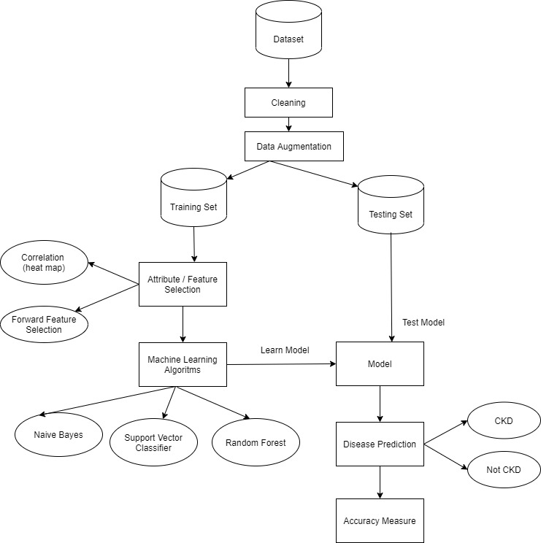
Architecture

Slide 12
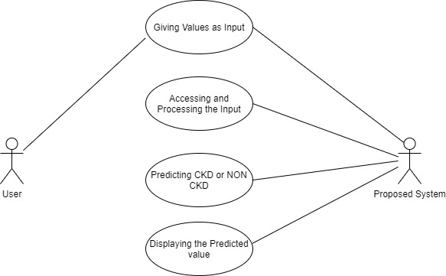
Use Case Diagram

Slide 13
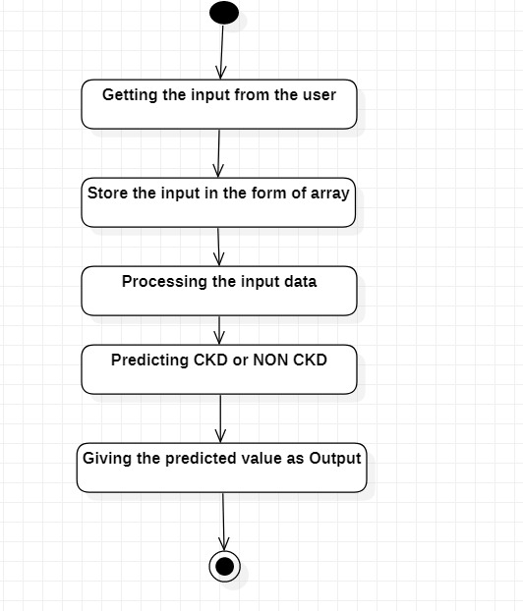
Activity Diagram

Slide 14
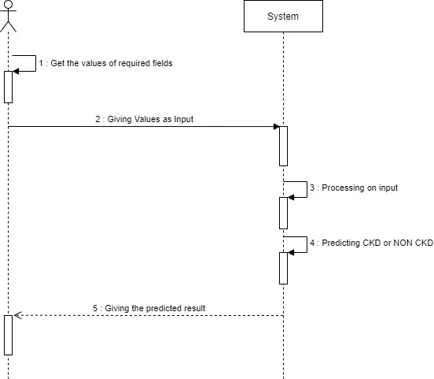
Sequence Diagram

Slide 15
Implementation
OBJECTIVE
It is an approach to predict the Chronic Kidney Disease.
Preprocessing of the dataset.
Outliers
Missing Values
Data Reduction
Working on various models to find the more accurate one.
It gives more efficient results.

Slide 16
Steps involved
Step1: Data Preprocessing
Step2: Data Visualization
Step 2: Data Augmentation
Step 3: Feature Selection
Step 4: Applying Classification Algorithms
Step 5: Creating User Interface

Slide 17
Data Preprocessing
Data preprocessing is a process of making data suitable for a machine learning model. It is the first and crucial step while creating a machine learning model.
When creating a machine learning project, it is not always a case that we come across clean and formatted data. And while doing any operation with data, it is mandatory to clean it and put it in a formatted way. So for this, we use data preprocessing task.
Data preprocessing is a required task for cleaning the data and making it suitable for a machine learning model which also increases the accuracy and efficiency of a machine learning model.
Pre-processing involves the below steps:
Getting the dataset
Importing libraries
Importing dataset
Detecting Outliers
Identifying and Handling Missing Values
Encoding Categorical Data

Slide 18
Dataset
The dataset consisting of 400 observations suffer from missing and noisy value.
The data includes 250 records of patients with CKD and 150 records of persons without CKD.
The CKD dataset has 24 features including 11 numeric features and 13 nominal features, and the 25th feature indicates the classification or state of CKD.

Slide 19
Age(numerical) age in years
Blood Pressure(numerical) bp in mm/Hg
Specific Gravity(nominal) sg - (1.005,1.010,1.015,1.020,1.025)
Albumin(nominal) al - (0,1,2,3,4,5)
Sugar(nominal) su - (0,1,2,3,4,5)
Red Blood Cells(nominal) rbc - (normal,abnormal)
Pus Cell (nominal) pc - (normal,abnormal)
Pus Cell clumps(nominal) pcc - (present,notpresent)
Bacteria(nominal) ba - (present,notpresent)
Blood Glucose Random(numerical) bgr in mgs/dl
Blood Urea(numerical) bu in mgs/dl
Serum Creatinine(numerical) sc in mgs/dl
Sodium(numerical) sod in mEq/L
Potassium(numerical) pot in mEq/L
Hemoglobin(numerical) hemo in gms
Packed Cell Volume(numerical)
White Blood Cell Count(numerical) wc in cells/cumm
Red Blood Cell Count(numerical) rc in millions/cmm
Hypertension(nominal) htn - (yes,no)
Diabetes Mellitus(nominal) dm - (yes,no)
Coronary Artery Disease(nominal) cad - (yes,no)
Appetite(nominal) appet - (good,poor)
Pedal Edema(nominal) pe - (yes,no)
Anemia(nominal) ane - (yes,no)
Class (nominal) class - (ckd,notckd)

Slide 20
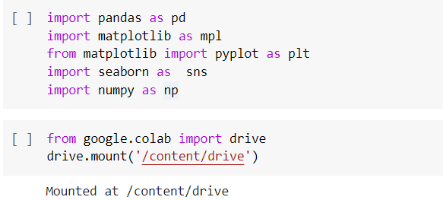
Importing Libraries
Importing Dataset

Slide 21
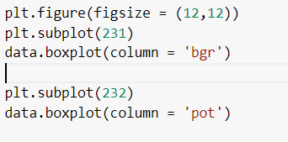
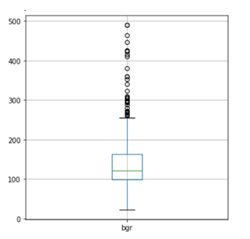
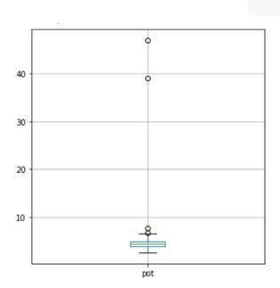
Detecting Outliers

Slide 22
Filling Missing Values
Data cleaning in data mining is the process of detecting and removing corrupt or inaccurate records from a record set, table or database.
This improves the quality of the training data for analytics and enables accurate decision-making.
Some data cleaning methods :-
You can use the attribute mean to fill in the missing value.
Use the most probable value to fill in the missing value.
You can fill in the missing value manually.
Encoding
Machine learning models require all input and output variables to be numeric.
This means that if your data contains categorical data, you must encode it to numbers before you can fit and evaluate a model.
For example in our dataset, whether a person is suffering from hypertension is given as yes or no labels. We encode them to 1 and 0 respectively.

Slide 23
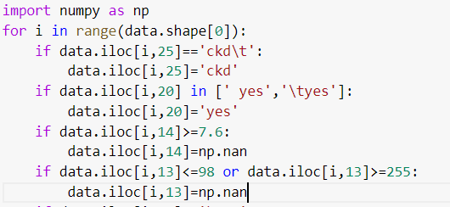
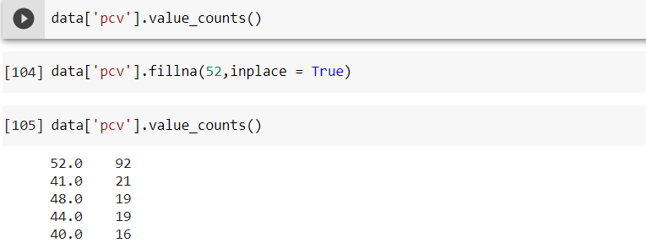

Handling Mistyped and null values

Slide 24
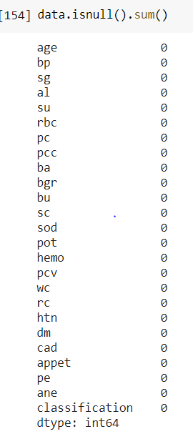
After filling the null values, there 0 null values in every feature of the dataset

Slide 25
Data Visualization
Visualization plays a key role in identifying key features to build our model.
With the help of visualization, we can see how the data look like and what kind of correlation is held by the attributes of the data.
Different methods are used for data visualization which include count plot, density plot, heap maps.
Seaborn Distplot
A Distplot or distribution plot, depicts the variation in the data distribution. Seaborn Distplot represents the overall distribution of continuous data variables. The Seaborn module along with the Matplotlib module is used to depict the distplot with different variations in it. The Distplot depicts the data by a histogram and a line in combination to it.
Count Plot
seaborn.countplot() method is used to Show the counts of observations in each categorical bin using bars. A count plot can be thought of as a histogram across a categorical, instead of quantitative, variable. The basic API and options are identical to those for barplot(), so you can compare counts across nested variables.

Slide 26
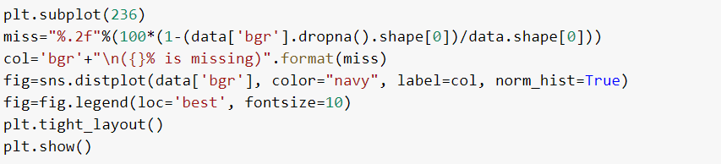
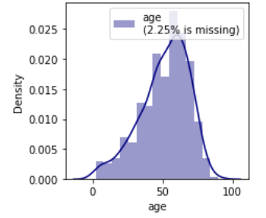
Heat map
Heat map is defined as a graphical representation of data using colors to visualize the value of the matrix. In this, to represent more common values or higher activities brighter colors basically reddish colors are used and to represent less common or activity values, darker colors are preferred. Heat map is also defined by the name of the shading matrix. Heat maps in Seaborn can be plotted by using the seaborn.heatmap() function.
Code for Distplot
Output

Slide 27
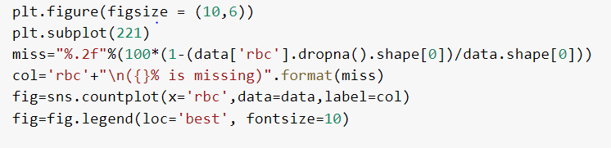
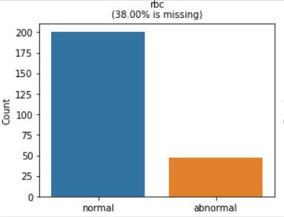
The above image represent the distplot for age in which, The length of the bar represent the count, The height of the line represents the density for that numerical value, The legend represents the percentage of missing values of that particular column.
Code for Count Plot
Output
The image represent the countplot for red blood cells in which, The length of the bar represent the count, X-axis represents the variables in that column, The legend represents the percentage of missing values of that particular column.

Slide 28
Data Augmentation
Data augmentation is a technique used to increase the amount of data by adding slightly modified copies of already existing data or newly created synthetic data from existing data. It acts as a regularizer and helps reduce overfitting when training a machine learning model. It is closely related to oversampling in data analysis.
Steps Involved:
First, we read the dataset in the form of exce.
We will separate the columns, in their respective variables.
Later we will find the Standard Deviation for every column and store it into another variable.
We will consider an empty list, and we add the existing rows into the list, by considering a dictionary in which column name is key and data is considered as value.
Later, we will add the new rows with random values in the range of standard deviation of the columns using random() function in numpy.
Finally we will convert the list into a dataframe and it is converted into a csv file.

Slide 29
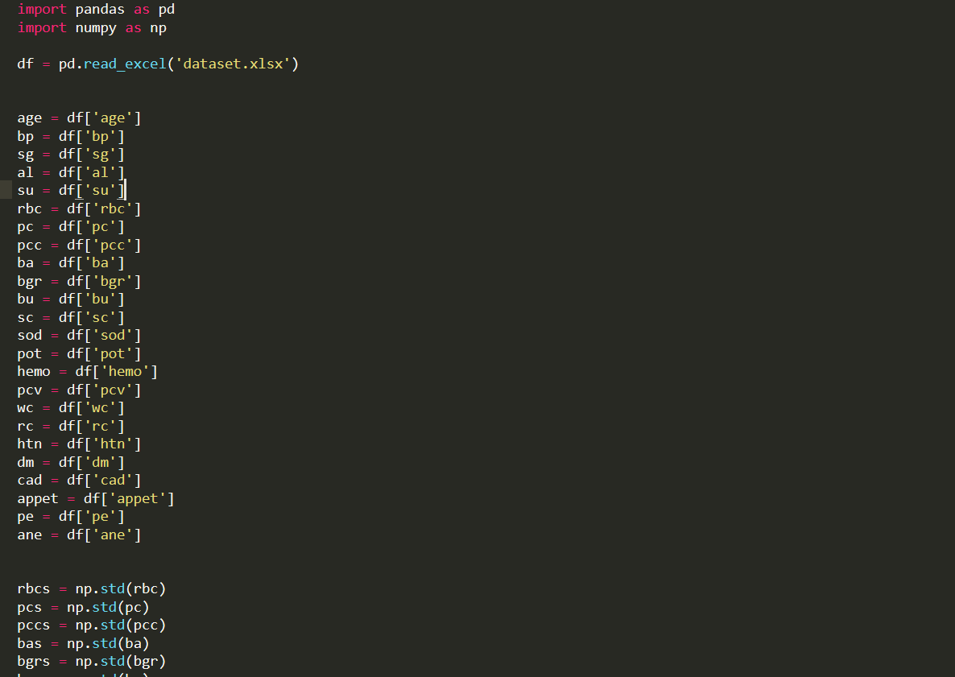
Data Augmentation

Slide 30
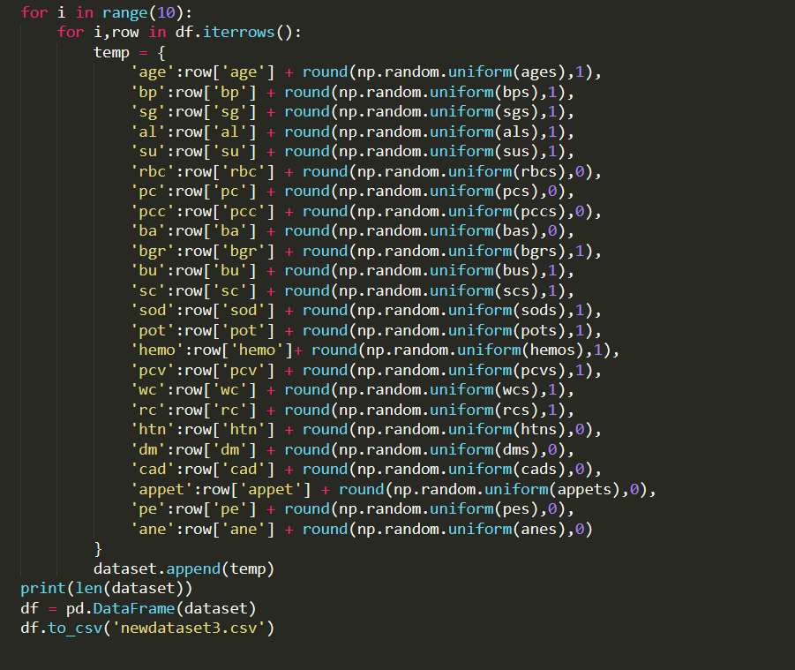

Slide 31
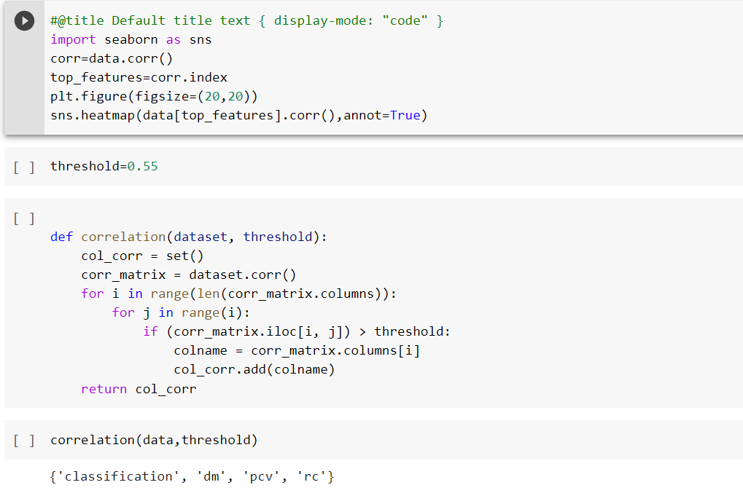
Feature Selection
It is the process of reducing the number of input variables when developing a predictive model.
Here we used Correlation heat map and one of the wrapper methods (Forward Feature Selection) techniques.
HeatMap

Slide 32
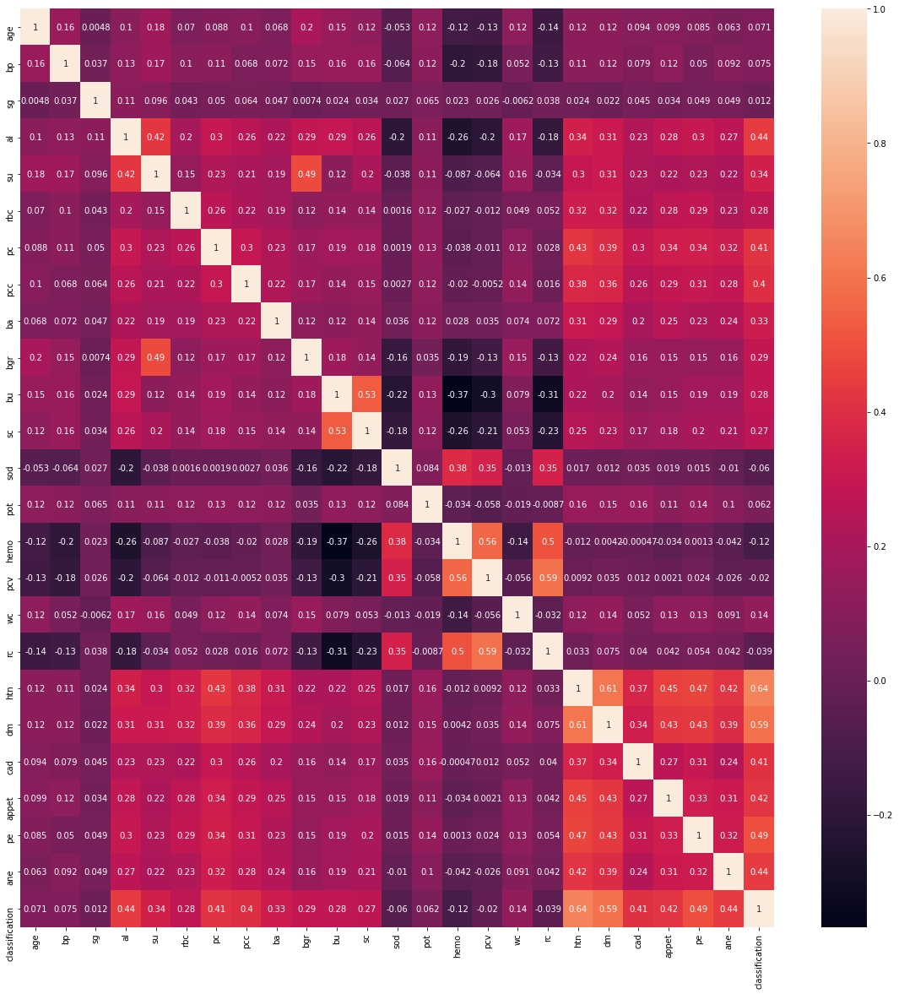

Slide 33
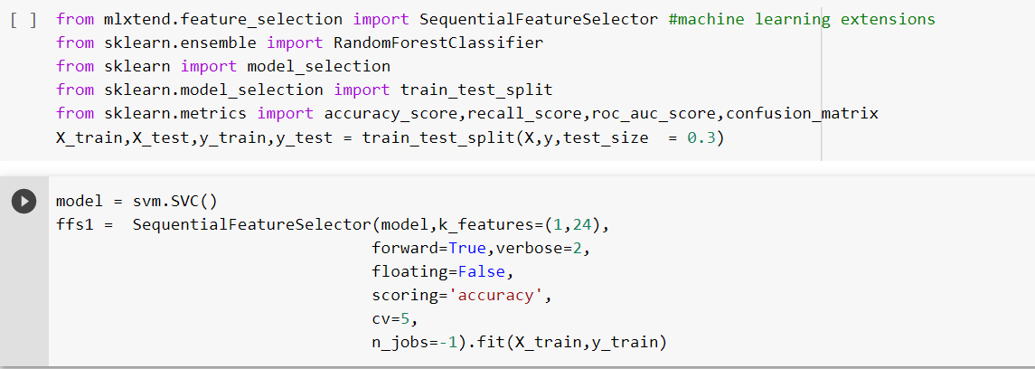
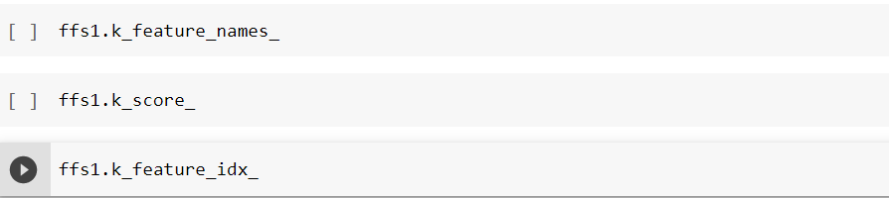
Forward Feature Selection

Slide 34
Applying classification algorithms
Naive Bayes algorithm: It is a classification technique based on Bayes’ Theorem with an assumption of independence among predictors. In simple terms, a Naive Bayes classifier assumes that the presence of a particular feature in a class is unrelated to the presence of any other feature.
Support Vector Machine: The goal of the SVM algorithm is to create the best line or decision boundary that can segregate n-dimensional space into classes so that we can easily put the new data point in the correct category in the future. This best decision boundary is called a hyperplane. SVM chooses the extreme points that help in creating the hyperplane. These extreme cases are called Support Vectors.
Random Forest: It is based on the concept of ensemble learning, which is a process of combining multiple classifiers to solve a complex problem and to improve the performance of the model. As the name suggests, "Random Forest is a classifier that contains a number of decision trees on various subsets of the given dataset and takes the average to improve the predictive accuracy of that dataset."

Slide 35
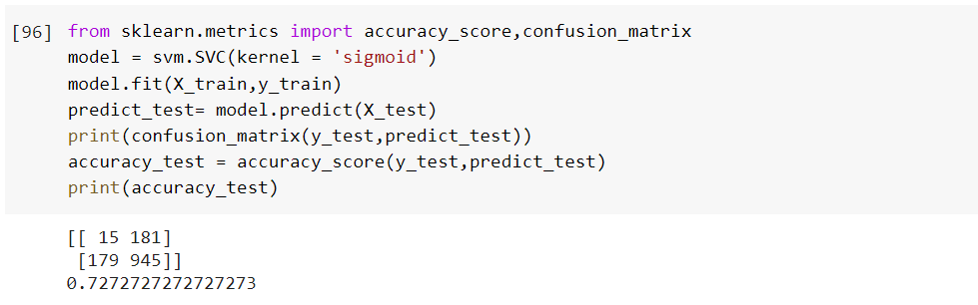
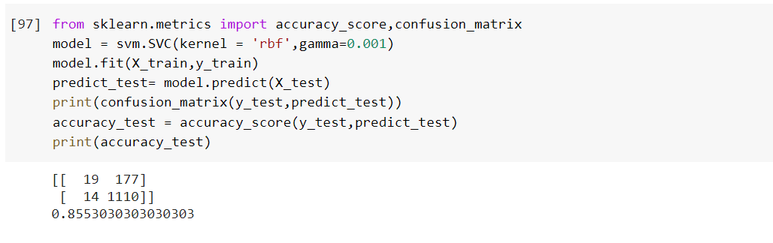
Support vector Machine

Slide 36
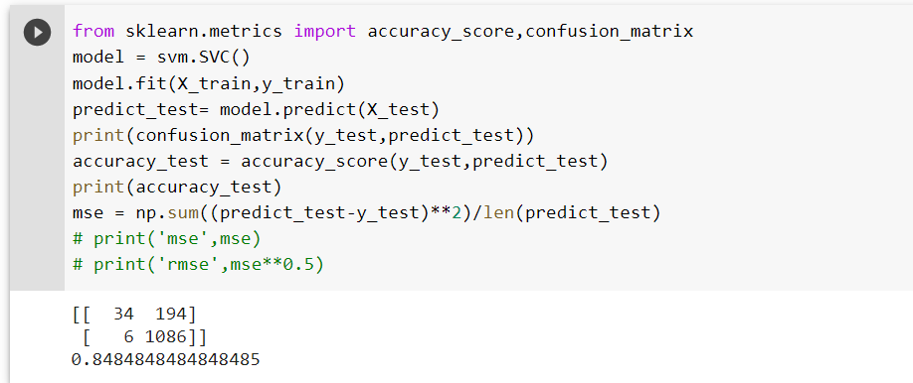
Support Vector Machine

Slide 37
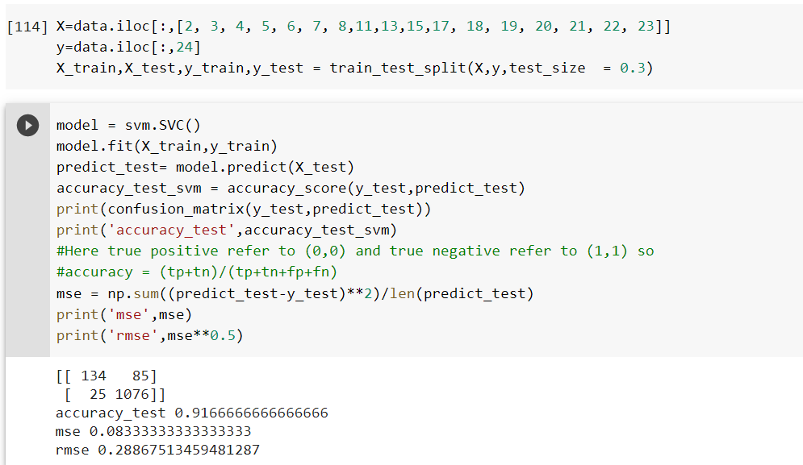
Support Vector Machine using Feature Selection

Slide 38
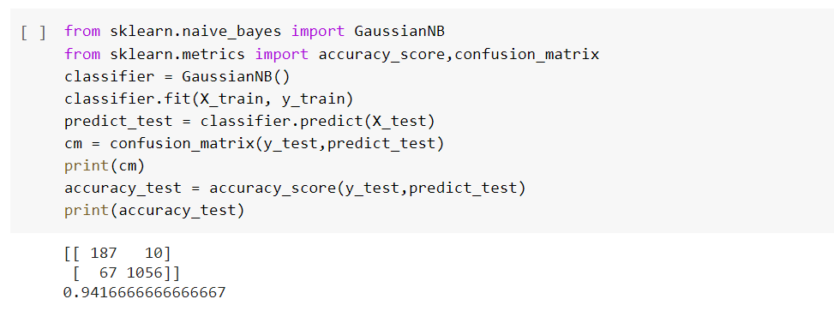
Naive Bayes

Slide 39
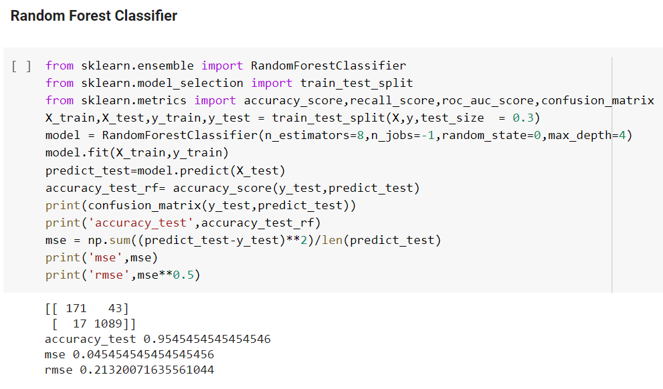
Random Forest

Slide 40
Testing
Test Case1:
row =[68.0, 80.0, 1.01, 3.0, 2.0, 0.0, 1.0, 1.0, 1.0, 157.0, 90.0, 4.1, 130.0, 6.4, 5.6, 16.0, 11000.0, 2.6, 1.0, 1.0, 1.0, 1.0, 1.0, 0.0]
Age - 68 Bp - 80 Sg - 1.01 Al - 3 Su - 2 Rbc - 0 Pc - 1 Pcc - 1 Ba - 1 | Bgr - 157 Bu - 90 Sc - 4.1 Sod - 130 Pot - 6.4 Hemo - 5.6 Pcv - 16 Wc - 11000 Rc - 2.6 | Htn - 1 Dm - 1 Cad - 1 Appetite - 1 Pe - 1 Ane - 0
Output:
1

Slide 41
Test Case2:
row = [52.0, 80.3, 1.01, 0.0, 0.0, 0.0, 0.0, 0.0, 0.0, 120.0, 34.0, 1.0, 138.3, 6.5, 13.6, 38.8, 10016.6, 8.0, 0.0, 0.0, 0.0, 1.0, 1.0, 0.0]
Age - 52 Bp - 80.3 Sg - 1.01 Al - 0 Su - 0 Rbc - 0 Pc - 0 Pcc - 0 Ba - 0 | Bgr - 120 Bu - 34 Sc - 1 Sod - 138.3 Pot - 6.5 Hemo - 13.6 Pcv - 38.8 Wc - 10016.6 Rc - 8 | Htn - 0 Dm - 0 Cad - 0 Appetite - 1 Pe - 1 Ane - 0
Output
0

Slide 42
THANK YOU

