Slide 1
F
E
D
Accessible solutions
C
B
A
A Low-Cost Assistive Web App for Deaf and Hard-of-Hearing Users
Amy Eden – 2514468e
Supervised by Derek Somerville
Notes:
Hi, welcome to my fourth-year dissertation project: Accessible solutions – a low-cost assistive web-app for deaf and hard-of-hearing users

Slide 2
F
E
Motivation
D
C
B
Over 5% of the global population, need rehabilitation for their hearing loss.
Approx. 80% of individuals with hearing loss reside in countries classified as low- and middle-income.
The cost-of-living crisis in the UK affects those who cannot afford essential assistive technology.
Abandoning assistive technology has links to dementia and mortality as well as mental stress.
A
Notes:
Over 5% of the global population, need rehabilitation for their hearing loss. By 2050, it is projected that this number will surpass 700 million, affecting approximately one in every ten people worldwide.
Currently, approximately 80% of individuals with hearing loss reside in countries classified as low- and middle-income. Several frameworks aim to advance assistive technology implementation in low- and middle-income countries, such as the Global Cooperation on Assistive Technology and the United Nations Convention on the Rights of Persons with Disabilities (CRPD). However, these mandates have been neglected due to insufficient funding, hindering progress.
In the UK, the cost-of-living crisis hits impoverished individuals hard, making essential assistive technology unaffordable. This worsens existing inequalities, hindering health management and communication for those in need.
Abandoning assistive technology poses challenges in speech interpretation, leading to diminished capacity for effective communication, delays in language acquisition, economic and educational disadvantages, social isolation, stigmatisation, and a compromised quality of life. Recent studies have also shown links to abandoning hearing aids to dementia and mortality. Hearing aids are crucial interventions, effectively mitigating these challenges and improving the quality of life for individuals with hearing loss.

Slide 3
F
E
Aims
D
C
Affordable
Inclusive
User-Centric
Usable
Collaborative
Versatile
B
A
Notes:
Here we define 6 project aims that we wish to accomplish:
The web-app should be affordable with the application’s primary aim being to offer its services entirely free of charge, lessening any financial barriers that could limit access to essential assistive technologies for the Deaf and Hard-of-Hearing community.
The web-app should be inclusive and should aim to cater to individuals across the spectrum of hearing loss, acknowledging and addressing the diverse needs and variations among users. Its features are tailored to be adaptable and accommodating for all levels of hearing loss.
The web-app should be user-centric meaning that throughout the development and evolution of the application, the primary focus is to prioritise user needs, preferences, and feedback. Regular updates and feature enhancements stem from user engagement studies, ensuring that the platform evolves in direct response to user input.
The web-app should be usable where the application is engineered with usability at its core, ensuring users of all abilities can utilise the web-app. This includes adherence to universal design principles, variability for text features, being able to access the web-app on various devices and integrating intuitive interfaces to accommodate a wide range of users.
The web-app should be collaborative meaning The platform should foster a sense of community and engagement, encouraging the Deaf and Hard-of-Hearing community to actively participate in its upkeep, suggest improvements, report issues, and collectively contribute to its maintenance and growth.
The web-app should be versatile, recognising the diversity in device usage, ensuring seamless functionality across various devices and operating systems, including smartphones, tablets, laptops, Raspberry pi, and desktops. This ensures users can access the platform conveniently regardless of their preferred device.
From these aims we also define UI and UX requirements that will be assessed in the final evaluation.

Slide 4
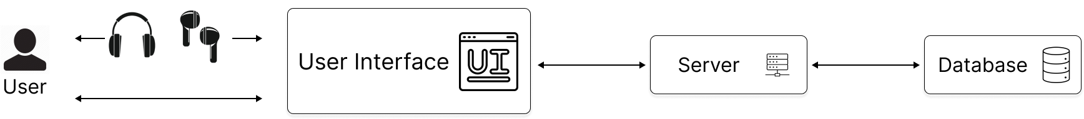
F
E
D
C
B
Architecture
A
Speech-to-text
Text-to-speech
Audio playback
Profiles
Saves
Notes:
Here is the design architecture of the web-app, allowing users to interact with the user interface with or without hardware depending on their intended features. We leverage React's client and server-based architecture, utilizing RESTful APIs for simplified data exchange and ensuring interoperability.

Slide 5
F
E
Initial Approach
D
C
Real time amplification
Edge-computing for user data
Speech Recognition
Speech Synthesis
B
A
Notes:
Moving onto implementation, the initial requirements of the project aimed at real-time sound amplification, alongside edge computing for additional functionalities like user information management, speech recognition, and synthesis.
However, as our research deepened and time constraints became apparent, we made strategic decisions to streamline our focus to a simplified approach, substituting real-time amplification with a more manageable frequency cut-off mechanism along-side gain and Q value adjustment, enabling users to manipulate sound waves effectively through their earbuds.
Additionally, instead of delving into intricate edge computing processes, we simplified the architecture to incorporate essential elements through API calls.

Slide 6
F
E
Technology
D
C
B
A
Notes:
Here we will outline our technological stack

Slide 7
F
E
Technology
D
C
React
B
A
Notes:
Starting with React being the framework that allowed us to build the web application.

Slide 8
F
E
Technology
D
C
React
Web Speech API
B
A
Notes:
We used Web Speech API for Speech Recognition and Speech Synthesis. The Web Speech API empowers the integration of voice data into web applications, consisting of two primary components: SpeechRecognition for Asynchronous Speech Recognition and SpeechSynthesis for Text-to-Speech capabilities.

Slide 9
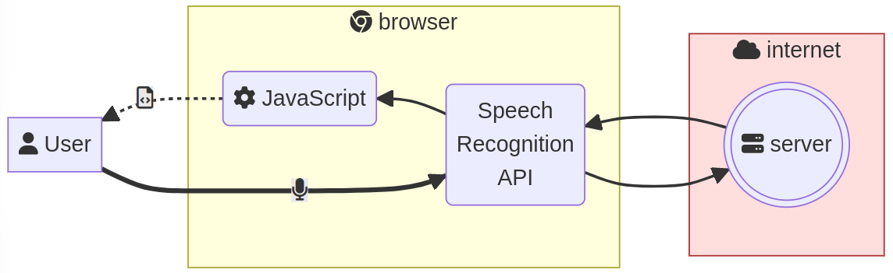
F
E
Web Speech API
D
C
Speech Recognition
B
A
Notes:
The Web Speech API's speech recognition captures speech via a device's microphone. This input is checked against a predefined grammar list. Upon successful recognition, the result is returned as text, triggering subsequent actions.

Slide 10
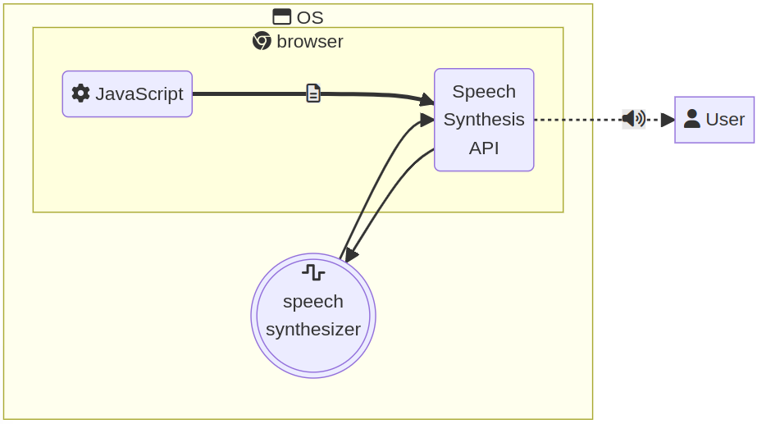
F
E
Web Speech API
D
C
Speech Synthesis
B
A
Notes:
The Web Speech API smoothly integrates speech synthesis, enabling text-to-speech conversion.
It enhances vocal communication by providing clear, customizable auditory feedback. Controlled by the SpeechSynthesis interface, it utilizes the device's default speech synthesizer.
Various voice options are managed by SpeechSynthesisVoice objects, while SpeechSynthesisUtterance objects encapsulate designated text sections for speech. This feature ensures compatibility and optimal performance across operating systems.

Slide 11
F
E
Technology
D
C
React
Web Speech API
B
A

Slide 12
F
E
Technology
D
C
React
Web Speech API
Web Audio API
B
A
Notes:
We used Web Audio API for real-time sound manipulation to allow for the audio playback feature.

Slide 13
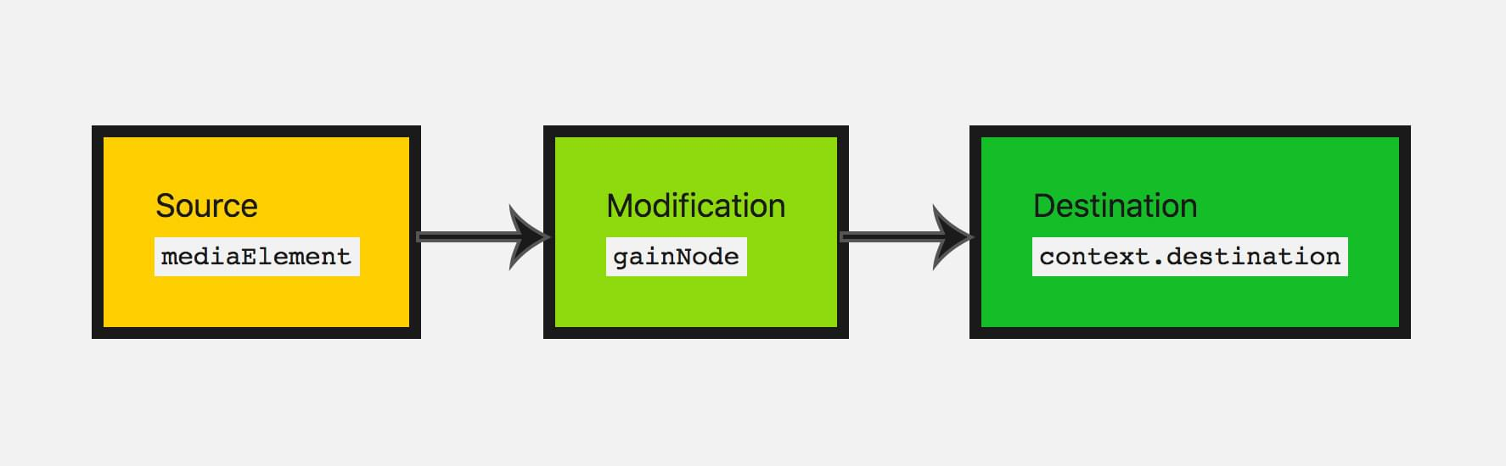
F
E
Web Audio API
D
C
B
A
Notes:
The Web Audio API offers developers a comprehensive toolset for audio manipulation on the web.
Operating within an audio context, it utilizes a modular routing system where interconnected audio nodes form an audio routing graph.
These nodes represent various audio sources like oscillators, buffers, media elements, and streams.
Developers can dynamically process audio samples, applying effects, adjusting volume levels, and spatializing audio.

Slide 14
F
E
Technology
D
C
React
Web Speech API
Web Audio API
B
A

Slide 15
F
E
Technology
D
C
React
Web Speech API
Web Audio API
Clerk
B
A
Notes:
We used Clerk to be able to make profiles for users to save audio instances.

Slide 16
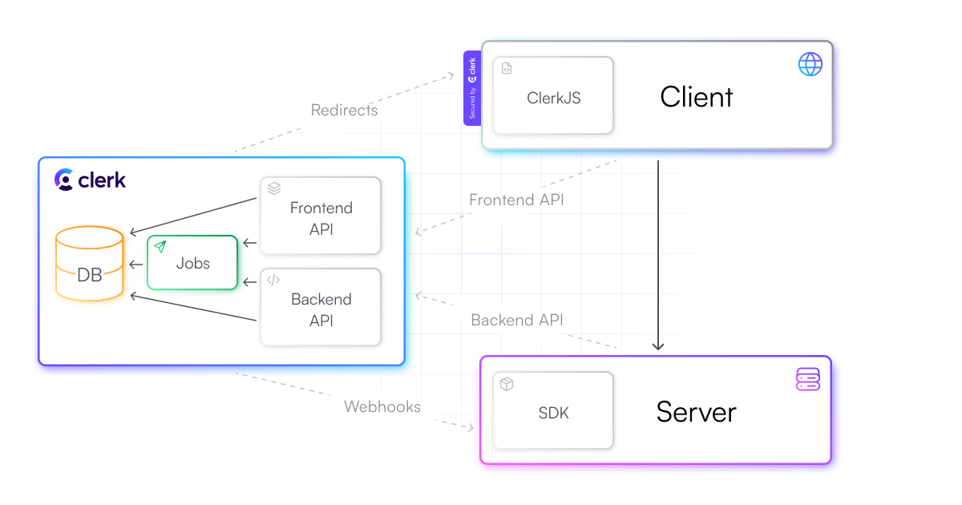
F
E
Clerk
D
C
B
A
Notes:
Clerk is a cloud-based authentication service, offering seamless integration with various front-end frameworks. It boasts a feature-rich environment covering user management, multi-factor authentication (MFA), and more.
Clerk's React API simplifies authentication tasks with pre-built components reducing development overhead.
Additionally, Clerk provides a solution for storing and managing user instances, enhancing the user experience. Developers can implement a secure system for users to save and select instances within their applications.

Slide 17
F
E
Technology
D
C
React
Web Speech API
Web Audio API
Clerk
B
A

Slide 18
F
E
Technology
D
C
React
Web Speech API
Web Audio API
Clerk
GitHub Pages
B
A
Notes:
Finally, we published the web-app using GitHub Pages with the advantage of seamless integration with other GitHub features, including issues and pull requests, streamlining the development workflow.

Slide 19
F
E
D
C
Live Demo
B
A
Notes:
Now we will perform a live demo!

Slide 20
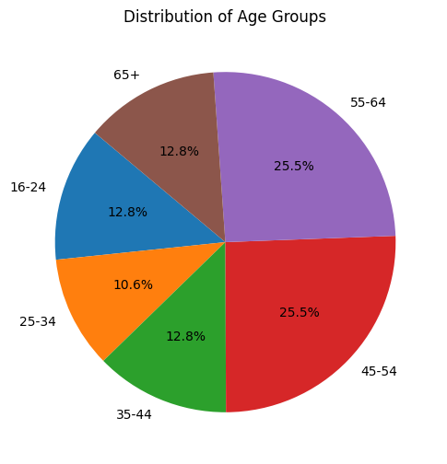
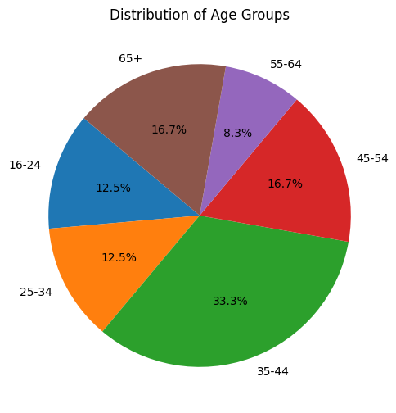
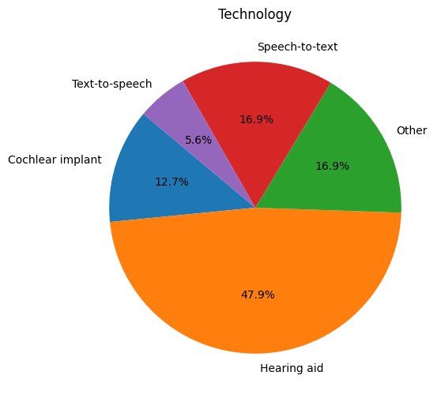
F
E
D
C
B
A
Notes:
Our first survey had a majority of individuals aged 45 to 64, indicating a skew towards an older demographic. This underscores the importance of tailoring the web-app's UI/UX to suit the needs and preferences of this age group. However our second survey had a majority of 35-44 indicating a need to be versatile for all age groups.
For technology, a large majority of participants relied on hearing aids, along with speech-to-text and text-to-speech.

Slide 21
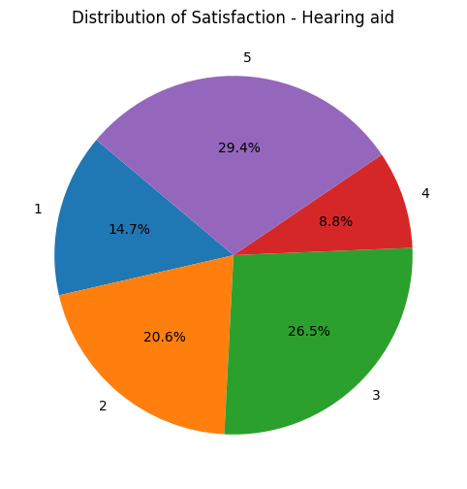
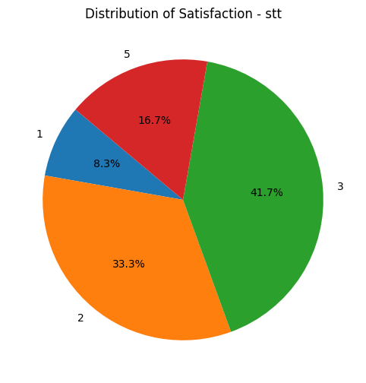
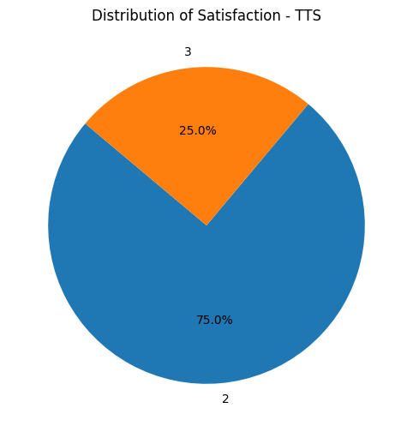
F
E
D
C
B
A
Notes:
While the satisfaction levels for hearing aids are spread out, the majority express high satisfaction. This satisfaction level drops with speech to text technology and drops even more with text-to-speech features. Our application aims to increases these satisfaction levels.

Slide 22
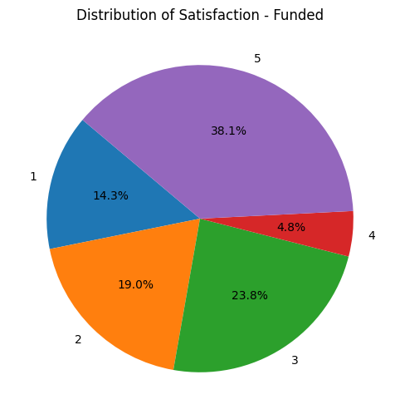
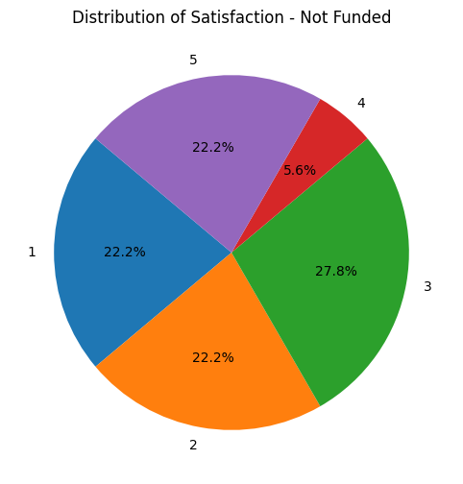
F
E
D
C
B
A
Notes:
A noteworthy finding from the survey relates to the funding status of assistive technologies, with a slight majority of respondents receiving funding support.
However, satisfaction levels differ between funded and non-funded individuals, with funded users expressing higher levels of satisfaction.
Interestingly, while a considerable portion of respondents spend nothing on assistive technology, those who do report spending over £1,000 exhibit varying levels of satisfaction. These findings emphasise the complex interplay between funding, costs, and user satisfaction in the adoption and utilisation of assistive technologies. It also underscores the need for low-cost solutions.

Slide 23
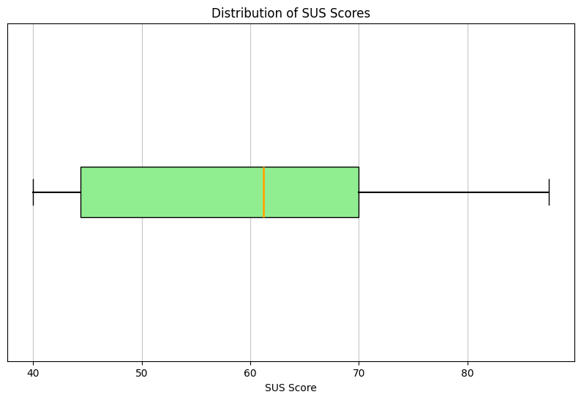
F
E
D
C
B
A
Notes:
Overall, the average System Usability Scale (SUS) score of 59.69, reflects generally positive usability experiences with assistive technologies, suggesting areas for improvement that we hope this web-app will bridge.

Slide 24
F
Features to Assess
E
D
C
B
Intuitive
Accurate
Comfortable
Usable
A
Notes:
Our evaluation intends to assess each feature against qualities such as being: - does each feature feel intuitive? - does each feature perform accurately? - does each feature feel comfortable to use? - is each feature usable?
We measure these by allowing participant engagement by introducing them to the entire system and guiding them through five tasks, each followed by a questionnaire. Finally, we administer a usability questionnaire, a modified System Usability Scale (SUS), to assess the web-app's effectiveness in meeting its requirements.

Slide 25
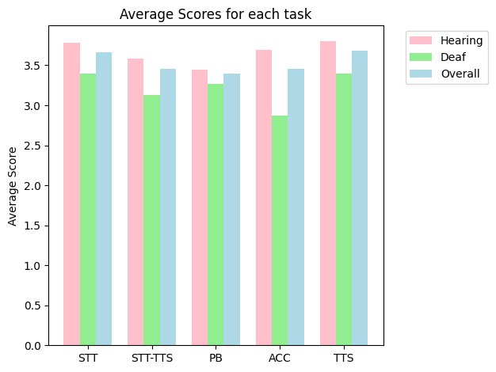
F
E
D
C
B
A
Notes:
Each task was rated higher or equal to 2.9 on a scale of 0-4, which is higher than the scores given in the survey for speech-to-text and text-to-speech. This indicates that each feature was indeed intuitive, accurate and comfortable with room for improvement.
Some challenges outlined in the speech-to-text feature were:
the feature’s occasional failure to recognise acronyms like ’LOL’, often mistaking them for ’Hello’.
Others observed minor inaccuracies in the transcription, attributing them to their strong Yorkshire accent. The persistent challenge posed by accent variations in speech recognition systems is a notable issue
Accuracy was dependant on the microphone device uses (i.e. wired headphones or the laptops built-in microphone had better accuracy)
one participant reported compatibility issues with the ’Ark’ browser, attributed to restrictions within the Web Speech API that render it suitable for specific browsers
For playback:
Some suggested that although the amount of variables can be effective to manipulate sound, some may find it difficult to learn, hence abandoning the web-app
Others suggested a better user guide, which we did update for more clarity and understanding, aiming to mitigate this issue
- One participant highlighted the necessity for significant layout improvements. They specifically noted the need for increase spacing between elements, noting frustration when using the web-app on a mobile devices due to their larger fingers. In response, we implemented borders between each feature and increased spacing between variables to address these usability concerns effectively.
For saves:
Despite many positive responses regarding the trigger word feature for naming saves, it was observed that the accuracy of save names depended heavily on how the speech recognition system formatted words. For instance, one participant named a save "passthrough”, as a full word, but the system outputted the text as "pass through," leading to the trigger word not being detected
For text to speech;
Participants expressed frustration with default settings, mentioning that their devices would revert to default settings, requiring them to change language or voice settings repeatedly, which they found cumbersome
some participants found the text-to-speech output to be choppy and unnatural, lacking the fluidity of a normal conversation.

Slide 26
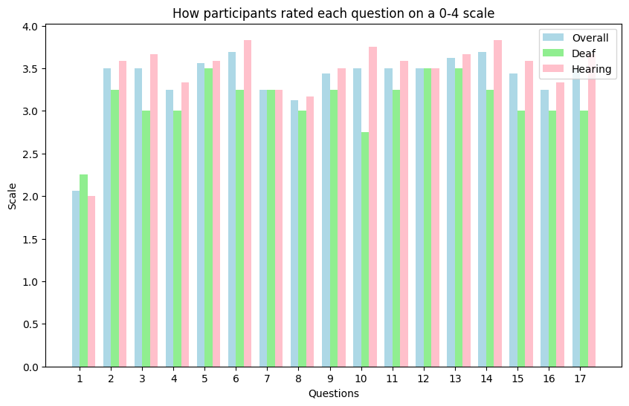
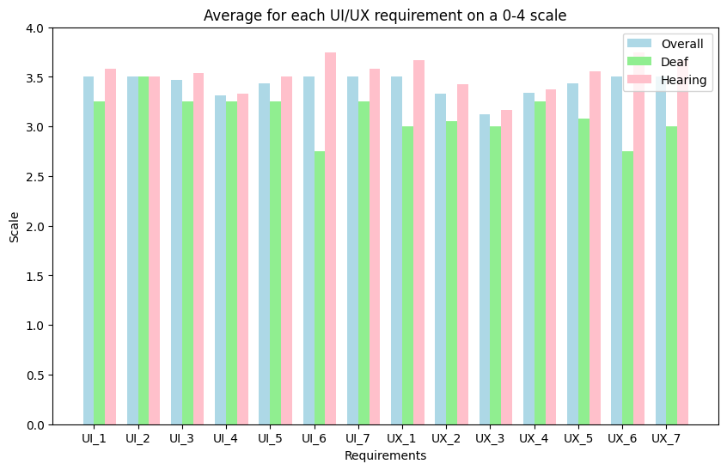
F
E
D
C
B
A
Notes:
Each question in the survey was linked to a specific project requirement to assess if project aims were achieved.
The examination revealed that all requirements received ratings equal to or greater than 2.75, with an average of 3.12 and a standard deviation on 0.2, indicating successful fulfilment of all objectives.
The requirement with the highest rating, reflected the web-app's consistency. This positive feedback highlights the effectiveness of maintaining uniformity throughout the user interface, contributing to a smoother user experience.
Notably, the lowest rated requirements reflected the need to enhance error communication and user guides. Participants encountered difficulties with the user guide, prompting revisions for clearer explanations.

Slide 27
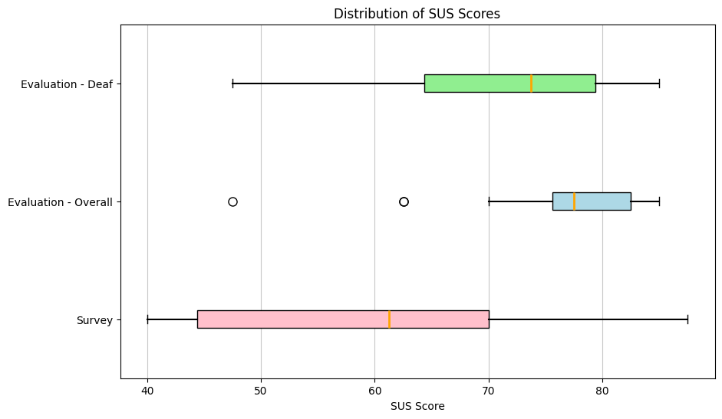
F
E
D
C
B
A
Notes:
We calculated an official SUS score of 75.6 from hearing participants and 70 from Deaf and Hard-of-Hearing participants. While the 5.6-point deviation isn't notably large, it suggests areas for improvement in the web-app.
Comparing these SUS scores to those from the usability survey, a remarkable increase is evident. The survey SUS score was significantly lower than the score obtained in this evaluation. This suggests that our web-app exhibits greater usability compared to current assistive technologies utilized by the Deaf and Hard-of-Hearing community.
** pause in case want to remove **
It is important to note that there are limitations within this evaluation with it’s small sample size of 17 (noting that only 5 of these are Deaf or Hard-of-Hearing). Additionally, participants with personal connections to the developers may provide feedback influenced by loyalty or familiarity, rather than unbiased assessments of usability.
** pause in case want to remove **

Slide 28
Conclusion
F
E
D
The study delved into the technical aspects of utilising the Web Speech API, evaluating its effectiveness in real-time scenarios, and considering the user experience and usability of the developed features.
It was found that this web app was seen to be 17.4% more effective than current assistive technology.
The web-app, though informed by the Deaf and Hard-of-Hearing community, serves as an infirmity model, helping users adapt to a hearing society.
We should consider replacing assistive technology for sign language for better integration.
C
B
A
Notes:
This study delved into the technical aspects of utilising the Web Speech API, evaluating its effectiveness in real-time scenarios, and considering the user experience and usability of the developed features in an attempt to bridge the gap left vacant by legislation.
Throughout this project, we defined numerous requirements to be fulfilled to demonstrate the feasibility of low-cost assistive technology. The analysis of our outlined requirements indicated that the web-app met these requirements, with room for improvement. Additionally, the evaluation resulted in a usability rating 17.4% higher than the score given for current assistive technology.
Although this project did involve the Deaf and Hard-of-Hearing community for their opinions and guidance on assistive technology, it is important to note that this web-app is an infirmity model as the web-app’s features aim to modify hearing loss to accustom Deaf users to a hearing society.
The Deaf and Hard-of-Hearing community are tired of the countless surveys being forced upon them with no significant outcome for their community. We should consider their opinions about replacing assistive technology with sign language to integrate both hearing and Deaf communities together, such as Deafness on Martha’s Vineyard, leading to a fully integrated community where communication barriers and feelings of isolation due to their hearing loss are rare.

Slide 29
Future Work
F
E
D
Further exploration of speech recognition, particularly addressing accent variability.
Complex features such as: speaker detection, siren detection, and offline capabilities.
Speaker direction leveraging directional sound cues could be a potential enhancement.
These advancements have the potential to significantly improve the accessibility and usability of the web-app for users with diverse needs.
C
B
A
Notes:
For future work, it is worthwhile delving deeper into speech recognition, particularly in terms of accent variability as this emerged as a notable challenge during the evaluation process.
Additionally, there is a need to explore complex features, such as the initial real-time amplification, speaker detection, siren detection, and offline capabilities, which were not fully implemented in this project.
Moreover, a participant dd describe an intriguing feature involving speaker detection leveraging directional sound cues. This feature would visually represent the speaker’s orientation on the screen, potentially through an arrow indicator.
Such advancements could significantly enhance the accessibility and usability of the web-app for users with diverse needs.

Slide 30
F
E
D
C
B
A
Thank you

