Slide 1
F
E
D
Accessible solutions
C
B
A
A Low-Cost Assistive Web App for Deaf and Hard-of-Hearing Users
Amy Eden – 2514468e
Supervised by Derek Somerville

Slide 2
F
E
Motivation
D
C
B
Over 5% of the global population, need rehabilitation for their hearing loss
The cost-of-living crisis in the UK affects those who cannot afford essential assistive technology
Abandoning assistive technology has links to dementia and mortality as well as mental stress
A

Slide 3
F
E
Aims
D
C
Affordable
Inclusive
User-Centric
Usable
Collaborative
Versatile
B
A

Slide 4
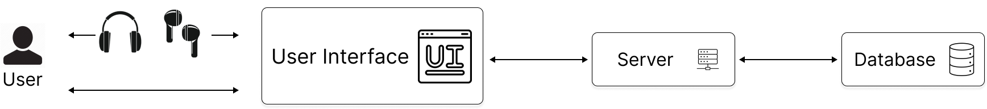
F
E
D
C
B
Architecture
A

Slide 5
F
E
Technology
D
C
React
Web Speech API
Web Audio API
Clerk
GitHub Pages
B
A

Slide 6
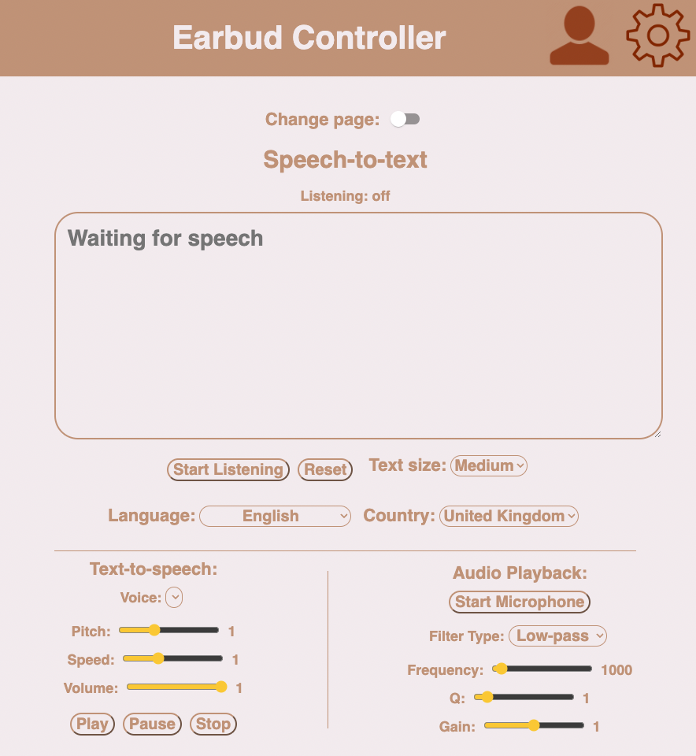
F
E
D
C
B
A

Slide 7
F
E
D
C
B
A

Slide 8
F
E
D
C
B
A

Slide 9
F
E
D
C
B
A

Slide 10
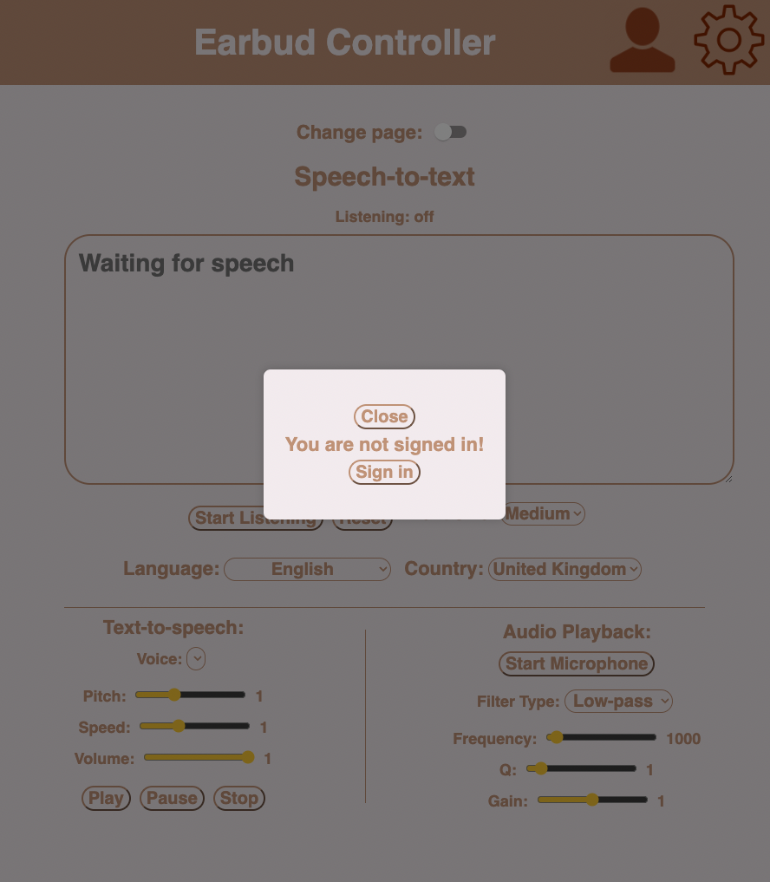
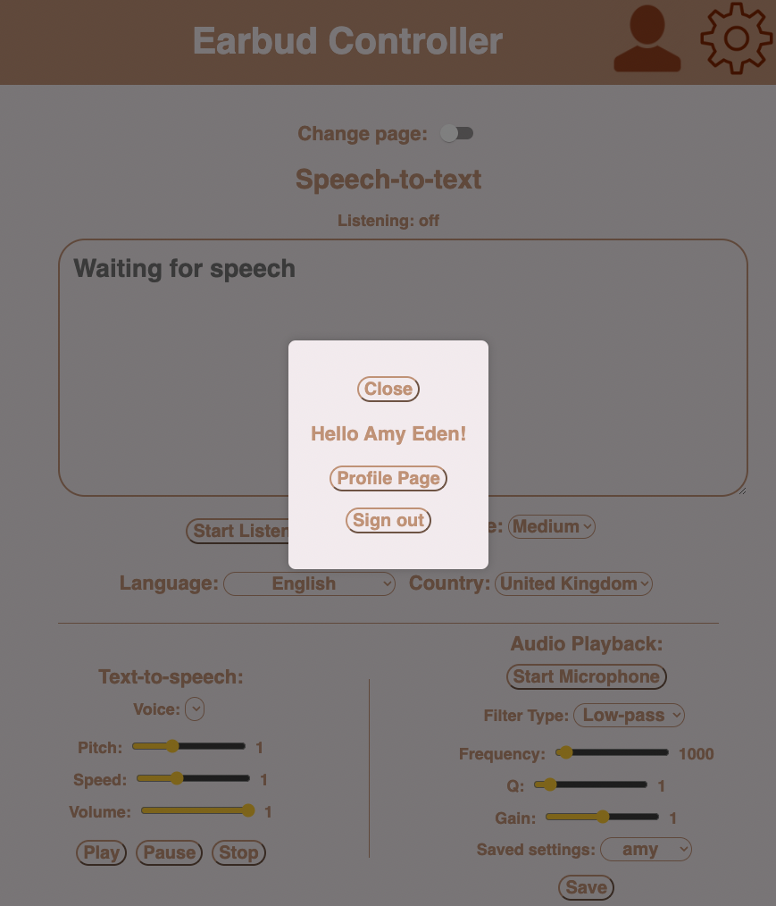
F
E
D
C
B
A

Slide 11
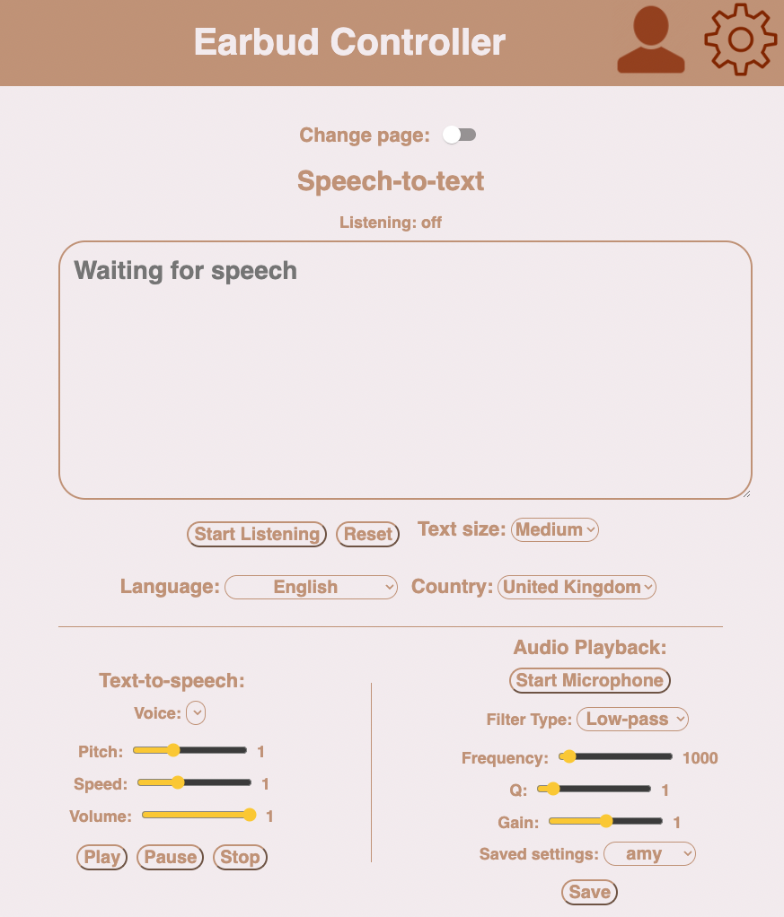
F
E
D
C
B
A

Slide 12
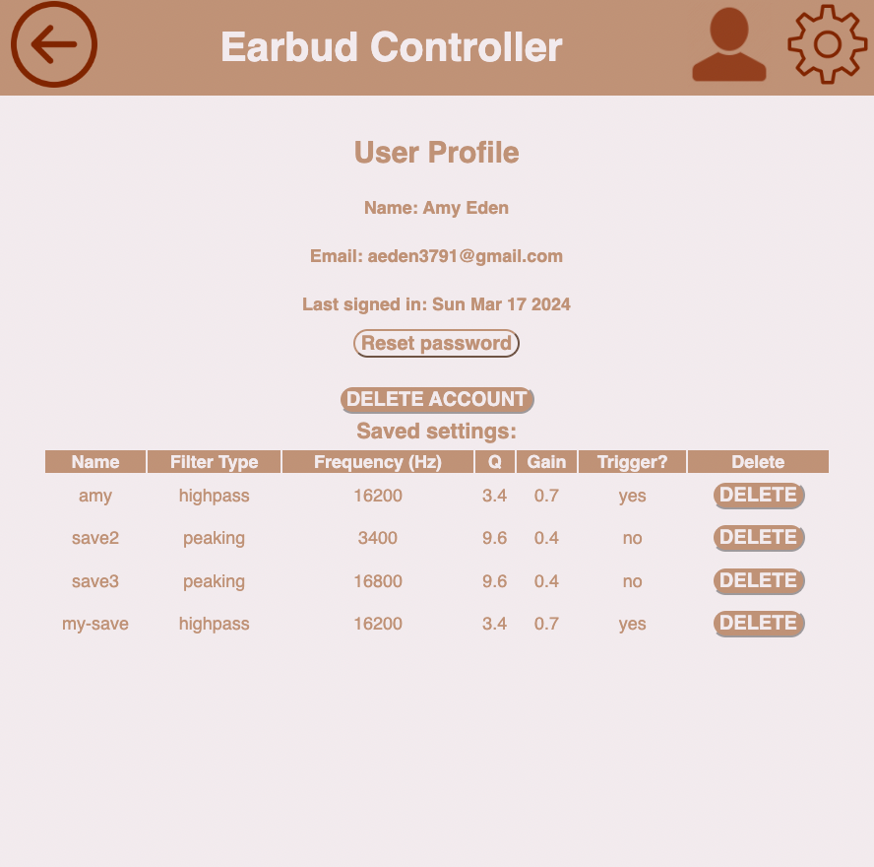
F
E
D
C
B
A

Slide 13
F
E
D
C
Live Demo
B
A

Slide 14
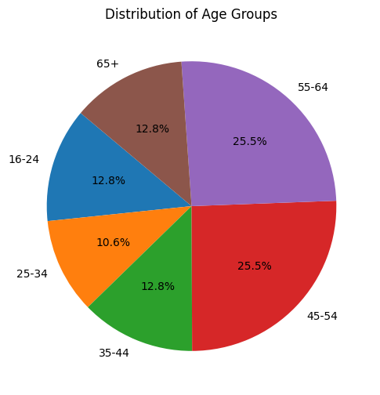
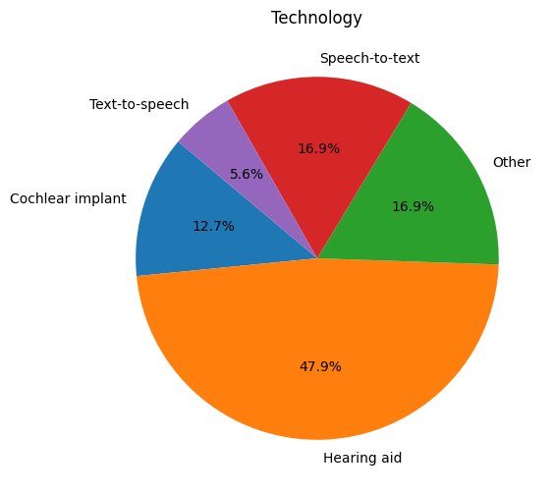
Affordability Survey
F
E
D
C
B
A
Notes:
Demographic of 45-64 age group indicates a need to tailor UI/UX for this population
Widespread reliance on assistive technologies, with nearly half using hearing aids, but satisfaction levels vary across different technologies

Slide 15
Affordability Survey
F
E
D
Higher satisfaction levels among funded users compared to non-funded individuals
Complex interplay between funding, costs, and user satisfaction underscores the challenges in adopting assistive technologies
C
B
A

Slide 16
Affordability Survey
F
E
User expectations include clear sound quality, accurate speech-to-text capabilities, ease of use, and customisation options
Preferences for discounted pricing, long battery life, offline capabilities, and compatibility with other devices, alongside concerns about privacy and data security
Approximately 28% of respondents find the proposed web-app useful, with suggestions such as incorporating features like directional sound indicators for future iterations
D
C
B
A

Slide 17
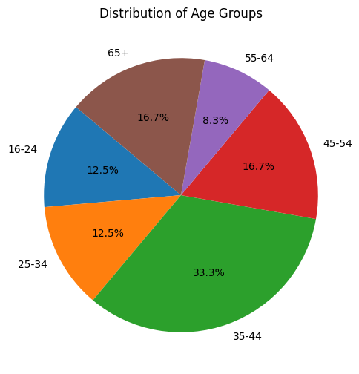
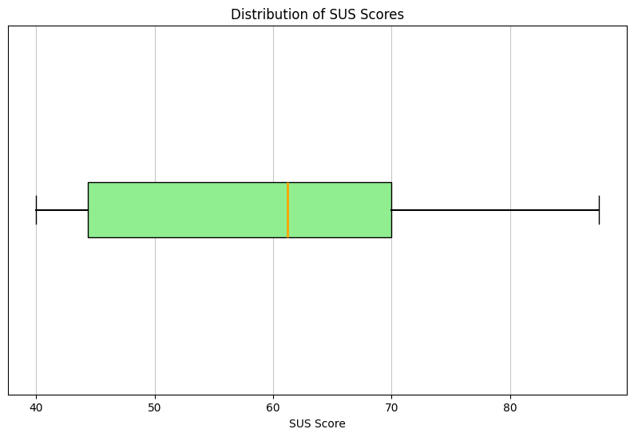
Usability Survey
F
E
D
C
B
A
Notes:
Survey gathered 24 responses primarily from the 35-44 age range, offering a new perspective on assistive technology usability
Average modified System Usability Scale (SUS) score of 59.69 out of 100 suggests generally positive usability experiences with room for improvement

Slide 18
Usability Survey
F
E
Qualitative analysis revealed frustration with phone communication due to inaccurate transcription apps and unreliable transcribing services during calls.
Limitations of current assistive technologies include reliance on Wi-Fi connectivity, challenges in noisy environments, and financial burdens
Perspective on technology serving to facilitate communication rather than fixing Deaf individuals sheds light on audism and underscores the importance of understanding and respecting Deaf culture and language
D
C
B
A

Slide 19
F
Features to Assess
E
D
C
B
Intuitive
Accurate
Comfortable
Usable
A

Slide 20
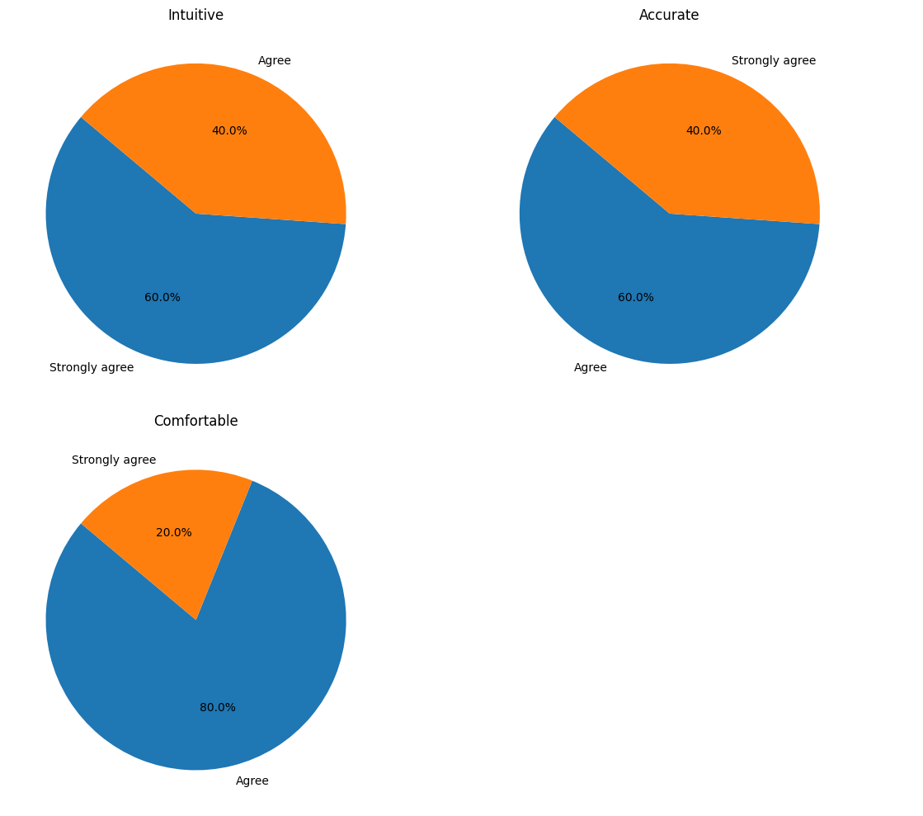
F
Speech-to-Text
E
D
C
B
A

Slide 21
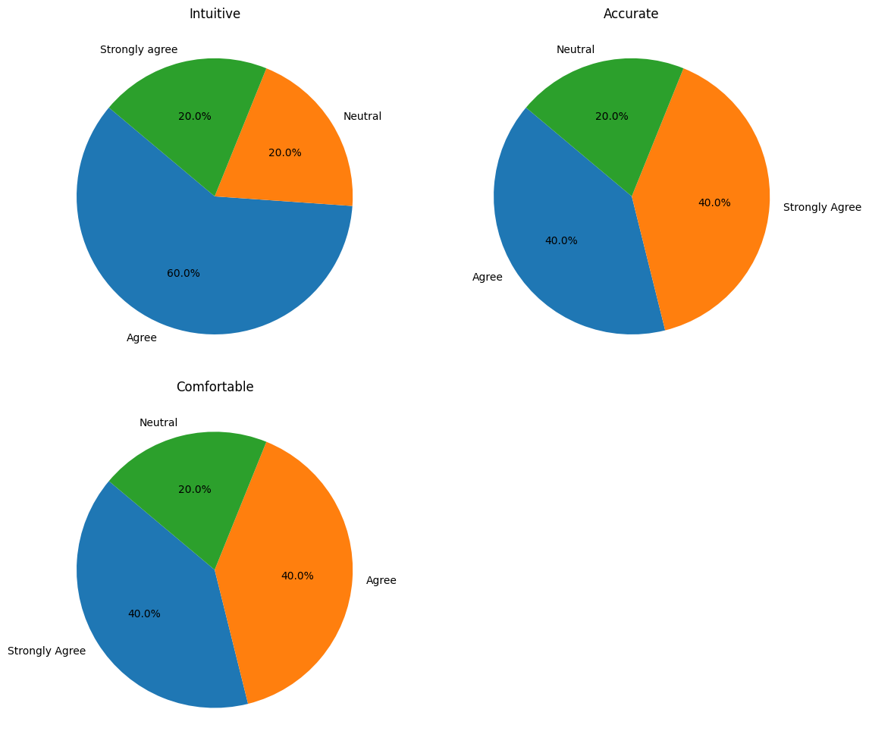
Speech-to-Text with Text-to-Speech
F
E
D
C
B
A

Slide 22
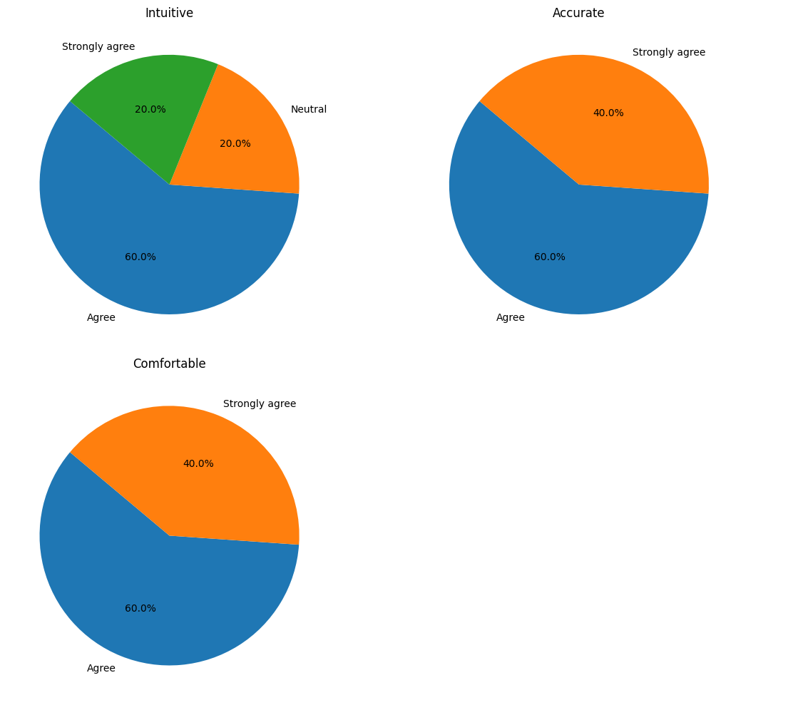
F
Audio Playback
E
D
C
B
A

Slide 23
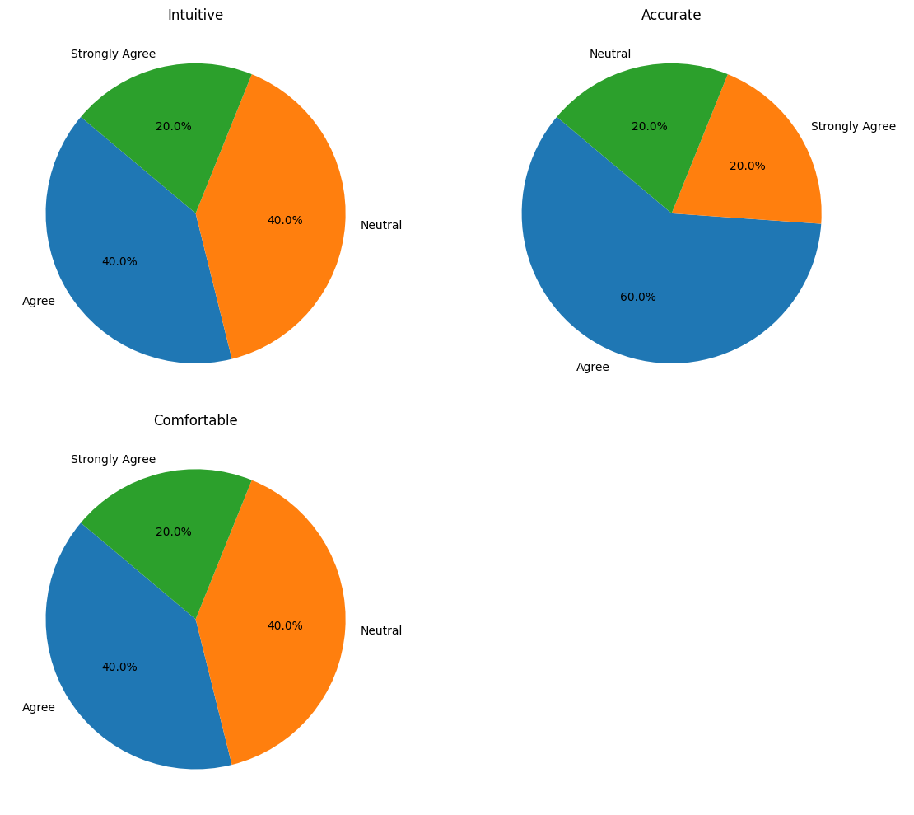
F
Account
E
D
C
B
A

Slide 24
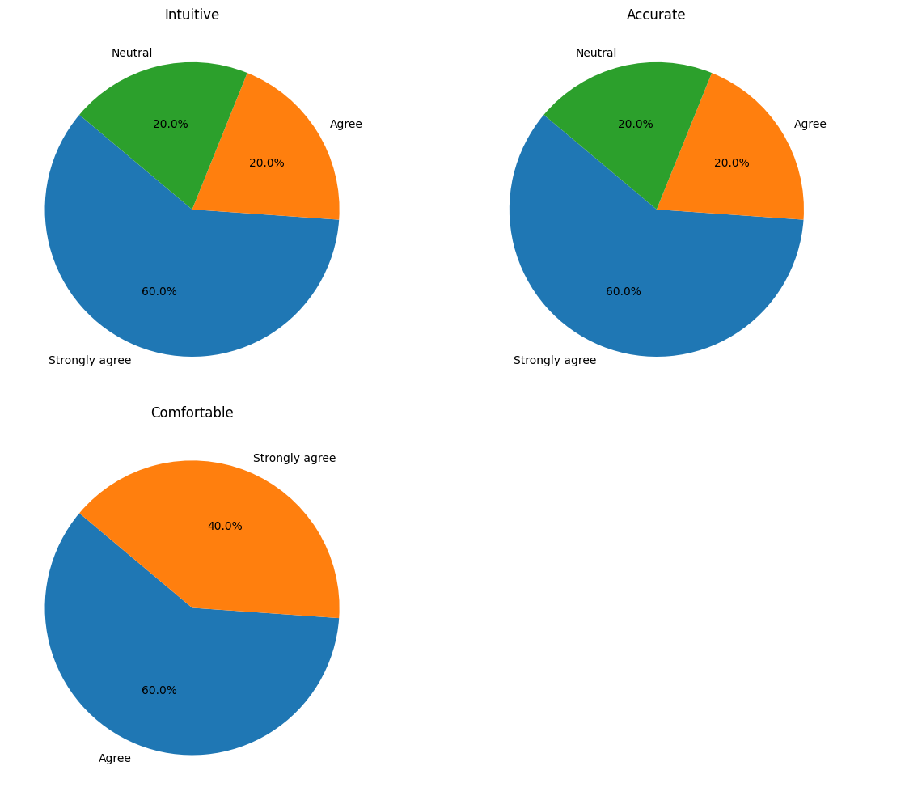
F
Text-to-Speech
E
D
C
B
A

Slide 25
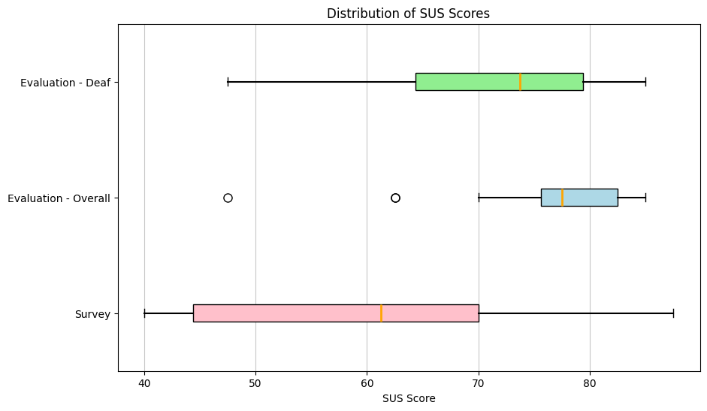
F
E
D
C
B
A

Slide 26
Conclusion
F
E
D
The study delved into the technical aspects of utilising the Web Speech API, evaluating its effectiveness in real-time scenarios, and considering the user experience and usability of the developed features
It was found that this web app was seen to be 17.4% more effective than current assistive technology
By presenting a comprehensive and affordable solution, this dissertation contributed to the advancement of assistive technologies, fostering a more inclusive digital landscape for individuals within the Deaf and Hard-of-Hearing Community
C
B
A

Slide 27
Conclusion
F
E
D
The web-app, though informed by the Deaf and Hard-of-Hearing community, serves as an infirmity model, helping users adapt to a hearing society
The Deaf and Hard-of-Hearing community is weary of numerous surveys yielding little impact
Instead, we must heed their suggestion to prioritise sign language over assistive technology, fostering integration akin to Martha's Vineyard's Deaf community, minimising communication barriers and isolation
C
B
A

Slide 28
Future Work
F
E
D
Further exploration of speech recognition, particularly addressing accent variability
Complex features such as: speaker detection, siren detection, and offline capabilities
Speaker direction leveraging directional sound cues could be a potential enhancement
These advancements have the potential to significantly improve the accessibility and usability of the web-app for users with diverse needs.
C
B
A

Slide 29
F
E
D
C
B
A
Thank you

