Slide 1
Application Landscape Management for Teams
Daniel Pozzi, FrOsCon 2019

Slide 2

Why are you here?
security
costs
data Flow
networks
lifecycle
health
dependencies
operators
ownership

Slide 3
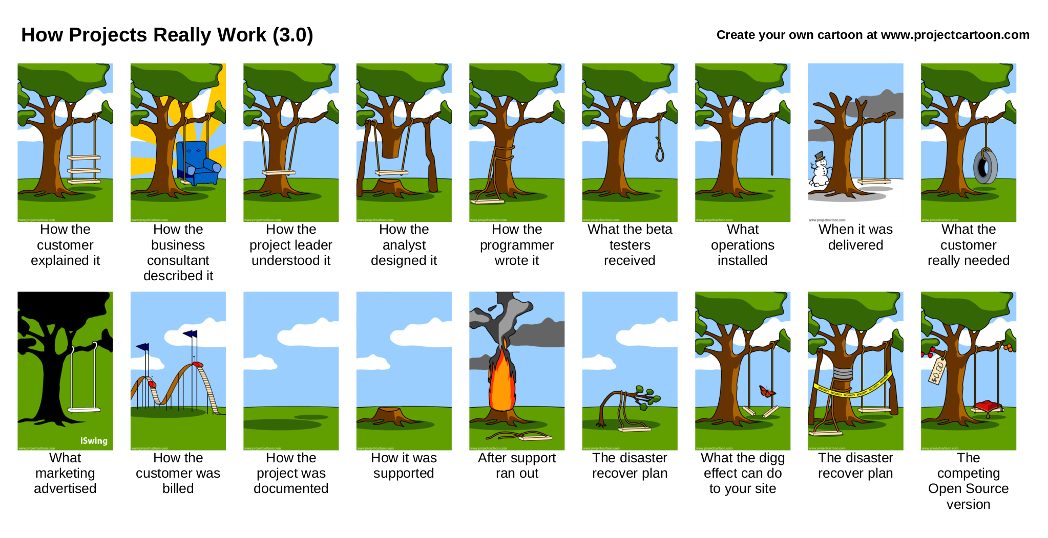
Licensed by projectcartoon.com under https://creativecommons.org/licenses/by/3.0/

Slide 4
What can you do?
Enterprise
https://wwwmatthes.in.tum.de/pages/exuqsrwkrch6/List-of-EAM-Tools
Scripted
- plantUML
- graphViz
Handmade art
- pencil
- OmniGraffle, Office
- draw.io
- wiki
Automated
- Vistecture
- pivio.io
- nivio
YAY!

Slide 5
Project Goals and
Non-Goals
no* installation
High automation level
no fees or costs
reuse existing sources
prefer ease of use over features
You name it!
YAY!
Focus on tech / team people
Extend generated textual documentation a bit
Introduce more artifact types (graphs, docs...)
Not become professional EAM-tool
with TOGAF support and white collar stuff

Slide 6
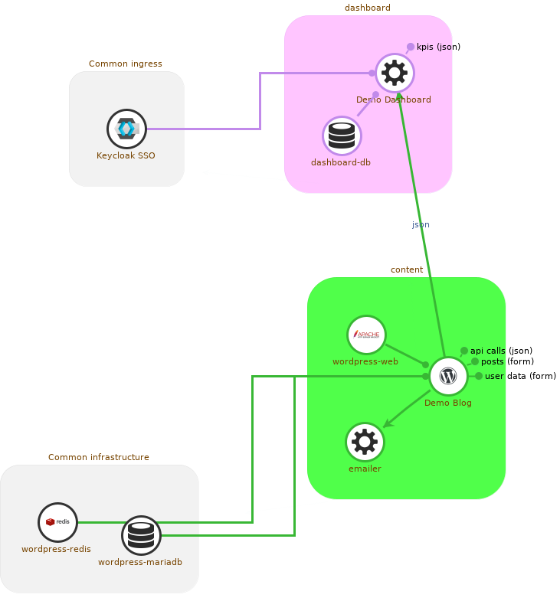
Demo Current Progress

Slide 7
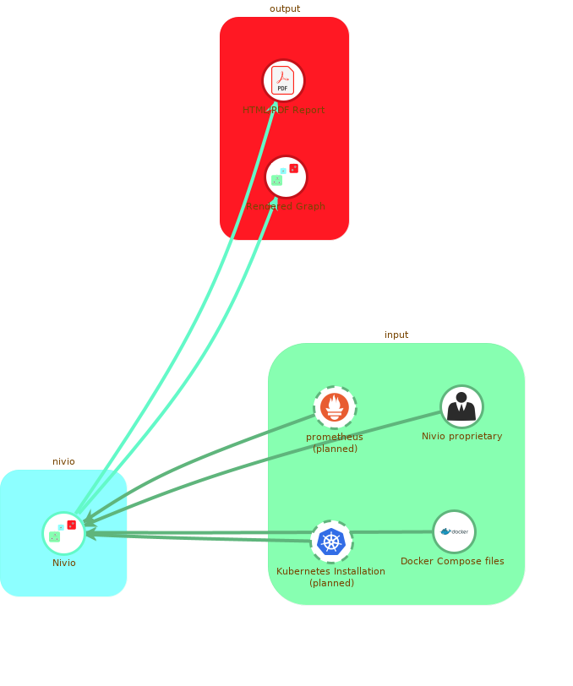
Icons in the image loaded from GitHub or Wikimedia. Licensed under open source licenses by their respective owners.

Slide 8
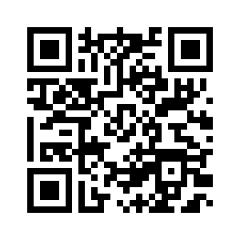
The Plan
1.Get Feedback
2.First Adopters
3.Get More Feedback
4.Become the Most Visually Appealing Tool
Feedback on GitHub!
https://github.com/bonndan/nivio/issues

