Slide 1

Nivio
Application Landscape Management for Teams
„Can I turn this off?“

Slide 2
Challenges
security
costs
data Flow
networks
lifecycle
health
dependencies
operators
ownership

Slide 3
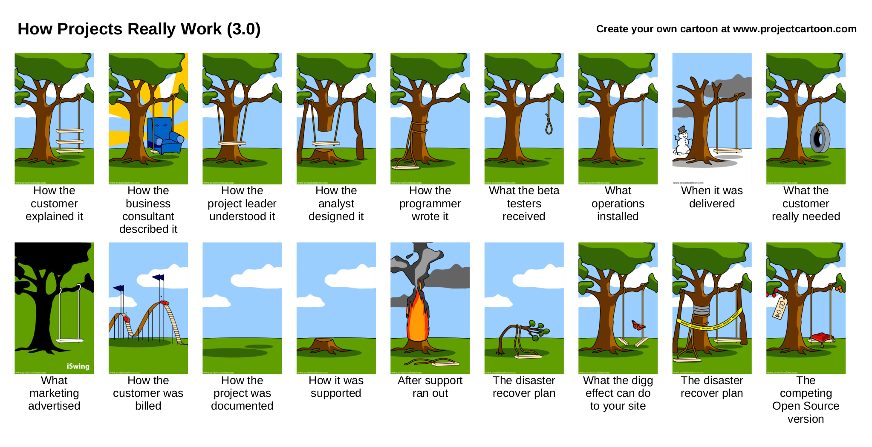
Licensed by projectcartoon.com under https://creativecommons.org/licenses/by/3.0/

Slide 4
Approaches to
Application Landscape Management
Enterprise
https://wwwmatthes.in.tum.de/pages/exuqsrwkrch6/List-of-EAM-Tools
Scripted
- plantUML
- graphViz
Handmade Art
- pencil
- OmniGraffle, Office
- draw.io
- wiki
Automated
- Vistecture
- pivio.io
- nivio

Slide 5
Project Goals
Hands-on appreoch
for tech people
No* installation and high automation level
reuse existing sources like git repos
prefer ease of use over features
no fees or costs

Slide 6
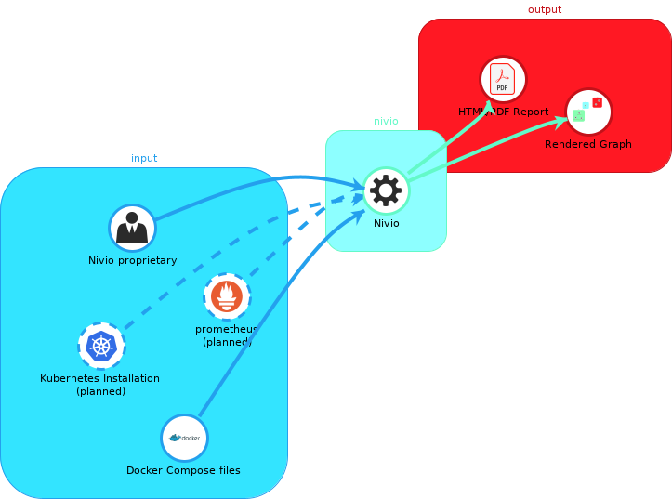
Reuse of Existing Sources
Icons in the image loaded from GitHub or Wikimedia. Licensed under open source licenses by their respective owners.

Slide 7
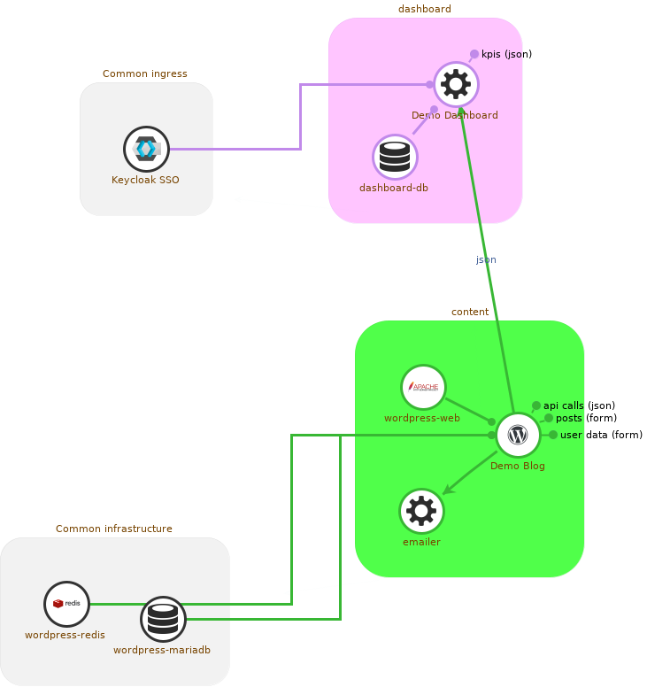
Demo Current Progress

Slide 8
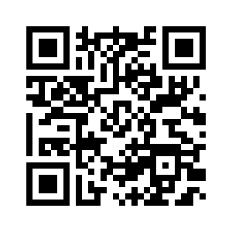
The Plan
1.Get Feedback
2.First Adopters
3.Get More Feedback
4.Become the Most Visually Appealing Tool
https://github.com/bonndan/nivio/issues

