Slide 1

Forward-secrecy on POP
Arthur Villard
School of Computer and Communication Sciences
Decentralized and Distributed Systems lab
Master Thesis – September 2017
Responsible
Prof. Bryan Ford
EPFL / DEDIS
Prof. Ewa Syta
Trinity College
Supervisor
Linus Gasser
EPFL / DEDIS

Slide 2
Context
Online collaborative service (e.g. Wikipedia)
Authenticate users anonymously against a list
Link authentication attempts
Other example: e-voting

Slide 3
Overview
Introduction
PoP and DAGA interaction
Implementing DAGA
Improving DAGA
Conclusion & Future work

Slide 4
Overview
Introduction
PoP and DAGA interaction
Implementing DAGA
Improving DAGA
Conclusion & Future work

Slide 5
Frameworks
Introduction | PoP and DAGA interaction | Implementing DAGA | Improving DAGA | Conclusion
PoP: Proof of Personhood – DEDIS
  Creation of the user list
  Authentication protocol
  Anonymity within the group
  No forward-secrecy
DAGA: Deniable Anonymous Group Authentication – Ewa Syta
  Authentication protocol
  Forward-secrecy

Slide 6
Goals
Introduction | PoP and DAGA interaction | Implementing DAGA | Improving DAGA | Conclusion
Using DAGA as PoP’s authentication protocol
Implementing DAGA in Go
Improving DAGA

Slide 7
Key concepts
Introduction | PoP and DAGA interaction | Implementing DAGA | Improving DAGA | Conclusion
Anonymity
  No information about the user is known
Accountability
  The sender can be held responsible for his action
Linkability
  Two messages come from the same user
Forward-secrecy
  Breaking a session does not break the previous ones

Slide 8
Overview
Introduction
PoP and DAGA interaction
Implementing DAGA
Improving DAGA
Conclusion & Future work

Slide 9
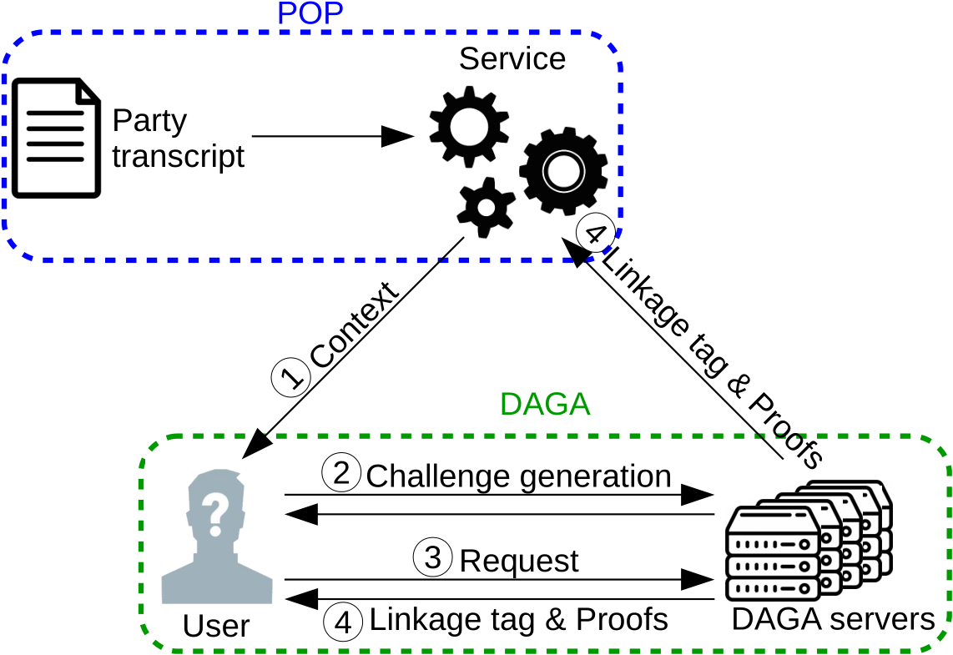
Integration
Introduction | PoP and DAGA interaction | Implementing DAGA | Improving DAGA | Conclusion

Slide 10
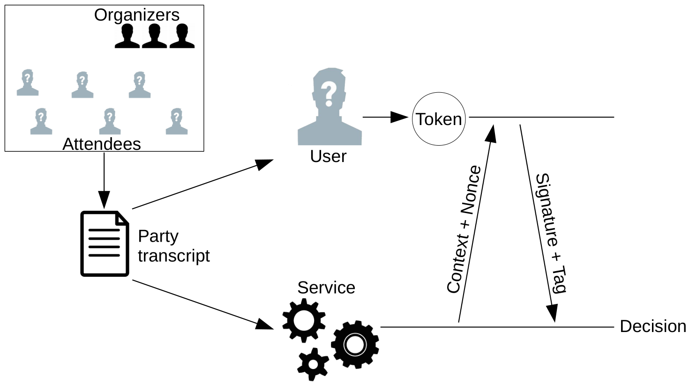
PoP: How it works
Introduction | PoP and DAGA interaction | Implementing DAGA | Improving DAGA | Conclusion

Slide 11
PoP: Weaknesses
Introduction | PoP and DAGA interaction | Implementing DAGA | Improving DAGA | Conclusion
No forward-secrecy
  Tag derived from private key
  Leakage allows to identify the user in previous sessions
Cross-service de-anonymisation
  Tags independent from the service
  Users can be tracked between different services
 Loss of anonymity

Slide 12



DAGA: How it works
Introduction | PoP and DAGA interaction | Implementing DAGA | Improving DAGA | Conclusion
Request generation
Proof generation
Compute initial tag
User
Challenge
Request
Linkage tag + Proofs
Request challenge
Context
DAGA servers
Distributed randomness

Slide 13
DAGA solutions
Introduction | PoP and DAGA interaction | Implementing DAGA | Improving DAGA | Conclusion
Forward-secrecy
  Tags derived from context elements only
  Private key used in client proof
  Proof does not leak information
Cross-service de-anonymisation
  Different services  Different contexts
   Different tags for the same user

Slide 14
Conclusion
Introduction | PoP and DAGA interaction | Implementing DAGA | Improving DAGA | Conclusion
DAGA can solve PoP weaknesses
DAGA and PoP can be interfaced
E-voting

Slide 15
Overview
Introduction
PoP and DAGA interaction
Implementing DAGA
Improving DAGA
Conclusion & Future work

Slide 16
Implementation
Introduction | PoP and DAGA interaction | Implementing DAGA | Improving DAGA | Conclusion
Go
RSA  Elliptic Curves
Distributed randomness


Slide 17
Code results
Introduction | PoP and DAGA interaction | Implementing DAGA | Improving DAGA | Conclusion
Library: Complete implementation
Test coverage 88%
Example scenario
Benchmark package

Slide 18
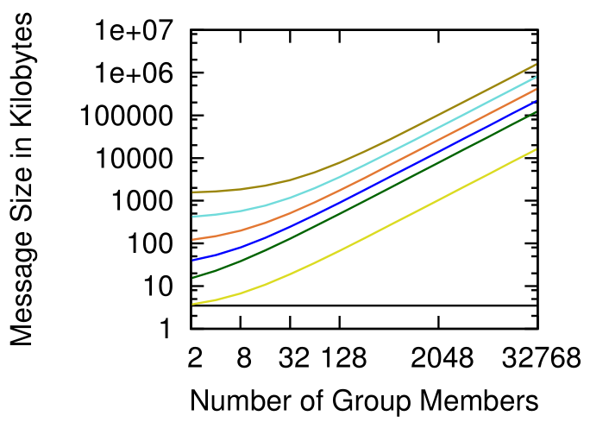
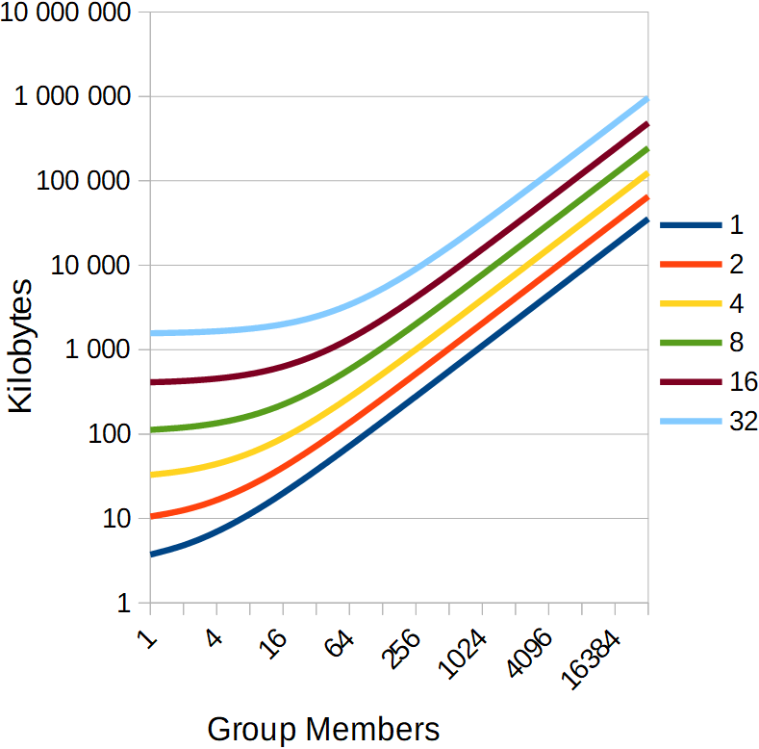
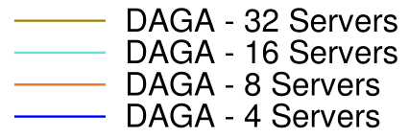
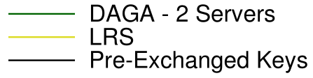
Benchmarks: Communication
Introduction | PoP and DAGA interaction | Implementing DAGA | Improving DAGA | Conclusion
Setup:
Ubuntu 12.04
x86-64
1 thread
Setup:
Windows 10
x86-64
1 thread
@4,5GHz
No improvement
No explanation yet

Slide 19
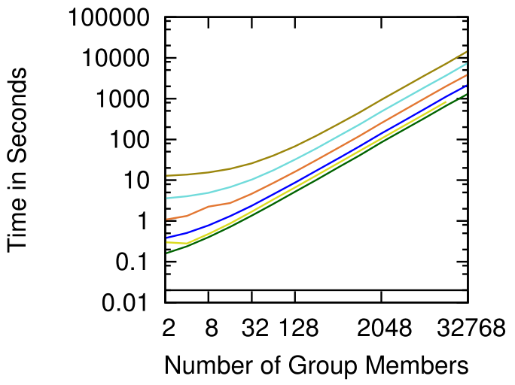
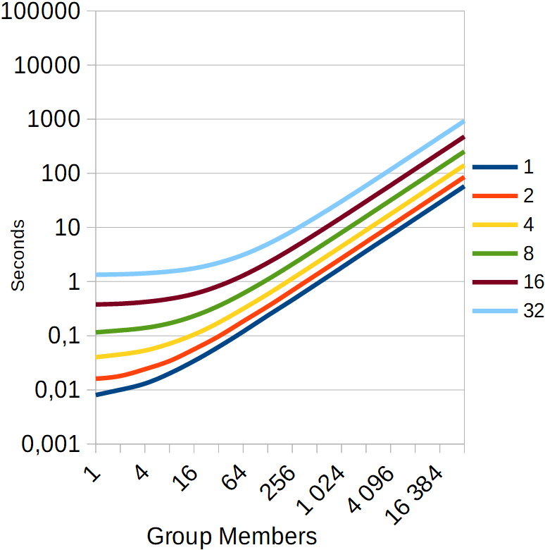
Benchmarks: Time
Introduction | PoP and DAGA interaction | Implementing DAGA | Improving DAGA | Conclusion
Setup:
Ubuntu 12.04
x86-64
1 thread
Setup:
Windows 10
x86-64
1 thread
@4,5GHz
32768 members / 32 servers
15 000 s
1 000 s
/15
Moore’s law 2012  2018: ~ /8 from hardware
Elliptic Curves

Slide 20
Conclusion
Introduction | PoP and DAGA interaction | Implementing DAGA | Improving DAGA | Conclusion
Complete implementation
Time improvement
Next step: Integrate it with PoP

Slide 21
Overview
Introduction
PoP and DAGA interaction
Implementing DAGA
Improving DAGA
Conclusion & Future work

Slide 22
Proof problem
Introduction | PoP and DAGA interaction | Implementing DAGA | Improving DAGA | Conclusion
Request generation
Proof generation
Compute initial tag
User
Challenge
Request
Linkage tag + Proofs
Request challenge
Context
DAGA servers
Distributed randomness

Slide 23
Proof problem
Introduction | PoP and DAGA interaction | Implementing DAGA | Improving DAGA | Conclusion
Anonymity through a client OR proof:
  I know (private key 1 OR private key 2 OR … )
Growth , n = #members
  32768 members / 32 servers
    Proof ~6,3 MB, total cost ~200 MB  ~20% of total

Slide 24
Improving the proof
Introduction | PoP and DAGA interaction | Implementing DAGA | Improving DAGA | Conclusion
Work with Kasra Edalatnejadkhamene, PhD student
Survey of the field
Split the proof
  Proof of membership: Accumulator
  Proof of knowledge: Signature of knowledge
No concrete scheme

Slide 25
Overview
Introduction
PoP and DAGA interaction
Implementing DAGA
Improving DAGA
Conclusion & Future work

Slide 26
Conclusion & Future work
Introduction | PoP and DAGA interaction | Implementing DAGA | Improving DAGA | Conclusion
DAGA and PoP can work together
Complete Go implementation of DAGA
Improvement guidelines for the proof
Next steps
  Integrate DAGA and PoP
  Optimize network consumption
  Continue the work on the proof
  Improve implementation resistance
  (secure memory management, constant-time, … )

Slide 27
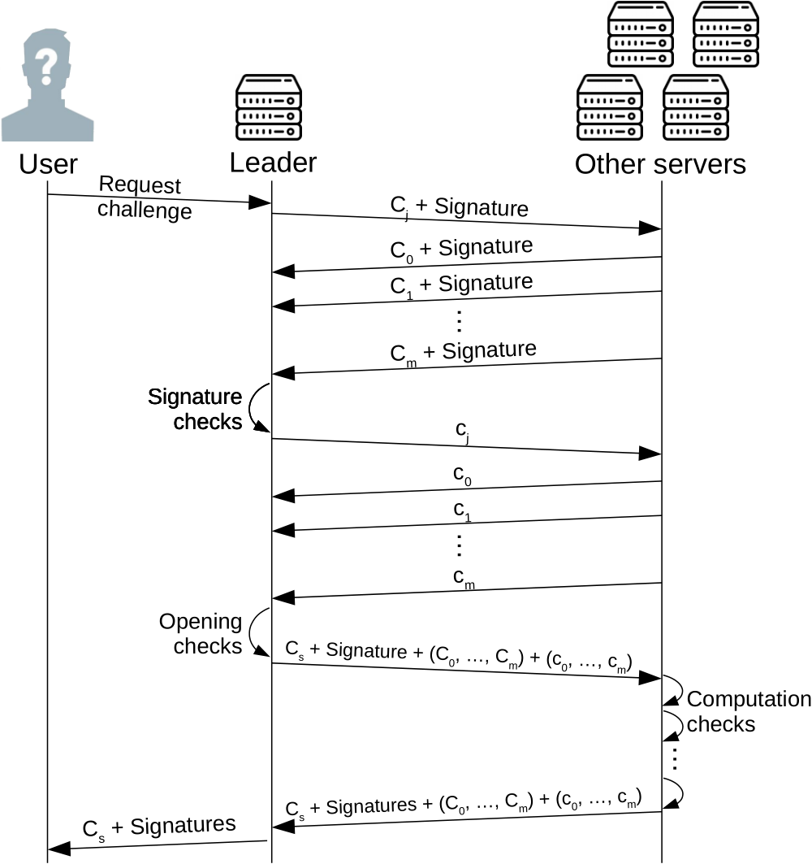
Distributed randomness

Slide 28
Context
User public keys (#members)
Server public keys (#servers)
Server random commitments (#servers)
Client random generators (#members)

Slide 29
Accumulator
Accumulators from Bilinear Pairings and Applications
L. Nguyen, 2005
Adjustments:
  Trusted setup
  Bounded
  Efficiency based on trusted authority

Slide 30
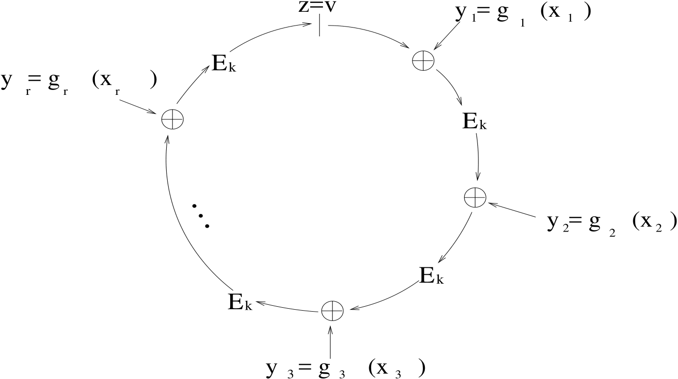
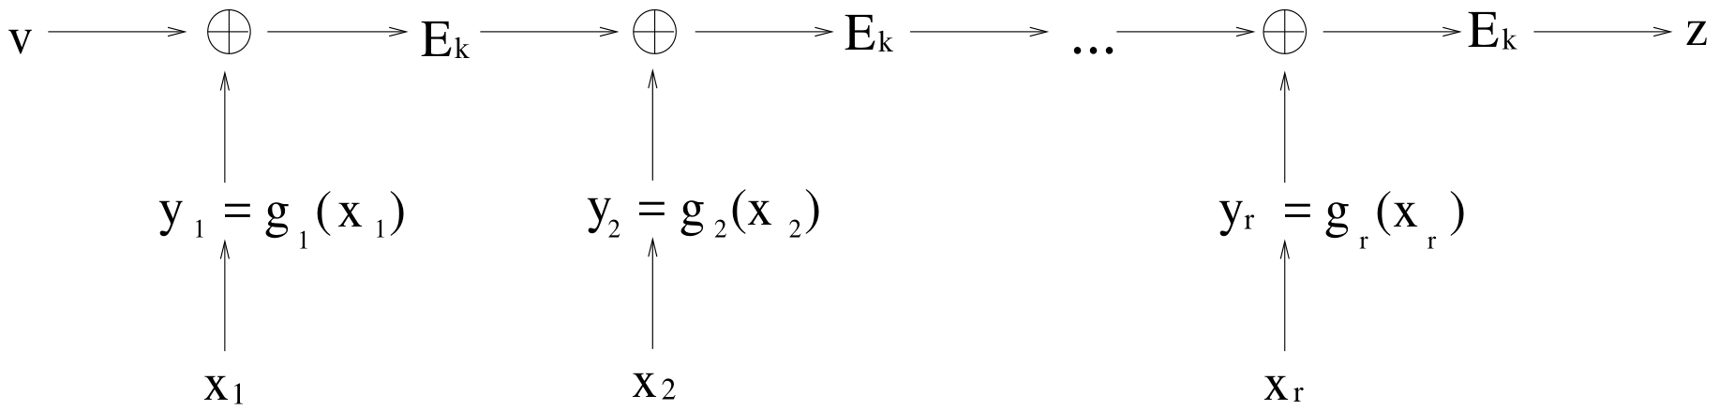
Ring signature
How to Leak a Secret, R. Rivest, A. Shamir and Y. Tauman

