Slide 1
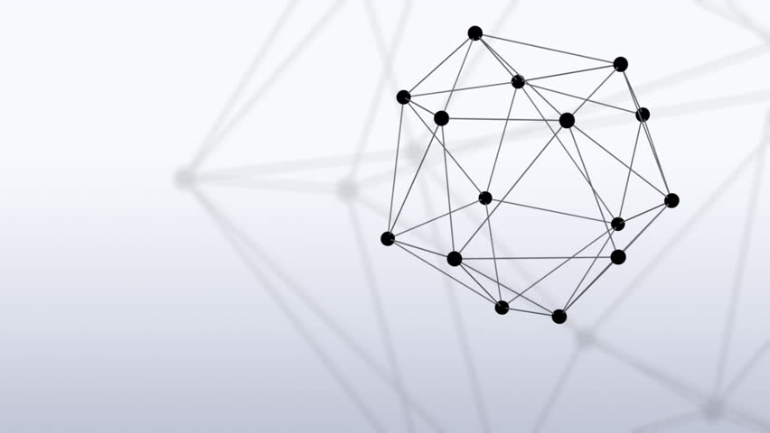


Blockchain Based Approach for Preserving Car Maintenance History
Master Project
Decentralized and Distributed Systems Lab
Iva Najdenova
Professor: Bryan Ford
Supervisor: Linus Gasser
External Supervisor: Alexandru Rusu

Slide 2
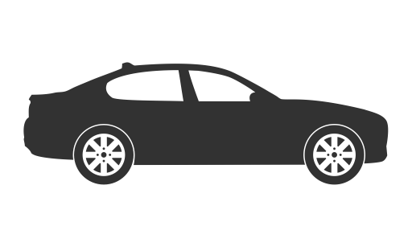


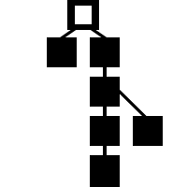


Overview
INTRODUCTION
BYZCOIN
IMPLEMENTATION
DEMO
EXPERIMENTS
CONCLUSION
Notes:
say what the presentation is going to be about

Slide 3
Overview
INTRODUCTION
BYZCOIN
IMPLEMENTATION
DEMO
EXPERIMENTS
CONCLUSION

Slide 4
Motivation
Fighting frauds in the automotive industry
low quality repairs
tampering odometers (mileage)
hiding accidents

Slide 5


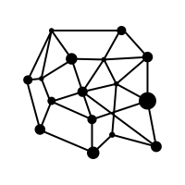
Goal
Establish trust between:
Car buyers
Car owners
Car dealers
Insurance companies
…

Slide 6
Overview
INTRODUCTION
BYZCOIN
IMPLEMENTATION
DEMO
EXPERIMENTS
CONCLUSION

Slide 7
Blockchain Data Structure
Source: NAKAMOTO, S. Bitcoin: A Peer-to-Peer Electronic Cash System, 2008

Slide 8




Submitting a Transaction to a Blockchain
2. Broadcast
4. Block Creation
1. Create Transaction
3. Transaction Verification
5. Broadcast
8. Transaction Confirmation
7. Consensus

Slide 9
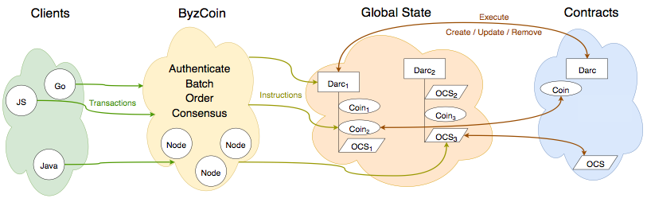
ByzCoin
Source: https://raw.githubusercontent.com/dedis/cothority/master/byzcoin/ByzCoin.png
Notes:
explain in general before going into details

Slide 10
ByzCoinX Consensus Protocol
Collective Signing
Absolute Finality
Open Membership
Tree Structure for Communication
Cothority
Source: https://raw.githubusercontent.com/dedis/cothority/master/byzcoin/ByzCoin.png

Slide 11
ByzCoin
Source: https://raw.githubusercontent.com/dedis/cothority/master/byzcoin/ByzCoin.png
Notes:
explain in general before going into details

Slide 12
Instructions
Spawn
Invoke
Delete

Slide 13
ByzCoin
Source: https://raw.githubusercontent.com/dedis/cothority/master/byzcoin/ByzCoin.png
Notes:
explain in general before going into details

Slide 14
Distributed Access Right Controls
Set of rules
Rule – “action” : ”expression with allowed identities”
Evolution of Rules
Delegating the permissions to another DARC
Source: https://raw.githubusercontent.com/dedis/cothority/master/byzcoin/ByzCoin.png

Slide 15
Calypso
Private Data over a Blockchain

Slide 16
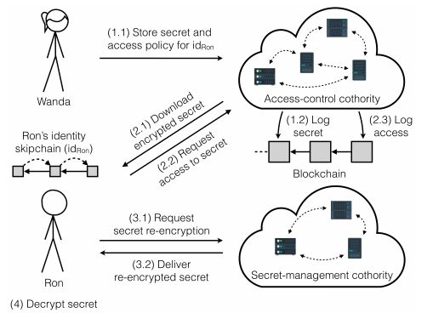
Calypso
Source: CALYPSO: Auditable Sharing of Private Data over Blockchains, 2018
Notes:
Shorter for Wanda’s and Ron’s actions
compromise decentralization -> channels Hyperledger Fabric, certificates issued by a central authority

Slide 17
Overview
INTRODUCTION
BYZCOIN
IMPLEMENTATION
DEMO
EXPERIMENTS
CONCLUSION

Slide 18
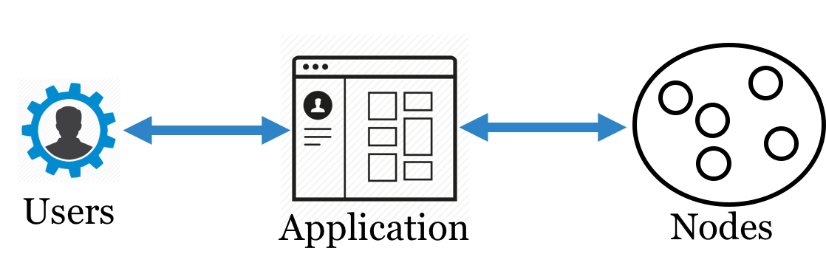
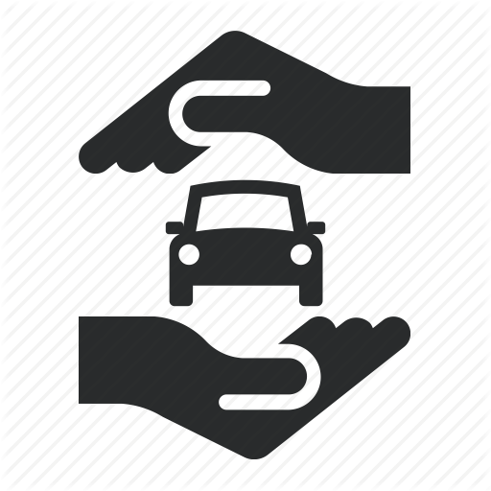





Implementation
$$3f+2$$
$$f$$
- faulty nodes
Insurance Companies
Notes:
The nodes would be distributed among Swisscom and Autosense as providers of the service, AMAG the main car dealer in Switzerland and insurance companies

Slide 19
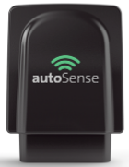
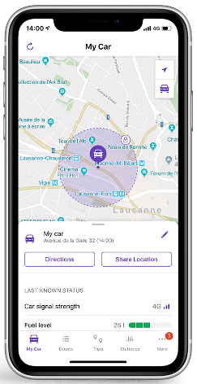
Business Case
AutoSense IoT Devices
Profit – customers of dongle devices
AMAG – increased value of cars
Insurance Companies – accidents detection in real time
Notes:
Insurance Companies – accident detection in real time and position damage estimation

Slide 20
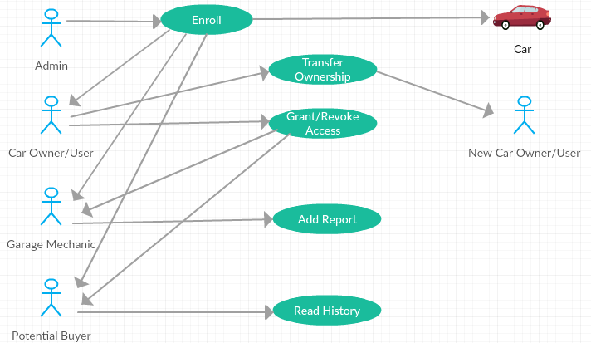
Use Case Diagram

Slide 21
DARCs
Access Control in the System

Slide 22
DARCs
Genesis DARC
spawn:darc
Admin DARC
“_sign” : ”PublicKeyAdmin”
“invoke:evolve” : ” PublicKeyAdmin”
“spawn:darc” : ” PublicKeyAdmin”

Slide 23
DARCs
Admin DARC
spawn:darc
spawn:darc
spawn:darc
User DARC
Car Owner DARC
Car Garage DARC
spawn:darc
spawn:darc
Car Reader DARC
Car DARC
Notes:
Explain what spawn means
Explain that the user darc which is the current owner of the car can evolve the car owner darc by submiting a txn to byzcoin signed with the private key associated with the right to evolve

Slide 24
DARCs
Car DARC
“spawn:car” : ”adminDARC”
“invoke:car.addReport” : ” carGarageDARC”
“spawn:calypsoWrite” : “carGarageDARC”
“spawn:calypsoRead” : “carReaderDARC”

Slide 25
Car Contract
Instructions:
spawn : car
invoke : car.addReport
Data Structures:
Car
string VIN
[]Report Reports
Report
string Date
string GarageID
[]byte WriteInstanceID
SecretData
string Mileage
boolean Warranty
string RepairNote
string Score

Slide 26
Client Application
User-Friendly Way of Interaction

Slide 27
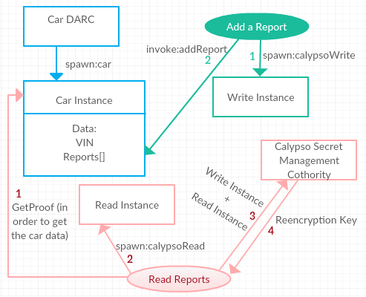
Client Application

Slide 28
Overview
INTRODUCTION
BYZCOIN
IMPLEMENTATION
DEMO
EXPERIMENTS
CONCLUSION

Slide 29
DEMO
Logs of Conodes
User Interface (Desktop Application)

Slide 30

DEMO
Notes:
Explain what happens in the background

Slide 31
Overview
INTRODUCTION
BYZCOIN
IMPLEMENTATION
DEMO
EXPERIMENTS
CONCLUSION

Slide 32
Experiments
Larger Networks and Concurrent Transactions
IC Cluster with Mininet Platform:
Each Server: 24 cores, 256GB of RAM, 2.5GHz processor
Measure:
Wall Time
System Cost

Slide 33
Experiments
Constant Number of Nodes
Variable Number of Concurrent Car Enrollments

Slide 34
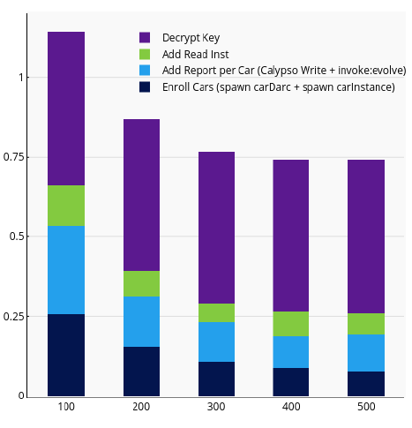
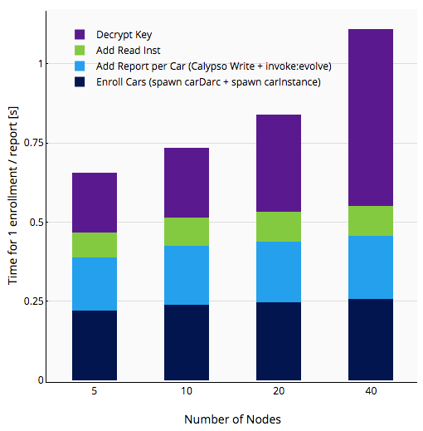
Experiments
Wall Time
5 Nodes, 2 servers
Bandwidth = 100Mbps
Delay = 100ms
Block Interval = 5s
Number of concurrent enrollments / reports

Slide 35
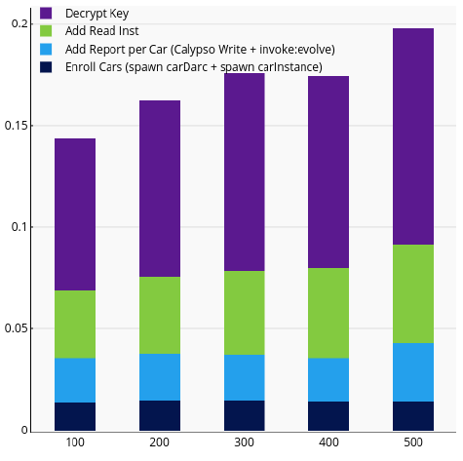
Experiments
System Cost
5 Nodes, 2 servers
Bandwidth = 100Mbps
Delay = 100ms
Block Interval = 5s
Number of concurrent enrollments / reports
Notes:
*business case
*

Slide 36
Experiments
Constant Number of Concurrent Car Enrollments
Variable Number of Nodes

Slide 37
Experiments
Wall Time
2 servers
Bandwidth = 100Mbps
Delay = 30ms
Block Interval = 5s

Slide 38
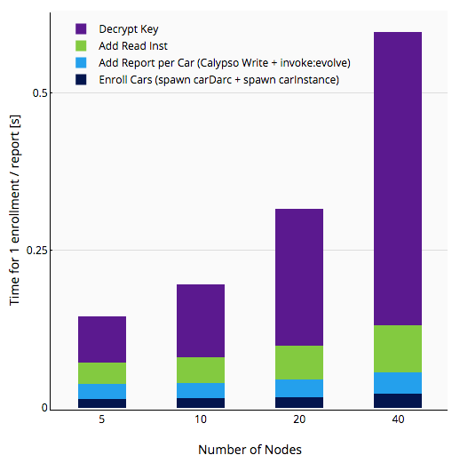
Experiments
System Cost
2 servers
Bandwidth = 100Mbps
Delay = 30ms
Block Interval = 5s

Slide 39
Overview
INTRODUCTION
BYZCOIN
IMPLEMENTATION
DEMO
EXPERIMENTS
CONCLUSION

Slide 40
Conclusion
Proof of Concept
Implementation
Car Contract
Access Control
Calypso Interaction
Java Desktop Application
Experiments
Future Work

Slide 41
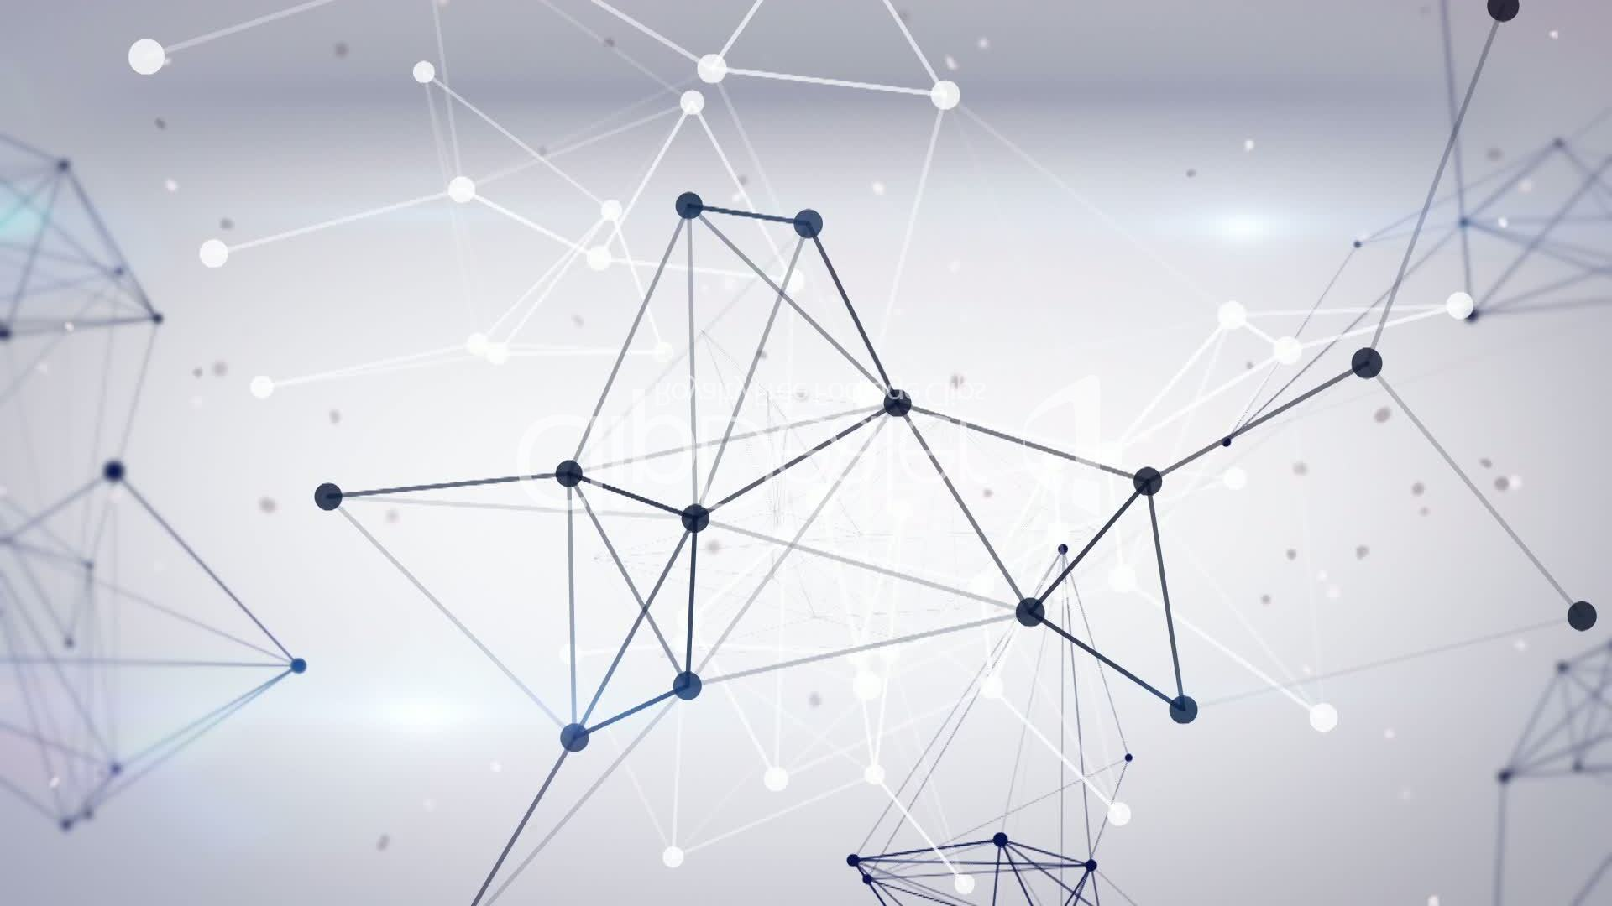
Thank You for Your Attention!

Slide 42
Overview
INTRODUCTION
BYZCOIN
IMPLEMENTATION
DEMO
EXPERIMENTS
CONCLUSION

Slide 43
Skipchain
Source: https://raw.githubusercontent.com/dedis/cothority/master/byzcoin/ByzCoin.png

Slide 44
Client Application
JavaFX Desktop Application
Register Members / Cars (spawn:darc / spawn:car)
Grant/Remove Access Right (invoke:evolve)
Add Maintenance Report (spawn:calypsoWrite + invoke:evolve)
Read Car History (spawn:calypsoRead)

Slide 45
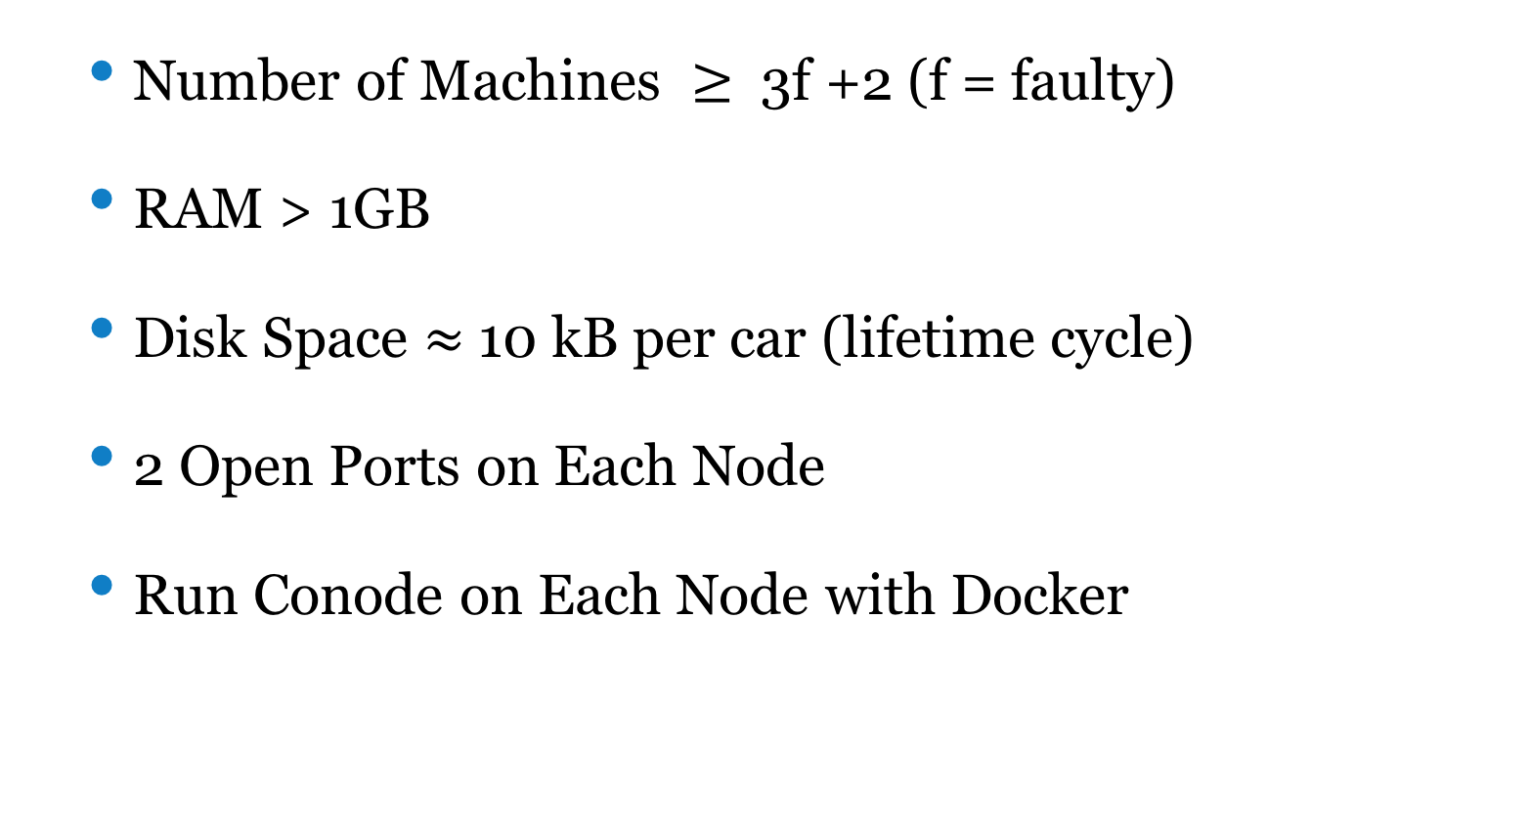
Implementation Details
Number of Machines $≥$ 3f +2 (f = faulty)
RAM > 1GB
Disk Space $≈$ 10 kB per car (lifetime cycle)
2 Open Ports on Each Node
Run Conode on Each Node with Docker

Slide 46
Blockchain
2. Broadcast
4. Block Creation
1. Create Txn
3. TxnVerification
5. Broadcast
8. Txn Confirmation
7. Consensus
6. Block Verification

Slide 47
Introduction
INTRODUCTION
BYZCOIN
IMPLEMENTATION
DEMO
EXPERIMENTS
CONCLUSION
Notes:
a bit of a background info about blockchain technology:

Slide 48
DARCs
User DARC
“_sign” : ”userID”
“invoke:evolve” : ” userID | adminID”

Slide 49
DARCs
Admin DARC
spawn:darc
spawn:darc
spawn:darc
User DARC
Car Owner DARC
Car Garage DARC
spawn:darc
spawn:darc
Car Reader DARC
Car DARC

Slide 50
DARCs
Car Owner DARC
“_sign” : ”userDARC”
“invoke:evolve” : ” userDARC”

Slide 51
DARCs
Admin DARC
spawn:darc
spawn:darc
spawn:darc
User DARC
Car Owner DARC
Car Garage DARC
spawn:darc
spawn:darc
Car Reader DARC
Car DARC

Slide 52
DARCs
Car Garage DARC
“_sign” : ”carOwnerDARC | garageID | …”
“invoke:evolve” : ” carOwnerDARC”

Slide 53
DARCs
Admin DARC
spawn:darc
spawn:darc
spawn:darc
User DARC
Car Owner DARC
Car Garage DARC
spawn:darc
spawn:darc
Car Reader DARC
Car DARC

Slide 54
DARCs
Car Reader DARC
“_sign” : ”carOwnerDARC | readerID | …”
“invoke:evolve” : ” carOwnerDARC”

