Slide 1

Exploring the Resolution of Delegations in Liquid Democracy with Fractional Delegation
David Holzwarth
Advisor: Prof. Dr. Bryan Ford
Chair of Computer Systems
https://dse.in.tum.de/
08.04.2025– 05.08.2025

Slide 2
Structure
Introduction
Problem Statement
Design
Implementations
Evaluation

Slide 3
Liquid Democracy: Introduction & Motivation
Direct Democracy
Liquid Democracy
Representative Democracy
Notes:
Flexibility vs accountability

Slide 4
Liquid Democracy – Fractional Delegation
Currently: one person, one delegation
Fractional delegation: one person, many delegations
Motivation:
Less concentration of voting power
Less loss of voting power
Empowers voters
Drawbacks:*
Less intuitive
Not computationally trivial
Notes:
The cons also apply to liquid democracy

Slide 5
Problem statement
Given:
Voters who vote directly
Voters who delegate their vote
Find:
Each voter‘s final voting power according to the delegations
Power must be conserved*
Challenge: cyclic delegations & efficient computation
Notes:
1. Given
votes directly
delegates their vote in its entirety
2. Find:
voting power such that
Delegators = 0
Sinks’ final power = own vote + received delegations
Power is conserved

Slide 6
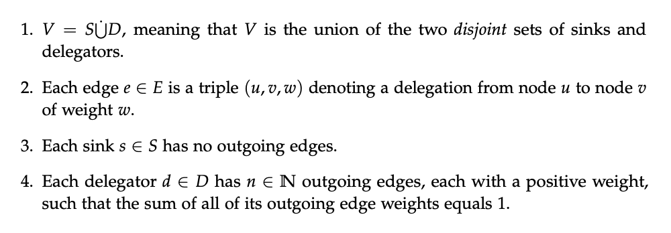
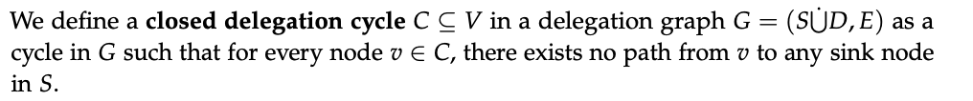
Design
Definition: Well-formed delegation graph:
1. Delegation graph with 2. no closed delegation cycles
Notes:
These are necessary for the design

Slide 7
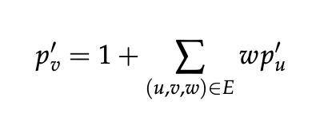
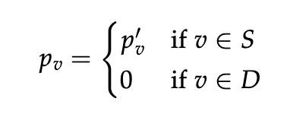
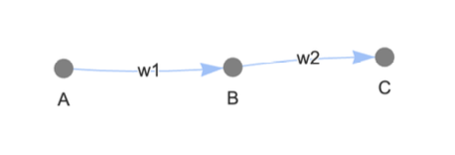
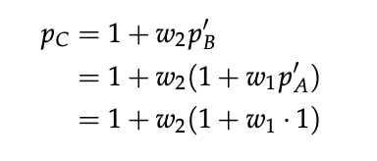
Design: Resolving Delegations
For all nodes v:
System of linear equations
A well-formed delegation graph:
Has exactly one solution,
which conserves power

Slide 8
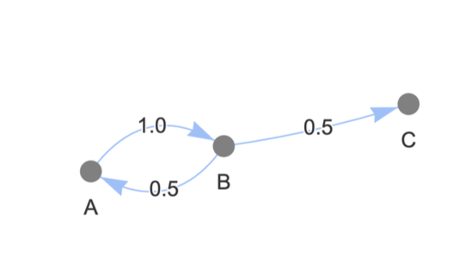
Implementations
Linear Systems Solver
Linear Programming Solver
Iterative Solver
Provably similar to the other approaches

Slide 9
Implementations: Robustness
 | Invalid Delegations | Closed Delegation Cycles
Linear Systems Solver | Invalid solution | Error
Linear Programming Solver | Invalid solution | Error
Iterative Solver | Depends | Won’t terminate

Slide 10
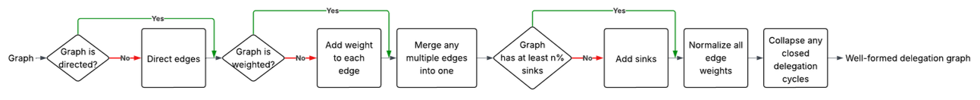
Evaluation: Method
Preprocessing
The „Add sinks“ step is only for experimental purposes, to have the option to avoid graphs with no sinks for benchmarks
Measurement
of solving time only
Notes:
Measurement:
Set up time not included
Run it multiple times

Slide 11
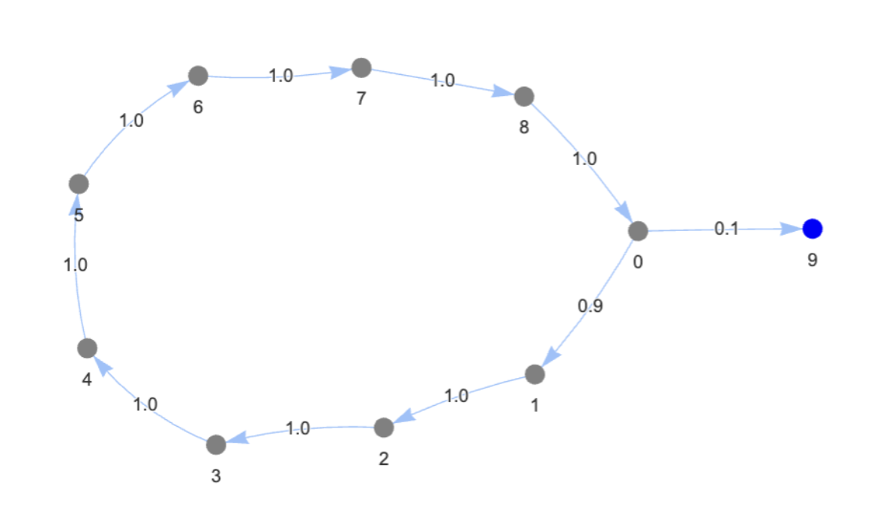
Evaluation: Overview
Synthetic graphs
Small graphs
Large graphs
Dense graphs
Cycles which retain a lot of their power
No delegations
Synthetic Social graphs
Small world graphs
R-Mat graphs
Real-World Datasets
Bitcoin OTC trust network, Epinions, Slashdot Zoo

Slide 12
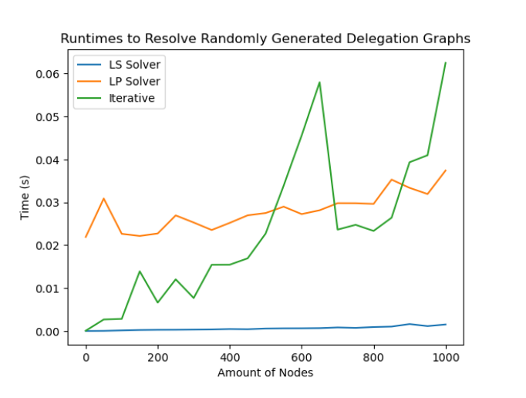
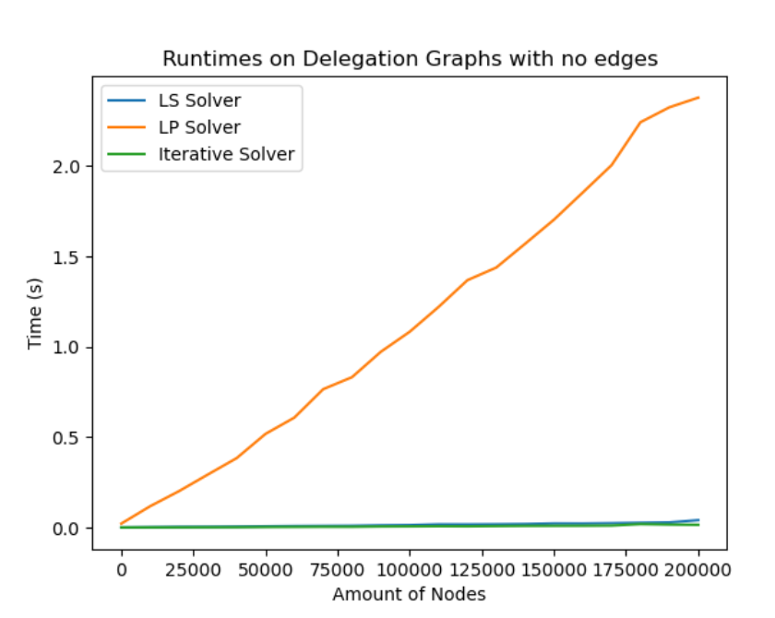
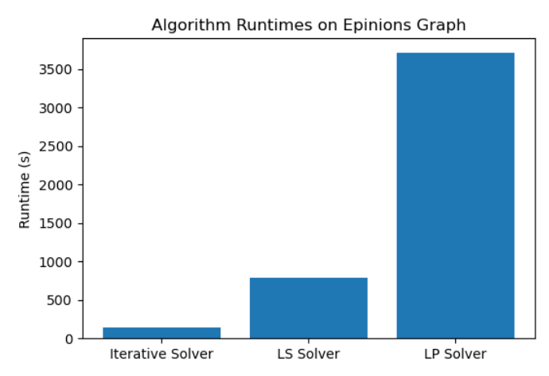
Evaluation: Key Insights
Small graphs:
Linear Systems Solver
Very sparse, very large graphs:
Iterative Solver (not perfectly precise!)
Linear Programming Solver‘s runtime grows slower, but it is slower
Notes:
Bitcoin OTC has about 75k nodes

Slide 13
For the Future
Does fractional delegation actually reduce vote power concentration?
Benchmarking on real world data
User study:
How easy is it to understand Liquid Democracy with fractional delegation?
Do / How do people delegate?
Notes:
Bitcoin OTC has about 75k nodes

Slide 14
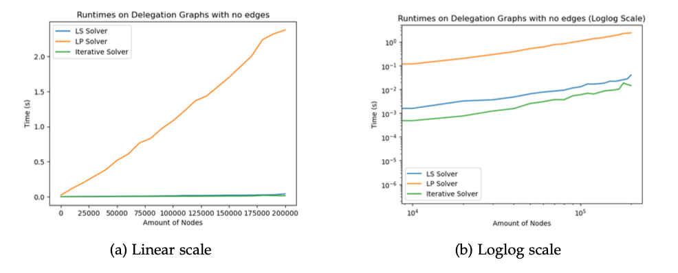
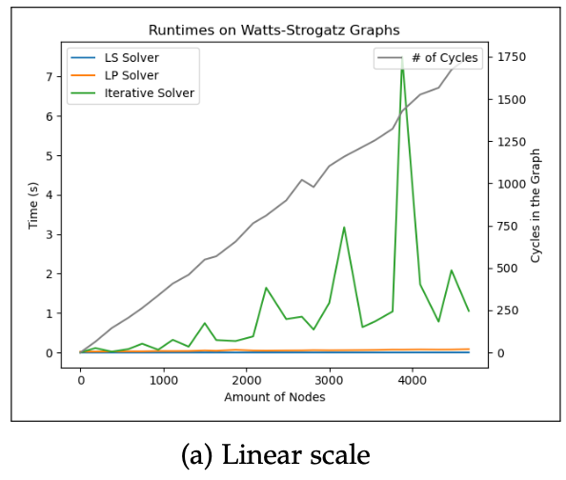
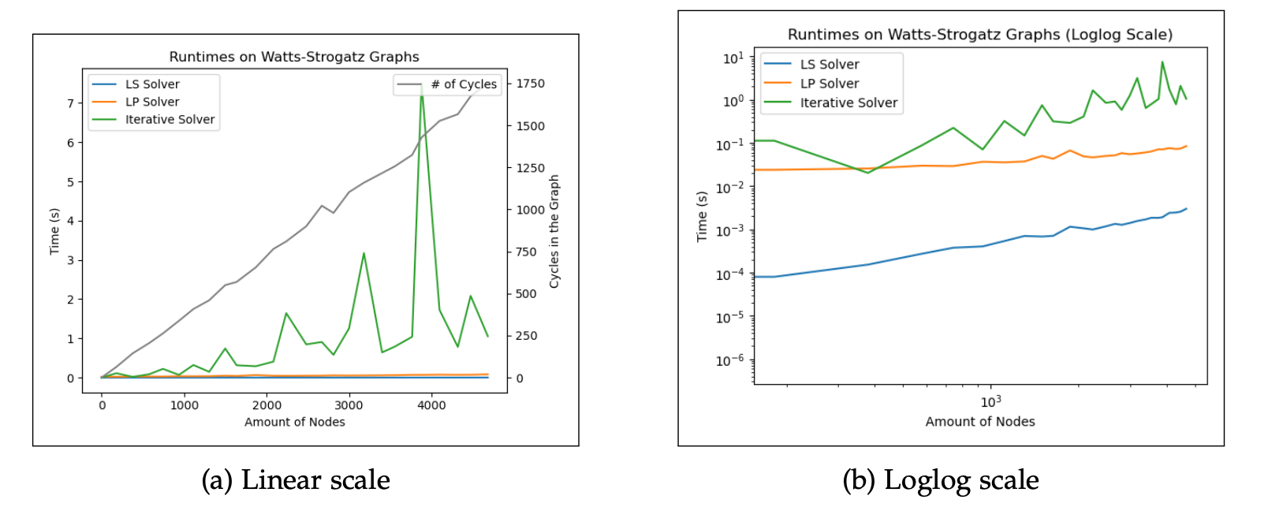
Thank you!

Slide 15
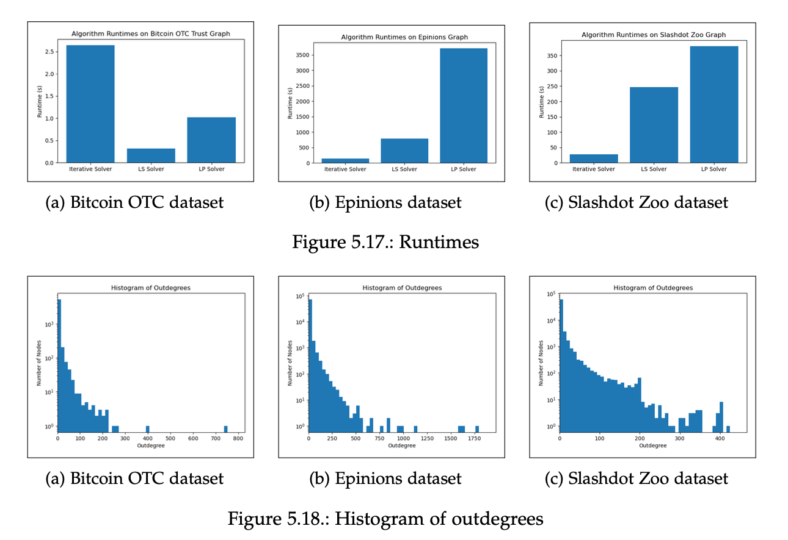
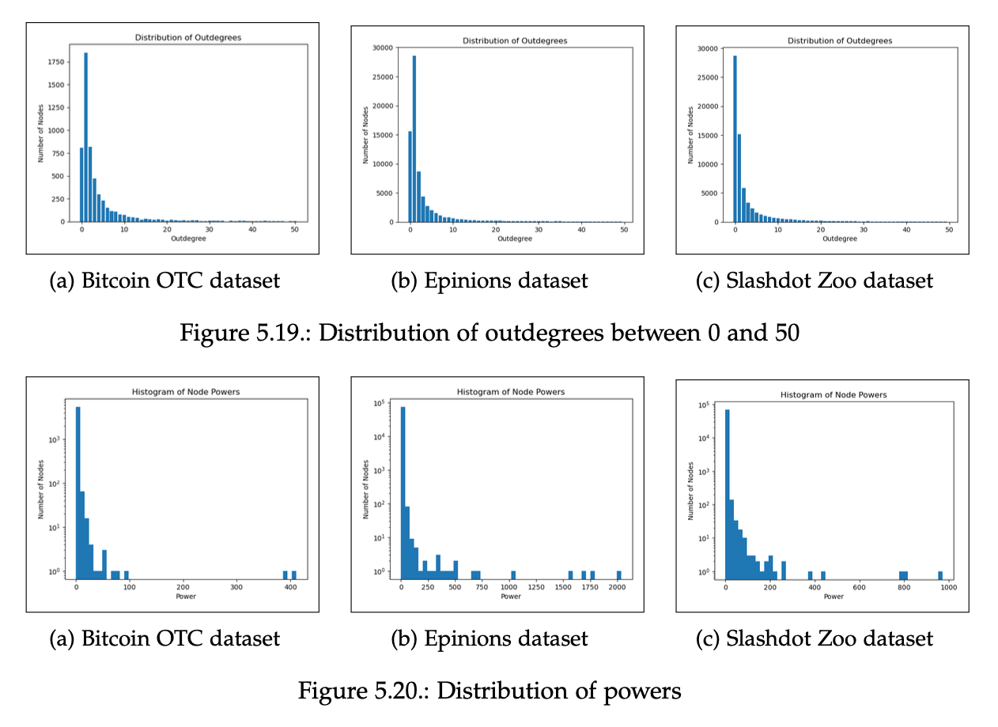
Thank you!

