Slide 1
Alpha Diversity

Slide 2
Alpha diversity
Diet group

Slide 3

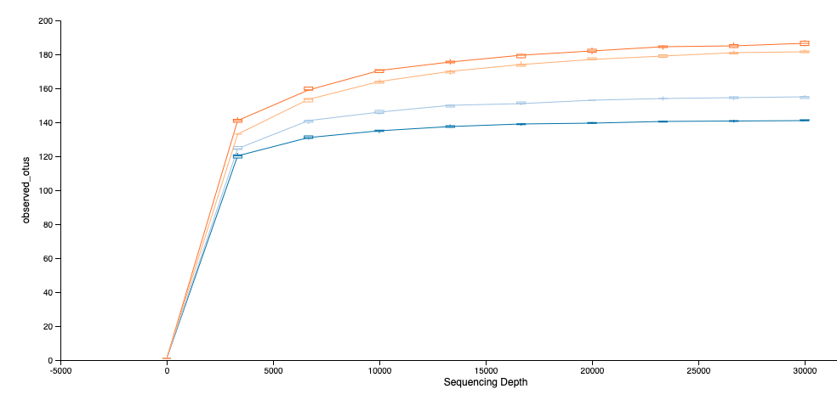
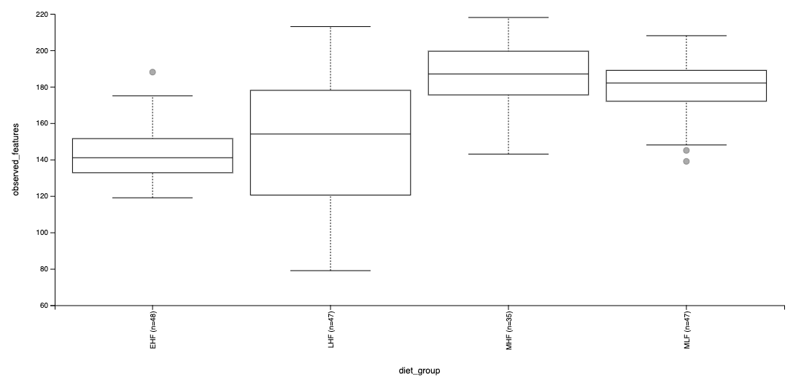
Alpha diversity Observed features (Richness)
No significant differences between meal fed groups
No significant differences between timed fed groups
All other were significant
Notes:
“Observed features” is a measure of community richness, and more accurately would be called “Observed Features”. In this context, it really means “observed sequence variants”, since that's what your features are.

Slide 4
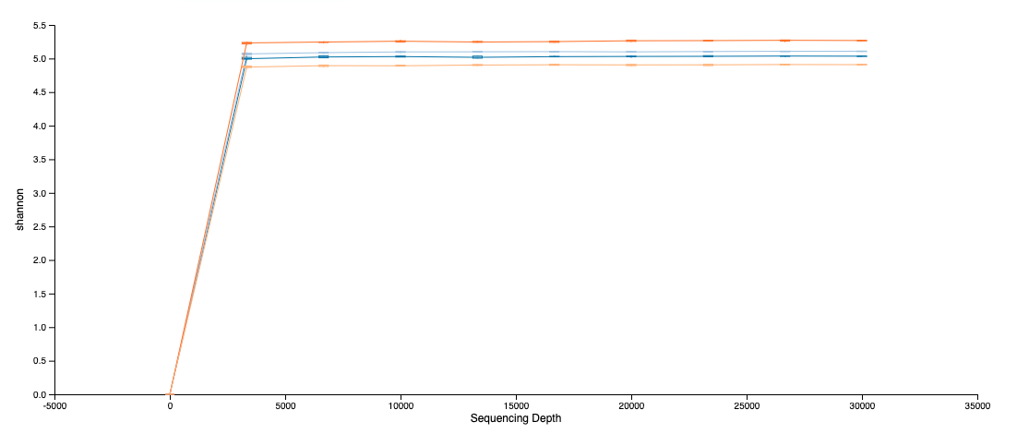
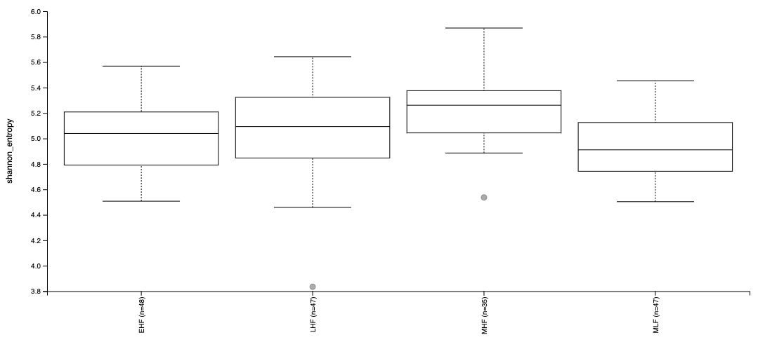
Alpha diversity Shannon (Diversity)
No significant differences between EHF vs LHF and EHF vs MLF
All other pairwise comparisons significant
Notes:
The Shannon index is a measure of diversity, not richness. It measures the number of features in your sample (richness) but scales them based on the evenness of the community. If the controls have more features but a small number of those features dominate the sample they will report a lower Shannon diversity than a a community with fewer features evenly distributed. I've attached a small Excel example of this

Slide 5
Alpha diversity
Sex

Slide 6

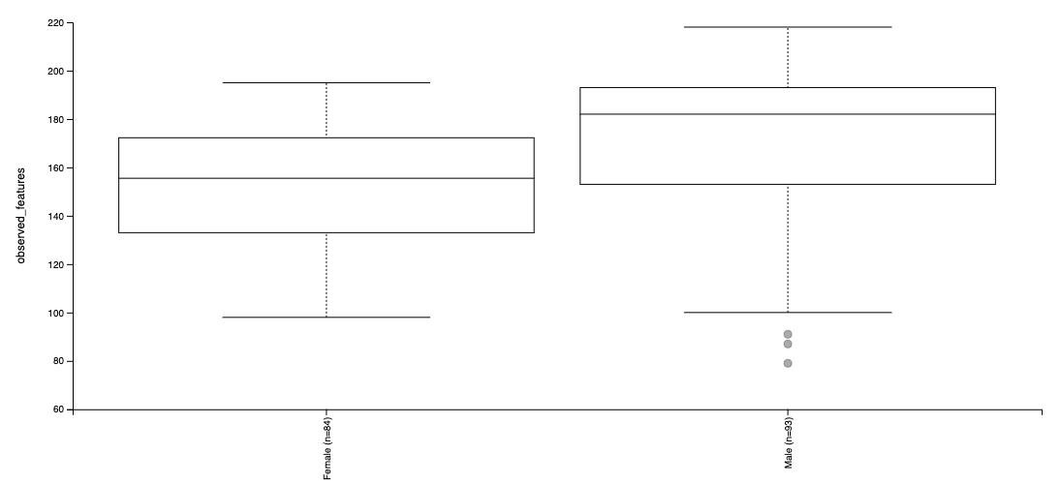
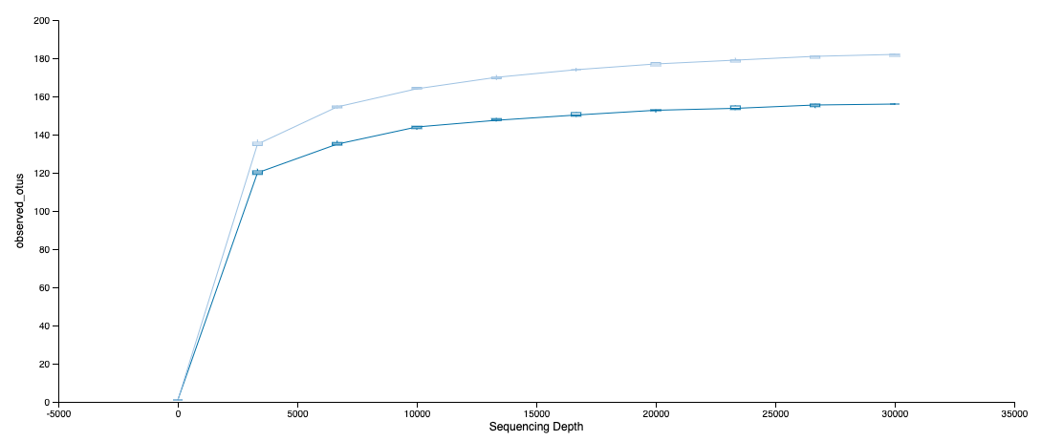
Alpha diversity Observed features (Richness)
Significant differences by sex

Slide 7
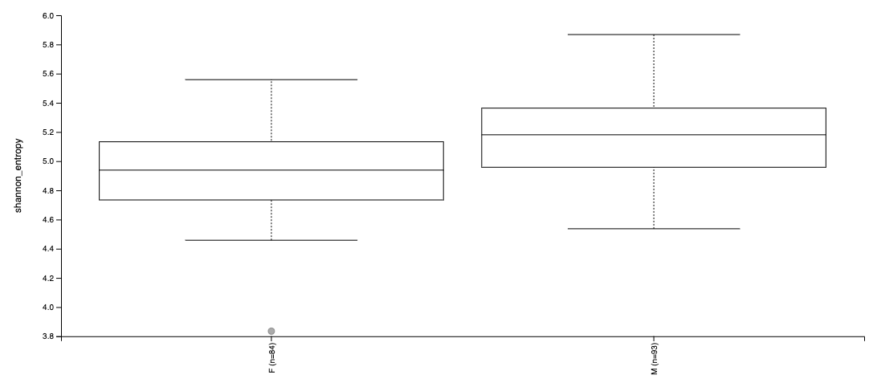
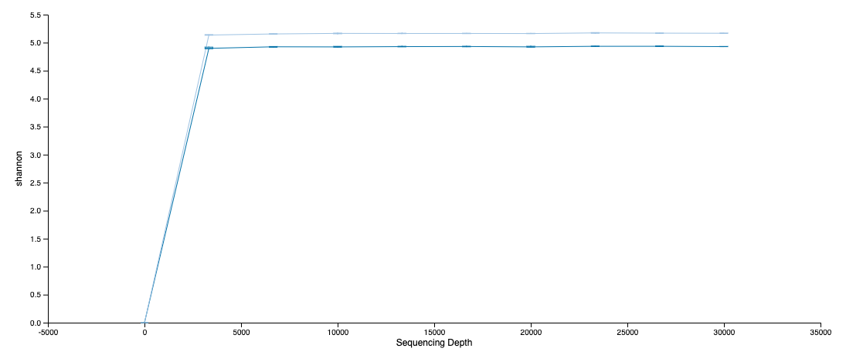
Alpha diversity Shannon
Significant differences by sex

Slide 8
Alpha diversity
ZT_time

Slide 9

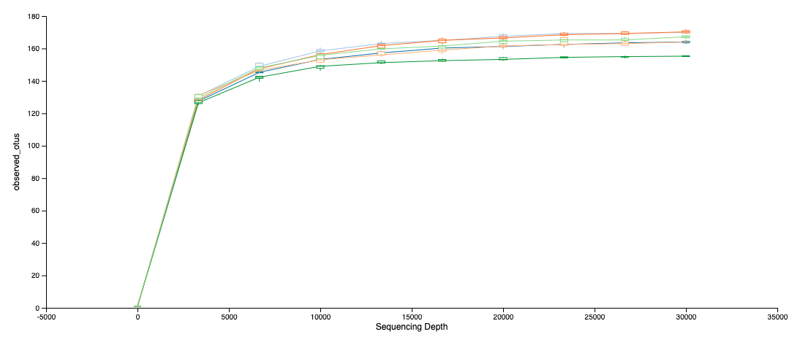
Alpha diversity Observed_features
No significant differences by zt time

Slide 10
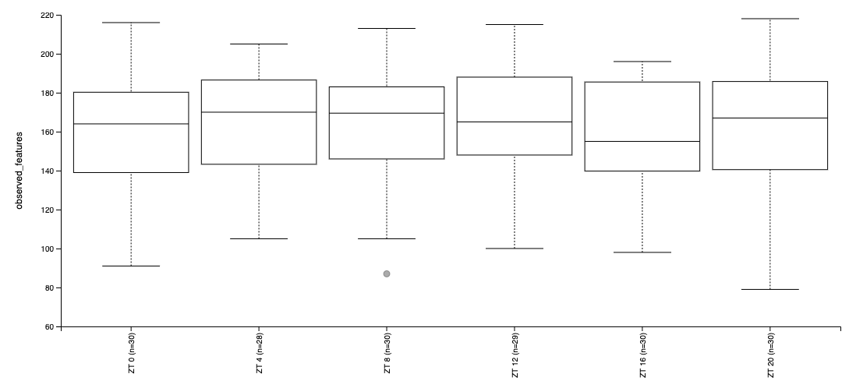
Alpha diversity Observed_features

Slide 11
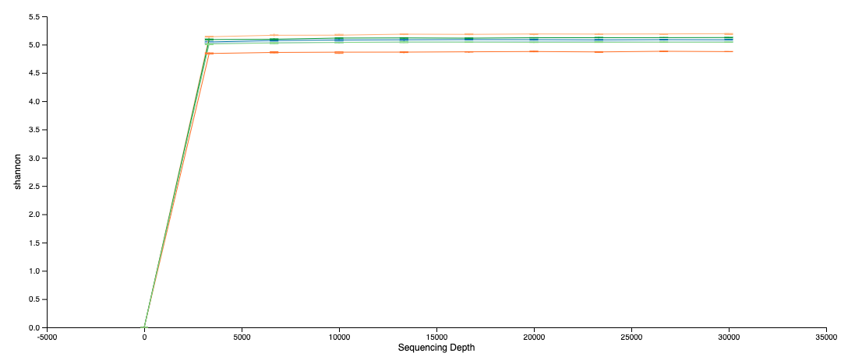
Alpha diversity Shannon

Slide 12
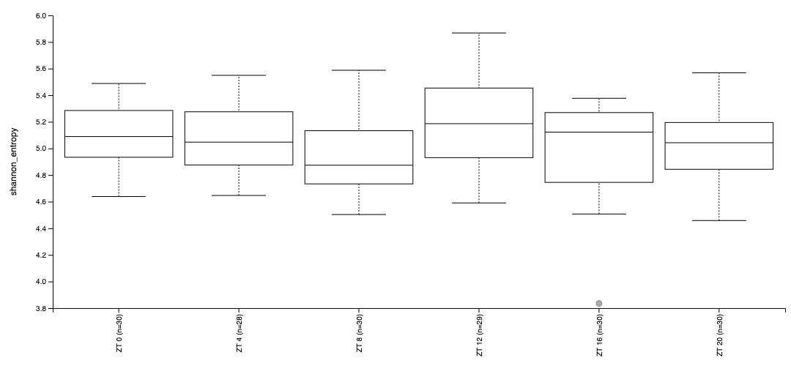
Alpha diversity Shannon
No significant differences by zt time

Slide 13
Beta Diversity

Slide 14
Beta diversity Variation of microbial communities between samples How different is the microbial composition in one environment compared to another?
Bray–Curtis dissimilarity
- based on abundance or read count data
- differences in microbial abundances between two samples (e.g., at species level) values are from 0 to 1
0 means both samples share the same species at exact the same abundances
1 means both samples have complete different species abundances
Jaccard distance
- based on presence or absence of species (does not include abundance information)
- different in microbial composition between two samples
0 means both samples share exact the same species
1 means both samples have no species in common
UniFrac
- sequence distances (phylogenetic tree)
based on the fraction of branch length that is shared between two samples or unique to one or the other sample
unweighted UniFrac: purely based on sequence distances (does not include abundance information)
weighted UniFrac: branch lengths are weighted by relative abundances (includes both sequence and abundance information)

