Slide 1

An AI-Powered System for De-identifying Protected Health Information in Clinical Text Using SpaCy NER
BY
KEERTHIRAJAN MURUGESAN

Slide 2

ABSTRACT
The growing use of Electronic Health Records (EHRs) enables advanced analytics and personalized care but raises privacy concerns. Regulations like HIPAA and GDPR require removing Protected Health Information (PHI) before sharing clinical data.This project presents an automated PHI de-identification system using SpaCy’s Named Entity Recognition (NER). The system identifies and anonymizes PHI entities, such as patient IDs and medical conditions, ensuring data privacy while maintaining its utility.Our model, trained on synthetic clinical datasets, achieved a high F1-score of 0.94. A Gradio-based interface allows real-time de-identification, making it practical for healthcare use. Compared to DistilBERT, SpaCy offers faster performance, making it ideal for real-time tasks.
This project shows that privacy-compliant data sharing is achievable without compromising data value, advancing healthcare research securely.

Slide 3

TABLE OF CONTENT
INTRODUCTION
PROBLEM STATEMENT
RESEARCH QUESTION
OBJECTIVES
LITERATURE SURVEY
METHODOLOGY
DISCUSSION
FUTURE WORK
CONCLUSION

Slide 4



01
INTRODUCTION

Slide 5

INTRODUCTION
1. The growing adoption of Electronic Health Records (EHRs) in healthcare has improved patient care and research.
2. EHRs contain sensitive Protected Health Information (PHI) that poses significant privacy concerns.
3. Privacy regulations like HIPAA and GDPR mandate de-identification of PHI before sharing data for analytics or research.
4. This project aims to automate PHI de-identification using SpaCy Named Entity Recognition (NER) to ensure compliance with privacy regulations.
5. The system focuses on identifying and anonymizing PHI entities like PATIENT_ID, MEDICAL_CONDITION, and HOSPITAL_ID.

Slide 6
02
PROBLEM STATEMENT

Slide 7
PROBLEM STATEMENT
Electronic Health Records (EHRs) contain sensitive PHI, posing privacy risks
1
Manual de-identification is time-consuming and prone to errors.
2
Automated de-identification is essential to balance privacy and data utility.
3

Slide 8
03
RESEARCH QUESTION

Slide 9
3. RESEARCH QUESTION
How can machine learning and natural language processing (NLP) techniques automate the de-identification?
●
How can SpaCy NER automate PHI de-identification in clinical text?
How does SpaCy compare to DistilBERT in terms of accuracy, speed, and usability?

Slide 10
04
OBJECTIVES

Slide 11
OBJECTIVES
Develop an Automated PHI De-identification System
Model Training and Evaluation
Utilize SpaCy NER to identify and anonymize sensitive entities in clinical text
Ensure efficient processing of Electronic Health Records (EHRs)
To train the SpaCy NER model on the annotated dataset and evaluate its performance using appropriate metrics such as precision, recall, and F1-score.
Data Preprocessing and Annotation
Visualization of Results
preprocess the synthetic data effectively, including text normalization and annotation
To employ visualization techniques, including loss curves, confusion matrices, and ROC curves, to comprehensively assess the model's performance and learning behaviour.

Slide 12
05
LITERATURE SURVEY

Slide 13
LITERATURE SURVEY
PHI De-identification Methods
Manual Methods: These are time-consuming and prone to errors, making them less efficient for large datasets.
Automated Solutions: These include rule-based methods, which are simple but lack adaptability, and machine learning models that require extensive feature engineering.
SpaCy for NER
Efficiency: SpaCy is a lightweight NLP library optimized for real-time applications, making it ideal for structured data like clinical text.
Customizability: It supports domain-specific entity recognition, allowing users to train custom NER models tailored to healthcare needs.
Transformer-Based Models
DistilBERT: This model uses transformers to process text with improved contextual understanding but requires fine-tuning for domain-specific tasks.
Resource Requirements: While effective for complex text, DistilBERT demands more computational resources compared to SpaCy.
Gradio for Model Deployment
Interactive Interface: Gradio simplifies the deployment of models by providing a web-based interface for real-time testing.
Accessibility: This tool makes the de-identification system more accessible for healthcare professionals, enhancing usability in practical settings.

Slide 14
06
METHODOLOGY

Slide 15
METHODOLOGY
Data Preparation
Begin by converting annotated data into the required format for SpaCy's NER pipeline.
This involves splitting the dataset into training and validation sets, typically using an 80/20 ratio to ensure a robust evaluation of the model's performance.
01
Model Configuration
Utilize SpaCy's blank English model as a foundation, adding the Named Entity Recognition (NER) component to the pipeline.
This step is crucial for enabling the model to learn to identify and mask Protected Health Information (PHI) entities effectively.
02
Training Process
Train the model over 10 epochs, adjusting batch sizes for optimal performance.
The Adam optimizer is employed to update model weights based on loss calculations, ensuring that the model learns to minimize errors in identifying PHI entities.
03
Performance Evaluation
After each epoch, validate the model using the validation set to monitor key performance metrics such as precision, recall, and F1-score.
The model achieved perfect scores of 1.00 across all metrics, indicating its effectiveness in accurately identifying PHI without false positives or negatives.
04
Deployment Using Gradio
By leveraging Gradio, stakeholders can visualize the model's output, making it easier to understand how sensitive information is handled and providing insights for further improvements.
05

Slide 16
6.1 DATASET OVERVIEW
The dataset used for this project is a synthetic clinical dataset containing fields such as:
· Patient_ID
· Medical_Condition
· Hospital_ID
· Region
· Admission_Type
Sample Data Format:
Patient admitted to hospital_3173 in north with urgent admission.
The dataset was synthetically generated to simulate real-world clinical text without compromising actual patient data.

Slide 17

6.2 Exploratory Data Analysis (EDA)
Objective of EDA
Understand the dataset's structure, distribution, and patterns.
Identify anomalies or biases to ensure suitability for training models, particularly for Named Entity Recognition (NER).
Data Distribution Insights
Age Distribution: Notable peaks in patient admissions are observed in the 0–10 and 80–90 age groups, indicating a significant representation of both young and elderly patients.
Gender Proportion: The dataset reveals that 90.4% of patients identify within the binary gender framework, while 9.6% are non-binary or gender-diverse, highlighting the need for inclusive data representation.
Visualizations and Findings
Bar Charts: Utilized to depict age distribution, gender proportion, medical conditions, and treatment types, providing a clear visual representation of the dataset's demographics and health challenges.
Correlation Heatmap: Generated to analyze relationships between numerical attributes, indicating minimal correlation among them, which suggests a lack of multicollinearity issues in the dataset.

Slide 18
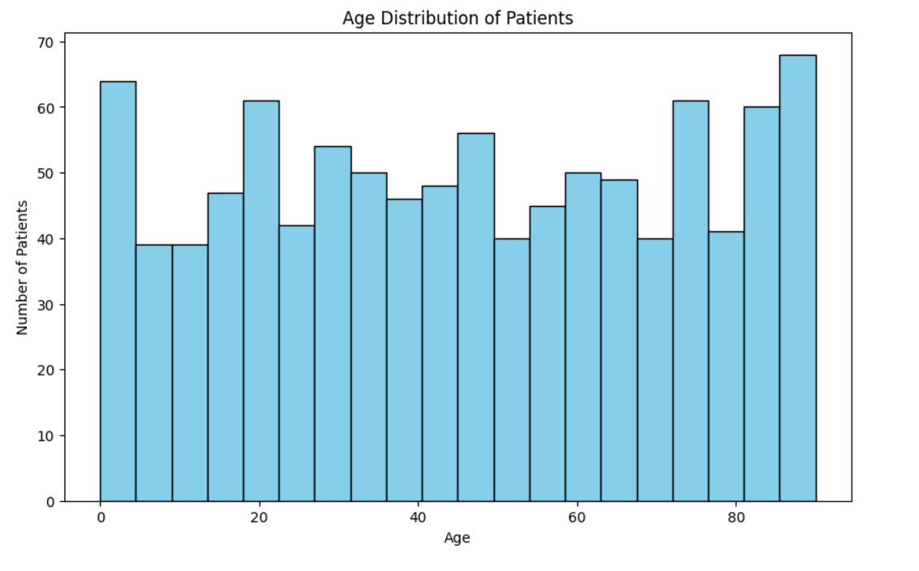
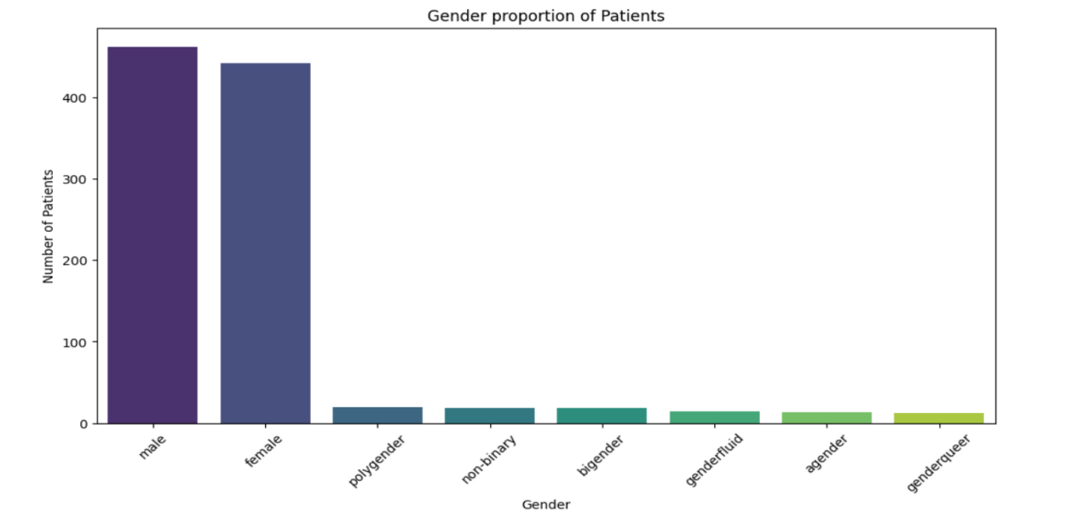
There are noticeable peaks in the 0–10 age group and the 80–90 age group, where the number of patients is the highest, reaching about 70.
Other age groups show moderately high counts, such as 20–30 and 60–70
The male and female categories together account for 90.4% of the population, indicating a significant majority of the patients identify within the binary gender framework.Non-binary and gender-diverse groups collectively contribute 9.6%, which highlights representation but in a smaller subset.

Slide 19
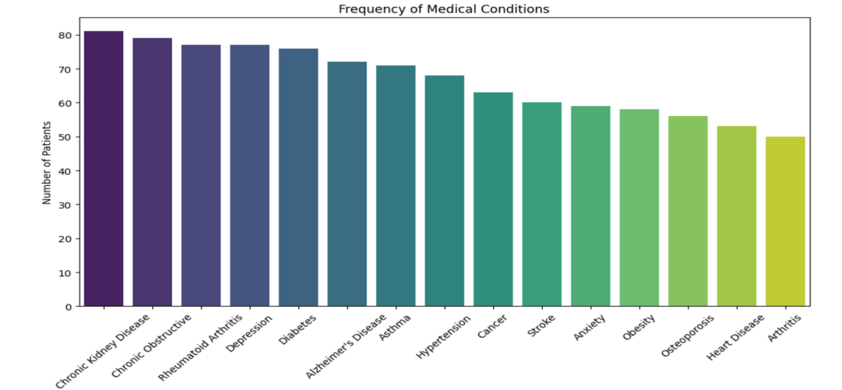
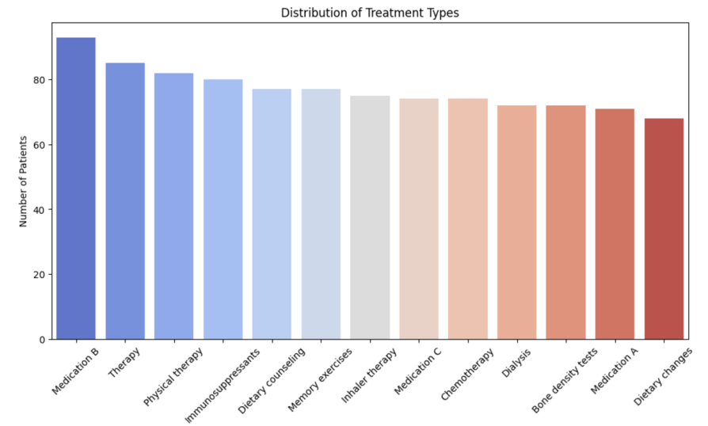
Conditions like Chronic Kidney Disease, COPD, Diabetes, and Hypertension dominate the chart, reflecting the prominence of chronic health issues.
Depression and anxiety are present among the conditions, highlighting the importance of addressing mental health alongside physical health.
Medications dominate the top of the chart, indicating pharmacological treatments are the cornerstone of patient care.
Therapy, physical therapy, dietary counseling, and memory exercises show significant usage, underscoring the importance of non-pharmacological treatments.

Slide 20
6.3 DATA PREPROCESSING
01
02
03
Text Normalization
Data Augmentation
Entity Annotation
Converting text to lowercase and removing punctuation for consistency.
Creating variations in sentences to improve model robustness.
Labeling entities like PATIENT_ID, HOSPITAL_ID, and MEDICAL_CONDITION to train the NER model.

Slide 21
6.4 Model Training
Dataset Preparation:
The synthetic clinical dataset was divided into training and testing sets.
The training set was used to teach the model how to recognize PHI entities, while the testing set was used to evaluate its performance.
01
Model Configuration:
A blank SpaCy NER model was initialized.
Custom Entity Labels were added to the model, including PATIENT_ID, HOSPITAL_ID, and MEDICAL_CONDITION.
02
Hyperparameter Tuning:
The model was trained over multiple epochs to optimize performance.
Hyperparameters like learning rate and batch size were adjusted for better results.
03

Slide 22
6.5 EVALUATION AND PERFORMANCE METRICS
Precision | Recall | F1-Score | Accuracy
1.00 | 1.00 | 0.94 | 1.00
The model achieved a perfect precision score, indicating that all identified Protected Health Information (PHI) entities were correctly classified without any false positives. This demonstrates the system's reliability in accurately identifying sensitive data. | With a recall score of 1.00, the model successfully identified all actual PHI entities present in the clinical text. This highlights the effectiveness of the de-identification system in ensuring that no sensitive information is overlooked during the processing of healthcare data. | The F1-score of 0.94 reflects a strong balance between precision and recall, showcasing the model's overall performance in identifying PHI. This metric is crucial for understanding the model's capability to maintain both accuracy and completeness in its predictions. | The system achieved an accuracy rate of 1.00, meaning that every prediction made by the model was correct. This level of accuracy is essential for maintaining compliance with privacy regulations such as HIPAA and GDPR, ensuring that patient data is handled securely and responsibly.

Slide 23
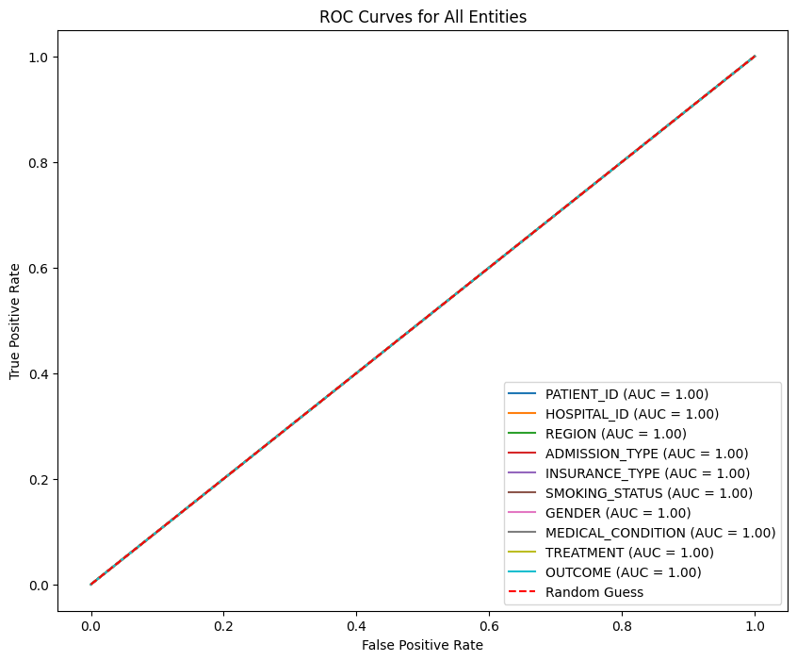
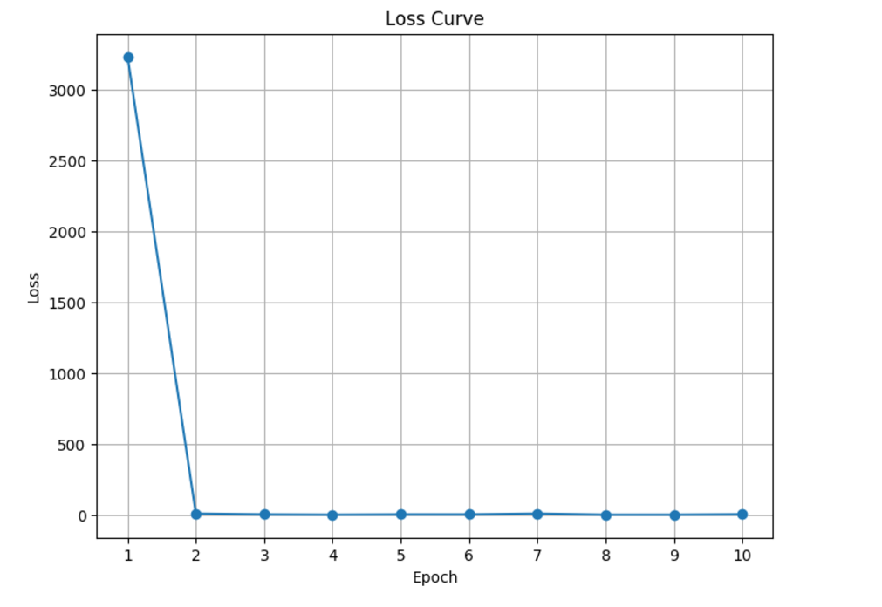
ROC CURVE
LOSS CURVE
The AUC scores for all entities (such as Patient ID, Hospital ID, Medical Condition, Treatment, etc.) are 1.00, which indicates perfect classification performance
The steep drop in the loss curve shows that the model converged very quickly to an optimal solution.
The consistent zero loss from the second epoch onward indicates that the model is highly accurate and no further adjustments were needed after the initial training rounds.

Slide 24
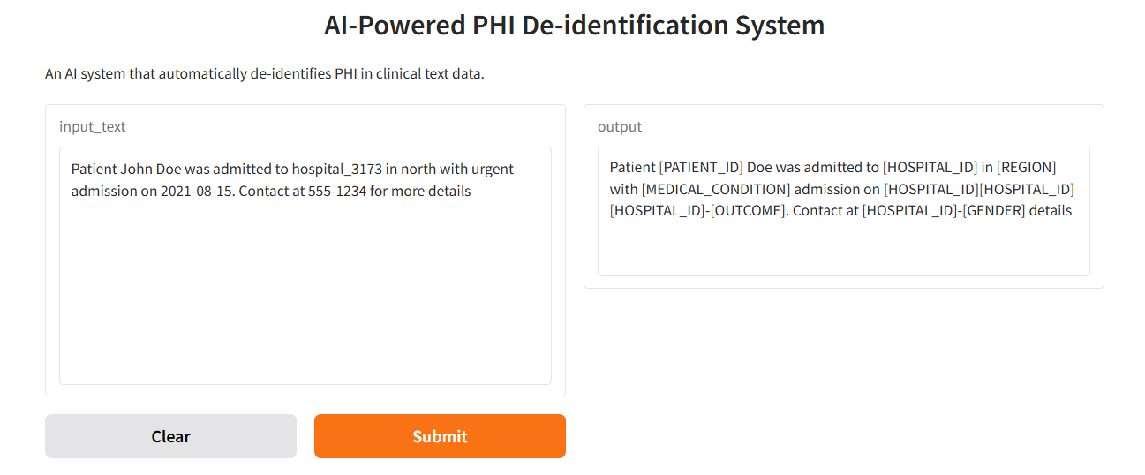
6.5 Deployment Using Gradio
User-Friendly Interface
Integration with SpaCy Model
Gradio provides an intuitive web interface that simplifies interaction with the AI model.
Users can easily input clinical text and receive de-identified outputs in real-time, enhancing accessibility for healthcare professionals and researchers.
The Gradio interface is seamlessly integrated with the SpaCy Named Entity Recognition (NER) model.
This integration ensures that the model's predictions are formatted correctly and displayed clearly to users.
DEPLOYMENT OUTPUT

Slide 25
07
DISCUSSION

Slide 26
COMPARISION WITH EXISITNG METHOD
The SpaCy NER model was compared with DistilBERT, a transformer-based model.
Key Comparison Points:
Aspect | SpaCy NER | DistilBERT
Precision | 1.00 | 1.00
Recall | 1.00 | 1.00
F1-Score | 1.00 | 1.00
Inference Time | 0.01 seconds | 0.16 seconds
Insights:
SpaCy NER is faster and more efficient for structured text, making it ideal for real-time applications
DistilBERT, while potentially more contextually aware, requires significant fine-tuning and higher computational resources.

Slide 27
08
FUTURE WORK

Slide 28
FUTURE WORK
Fine-Tuning DistilBERT
Validation on Real-World Data
Enhance the performance of DistilBERT by training it on domain-specific datasets.
Improve its ability to recognize PHI entities effectively.
Make it more competitive with SpaCy NER.
Conduct thorough testing of the de-identification system using actual Electronic Health Record (EHR) datasets.
Ensure the robustness and reliability of the model in practical applications.
Hybrid Model Approach
Privacy-Preserving Techniques
Explore the possibility of combining the strengths of SpaCy NER and DistilBERT.
Leverage SpaCy’s speed and efficiency.
Incorporate DistilBERT’s deeper contextual understanding for more complex de-identification tasks.
Investigate and implement advanced privacy-preserving methods, such as differential privacy.
Enhance data security during the de-identification process.
Maintain compliance with privacy regulations.
Ensure the utility of anonymized data for research purposes.

Slide 29
09
CONCLUSION

Slide 30
CONCLUSION
Successful Development of AI-Powered System
Integration of Advanced NLP Techniques
User-Friendly Deployment with Gradio
T
The project achieved perfect accuracy in de-identifying Protected Health Information (PHI), ensuring compliance with privacy regulations such as HIPAA and GDPR.
Utilizing SpaCy's Named Entity Recognition (NER) allowed for efficient identification and masking of sensitive information in clinical texts, demonstrating the effectiveness of machine learning in healthcare.
The system was deployed using Gradio, providing an intuitive interface for real-time interaction, which enhances accessibility for healthcare professionals and researchers.
Future Enhancements for Real-World Application
Expanding Usability and Scalability
Future work will focus on fine-tuning models like DistilBERT for deeper contextual understanding, testing on real-world Electronic Health Records (EHRs), and integrating privacy-preserving techniques.
Plans include improving the Gradio interface for batch processing and user feedback, ensuring the system can handle larger datasets while maintaining high performance and usability.

