Slide 1
tamVR Topographic Attribute Maps in Virtual Reality
Ekaterina Baikova
20.04.2023

Slide 2
Table of content
Project description
Application features and architecture
Demo

Slide 3

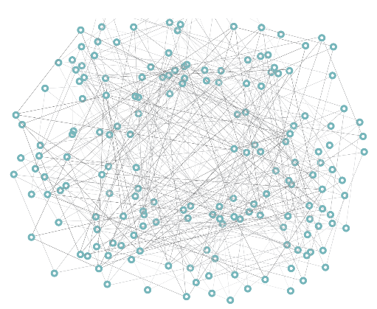
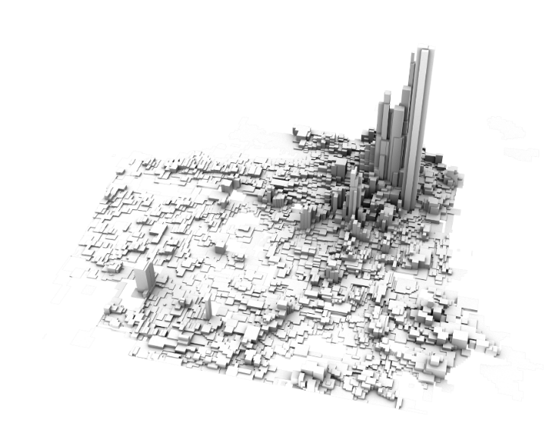
Project Description
GEDCOM data
tamVR is a Unity VR application that
transforms GEDCOM data into an interactive graph
builds a landscape with heights based on birth year of each person
Let the user explore the landscape
Graph
Landscape

Slide 4
Development Tools
Software | Hardware
Unity Editor 2021.3.20.f1 | VR Device (TBA)
Visual Studio IDE | VR Controller (TBA)
Git | PC

Slide 5
Architecture (Demo Version)
Controls:
XR Interaction Toolkit [1]
GEDCOM json
DataLoader
GraphController
LandscapeRenderer
Graph Data
GraphRenderer
Scene
[1] https://docs.unity3d.com/Packages/com.unity.xr.interaction.toolkit@2.3/manual/index.html

Slide 6
Demo Showcase
Problems:
Json file was used from tam repo: Should I write a parser for GEDCOM/Use the parser from tam repo?
How to interpolate generated mesh vertices: manually/heightmap generation?
How to create tunnels in the mesh: having a set of edge intersections?
Next steps:
Two scenes for graph and landscape
Terrain generation from a height map (like Perlin Noise)
Graph projection on landscape mesh
Mini map of the graph

Slide 7
Planned feature set
Main features:
Colormap of the landscape with several options
Mini map of the graph
Zoom-in
Teleportation
Flight mode

Slide 8
Thank you for your attention!

