Slide 1

Classification Models in Machine Learning
An overview of techniques and application

Slide 2
Introduction
What is classification?
Examples: Spam detection, Disease diagnosis, Fraud detection

Slide 3
Types of Machine Learning
Supervised vs Unsupervised
Classification = Supervised learning

Slide 4
Type Of Classification
1. Binary Classification
Predicts between two classes only (Yes/No, 0/1).
Example: Detecting whether an email is spam or not spam.
2. Multi-class Classification
Predicts among more than two classes.
Example: Classifying an image as cat, dog, or bird.

Slide 5
Data for Classification
Features (inputs)
Labels (target variable)

Slide 6
Workflow of a Classification Task
1. Data collection
2. Preprocessing
3. Model training
4. Evaluation

Slide 7
Logistic Regression
Definition
A supervised learning algorithm used for classification (not regression, despite its name).
Predicts the probability that an instance belongs to a particular class.
How it Works
Uses a sigmoid (logistic) function to map outputs to a probability between 0 and 1.
Decision is made by applying a threshold (commonly 0.5).
Key Features
Simple, fast, and interpretable.
Works well for linearly separable data.
Provides probabilistic outputs.

Slide 8
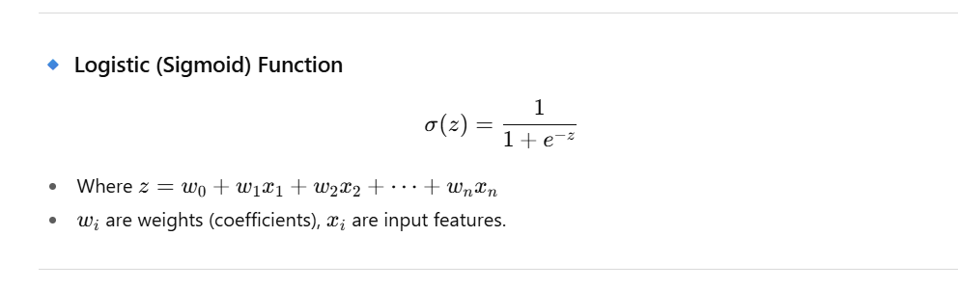

Slide 9
Logistic Regression
Advantages
Easy to implement and efficient.
Good baseline model for binary classification.
Coefficients show importance of features.
Limitations
Assumes a linear relationship between features and log-odds.
Not suitable for complex non-linear patterns.

Slide 10
Decision Tree
Definition
A supervised learning algorithm that splits data into branches using if-then rules, forming a tree-like structure.
Each internal node = decision on a feature, each branch = outcome, each leaf = final class.
How it Works
Splits data by selecting features that best separate classes (using metrics like Gini Index or Entropy/Information Gain).
Keeps splitting until a stopping criterion is met (like max depth or min samples).
Key Features
Easy to interpret and visualize.
Handles both categorical and numerical data.
Works well without much data preprocessing.

Slide 11
Decision Tree
Advantages
Simple and interpretable results.
Can capture non-linear relationships.
Requires little data preparation (no scaling needed).
Limitations
Prone to overfitting if the tree is too deep.
Small changes in data can lead to very different trees.

Slide 12
Bagging (Bootstrap Aggregating)
Definition
Bagging builds multiple models independently on different random subsets of the data (bootstrap samples).
Final prediction is made by averaging (regression) or majority vote (classification).
How it Works
Randomly sample the dataset with replacement.
Train separate models (often Decision Trees) on each sample.
Combine predictions by majority voting/averaging.
Advantages
Reduces variance (less overfitting).
Stable and robust model.
Works well with high-variance models (like Decision Trees).
🔹 Example
Random Forest = Bagging + random feature selection.

Slide 13
Boosting
Definition
Boosting builds models sequentially, where each new model focuses on errors (misclassified samples) made by previous ones.
Final prediction is a weighted combination of all models.
How it Works
Start with a weak learner (e.g., shallow tree).
Increase weights for misclassified samples.
Train the next model to correct previous mistakes.
Repeat for many rounds.
Advantages
Reduces bias (improves weak learners).
Often achieves very high accuracy.
Popular algorithms: AdaBoost, Gradient Boosting, XGBoost, LightGBM, CatBoost.
Example
XGBoost is widely used in Kaggle competitions for classification/regression tasks.

Slide 14
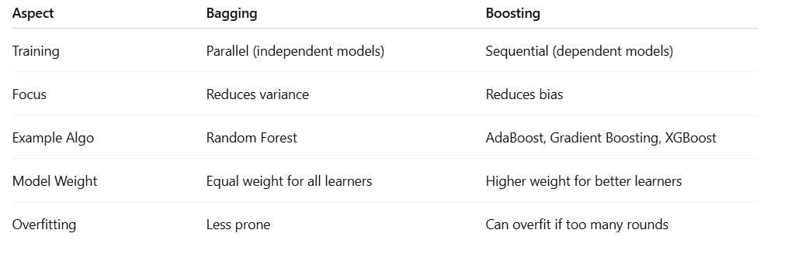
Bagging vs Boosting (Quick Comparison)

Slide 15

Random Forest
Random Forest
Random Forest is a machine learning algorithm that belongs to the ensemble learning family.
It combines multiple decision trees to make predictions that are more accurate and stable.
Think of it like asking a group of people (trees) instead of just one person (a single decision tree). The group’s majority opinion is usually better than one person’s guess.
How it Works
Bagging (Bootstrap Aggregation)
Randomly select samples (with replacement) from the training data.
Build a decision tree for each sample.
Random Feature Selection
At each split in the tree, instead of considering all features, it chooses a random subset of features.
This ensures diversity among trees.
Prediction
For classification → Each tree votes, and the majority class wins.
For regression → The average of all trees is taken.

Slide 16

Random Forest
Advantages
Reduces overfitting compared to a single decision tree.
Works well with large datasets.
Handles both classification and regression.
Provides feature importance.
Disadvantages
Can be slow with too many trees.
Less interpretable than a single decision tree.

Slide 17
Support Vector Machine (SVM)
Finds hyperplane
Works well for small/medium datasets

Slide 18
K-Nearest Neighbors (KNN)
KNN:
K-Nearest Neighbors (KNN) is a supervised machine learning algorithm used for both classification and regression.
It works by comparing distances between a new data point and the existing data points, then making predictions based on its nearest neighbors.
How KNN Works
Choose a value of K (number of neighbors).
For a new data point:
Calculate the distance from all other points (commonly Euclidean distance).
Find the K nearest neighbors.
Prediction:
Classification → Majority voting (the class most neighbors belong to).
Regression → Average of neighbors’ values.

Slide 19
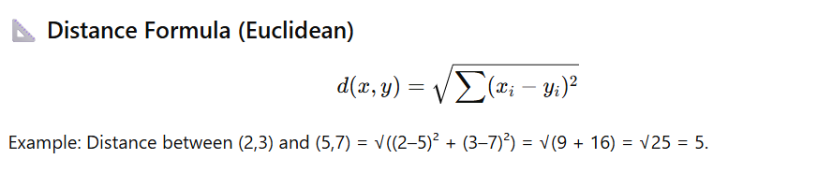
K-Nearest Neighbors (KNN)

Slide 20
K-Nearest Neighbors (KNN)
Advantages
Simple and intuitive.
No training phase (lazy learning).
Works well with smaller datasets.
Disadvantages
Slow with large datasets (distance calculated for every point).
Sensitive to irrelevant features and scaling.
Choice of K is crucial:
Small K → Noisy, unstable.
Large K → Too smooth, may miss patterns.

Slide 21
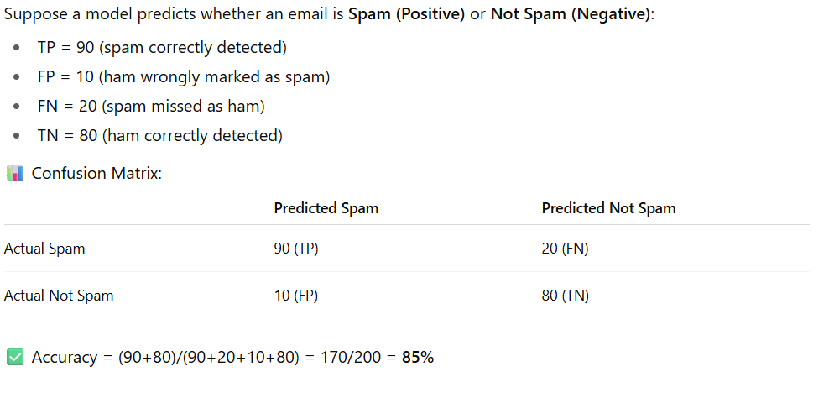
Example

Slide 22
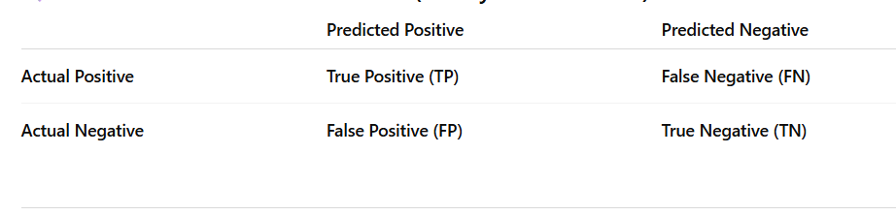
Confusion Matrix
A confusion matrix is a table used to evaluate the performance of a classification model. It compares the predicted labels with the actual labels.
Explanation
True Positive (TP): Model correctly predicts Positive.
True Negative (TN): Model correctly predicts Negative.
False Positive (FP): Model incorrectly predicts Positive (Type I Error).
False Negative (FN): Model incorrectly predicts Negative (Type II Error).

Slide 23
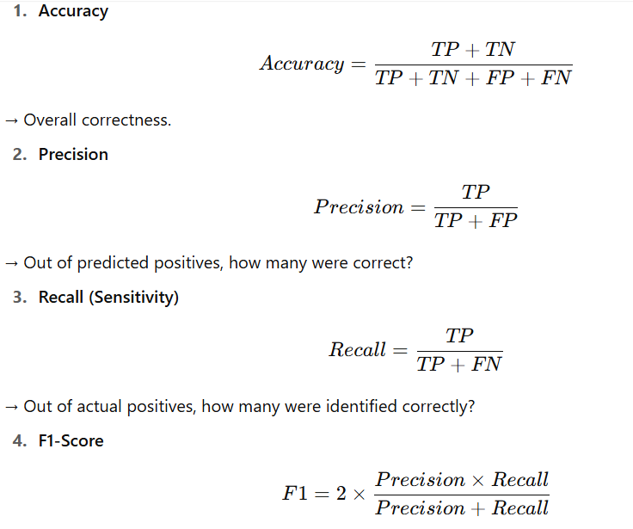
Evaluation Metrics (1)

Slide 24
Bias–Variance Tradeoff
Bias
Bias = Error from overly simplifying the model (wrong assumptions).
High bias → Model ignores important patterns.
Example: Using a straight line (linear regression) for a curved dataset.
Variance
Variance = Error from being overly sensitive to training data.
High variance → Model captures noise & fluctuates with different samples.
Example: A deep decision tree memorizing every training point.
Tradeoff Explanation
Goal: Minimize Total Error = Bias² + Variance + Irreducible Error
If model is too simple → High Bias, Low Variance → Underfitting.
If model is too complex → Low Bias, High Variance → Overfitting.
Ideal model → Balance bias & variance → Good generalization.
Visual Concept
Imagine fitting curves to data:
High Bias (Underfit): Straight line → misses patterns.
High Variance (Overfit): Wiggly curve → fits noise too.
Good Fit: Smooth curve → captures trend, ignores noise

Slide 25
Bias–Variance Tradeoff
Type | Bias | Variance | Train Accuracy | Test Accuracy
Underfitting | High | Low | Low | Low
Good Fit | Balanced | Balanced | High | High
Overfitting | Low | High | Very High | Low

Slide 26
Overfitting vs Underfitting
Underfitting
Model is too simple → cannot capture underlying patterns.
High Bias (strong assumptions about data).
Low Variance (model is stable but inaccurate).
Example: Using a straight line (Linear Regression) to fit complex curved data → poor accuracy on both training & test data.
Overfitting
Model is too complex → learns noise as well as patterns.
Low Bias (fits training data very well).
High Variance (fails to generalize → poor test accuracy).
Example: Decision Tree that keeps splitting until every training point is classified → 100% training accuracy but poor test accuracy.

Slide 27
Conclusion & Q/A
Summary of key points
Open for discussion

