Slide 1
Final Dissertation Defense
Essays on Heterogeneous Returns, Trust, and Household Wealth
Core theme: wealth inequality is shaped not only by earnings and savings, but by heterogeneity in rates of return, trust-related performance, and how we measure unequal wealth distributions.
Decory Edwards
June 22, 2026
Defense structure
Introduction
Three chapters
Synthesis and conclusion

Slide 2
Roadmap
The dissertation asks one broad question
How do heterogeneous rates of return reshape the explanation, performance, and measurement of wealth inequality?
Chapter 1
Structural macro
Chapter 2
Trust and performance
Chapter 3
Wealth inequality under ambiguity
Embed return heterogeneity in a standard heterogeneous-agent model and estimate the return distribution needed to match wealth moments.
Measure returns to net wealth in the HRS and test whether trust has a nonlinear relationship with long-run household investment performance.
Motivated by Rawls, build an ambiguity-based wealth inequality measure and compare it with the standard objective-uncertainty benchmark.
Essays on Heterogeneous Returns, Trust, and Household Wealth
2

Slide 3
Chapter 1
Matching wealth moments with heterogeneous returns
Claim
Return heterogeneity is a quantitatively important missing ingredient in structural macro models of wealth inequality.
Model logic
• Income risk and life-cycle structure explain part of wealth dispersion, but not enough.
• A return distribution lets the model fit the lower and upper tails much more closely.
• That better fit matters for aggregate MPCs, tax comparisons, and the interpretation of wealth concentration.
• Start from a standard heterogeneous-agent model with labor income risk.
• Estimate the return distribution needed to match SCF wealth moments.
• Interpret the implied dispersion as consistent with empirical heterogeneity in realized rates of return.
Essays on Heterogeneous Returns, Trust, and Household Wealth
3

Slide 4
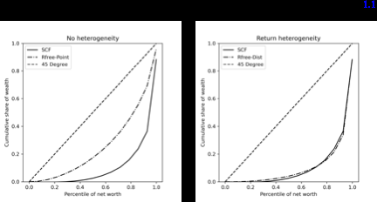
Chapter 1 Result
Heterogeneous returns sharply improve the fit to the wealth distribution
Estimated return distribution
Top 5% wealth share
R = 1.0204
∇ = 0.0683
Data 57.4%
No het. 23.3%
Het. 58.8%
Life-cycle implication
Aggregate MPC rises from about 12.6% to 27.8% once return heterogeneity is added.
• The Lorenz curve with return heterogeneity tracks the SCF much better than the no-heterogeneity benchmark.
• The estimated return distribution is modest in scale, not an implausibly extreme calibration.
• Takeaway: heterogeneous returns can be a disciplined explanation for observed wealth concentration.
Essays on Heterogeneous Returns, Trust, and Household Wealth
4

Slide 5
Chapter 2
Moderate trust and maximum performance on financial investments
Question: if trust shapes how households interact with financial institutions and markets, does a moderate amount of trust maximize returns to net wealth?
Net wealth return distribution
Why CRE matters
Mean 0.201
Median 0.084
P99 2.697
Trust is time-invariant in the HRS, so panel structure matters for identification.
• Use the RAND HRS panel to construct realized returns to net wealth.
• Trust in people is observed in 2020 on a 1 to 10 scale.
• Estimate pooled, FE, RE, and CRE specifications to separate time-varying and persistent return components.
Empirical target
Estimate a hump-shaped relationship in trust while retaining an interpretable persistent household component in returns.
Essays on Heterogeneous Returns, Trust, and Household Wealth
5

Slide 6
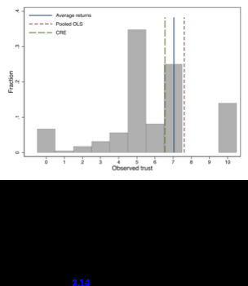
Chapter 2 Result
Returns peak at moderate trust, and persistent heterogeneity survives richer controls
Avg. returns peak
Pooled OLS peak
CRE peak
Trust* = 7.07
Trust* = 7.61
Trust* = 6.59
• CRE estimates keep trust and trust squared jointly significant while allowing a persistent return component.
• The estimated persistent component is comparable in shape to empirical return heterogeneity found in other datasets.
• The RE restriction is rejected; CRE is the preferred panel specification.
Robustness: once portfolio-share controls are added, the fixed-effect distribution changes little and the trust result survives.
Essays on Heterogeneous Returns, Trust, and Household Wealth
6

Slide 7
Chapter 3
Wealth inequality under ambiguity
Motivation: if wealth is tied to ownership rights, institutions, and social history, then ranking wealth distributions should allow for ambiguity, not only objective risk.
Proposed measure
IA = 1 - wEDE / μ
Rawls-inspired move
Interpretation: the equally distributed equivalent wealth level falls when ambiguity about socially relevant states matters, pushing measured inequality up.
• Treat socially relevant states, such as race, as part of the ranking problem.
• Use choice under ambiguity to build a welfare-based wealth inequality measure.
• Compare it directly with the objective-uncertainty benchmark used in the standard Atkinson-style approach.
Essays on Heterogeneous Returns, Trust, and Household Wealth
7

Slide 8
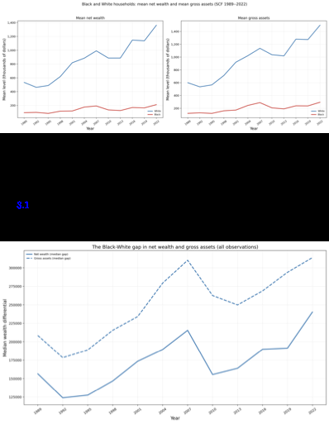
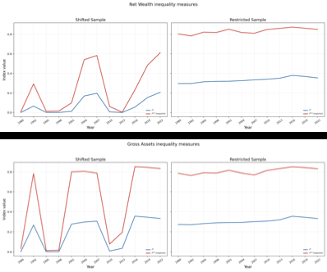
Chapter 3 Result
Ambiguity-based wealth inequality is systematically higher and tracks racial wealth-gap dynamics
Figure 3.2: the median Black-White wealth gap is positive and persistent over time.
Figure 3.3: even at low curvature, IA stays above the objective benchmark IO.
Essays on Heterogeneous Returns, Trust, and Household Wealth
8

Slide 9
Synthesis
The three chapters connect through one unifying lesson
Rates of return matter for wealth inequality at three margins: distributional explanation, realized performance, and welfare-based measurement.
Explaining concentration
Explaining performance
Explaining measurement
Structural macro models need heterogeneity in returns to reproduce empirical wealth moments and realistic MPC implications.
Moderate trust is associated with higher returns to net wealth, while persistent household-specific return heterogeneity remains economically important.
Once socially relevant ambiguity is admitted, standard objective inequality measures understate wealth inequality in the data.
Big picture: wealth inequality is not only about who saves more. It is also about who earns different returns, why, and how we judge the inequality those returns create.
Essays on Heterogeneous Returns, Trust, and Household Wealth
9

Slide 10
Conclusion
Main takeaways for the defense
Across the dissertation, heterogeneous returns are central to understanding wealth dynamics in the data and to evaluating wealth inequality in theory.
• Chapter 1: return heterogeneity can match key SCF wealth moments in a structural macro model, with an implied return distribution close to empirical evidence.
• Chapter 2: returns to net wealth display a hump-shaped relationship with trust, peaking in a moderate range around 6 to 7, while persistent heterogeneity remains after richer controls.
• Chapter 3: an ambiguity-based wealth inequality measure implies more inequality than the objective benchmark for the same wealth distribution and co-moves with the Black-White median wealth gap.
Thank you. I look forward to your questions.
Essays on Heterogeneous Returns, Trust, and Household Wealth
10

