Slide 1

Damage Control Simulator
Safety Briefing
INDONESIA 2023

Slide 2

Damage Control Simulator Safety Briefing
Safety Measures
First priority in training is Safety

Slide 3
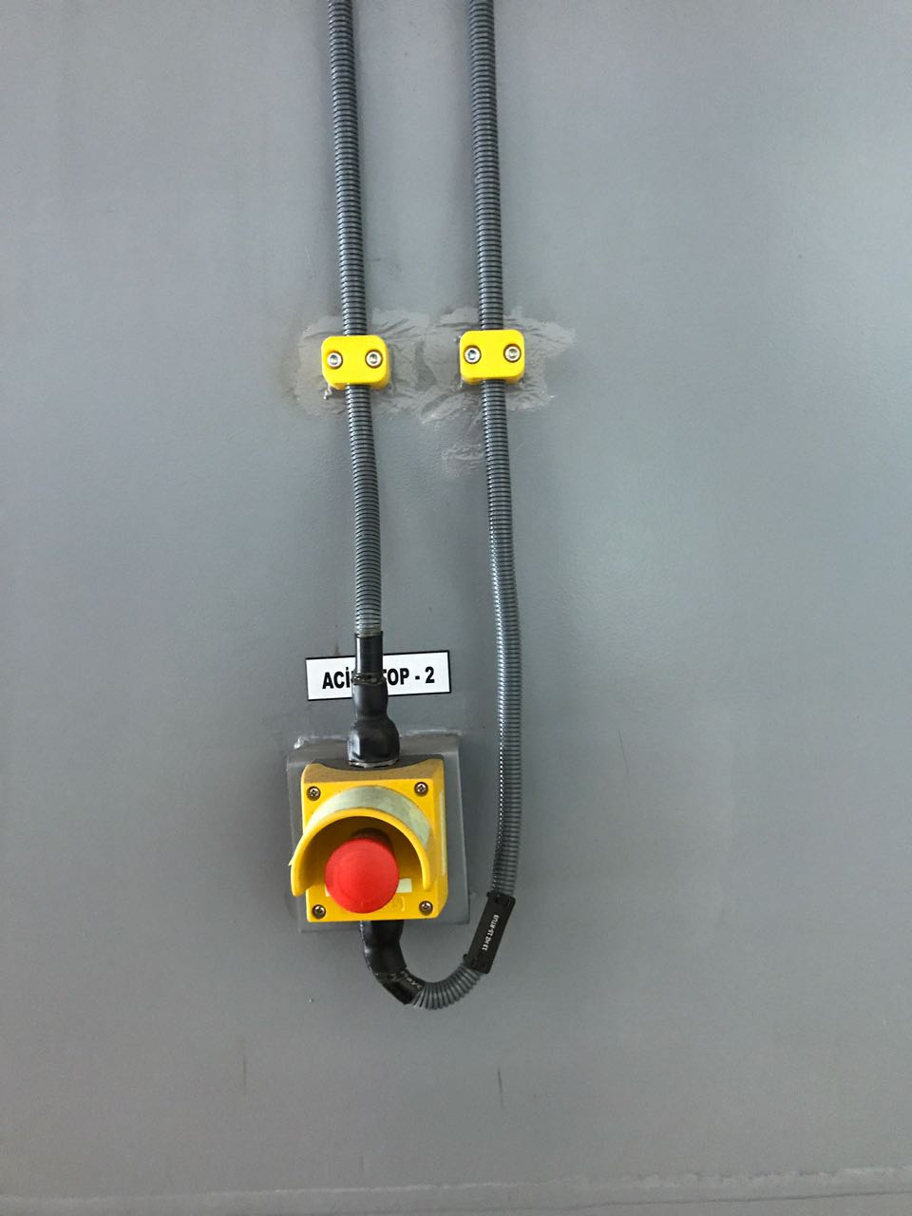
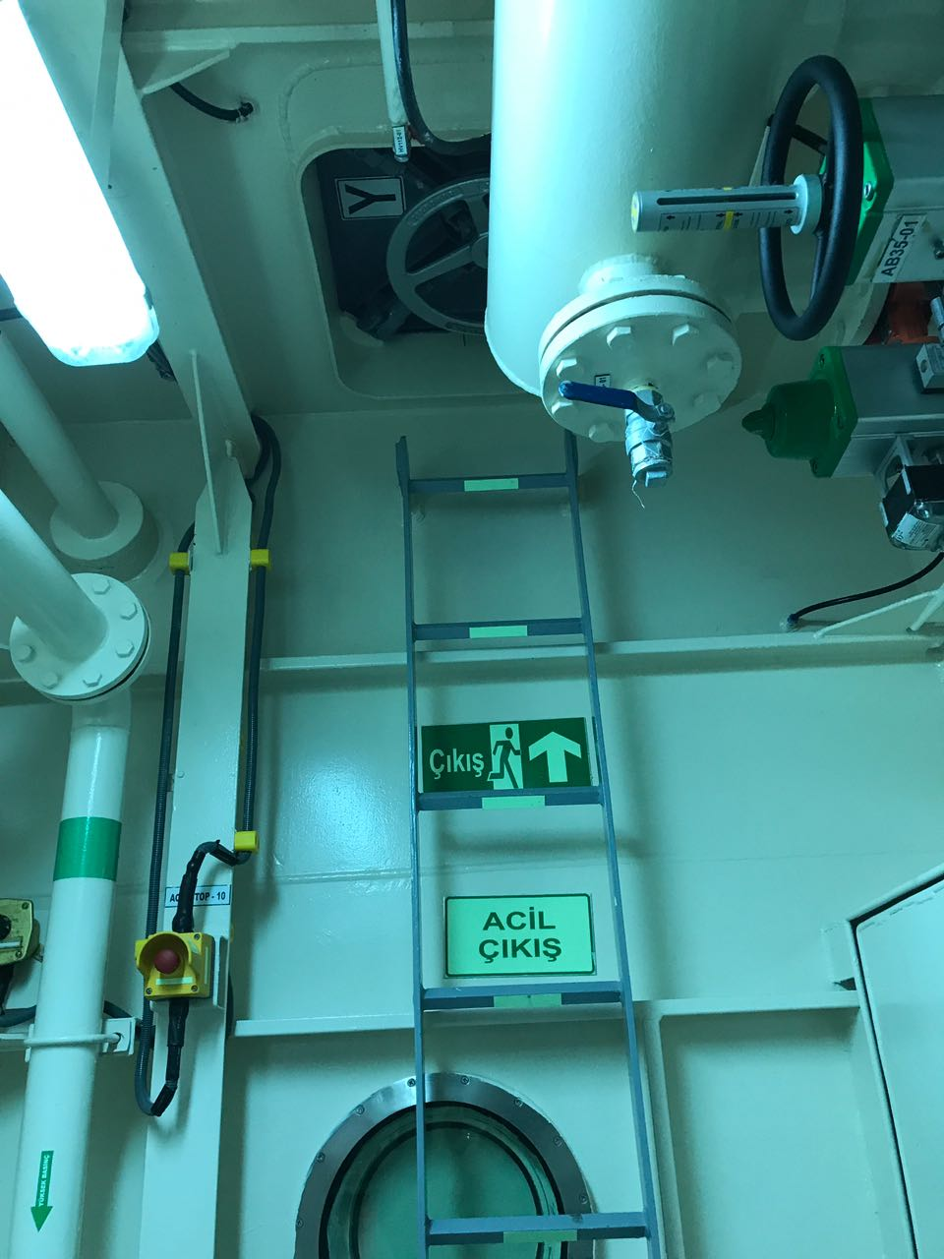
Safety Measures
Each training site has an ‘EMERGENCY STOP’ button and ‘EMERGENCY EXIT,. Any trainee who detects that safety has been compromised and wishes to stop the training urgently can use the‘ EMERGENCY STOP ’button and abandone the site.

Slide 4
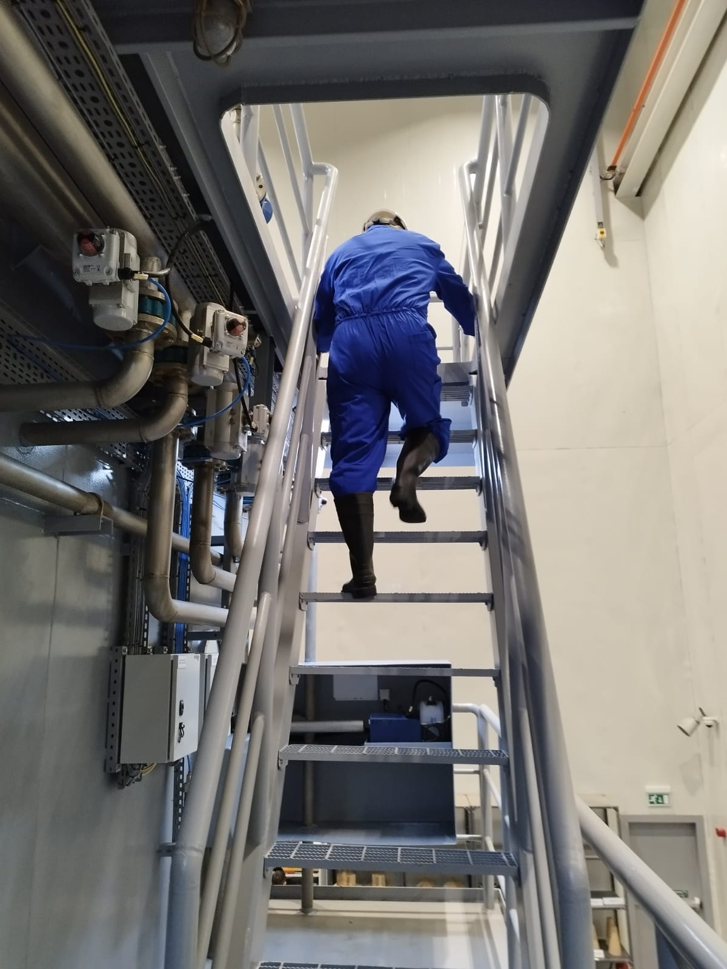
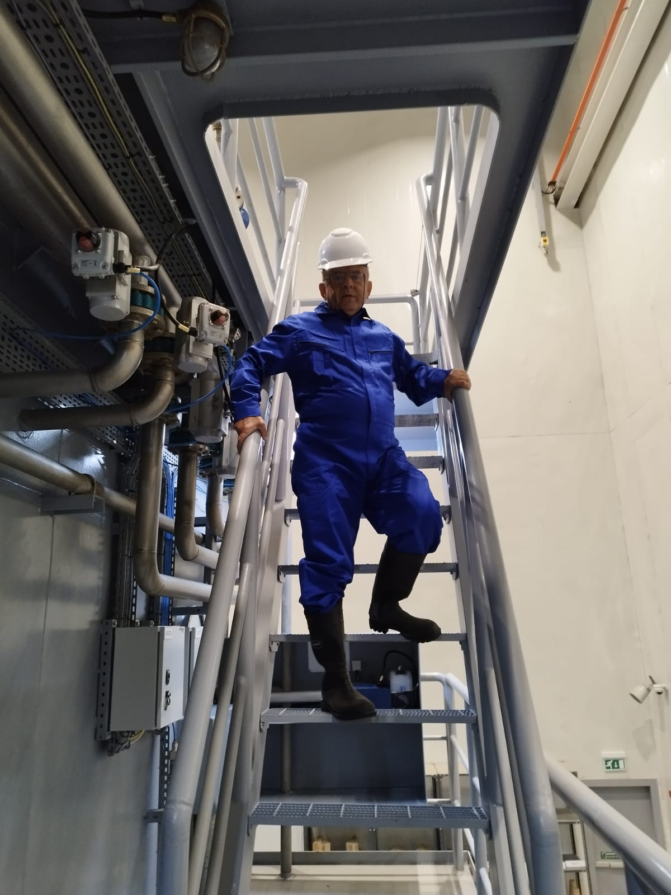
Damage Control Simulator Safety Briefing
Safety Measures
RIGHT
WRONG
When going up and down from the ladders, the face will be turned to the ladder, and the handle will be handled.

Slide 5
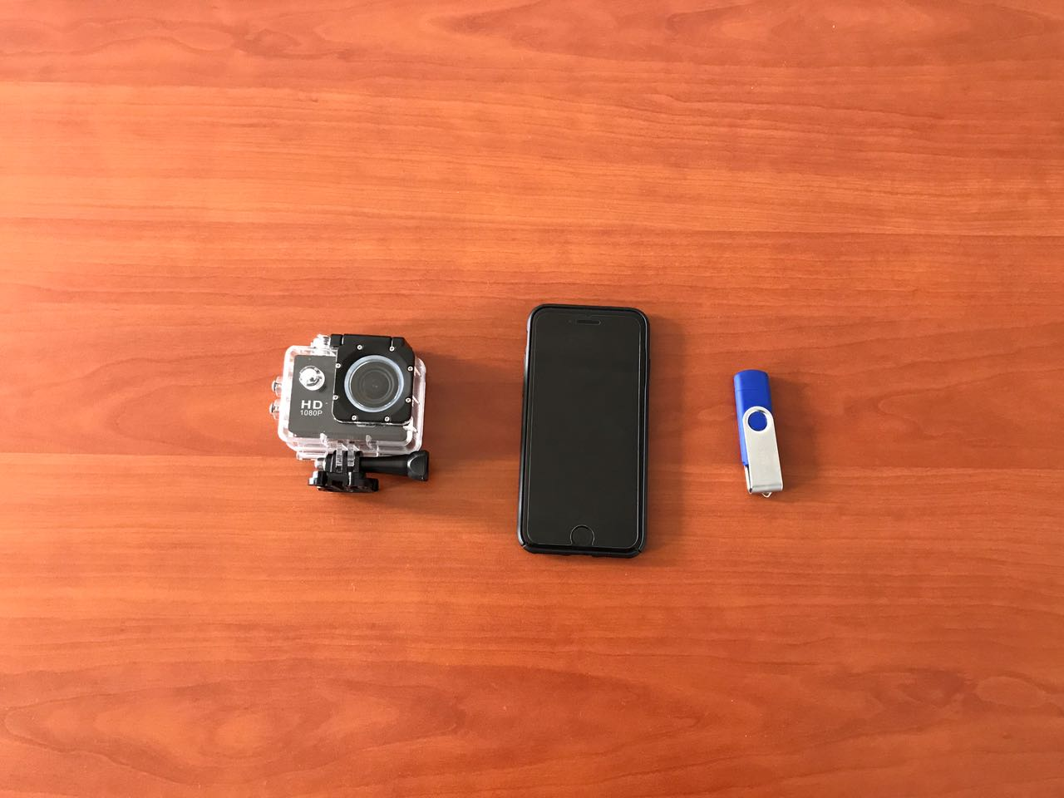
Damage Control Simulator Safety Briefing
Safety Measures
Simulator field must not be entered with electronic material such as mobile phones, USB memories, cameras, recorders.

Slide 6
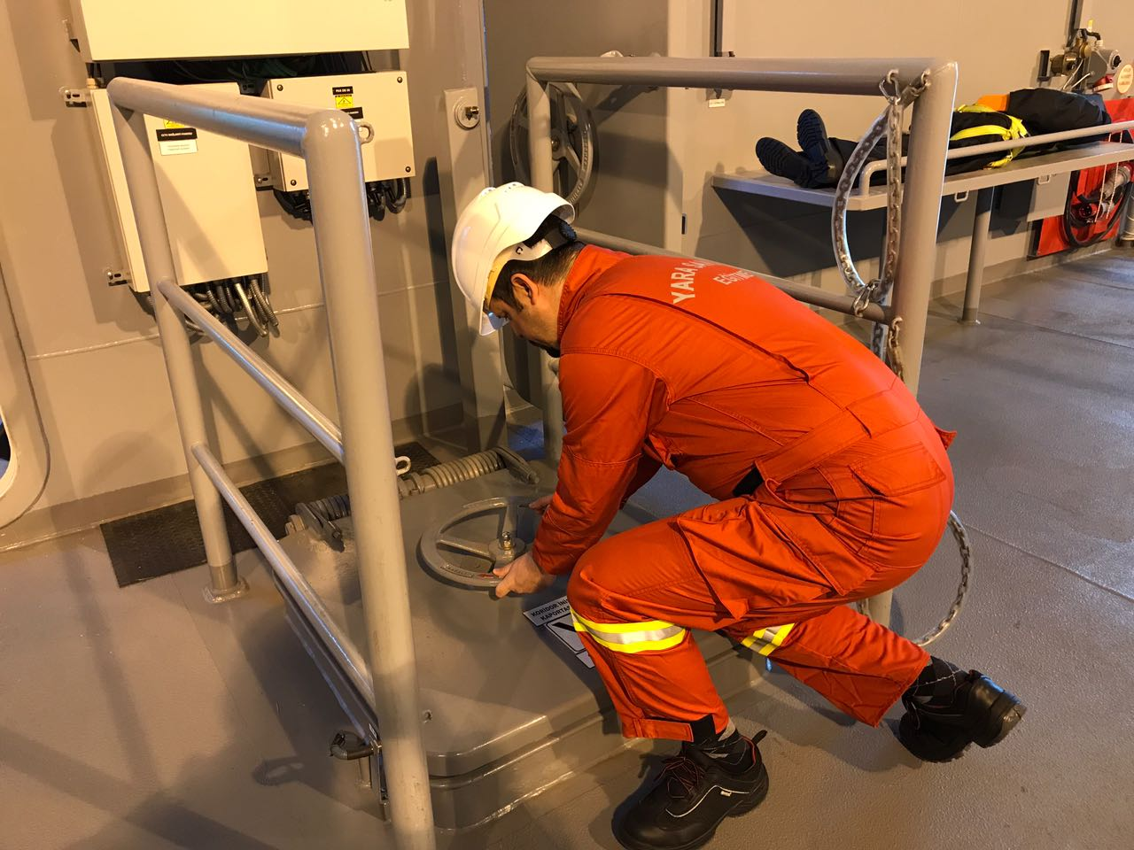
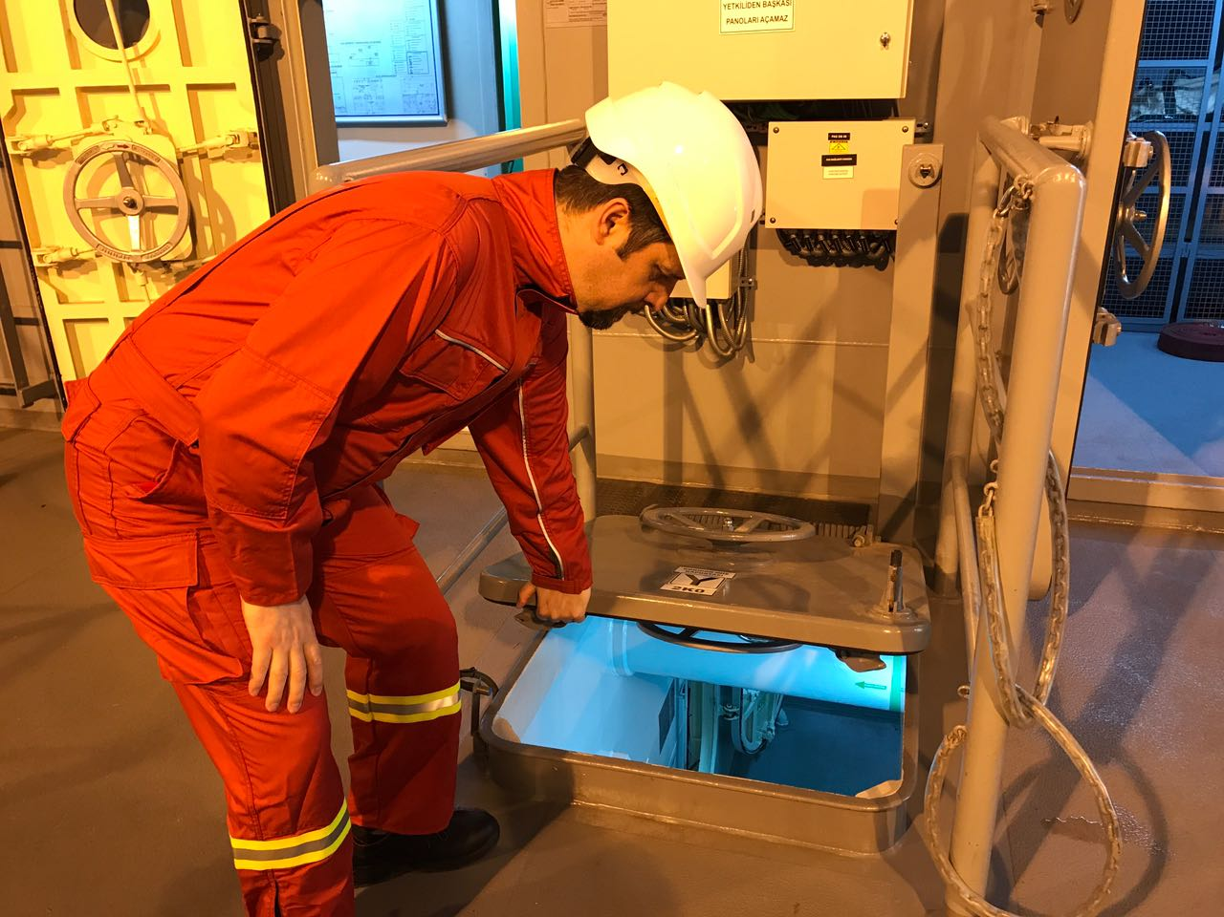
Damage Control Simulator Safety Briefing
Safety Measures
RIGHT
WRONG
When closing the hatch, utmost attention should be paid to avoid pinching fingers and feet between the hatch and the hatch coaming.

Slide 7
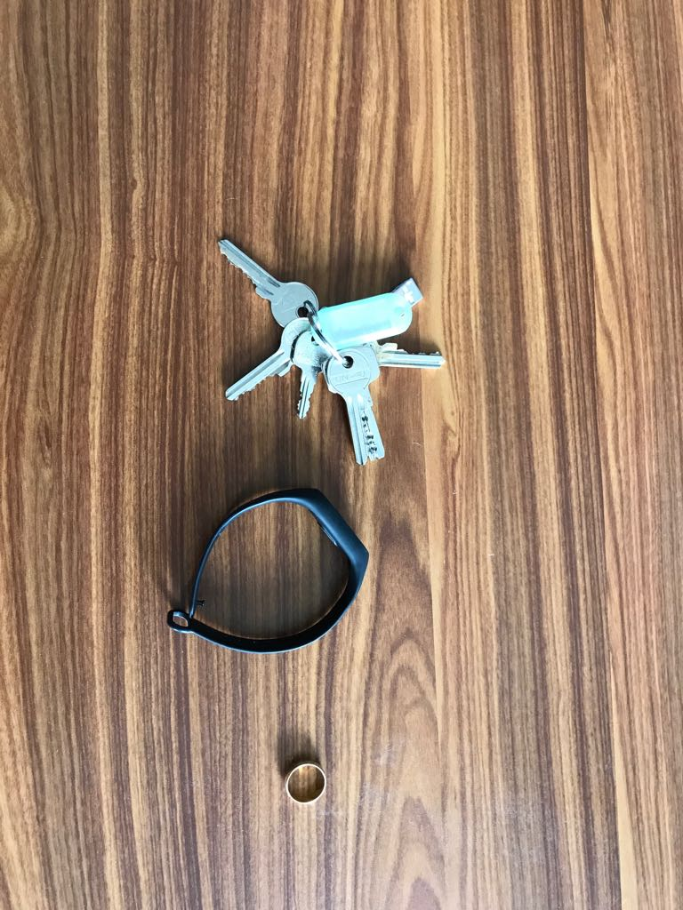
Damage Control Simulator Safety Briefing
Safety Measures
During the trainings, it’s not allowed to wear things such as necklace, watch,ring.

Slide 8
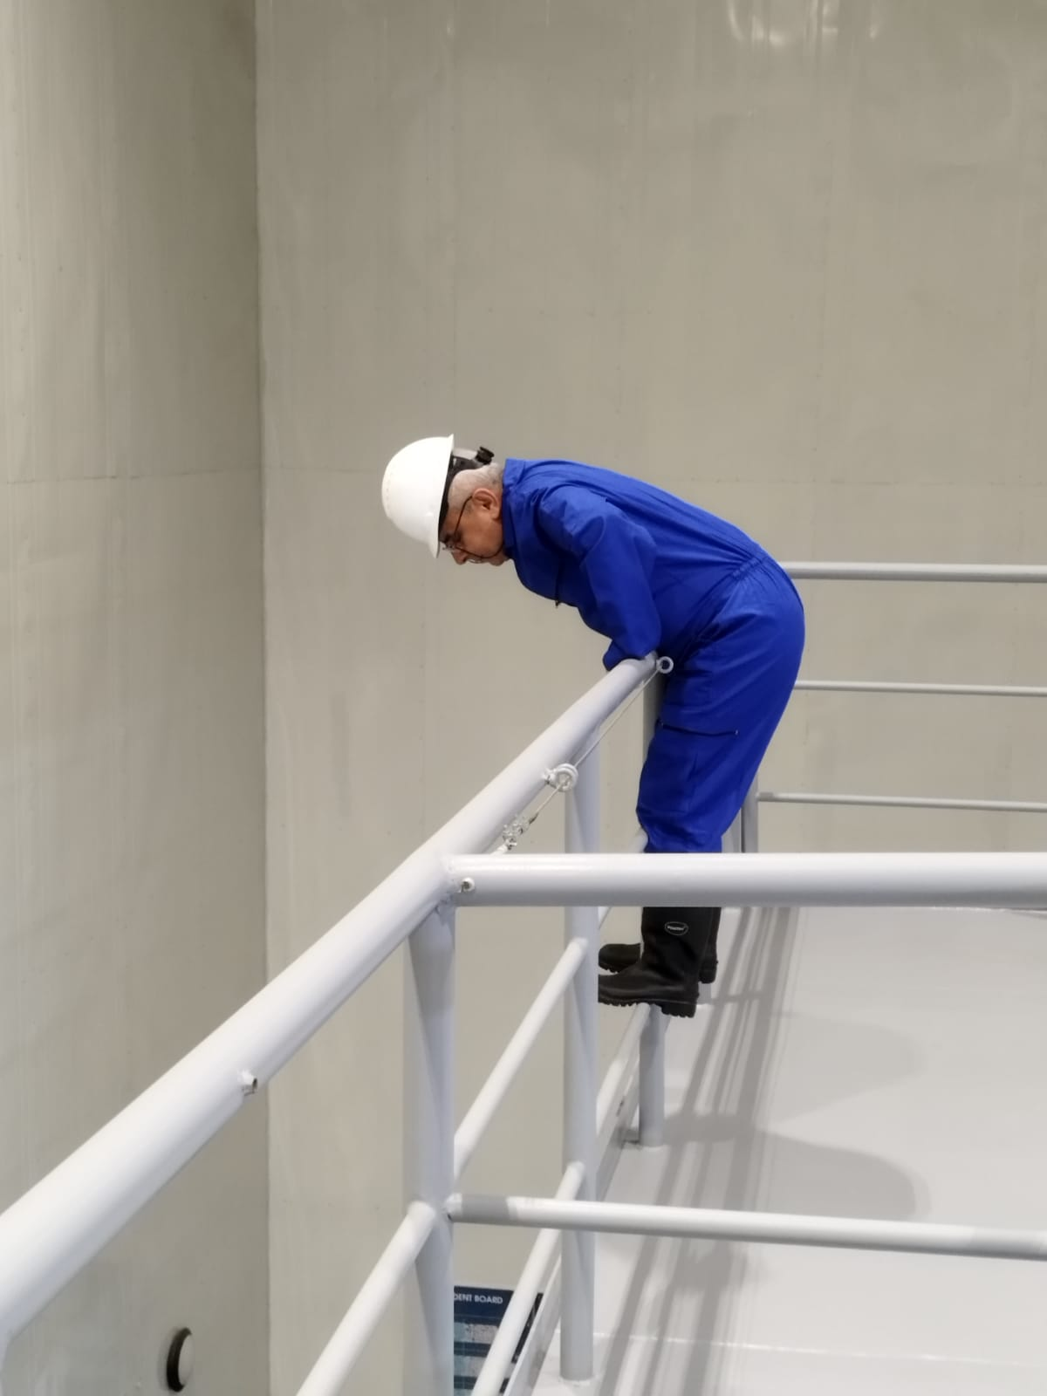
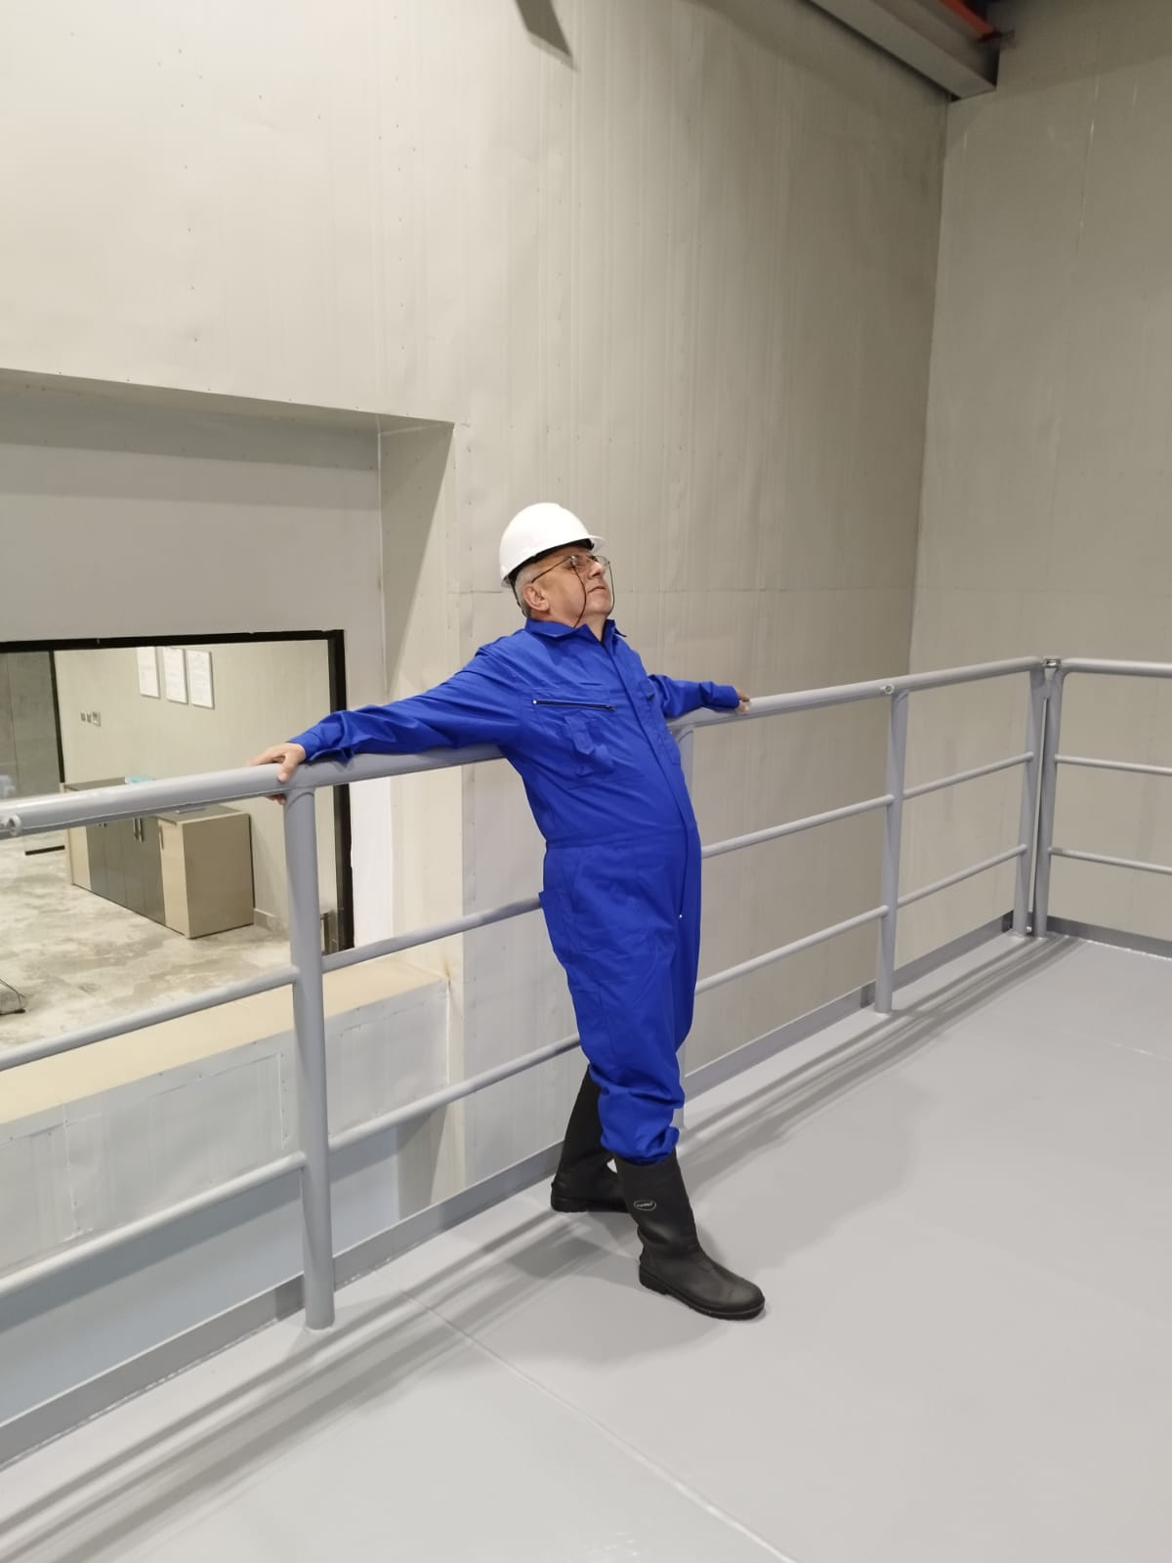
Damage Control Simulator Safety Briefing
Safety Measures
WRONG
WRONG
Personnel on the simulator open deck must not lean and hang down the handrail.

Slide 9
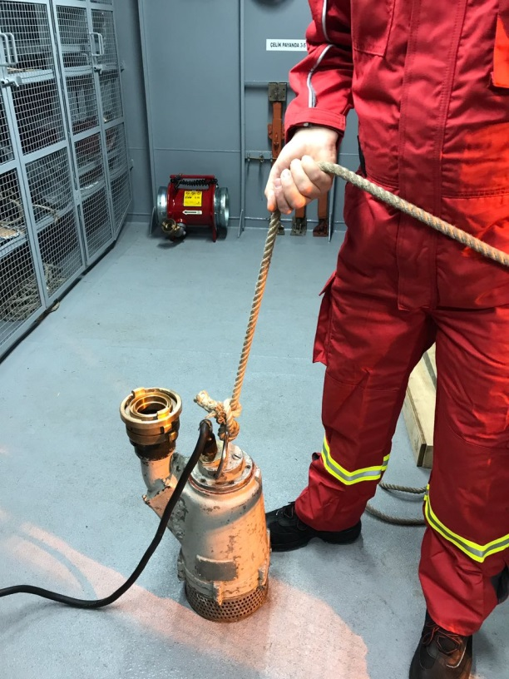
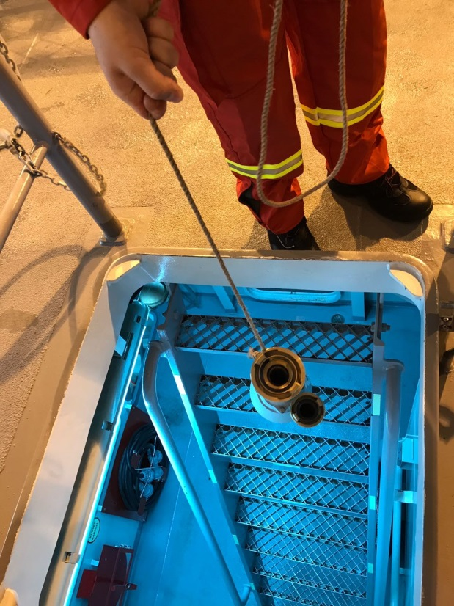
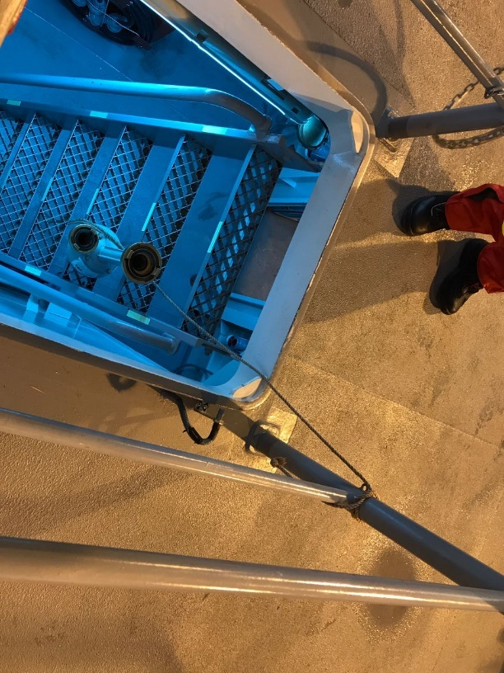
Damage Control Simulator Safety Briefing
Safety Measures
When the portable evacuation tool is lowered to the training area, it must be held by the transport rope and the tool must be lowered after checking no one is under.

Slide 10

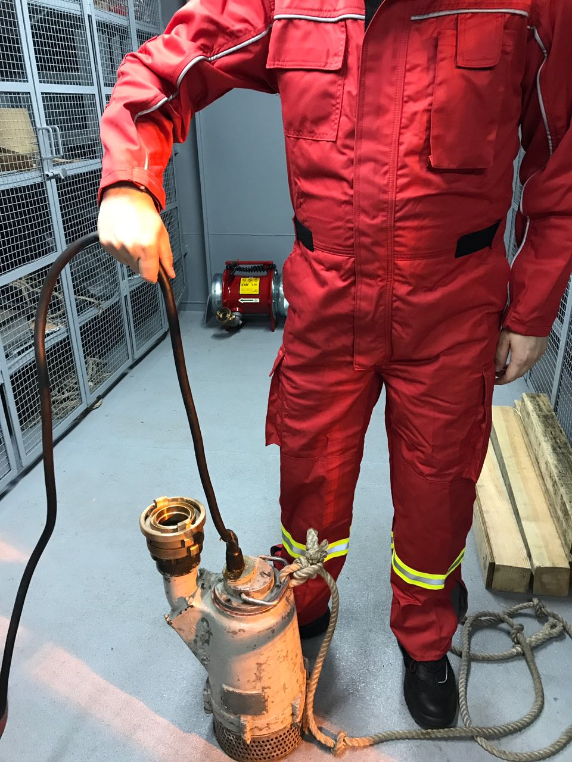
Damage Control Simulator Safety Briefing
Safety Measures
RIGHT
WRONG
Submersible pump must never be carried by holding the cable.

Slide 11
Damage Control Simulator Safety Briefing
Safety Measures
The instruction given by the instructor should be strictly followed.
No devices or systems which you are not informed about should not be used.

Slide 12
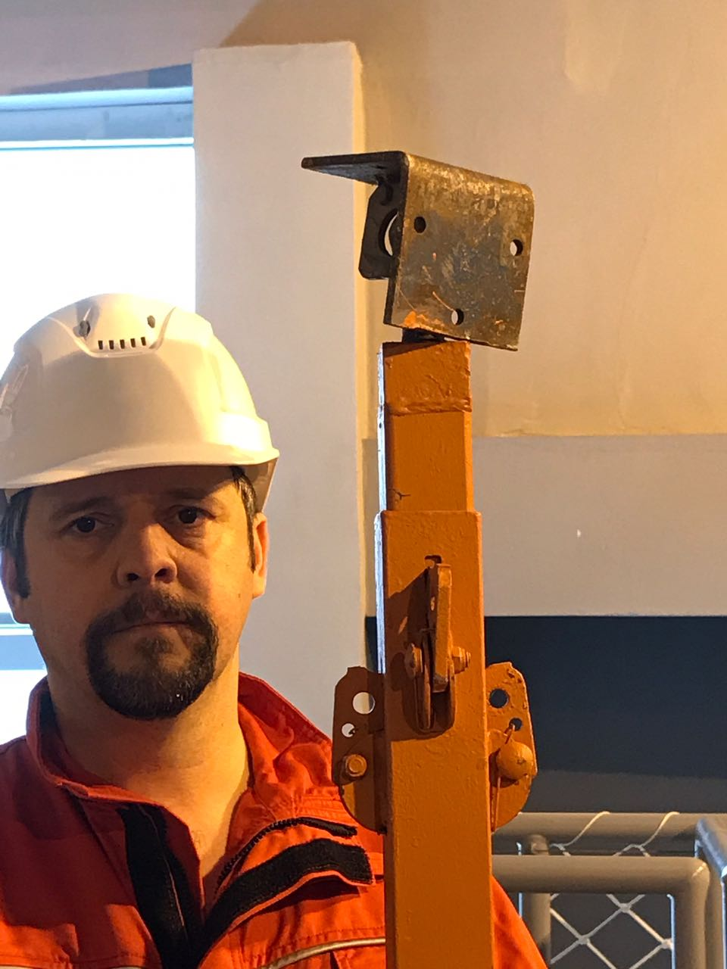
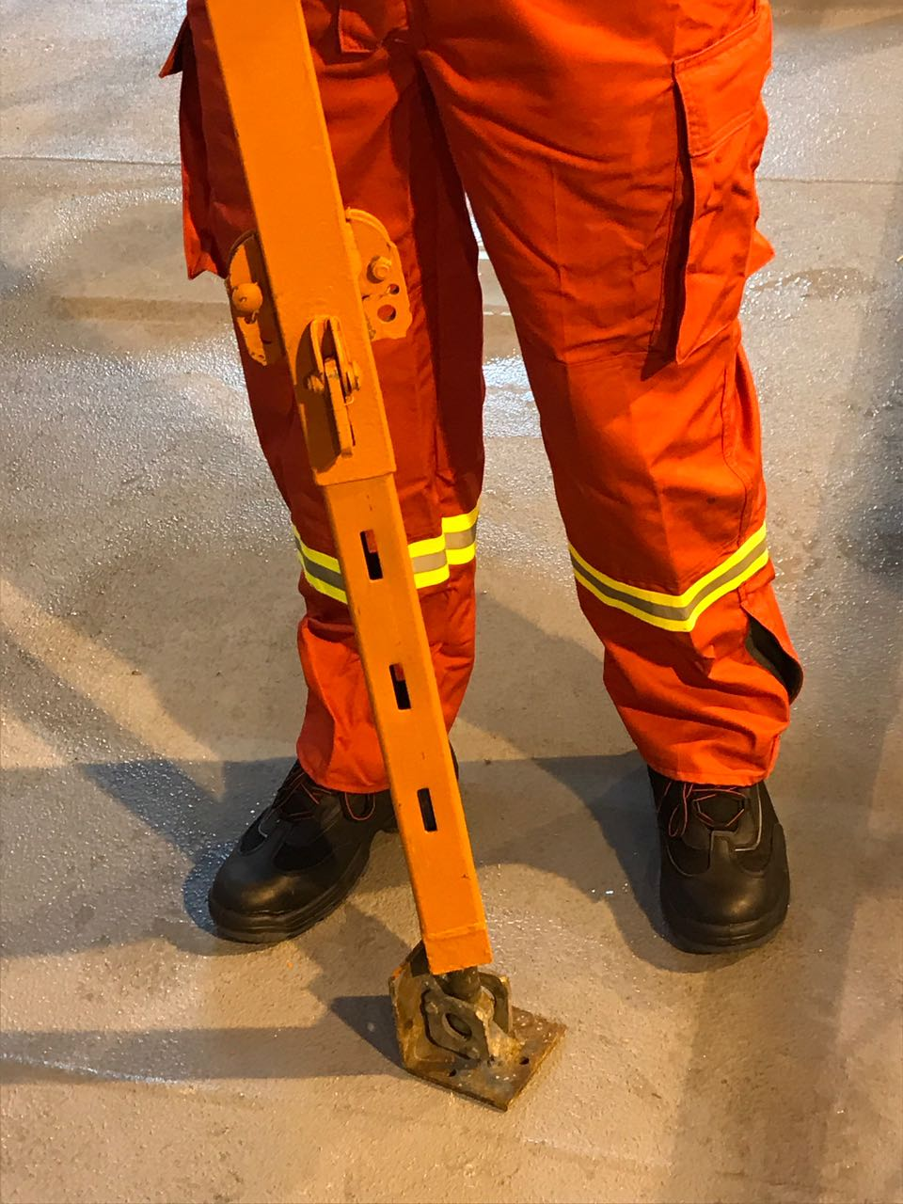
Damage Control Simulator Safety Briefing
Safety Measures
RIGHT
WRONG
Maximum attention should be paid when carrying steel shoring, and the movable side should be carried up.

Slide 13
Damage Control Simulator Safety Briefing
Safety Measures
The trainee who has any illness must tell the condition before the training.
While using ‘’ wooden hammer" for training purposes, around control must certainly be done.
All warnings and warning signs hanging in the simulators must be obeyed.
Remember that the training location will be wet and slippery.

Slide 14
Damage Control Simulator
Safety Briefing
Thanks...
INDONESIA 2023

