Slide 1
WEB1
Main Goal: Build a website!
Objectives:
Apply an appriopriate process to build a website.
Get to know HTML
Get to know CSS
Get to know JS
Get to know PHP &MySql

Slide 2
Your teacher
Chung Kuah
Room: 2.41
c.kuah@fontys.nl
Emin Thaqi
Room: 2.37
e.thaqi@fontys.nl
John Lara R.
Room: 2.41
j.lararojas@fontys.nl

Slide 3
Week1: Process & Design
Target Audience
Sitemap
Wireframe
Visual Design
Notes:
Create a detailed and a deep, nice looking document!

Slide 4
1. Who is the site for?
Why do they visit your site?
They understand and value the social good done by the charity
What do they want to reach?
They want to take part in making other people’s lives better, easier and fulfilled
What information do they need?
For whom they are donating money, how the money is used and why it is being used for these people, and They’ll want to know how they’re making a difference to someone’s life.
Notes:
Demographics – age, etc…

Slide 5
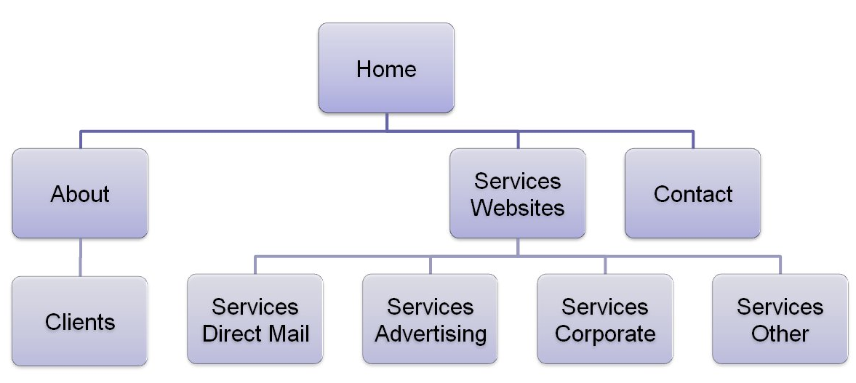
2. Sitemap
Determines structure of your website.
Notes:
Think of a target audience. The target audience is the one who determines the structure of the website!
Let the users structure your website.
Never ask for opinions. Do card sorting! Next slide

Slide 6
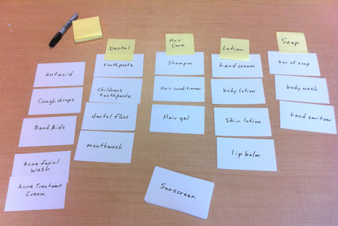
2. Sitemap
Tip: Let the users/visitors determine the structure.
How?... Card Sorting
Notes:
Let users determine the structure
Card sorting :
reduces workload
Write down the content on the pages into different groups.
A better way to determine the groups

Slide 7
3. Wireframe
Shows Content and its location in a web page. NOTHING ELSE!
Depicts the page layout (see chapter 15: Layout p.377-382).
Shows hierarchy of content.
Notes:
Content and location

Slide 8
4. Visual design
Purpose: To Communicate!
You have the content already. It is time to Prioritize and Organize it applying visual design concepts:
Visual Hierarchy (size, color, style, contrast, etc.)
Gestalt Laws (Proximity, similarity, closure, etc.)
Navigation Design (consize, selective, interactive, etc.)
Notes:
Fit’s law
Gestalt law ar

Slide 9

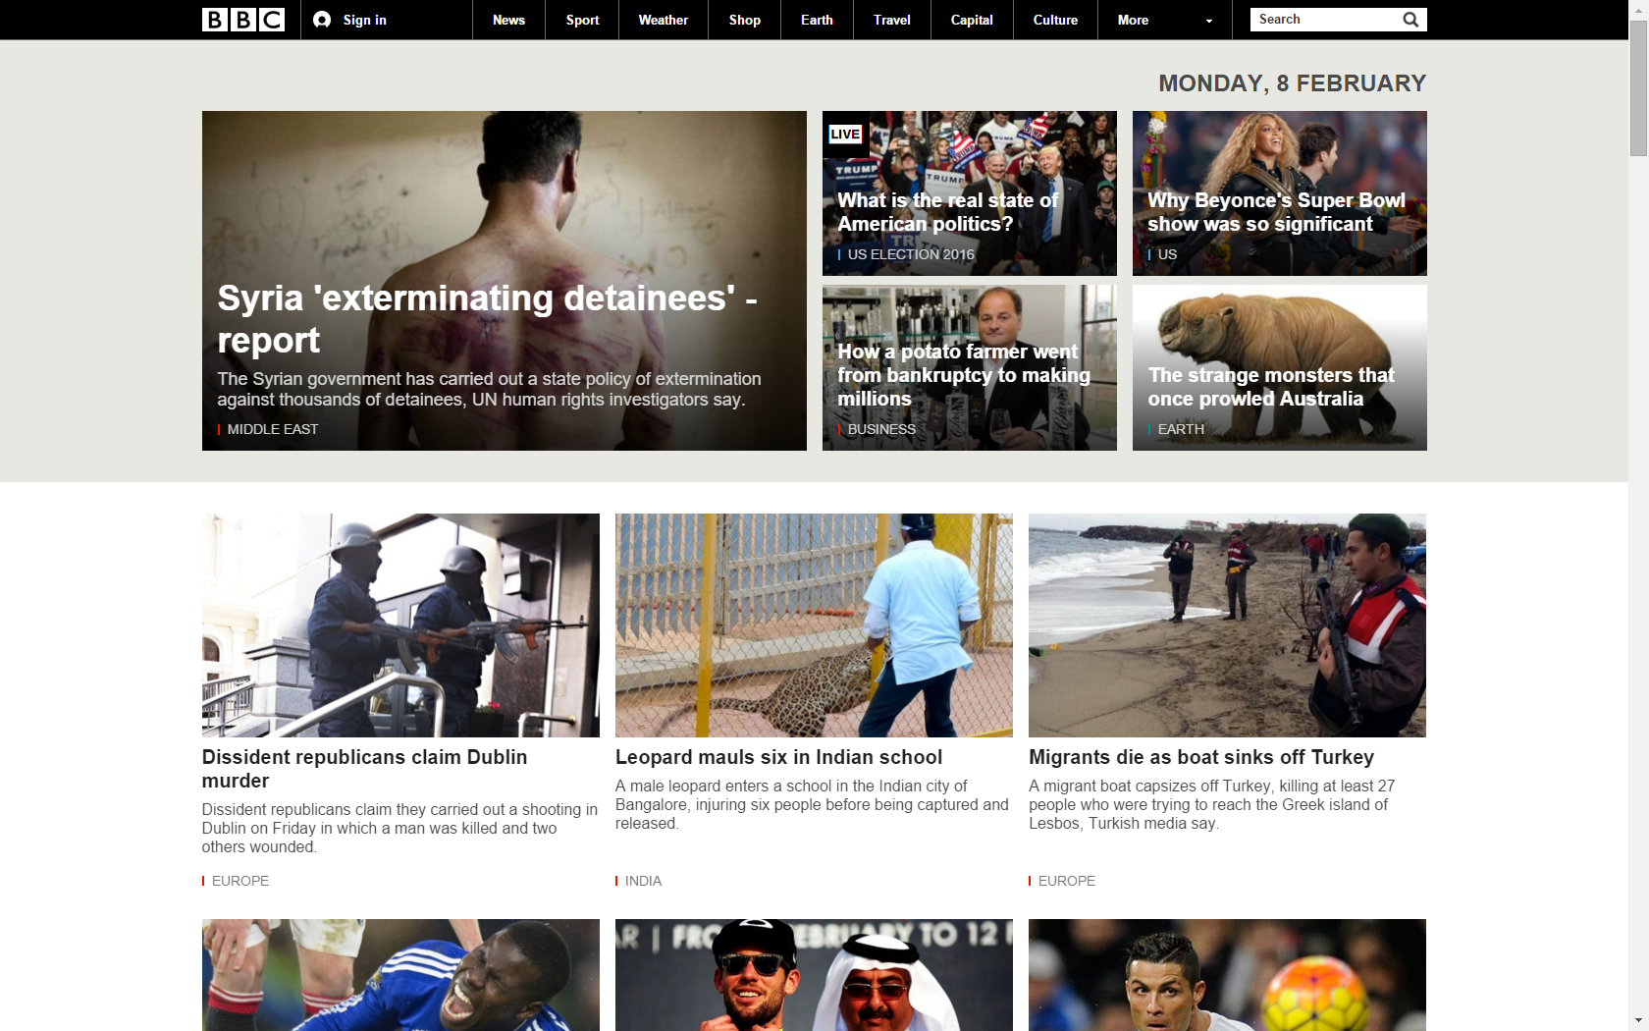
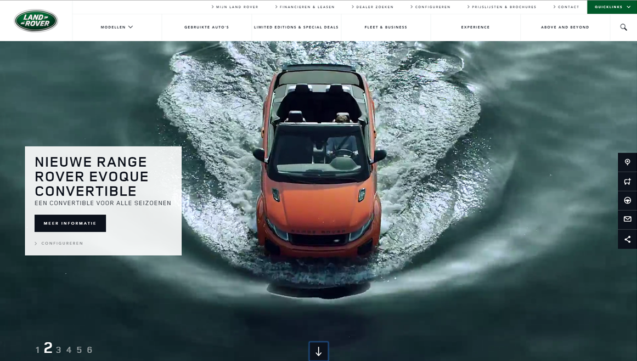
Visual Hierarchy

Slide 10
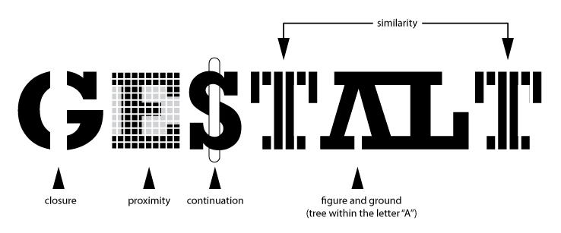
Gestalt Laws

Slide 11
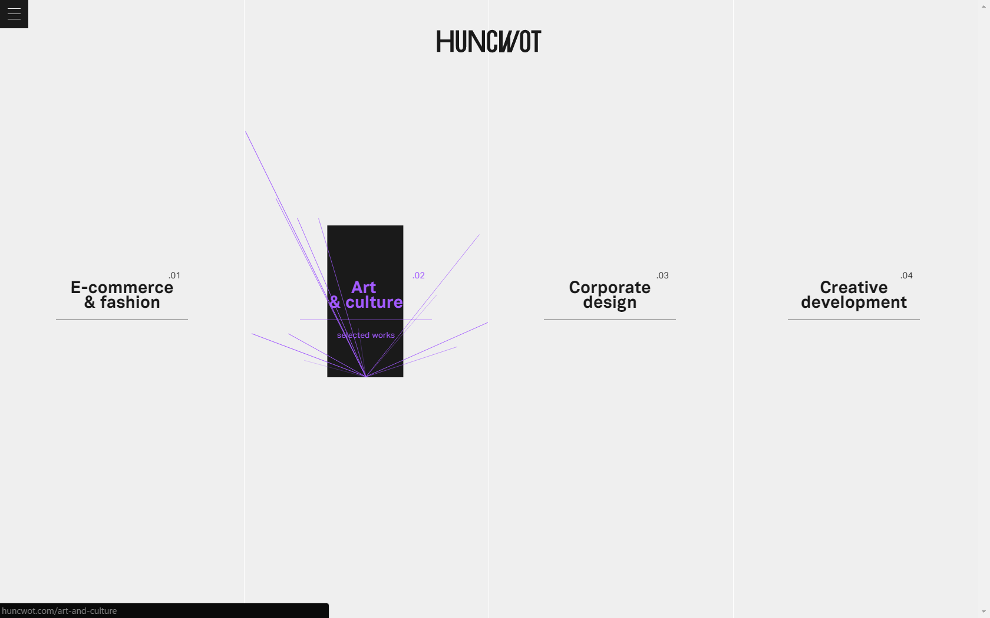
Navigation Design

Slide 12
Questions?

