Slide 1
WEB1 – Week 1

Slide 2
Your teacher
Chung Kuah
Abbreviation: kuah
Email: c.kuah@fontys.nl
Room: 2.41

Slide 3
My rules
Be on time
For some reason to late? Be like a ninja!
Unable to attend class?
Let me know before class starts
During class you work on the course
Put your phone on silent
No gaming, movie watching, etc.
Got caught? Out of the course!
Ask me questions!

Slide 4
WEB1 (1/2)
Main Goal: Build a website!
Objectives:
Apply an appriopriate process to build a website.
Get to know HTML
Get to know CSS
Get to know JS
Get to know PHP &MySql

Slide 5
WEB1 (2/2)
Required knowledge:
Programming
Database
IDE & VCS

Slide 6
Resources
Book: HTML & CSS design and build websites by Jon Duckett (ISBN 978-1-118-00818-8)
See course information on Sharepoint

Slide 7
The logistics
 | Topic | Practical | Deadlines
week 1 | Introduction WEB1, the process of building a website | Install all required tools (see w1 resources) Create an Athena account to host your website Work on Design Document | Week2 (before theory lecture)
week 2 | HTML | Structure your website using HTML | Week3 (before theory lecture)
week 3 | CSS | Style your website applying CSS | Week4 (before theory lecture)
week 4 | JS | input validation use of Ajax | Week5 (before theory lecture)
week 5 | PHP | Template System File Structure | Week6 (before theory lecture)
week 6 | PHP | Authentication and Authorization. | Week7 (1 day before presentation)
week 7 | Presentation
See course information on Sharepoint

Slide 8
Classes
WEB1 = 3EC (=84 study hours)
Each week 4 hours at school
1 ~ 2 hour of theory
2 ~ 3 hours of practical
Each week 8 hours as self-study & homework

Slide 9
How to pass?
Based on the deliverables
Go or no-go per week
Missed deadlines?
1 time: 0 point and final grade is decreased by 1
> 1 time: No go
See course information on Sharepoint
Description | Weight on final grade
Design Document | 20%
Front End development | 50%
Back End Development | 30%

Slide 10

Questions?

Slide 11
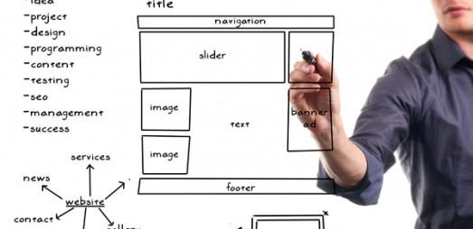
Week1: Process & Design
Target Audience
Sitemap
Wireframe
Visual Design

Slide 12
1. Who is the site for?
Why do they visit your site?
What do they want to reach?
What information do they need?

Slide 13
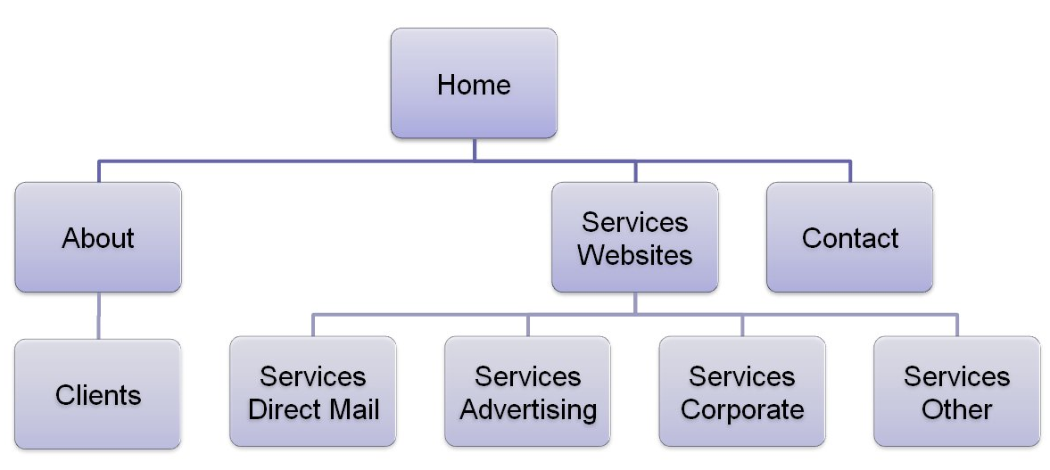
2. Sitemap
Determines structure of your website.

Slide 14
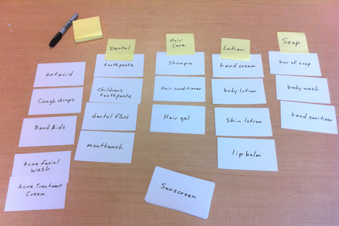
2. Sitemap
Tip: Let the users/visitors determine the structure.
How?... Card Sorting

Slide 15
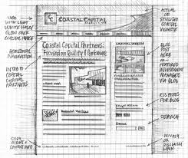
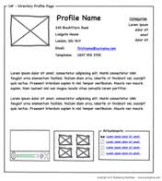
3. Wireframe
Shows Content and its location in a web page. NOTHING ELSE!
Depicts the page layout (see chapter 15: Layout p.377-382).
Shows hierarchy of content.

Slide 16
4. Visual design
Purpose: To Communicate!
You have the content already. It is time to Prioritize and Organize it applying visual design concepts:
Visual Hierarchy (size, color, style, contrast, etc.)
Gestalt Laws (Proximity, similarity, closure, etc.)
Navigation Design (consize, selective, interactive, etc.)

Slide 17

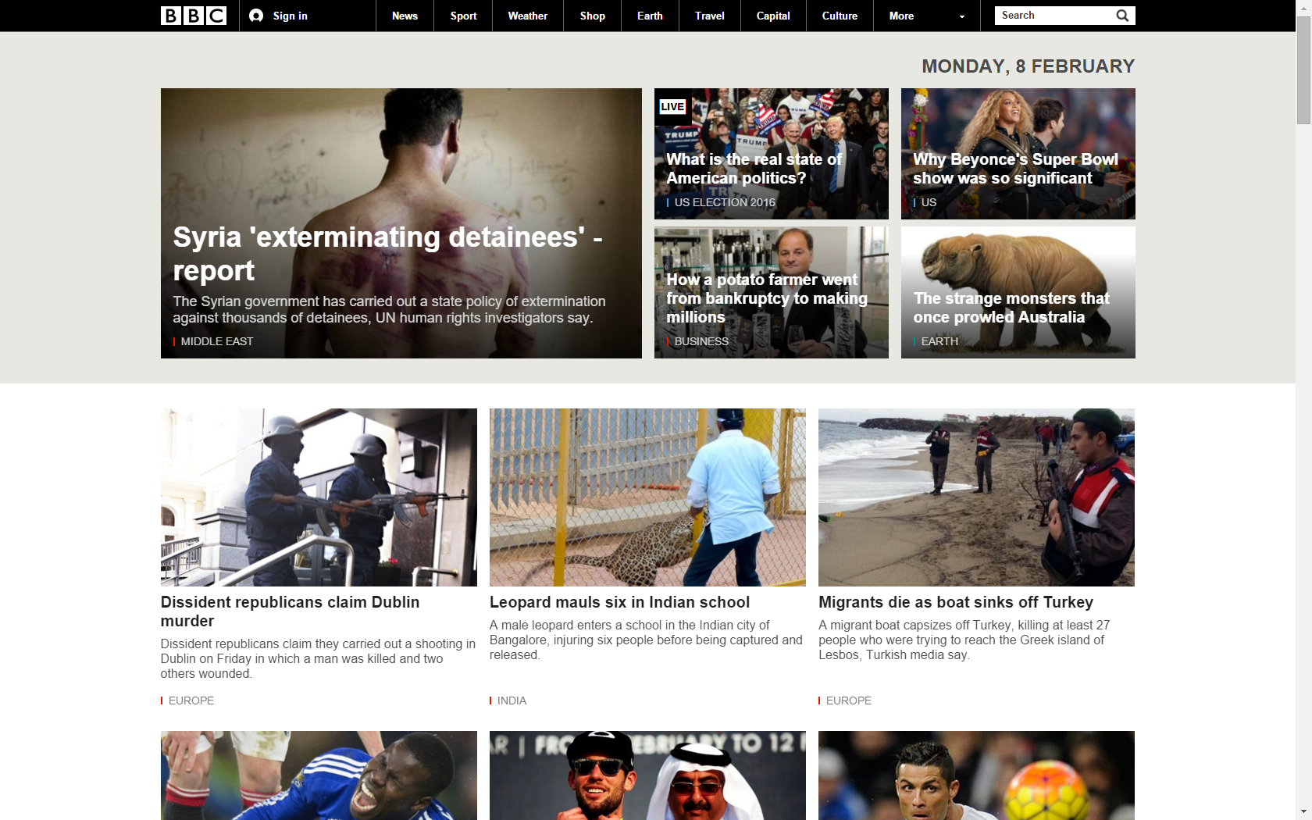

Visual Hierarchy

Slide 18
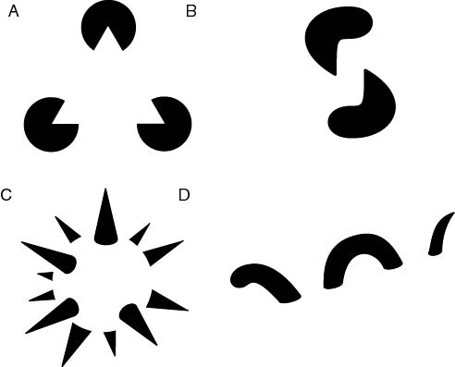
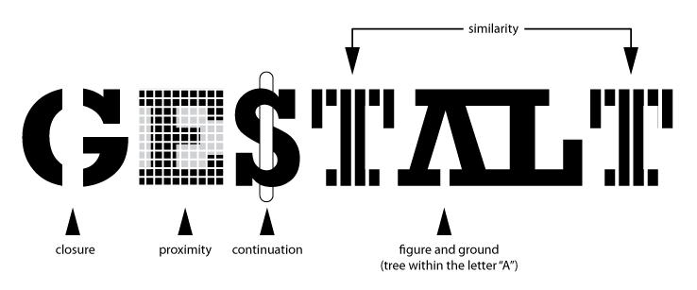
Gestalt Laws
Notes:
The eye differentiates an object form its surrounding area. a form, silhouette, or shape is naturrally perceived as figure (object), while the surrounding area is perceived a ground (background).
Similarity occurs when objects look similar to one another. People often perceive them as a group or pattern.
Continuation occurs when the eye is compelled to move through one object and continue to another object.
Closure occurs when an object is incomplete or a space is not completely enclosed. If enough of the shape is indicated, people percieve the whole by filling in the missing information.
Proximity occurs when elements are placed close together. They tend to be perceived as a group.
See: http://graphicdesign.spokanefalls.edu/tutorials/process/gestaltprinciples/gestaltprinc.htm

Slide 19
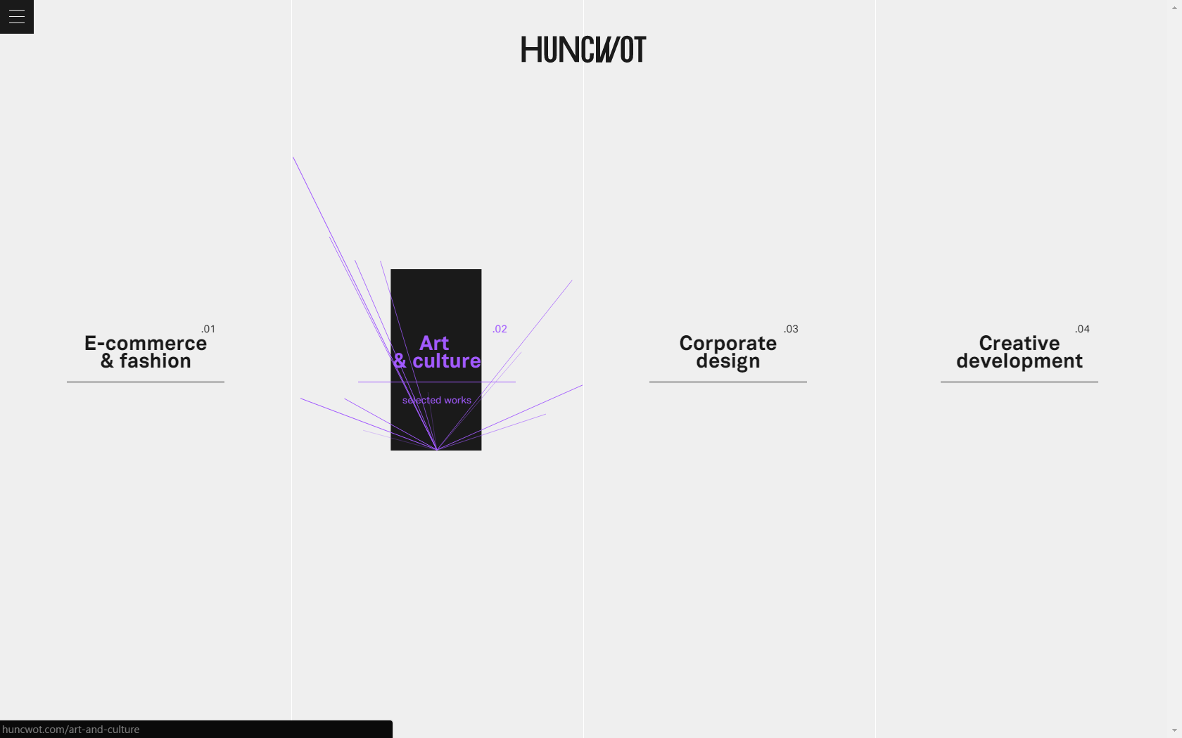
Navigation Design

Slide 20
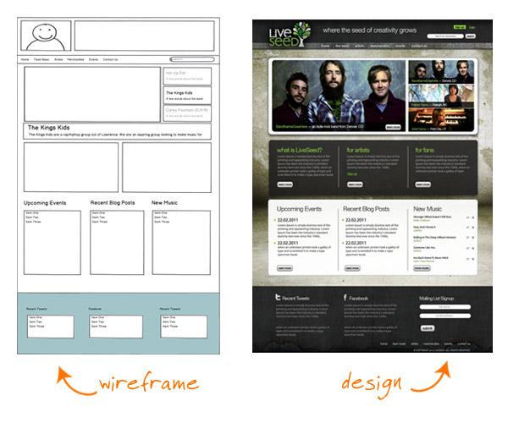
Example: Wireframe & visual design

Slide 21
What now?
Form groups of 2
Work on deliverable A
See course description
Create a wireframe for each item in sitemap

Slide 22
Questions?

