Slide 1
Week 2: HTML
But first an introduction of:
How the Internet works

Slide 2
ACCESSING THE WEB
.
.
.
.
.
.
.
.
.
.
.
.
.
.
.
.
.
.
.
.
.
.
.
.
.
.
.
.
.
.
.
.
.
.
.
.
.
.
.
.
.
.
.
.
.
.
.
.
.
.
.
.
.
.
.
.
.
.
.
.
.
.
.
.
.
.
.
.
.
.
.
.
.
.
.
.
.
.
.
.
.
.
.
.
.
.
.
.
.
.
.
.
.
.
.
.
.
.
.
.
.
.
.
.
.
.
.
.
.
.
.
.
.
.
.
.
.
.
.
.
.
.
.
.
.
.
.
.
.
.
.
.
.
.
.
.
.
.
.
.
.
.
.
.
.
.
.
.
.
.
.
.
.
.
.
.
.
.
.
.
.
.
Notes:
Explain: People access websites via a web browser (e.g. Firefox, IE, Chrome, Safari)
Explain: Users type in URL for web page, follow link, or click on bookmark
Explain: Browser makers regularly release new versions of their browsers
Click: Arrows point to a server
Explain: When you request a web page, the request goes to a web server that hosts the site
Explain: What a server is (and the role of hosting companies)
Click: Tablet/phone fades in
Explain: Browsers come on different devices, desktop computers, mobile, tablet, tv etc.
Click: Headphones fade in
Explain: Screen readers (depicted here by headphones)

Slide 3
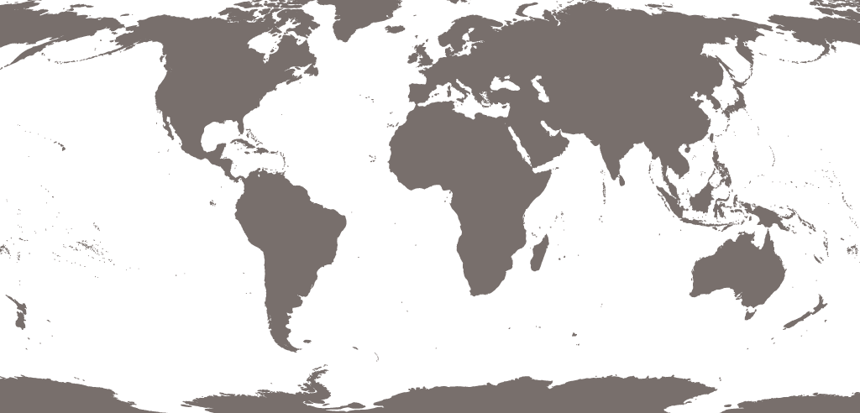
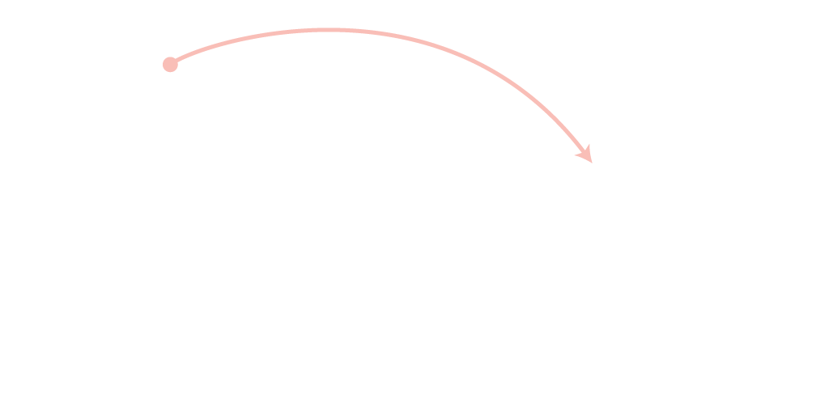
HOW THE WEB WORKS
A user in Vancouver visits airindia.in in Bangalore
Notes:
Illustrates how web users can be anywhere in the world, and request pages from servers in other parts of the world.

Slide 4
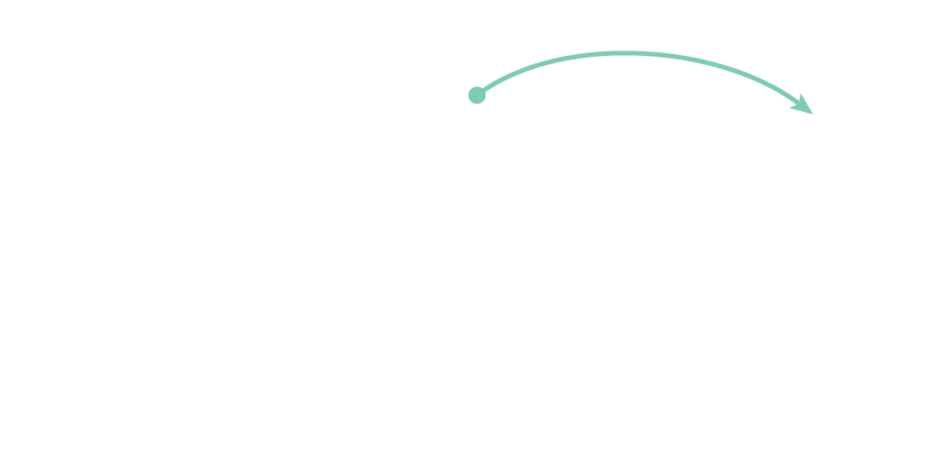
HOW THE WEB WORKS
A user in Barcelona visits sony.jp in Tokyo

Slide 5
HOW THE WEB WORKS
A user in Barcelona visits sony.jp in Tokyo

Slide 6
HTML
HyperText Markup Language
Chapter: 1-9

Slide 7
HTML
Marks up and structures content in WebPages
Current version: HTML5
Text and <tags>
Filenames: *.html
Other markup languages? (xml, etc.)

Slide 8
Tags (also called elements)
<tag />
<tag> …. </tag>
Examples of an empty element ( <tag />):
<hr /> horizontal ruler (line)
<br /> break (new line)

Slide 9
HTML: PAGE STRUCTURE
<html>
<head>
<title>My first website</title>
</head>
<body>
<h1>This is the Main Heading</h1>
<p>This text might be an introduction to
the rest of the page.</p>
<h2>This is a Sub-Heading</h2>
<p>Many long articles have sub-headings
to help you follow the structure.</p>
</body>
</html>
Notes:
Explain: HTML uses tags to act like containers. They indicate the structure of things found inside them.
Click: Outlines around <html>
Click: Outlines around <body>
Click: Outlines around <h1>
Click: Outlines around <h2>
Click: Outlines around <p>

Slide 10
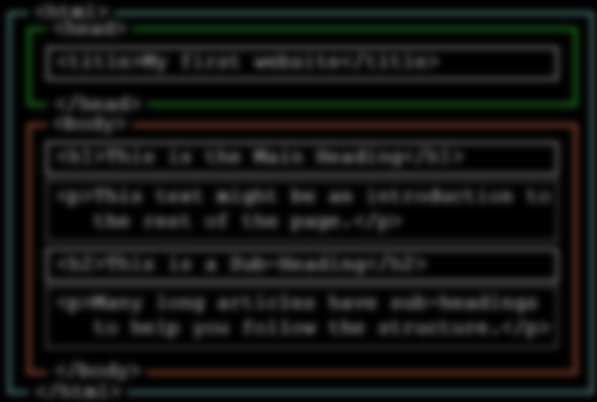
HTML: !DOCTYPE declaration
<!DOCTYPE html>
First line in your html file.
It is not a tag.
It tells the browser the version of html being used.
Notes:
Explain: HTML uses tags to act like containers. They indicate the structure of things found inside them.
Click: Outlines around <html>
Click: Outlines around <body>
Click: Outlines around <h1>
Click: Outlines around <h2>
Click: Outlines around <p>

Slide 11
Tags
Text
List
Links
images
Tables
Forms
Video, audio
Extra markup (Div, iframes)

Slide 12
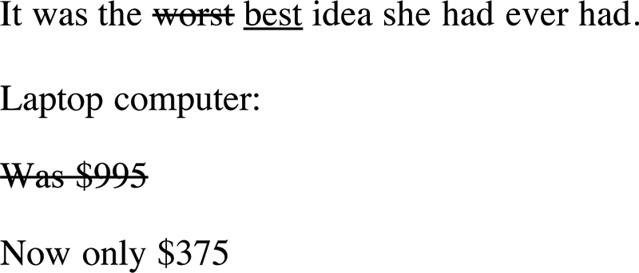
Text
<p>It was the <del>worst</del> <ins>best</ins>
idea she had ever had.
</p> <p>Laptop computer:</p> <p><s>Was $995</s></p> <p>Now only $375</p>

Slide 13



LIST
ORDERED
UNORDERED
DEFINITION
1. Chop potatoes into quarters 2. Simmer in salted water 3. Heat milk and butter 4. Drain potatoes and mash 5. Mix in the milk mixture
• 1kg King Edward potatoes • 100ml milk • 50g salted butter • Freshly grated nutmeg • Salt and pepper to taste
Sashimi Sliced raw fish Scale A device used to accurately measure weight
Notes:
Explain: There are three different types of list...
1. Ordered - The order of list items is important
2. Unordered - The order of list items is not important
3. Definition - To explain the meaning of terms

Slide 14
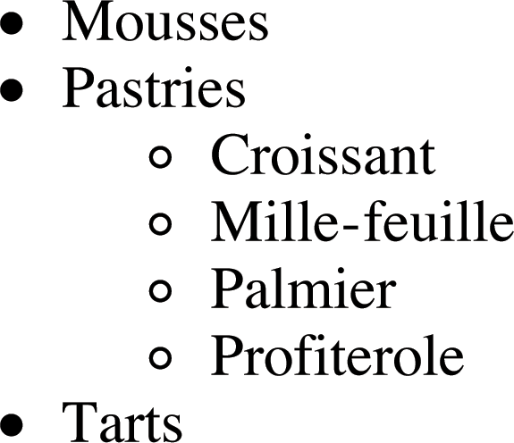
Unordered nested List
<ul>
<li>Mousses</li>
<li>Pastries</li>
<ul>
<li>Croissant</li>
<li>Milles-feille</li>
<li>Palmier</li>
<li>Profiteroles</li>
</ul>
<li>Tarts</li>
</ul>

Slide 15

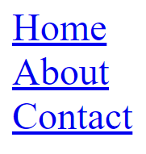
Links
Absolute URI (Uniform Resource Identifier):
<a href="http://www.fontys.nl">Visit Fontys</a>
Relative URI:
<a href=”index.html”>Home</a><br /> <a href=”about.html”>About</a><br /> <a href=”contact.html”>Contact</a>

Slide 16
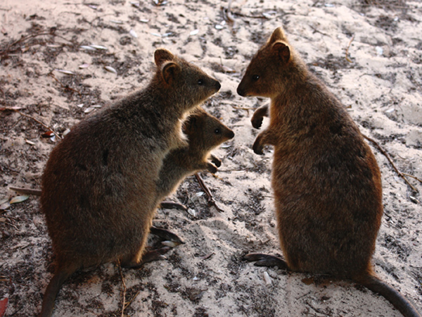
Images
<img src="images/quokka.jpg" alt="A family of quokka" title="The quokka is an Australian marsupial that is similar in size to the domestic cat" width="600" height="450" />

Slide 17
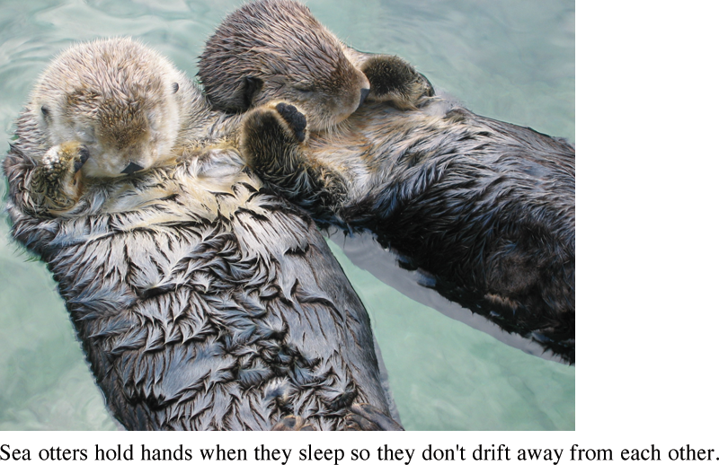
Images: HTML5 tag <figure>
<figure> <img src="images/otters.gif" alt="Photograph of two sea otters floating in the water" /> <br /> <figcaption>Sea otters hold hands when they sleep so that they don’t drift away from each other. </figcaption> </figure>

Slide 18


Image Dimensions
Create each image the same width and height as you would like it to appear on your website.
Squished?
Too small to enlarge?

Slide 19
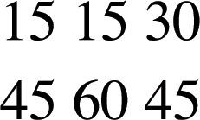
Table: basic structure
<table> <tr> <td>15</td> <td>15</td> <td>30</td> </tr> <tr> <td>45</td> <td>60</td> <td>90</td> </tr> </table>

Slide 20
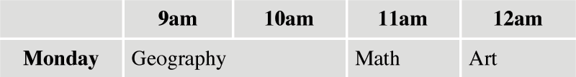
Table: Headers & Spanning
<table>
…
<tr> <th>Monday</th> <td colspan="2">Geography</td> <td>Math</td> <td>Art</td> </tr>
…
</table>

Slide 21
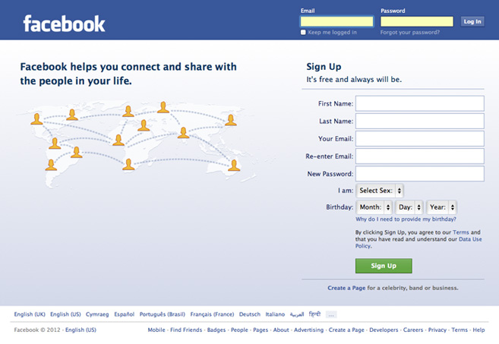
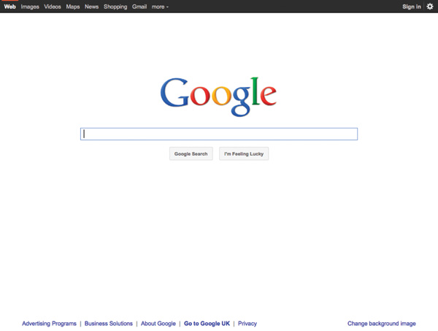
FORMS
Notes:
Explain: Mostly, when you need to collect data from a user you need a form
Click: Google search form
Click: Facebook login form
Click: Amazon shipping form

Slide 22
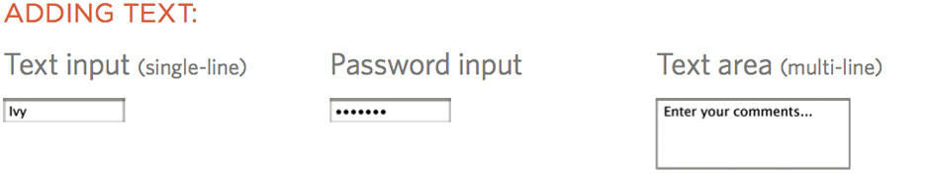
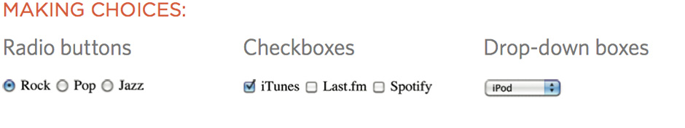
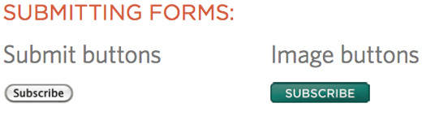
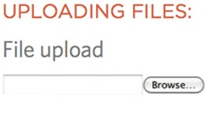
FORM CONTROLS
Notes:
Explain: how there are different types of form control
You need to choose the right type of control to get the information you need
Click: ways to provide text
Click: ways to make choices between fixed options
Click: ways to submit information
Click: how to upload files

Slide 23

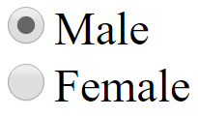

Form: main structure
<form action="http://example.com/join.php" method="get">
<!--This is where the form controls will appear.-->
</form>
First name:<input type="text" name="firstname" value="">
<input type="radio" name="gender" value="male“ checked>Male <br />
<input type="radio" name="gender" value="female">Female
<input type="file" name="userUpload">

Slide 24
Video: HTML5 tag <video>
<video poster="images/puppy.jpg" width="400" height="300" preload controls loop> <source src="video/puppy.mp4" /> <source src="video/puppy.webm" /> <p>A video of a puppy playing in the snow.</p> </video>
Demo: http://www.w3schools.com/html/html5_video.asp

Slide 25
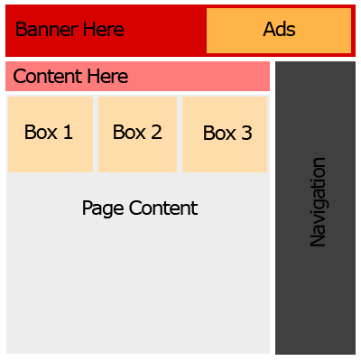
Extra markup: DIV <div>
A container unit
Divides your doc into sections.
Apply style (CSS) to many elements at once.

Slide 26
NEW HTML5 LAYOUT ELEMENTS
<body>
<div id="page">
<header>
<nav>
<div id="content">
<aside>
<article>
<article>
<footer>
Notes:
Explain: Going to see markup typically used to create this kind of layout
Click: sections of page appear, until you see two articles in the middle

Slide 27
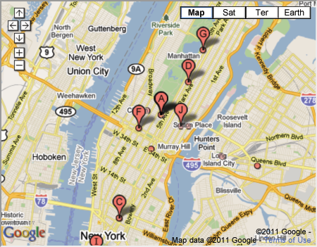
Extra markup: iframes <iframe>
An inline frame is used to embed another document within the current HTML document.
<iframe width="450" height="350“ src = "http://maps.google.co.uk/maps? q=moma+new+york&amp;output=embed" frameborder = "0" scrolling = "0">
</iframe>
Do not use <iframe> for layout.

Slide 28
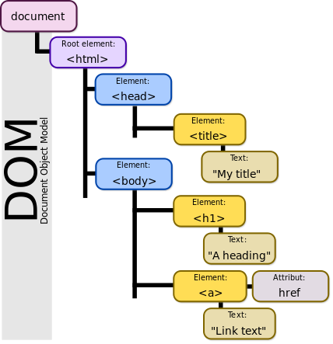
DOM
It provides a structured representation of your .html document (a tree).
that structure can be accessed from programs so that they can change the document structure, style and content.
It is loaded on the browser

