Slide 1
SDA-DSC-211 / TAMWEEL LITE
PROBLEM & PRACTICAL VALUE
Which applications should receive review?
A decision-support exercise: rank simulated 90-day default risk while respecting review capacity.
The decision
What counts as useful?
Flag a limited set of applications for additional review, not automatic loan rejection.
Inputs: synthetic loan features; target: default within 90 days.
Simulated cost = 10 × false negatives + 1 × false positives.
Capacity: at most 12% of applications flagged per validation period.
No real-world credit or legal claim.
01 / 05 • Synthetic data • Educational use only

Slide 2
SDA-DSC-211 / TAMWEEL LITE
METHOD
A leakage-aware, reproducible pipeline
Selection evidence is separated from calibration and from the unlabeled challenge batch.
DATA & SPLITS
TRAIN & SELECT
FREEZE & APPLY
Synthetic train/challenge roles. Forward-time, customer-separated folds; respect label maturity.
Drop leakage features (days_past_due_60, collection_calls). Fit preprocessing and tuning on eligible training rows only.
2,155 LIVE OOF rows across three folds support the final comparison. Freeze model, calibrator and policy before challenge scoring.
Data → forward OOF comparison → KEEP SINGLE → calibration → frozen threshold & 12% cap
02 / 05 • Synthetic data • Educational use only

Slide 3
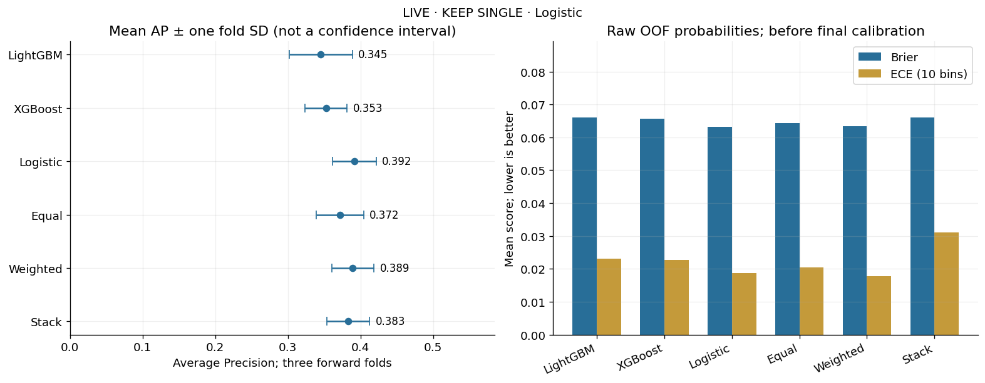
SDA-DSC-211 / TAMWEEL LITE
EVIDENCE & ENSEMBLE DECISION
KEEP SINGLE · Logistic Regression
The predefined Worth-It Gate did not justify additional ensemble complexity.
Measured decision
Mean OOF AP: Logistic 0.3917; Weighted 0.3894; Equal 0.3717.
Fold SD reference: 0.0298 (not a confidence interval).
OOF policy: threshold 0.16892; simulated loss 1,111; 245/2,155 flagged (11.37%).
FN = 10, FP = 1. OOF evidence is not an unbiased challenge performance estimate.
03 / 05 • Synthetic data • Educational use only

Slide 4
SDA-DSC-211 / TAMWEEL LITE
INTERPRETATION & CALIBRATION
Explain the model—and the limits
Day 4 interpretation belongs to its Day 4 model; it does not automatically explain final Logistic Regression.
One Day 4 example
Final calibration diagnostic
Application TR-009585: raw model probability ≈ 0.9031; calibrated ≈ 0.4795.
SHAP values were expressed in raw log-odds for the Day 4 tree model; feature contributions are associative, not causal.
On the 836-row calibration-fit sample (78 positives):
Brier: 0.07647 raw → 0.07806 sigmoid.
ECE: 0.02112 raw → 0.03487 sigmoid.
Neither improved here. In-sample diagnostics are not independent calibration validation.
Further review: independent calibration testing, reliability over time and region-level error stability.
04 / 05 • Synthetic data • Educational use only

Slide 5
SDA-DSC-211 / TAMWEEL LITE
DECISION, LIMITATIONS & FOLLOW-UP
Freeze, verify, monitor—do not overclaim
The project supports an educational ranking/review workflow, not deployment approval.
Final operational decision
What would change my decision?
KEEP SINGLE Logistic Regression.
Frozen OOF threshold: 0.16892 (raw-score policy).
Unlabeled challenge: 2,500 rows; 300 flagged under 12% batch cap. No challenge AP, loss or fairness metric is available.
1. Fresh labeled, time-separated data could change AP, simulated loss or the Worth-It Gate result.
2. Monitor calibration, capacity, temporal drift and region-level errors; retrain/recalibrate only with a new honest validation plan.
Evidence: notebooks 01–05, artifacts/final_metrics.json, reports, and frozen inference outputs. Repo: dee2002al-c / Advanced-Machine-Learning-Techniques-211--Deema-Abdullah
05 / 05 • Synthetic data • Educational use only

