Slide 1
On the seasonal predictability of wet season rainfall anomalies over the Southern Amazonia
Wendy Fu

Slide 2
General Prediction Methods
Dynamical predictions
Eg. North American Multi-Model Ensemble (NMME)
Statistical predictions
We need to know the dominant influencing factors
Apply machine learning tools

Slide 3
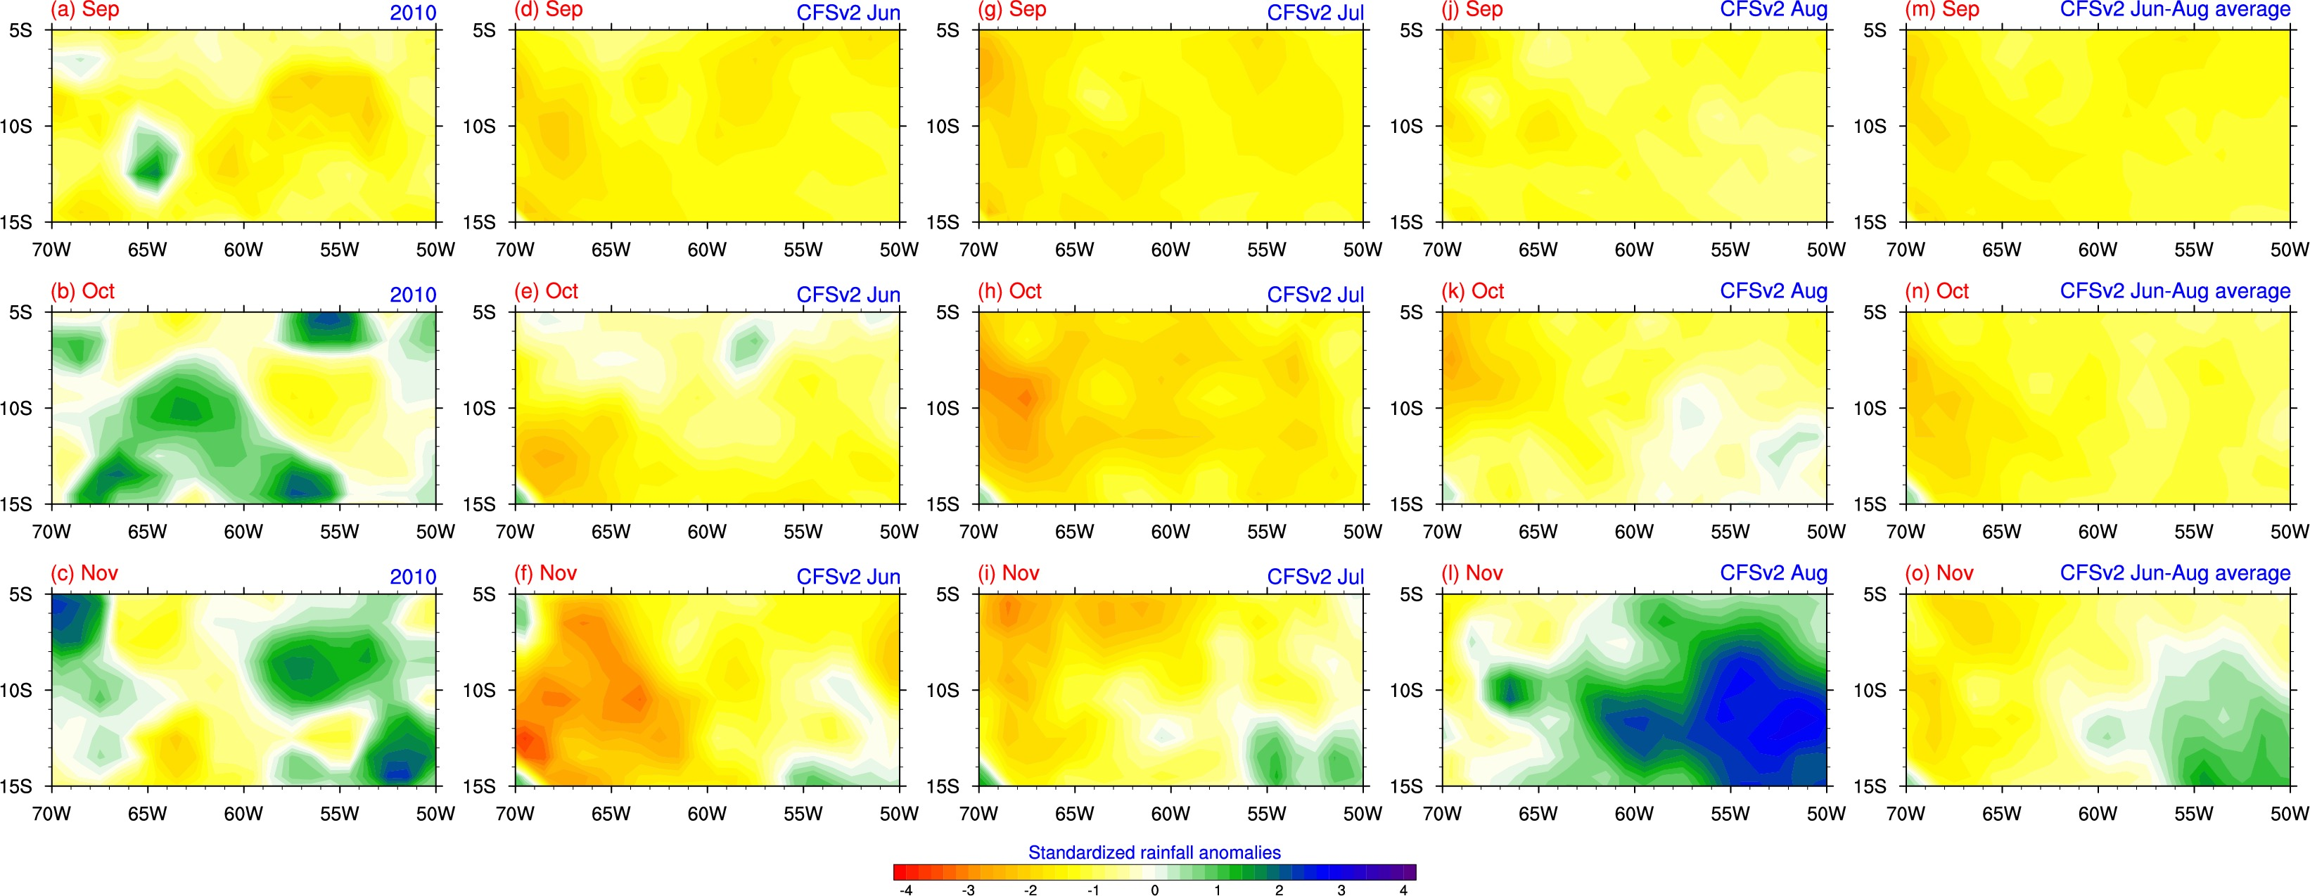
CFSv2 seasonal forecast

Slide 4
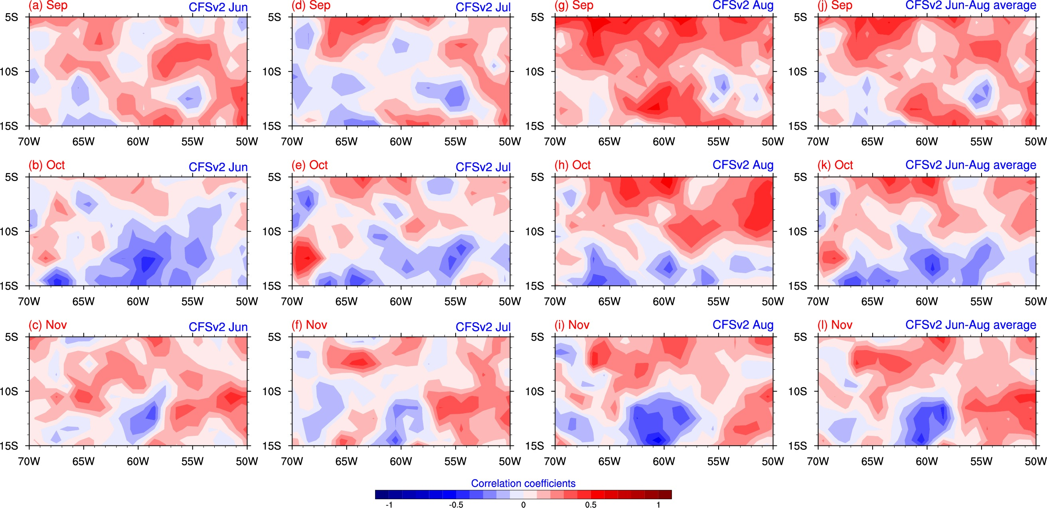
Correlation between CFSv2 and observations

Slide 5
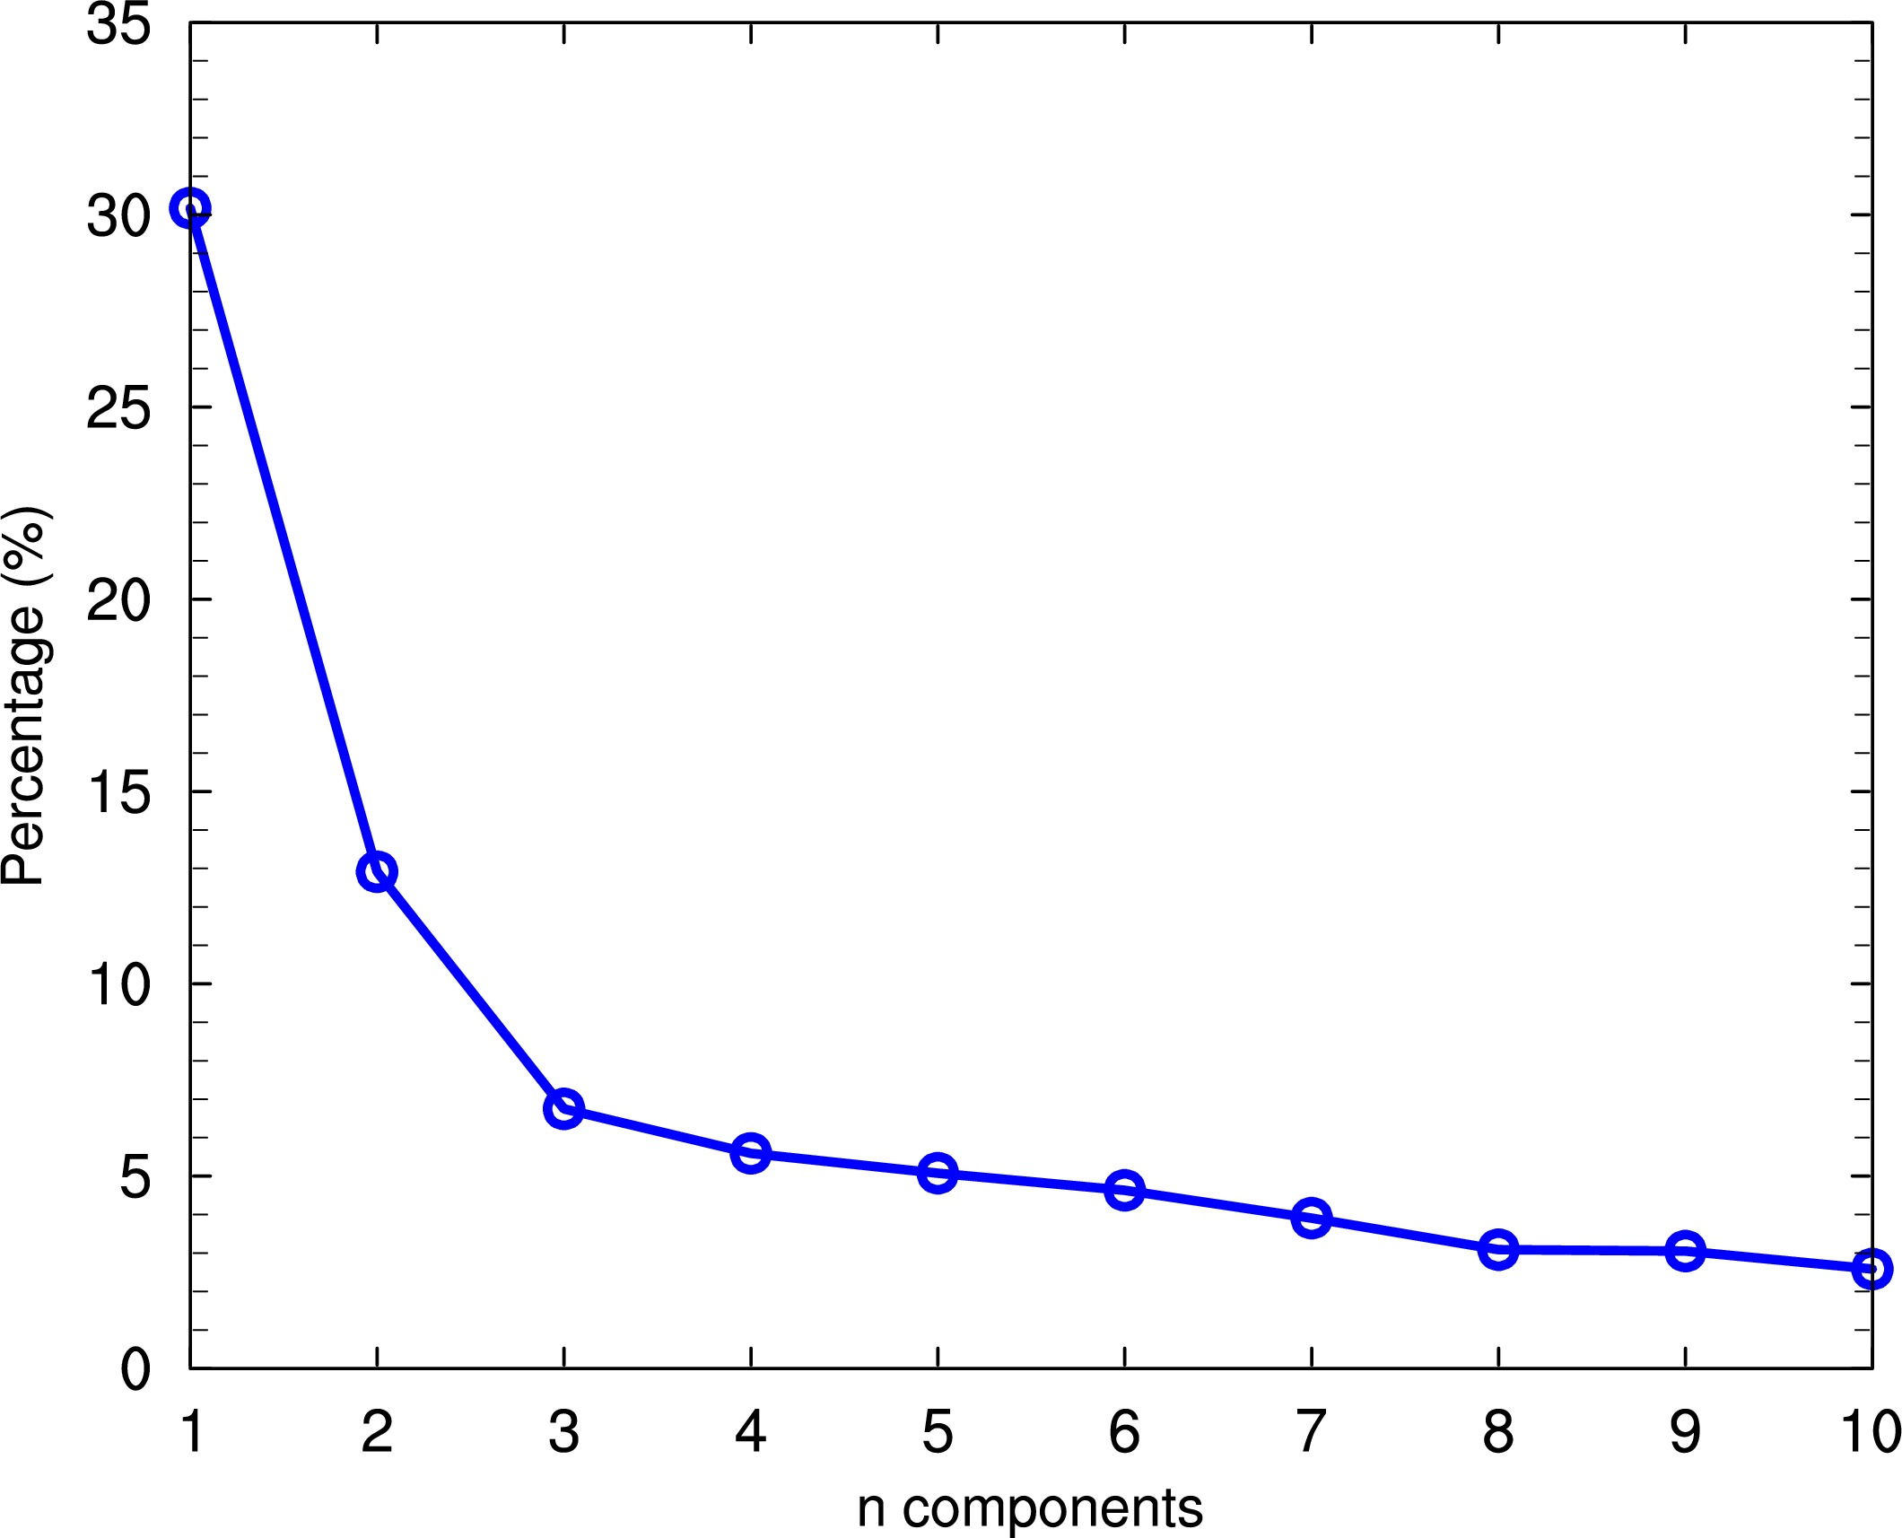
Statistical predictions
Input variables from 1979-2015:
CIN (0-30ºS, 40-80ºW)
CAPE
RH at surface
Z at 200 hPa
Multiple EOF analysis
Retain first 10 EOF modes, accounting for about 77% of the total variance.
Output variable: rainfall anomalies (5º-15ºS, 50º-70ºW)

Slide 6
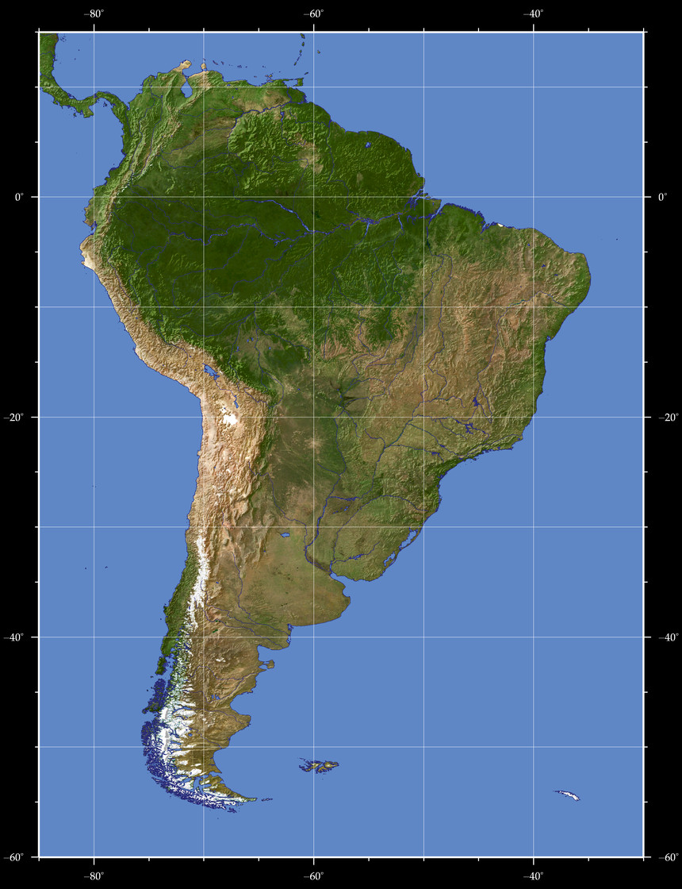

Slide 7
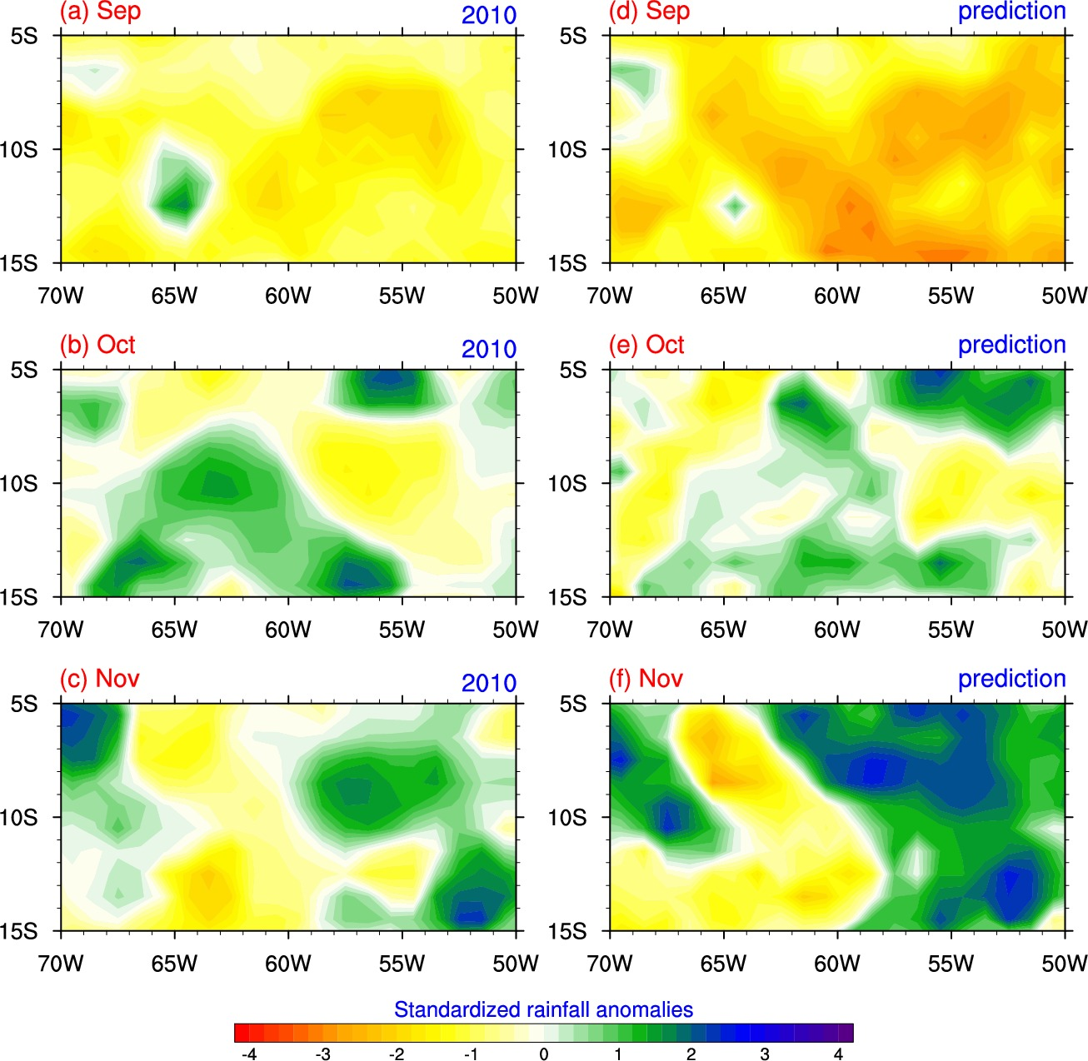
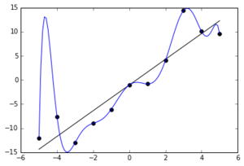
All-year regression
Problems
Overfitting

Slide 8
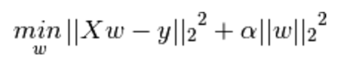
Different regression algorithms
Ordinary least squares (OLS)
Ridge Regression
Lasso Regression

Slide 9
K-fold cross-validation
1979 | 1980 | 1981
1982 | 1983 | 1984
1985 | 1986 | 1987
1988 | 1989 | 1990
1991 | 1992 | 1993
1994 | 1995 | 1996
1997 | 1998 | 1999
2000 | 2001 | 2002
2003 | 2004 | 2005
2006 | 2007 | 2008
2009 | 2011 | 2012
2013 | 2014 | 2015
12 folds
Algorithm:
Loop (alphas){
Fit the model in training datasets
Calculate sum of square errors for validation datasets
Do the above for 12 times.
}
Find the penalty parameter that make the sum of square errors lowest.
2010

Slide 10
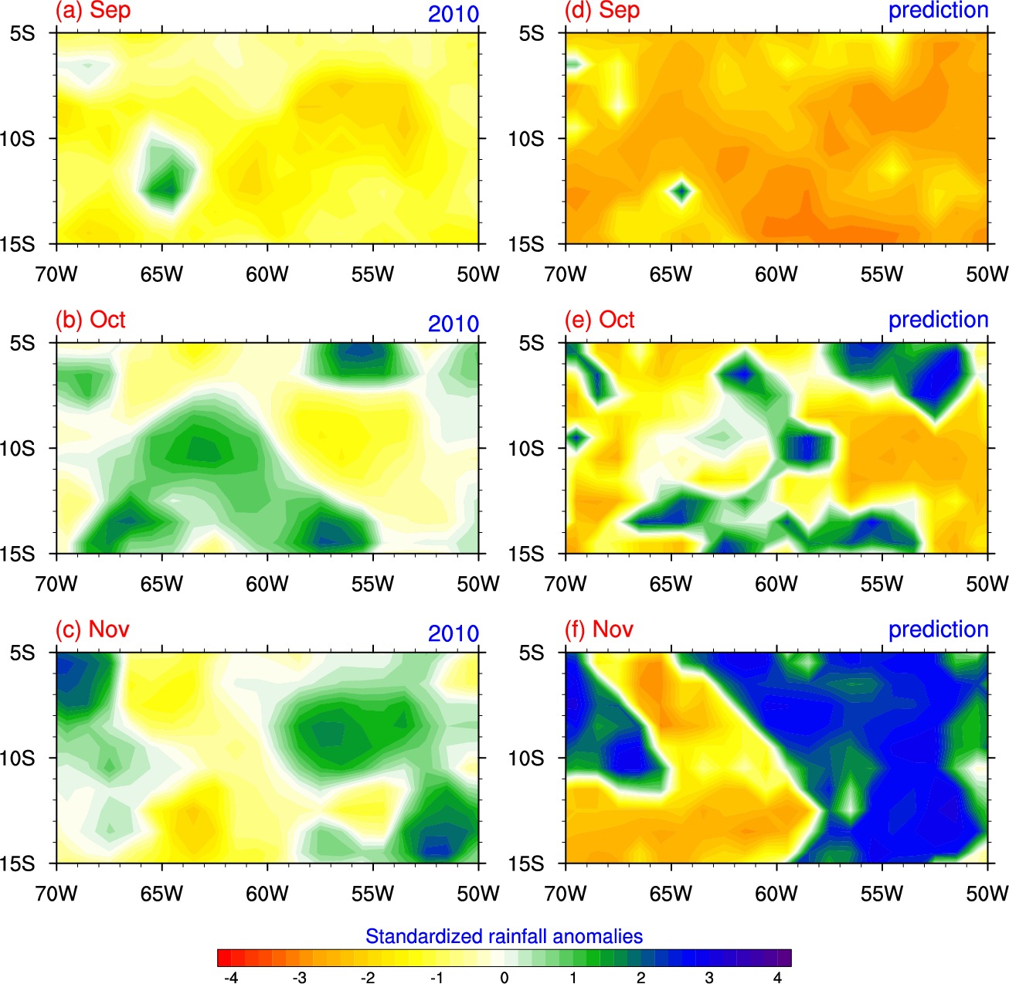
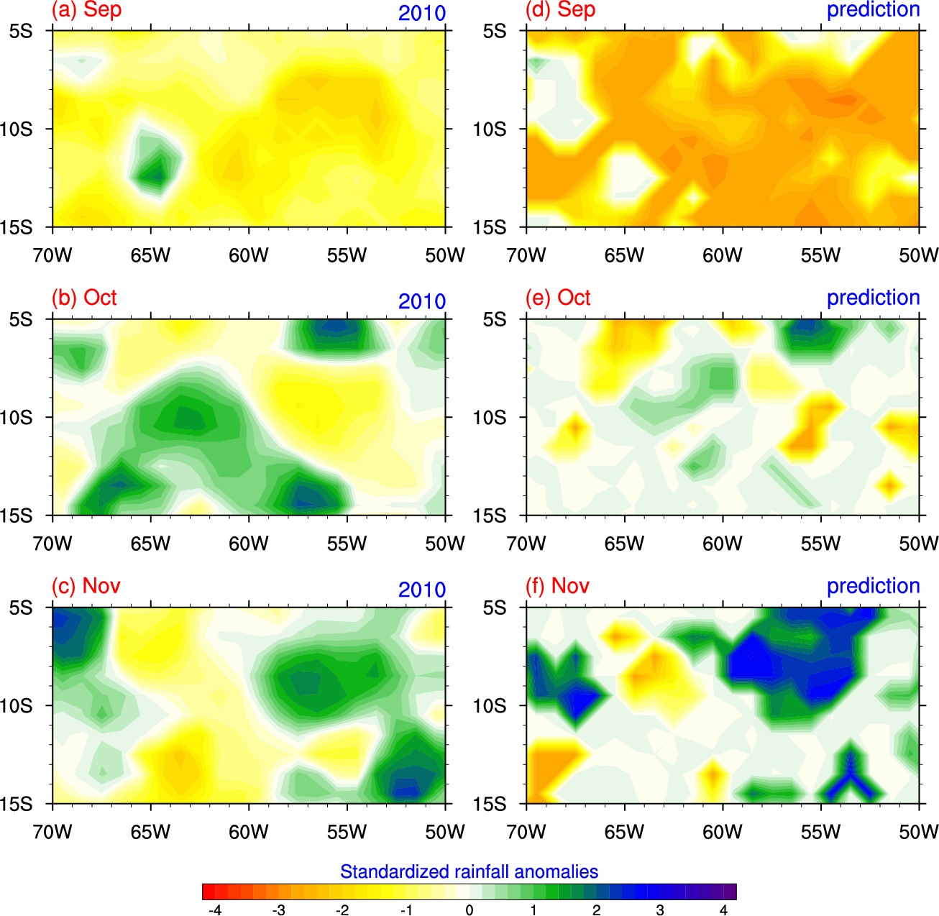
Ridge Regression
Lasso Regression

Slide 11
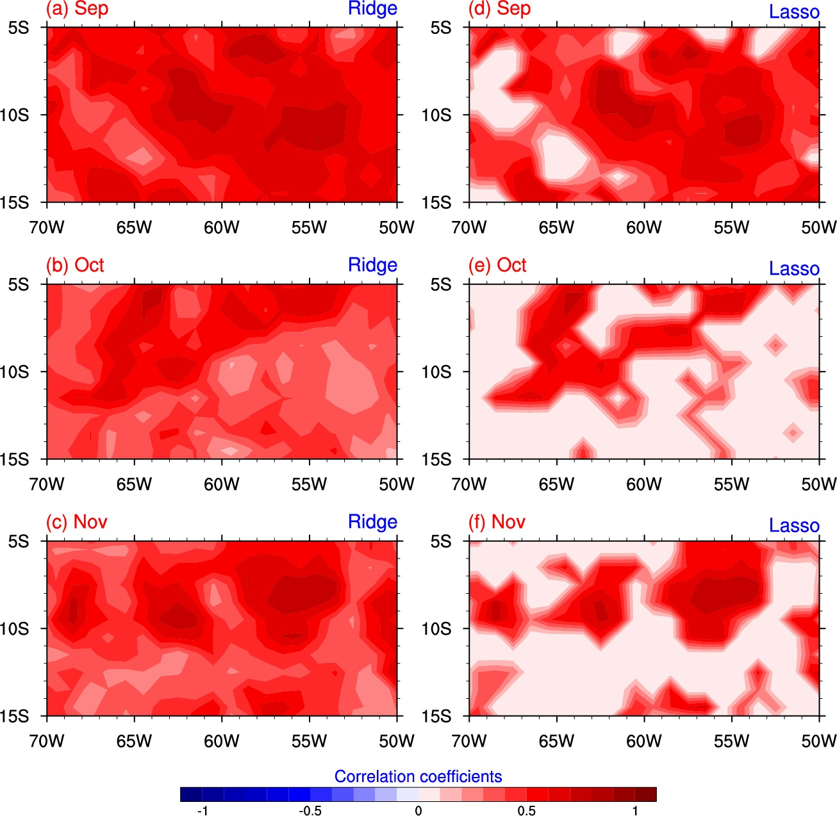
Correlation between prediction and observations

Slide 12
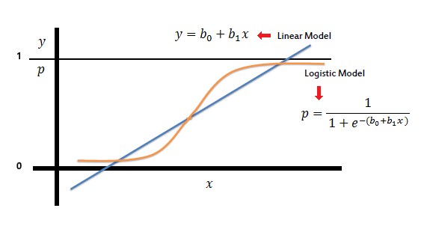
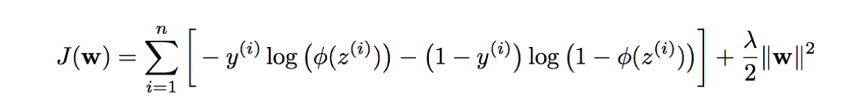
Logistic regression

Slide 13
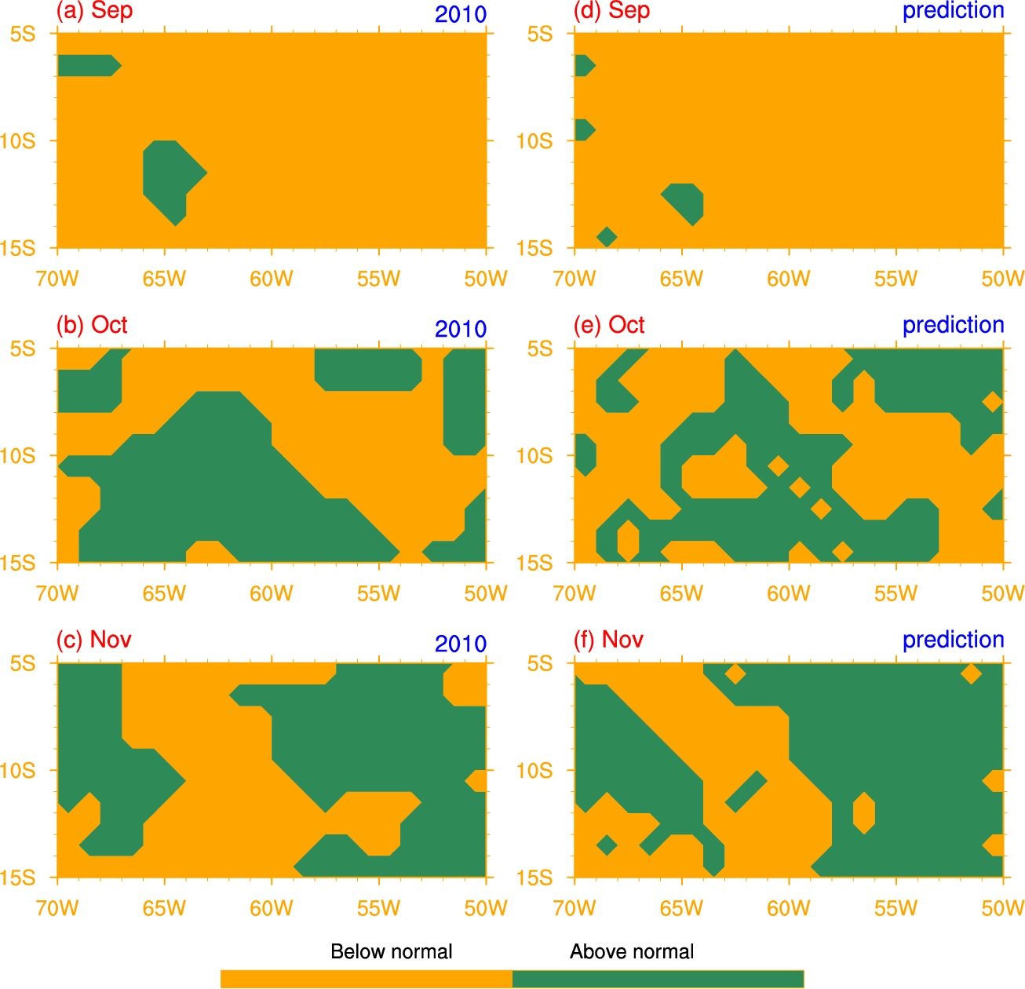
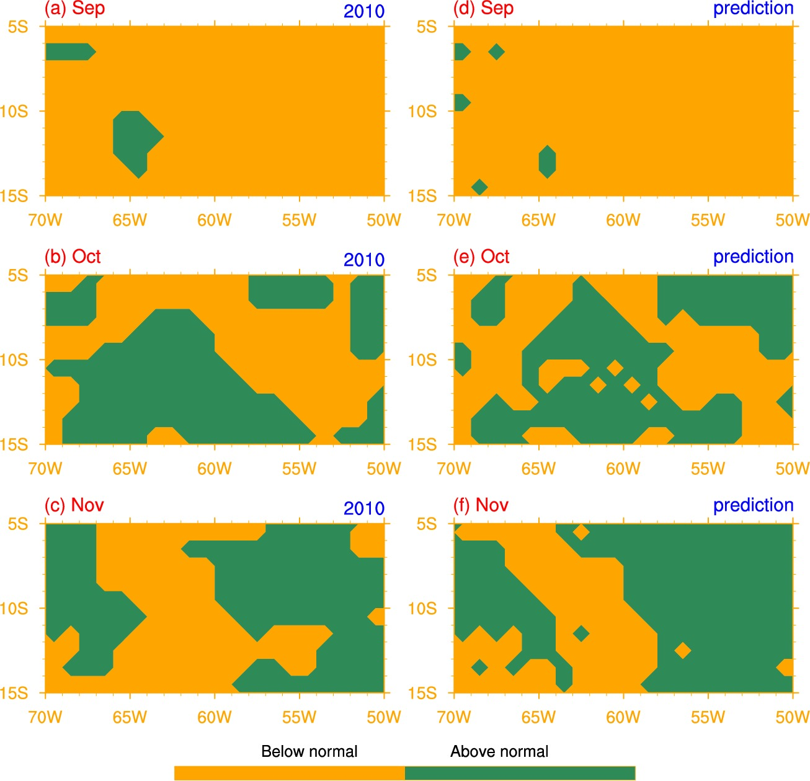
L2
L1

Slide 14
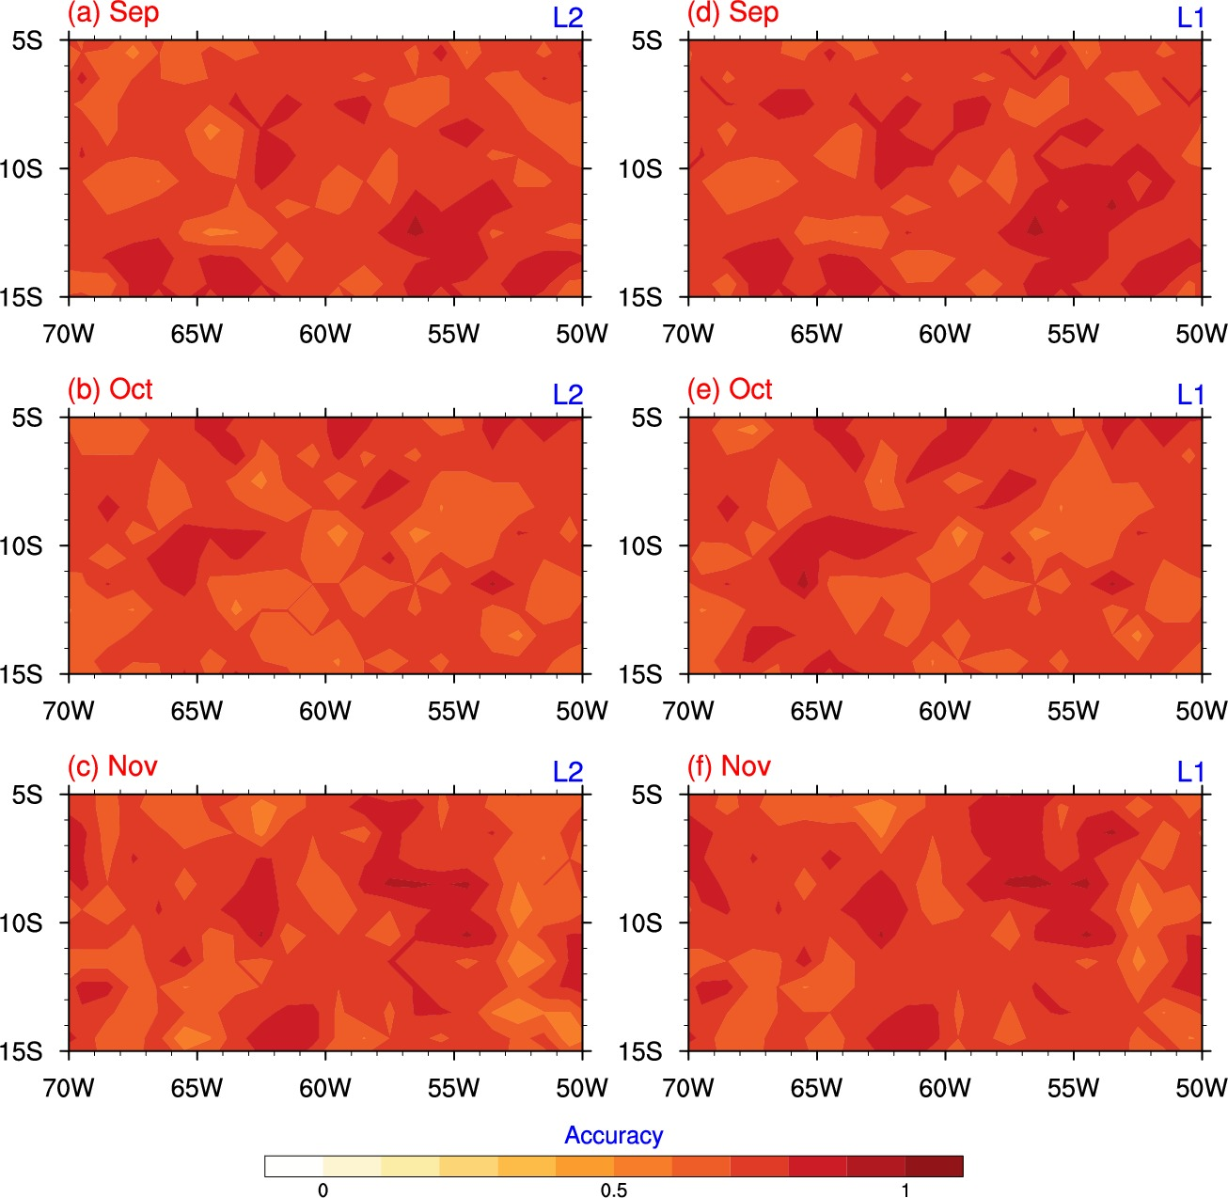
Accuracy

Slide 15

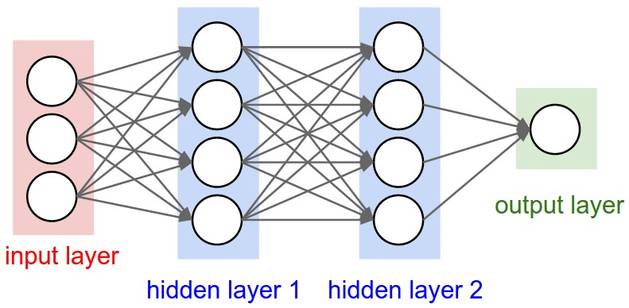

Convolutional Neural Networks (CNN)
Output layer: 2 units
Input layer: 10 units
1 hidden layer: 5 units
12-fold cross-validation

Slide 16
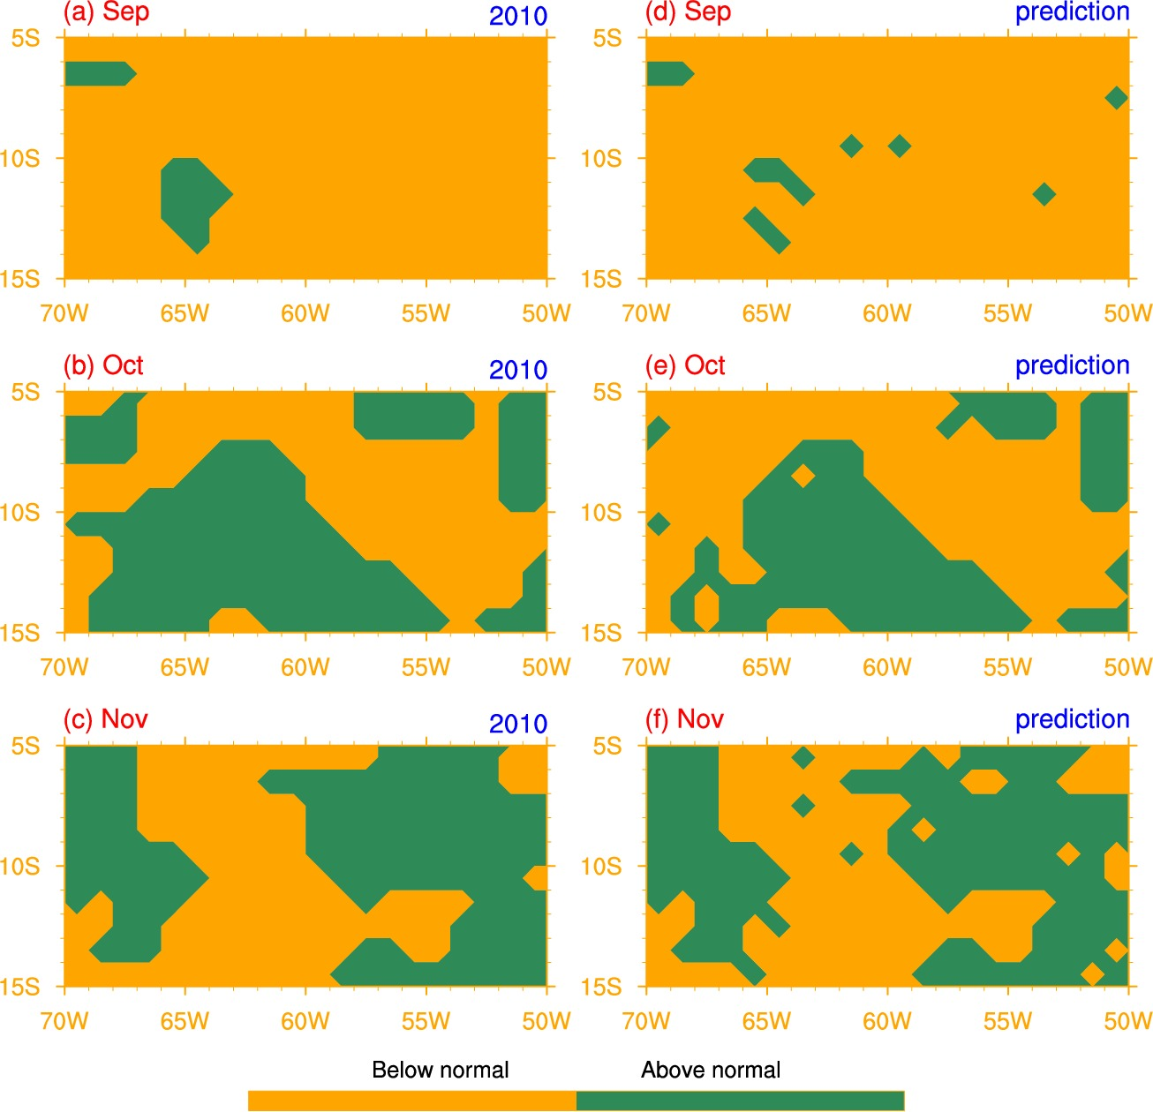
Prediction

Slide 17
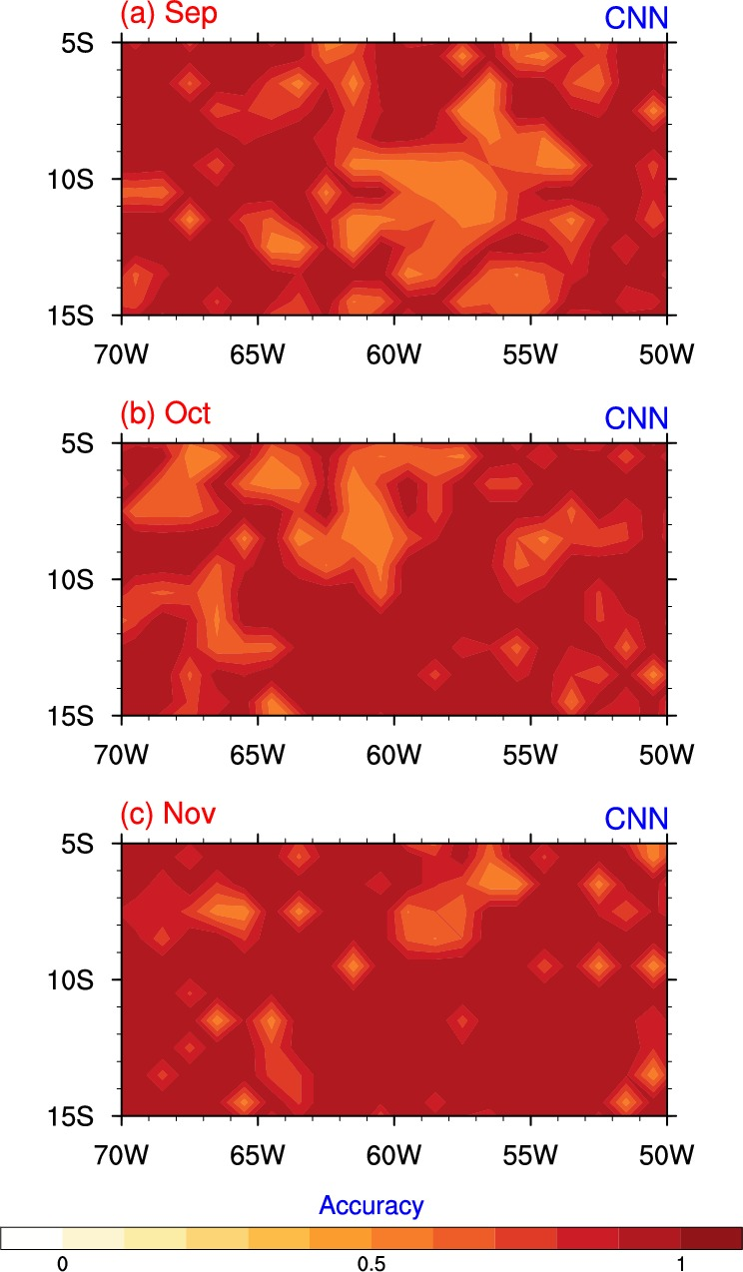
Accuracy

Slide 18
Conclusion and Discussion
Statistical models generate more accurate seasonal predictions of rainfall anomalies than dynamical models.
It is easier to predict anomalous signs than exact magnitudes.
CNN works better than simple logistic regressions, implying non-linear properties in the climate system.
Sample size is very important.

Slide 19
+1
+1
…
…
10 EOF inputs
5 units
output layer
input layer
hidden layer

Slide 20
K-fold cross-validation
1 | 1979 | 1980 | 1981
2 | 1982 | 1983 | 1984
3 | 1985 | 1986 | 1987
4 | 1988 | 1989 | 1990
5 | 1991 | 1992 | 1993
6 | 1994 | 1995 | 1996
7 | 1997 | 1998 | 1999
8 | 2000 | 2001 | 2002
9 | 2003 | 2004 | 2005
10 | 2006 | 2007 | 2008
11 | 2009 | 2011 | 2012
12 | 2013 | 2014 | 2015
test data
training data
2010
validation data

