Slide 1


Slide 2
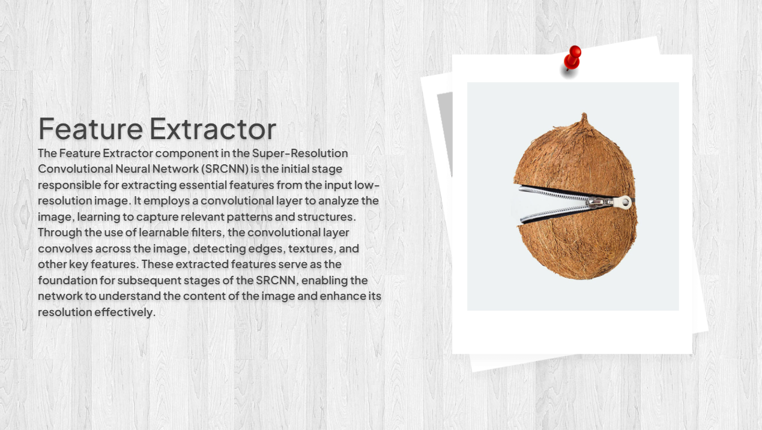

Slide 3
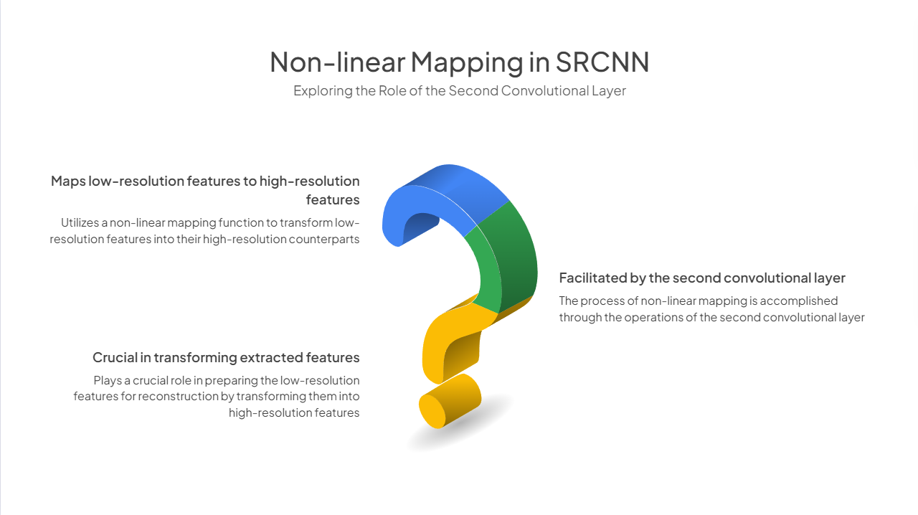


Slide 4
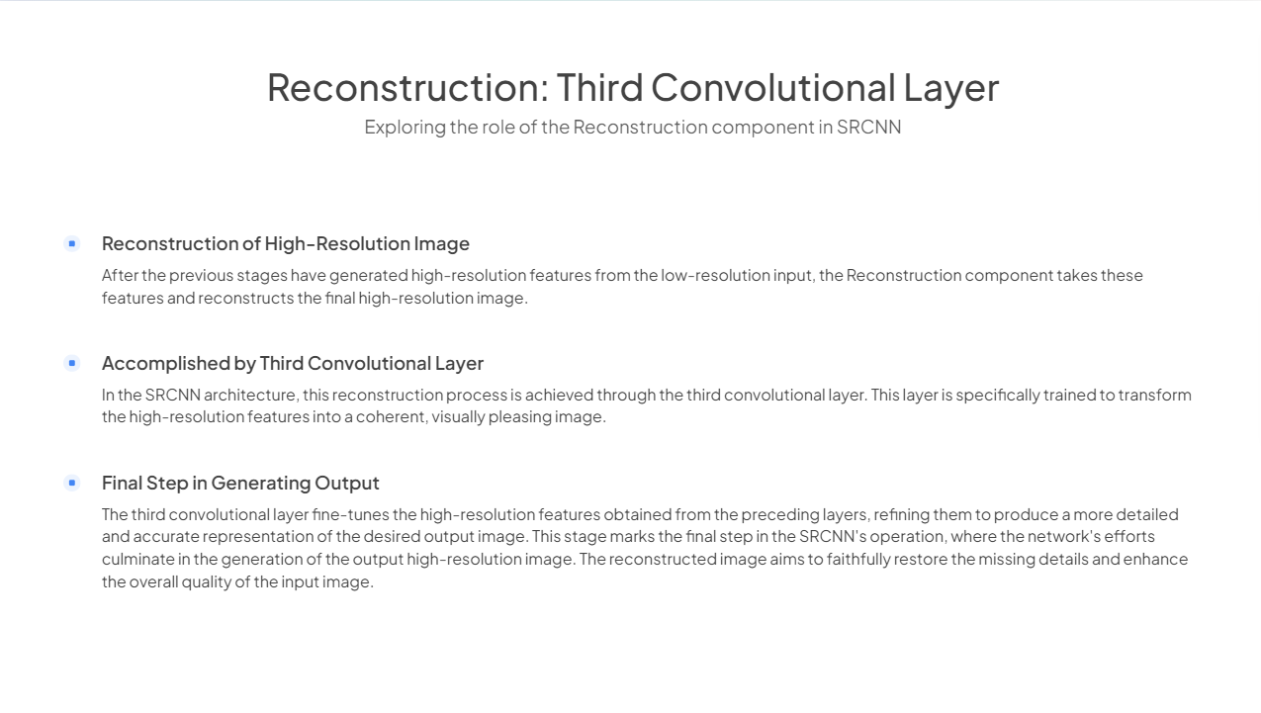
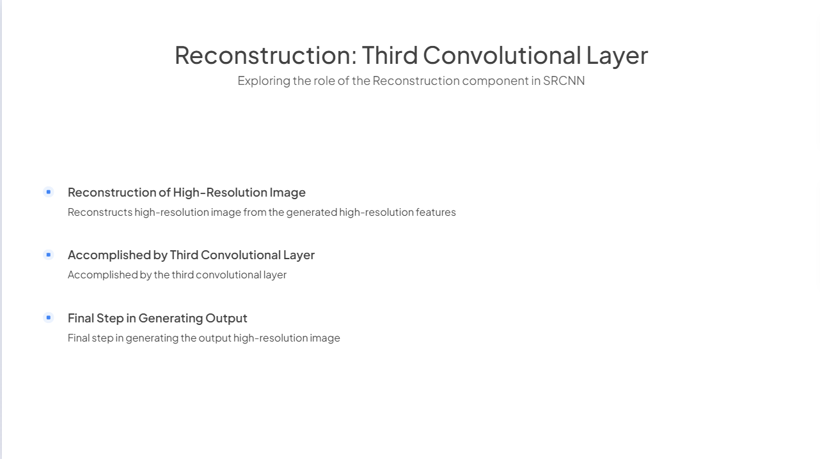
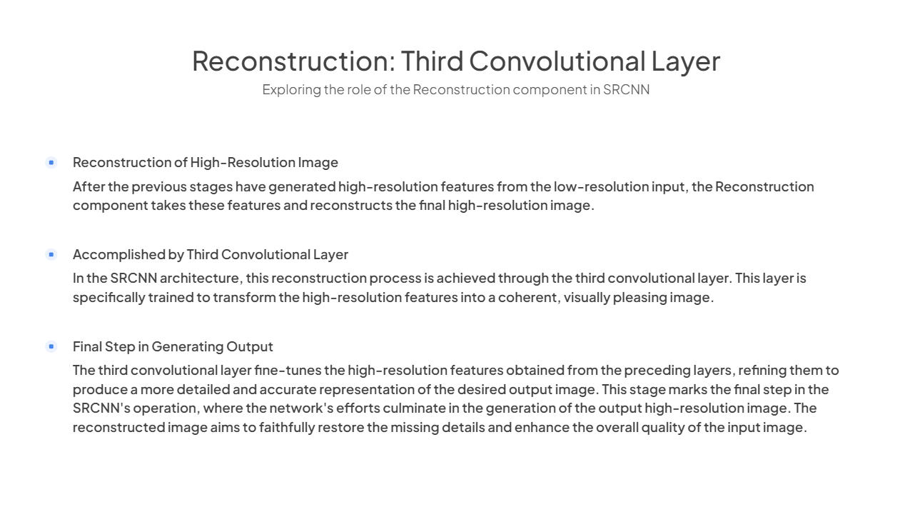

Slide 5
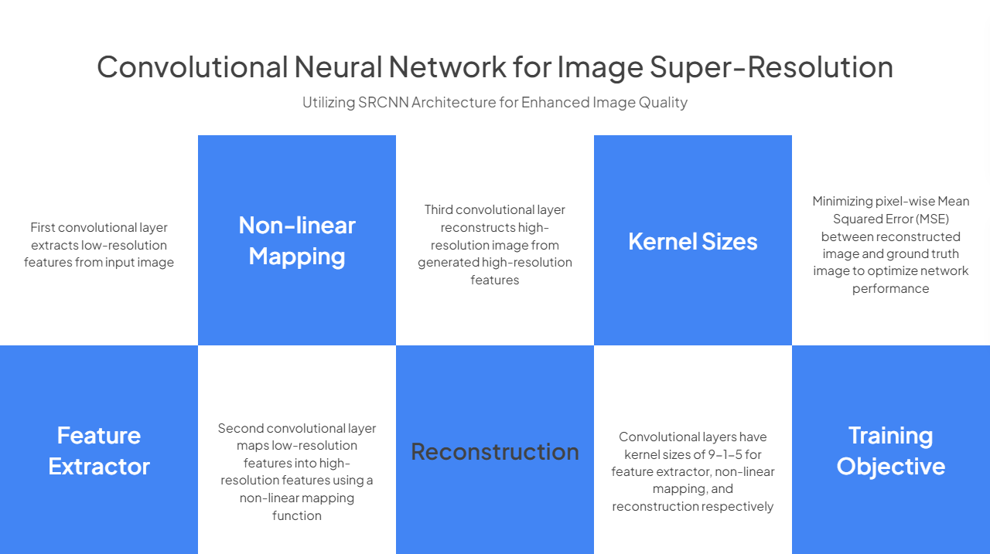

Slide 6
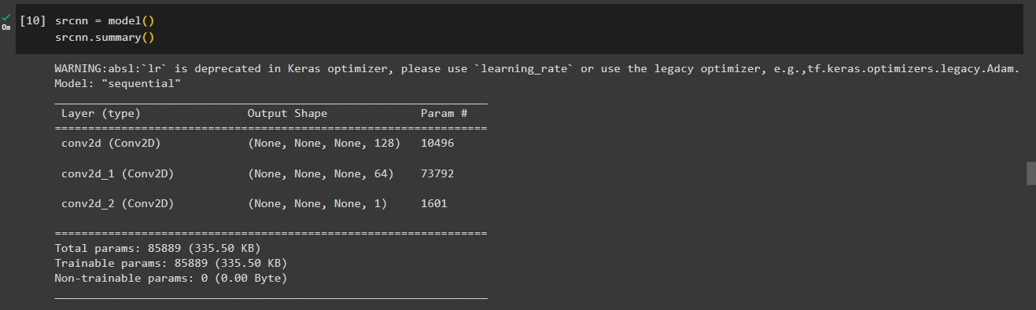
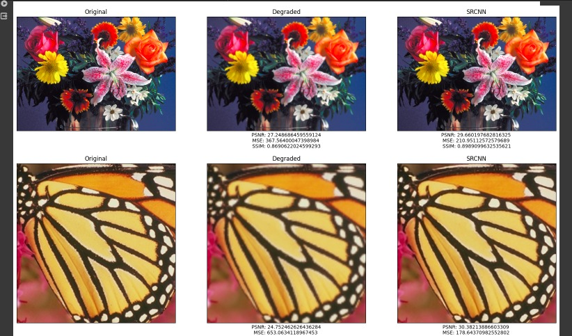
Outputs Of Few Images

Slide 7
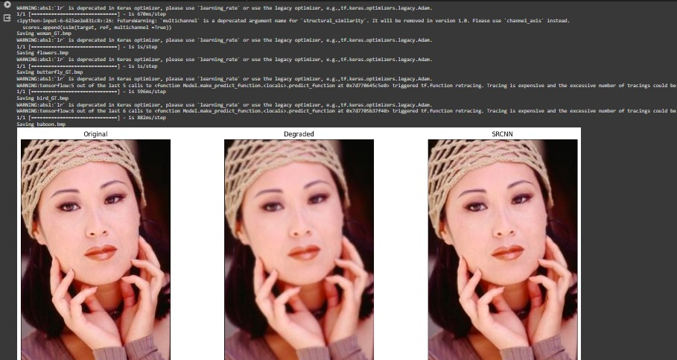

Slide 8
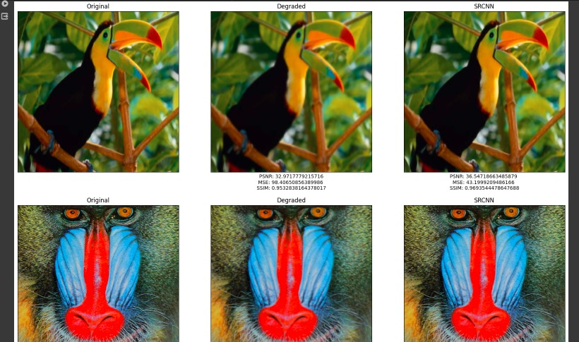

Slide 9
Reference & Git hub links:
Reference
https://github.com/MarkPrecursor/SRCNN-keras
https://github.com/kunal-visoulia/Image-Restoration-using-SRCNN
Git hub
https://github.com/Bhargava-Srinivasan/Image-Super-Resolution-using-SRCNN

