Slide 1

DEPARTMENT OF COMPUTER SCIENCE AND ENGINEERING
CB23F35 - LOW-CODE APPLICATION DEVELOPMENT USING ZOHO CREATOR
ACY 2026-27
III YEAR- V SEM
PROJECT
SERVICE CENTRE MANAGEMENT SYSTEM
DATE : 10-11-2026
TEAM : INDIVIDUAL PROJECT
REG : 240701098
NAME : DEEBAC Y K

Slide 2
ABSTRACT
Service Centre Management System is a low-code application developed using Zoho Creator to organise customer service requests and repair activities in one place.
The application is designed to maintain customer details, service items, complaints, job cards, technician assignments, service progress and payment records. It helps staff register a service request, assign work and monitor each request until completion.
Zoho Creator forms and reports provide structured data entry and clear status tracking, while workflows can automate notifications and routine updates. The system aims to reduce paper-based registers, repeated calls and scattered spreadsheets.
The project is a service-management prototype. Its actual performance and available functions depend on the forms, reports, permissions and workflows configured in the Zoho Creator application.

Slide 3
PROBLEM STATEMENT
Service centres handle multiple customers, service requests, devices or products, technicians and repair activities every day.
When these details are maintained in separate registers or spreadsheets, staff may find it difficult to track request status, service history, assigned technicians and pending work.
Manual coordination can lead to delayed updates, missed follow-ups, duplicate entries and difficulty identifying completed or overdue jobs.
Problem: How can a Zoho Creator application centralise customer and service records, organise technician assignments and track service requests from registration to completion?

Slide 4
INTRODUCTION
Service centres provide inspection, maintenance, troubleshooting and repair services to customers.
A typical service process involves customer registration, recording the item or issue, creating a service request, assigning a technician, updating work progress and communicating the final status.
When information is stored in different places, it becomes difficult to obtain a complete view of each customer's service history and the centre's pending workload.
Service Centre Management System uses Zoho Creator to bring customer records, service requests, job tracking, reports and workflow automation into one low-code application.

Slide 5
LITERATURE REVIEW
Zoho Creator Documentation: Explains how to build business applications using forms, reports, pages, workflows and application settings.
Zoho Creator Forms: Describes field types, mandatory fields, lookups, validation and structured record collection.
Zoho Creator Reports and Pages: Covers list, summary and chart reports, dashboards and application navigation.
Deluge Scripting Documentation: Provides scripting capabilities for validating records and automating actions in Zoho applications.
Project relevance: These platform capabilities support a centralised service-centre workflow. The application is a low-code prototype, and its functions depend on the records and automation configured.

Slide 6
EXISTING SYSTEM
Customer details may be stored in paper forms, spreadsheets or separate office files.
Service complaints and repair requests may be recorded manually and communicated to technicians through calls or messages.
Technician assignments, job progress, spare-part usage and service completion details may be tracked in separate records.
Staff may need to search multiple sources to answer customer questions or prepare daily service summaries.
The proposed Zoho Creator application centralises these records and provides a common process for tracking service activities.

Slide 7
LIMITATIONS
Separate records make it difficult to retrieve a customer's complete service history.
Manual job allocation can delay work and make technician workload difficult to monitor.
Customers may not receive timely updates about request status or expected completion.
Missing service notes can affect repair continuity and future maintenance decisions.
Preparing pending-job, completed-job and technician summaries manually requires repeated data collection.
A centralised application can improve visibility, but accurate results still depend on timely and correct data entry.

Slide 8
PROPOSED SYSTEM
Register customers and maintain details of the products, equipment or vehicles brought to the service centre.
Create service requests with complaint details, request date, priority and customer contact information.
Assign each request to an available technician and record inspection findings, work notes and service progress.
Track job status through stages such as Received, Assigned, In Progress, Waiting for Parts and Completed.
Maintain service charges, payment status, delivery details and customer feedback where those modules are configured.
Use Zoho Creator reports, dashboards and workflow notifications to monitor pending requests, completed jobs and service-centre activity.

Slide 9
METHODOLOGIES
1. Requirement analysis – identify service-centre users, customer details, service categories and repair stages.
2. Data modelling – design forms for customers, service items, service requests, technicians, job cards and payment records.
3. Form configuration – define field types, mandatory values, lookup relationships and input validation.
4. Workflow automation – configure notifications, technician assignment support and status-related actions.
5. Reporting and testing – prepare service request and job reports; verify form submission, workflow conditions and status tracking.

Slide 10
ARCHITECTURE
USER LAYER
DATA ENTRY
PROCESSING
OUTPUT LAYER
Service-centre users
Admin • Reception
Technicians • Manager
Customers (as permitted)
Zoho Creator forms
Customer details
Service requests
Technician / job records
Field validation
Technician assignment
Status updates
Workflow notifications
Service status
Pending job report
Completed jobs
Customer / payment view
USER / SERVICE CENTRE → registers customers, creates service requests, assigns technicians and tracks each job through completion.
LOW-CODE FOUNDATION: Zoho Creator forms + lookup relationships + reports/pages + workflow automation and Deluge actions.

Slide 11
METHODOLOGY 1
Identify the service-centre roles, such as administrator, reception staff, manager and technician.
Define the customer information and service-item details required when a new request is registered.
Design service request fields for issue description, service category, request date, priority and contact details.
Configure lookup relationships between customers, service requests, technicians and job records; apply required-field and input validations.
Create reports and workflows so staff can review pending requests, monitor job progress and record service completion.

Slide 12
RESULTS (VALUES/TABLE)
PROJECT IMPLEMENTATION SUMMARY
Core platform
Zoho Creator
Main data modules
Customers, service requests, technicians
Service tracking
Assignment, job progress, completion
Reports
Pending jobs, completed jobs, service history
The application is designed to organise customer and service records and support a consistent process from request registration to service completion.
Confirm the exact form, report and workflow counts using the live Zoho Creator application.

Slide 13
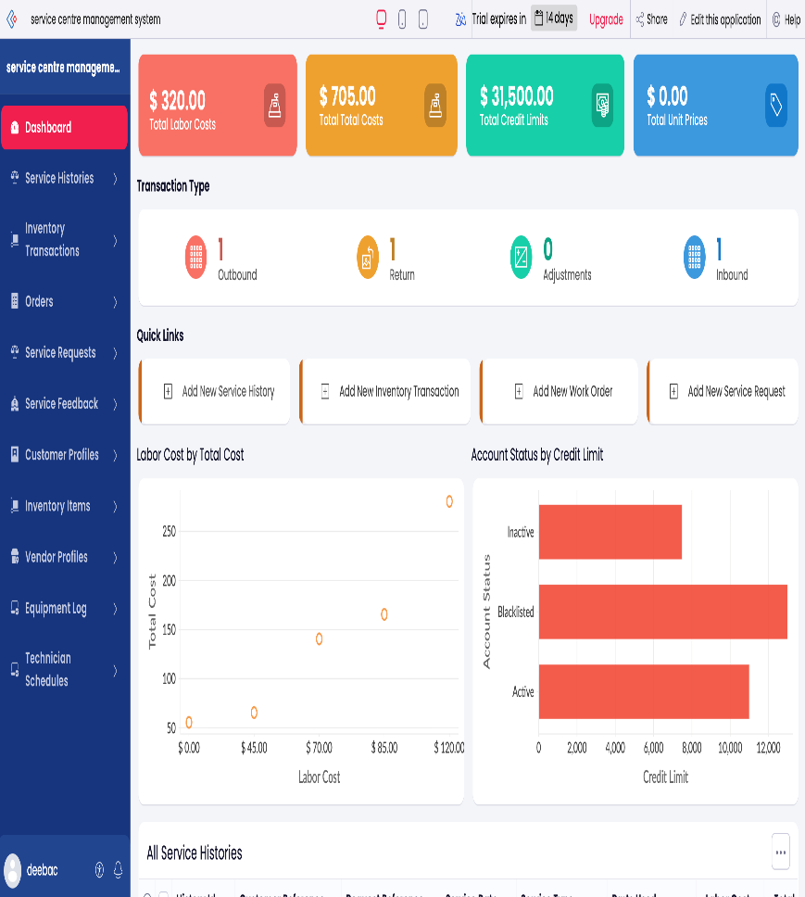
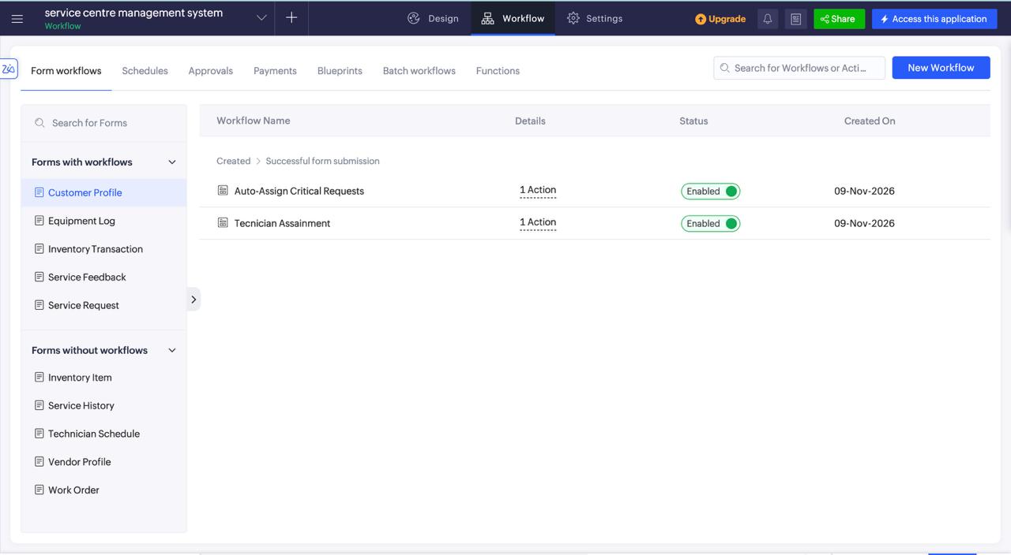
RESULTS
ZOHO CREATOR HOME / DASHBOARD
SERVICE REQUEST / JOB TRACKING
INSERT ACTUAL ZOHO CREATOR SCREENSHOT
Home page showing service-centre navigation, summary cards and reports.
INSERT ACTUAL ZOHO CREATOR SCREENSHOT
Customer service request, technician assignment or job status view.

Slide 14
CONCLUSION
Service Centre Management System provides a centralised approach to maintaining customer information and service request records.
The proposed workflow connects request registration, technician assignment, repair progress, service completion and customer communication.
Zoho Creator low-code forms, lookup fields, reports and workflows can reduce dependence on separate registers and informal coordination.
The application supports better visibility of pending work, completed services and customer history. Its effectiveness depends on accurate data entry, suitable access permissions and consistent use by service-centre staff.
The system is intended to support service operations; it does not replace professional diagnosis or technical repair judgement.

Slide 15
FUTURE ENHANCEMENT
Add customer-facing service-status tracking and automated SMS or email updates.
Introduce appointment scheduling and service-slot availability management.
Add spare-parts inventory, stock alerts and parts usage linked to each job card.
Provide technician workload charts, turnaround-time analysis and pending-job dashboards.
Enable invoice generation, online payment integration and digital service-history access.
Add QR-code based item identification, customer feedback collection and role-based access controls.

Slide 16
REFERENCES
[1] Zoho Corporation, Zoho Creator Help – Forms and Fields, official Zoho Creator documentation.
[2] Zoho Corporation, Zoho Creator Help – Reports, Pages and Dashboards, official Zoho Creator documentation.
[3] Zoho Corporation, Zoho Creator Help – Workflows and Automation, official Zoho Creator documentation.
[4] Zoho Corporation, Deluge Scripting Language – Official Deluge documentation.
[5] CB23F35 – Low-Code Application Development using Zoho Creator, course learning materials, Academic Year 2026–27.
[6] Service Centre Management System – project concept, module design and application requirements prepared for the course project.

