Slide 1
CIDA Certificate in Digital Applications
Introduction

Slide 2
Unit 1 - Developing Web Products.
A two and a half hour practical exam –worth 25%
Using Adobe Dreamweaver, Photoshop and Fireworks to create a multi media website.
We are starting this in Year 11

Slide 3
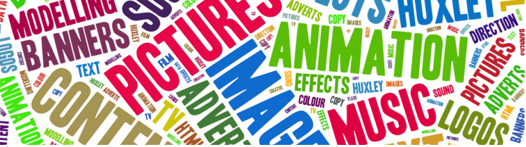
Unit 3 - Artwork and imaging.
Coursework –worth 75%
Using Adobe Illustrator, Dreamweaver, Photoshop and Fireworks to design and create vector and bitmap graphics according to a brief given to us in late September.
Exhibit the images in a website
We are starting with this in year 10

Slide 4
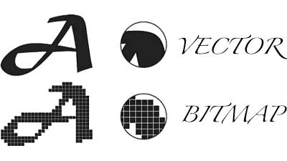
Vector vs Bitmap
Vector lines are drawn from one point (vector) to another.
To increase the size of a vector image you just move the point further away. No blurring! Vector images have a small file size.
Bitmap images are made up of pixels. To enlarge a bitmap and keep it sharp you would have to add more pixels. To reduce the image size means pixels are destroyed.
The more pixels the greater the file size

Slide 5
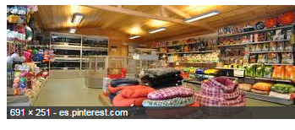
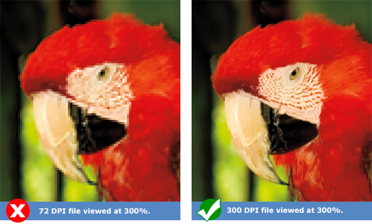
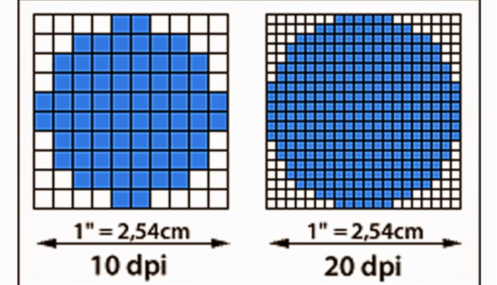
Resolution
Resizing means pixels are lost or added
Print outs
When printing we use dpi or dots(pixels) per inch to measure resolution. We can change the print size without effecting the actual image size

Slide 6
Design.
Design is a way to communicate an idea or concept using design principles and graphical elements
Designers are given a problem Design process Finished artwork A company’s image is old fashioned Research/Plan/Design Modern logo etc

Slide 7
Making quality artwork
Repetition
Alignment
Design Principles
Proximity
Contrast
Balance
Notes:
Alignment looks bad if not done can use to break tension or highlight some thing. Contrast 2 or more elements are different –greater difference > contrast
Repetition: adds consistency Balance: Make sure graphics don’t overpower

Slide 8
Making quality artwork
Emotion
Lines
Colour
Design Elements
Form
Lines make shapes
Space
Texture
Tactile
Focus
Notes:
Don’t overdo texture. Red BP and stress space Google search

Slide 9
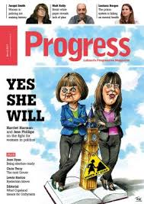
Exercise Find an image in a magazine. Highlight design elements and design principles E.g. Use of space, texture, balance etc.

Slide 10
Organising Folders:

