Slide 1
Programming for Big Data
Lecture 2
Some Basics
Higher Diploma in Data Analytics (On-line)
Dr Eugene O’Loughlin
eoloughlin@ncirl.ie
01-4498561
Notes:
Material for this lesson is taken from the R Cookbook (Teetor, 2011).

Slide 2

Lecture 02 - Objectives
At the end of this section you should be able to:
Set, list, and delete variables
Create a vector
Compute basic statistics
Create sequences
Compare vectors
Select vector elements
Perform arithmetic
Get operator precedence right
Notes:
Lot!

Slide 3

Reading
Teetor P. (2011), R Cookbook, O’Reilly Media, [ISBN: 0596809158]
Chapter 2
Some Basics

Slide 4
Setting Variables
Use the assignment operator (<-)
There is no need to declare a variable first (R does this for you)
For example:
x <- 2
y <- 3
z <- x + y
z
z <- sqrt(x^2 + y^2)
R is a dynamically typed language
x <- 10
print(x)
x <- c(“Fee", "Fie", "Foe", “Fum")
print(x)
Functions:
sqrt() – Square root of a number
print() – Print something
c() – combine data to a vector
Notes:
Data Types – check out this link to Quick-R website in Moodle to see about data types in R:
https://www.statmethods.net/input/datatypes.html
EG:
Data Types
R has a wide variety of data types including scalars, vectors (numerical, character, logical), matrices, data frames, and lists.
Vectors
a <- c(1,2,5.3,6,-2,4) # numeric vector b <- c("one","two","three") # character vector c <- c(TRUE,TRUE,TRUE,FALSE,TRUE,FALSE) #logical vector

Slide 5
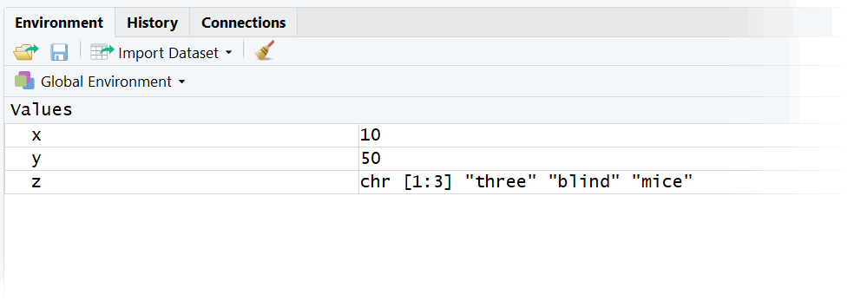
Listing Variables
Problem – you want to know what variables and functions are defined in your workspace
ls and ls.str functions
For example:
x <- 10
y <- 50
z <- c(“three”, “blind”, “mice”)
ls()
ls.str()
(More likely to use R Studio)
Notes:
Won’t use much.

Slide 6
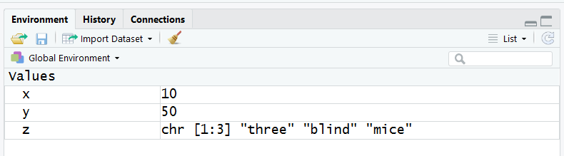
Deleting variables
Remove unneeded variables
Use rm function
Code:
x <- 2*pi
x
rm(x)
x
Clear objects ALL from the workspace
Notes:
R Cookbook: “Be Polite”. Be careful not to put rm into code shared with others -> RUDE!

Slide 7
Create a vector
Vector
Central component of R
Can contain either numbers, strings, or logical values (but not a mixture)
Use c(…) combine operator to construct a vector from simple elements
Code – create vectors:
c(1*pi, 2*pi, 3*pi,4*pi)
c("Everyone", "loves", "stats.")
c(TRUE, TRUE, FALSE, TRUE)
Code - combine vectors:
v1 <- c(1,2,3)
v2 <- c(4,5,6)
c(v1, v2)
Notes:
Another eg:
name <- c("Mike", "Lucy", "John")
age <- c(20, 25, 30)
Vectors cannot contain a mix of data types – eg, try:
v1 <- c(1,2,3)
v3 <- c(“A”, “B”, “C”)
c(v1, v3)
What happens?

Slide 8
Compute basic statistics
Calculate: mean, median, standard deviation, variance, and correlation
Use:
mean(x)
median (x)
sd(x)
var(x)
cor(x, y)
Read in some data
x <- c(50, 46, 54, 55, 55, 52, 53, 51, 47, 49, 51, 55)
y <- c(1267, 1238, 1157, 1192, 1234, 1231, 1267, 1246, 1260, 1237, 1283, 1314)
Calculate basic statistics for x and y
Month | Crude Oil ($) | Gold Price ($)
Oct-16 | $50 | $1,267
Nov-16 | $46 | $1,238
Dec-16 | $54 | $1,157
Jan-17 | $55 | $1,192
Feb-17 | $55 | $1,234
Mar-17 | $52 | $1,231
Apr-17 | $53 | $1,267
May-17 | $51 | $1,246
Jun-17 | $47 | $1,260
Jul-17 | $49 | $1,237
Aug-17 | $51 | $1,283
Sep-17 | $55 | $1,314
Notes:
Data taken from BDA exam question (January 2018)

Slide 9
Displaying Data from a File
Download file OilGold.csv from Moodle into your Working Folder
Read into R Studio using read.csv() function
priceData <- read.csv(file="OilGold.csv",head=TRUE,sep=",")
Display data:
priceData
priceData$Oil
priceData$Gold
Calculate basic statistics:
mean(priceData$Oil)
median(priceData$Gold)
sd(priceData$Oil)
var(priceData$Gold)
cor(priceData$Oil, priceData$Gold)
Oil | Gold
50 | 1267
46 | 1238
54 | 1157
55 | 1192
55 | 1234
52 | 1231
53 | 1267
51 | 1246
47 | 1260
49 | 1237
51 | 1283
55 | 1314

Slide 10
Create a sequence
You want to create a sequences of numbers
Use an n:m expression to create a simple sequences: n, n+1, n+2….
Use seq function to create a sequences with an increment other than 1
Use rep function to create a series of repeated values
Code:
1:5
seq(from=1, to=5, by=2)
rep(1, times=5)
Other examples (R Cookbook):
0:9
10:19
9:0
seq(from=0, to=20)
seq(from=0, to=20, by=2)
seq(from=0, to=20, by=5)
seq(from=0, to=20, length.out=5)
seq(from=0, to=100, length.out=5)
seq(from=1.0, to=2.0, length.out=5)

Slide 11
Compare Variables
Problem: You want to compare two variables
Use: Comparison operators
Comparison | Operator
Equals | ==
Not equals | !=
Less than | <
Greater than | >
Less than or equal | <=
Greater than or equal | >=

Slide 12
Compare Variables
Code
x <- 5
y <- 10
x == y
x != y
x < y
x > y
x <= y
x >= y
Comparison | Operator
Equals | ==
Not equals | !=
Less than | <
Greater than | >
Less than or equal | <=
Greater than or equal | >=
Notes:
Output will be:
x == y
>
[1] FALSE
>
x != y
[1] TRUE
>
x < y
[1] TRUE
>
x > y
[1] FALSE
>
x <= y
[1] TRUE
x >= y
[1] FALSE
>

Slide 13
Compare Variables
Comparison | Operator
Equals | ==
Not equals | !=
Less than | <
Greater than | >
Less than or equal | <=
Greater than or equal | >=
Power of R
Compare entire vectors at once
Code
x <- c(3, 4, 5)
y <- c(3, 5, 4)
x == y
x != y
x < y
x > y
x <= y
x >= y
Notes:
Output will be:
> x <- c(3, 4, 5)
> y <- c(3, 5, 4)
> #
> x == y
[1] TRUE FALSE FALSE
> x != y
[1] FALSE TRUE TRUE
> x < y
[1] FALSE TRUE FALSE
> x > y
[1] FALSE FALSE TRUE
> x <= y
[1] TRUE TRUE FALSE
> x >= y
[1] TRUE FALSE TRUE
>

Slide 14
Select Vector Elements
You want to extract one or more elements from a vector
Indexing technique
Code:
# Select vector elements
fib <- c(0, 1, 1, 2, 3, 5, 8, 13, 21, 34)
fib
#
fib[1]
fib[7]
fib[8:10]
fib < 10
fib[fib < 10]
Notes:
Output will be:
> fib <- c(0, 1, 1, 2, 3, 5, 8, 13, 21, 34)
> fib
[1] 0 1 1 2 3 5 8 13 21 34
> #
> fib[1]
[1] 0
> fib[7]
[1] 8
> fib[8:10]
[1] 13 21 34
> fib < 10
[1] TRUE TRUE TRUE TRUE TRUE TRUE TRUE FALSE FALSE FALSE
> fib[fib < 10]
[1] 0 1 1 2 3 5 8
>

Slide 15

Select Vector Elements
Select elements by name
Code:
years <- c(1998, 2002, 2006, 2010, 2014)
names(years) <- c("France", "Brazil", "Italy", "Spain", "Germany")
years
years["Brazil"]
years[c("Italy", "Germany")]
Image source: FIFA.com
Notes:
Output will be:
> years <- c(1998, 2002, 2006, 2010, 2014)
> names(years) <- c("France", "Brazil", "Italy", "Spain", "Germany")
> years
France Brazil Italy Spain Germany
1998 2002 2006 2010 2014
> years["Brazil"]
Brazil
2002
> years[c("Italy", "Germany")]
Italy Germany
2006 2014
>
NOTE:
2018 World Cup won by France – try to add to code

Slide 16

Perform Vector Arithmetic
You want to operate on an entire vector at once
Use arithmetic operators (+, -, *, /, ^), and statistics functions
Code:
v <- c(11, 12, 13, 14, 15)
w <- c(1, 2, 3, 4, 5)
v + w
v - w
v * w
v / w
v ^ w
mean(v)
sum(w)
sd(v)
log(w)
sin(w)
Image source: http://kidsarithmetic.com
Notes:
Output will be:
> v <- c(11, 12, 13, 14, 15)
> w <- c(1, 2, 3, 4, 5)
> v + w
[1] 12 14 16 18 20
> v - w
[1] 10 10 10 10 10
> v * w
[1] 11 24 39 56 75
> v / w
[1] 11.000000 6.000000 4.333333 3.500000 3.000000
> v ^ w
[1] 11 144 2197 38416 759375
> mean(v)
[1] 13
> sd(v)
[1] 1.581139
> log(w)
[1] 0.0000000 0.6931472 1.0986123 1.3862944 1.6094379
> sin(w)
[1] 0.8414710 0.9092974 0.1411200 -0.7568025 -0.9589243

Slide 17
Getting Operator Precedence Right
:: ::: | access variables in a namespace
$ @ | component / slot extraction
[ [[ | indexing
^ | exponentiation (right to left)
- + | unary minus and plus
: | sequence operator
%any% | special operators (including %% and %/%)
* / | multiply, divide
+ - | (binary) add, subtract
< > <= >= == != | ordering and comparison
! | negation
& && | and
| || | or
~ | as in formulae
-> ->> | rightwards assignment
<- <<- | assignment (right to left)
= | assignment (right to left)
? | help (unary and binary)
What is 2 + 5 * 10?
52?
70?
Rules of precedence
The following unary and binary operators are defined
They are listed in precedence groups, from highest to lowest
2 + 5 * 10 = 52
(2 + 5) * 10 = 70
Notes:
Source: https://stat.ethz.ch/R-manual/R-devel/library/base/html/Syntax.html
Sample code:
a <- 2
b <- 5
c <- 10
#
z <- a + b * c
z
z <- (a + b) * c
z

Slide 18
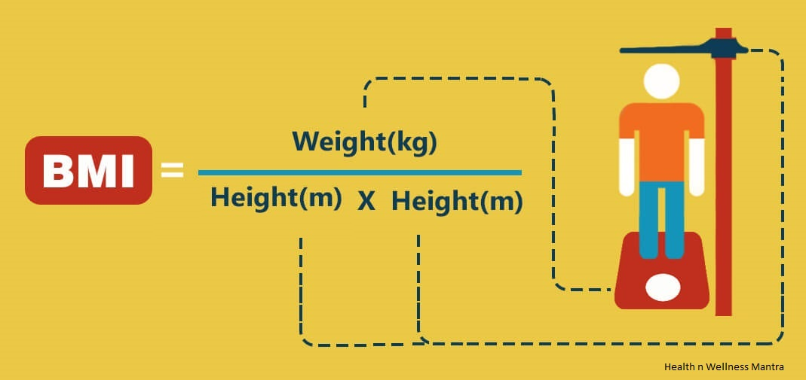
Exercise 1: BMI Calculator
Body Mass Index (BMI)
BMI = Weight (kg)/ Height (m)²
Write R code to calculate your BMI
Eugene
Weight = 101kg Height = 1.82m BMI = 101/1.82² = 30.5
Self assessment
Compare your result to Eugene’s solution
Notes:
Eugene’s code (keep this file – will be using later in course):
# set weight at 101kg
weight <- 101
#
# set height at 1.82 metres
height <- 1.82
#
# square height (simple)
height2 <- height * height
height2
#
# calculate BMI
bmi <- weight / height2
#
# display result
bmi
Output:
> bmi
[1] 30.49149

Slide 19

Exercise 2: Google Stock (May 2018)
Download GOOG_May18.csv file from Moodle into your Working Folder
Open file in Excel and examine data
Read file into R
Tasks:
Display all closing prices only
Display all volumes only
Show closing price for 10th date (14th May)
Show volume for 10th date
Calculate Value for each date (Close x Volume)
Show Value for 10th date
Calculate total Value for month of May
Display all results
Self assessment
Compare your result to Eugene’s solution
Notes:
Eugene’s code and output:
> # Read in CSV file
> googStock <- read.csv(file="GOOG_May18.csv",head=TRUE,sep=",")
> #
> # display contents of file
> googStock
Date Close Volume
1 01/05/2018 1037.31 1427900
2 02/05/2018 1024.38 1603100
3 03/05/2018 1023.72 1815100
4 04/05/2018 1048.21 1938700
5 07/05/2018 1054.79 1466100
6 08/05/2018 1053.91 1217700
7 09/05/2018 1082.76 2032800
8 10/05/2018 1097.57 1443000
9 11/05/2018 1098.26 1253700
10 14/05/2018 1100.20 1518100
11 15/05/2018 1079.23 1494900
12 16/05/2018 1081.77 1097300
13 17/05/2018 1078.59 1043800
14 18/05/2018 1066.36 1565200
15 21/05/2018 1079.58 1023200
16 22/05/2018 1069.73 1090000
17 23/05/2018 1079.69 1030000
18 24/05/2018 1079.24 756800
19 25/05/2018 1075.66 899400
20 29/05/2018 1060.32 1856900
21 30/05/2018 1067.80 1138500
22 31/05/2018 1084.99 3088300
> googStock$Close # just show Closing prices
[1] 1037.31 1024.38 1023.72 1048.21 1054.79 1053.91 1082.76 1097.57 1098.26 1100.20 1079.23
[12] 1081.77 1078.59 1066.36 1079.58 1069.73 1079.69 1079.24 1075.66 1060.32 1067.80 1084.99
> googStock$Volume # just show volumes
[1] 1427900 1603100 1815100 1938700 1466100 1217700 2032800 1443000 1253700 1518100 1494900
[12] 1097300 1043800 1565200 1023200 1090000 1030000 756800 899400 1856900 1138500 3088300
> #
> googStock$Close[10] # show closing price for 10th date (14th May)
[1] 1100.2
> googStock$Volume[10] # show volume for 10th date (14th May)
[1] 1518100
> #
> # Use vector arithmetic to calculate "Value" per day (Close * Volume)
> googStock$Close*googStock$Volume # shows volume per month
[1] 1481174949 1642183578 1858154172 2032164727 1546427619 1283346207 2201034528 1583793510
[9] 1376888562 1670213620 1613340927 1187026221 1125832242 1669066672 1104626256 1166005700
[17] 1112080700 816768832 967448604 1968908208 1215690300 3350774617
> googStock$Close*googStock$Volume[10] # Does not show volume for 10th date (need vector)
[1] 1574740311 1555111278 1554109332 1591287601 1601276699 1599940771 1643737956 1666221017
[9] 1667268506 1670213620 1638379063 1642235037 1637407479 1618841116 1638910398 1623957113
[17] 1639077389 1638394244 1632959446 1609671792 1621027180 1647123319
> #
> # Display volume for 10th date (14th May)
> x <- googStock$Close*googStock$Volume
> x[10]
[1] 1670213620
> #
> # Calculate total value by adding up volume figures using sum
> totalValue <- sum(googStock$Close*googStock$Volume)
> totalValue
[1] 33972950751

