Slide 1
Stock Price Prediction
Worried about your stocks? Say Hello to

Slide 2
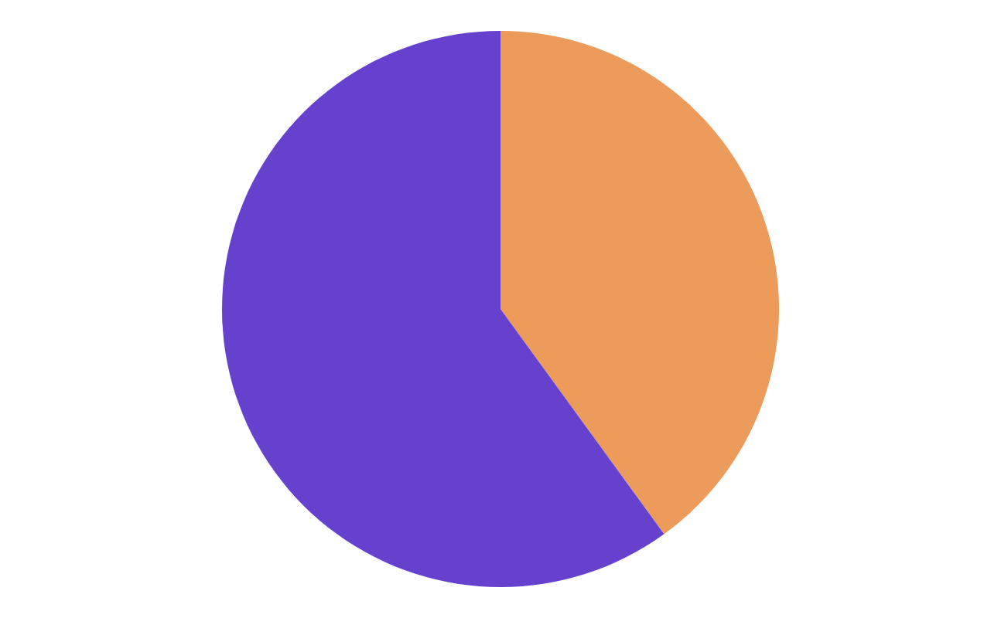
How are we doing it?
We are examining a number of different forecasting techniques to predict future stock returns based on past returns and numerical news indicators to construct a portfolio of multiple stocks in order to diversify the risk. We do this by applying supervised learning methods for stock price forecasting by interpreting the seemingly chaotic market data.
60%
40%
Weekly
Historic

Slide 3
Let’s break it into steps
Data Extraction
Feature Engineering
Prediction Parameter
Models
We are extracting the valuable data from our dataset and mapping it
We are selecting, manipulating, and transforming raw data into features
We are setting up a minimum probability threshold for the outputs
We are deploying various models and comparing their accuracies

Slide 4
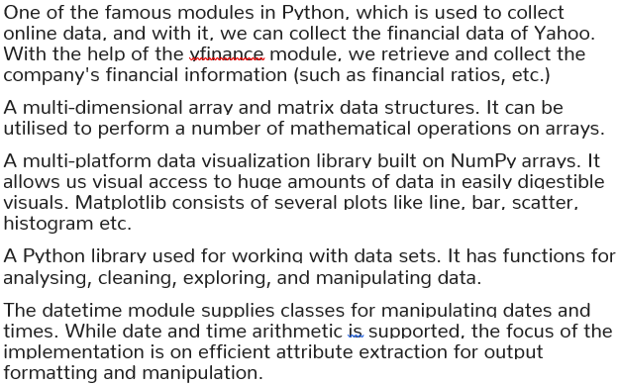
Our dependencies
Yfinance
Numpy
Matplotlib
Libraries
Pandas
Date-Time Module

Slide 5
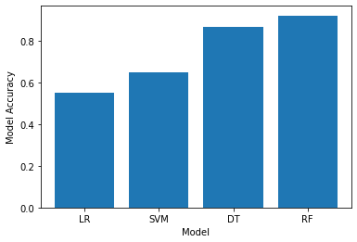
Our Results after comparing accuracies of different models
Random Forest
90%
Supervised Learning Technique used for classification and regression
Decision Tree
85%
Non-parametric supervised learning algorithm, which is utilized for both classification and regression tasks.
Support Vector
70%
Supervised learning methods used for classification, regression, and outliers detection.
Logistic Regression
58%
Supervised Learning Technique used to solve classification problems

Slide 6
Thank You!

